Slide 1




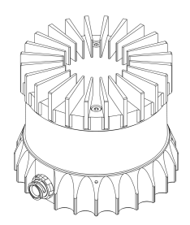
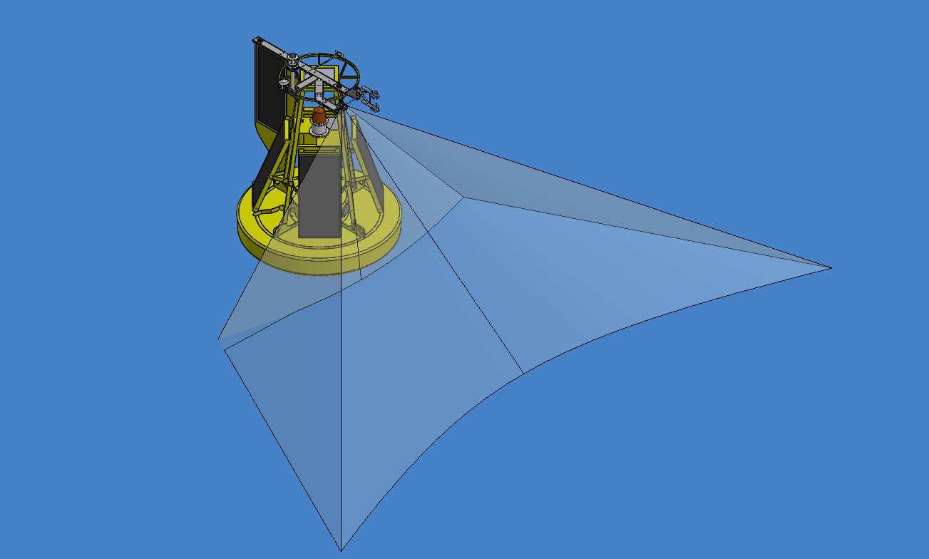
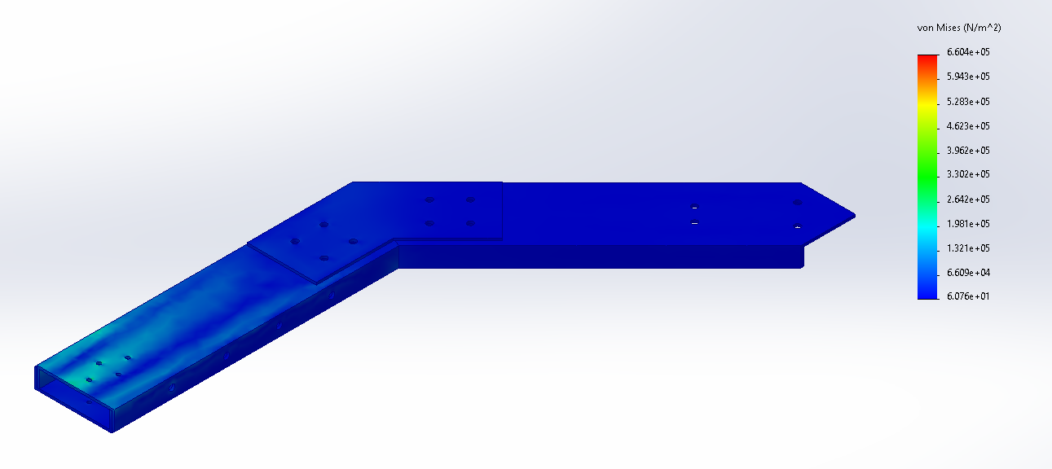

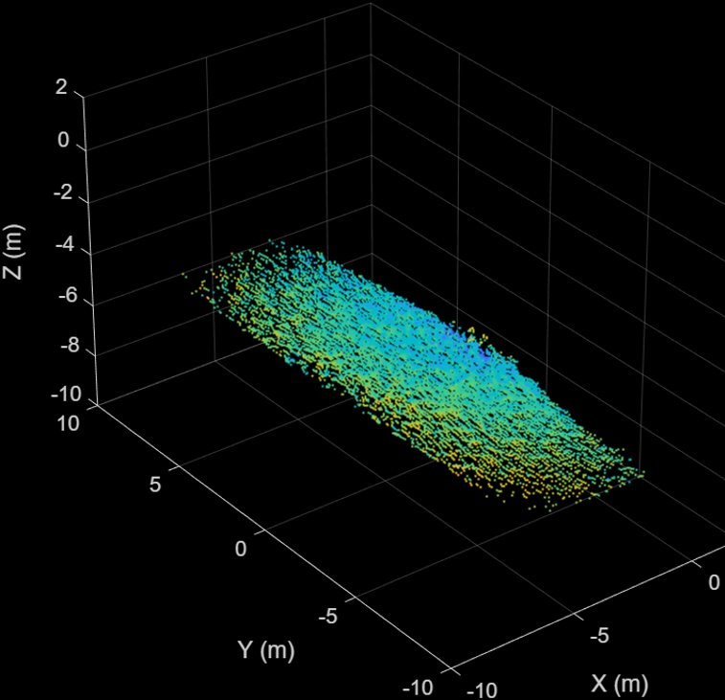
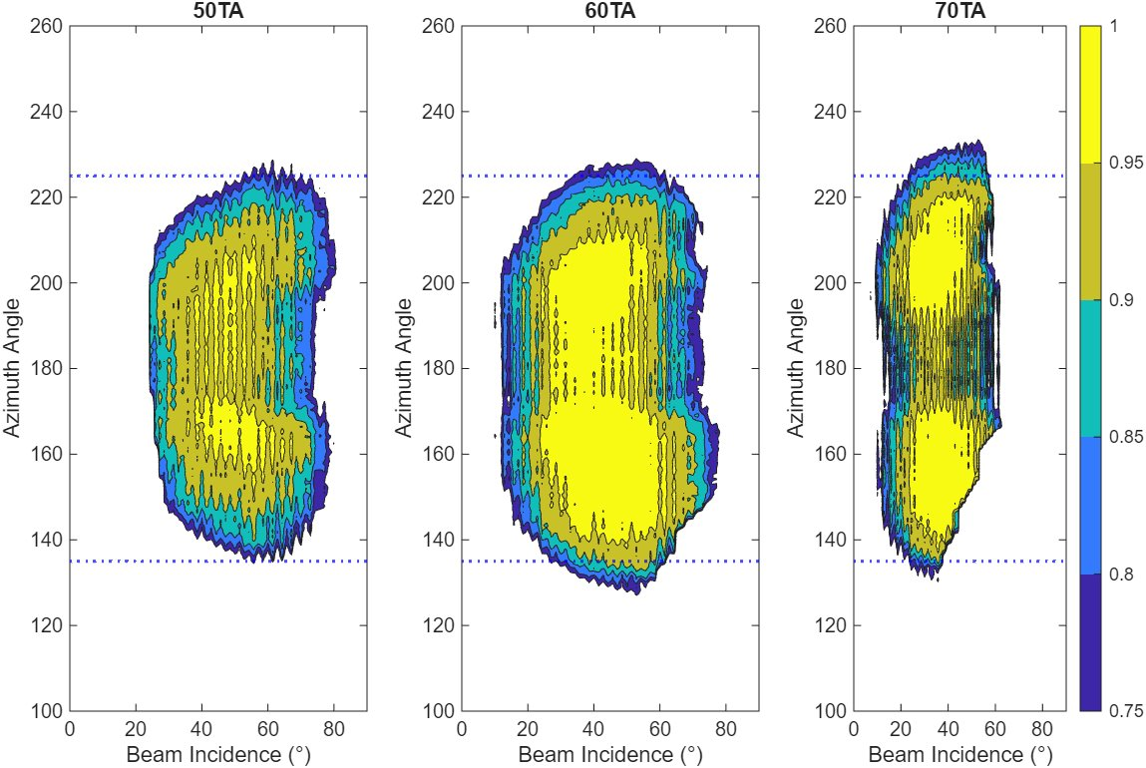
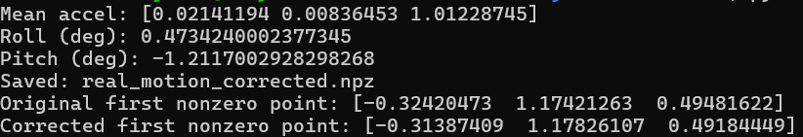
Air Sea Flux LiDAR Buoy
Ethan Hickey, Tatum Laws, Joey Baker
Department of Ocean Engineering, University of New Hampshire, Durham, NH 03824
Introduction
Duty Cycle
Circuitry and Electrical Components
The ASFLB is a metrological buoy that collects measurements that are used to research the stability conditions relating to the turbulent air-sea boundary layer.
With these parameters, researchers have been able to study the changes in momentum, heat, gas, and humidity fluxes that can help characterize the behavior of the Air Sea Boundary Layer.
One of the parameters the buoy was not able to measure was locally wind driven waves. The goal of this project is to incorporate a scanning LiDAR (Light, Detection, and Ranging) into the buoy so these waves can be recorded.
The LiDAR will be controlled with a combination of the onboard CR6 and a Raspberry-PI. This will allow researchers to study the local wind forcing and the effect of surface roughness and atmospheric stability conditions.
CR6 powers the Relay
Via the CR6 the GQ7 syncs the buoy IMU with the LIDAR
CR6 receives the proof of life and cuts power supply to Rasp-Pi, terminating the cycle.
12V Battery
GND
12V
. .
- - - + + +
Power Bus
. . . .
12V
12V
CR6
Rasp-Pi powering on initiates duty cycle
Rasp-Pi opens serial communication with CR6, sets Rasp-Pi system clock
Rasp-Pi sets the recording settings of the LiDAR
The Rasp-Pi starts the ten minute recording
The Rasp-Pi saves the files to the external drives and sends a storage percentage to the CR6
GND
12V
Relay
GND
12V
. .
GND
- - - - - + + + + +
Power Bus
GND
. . . .
12V
12-5V converter
5V
Rasp-Pi
12V
GND
GND
12-24V converter
To run a successful deployment, a duty cycle was developed to take measurements without human input. To start, the CR6 uses a relay to send power to a Raspberry Pi and LiDAR. On boot, the Pi then initiates a recording sequence, where it sets the clock with the CR6, starts a scan, and then saves the data to the connected hard drives, before powering down to repeat the cycle again later. This duty cycle will be repeated twice an hour for the duration of the deployment.
GND
24V
Ethernet
LiDAR power box
OS1 LiDAR
The buoy battery is powered by the solar panels and all the power runs through a central power bus before being sent to the rest of the buoy. The CR6 and Irgason control board are set up on one tray, and the rest of the components are on another. The CR6 and LiDAR are set up on the top of the buoy.
OS1 Ouster LiDAR Specs
Designing a Mount
OS1 Ouster LiDAR: This LiDAR uses an 865nm laser and has 64 vertical channels that cover 42.4 degrees, recording up to 2048 data points at each channel to create a 360-degree point cloud.
The LiDAR is capable of doing this at a rate of 20 times a second, allowing it to record high frequency waves.
For this project, the LiDAR will record at a rate of 10hz with 512 points per channel, and 120 degrees of the horizontal range will be recorded.
SolidWorks Model
Stress Test of Mounting Arm
Deployment Site
The completed Air-Sea Flux Buoy will be deployed off the New Hampshire coast late Spring of 2026.
It will remain there for around three months. The buoy will be deployed by the R/V Gulf Challenger.
The mooring site is exposed to surf action and wind stress. It is close to shore for easy drone access from Odiorne Point.​
The model includes a mount arm, support plates, the LiDAR and its mount, as well as the projected scanning area on the water.
This is a stress test of estimated load and gravity forces of the mount arm in the ocean. Several different forces were applied to get the most accurate result.
Location: 1 km off Rye NH​
Depth: ~15 m​
Date: Late May
LiDAR Recording Angle
sTAMD Simulations
Acknowledgements
Motion Correction
To optimize the mounting angle for the LiDAR a scan of capillary waves was taken from a bridge.
Using the recordings taken from multiple incidence angles, it was determined that a beam incidence angle of 60 degrees below the horizontal was most optimal.
A motion correction routine was developed to ensure accuracy during data acquisition.
It takes acceleration data from the Inertial Measurement Unit, calculates the pitch and roll of the buoy, then applies rotation matrices to the actual LiDAR point cloud.
An example output of the code can be seen below, and a point cloud is shown to the right.
Faculty Advisor: Nathan Laxague, Doug Vandemark
Research Scientists: Shawn Shellito, Marc Emond
Machine Shop: Chase OE Lab; Mike Tuttle
Organizations: DOE, UNH, NH Sea Grant, NSF
References
Monin, A. S. (1970). The Atmospheric Boundary Layer. Institute of Oceanology, Academy of Sciences.
Ouster, Inc. (2023). OS1 mid-range high-resolution imaging lidar datasheet (Rev7, firmware v3.1.x).
Ouster, Inc. (2023). Ouster Sensor SDK documentation.
Gimple, M. (2024). LiDAR sensing systems: A viable approach to near-field wave elevation measurements (Master’s thesis, University of Rhode Island).
Feddersen, F., Marques, O. B., MacMahan, J. H., & Grenzeback, R. L. (2024). Estimating directional wave spectra properties in nonbreaking waves from a UAS-mounted multibeam LiDAR. Journal of Atmospheric and Oceanic Technology
​
LiDAR scan taken at Scammell Bridge

