Slide 1

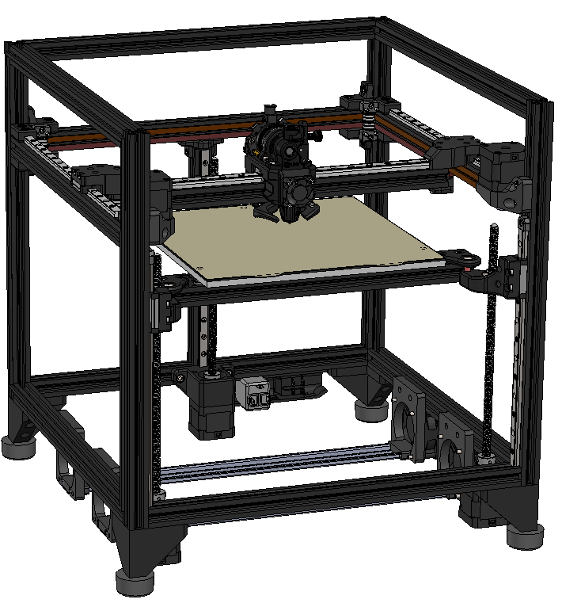
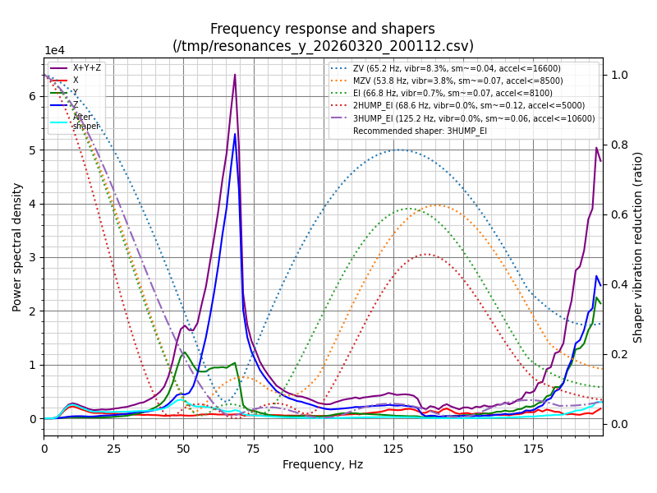
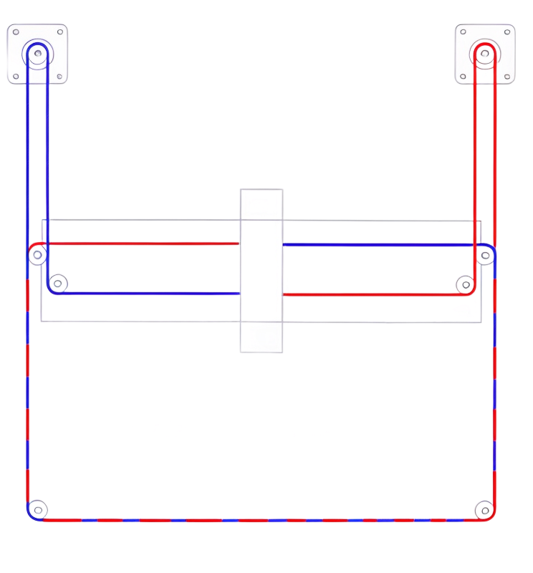
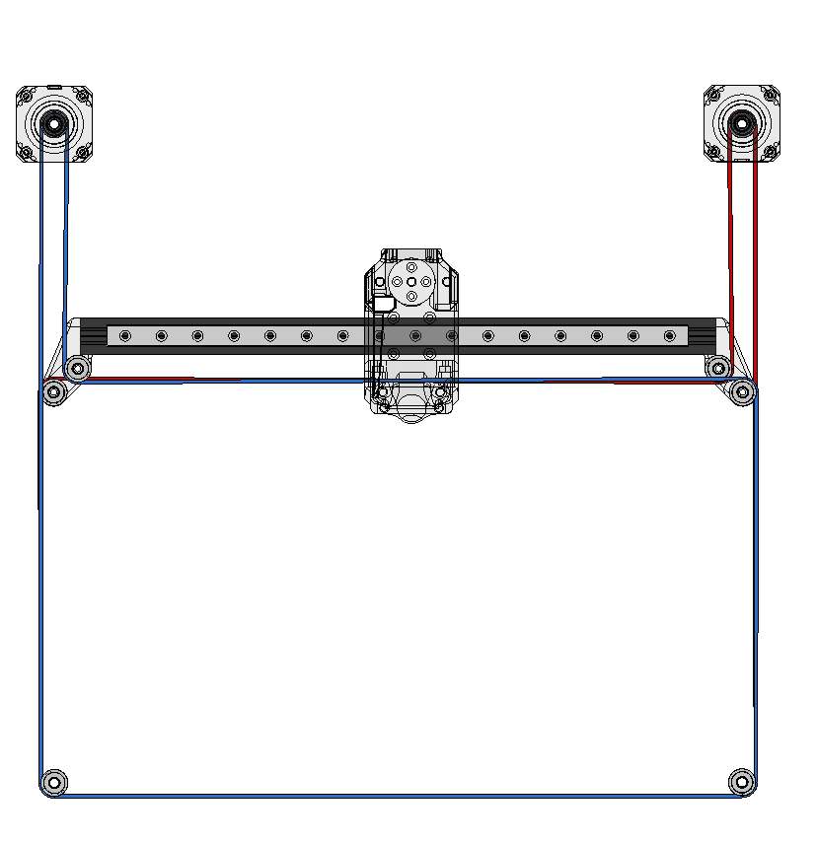
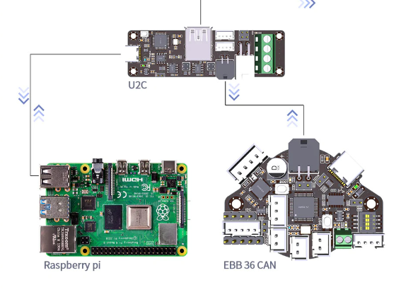
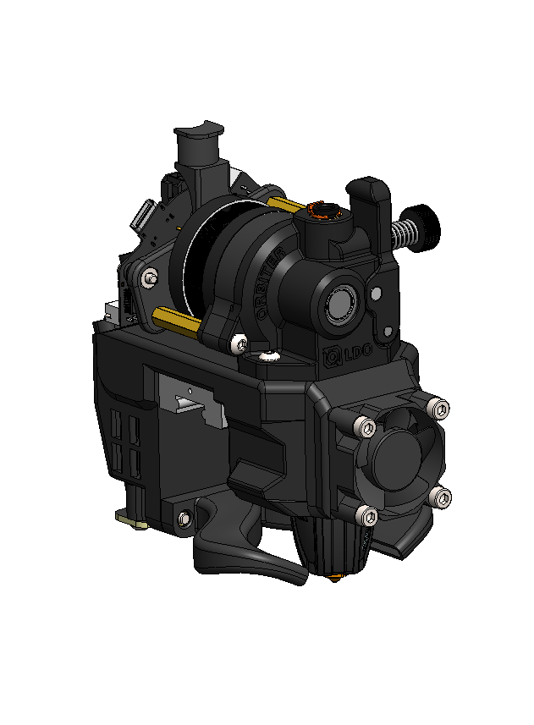
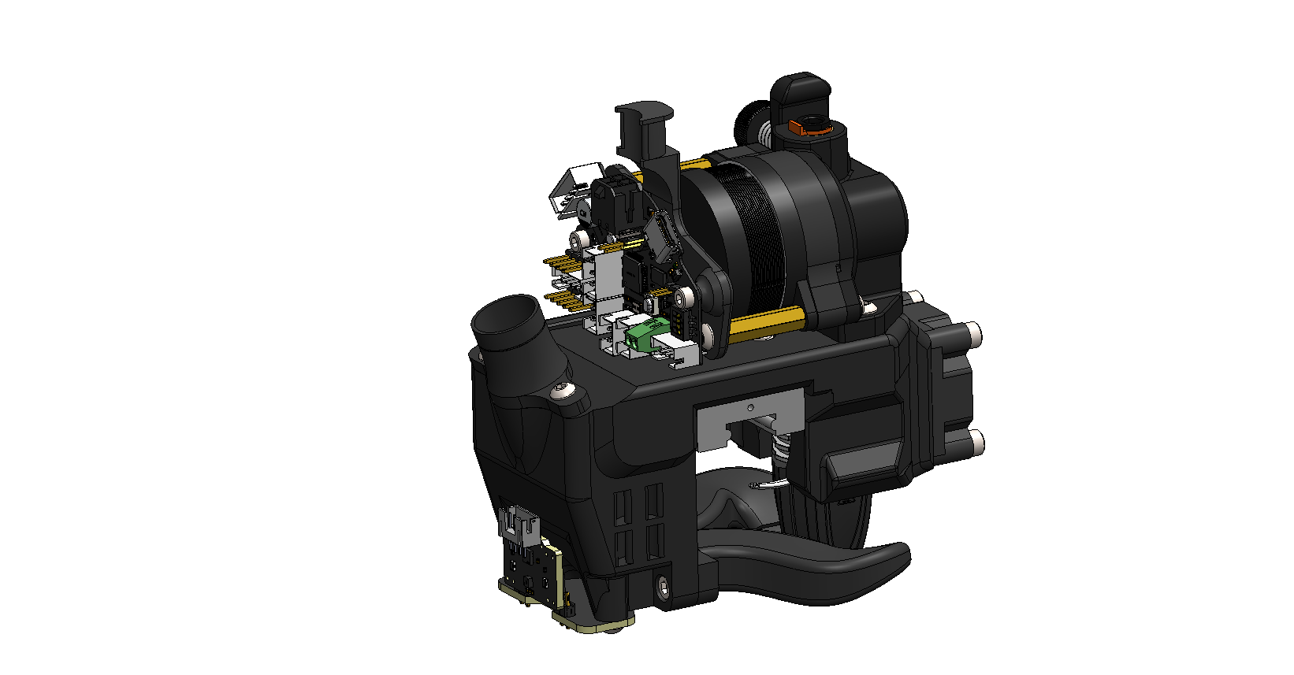
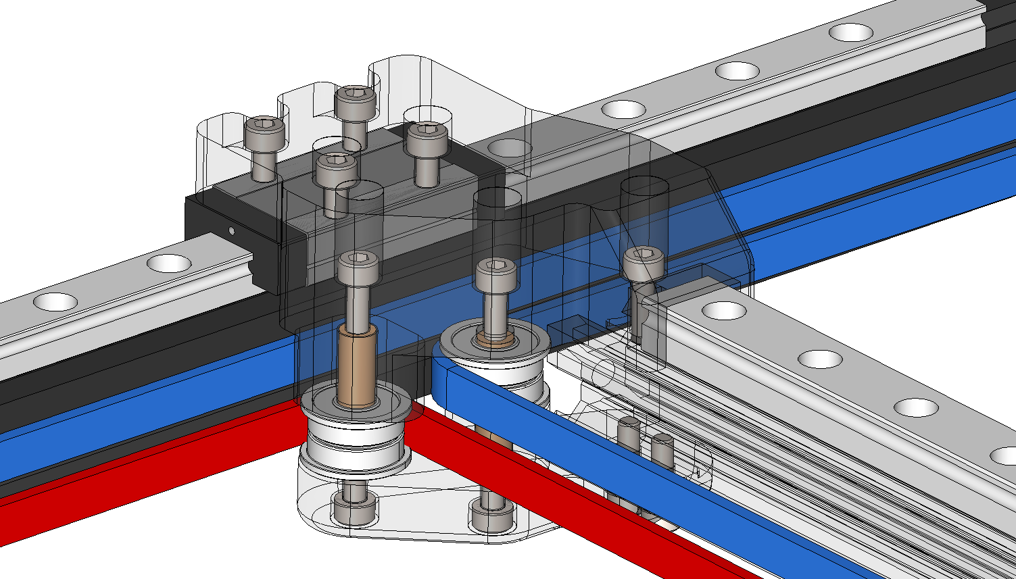
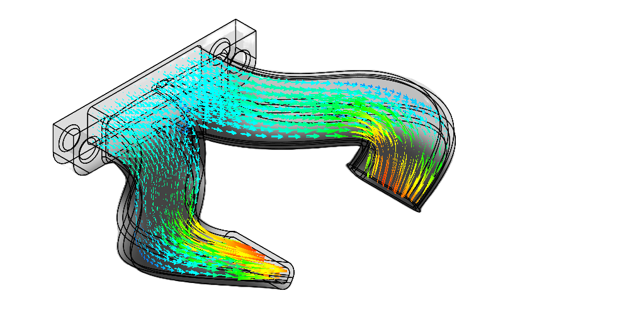
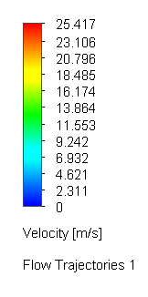
Design and Implementation of a CoreXY 3D Printer Using Off-the-Shelf Components
By: Pavel Subotskij
University of New Hampshire | Mechanical Engineering
Project Overview
Vibration Reduction & Motion Control
This project develops a fully custom CoreXY 3D printer with complete hardware and firmware control. This enables targeted optimization of motion, vibration, and cooling. The system is designed to push the performance limits of desktop 3D printing beyond typical commercial capabilities.
Frame built with 2020 Aluminium extrusions
Belt Tensioner
Frequency response measured using Klipper resonance testing with an ADXL345 accelerometer
A tuned shaper reduces ringing and improves print quality at high acceleration
A well defined resonance peak enables more effective ringing reduction and reduces negative effects of toolhead intertia
Frequency response graphs show issues with printer that cannot be noticed by eye
Core XY Belt Path
Toolhead
255x255x8mm MIC 6 Cast Aluminium Bed
Design Goals & Constraints
Budget Constraint: Target budget <$1500
Compact System: 250x250x200mm build volume, minimized footprint
High Speed Motion: >15,000 mm/s² target acceleration and 500mm/s printing speed
Modularity: Use of off-the-shelf components for easy assembly and part replacement
3z-axis tramming system for print bed
All printed parts use ASA-CF
Y-axis
X-axis
CoreXY Motion System
Stationary motors remove ~500 g from the moving system, enabling higher acceleration
Dual-motor control shares motion loads, enabling higher acceleration and print speeds
Motion Control
Failure Modes / Design Challenges
Klipper Firmware: Enables advanced motion tuning not available in most commercial systems
Raspberry Pi: Handles real time motion planning
EBB36&U2C board: Communicates to pi via CAN-Bus, allows for cleaner toolhead wiring
Uneven belt tension (both must be tensioned equally)
Poor manufacturing: incorrect dimensions on sent parts
Frame construction: Frame squareness affects motion
Interacting parts: Designing a layout of components that allows correct interaction of parts.
Original CoreXY Belt Layout
Modified CoreXY Belt Layout (routed behind the X-axis extrusion)
XY Joints
The Toolhead
Air Duct CFD Analysis
Results & Performance
XY Joints are a critical interface linking belts to toolhead
Geometry controls belt alignment and tension consistency along both X&Y
ASA-CF resists creep well under constant tension & heat
A light toolhead allows for faster speeds while printing
Hot end mounted close to X-axis to reduce moment arm
CPAP cooling system frame-mounted blower fan to reduce toolhead mass while maintaining high airflow
Toolhead weight ~ 450 grams
High-speed printing requires rapid material solidification to maintain quality and accuracy
CFD used to ensure duct efficiency and quantify data for future duct development.
Airflow accelerates from 7.5 m/s at the inlet to ~25 m/s at the outlet, maintaining smooth, directed flow
Stable operation at 15,000mm/s² acceleration & 500 mm/s printing speed
~$1400 total cost with consistent performance (~50 hours total printing time)
Reduced ringing through mechanical optimization and input shaping
EBB36 CAN Board
LDO Orbiter Extruder
Sources & Credits
CPAP Cooling hose Inlet
Research Advisor: Juan Carlos Cuevas Bautista, University of New Hampshire
CEPS Makerspace: Support with fabrication and ASA-CF printing
E-Center: Providing a space to build the project
Eddy Current Probe (for tramming bed) w/ ADXL345
Air Ducts
https://doi.org/10.1016/j.matpr.2021.10.444
https://oulurepo.oulu.fi/bitstream/handle/10024/48602/nbnfioulu-202404052565.pdf;jsessionid=26DB04669D857F446004A2B7DC8D3129?sequence=1
https://3ddistributed.com/corexy-3d-printer/corexy-kinematics/
Rapido HF Hotend

