Slide 1

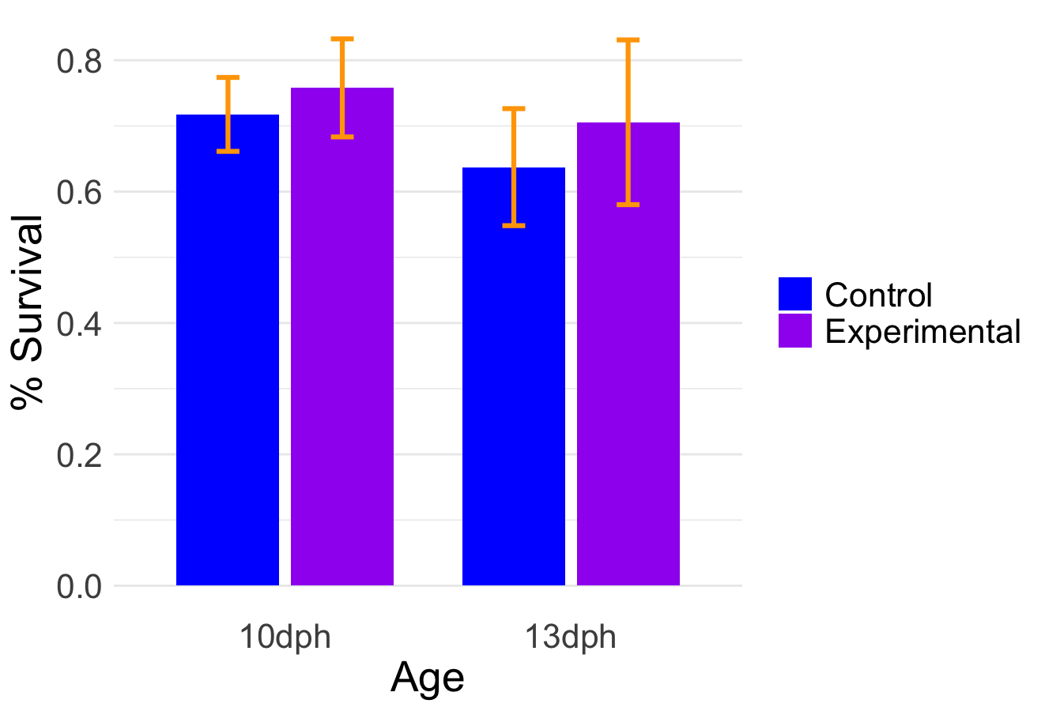
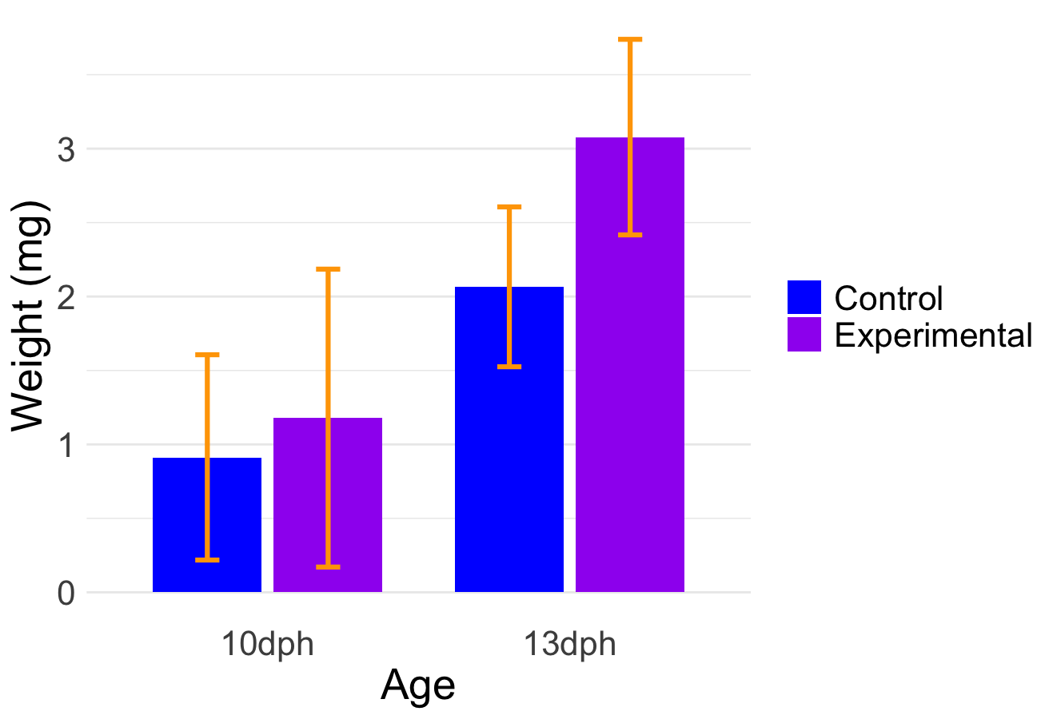
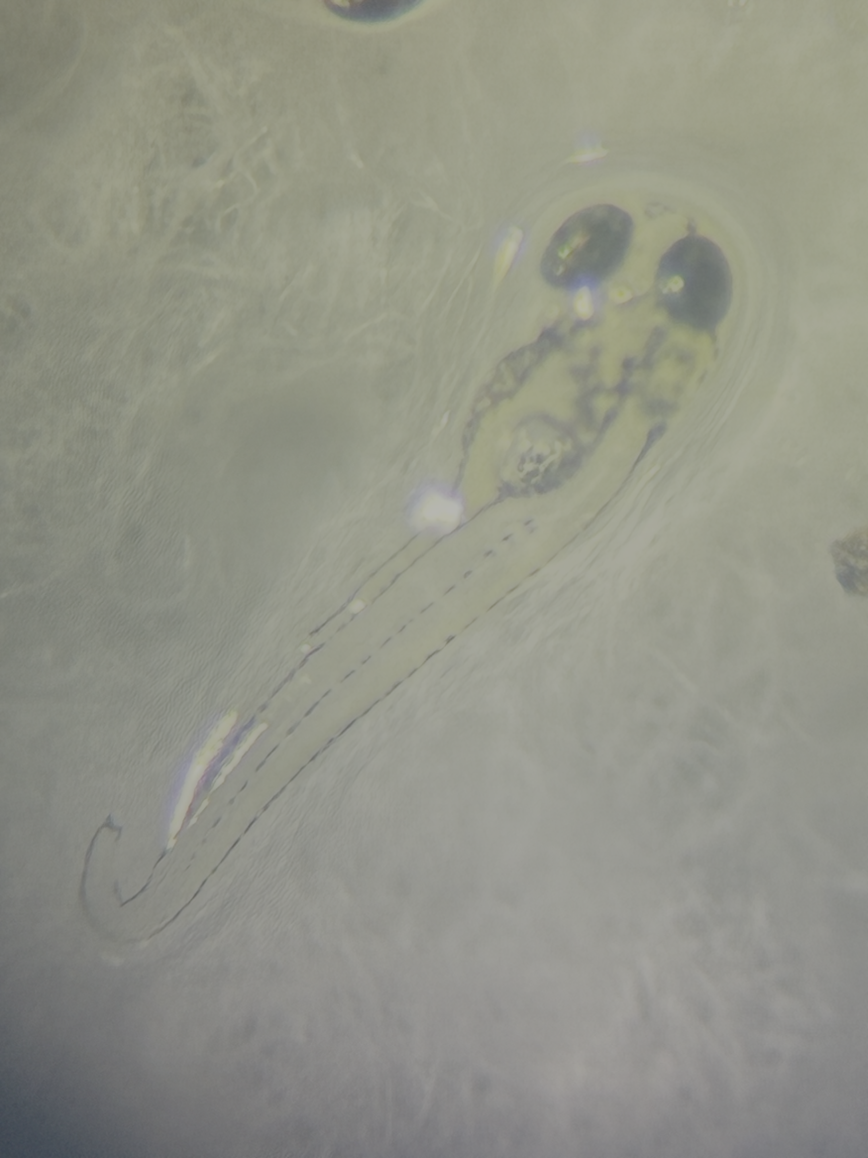
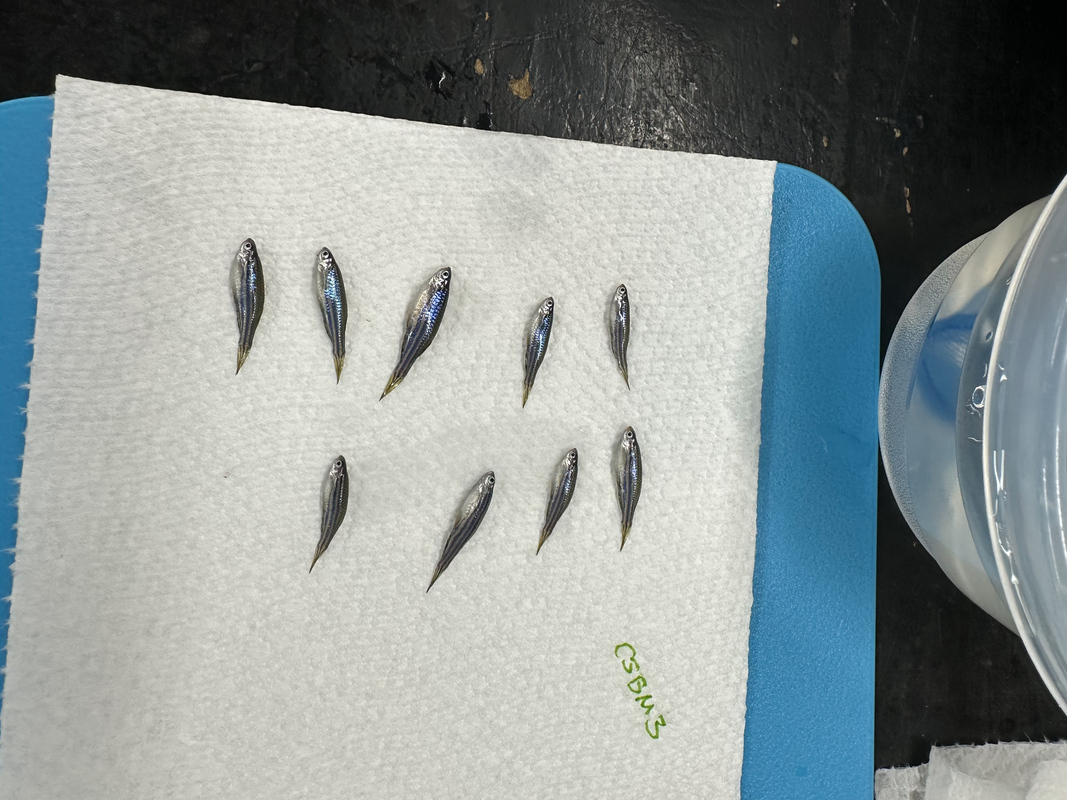
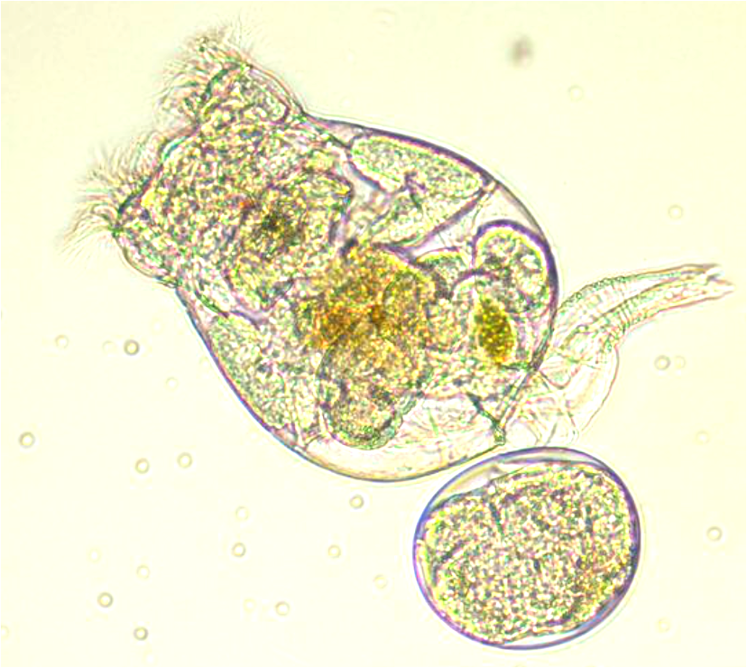
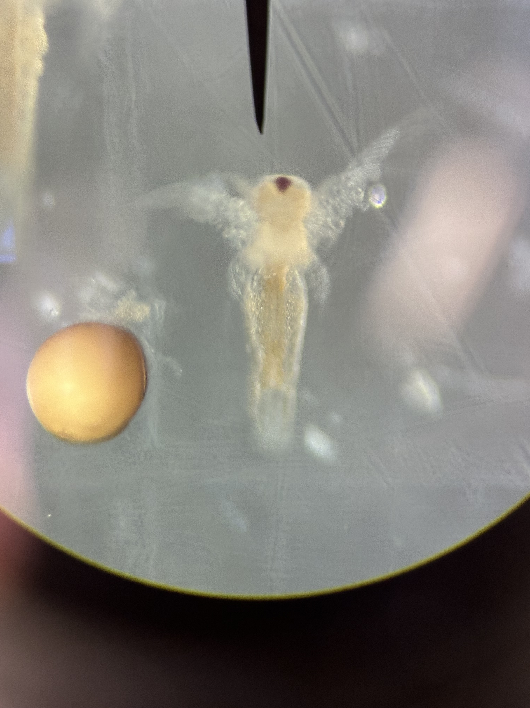
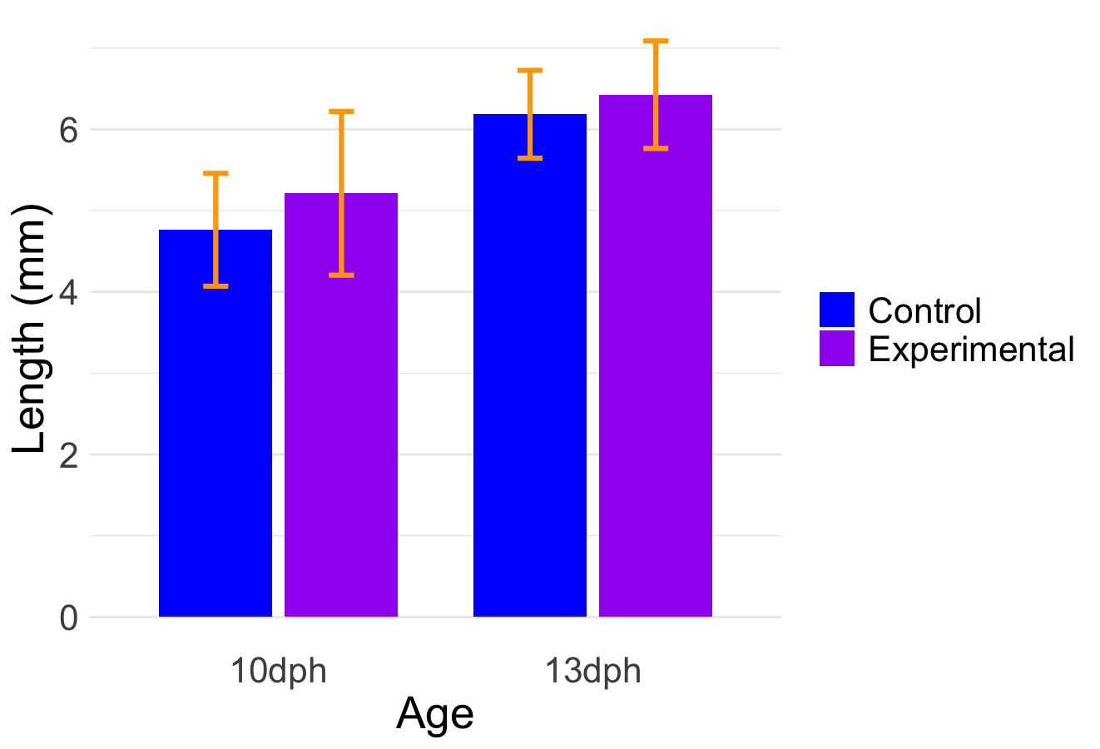



Playing with Sea Monkeys: An Examination of the Use of Decapsulated Artemia as a Means of Improving Current Zebrafish (Danio rerio) Culture Practices
Esher Swanson, Jessica Robinson, and Karolina Kwasek
Introduction
Results
Results Continued
Zebrafish serve as a model for vertebrates in the fields of genetics, environmental health, toxicology, human health, and neurobiology^{1,2,3,4,5}. Simpler culture/husbandry protocols could increase accessibility of studies using this valuable model species^{6.}
*
*
*
Larval Stage of Zebrafish
Rotifers
Decapsulated Artemia (decaps):
Study Organism
Small hatch size (~3mm)⁷
    → small mouth size
Poor mobility and vision²
Digestive tract Undeveloped⁸
Requires use live feed
  during first feeding⁸
    → rotifers, Artemia nauplii
Standard Live Feed^{8,9}
Size: ~191.1 x 146.3µm^{10,11}
continuously maintained^{8,9,12}
labor intensive and expensive¹²
prone to population collapse^{8,12}
Used in standard feed protocols^{8,9} (Fig. 5)
Proposed Live Feed
Size: 431.2 x 157.8µm¹⁰
can be produced on demand from cysts⁸
more predictable; requiring less care
more visible to larval fish¹³
decapsulation = disinfection of cysts¹⁴
Larval Form
Adult
Nauplii
Image by Esher Swanson
Image by Jessica Robinson
Image by Girish Mahajan
Image by Jessica Robinson
Cyst
Figure 2: Percent survival for control and experimental groups at sampling ages as predicted through daily mortality counts. All relationships between control and experimental were significant (10dph Tcalc = 5.95, 10dph df = 378; 13dph Tcalc = 5.78, 13dph df = 337). Significance is indicated by (*). Error bars indicate standard deviation from the mean.
Figure 4: Weight (mg) for control and experimental groups at both sampling ages. Only the 13dph relationship between treatment groups was significant (10dph Tcalc = 1.66, 10dph df = 114; 13dph Tcalc = 13.07, 13dph df = 302). Significance is indicated by (*).Error bars indicate standard deviation from the mean.
Takeaways
Hypothesis supported: For every study parameter (length, weight, survival) fish fed decaps performed better or equivalent to fish fed rotifers.
    → Fish fed decaps had a significantly higher weight at 13dph and significantly higher survival at both 10dph and 13dph.
Replacement of rotifers with decaps during first feeding improves fish larvae performance, simplifies zebrafish care protocols, and potentially lowers operating costs.
Use of decaps could increase the accessibility of research using larval zebrafish as a model, potentially enabling breakthroughs in other fields through the concept of “serial dependence” (Discovery A provides knowledge causing Discovery B).
Decapsulation of regular Artemia cysts uses a hypochlorite solution to remove the hard outer layer of the cyst (dormant egg), allowing earlier hatch at a smaller size that would potentially fit larval zebrafishes’ smallest mouth sizes.¹⁰
Figure 3: Total body length (mm) for control and experimental groups at both sampling ages. Neither of the relationships between treatment groups were significant (10dph Tcalc = 1.78, 10dph df = 117; 13dph Tcalc = 1.03, 13dph df = 302). Error bars indicate standard deviation from the mean.
Objectives: assess the short (10 days post hatch) and long term (13 days post hatch) suitability (total length, weight, survival) of decapsulated Artemia (decaps) as a first feed compared to the standard rotifer protocol
Experimental Group (decaps)
Hypothesis
Control Group (rotifers)
Methods Continued
Decaps & Non-decaps
References
▸Survival ▸Total Length ▸Weight
$$≥$$
  ▸Survival ▸Total Length ▸Weight
Experimental Feeding Regime (decaps)
Days Post Hatch (dph)
Standard Feeding Regime (rotifers)
▴ = Sampling Event
Key:
Decaps
Non-Decaps
0
2
7▴
10
13▴
Methods
  Experimental Setup:
  Iwaki Aquatic semi-recirculated system with UV disinfection, a sump reservoir, a pump, and biological, mechanical, and chemical forms of filtration.
  200 larval zebrafish per 4.5L tank fed to satiation (in excess)
  three replicate tanks per treatment group (6 total)
  Daily water chemistry sampling
  Two-tailed independent samples t-test
Rotifers
Rotifers & Non-decaps
Non-Decaps
Acknowledgements
Figure 5: Study protocol showing the two feeding regimes used and sampling events. The fish hatched at 0 days post hatch (dph) and the study ended at 13dph before dry feed transition would
pH: 8.30 ±.11
normally occur. Larval fish start swimming and eating tested feeds (rotifers vs. decaps) at 2 (dph) before transitioning to a standard feed of non-decapsulated (non-decaps) Artemia from 7-10dph. Fish were sampled for short-term and long-term growth (length and weight) at 10 and 13dph, respectively.
Temperature: 27.8ºC ±0.2ºC
Conductivity: 1197.7µS ±12.3µS

