Slide 1


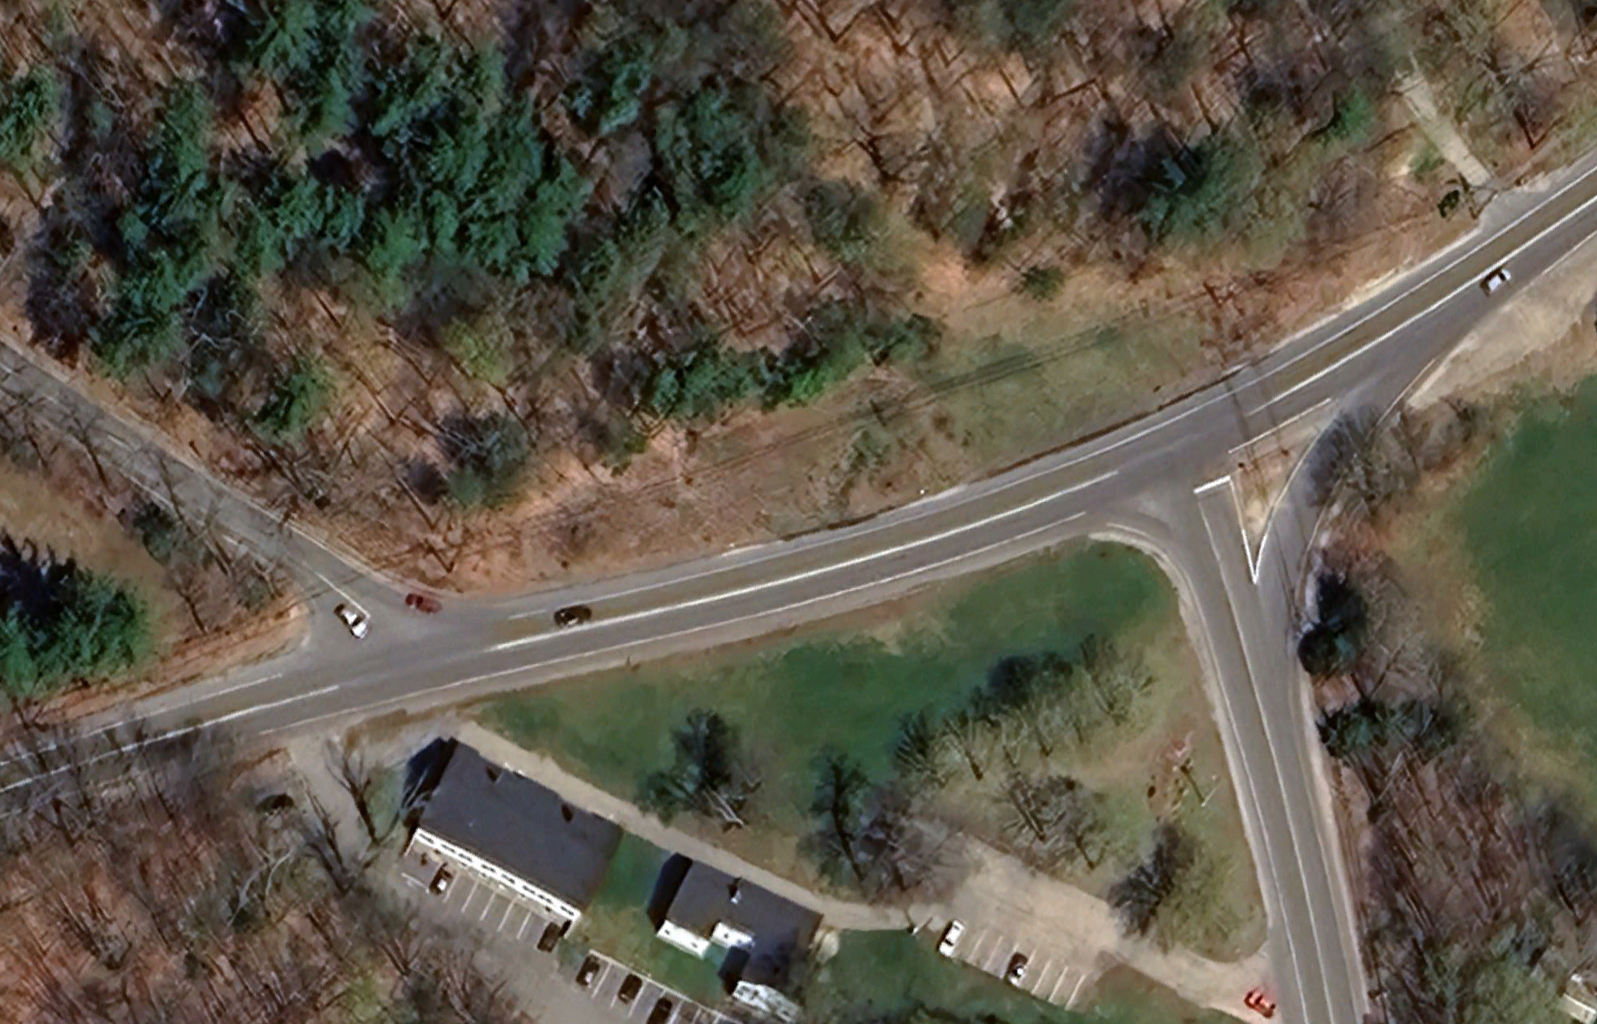

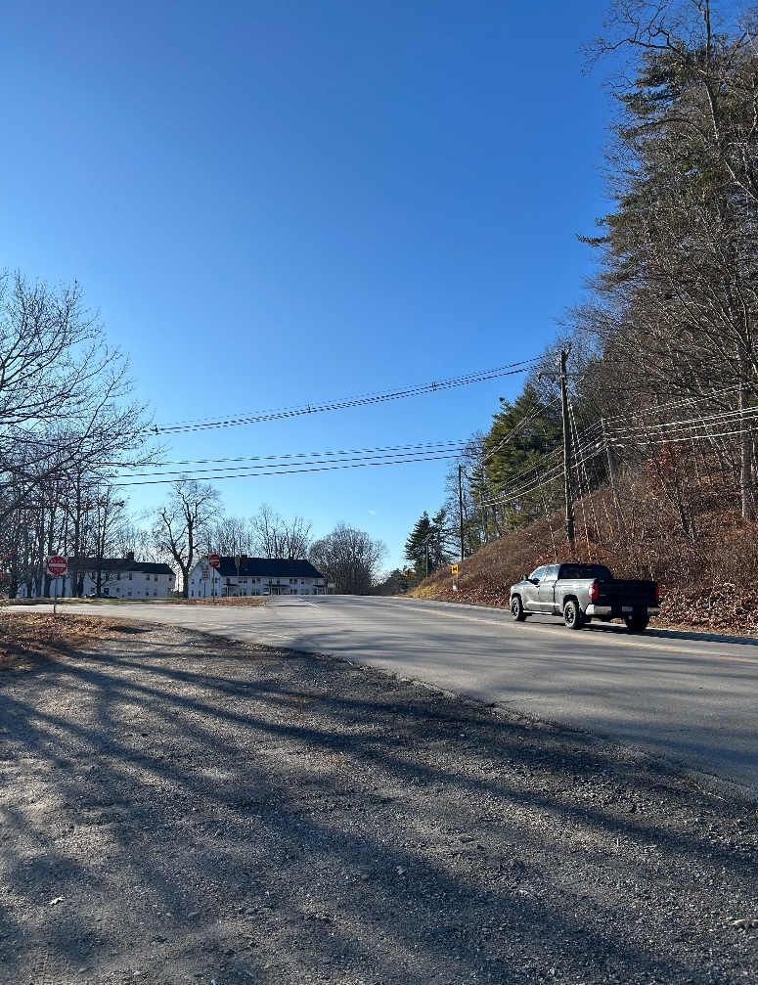
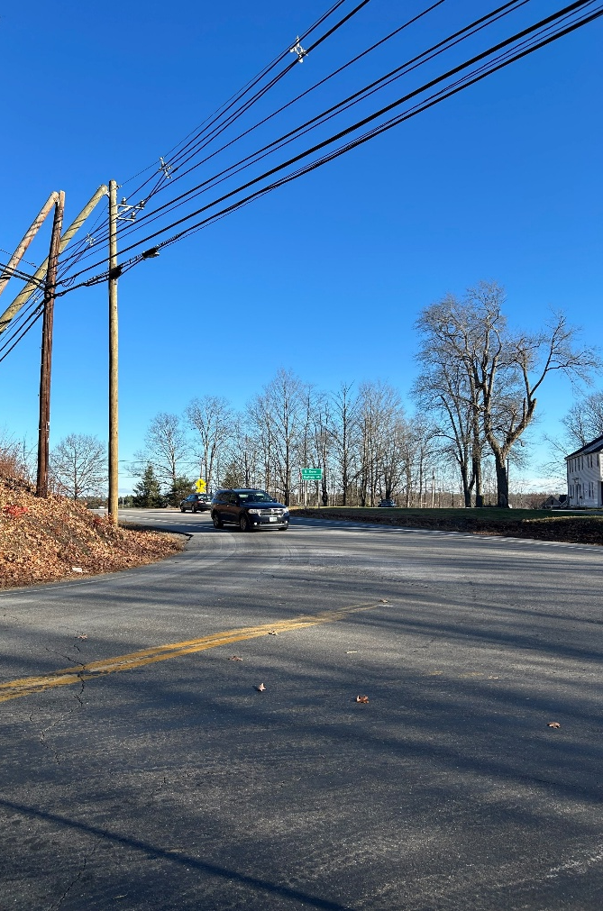
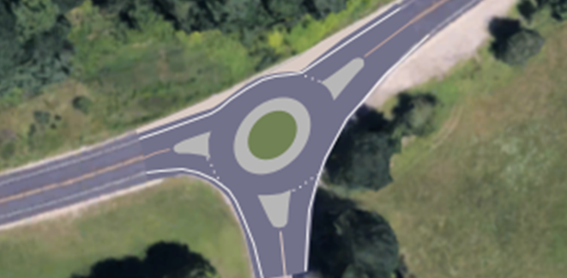
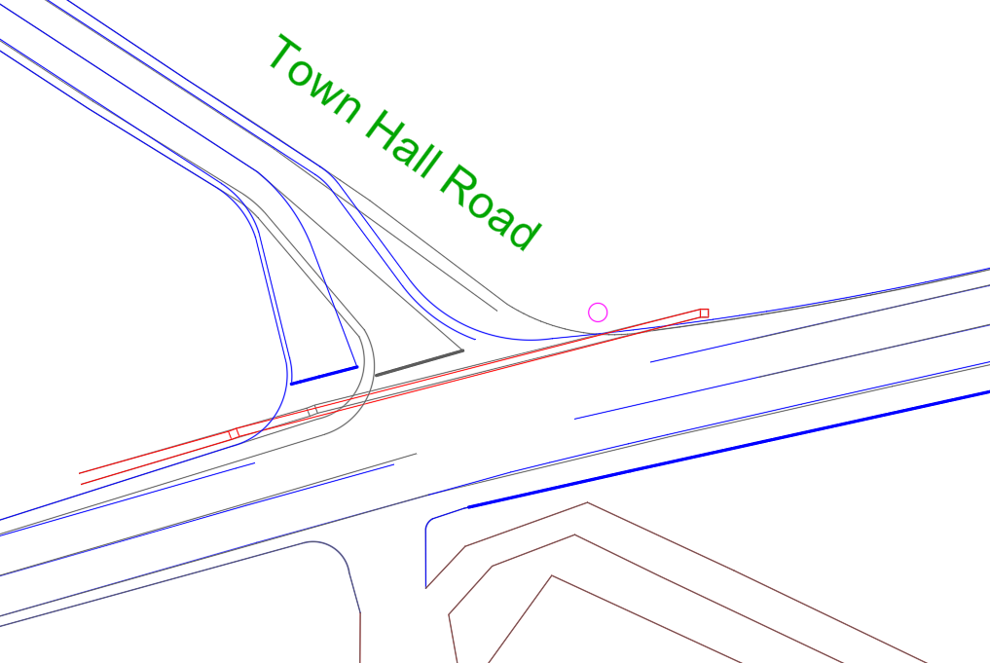
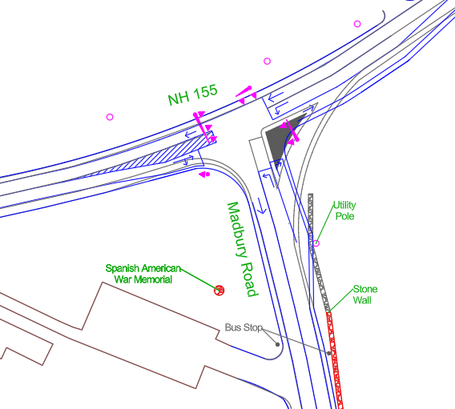
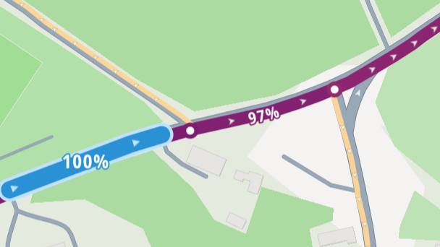
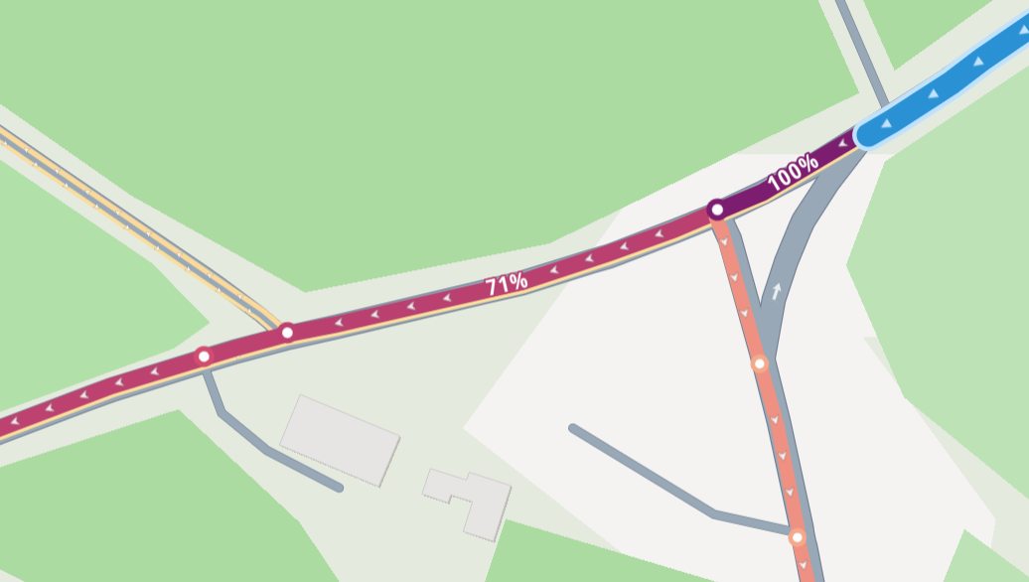
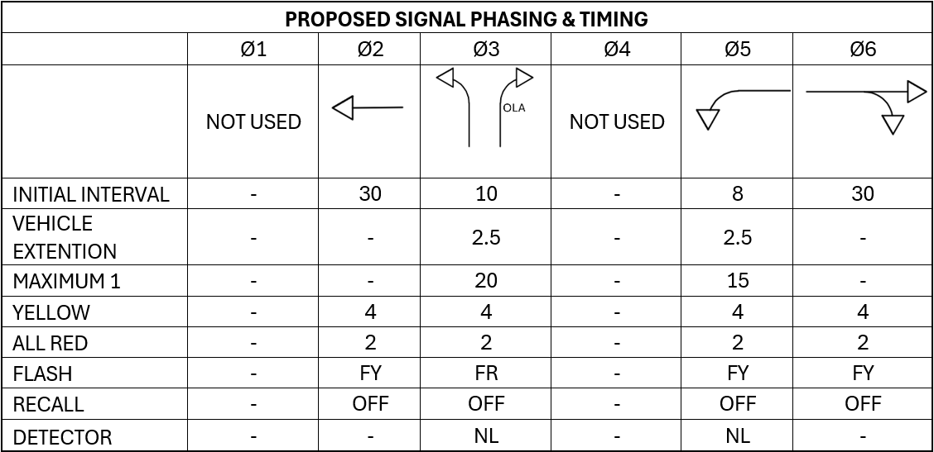


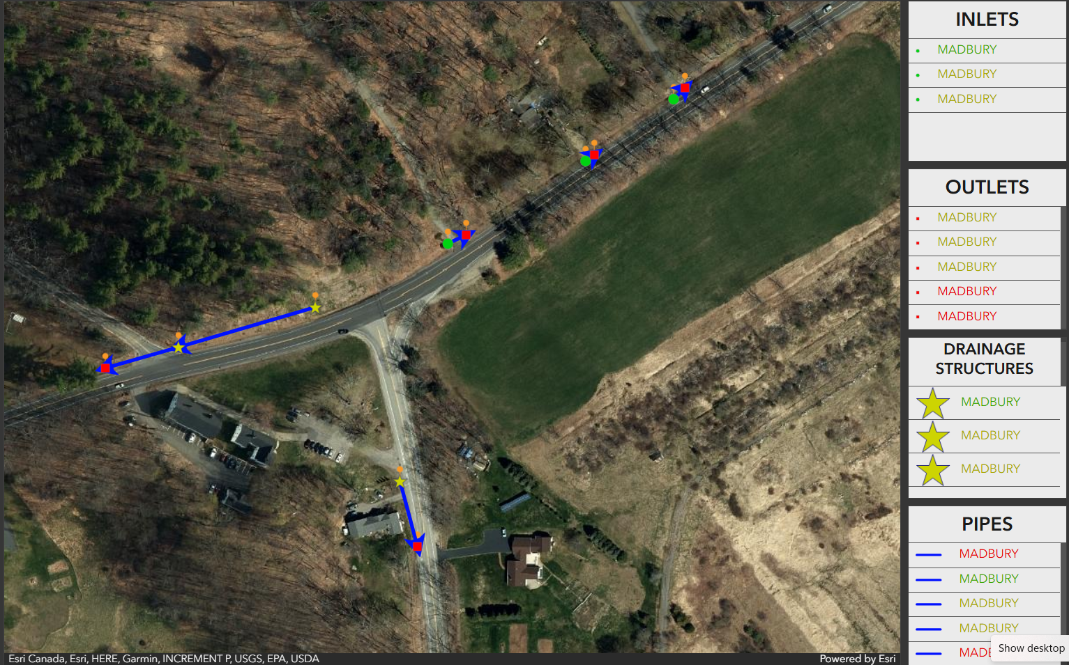
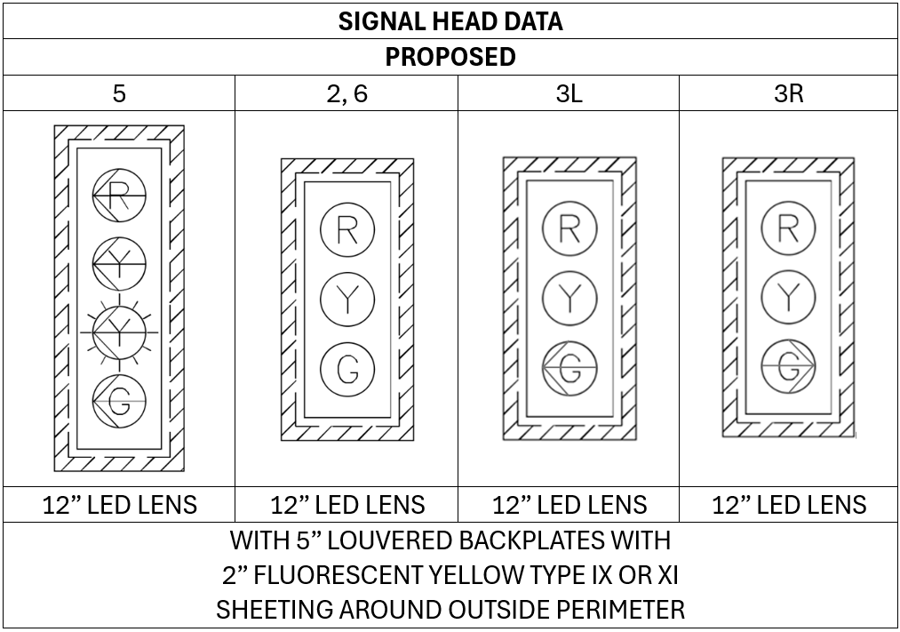
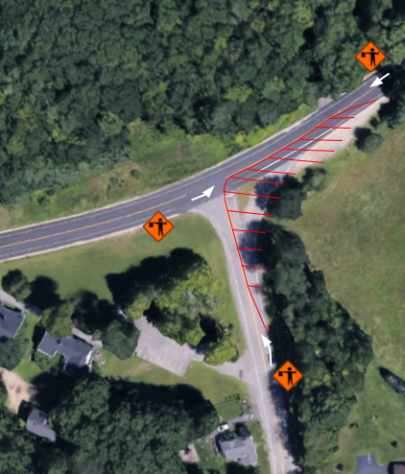
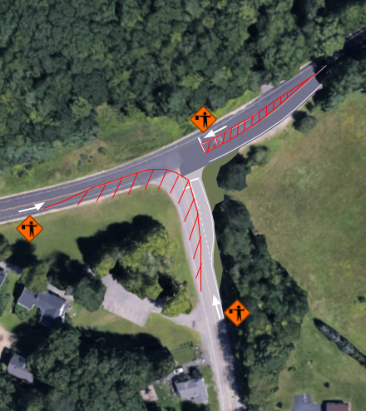
NH 155 at Madbury Road Intersection Design
Nathan Taylor, Jacob Holt, Eric Ierardi, Caden Small, Drew Gully
Civil & Environmental Engineering, University of New Hampshire, Durham, NH 03824
Place your Project Logo Here
Introduction
Project Location (Madbury, NH)
Safety Concerns
Alternatives
Capstone Team 5 worked with the New Hampshire Department of Transportation (NHDOT) to develop alternatives for the existing intersection of NH155 and Madbury Road in Madbury, NH. The chosen alternative will aim to improve overall intersection safety while minimizing delays. The NHDOT and the towns of Madbury and Durham have raised mutual support for safety improvements at the intersection.
Limited signage
Poor sightlines
Driver Behavior
Traffic backups during peak hours
Four Alternatives Evaluated:
Roundabout
Signals
Turning lane additions
All way stop
Town Hall Road
NH 155
Madbury Road
Data & Information
Proposed Intersection Geometry & Signal Layout
Decision Matrix
Northbound Traffic
93%
Existing Layout
Proposed Signals
3%
Proposed Roadway
Utility Poles
New Conditions
Sewer Grate
4%
Southbound Traffic
Cost Analysis
2%
Signal Design
69%
29%
Total Cost:
≈ 3 Million
Construction Phasing
Earthwork & Pavement
Phase 1
Phase 2
Utilities & Other Costs
Red lines show cones and construction barriers.
White arrows depict traffic flow controlled by flagger.
Traffic Control Devices & Signage
Acknowledgements
Bill Lambert – NHDOT Highway Safety Administrator
Corey Spetelunas – NHDOT Highway Safety Project Manager
Dr. Eshan Dave – Faculty Advisor
Eric Fiegenbaum – Madbury Town Administrator

