Slide 1


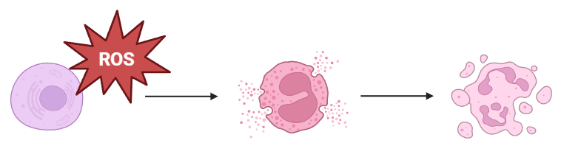
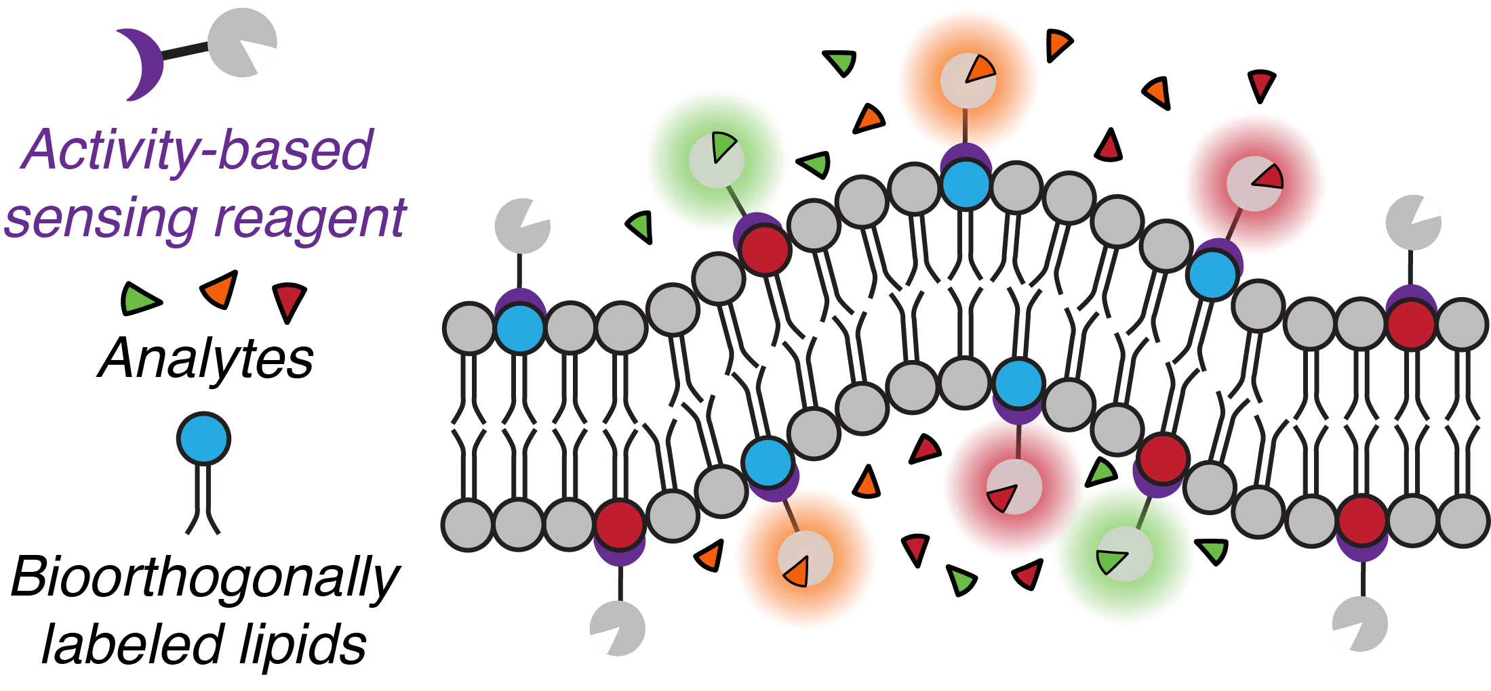
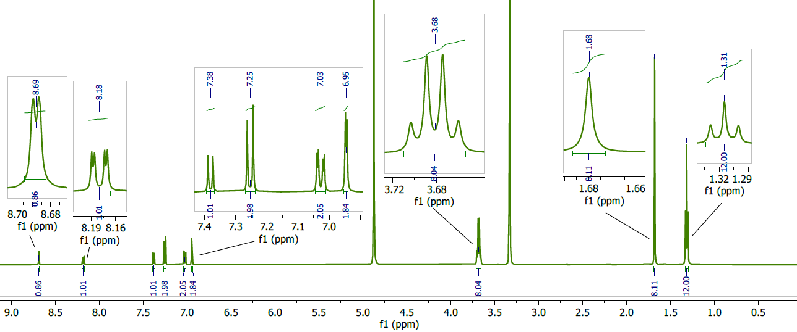
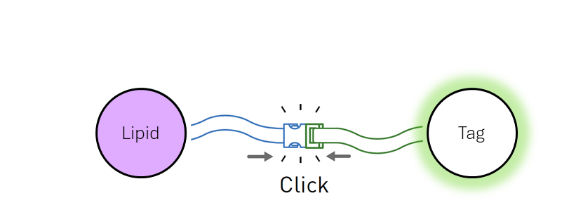
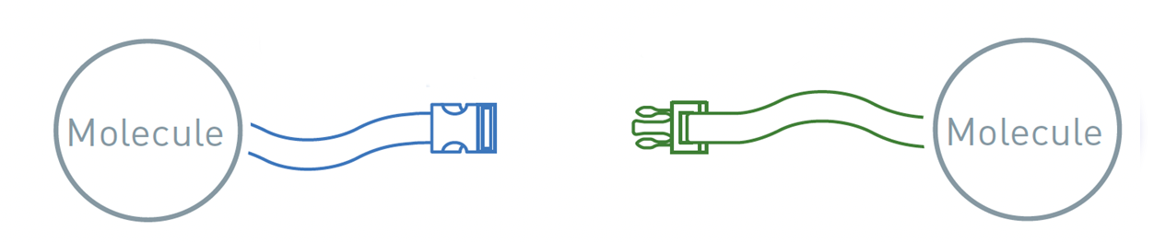

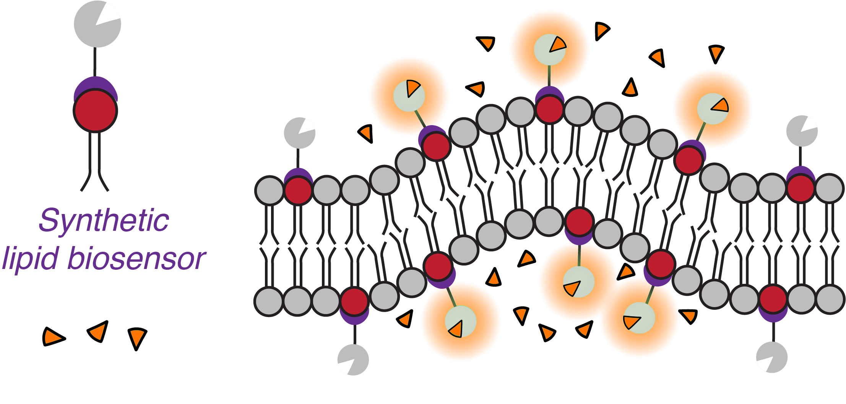
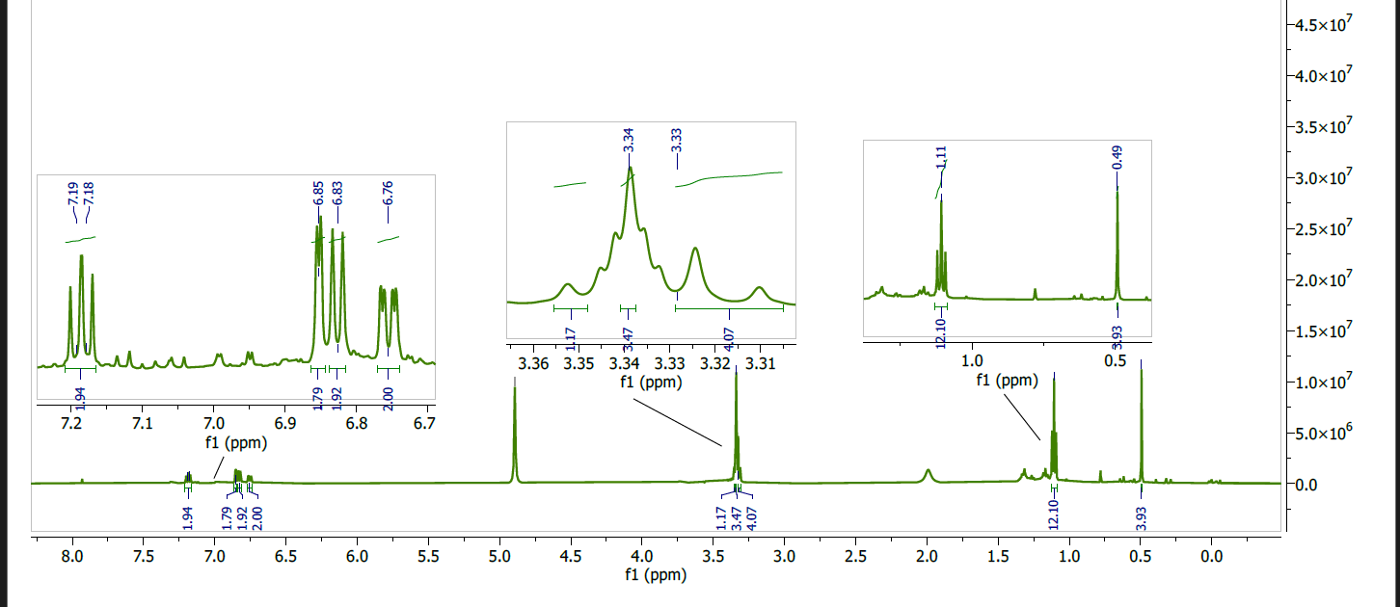
Activity-Based Sensor Development for Imaging Iron(II)
Nicholas Mixon, Thomas DiPhilippo, Brittany White-Mathieu*
Chemistry Department, University of New Hampshire, Durham, NH 03824
Nicholas.Mixon@unh.edu
linkedin.com/in/n-mixon/
Introduction
Methods and Results
Future Directions
  Reactive oxygen species (ROS), such as H₂O₂, degrade cellular membranes and result in cell death.
I: Synthesis of a critical precursor for a rhodamine activity-based sensor⁷
III: SPAAC “click” reaction of biosensor and synthetic phospholipid.
[1.]
Oxidative damage caused by H₂O₂,and other ROS are connected to:
Aging
Cancer
Cardiovascular Disorders
Neurodegenerative Diseases
Characterization of membrane degradation events is of fundamental importance for understanding disease.
Enables incorporation of
various sensors for characterizing membrane degradation
during
ferroptosis…
[2.]
Fluorescent activity-based biosensors are uniquely poised to achieve both detection of reactive substrates and characterization of membrane structure by illuminating areas where the analyte is present.
Ferroptosis induces cell death by extensive lipid peroxidation. Iron (II) reduces hydrogen peroxide to a hydroxyl radical, becoming oxidized to iron (III). Subsequent oxidation of this reduced free-radical species drives peroxidation of polyunsaturated fatty acids (PUFAs), degrading membranes cell-wide. [9.]
[2–4.]
II: Synthesis of a critical precursor for a silicon-rhodamine activity-based sensor.⁸
Bioorthogonal strain promoted azide-alkyne cycloaddition (SPAAC) click chemistry facilitates covalent bond formation between activity-based biosensors and individual lipids.
These phospholipids can then be incorporated into the membranes of live cells. [6.]
We aim to characterize membrane decomposition with the use of these anchored fluorescent sensors.
[5.]
Acknowledgments
White-Mathieu Lab:
Paige Ring
Saghar Jarollahi
Tom DiPhilippo
Yagmur Altunsoy
Arpan Ghosh
Prasanna Ganesh
Muriel Lubelczyk
Samuel Moreau
Mason Russell
Aliyah Krestalica
Maddie Pageau
Aakriti Garg
Funding Generously Provided By…
Special thanks to:
Nayanthara Krishnan &
Charles Wilson
for their help in understanding key concepts.
Lipid
Tag
&
Synthetic lipid biosensors incorporate into natural phospholipid membranes
&
react with specific
analytes.
References
[1.] Biorender. https://www.biorender.com
[2.] Chang, M. C. Y.; Pralle, A.; Isacoff, E. Y.; Chang, C. J. J. Am. Chem. Soc. 2004, 126 (47), 15392–15393.
[3.] Xu, K.; Wang, L.; Qiang, M.; Wang, L.; Li, P.; Tang, B. Chem. Commun. 2011, 47 (26), 7386.
[4.] Hirayama, T.; Okuda, K.; Nagasawa, H. Chem. Sci. 2013, 4 (3), 1250.
[5.] Nobel Prize, Chemistry 2022. https://www.nobelprize.org/prizes/chemistry/2022/popular-information/
[6.] Alamudi, S. H.; Satapathy, R.; Kim, J.; Su, D.; Ren, H.; Das, R.; Hu, L.; Alvarado-Martínez, E.; Lee, J. Y.; Hoppmann, C.; Peña-Cabrera, E.; Ha, H.-H.; Park, H.-S.; Wang, L.; Chang, Y.-T. Nat. Com. 2016, 7 (1).
[7.] Grimm, J. B.; Lavis, L. D. Org. Lett. 2011, 13 (24), 6354–6357.
[8.] Grimm, J. B.; Brown, T. A.; Tkachuk, A. N.; Lavis, L. D. ACS Cent. Sci. 2017, 3(9), 975–985.
[9.] Jiang, X.; Stockwell, B. R.; Conrad, M. Nat Rev Mol Cell Biol 2021, 22 (4), 266–282.
Fe ²⁺

