Slide 1

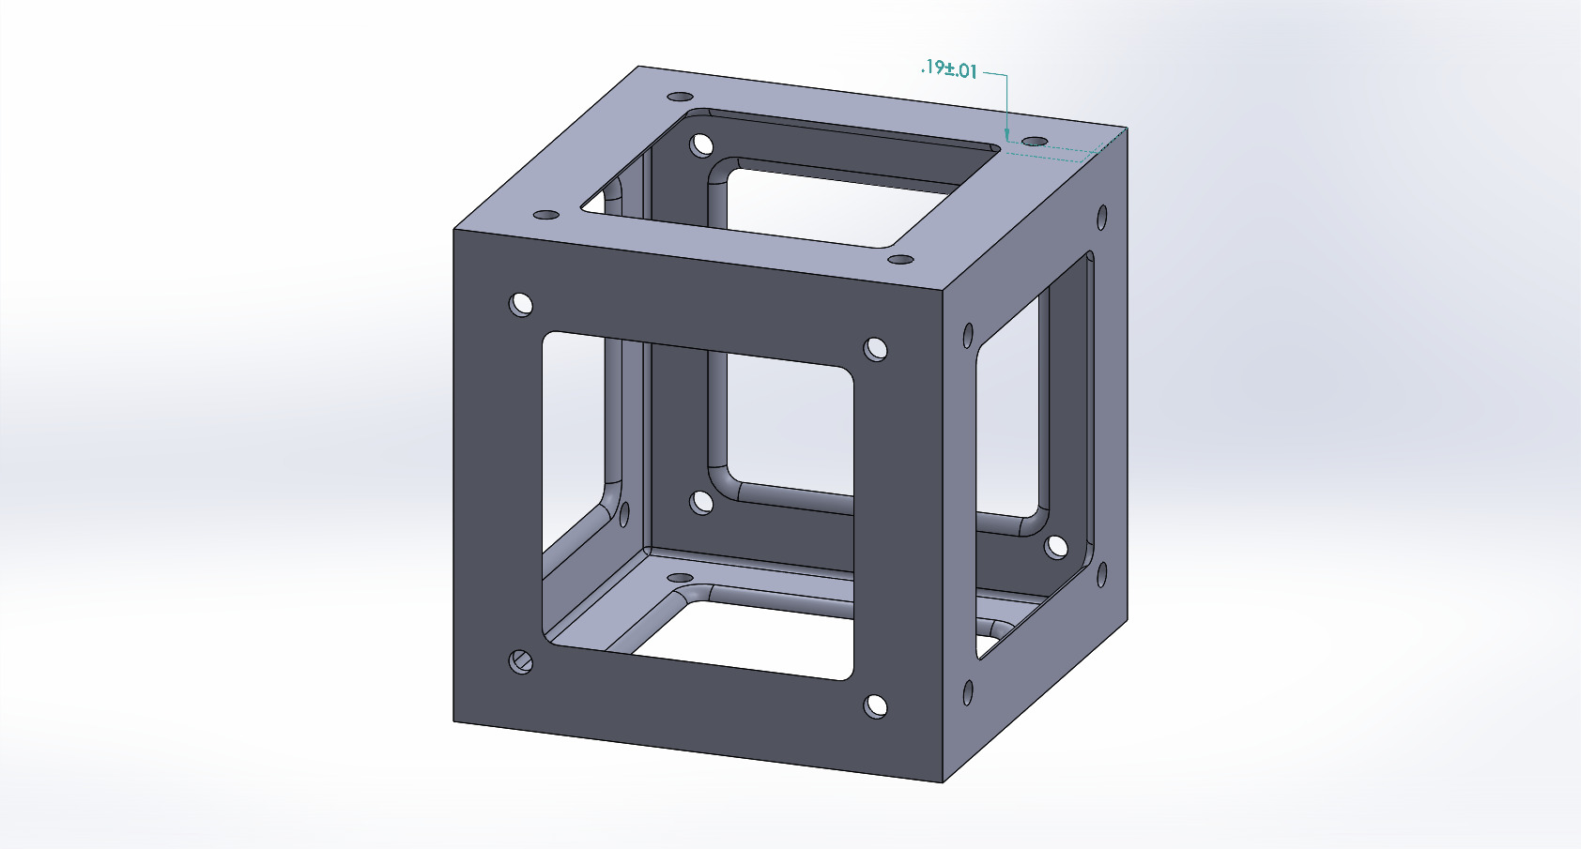
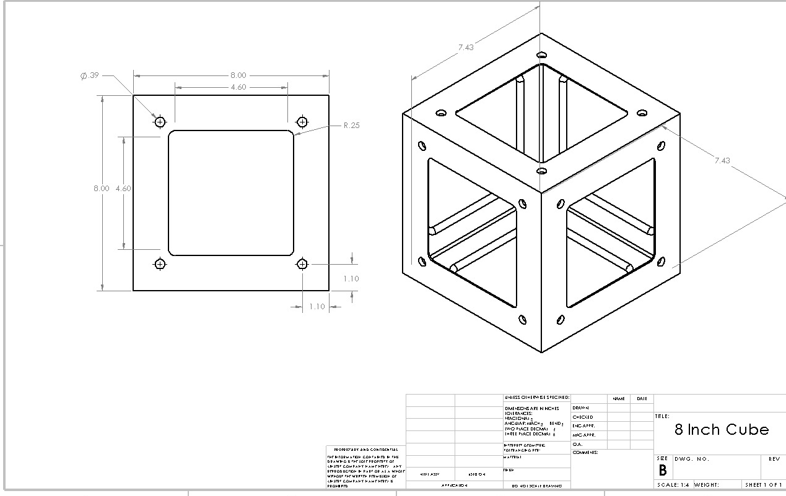
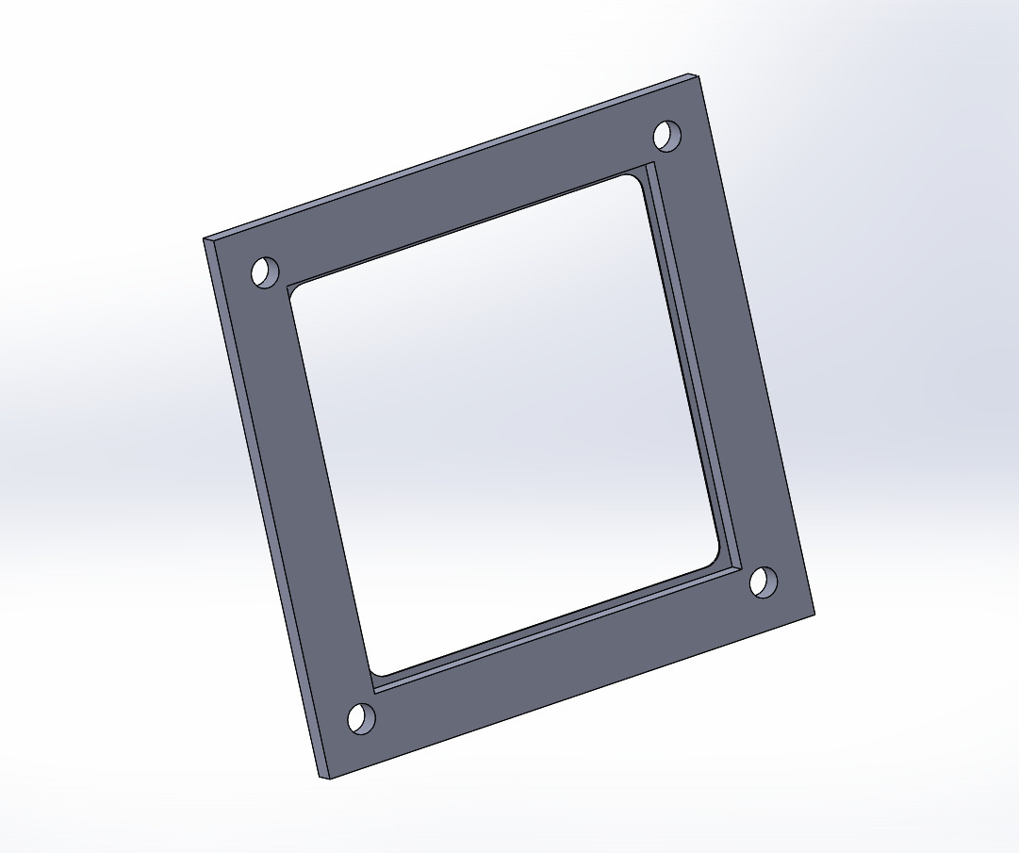
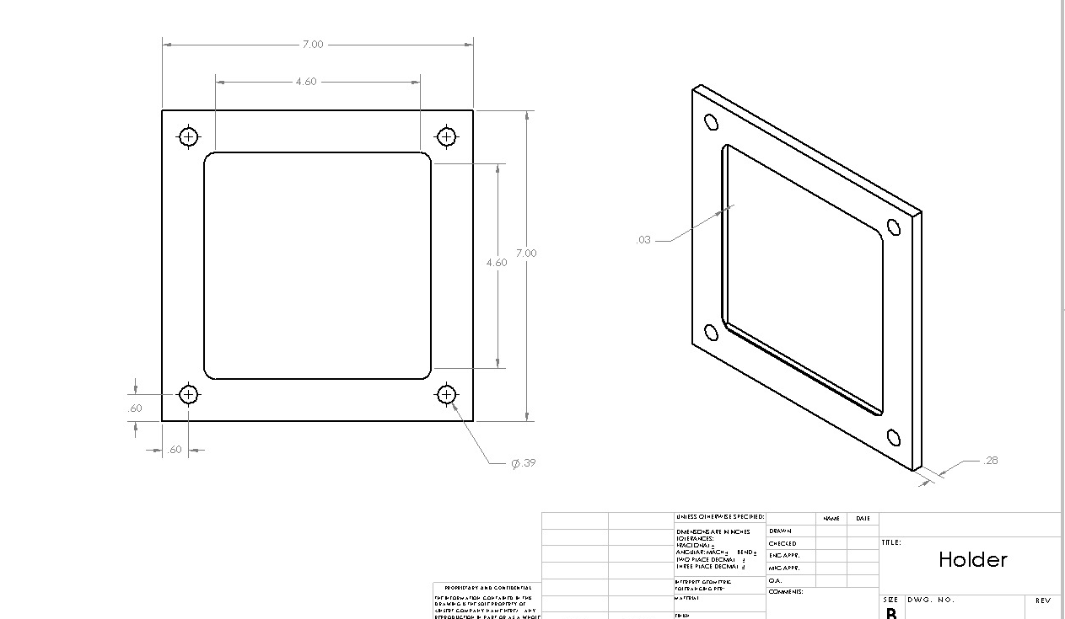
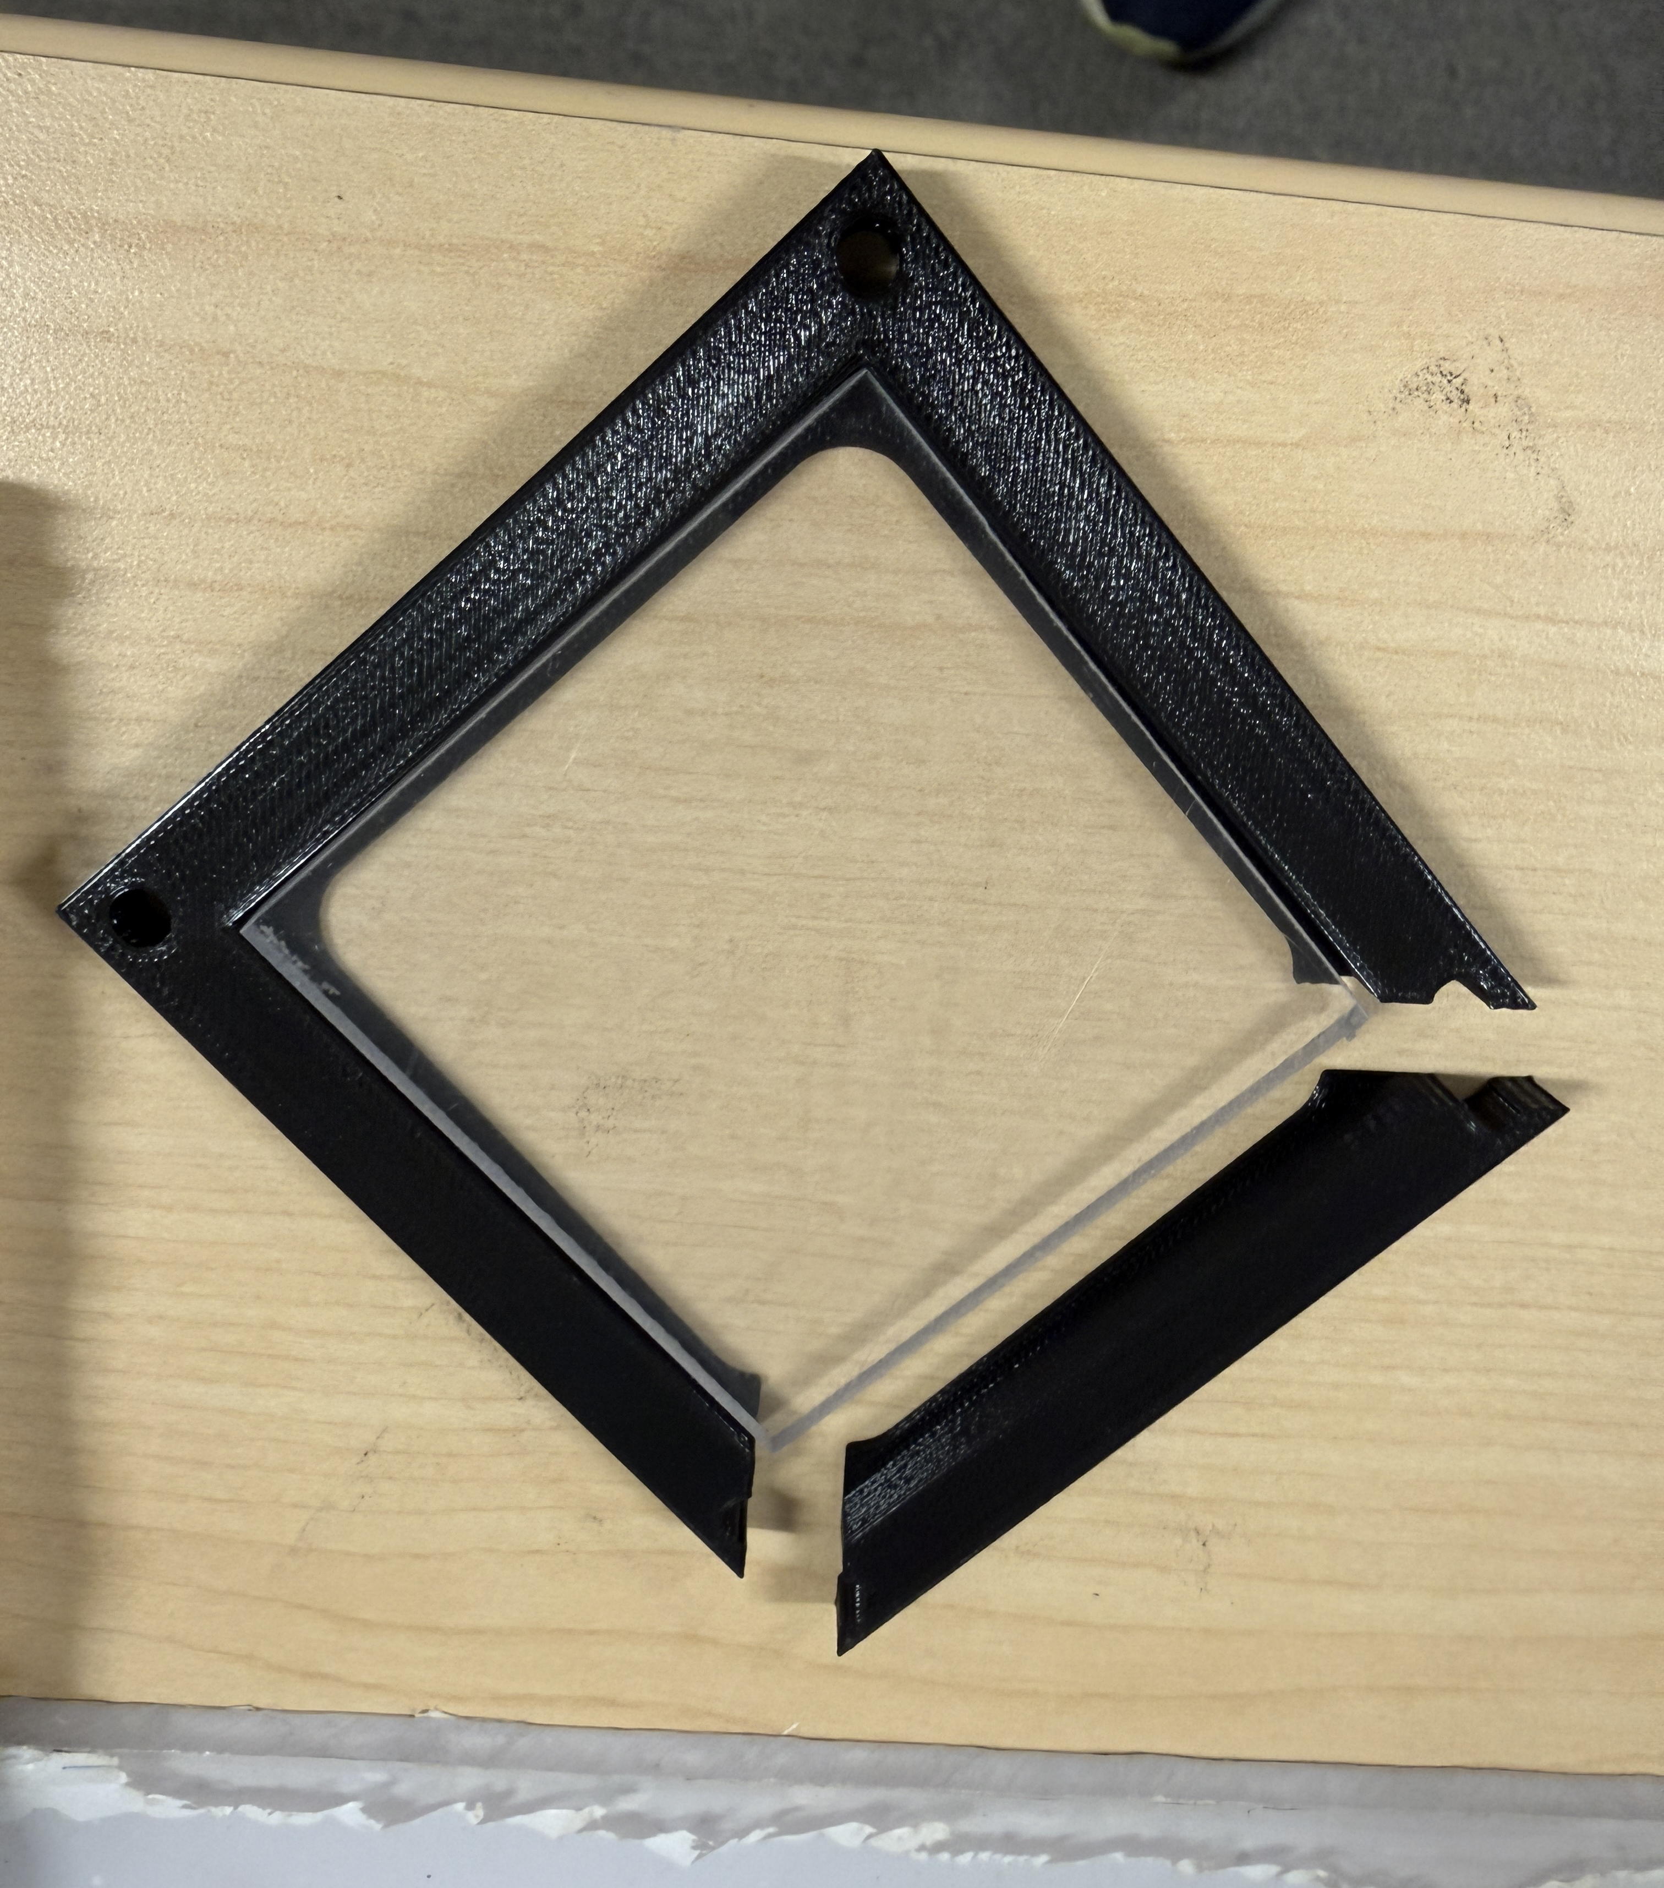
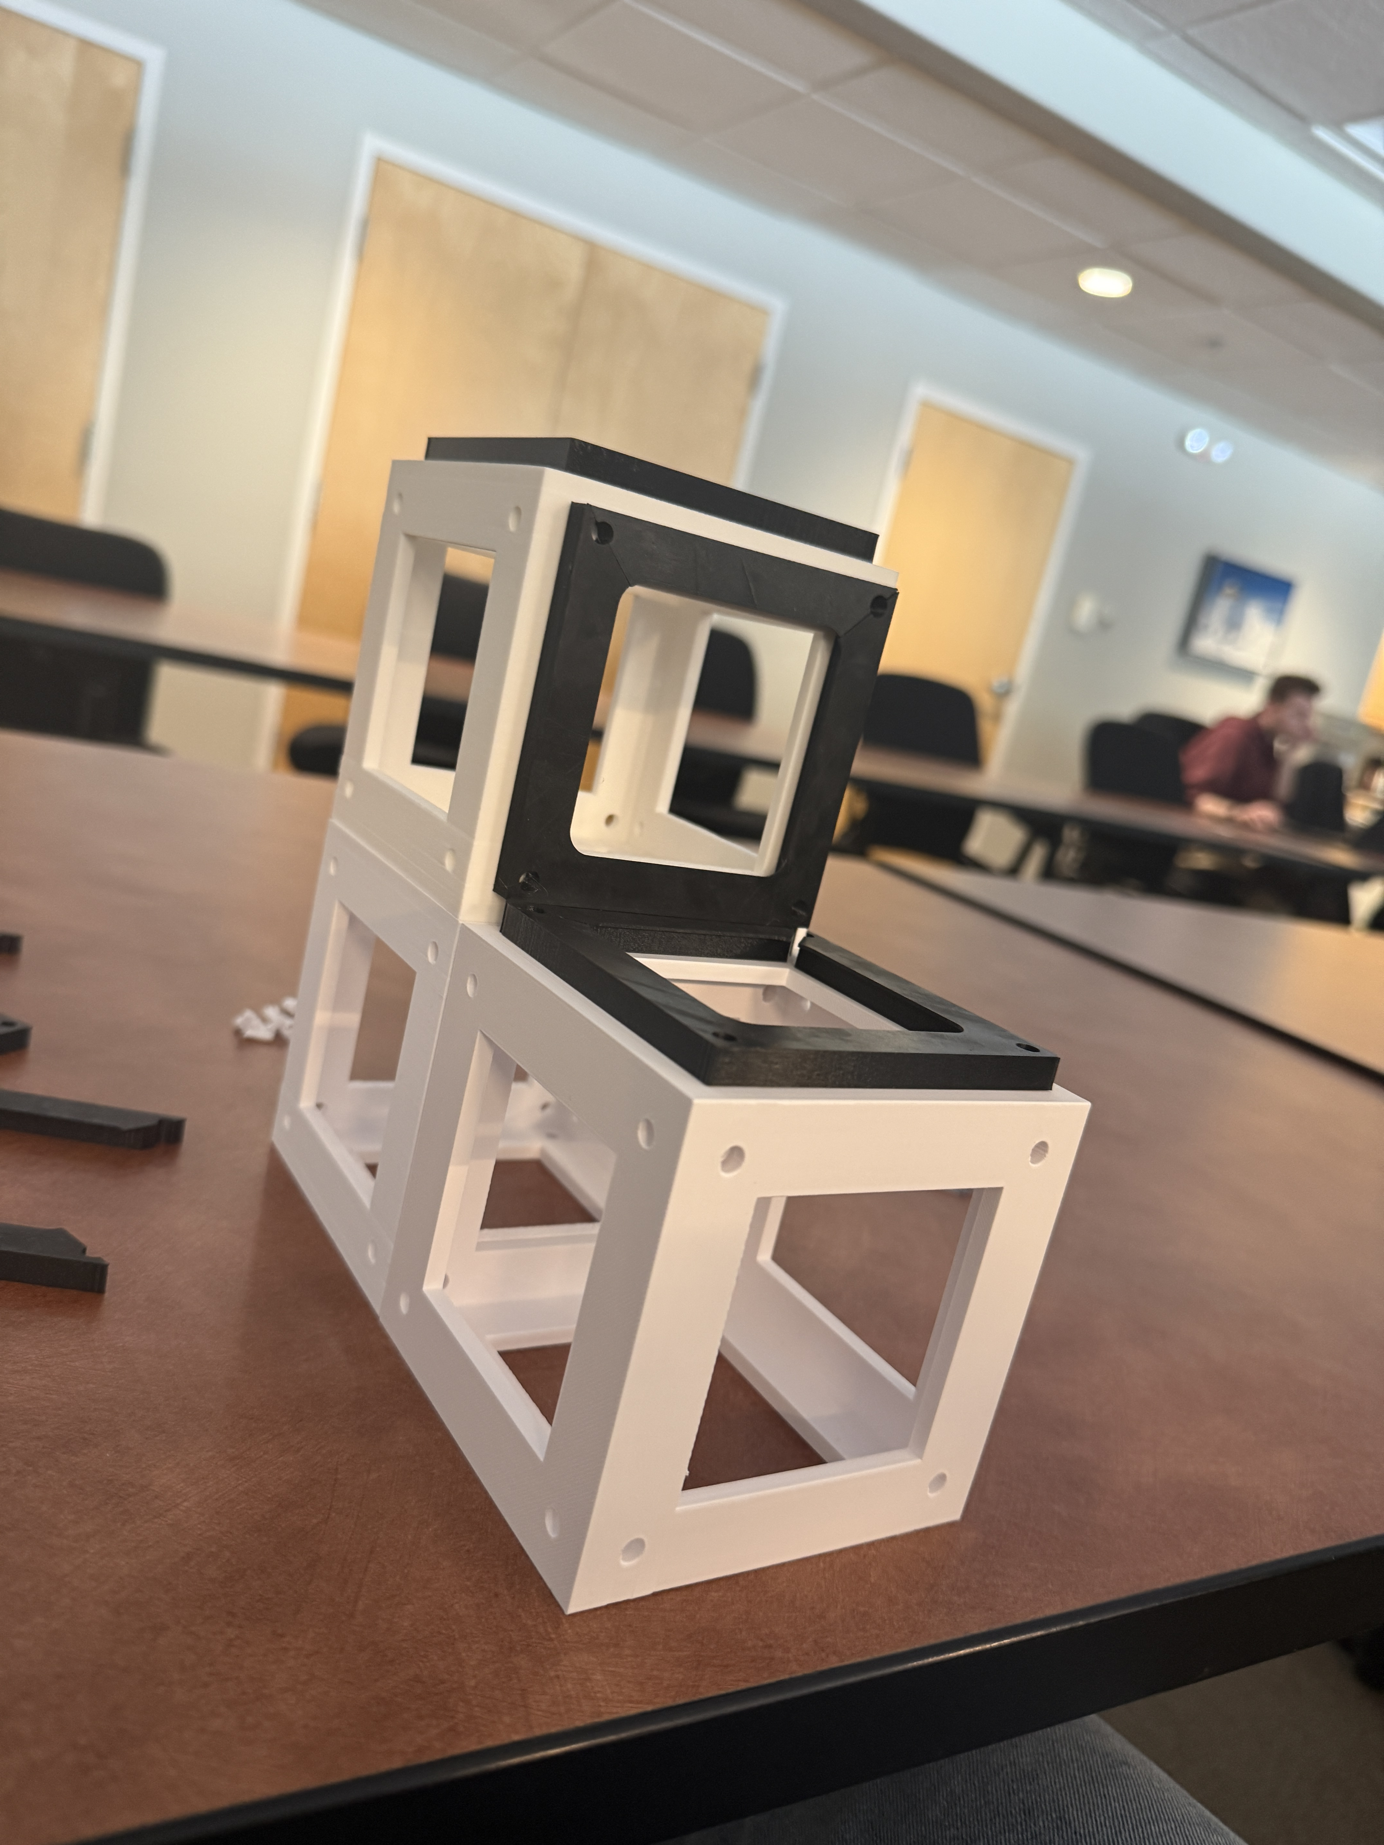
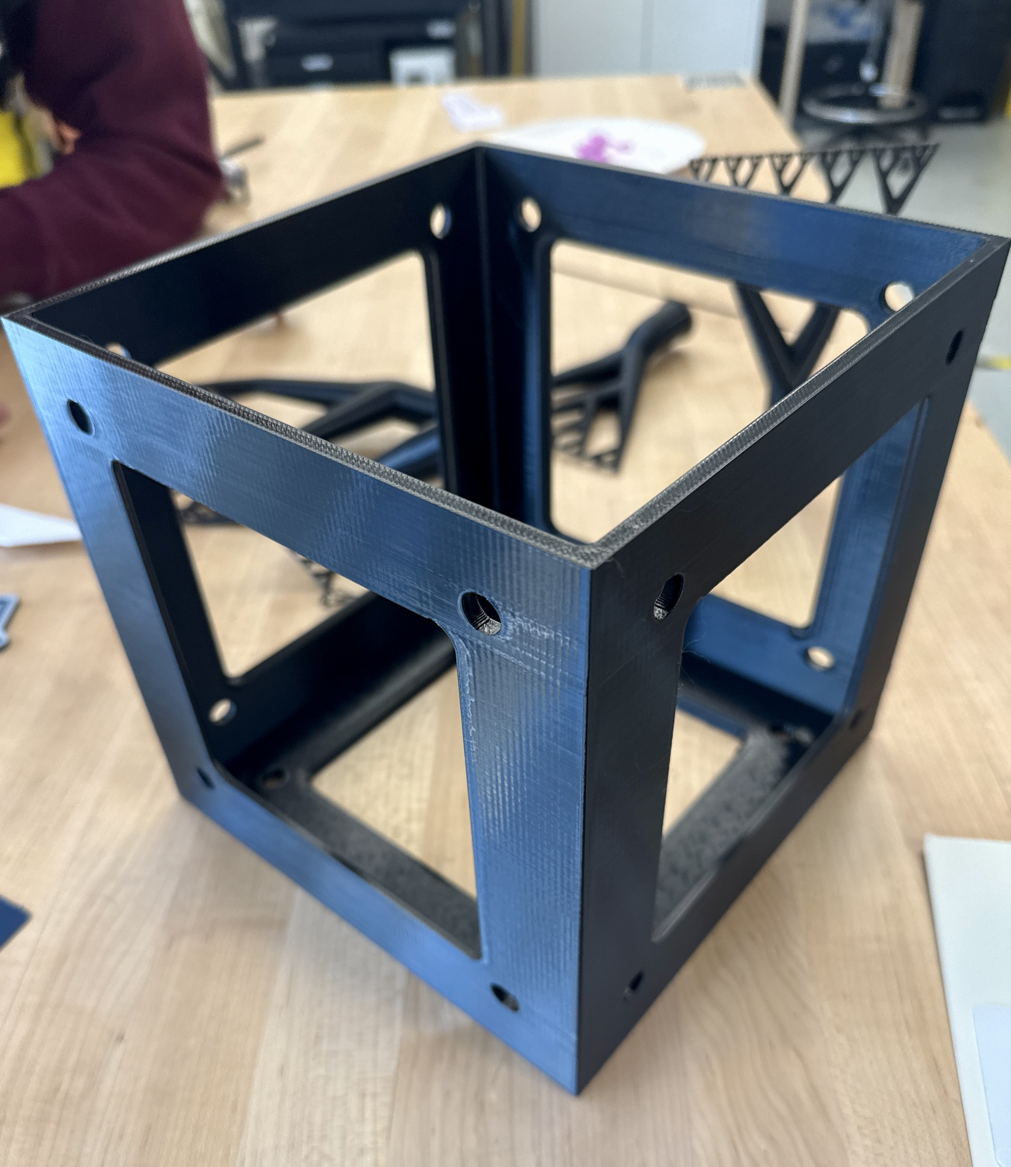
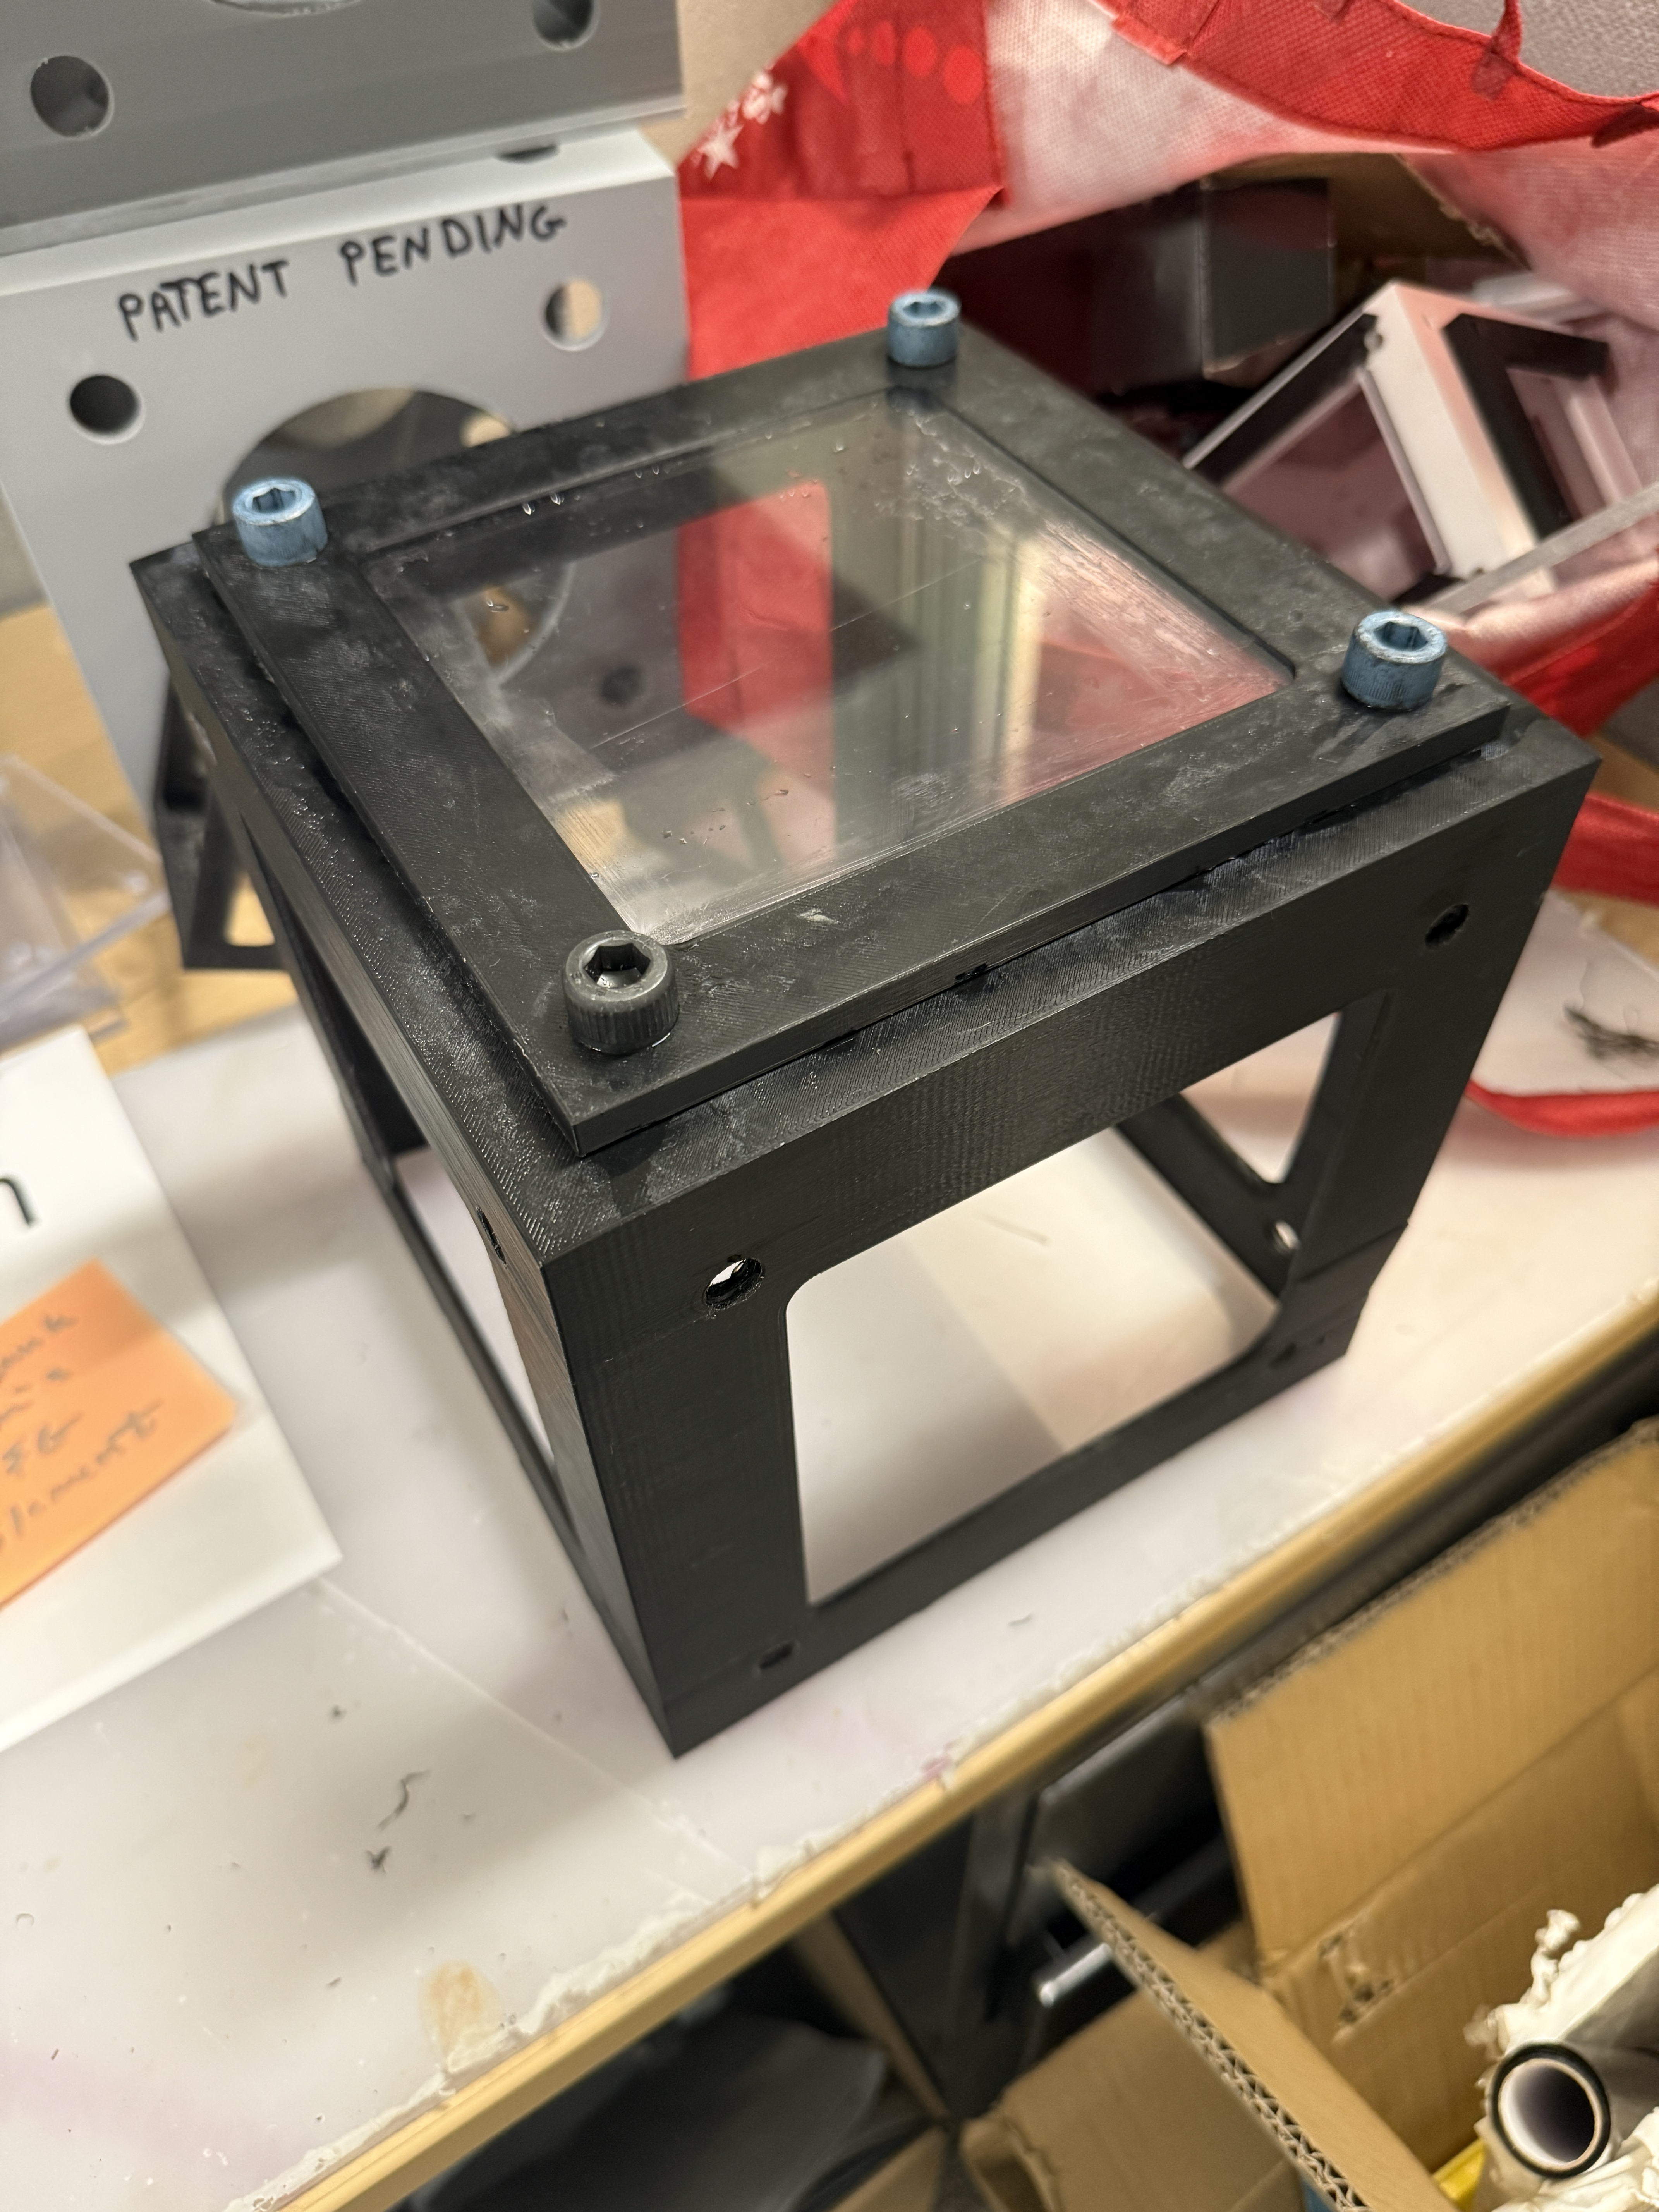
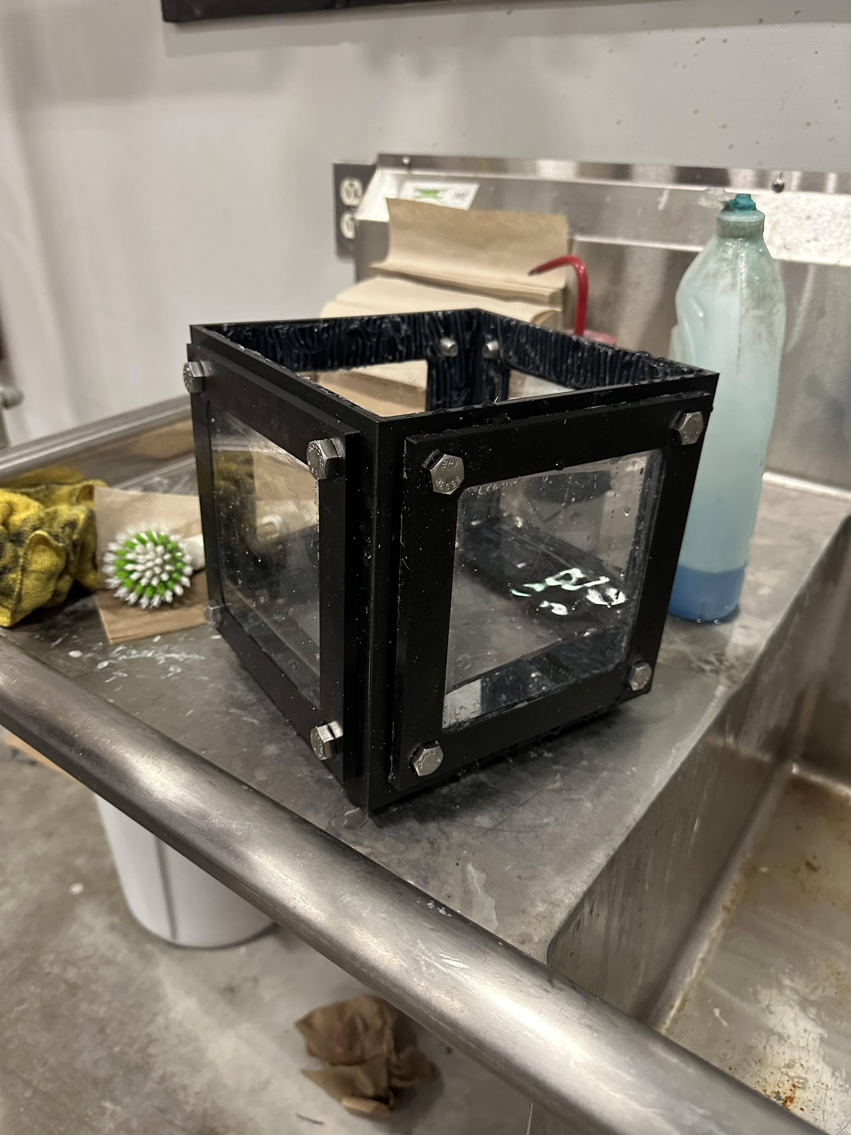
3D Printed Modular Fish Tanks
Cara Berman, Olivia Rogers, Kendall Hatch
Innovation Scholars, Advanced Manufacturing, University of New Hampshire
Introduction
Fish Tank Cube Unit
Materials Research
Initially based on the Incrediblocks LLC. design for seawall bricks, we developed a modular cube design intended to be used as a fish tank unit. The goal was to engineer and implement waterproof connection points that are functional for different scales of water volume. One of the major benefits of the initial design is that it allows for a variety of different attachments, like custom filtration systems, screens, and doors that could provide both further functionality and aesthetics in future developments of this project. The intention behind this research was to create a viable product which uses relatively common and fish safe resources .
To our knowledge, no comparable designs have been documented, making this a completely original concept. We highlighted that material choice was an extremely important part of the design process. The qualifications for selected materials focused on fish safety. PETG was chosen over the more standard PLA or ABS due to its water resistance and absence of harmful chemicals that could prove toxic to aquatic life. Similarly, stainless steel hardware was selected over standard brass fittings, which may release heavy metals into the water. For larger-scale or commercial production, alternative materials such as fully acrylic design or fibreglass could offer improved durability and manufacturability.
Image 1.1: Digital 3D Model (Cube)
Image 1.2: SolidWorks Drawing (Cube)
Side Panel Attachments
Image 2.1: Digital 3D Model (Sides)
Image 2.1: SolidWorks Drawing (Sides)
Discussion
Methods
The design and testing process gave valuable insight into the feasibility of this concept. The results suggest that with continued refinement, particularly in material optimization, this design has strong potential to become successful. The groundwork provides a meaningful starting point from which future research could continue.
Digital models of both a prototype and full-scale design were created using SolidWorks. We began making physical prototype was fabricated using 3D printing. After detailing issues with the initial design, our larger model constructed using a combination of PETG filament, water-jet cut acrylic, silicone sealant, and stainless steel hardware, all selected for their aquatic compatibility. The full-scale model was then tested to evaluate its performance.
Acknowledgements
Media
      We would like to thank Ben Mitchell, William Donnelly, and Sarah Souliere for their involvement and contributes to this project.
Contacts
      For more information contact: Cara.Berman@unh.edu, Olivia.Rogers@unh.edu, Kendall.Hatch@unh.edu
Image 3.1 - 3.5: Design Progress Progression

