Slide 1


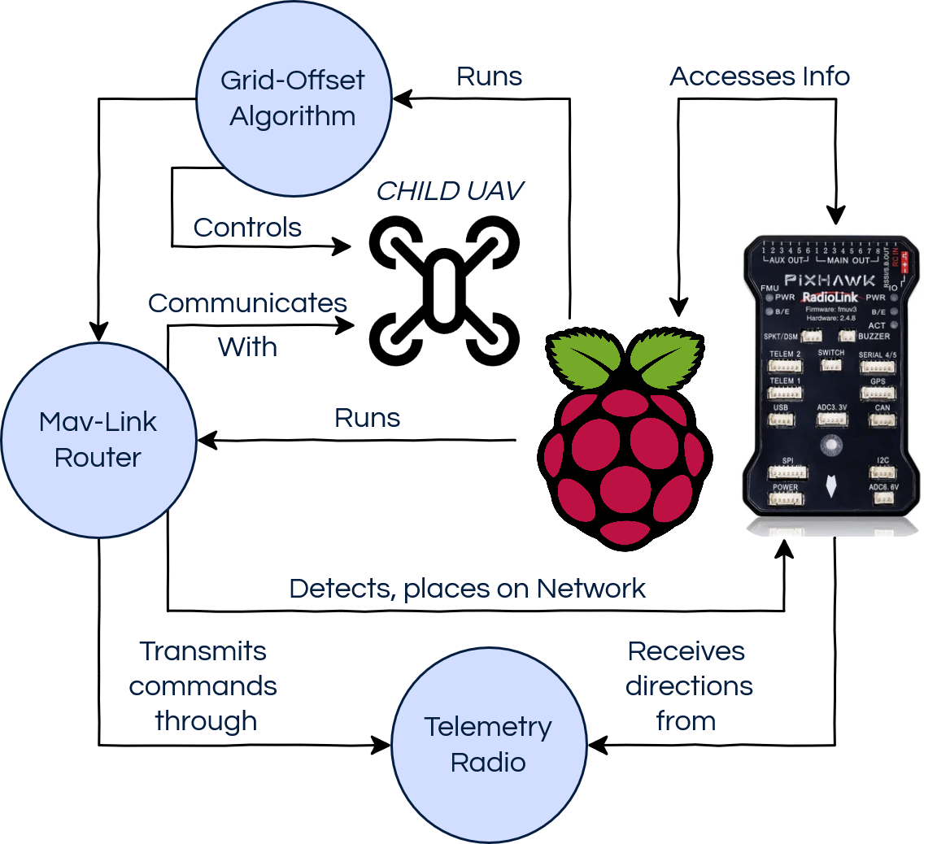
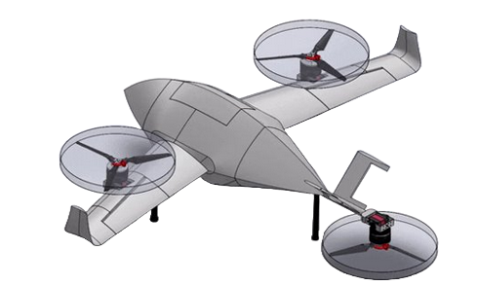
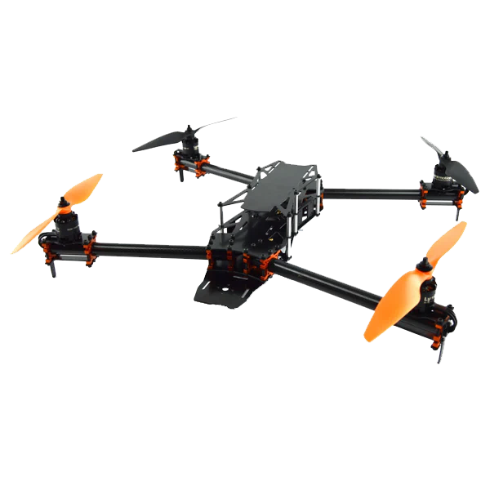
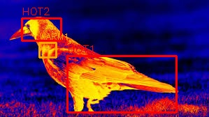
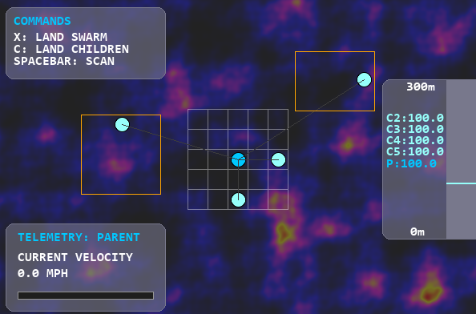
Quad-X Swarm
Collie Petersen, Grave Colandreo, Quinn Junco, Daniel O’Connell
Computer Science, University of New Hampshire, Durham, NH 03824
Introduction
Project Design
Evaluation
The goal of Quad-X Swarm is to develop the underlying swarm mechanics and expandable mission framework for autonomous unmanned aerial vehicles (UAVs) to complete complex multi-step missions. In this case we focused on thermal-imaging based search and rescue.
The UAVs will be controlled autonomously by a central ‘parent’ UAV. This unique centralized swarm mechanic is structured so that under ideal conditions collision avoidance is intrinsic to our grid-based approach.
All search areas & the area around the parent are divided into cells of 2.5 x 2.5 meters.
This grid enables the thermal imaging of individual cells used by the thermal detection algorithm for SAR operations.
Key: Black Box = PIxhawk, Raspberry = Pi
Fig 2. (right) shows how the parent-child setup is configured.
On startup the Grid-Offset Algorithm boots up and initiates the MAVLink network.
The Pixhawk flight controller receives directions over the telemetry radio on its MAVLink network.
The Pixhawk sends the current GPS and Inertial Measurement Unit (IMU) data to the Raspberry Pi.
The Raspberry Pi utilizes the IMU data as input to the perpetual Grid-Offset algorithm.
The Grid-Offset algorithm communicates relevant instruction data to the children to both maintain swarm structure and avoid collisions.
Fig 2. System Design
In addition to our listed requirements, we have also completed several target metrics to ensure safety and efficiency in our system framework.
Missions operate successfully and are completed under up to 5% MAVLink communication packet loss
Our UAVs maintain an average distance of 2.5 meters during 99% of flight, and collisions are minimized to near-zero probability.
Children land within 5 meters of the parent.
Missions are divided between children when a singular mission contains more than 36 cells.
SAR algorithm identifies & prioritizes all hotspots within a given search area.
Fig 1. VTOL and Child UAV
Shows how the Raspberry Pi and Pixhawk Flight controller work with our algorithm to enable our design
Conclusions
The Quad-X Swarm project as it stands offers a new method for UAV swarms to perform SAR operations.
Algorithm supports up to 8 child UAVs seamlessly
Current framework allows for expansion to other areas such as autonomous navigation or delivery.
Next steps:
Algorithm needs to undergo more rigorous unit testing in order to scope out any edge cases.
Integrating the system with physical UAVs and VTOL X.
Safety Features such as calculated positions and object avoidance.
Overall, we succeeded in setting up a modular swarm & mission framework from which SAR operations can be fine tuned, and missions such as delivery and civil engineering surveillance implemented with ease. Quad-X is ready for deployment and testing in the real world.
Implementation and Testing
Fig 4. Simulation
Parent-Child Swarm Hierarchy Implementation
  Communication between the parent and children uses the pymavlink library for real world uses while supporting direct simulated communication for our testing and demonstration.
  Data involving the parent velocity and all UAVs’ altitude are displayed and recorded.
  Location, velocity, and acceleration data of the UAVs are generated to simulate real movements and reactions to movement commands over MAVLink during testing.
  Resilience testing was done to ensure safe distances between UAVs to avoid collisions.
Thermal Detection Algorithm
  Separate algorithm developed for individual image analysis and marking.
  Runs independently once thermal image of cell is taken by child UAV
  Analyzed images are marked with coordinates of hotspots noted in output file.
  Manual testing used to ensure accuracy in identification of hotspots as seen in figure 3. In addition, automated testing of missions in simulator was done to ensure consistent results.
Fig 3. Marked Thermal Image
Fig. 3: Output from thermal detection algorithm with multiple hotspots identified.
Requirements
Functional Requirements:
  The parent must control all children’s take off, flight and landing.
  The parent must avoid collisions with children and prevent collisions between children.
  Thermal processing must be done over the entirety of the search area.
  Thermal Processing must be lightweight and not overwhelm the parent’s processor.
  The system must accurately simulate latency for UAV communications.
  Simulated physics must be realistic.
  Simulator must produce relevant metrics.
Non-Functional Requirements:
  An easy to use interface for mission management and parent control.
  Physics and rendering must not impact performance of the simulation.
Fig. 4: Simulation used for testing algorithm correctness
Acknowledgements
Our utmost gratitude to: Our sponsor Dr. May Win Thein, our advisor Craig Smith and the VTOL X team for both guiding and working alongside us during this project. It wouldn't have been possible without them.
Notes:
prioritizes hotspots by thermal intensity
‹#›

