Slide 1

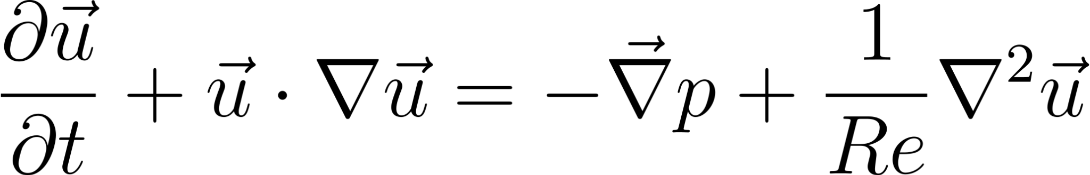
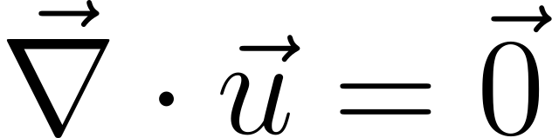
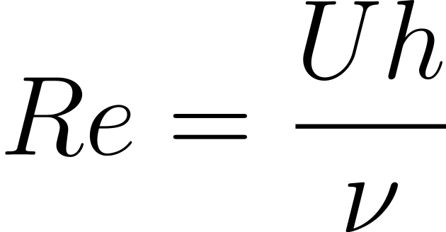
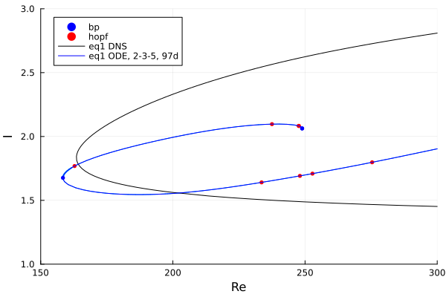
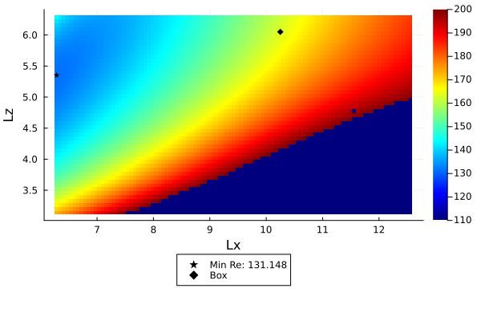
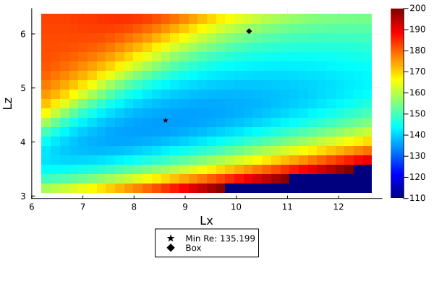
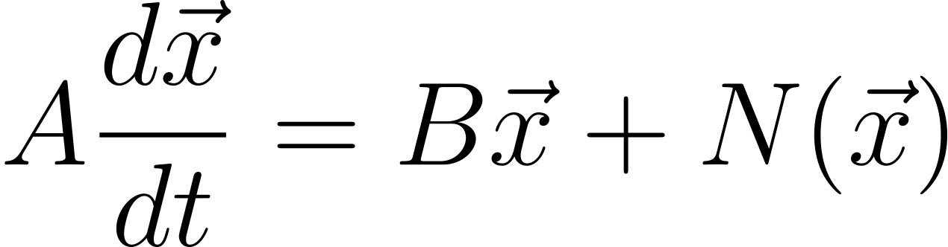
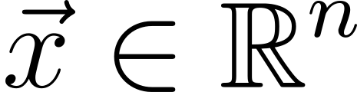
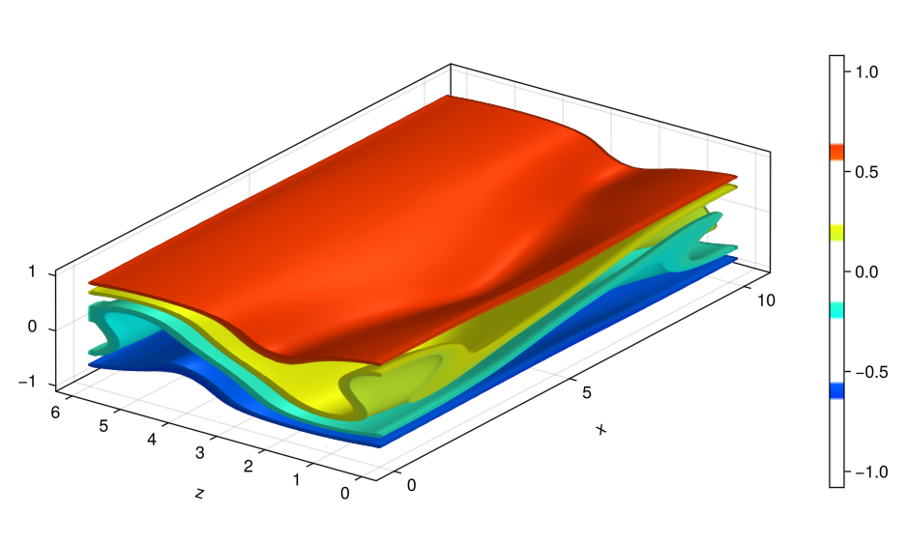
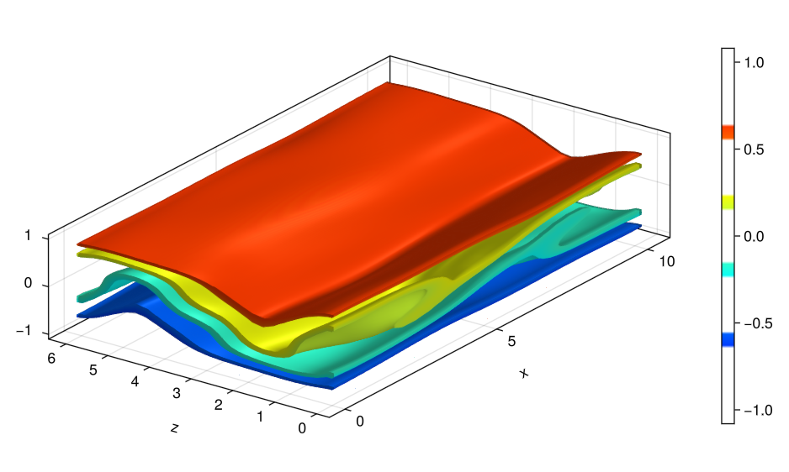
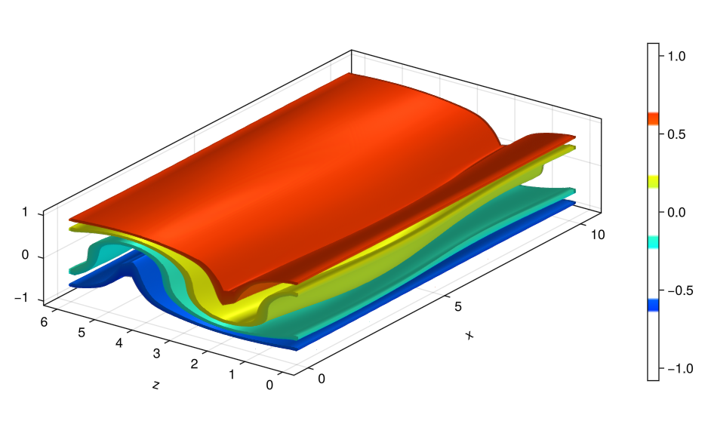
Low Dimensional Models of Steady State Solutions in Plane Couette Flow
Christian Balusek, Trevor Cormier, Samuel Geho, and Samuel O’Connell
Innovation Scholars, University of New Hampshire
Introduction
Methods
Navier Stokes Equations:
Plane Couette Flow
Steady State Solutions
Ordinary Differential Equations (ODEs)
Galerkin Projection
Lx x 2 x Lz : Domain with Periodic Boundary Conditions
Model Parameters: J, K, L, Re, and Symmetries in U
Compare Low-D ODE models to Direct Numerical Simulation (DNS) for Equilibria
Finding the Critical Re for Equilibria
Used CloudAtlas and BifurcationKit for parametric continuation using initial guess to find critical Re of the ODE for given Parameters
Wrote Julia Code to find critical Re as a function of box parameters Lx, Lz to see how altering horizontal box parameters affected the critical Re of model
Results
y
z
x
J, K, L : 1, 1, 3
J, K, L : 2, 3, 5
J, K, L : 1, 1, 3
J, K, L : 2, 3, 5
DNS
Lx, Lz: 10.25, 6.05
Acknowledgements
References
Our thanks go to Professor Gibson and Eben Quenneville, who have helped us with the scope of this project, and provided data to help the development of this project.
Julia Language
BenchmarkTools
Revise
Polynomials
DelimitedFiles
LinearAlgebra
JLD2
GLMakie
FastChebInterp
BifurcationKit
PlotlyJS
NCDatasets
CloudAtlas
Makie
.

