Slide 1


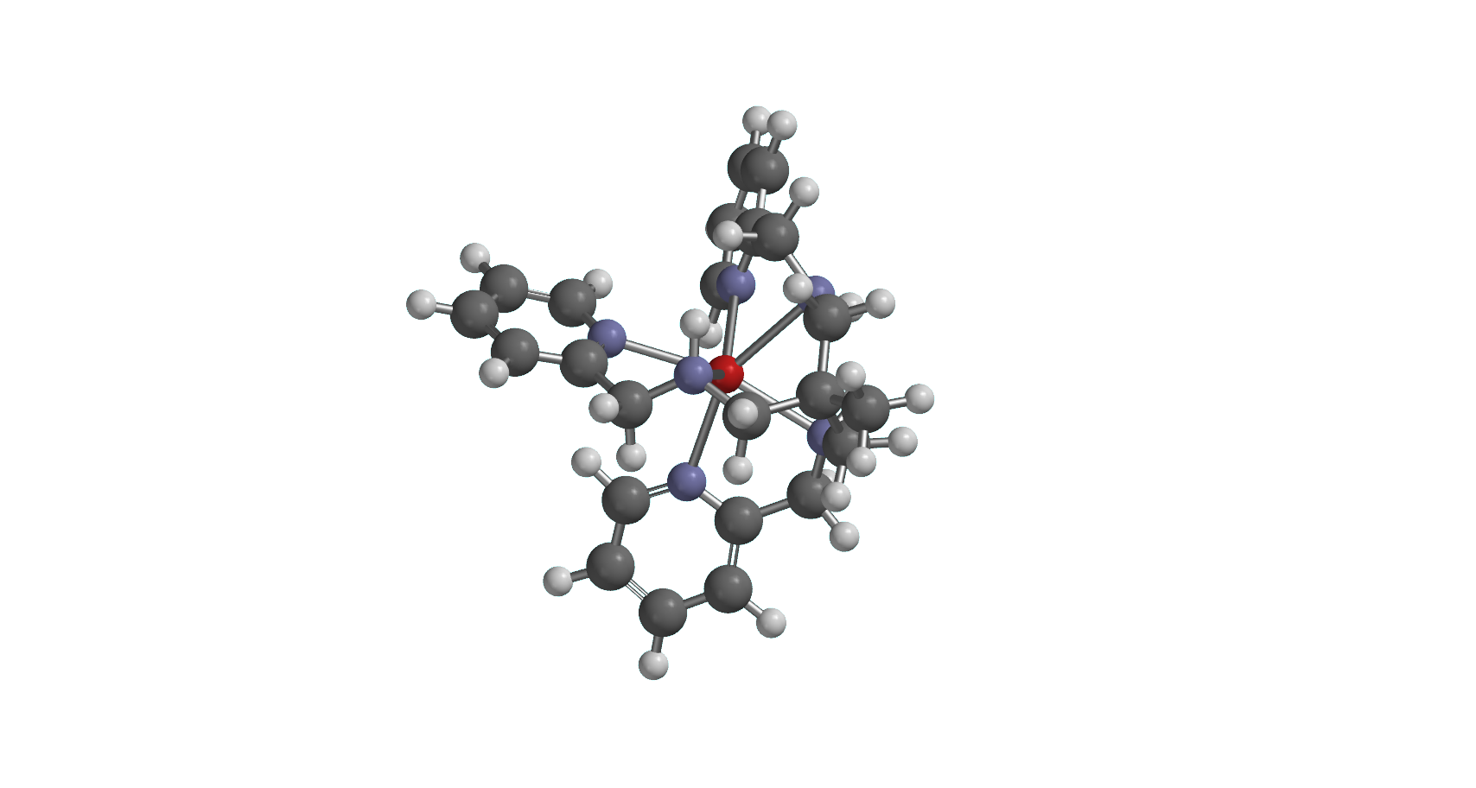
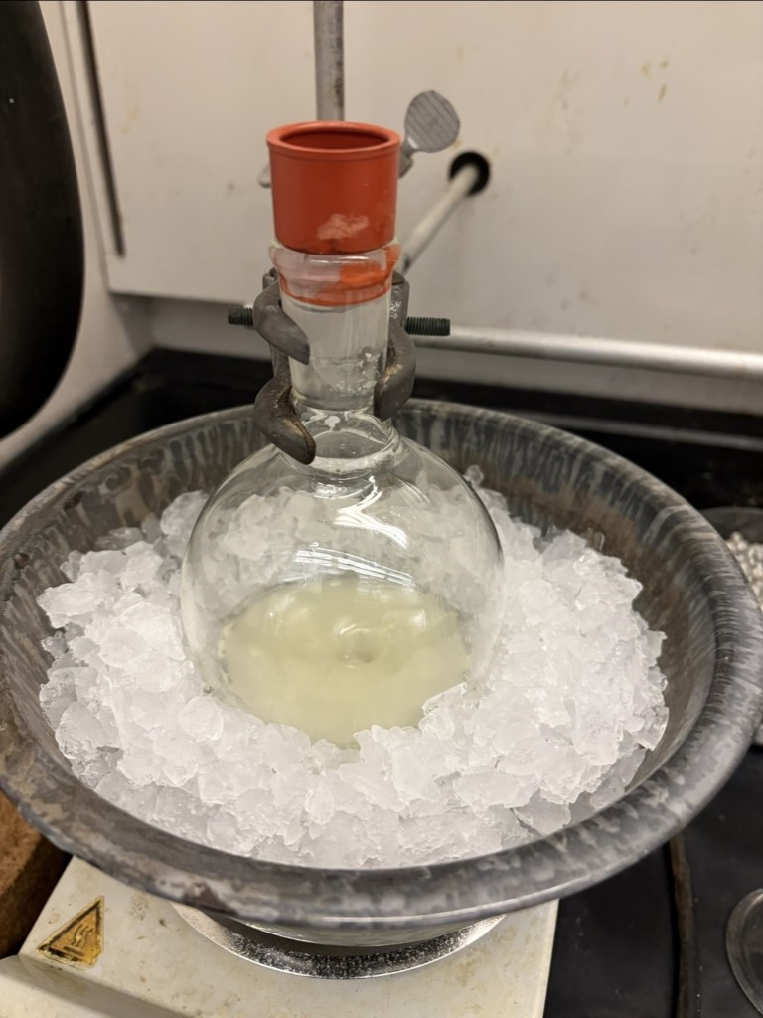
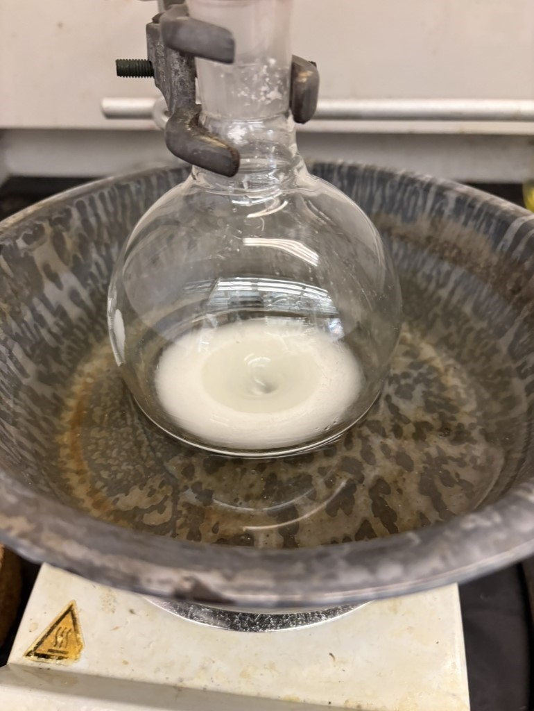
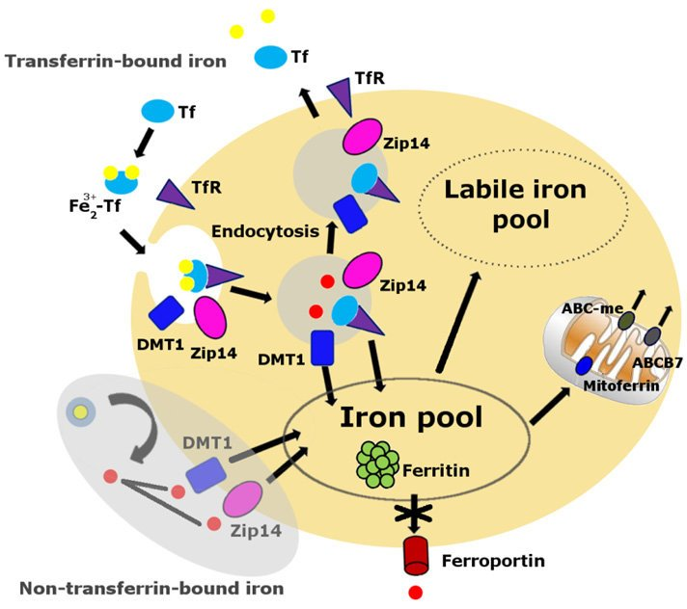
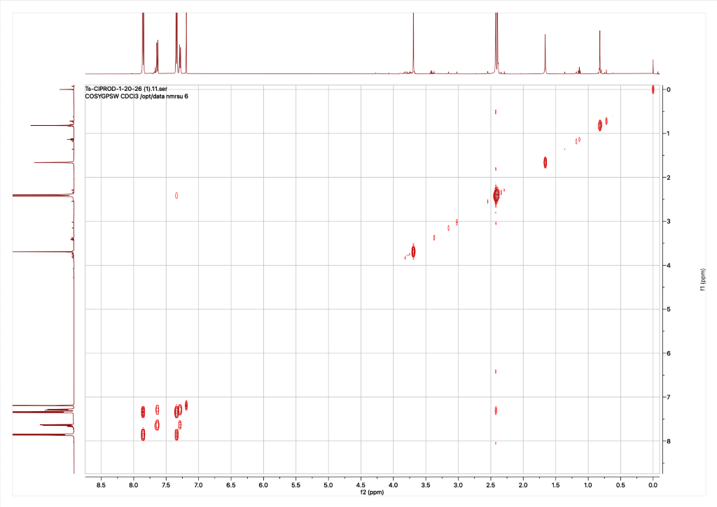
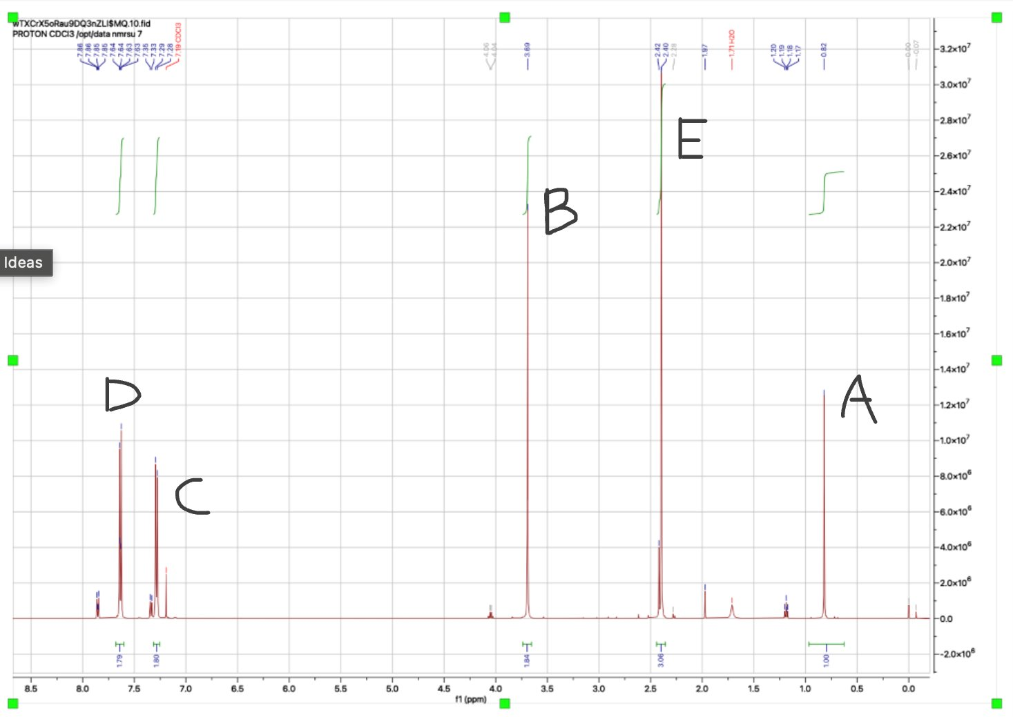
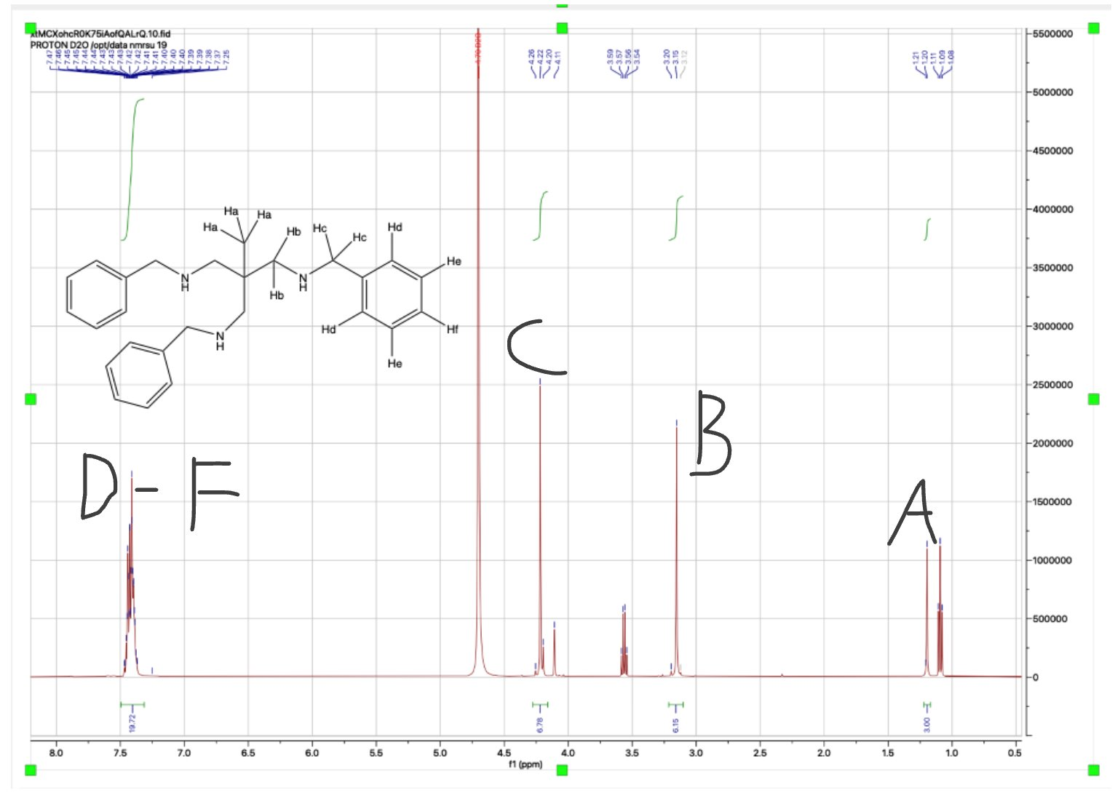
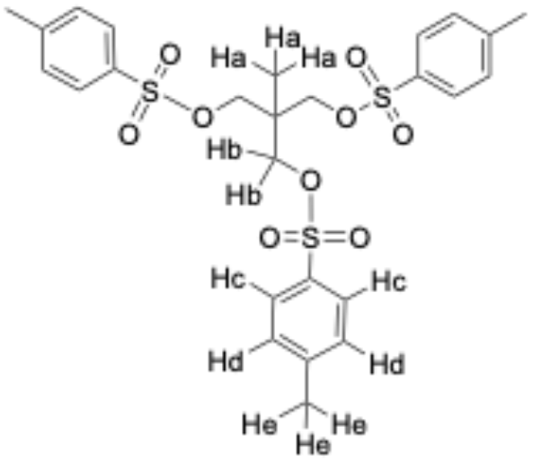


















































































































NOVEL LIGAND DESIGN, SYNTHESIS, AND CHARACTERIZATION FOR BIOLOGICAL IRON REMOVAL
Shane Stukenborg, Tristan O’Harte, Roy P. Planalp
Department of Chemistry, University of New Hampshire, Durham, NH 03824
Introduction
Schemes and Diagrams
Iron is a well-known necessity in sustained human biology and health. Despite its requirement in cellular homeostasis, an overabundance of iron is associated with various health defects, such as Alzheimer's, and certain cancers. With these conditions in mind and to better understand the biochemistry of such diseases, a chelator resembling a claw was favored for its properties. The molecule TAME-pyr ([N,N',N''-tris(2-pyridylmethyl)-1,1,1-tris(aminomethyl)ethane]) was assessed for iron chelation and synthesized with appropriate characterization.
Overall Synthetic Scheme
Image #1 Visualization of The Labile Iron Pool
Image #2 Visualization of Iron Complex
Methodology
Results & Future Work
Successful preparation of TAME precursors and improvement of purification practices.
Computational work completed to gauge the capabilities of ligands for metal bonding
Steps have been taken towards chelation/complex formation with Zn and Fe
We are pursuing the preparation of TAME-pyr via new and old synthetic methods
We plan to attach chelator to a peptide for medicinal use
Image #1: Iron Labile Pool hold redox-ready iron throughout the body with its respected biological pathways.
Image #2: Computational structure of TAME-pyr complexed to Fe(II). Image derived from Spartan program.
Data
sTAMD Simulations
Acknowledgements
Spectral Analysis
COSY spectra
H¹ NMR Spectra
H¹ NMR Spectra
I would like to give a big thank you to all that helped me through this project. My Professor, Roy P. Planalp, and Grad student, Tristan O’Harte, and my friends and family for always encouraging me to do my best.
References
Qin, C.-J.; James, L.; Chartres, J. D.; Alcock, L. J.; Davis, K. J.; Willis, A. C.; Sargeson, A. M.; Bernhardt, P. V.; Ralph, S. F., An Unusually Flexible Expanded Hexaamine Cage and Its CuII Complexes: Variable Coordination Modes and Incomplete Encapsulation. Inorganic Chemistry 2011 50 (18), 9131-9140.
Whittington, M.D., C. (n.d.). Ironic Health Is Too Much Iron Making You Ill? Hemochromatosis The Most Common Inherited Disorder In The World (1st ed., pp. 1–111) [Review of Ironic Health Is Too Much Iron Making You Ill? Hemochromatosis The Most Common Inherited Disorder In The World]. Cinori Publishing. (Original work published 2001)
Xu, J.; Jia, Z.; Knutson, M. D.; Leeuwenburgh, C. Impaired Iron Status in Aging Research. International Journal of MolecularSciences 2012, 13 (2), 2368–2386. https://doi.org/10.3390/ijms13022368.​
Graph #1: Crude COSY spectra of
1,1,1-tris((p-toluenesulfonyloxy)methyl)ethane
Graph #1: Labeled Proton NMR spectra of pure
1,1,1-tris((p-toluenesulfonyloxy)methyl)ethane
Graph #2 Labeled Proton NMR spectra of pure 1,1,1-tris((benzylamino)methyl)ethane

