Slide 1


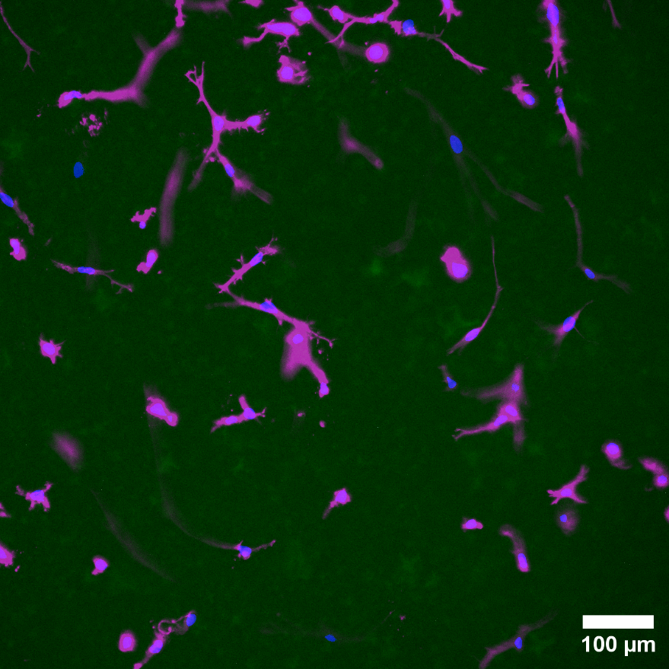
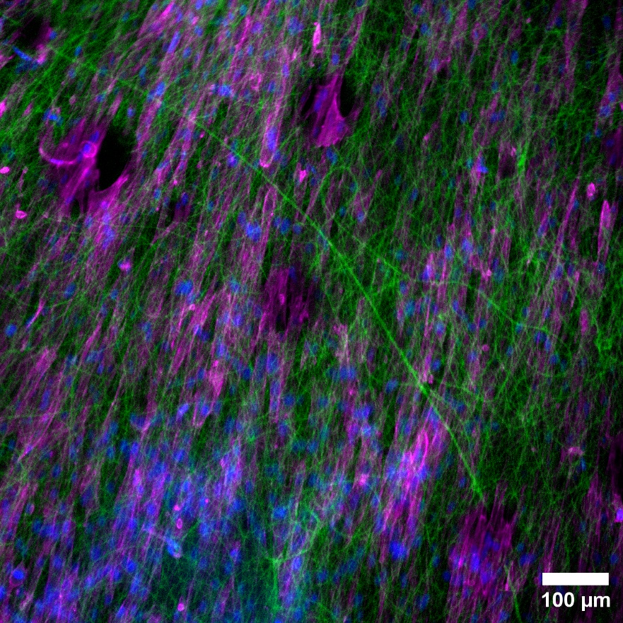
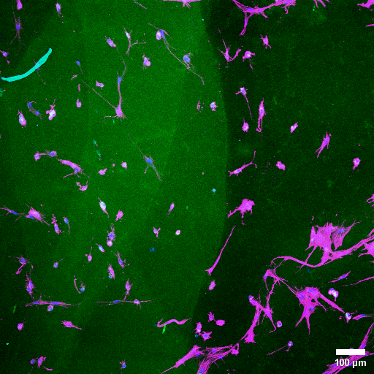
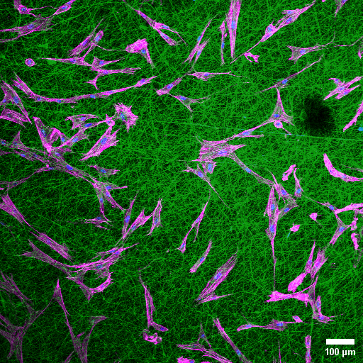
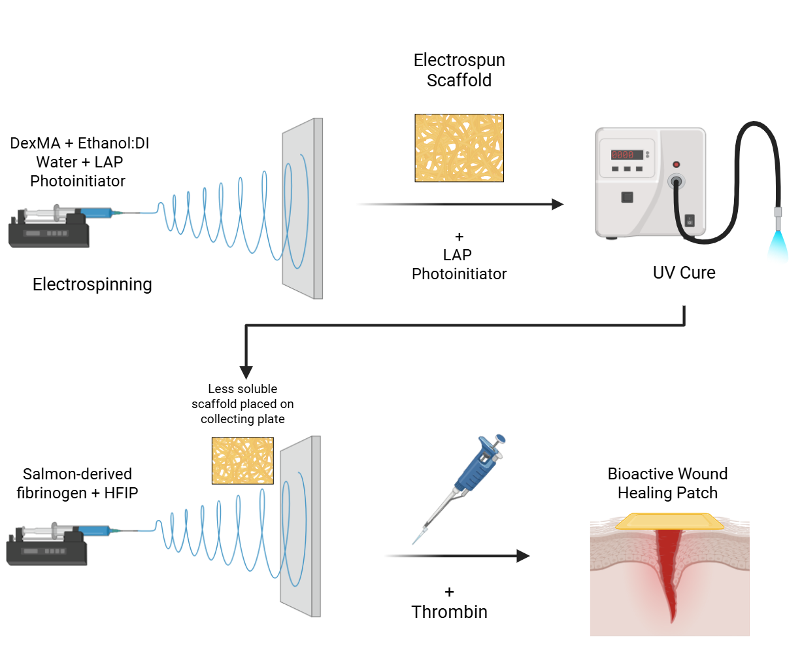
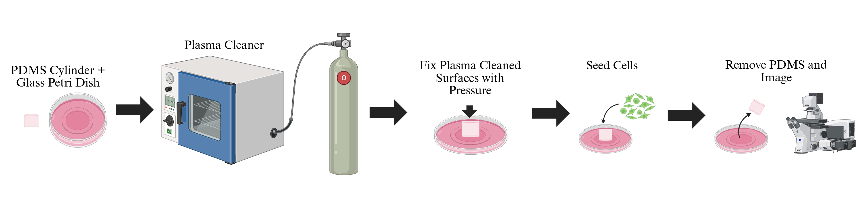
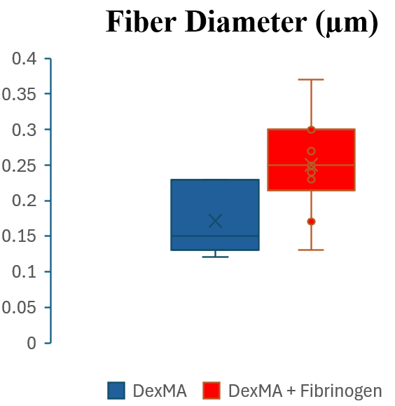
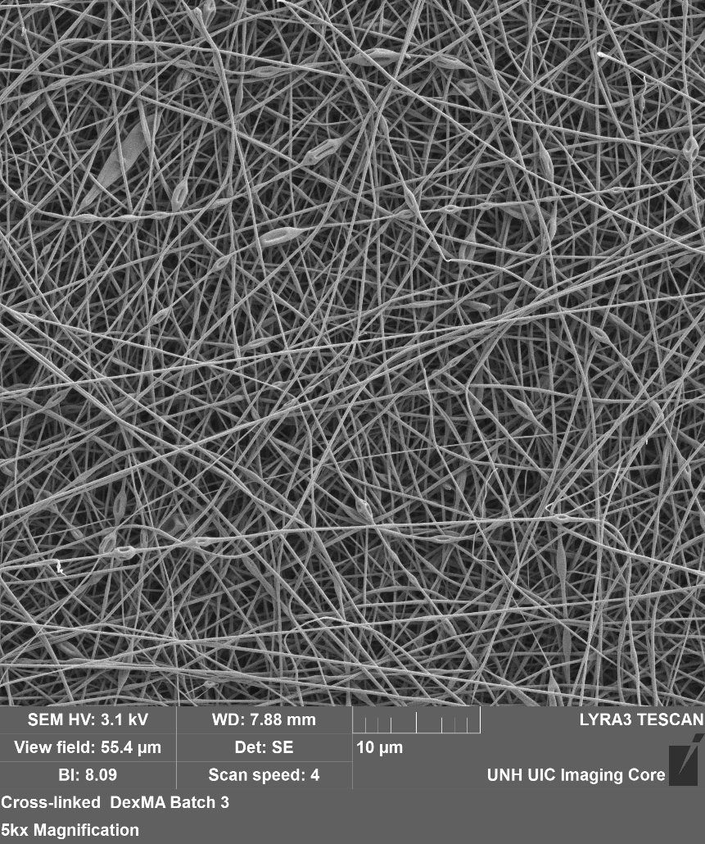
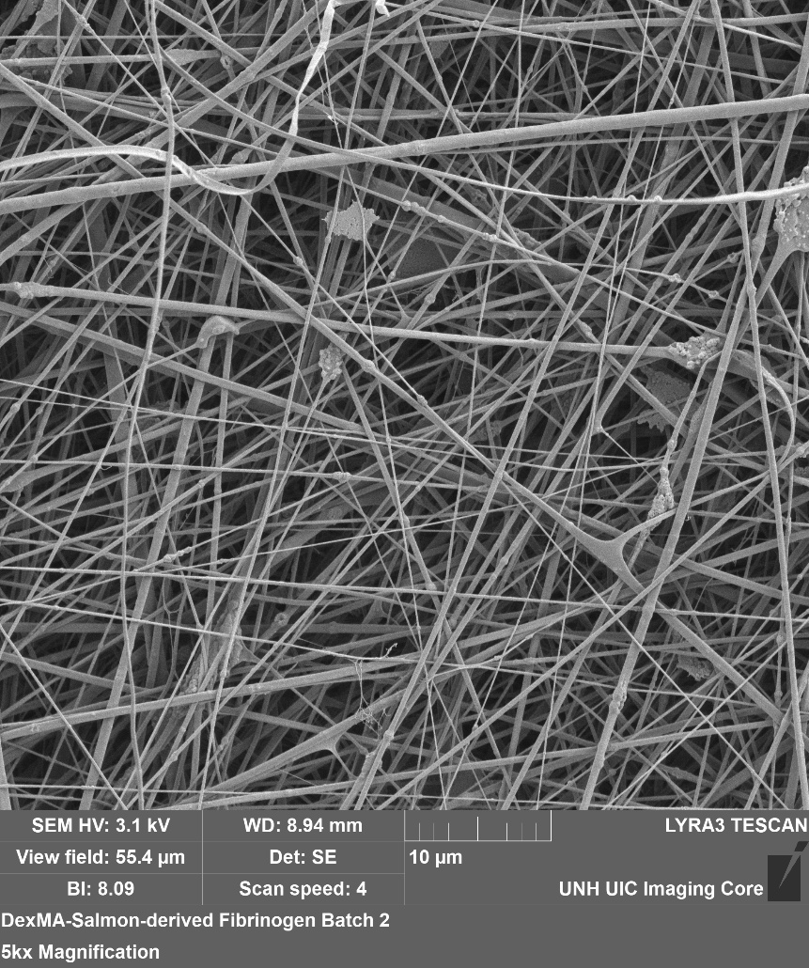
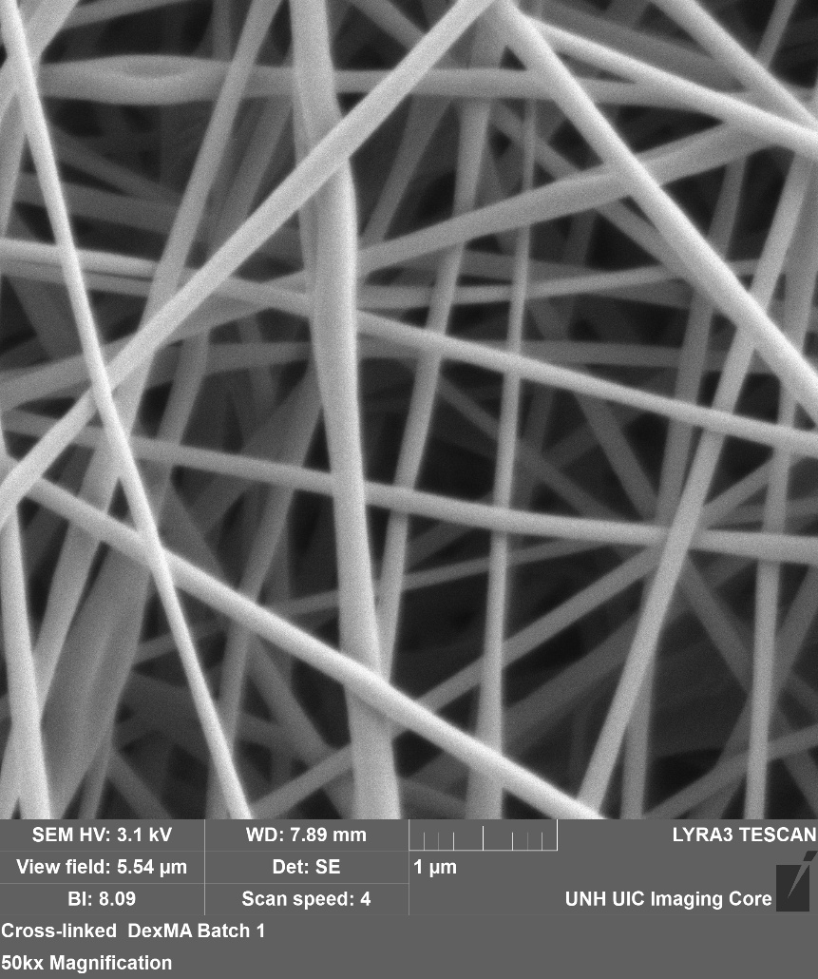
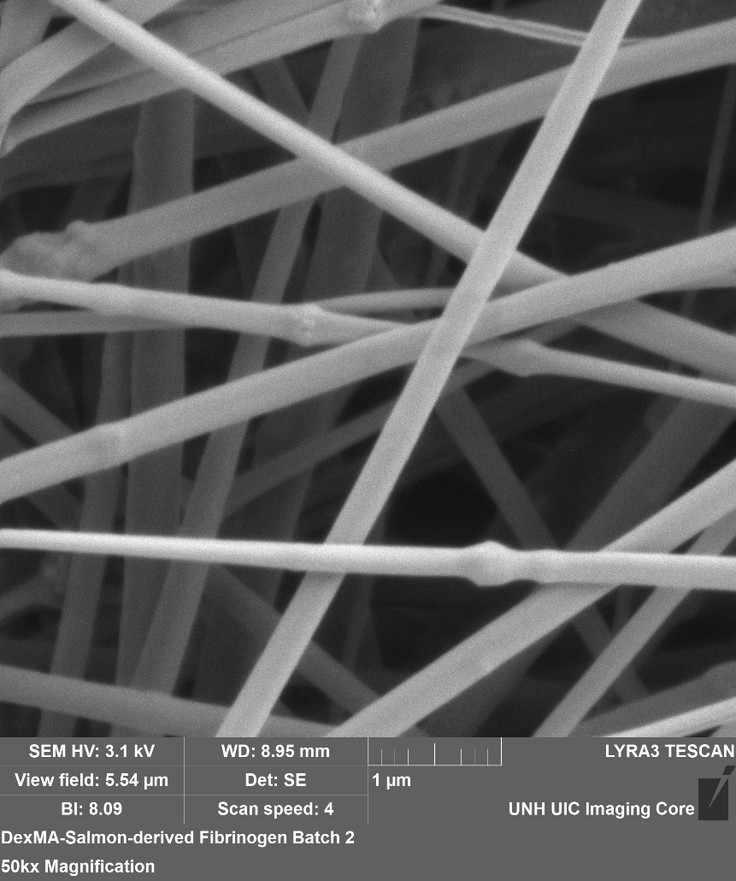
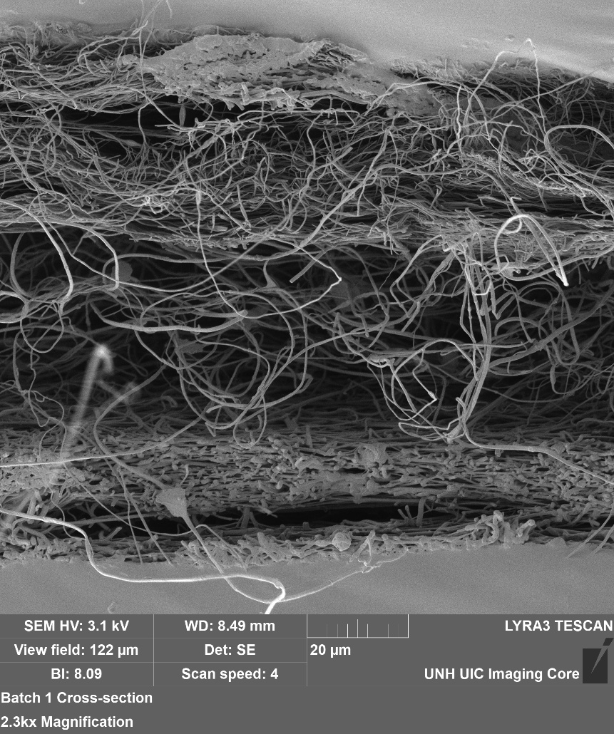
Fabrication of Electrospun Salmon-derived Fibrin Patch for Accelerated Wound Healing
Sean Boyle, Evan Guernelli, Trevor Convent, Jack Reynolds, Linqing Li
Chemical and Bioengineering, University of New Hampshire, Durham, NH 03824
Introduction
Fluorescent Images
Chronic wounds, including diabetic foot ulcers and pressure ulcers, affect over 6.5 million individuals annually in the United States¹ and represent a significant clinical and economic burden. These wounds often fail to progress through the normal stages of healing due to poor vascularization, persistent inflammation, and increased risk of infection.
Current wound dressings primarily provide passive protection through moisture retention but lack bioactive components necessary to actively promote tissue regeneration. As a result, there is a critical need for advanced wound care materials that both protect the wound and actively stimulate healing processes.
In this study, we developed a biomimetic electrospun patch composed of 86kD Dextran Methacrylate (DexMA) and salmon-derived fibrinogen, functionalized with thrombin to promote in situ fibrin formation. This design aims to enhance cell adhesion, accelerate clot formation, and improve wound closure outcomes.²⁻⁶
Human Dermal Fibroblasts (HDFs) were cultured on, washed DexMA and washed DexMA + fibrinogen.
Cells were stained after 48 hours with Phalloidin 647 to illustrate the actin filaments (shown in magenta), before transfer to a glass microscope slide. Green autofluorescence can be seen from the patch fibers due to the absorption of UV light during crosslinking, since both scaffold materials are protein derived.
The morphology of the cells in the DexMA + fibrinogen patch suggest increased cell attachment and rapid growth. Cells with poor adherence are seen in the DexMA patch, which may be due to the cells’ difficulty in finding focal adhesion points on the patch surface.
DexMA
DexMA/ Fibrinogen
EVOS
Fabrication Methodology
Confocal
Patch Fabrication:
- DexMA solution: 25% wt in 30% ethanol/DI water with LAP photoinitiator
Electrospinning parameters:
- Voltage: 10–16 kV
- Flow rate: 0.25–0.40 mL/hr
- Distance: ~10–14 cm
- UV crosslinking: 2 minutes on one side to
stabilize scaffold
Fibrinogen Layer:
- Electrospun onto DexMA scaffold
- Optimized solvent system to prevent protein denaturation
- 100 mg fibrinogen with 2 mL of HFIP
Thrombin Functionalization:
- Salmon-derived thrombin (~5 IU per patch)
- Enables in situ fibrin formation upon application
Cell Exclusion Assay
A PDMS cylinder was plasma treated and bonded to a glass coverslip-bottom petri dish to define a confined culture region. Human Dermal Fibroblasts (HDFs) were seeded around the cylinder and cultured until a confluent monolayer was formed.
After reaching confluency, the PDMS cylinder was removed, generating a circular cell-free region that mimics a wound environment. Electrospun patches were introduced into the system depending on experimental condition without additional washing steps.
Conclusions and Future Directions
SEM Characterization and Images
Conclusions
- Successfully fabricated electrospun DexMA–fibrinogen scaffolds
- Demonstrated stable fiber formation and structural integrity
- Preliminary biological results suggest potential for enhanced cell interaction
Limitations
- Cytotoxicity not fully resolved
- Imaging challenges
- Lack of quantitative migration data
Future Directions
- Optimize thrombin utilization using dry delivery method
- Improve assay design for direct visualization of cell migration
- Perform quantitative ImageJ analysis of migration and viability
- Expand to in vivo and mechanical testing
- Optimize fabrication and processing for fiber quality, reproducibility and handling.
- Begin preclinical evaluations using small animal wound models to assess wound healing efficacy
Scanning electron microscopy revealed the microstructural architecture of the two patch materials.
The DexMA layer exhibited a dense, homogeneous network with occasional nodular features and an average fiber diameter of 0.17 µm. In contrast, the fibrinogen layer, observed in the top view of the DexMA–fibrinogen composite patch, displayed a similar overall framework but with a larger average fiber diameter of 0.28µm and increased variability.
DexMA
DexMA / Fibrinogen
5,000X
Cross-Section Showing Material Interfaces
Acknowledgements
References
50,000X
We would like to acknowledge the University of New Hampshire Chemical and Biomedical Engineering Department for funding and support. We also thank Liquing Li for providing laboratory space and guidance. Nancy Cherim for scanning electron microscopy (SEM) imaging and Darcy Silver for equipment guidance and regulation. In addition, we are grateful to our collaborators at Li Lab and Salmonics LLC for their materials, insight, and continued collaboration.
Carter, Marissa J et al. “Chronic wound prevalence and the associated cost of treatment in Medicare beneficiaries: changes between 2014 and 2019.” Journal of medical economics vol. 26,1 (2023): 894-901. doi:10.1080/13696998.2023.2232256
Bønsdorff, T. B. et al. Salmon Thrombin for Topical Hemostasis: Biochemical Properties and Clinical Applications. J. Biomed. Mater. Res. B 109, 2113–2122 (2021).
Ju, Y.-E., Janmey, P. A., McCormick, M., Sawyer, E. S., & Flanagan, L. A. (2007). Enhanced neurite growth from mammalian neurons in three-dimensional salmon fibrin gels. Biomaterials, 28(12), 2097–2108.
Liu, J., Tan, Y., Zhang, H., Zhang, Y., Xu, P., Chen, J., Poh, Y.-C., Tang, K., Wang, N., & Huang, B. (2013). Soft fibrin gels promote selection and growth of tumourigenic cells. Nature Materials, 11(8), 734–741.
Sharp, K. G., Dickson, A. R., Marchenko, S. A., Yee, K. M., Emery, P. N., Laidmäe, I., Uibo, R., Sawyer, E. S., Steward, O., & Flanagan, L. A. (2012). Salmon fibrin treatment of spinal cord injury promotes functional recovery and density of serotonergic innervation. Experimental Neurology, 235(2), 162–173.
Weisshaar, C. L., Winer, J. P., Guarino, B. B., Janmey, P. A., & Winkelstein, B. A. (2011). The potential for salmon fibrin and thrombin to mitigate pain subsequent to cervical nerve root injury. Biomaterials, 32(35), 9738–9746.

