Slide 1


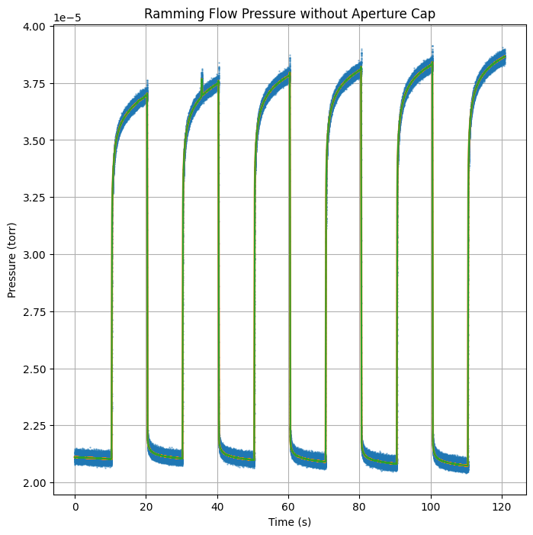
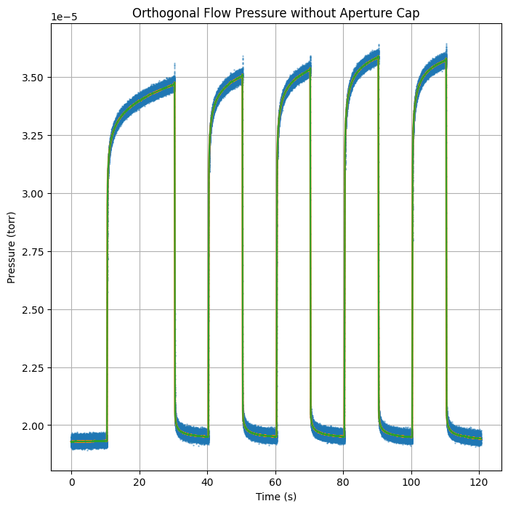
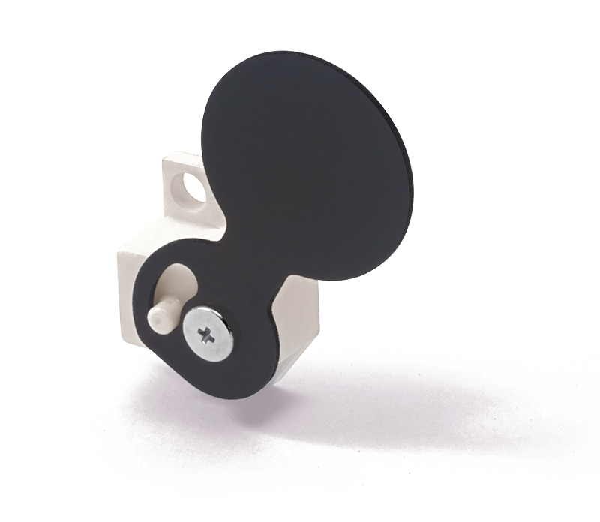
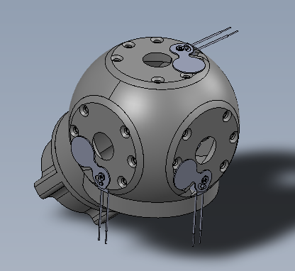
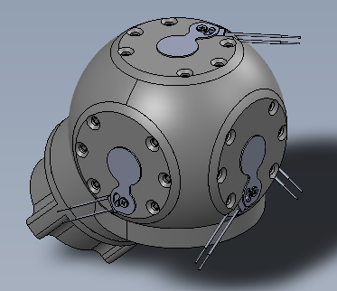
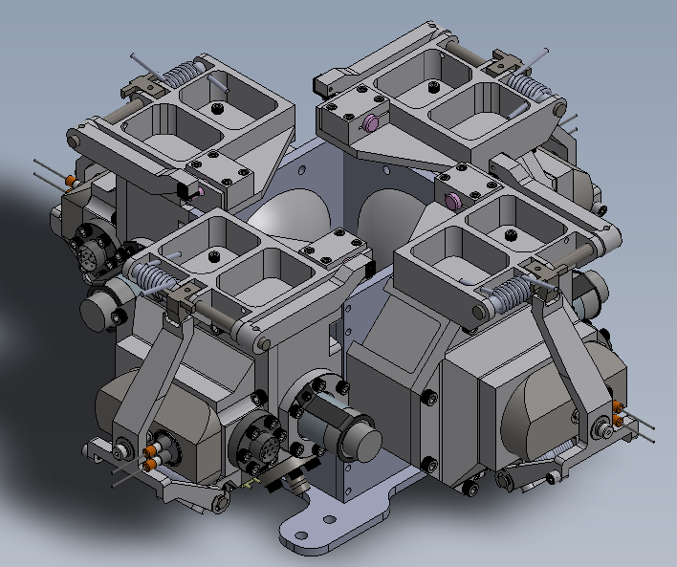
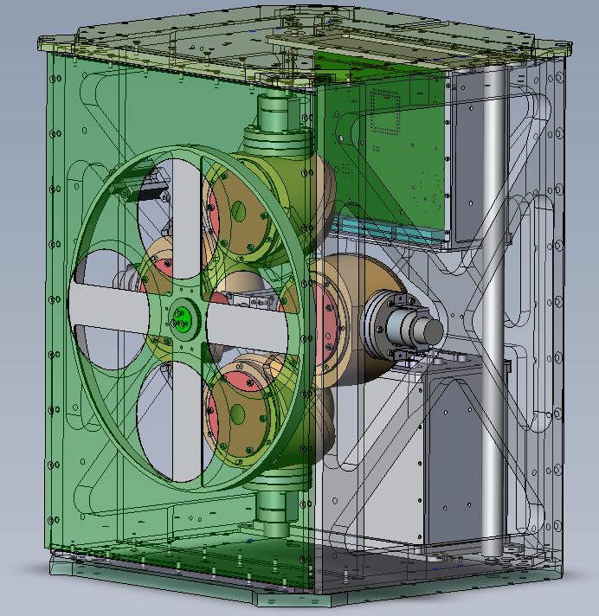
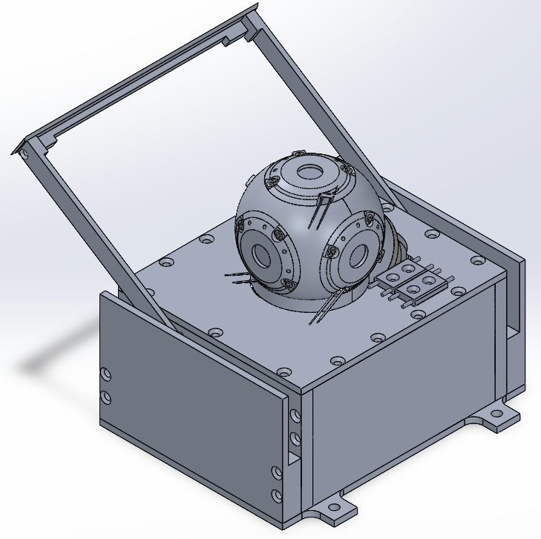
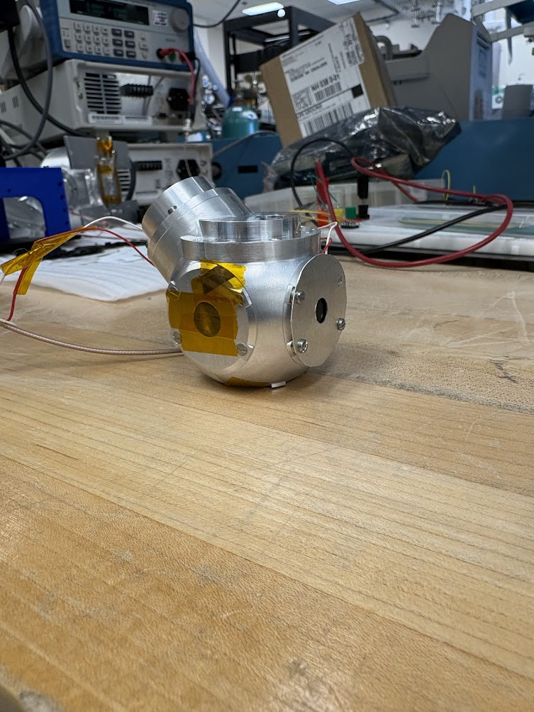
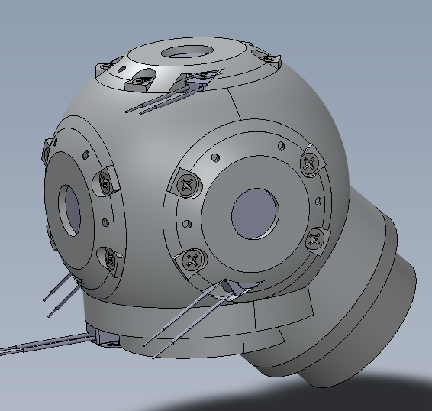
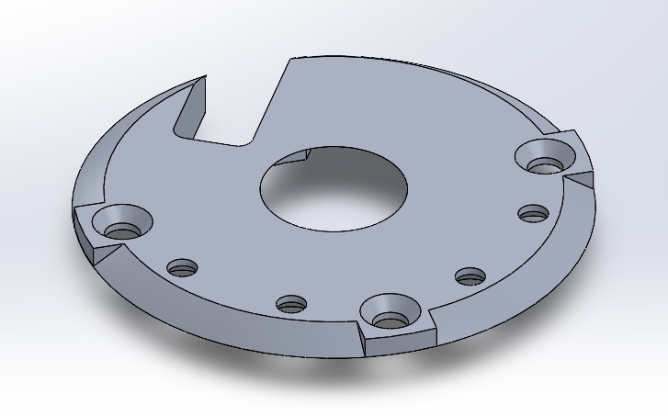
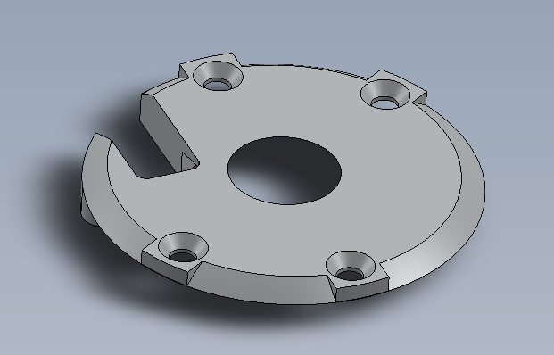
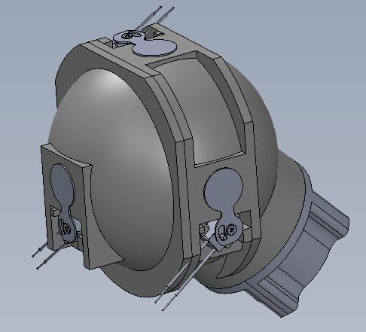
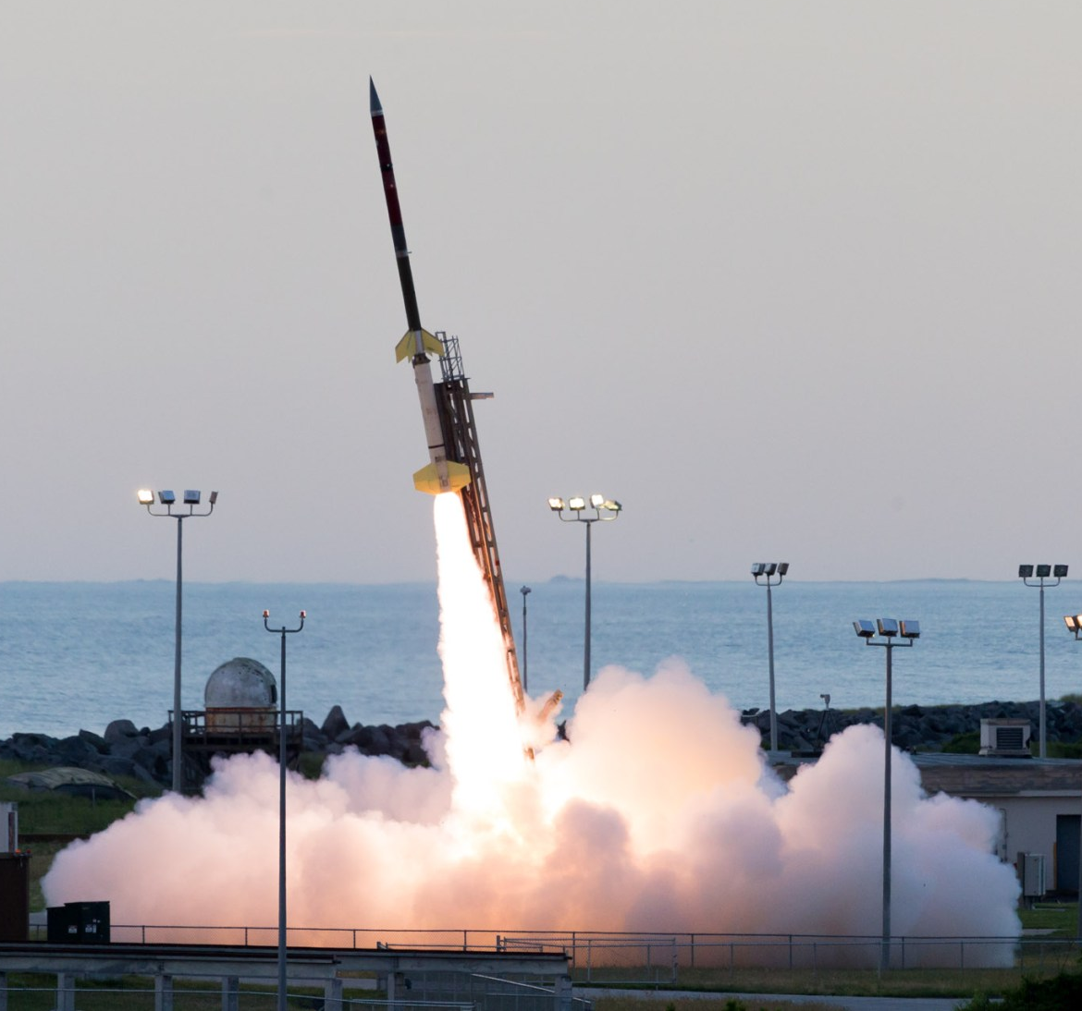
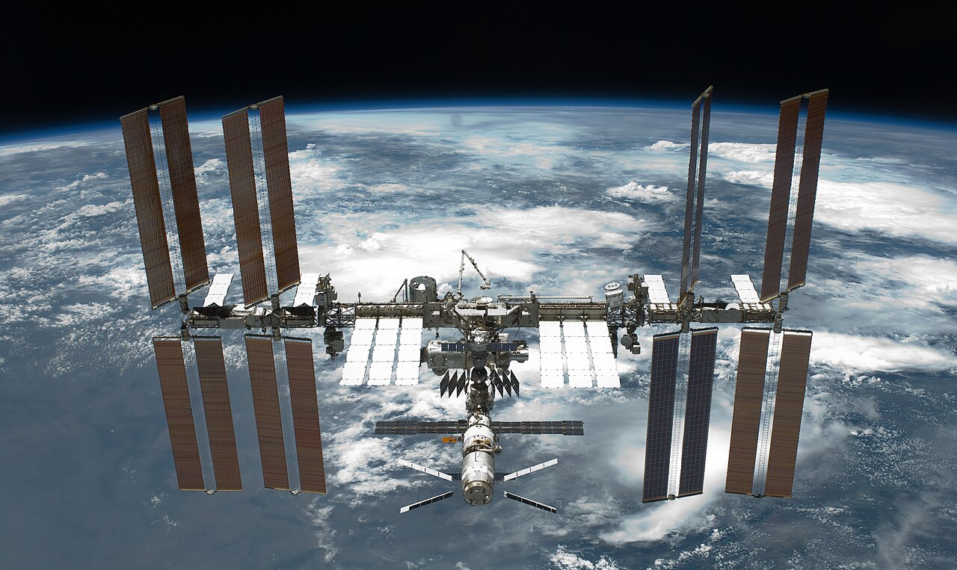
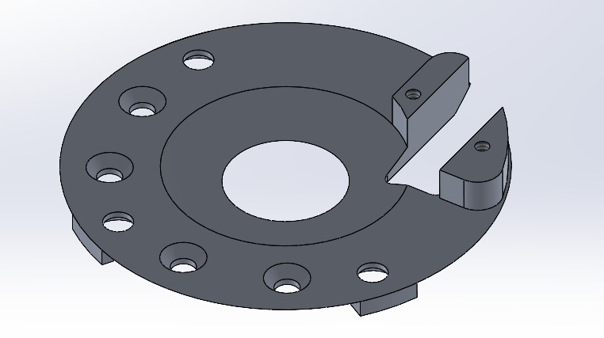
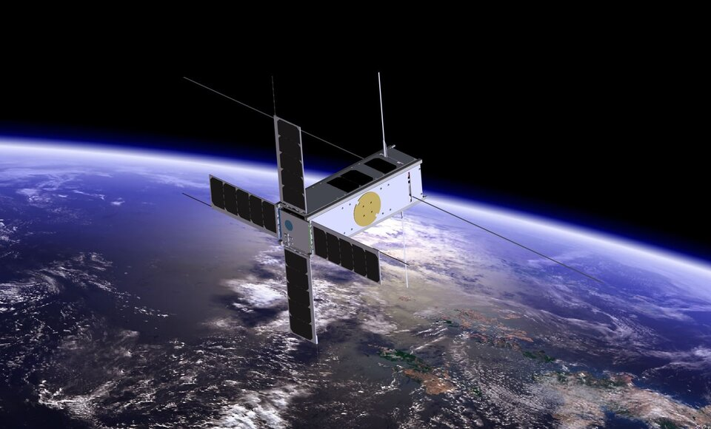
On the Design and Flight Qualification of Thermo5D for High-Resolution, Multidimensional Wind Measurements in the Thermosphere
Jackson Scheele advised by Dr. James Clemmons – University of New Hampshire, Experimental Space Research Group
Overview
Thermospheric winds remain underexplored despite their importance in space and atmospheric science Upper-atmospheric winds are strongly influenced by space weather events (e.g., coronal mass ejections) and can impact lower-atmosphere dynamics Improved understanding of thermospheric winds enables more accurate atmospheric and space weather modeling Existing instrumentation is often large, costly, and limited in its ability to capture a complete wind profile efficiently The Thermo5D instrument offers a compact, cost-effective solution with enhanced measurement capability A single instrument enables measurement of five key parameters: 3D wind velocity, density, and temperature
Bistable Shutter
Takano Bistable Optical Shutter (BOS5-8-T) Controls gas flow in/out of accommodation chamber Actuated via bidirectional current through an internal solenoid, toggling a permanent magnet between open and closed states Actuation time: <50ms Mass: 0.8g Low power due to bistable operation (power required only during state transition)
Testing
Simulated flight environment with vacuum chamber and Nitrogen beam (790m/s) Initial testing revealed accommodation chamber gas leak driving design of an aperture cap to better seal chamber
95% Settling Time Average: 0.174s
95% Settling Time Average: 0.617s
Shutters in Open Position
Shutters in Closed Position
IG Instrument
4+ required ionization gauges
WCT Instrument
4 required ionization gauges
Thermo5D Instrument,
1 required ionization gauges
Shutter Housing
Contains Solenoid & Permanent Magnet
Rev1 Design Proof of Concept Aperture Cap Final Design
Design Requirements
Modulate atmospheric gas flow into an accommodation chamber to enable accurate pressure measurements along three orthogonal axes Compatible with multiple platforms: sounding rockets, 1U CubeSat, and ISS Envelope: 250mm x 150mm x 200mm for rocket Mass: <1.5kg Require a near-spherical chamber geometry to minimize disturbance to ambient gas flow DFM to support scalable production and low barrier to entry Enable effective sealing of the chamber from ambient flow during measurement Achieve full measurement cycle time of 0.5s
Aperture Plate
Provides structural interface for mounting shutter Mechanically joins and secures accommodation chamber hemispheres Defines and controls aperture geometry and flow area Modular design enables rapid replacement and aperture size interchangeability Simplified geometry supports DFM requirement and scalable production
Outcome & Future Work
Thermo5D demonstrates accurate measurement of thermospheric winds with performance comparable to legacy systems at significantly reduced cost and complexity Scheduled for flight on sounding rocket mission Dynamo 3 in summer 2027 (slipped from Summer 2026) Ongoing development of automated testing to enable faster actuation and higher-fidelity data acquisition LabView→Digital I/O→H-bridge control system Rev2 prototype in development, incorporating aperture cap and full system integration for baffle validation Evaluation of long-life shutter alternatives for extended missions (small-sat/ISS platforms) BOS5-8-T: 500,000 cycles at 0.8g BOS10/15-S: 5,000,000 cycles at 11g Scalable design enables distribution to research groups for large-scale atmospheric modeling and improved space weather prediction
Chamber Mounting Holes
Aperture (1cm)
Final Aperture Plate Design (Top)
Shutter Mount
Early Aperture Plate Design
Early Chamber Design
Concept
Final Chamber Design
Concept
Aperture Cap Mounting Holes
Final Aperture Plate Design (Bottom)

