Slide 1


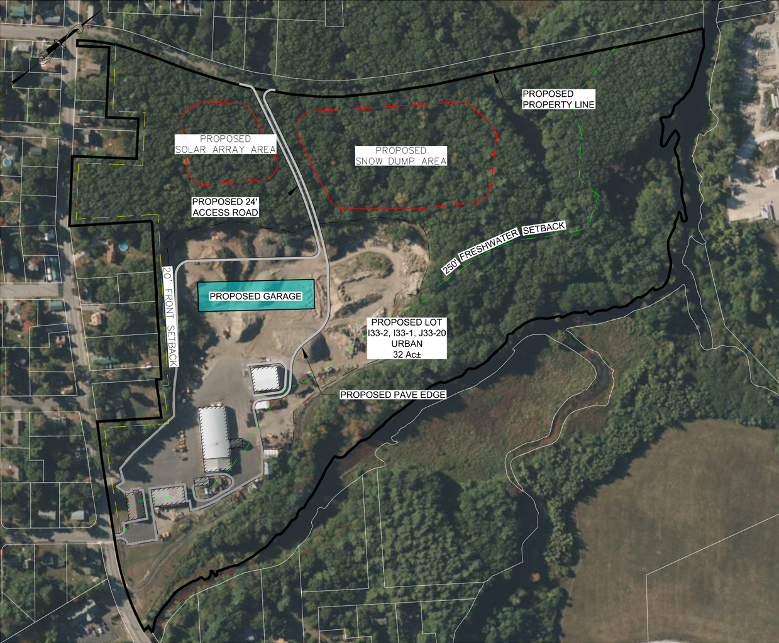
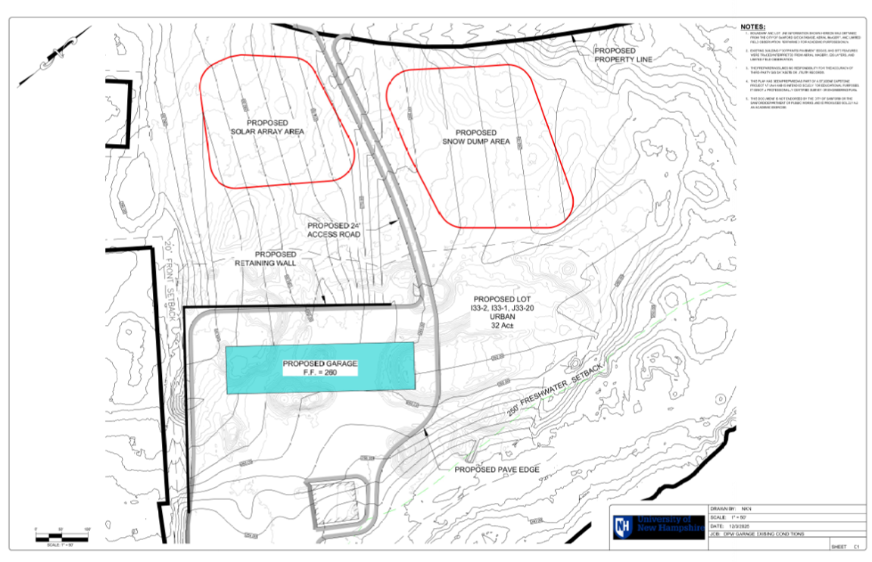
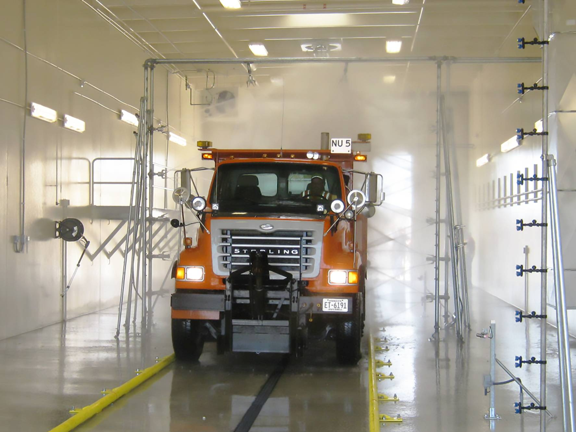
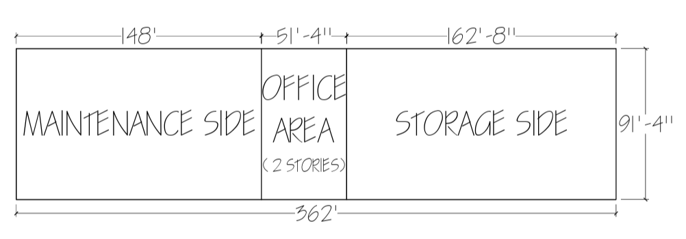
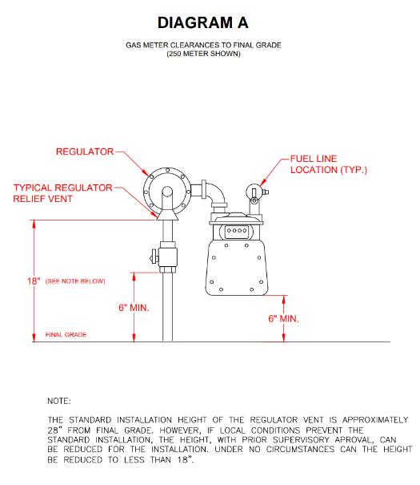
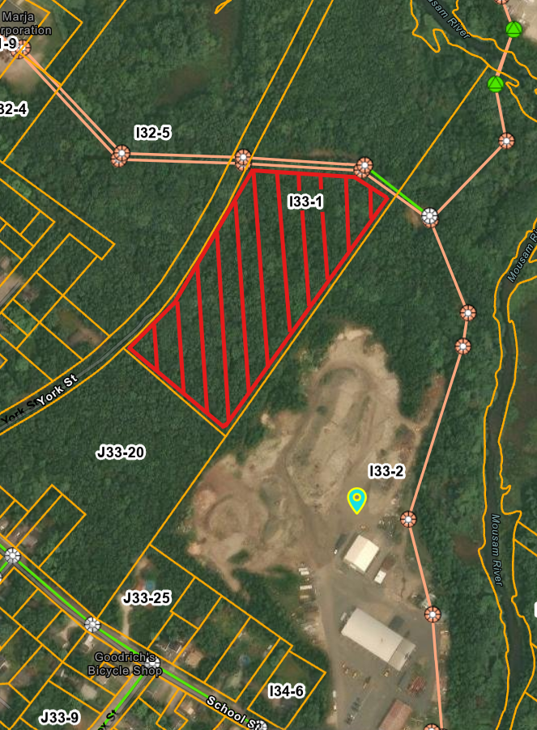
Sanford, ME Public Works Garage Replacement and Facility Improvements
Emmett Hardwick, Nathan Nicholson, Ryan Patten, Travis Perkins
Department of Civil and Environmental Engineering, University of New Hampshire, Durham, NH 03824
Faculty Advisor Anthony Puntin, P.E. & Sanford Maine Director of Public Works Matthew Hill, P.E.
Introduction
Proposed Site Plan
Grading Plan
Project Team Four has been tasked by the Sanford Public Works Department, Sanford, Maine, to provide preliminary engineering and planning services for the replacement and upgrade of the Department of Public Works (DPW) facility. The existing 24-acre site currently supports a warehouse with office and support spaces, equipment storage, sand and salt storage, and gravel processing areas. To accommodate the continued growth of the City of Sanford and the operational needs of its DPW, the proposed project includes the acquisition of two additional parcels totaling approximately 8 acres and the development of new and expanded facilities. Services to be provided by Project Team Four include coordination with the Sanford Public Works Department and project stakeholders, site investigations, collection and review of background information, development of conceptual design features, preparation of preliminary layout and grading plans, identification of permitting considerations, and preparation of probable construction cost estimates.
Early challenges included existing gravel piles, required tree clearing and excavation, proximity to the Mousam River and protected areas, impacts on nearby residences, potential access to York Street, and maintaining proximity to the existing office building. The team ultimately selected the existing gravel pile area as the preferred garage location, accepting the need to relocate the material in order to reduce environmental impacts, improve security and accessibility, maintain distance from the river, and simplify site preparation.
Truck Wash Bay
Site grading directs stormwater runoff away from the building and paved areas to prevent ponding and protect structural integrity. Gradual elevation changes improve vehicle circulation and accessibility, while a retaining wall along the south side minimizes impacts to adjacent properties, reduces earthwork within setback limits, and enhances slope stability.
Utilities Plan
Proposed Garage Layout
An indoor, fully automated wash bay was selected as the preferred option to improve equipment cleaning efficiency, protect workers, and extend vehicle life, with integrated drainage directing runoff to an exterior oil-water separator before discharge to the municipal sewer.
New utility infrastructure is required to support the proposed garage, including upgraded water, sewer, gas, and electric services. An extended water main will supply domestic use, a wash bay, and fire suppression, while a gravity-fed sewer connection will efficiently route wastewater to an existing manhole.
Snow Dump Relocation Map
With the existing offsite location deemed environmentally unfavorable due to its proximity to wetlands and a wellhead protection zone; as a result, an onsite snow dump on lot I33-1, located farther from the Mousam River and outside required setbacks, was identified as the most practical solution, providing convenient access for drivers while minimizing potential impacts to water quality.
The Sanford DPW garage layout was developed to create a facility that supports rapid snowplow deployment, maintenance efficiency, and improved working conditions. The design incorporates required storage, maintenance, and emergency bays; office and support spaces; floor drains with oil-water separation; HVAC and exhaust systems; and functional considerations such as radiant floor heat, improved sun orientation, and protection from heat loss through open doors. The garage was organized with maintenance functions on one side, storage bays for front-line plows on the other, and an office core dividing the two, including space for administrative staff and a conference/situation room.
References
City of Sanford, Me., Code of Ordinances pt. III, ch. 280 (Zoning) (adopted Nov. 21, 1995; amended in its entirety Aug. 16, 2016 by Order No. 16-106.04), https://ecode360.com/13226209
Maine Department of Environmental Protection, Stormwater Best Management Practices Manual, Vol. III: Technical Design Manual, ch. 8.0, Conveyance and Distribution Systems (May 2016), https://www.maine.gov/dep/land/stormwater/stormwaterbmps/vol3/chapter8.pdf.

