Slide 1

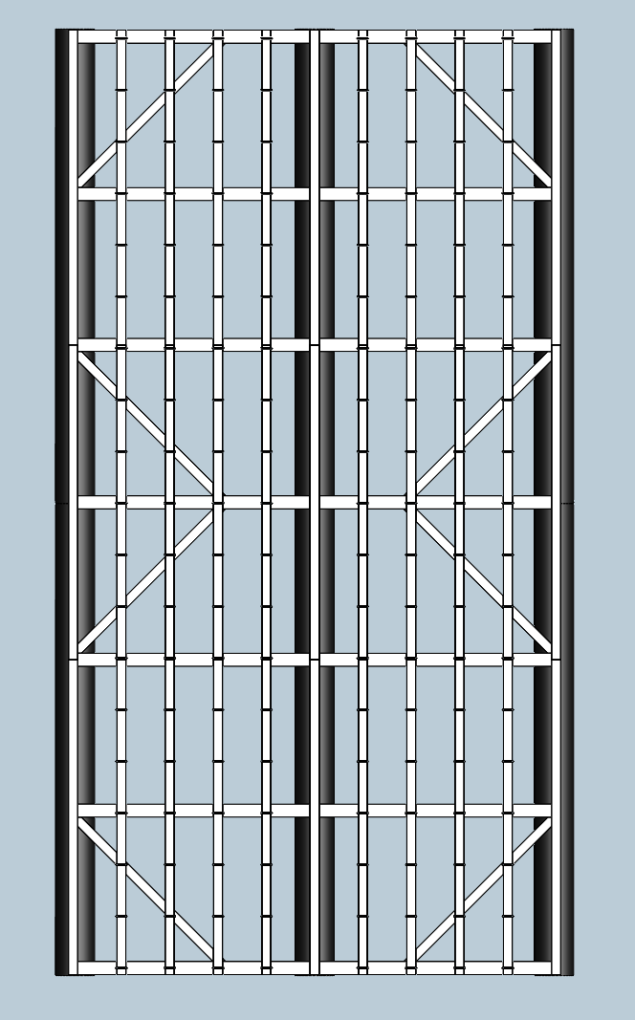
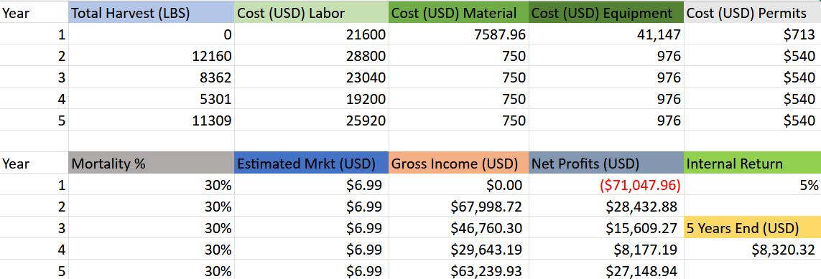
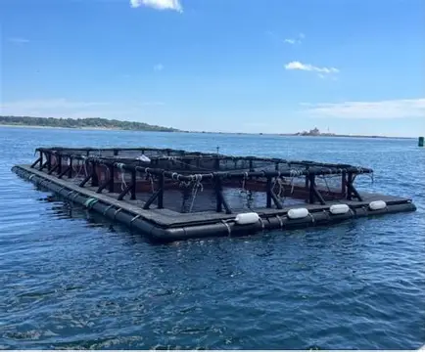
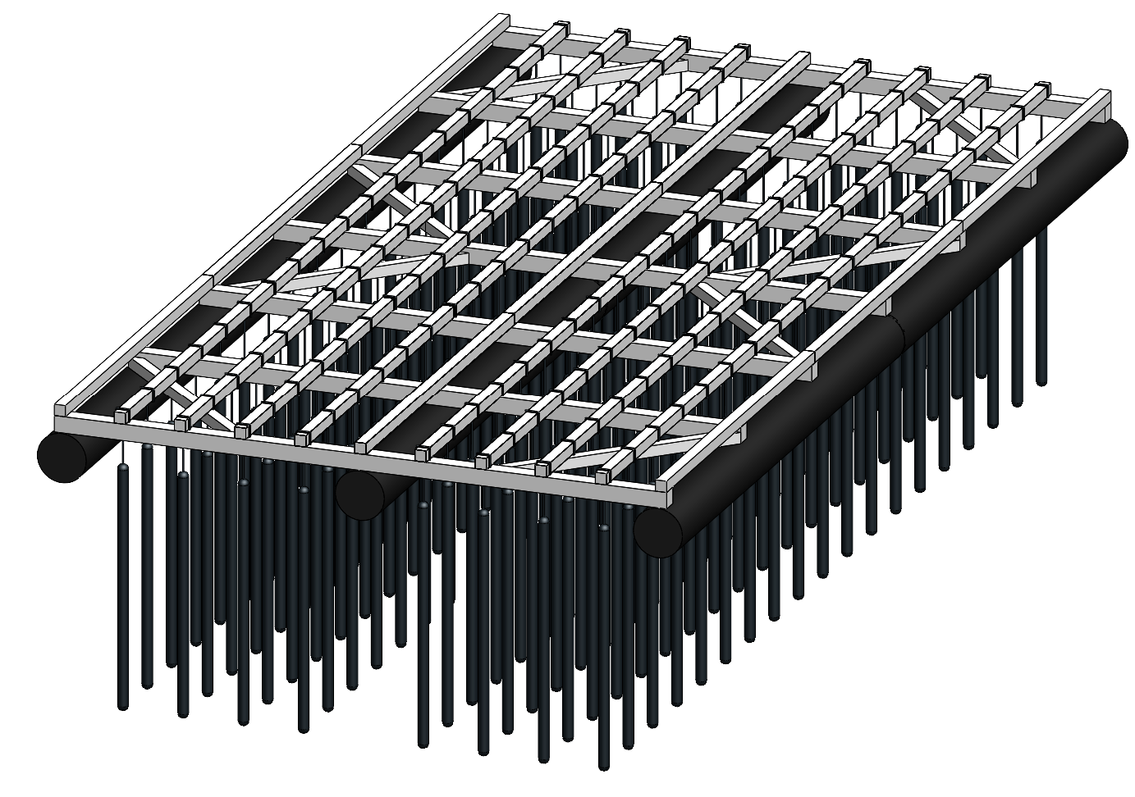
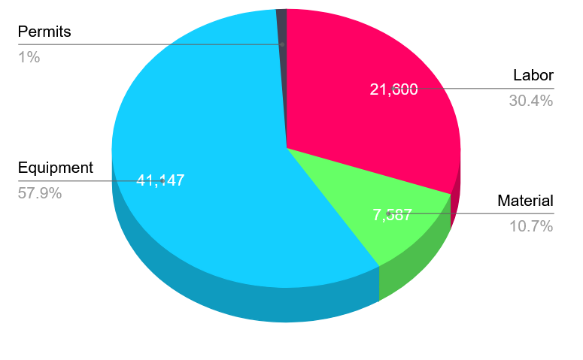
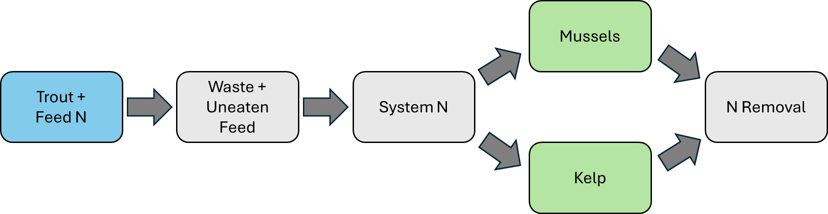
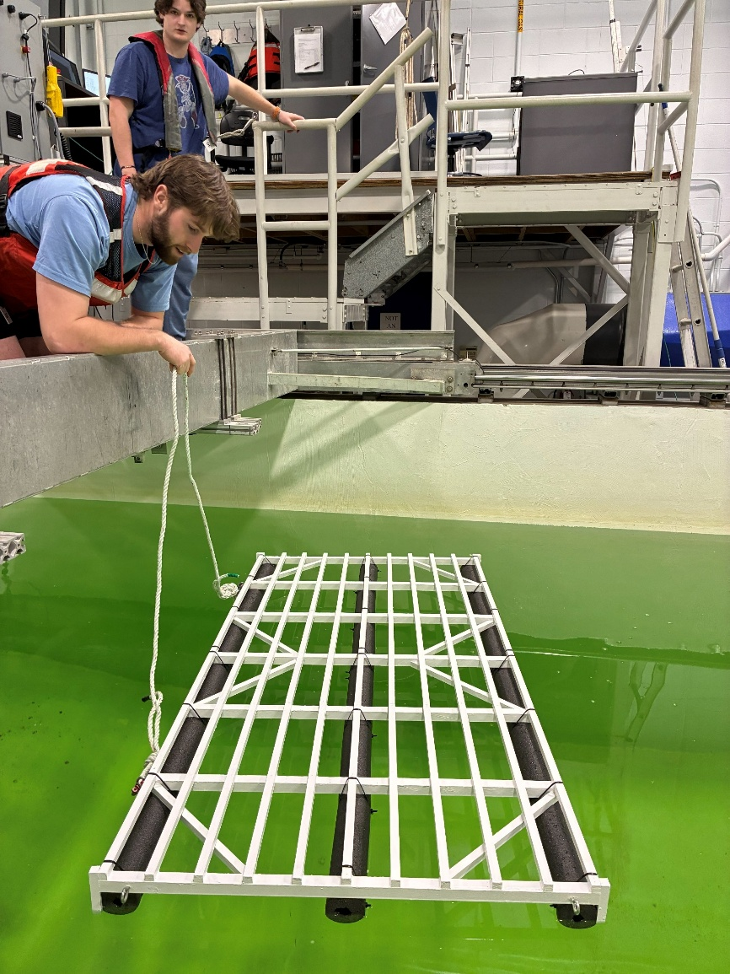
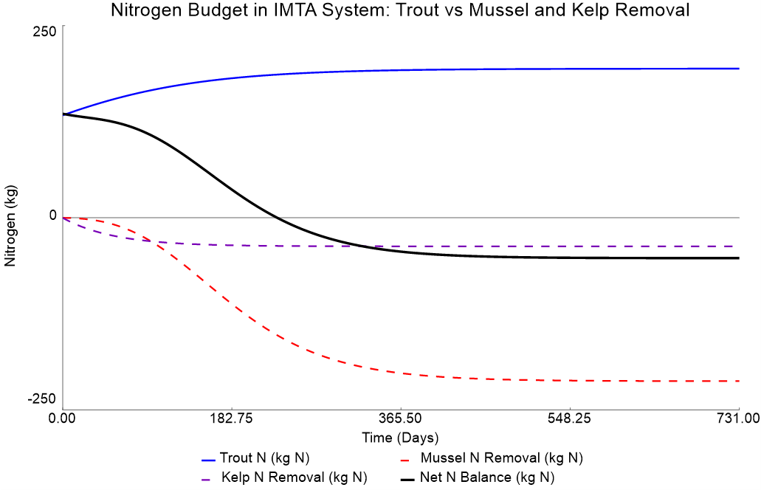
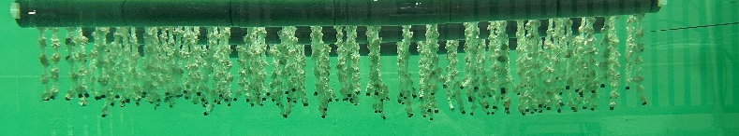
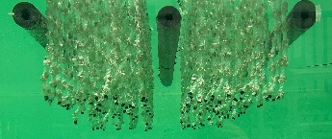
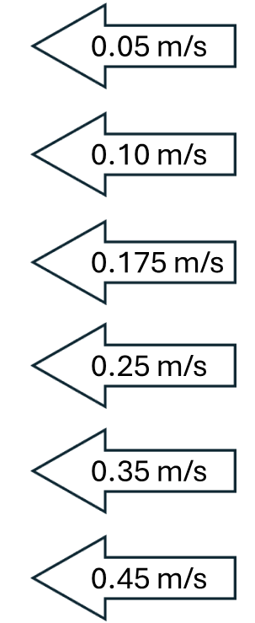
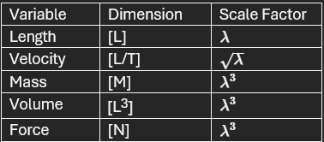
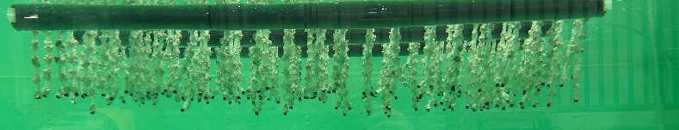
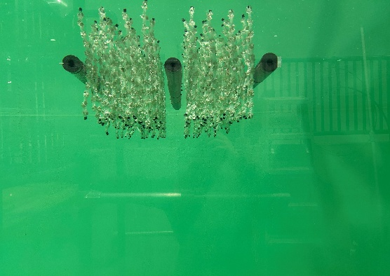
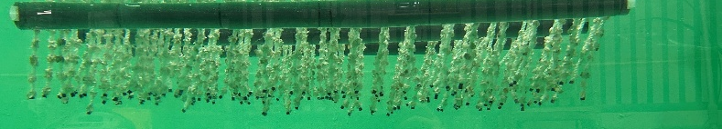
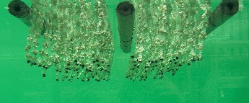
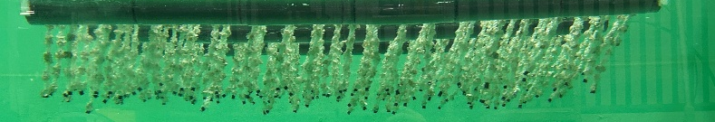
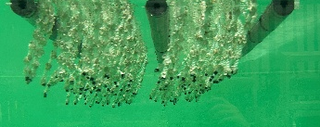
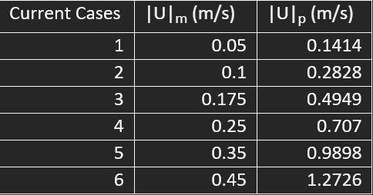
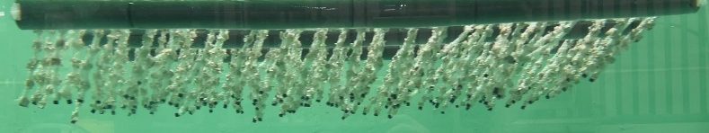
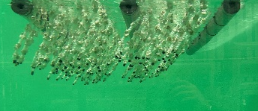
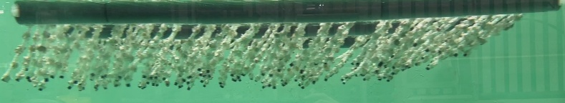
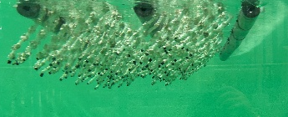
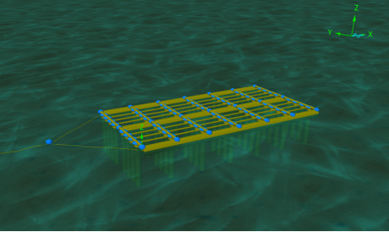
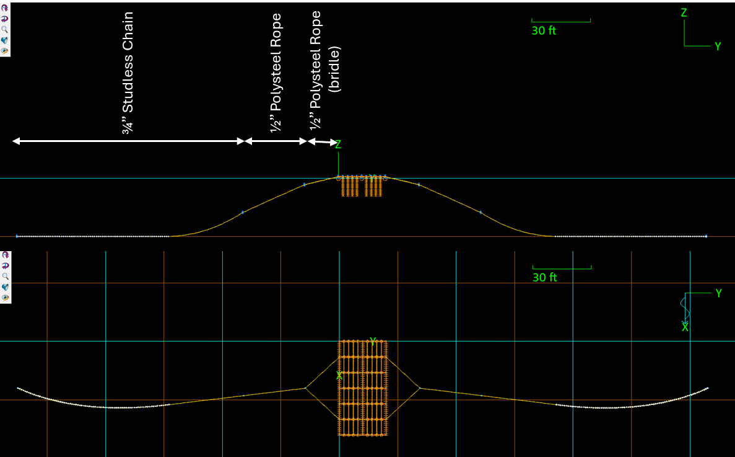

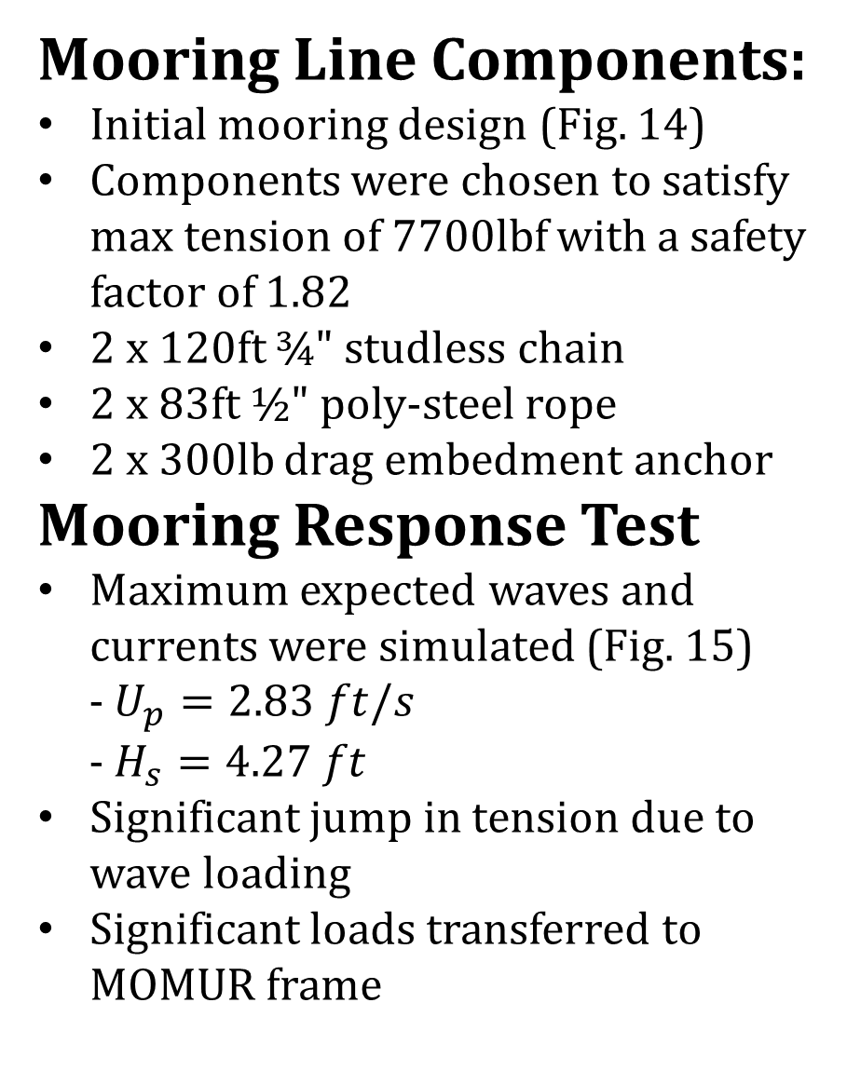
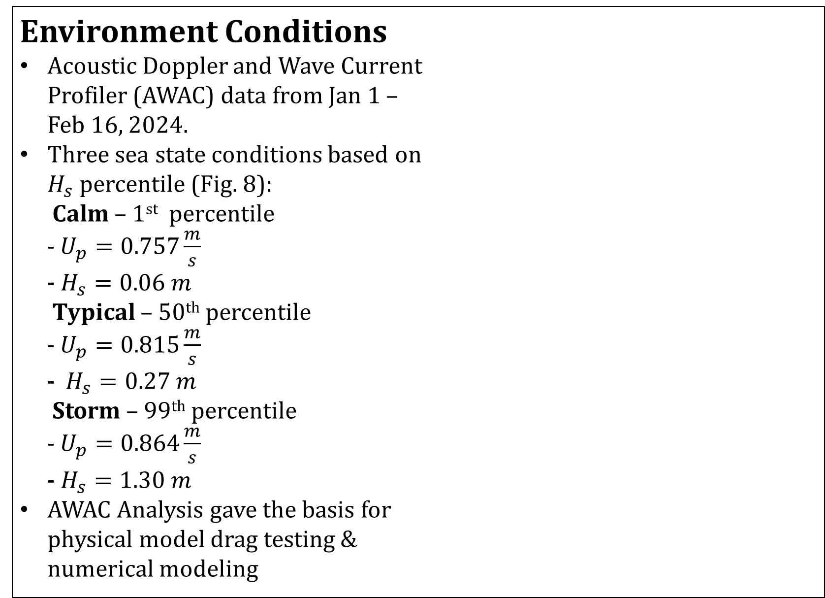
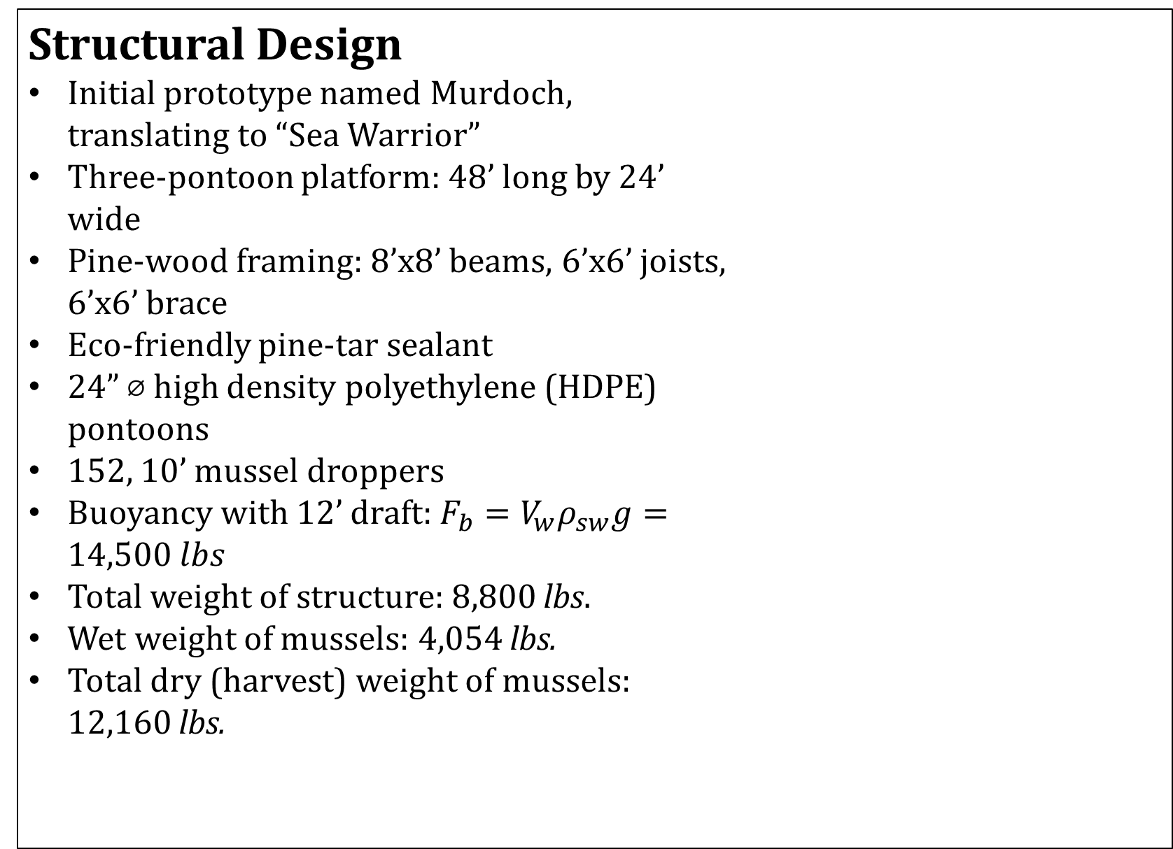
Mobile Mussel Raft (MOMUR) as a Component of an
Integrated Multi-Trophic Aquaculture System
Benjamin Hogan, Jake Overstreet, Gabriel Pointer, Zachary Smith, Kiara Summers, Michael Sutt, Zack Yeaton
Center for Sustainable Seafood Systems, University of New Hampshire, Durham, NH 03824
Team MOMUR Mission
MOMUR Prototype
Economics
The Mobile Mussel Raft's (MOMUR) mission is to raise blue mussels alongside steelhead trout in the existing AquaFort (Fig. 1) site as a component of an integrated multi-trophic aquaculture (IMTA) system. These mussels will grow on a dropper aquaculture raft system (Fig. 2) where they are able to balance the nutrients produced by the fish and use these nutrients to grow. The UNH AquaFort site is closed to shell fisheries so the raft is designed to be able to relocate to one of the open harvesting sites where the mussels can be filtered and then harvested. The MOMUR mission for this year was to create a preliminary design showing not only is this a viable concept but is worthy of attention and continued efforts.
Structural Design
Initial prototype named Murdoch, translating to “Sea Warrior”
Three-pontoon platform: 48’ long by 24’ wide
Pine-wood framing: 8’x8’ beams, 6’x6’ joists, 6’x6’ brace
Eco-friendly pine-tar sealant
24” ⌀ high density polyethylene (HDPE) pontoons
152, 10’ mussel droppers
Buoyancy with 12’ draft: $F_{b}=V_{w}ρ_{sw}g=14,500 lbs$
Total weight of structure: 8,800 lbs.
Wet weight of mussels: 4,054 lbs.
Total dry (harvest) weight of mussels: 12,160 lbs.
Environment Conditions
Acoustic Doppler and Wave Current Profiler (AWAC) data from Jan 1 – Feb 16, 2024.
Three sea state conditions based on $H_{s}$ percentile (Fig. 8):
Calm – 1st percentile
- $U_{p}=0.757\frac{m}{s}$
- $H_{s}=0.06 m$
Typical – 50th percentile
- $U_{p}=0.815\frac{m}{s}$
- $H_{s}=0.27 m$
Storm – 99th percentile
- $U_{p}=0.864\frac{m}{s}$
- $H_{s}=1.30 m$
AWAC Analysis gave the basis for physical model drag testing & numerical modeling
Table 3: A 5 Year Cost Analysis Table for the MOMUR Construction and Operation
Nitrogen
Economic Viability
First year material cost includes Raft construction (Table 3 & Fig. 16)
Total Profits after 5 Years - $8,320 (Table 3)
Gross income assumes 30% Mortality
Market Price Estimated from local projections
Internal Return of 5% after 5 Years
Figure 1: Steel Head Trout Farm (AquaFort)
Figure 2: MOMUR Prototype Design
Figure 7: Top-Down View of Frame and Pontoons
Figure 8: AquaFort Site Water Column Current Profile.
Nitrogen Balance
Drag Force Testing
Figure 16. Year 1 Cost Distribution
Physical Scale Model
1:8 Scale model using Froude scaling (Table 1)
3’ by 6’ platform dimensions
152 scaled mussel droppers
Low profile, lightweight bridal system
Instrumentation
Submersible in-line FUTEK load cell
NI cDAQ system for real-time force
acquisition
Testing Procedure
Tow in UNH Tow Tank (10-15m)
6 tow velocities derived from environmental conditions (Table 2)
2 orientations:
Orientation Narrow:
- 3’ width perpendicular to the flow
Orientation Wide:
- 6’ width perpendicular to the flow
3 runs each combination of speed and orientation
Objectives
Quantify system's drag coefficient, C_{d}
Determine current influence on area
Qualitative understanding of flow
Drag Test Results
Governing Equation: $F_{d}=\frac{1}{2}ρC_{d}Av^{2}$
Shape and area are velocity dependent
Tow Orientation Narrow :
- $C_{d}A=0.1935 m^{2}$
- $C_{d} ≈$0.62
- $A_{F}$ is less flow dependent (Fig. 11)
- More accurate $F_{d}$fit line (Fig. 10)
Tow Orientation Wide:
- $C_{d}A=0.2944 m^{2}$
- $C_{d} ≈$0.49
- $A_{F}$ has heavy flow dependence (Fig. 11)
- $F_{d}$ curve is more linear (Fig. 10)
Future Work
Continued Research
Expanding environmental input data to improve bioenergetic growth model
Perform dynamic load testing on the scale model
Observe heave response and RAO to determine natural frequency of system
Pinpoint weak areas in the current design such as attachment points
Further develop and test mooring system
Perform design analysis for anchor foundation
Prototype Refinement
Based on test results and analysis, optimize raft design for better strength and mussel capacity
Improve on hydrodynamics to reduce drag on the pontoons during towing
Incorporate predation protection nets and include in analysis
Perform all physical and numerical tests on refined design.
Figure 3: Conceptual Nitrogen Pathway in an IMTA System
Nitrogen Balance in an IMTA System: Trout Input vs Mussel and Kelp Removal
Assimilation
Model tracks nitrogen flow in an IMTA system (Fig. 3)
Tests if biological removal offsets aquaculture inputs
Trout ~ 190kg N, mussels ~ 212kg N, kelp ~ 37kg N
After ~ 200 days, removal exceeds input, leading to a net N decrease (Fig. 4)
Figure 10: Drag Force (N) vs Velocity (m/s) of Scale Model in Tow Tank
Figure 9: Physical MOMUR Model
Orientation Narrow
Orientation Wide
Current Velocity
Table 1: Froude-scaled variables
Figure 4: Nitrogen Dynamics in an IMTA System Including Trout, Mussels, and Sugar Kelp
Table 2: Tow Velocities
Acknowledgements
The authors would like to thank Professor Fredriksson, Professor Tsukrov, Zachary Davonski, and Longhuan Zhu, for their enthusiasm, support, and invaluable guidance. The authors would also like to express gratitude to the New Hamshire Sea Grant, who were the primary funders of this project, allowing us to bring our ideas into reality.
Mussel Growth Projection
Figure 11: Side Window View Dropper Response
Chlorophyll a Concentration (μ/L) and Length (mm)
Bioenergetic Model
Mytilus edulis growth projected with bioenergetic
growth model (Larsen, et al.)
Model Inputs: temperature and chlorophyll data (Fig. 5) from AquaFort (Daily avg.)
Applications: nitrogen assimilation modeling, economic analysis, MOMUR design considerations
Result: Projected time for Market size (45-60 mm) as 14-18 months (Fig. 6)
Strengths: mechanistic, environment-driven, predictive
Limits: No mortality, limited inputs, 1 year data set
Mooring System Design
Numerical Model
Full scale numerical model designed in OrcaFlex modeling software
Modeled with 56 droppers and scaled to represent full 152 droppers (Fig. 12)
Component mechanical properties configured to mimic prototype material specifications
Coefficient of drag dropper value derived from scale model testing results
Drag Tests
6 full scale velocity tests
Both orientations tested
Force-Velocity curve matches our physical model testing (Fig. 13)
Numerical and scale model agree
Mooring Line Components:
Initial mooring design (Fig. 14)
Components were chosen to satisfy max tension of 7700lbf with a safety factor of 1.82
2 x 120ft ¾" studless chain
2 x 83ft ½" poly-steel rope
2 x 300lb drag embedment anchor
Mooring Response Test
Maximum expected waves and currents were simulated (Fig. 15)
- $U_{p}=2.83 ft/s$
- $H_{s}=4.27 ft$
Significant jump in tension due to wave loading
Significant loads transferred to MOMUR frame
References
[1] Chambers, M., Coogan, M., Doherty, M., & Howell, H. (2024). Integrated multi-trophic aquaculture of steelhead trout, blue mussel and sugar kelp from a floating ocean platform. Aquaculture, 582, 740540. https://doi.org/10.1016/j.aquaculture.2024.740540
[2] Larsen, P. S., & Riisgård, H. U. (2016). Growth-prediction model for blue mussels (Mytilus edulis) on future optimally thinned farm-ropes in Great Belt (Denmark). Journal of Marine Science and Engineering, 4(3), 42. https://doi.org/10.3390/jmse4030042.
[3] Sunny, R. C., Fredriksson, D. W., Tsukrov, I., Zhu, L., Bowden, M., Chambers, M., & Silkes, B. (2024). Design considerations for a continuous mussel farm in New EnglandThe authors wo Offshore waters. Part I: Development of environmental conditions for engineering design. Aquacultural Engineering, 107, 102476. https://doi.org/10.1016/j.aquaeng.2024.102476
Figure 5: Projected Length vs Chlorophyll Concentration at AquaFort
Figure 12: OrcaFlex MOMUR Model (Narrow towing configuration)
Figure 14: Side and Top View of Twin Catenary Orcaflex Mooring Model
Length (mm) and Soft Parts Weight (mg)
Maximum Expected Tension
~7700lbf
Figure 6: Projected Growth of Blue Mussels to Market Size
Figure 13: Drag Force (N) vs Velocity (m/s) of Full Scale in OrcaFlex
Figure 15: Mooring Tension (lbf) in Response to Wave and Current Loading

