Slide 1


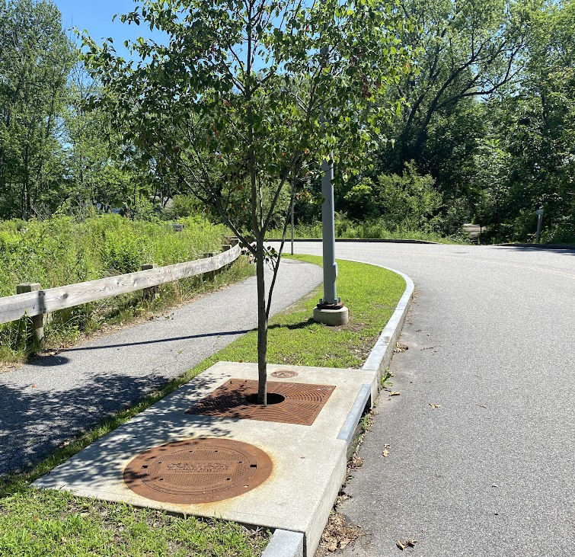
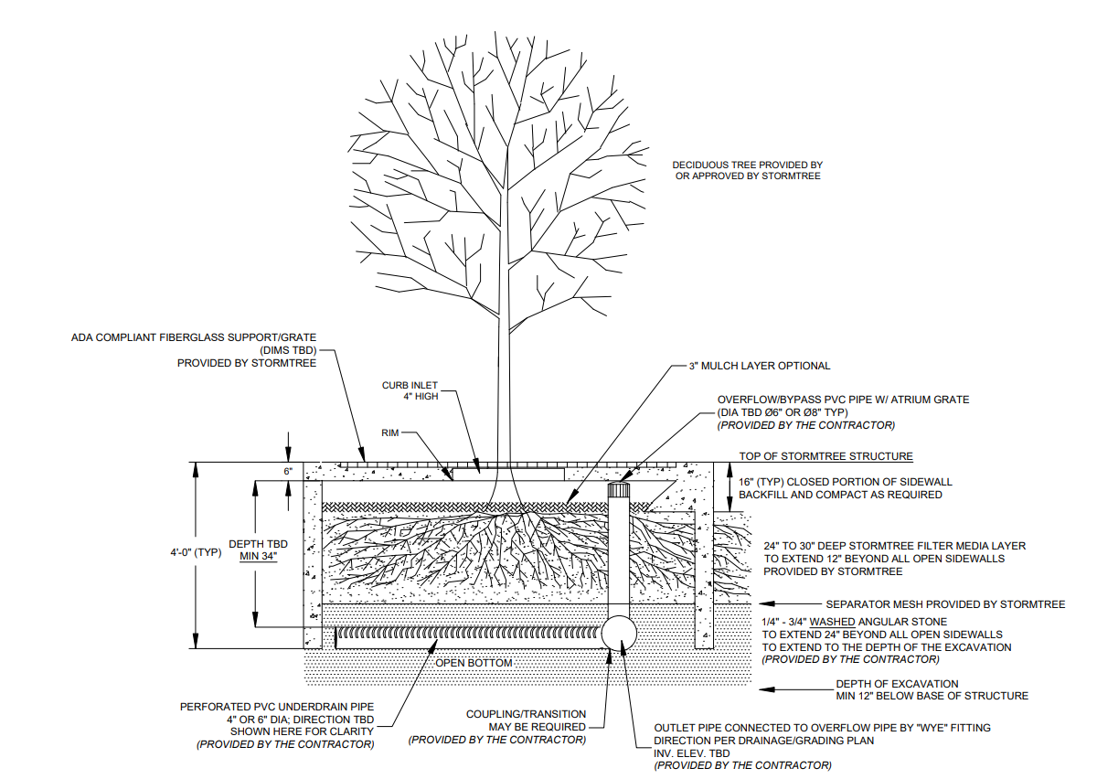
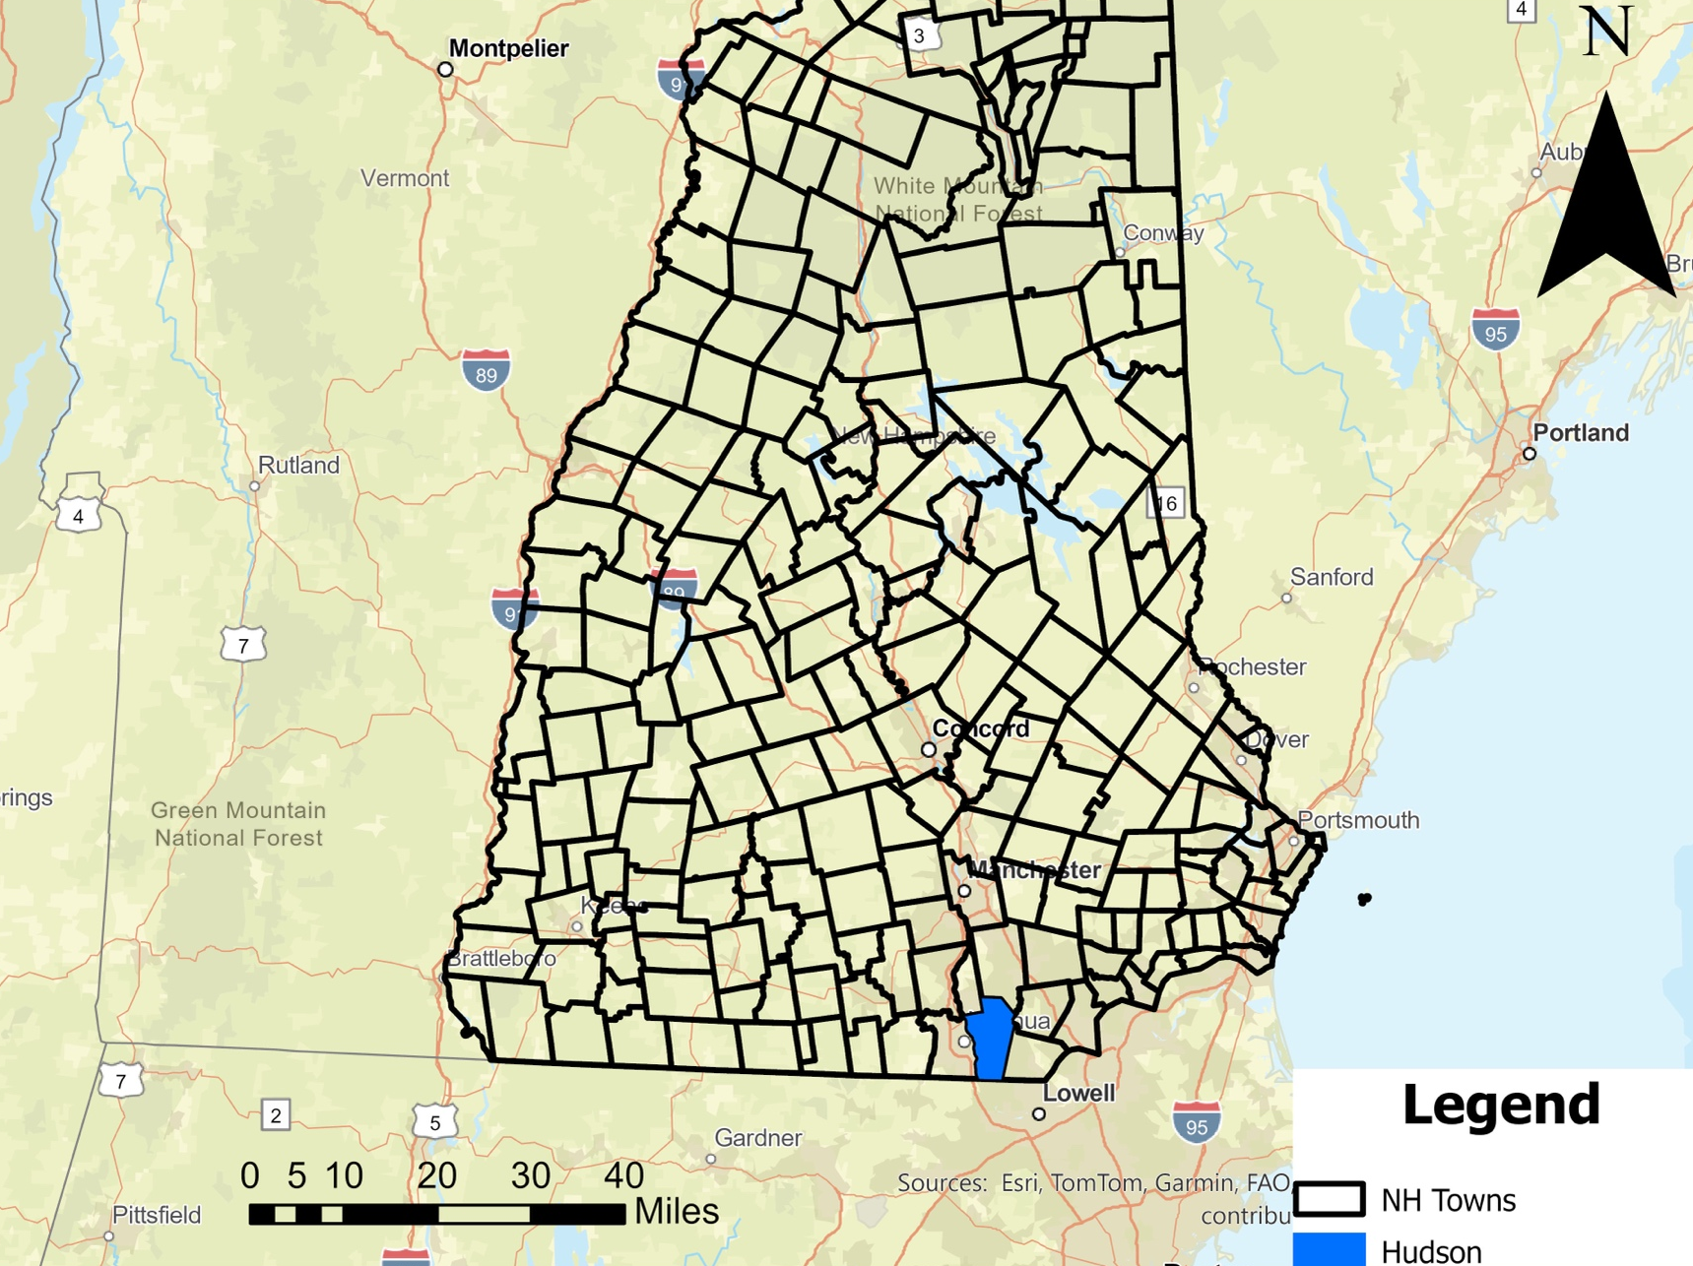
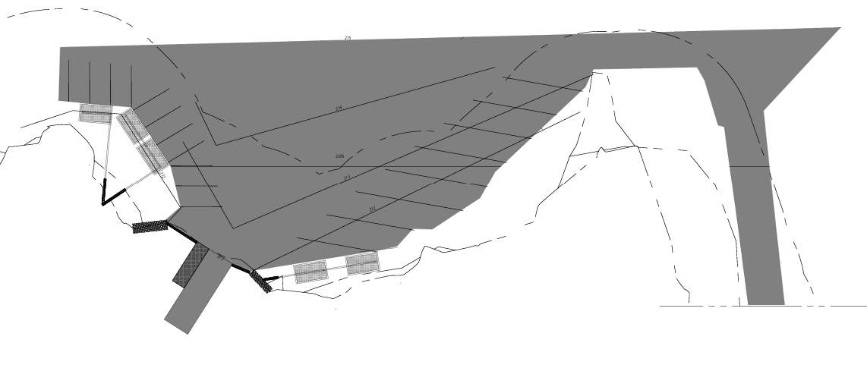
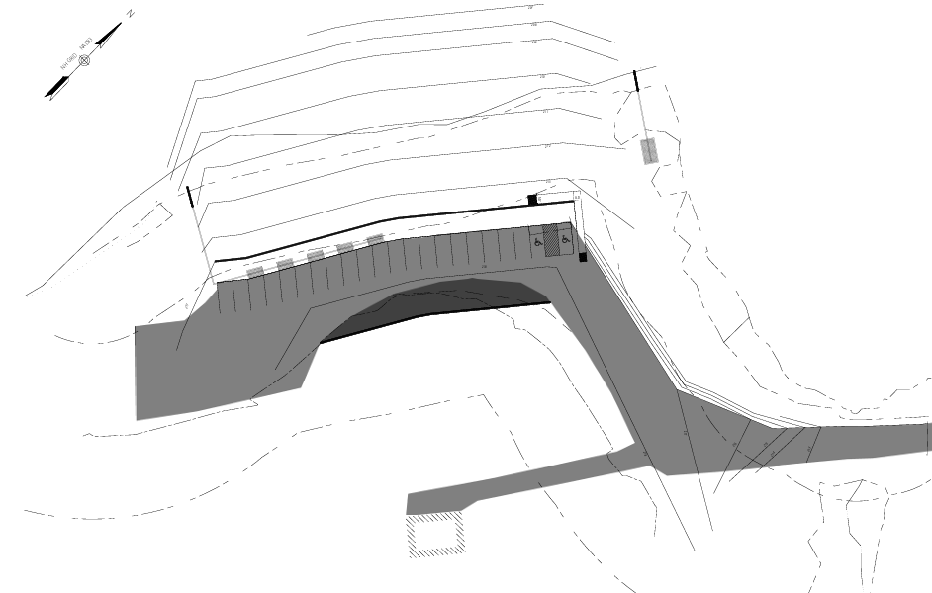
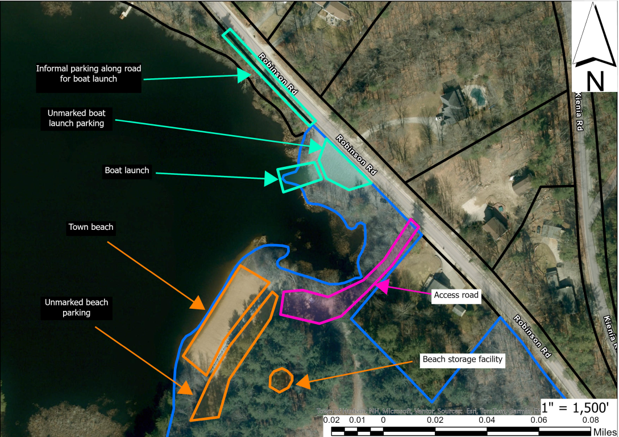
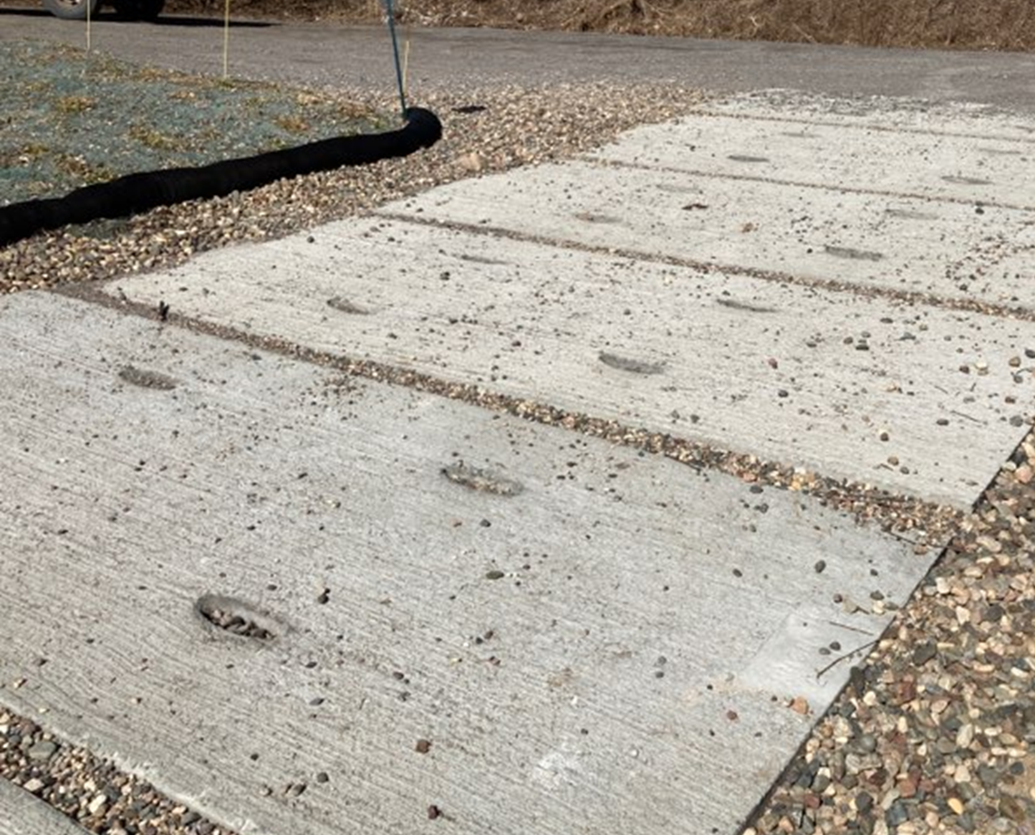
Robinson Pond Stormwater and Boat Access Improvements
Joshua Alpert, Nikhila Lampman, Joseph Pender, Rowan Pow and Matthew Runk
Civil and Environmental Engineering, University of New Hampshire, Durham, NH 03824
Project Background
Stormwater
Decision
Robinson Pond in Hudson, NH is a vital community resource for boating, swimming, and recreation. The site faces water quality, erosion, and accessibility challenges: elevated phosphorus has caused eutrophication and cyanobacterial blooms, stormwater runoff from unpaved parking areas drives erosion at the boat launch, and the existing boat launch and parking infrastructure is inadequate for safe, efficient use.
Project Goals:
Water Quality — Reduce phosphorus loading to meet Total Maximum Daily Load (TMDL) requirements.
Erosion Control — Manage stormwater runoff and mitigate ongoing erosion.
Public Access — Enhance the functionality and safety of the boat launch, parking areas, and beach access.
Tree box filters, bioretention basins, rain gardens, and permeable pavement were evaluated. Tree box filters were selected due to their small footprint and suitability for constrained sites. Systems were sized using the rational method using the 1-inch Water Quality Volume (WQV) and contributing drainage areas. Table 1 shows the area required for each filter at each location. Figure 3 shows an example tree box filter.
Both the stormwater treatment device and boat ramp surface material were evaluated using weighted decision matrices. The decision matrices are structured around a set of factors; each is assigned a weight based on its importance. Each alternative is given a score from one (least favorable) to five (most favorable) for each factor.
Both matrices included safety, cost, lifetime, sustainability, aesthetics, maintenance, and construction; the stormwater treatment decision matrix also considered phosphorus removal and size constraints. The analysis identified tree box filters as the preferred stormwater treatment device and concrete slabs as the preferred boat ramp surface material; however, after consulting with VHB and Dr. Jacobs, precast concrete panels were deemed more suitable for this site.
Table 1. Tree Box Filter Sizings
Figure 3. Tree Box Filter
Figure 4. Cross-Section of Tree Box Filter
 | Tree Box Filter (ft²)
Beach | 249
Edge of Beach | 82
Kiosk Area | 363
Boat Ramp Area | 192
A modular StormTree system was chosen, as shown in Figure 4. Runoff enters the system and is filtered through engineered media, where pollutants are removed through filtration and adsorption. Treated water then leaves through an underdrain. Maintenance includes routine debris removal, vegetation care, and periodic media replacement to maintain performance.
Site Location
Cost Estimate and Grants
Site Design
Quantities were estimated from the preliminary site plan, and unit prices were estimated using NHDOT Weighted Average Unit Prices. The Land and Water Conservation Fund could provide up to 50% matching funds.
The Boat Ramp Parking Area will be redesigned to include eight paved car parking spots, seven paved boat trailer parking spots, and informal gravel parking spaces. This area will be regraded to comply with the ideal slope of two to three percent for a parking lot. At the southwest end of the boat launch parking area is a wooden dock, concrete boat launch, and retaining wall. The general site design will require an asphalt overlay of approximately 42,000 sq. ft.
Table 2. Cost Estimate Summary
Expenses
Site Design | + $551,234.00
Stormwater | + $270,351.00
Boat Ramp | + $40,461.00
Contingency | + $86,205.00
Eligible Grants | - $474,126.00
Total Project Cost | $474,126.00
Figure 1. Locus Map of Hudson, New Hampshire
Acknowledgements
The Beach Parking Area will be redesigned to include 20 parking spots, along with two ADA parking spots. This parking layout will result in a cutback of the hillside and the addition of a retaining wall. An ADA-compliant ramp will be installed adjacent to the ADA spaces. The beach area will be regraded to stabilize the slope and to provide additional space for stormwater treatment.
We would like to thank our project sponsors, Garrison Beck and Derek Bosworth, VHB. We would also like to thank our advisor Dr. Jennifer Jacobs. Additional thanks go out to Dr. Thomas Ballestero and Dr. Fei Han for their help.
Figure 5. Site Plan
Boat Ramp and Permitting
References
The proposed boat ramp is intended to improve safe public access to Robinson Pond. The precast concrete panel system would be installed with a 14% slope, on a compacted granular base with geotextile stabilization and riprap along the edges and toe. Localized excavation and fill would provide a 3-foot launching depth, while construction within the existing disturbed shoreline would minimize erosion and wetland impacts. The general dimensions of the ramp will be 12 feet in width and 36 feet in length.
The project’s overall design will require both state and federal permitting. This covers all impacts to the shoreline and wetlands, A.O.T., and the Clean Water Act.
Minnesota Department of Natural Resources. (n.d.). Water access: Installing a boat ramp. Minnesota DNR Boat Ramp Guidance.
Drgfl. (2025, May 21). Boat Ramp Construction Guidelines - DRG Construction. DRG Construction. https://drgconstructionus.com/boat-ramp-construction-guidelines/.
Rector, P., Obropta, C., & Brown, J. (2013, August). Green infrastructure practices: tree box. Rutgers. https://njaes.rutgers.edu/fs1209/.
New Hampshire Stormwater Manual. (2025). In UNH Stormwater Center & New Hampshire Department of Environmental Services, NH.gov. New Hampshire Department of Environmental Services. https://scholars.unh.edu/cgi/viewcontent.cgi?article=1113&context=stormwater.
Tree Box Filters. (n.d.). Massachusetts Clean Water Toolkit. https://megamanual.geosyntec.com/npsmanual/treeboxfilters.aspx.
TRUEGRID Pavers (2024). From blueprint to blacktop: How to design a parking lot. TRUEGRID Permeable Paver. https://www.truegridpaver.com/how-to-design-a-parking-lot/?srsltid=AfmBOooXuJGElibJlWJHXSEUI81BzZHtggwPQl9o-duaNXCxfwbijJVs.
Figure 2. Current Site Layout at Robinson Pond
Figure 6. Precast Concrete Panels

