Slide 1


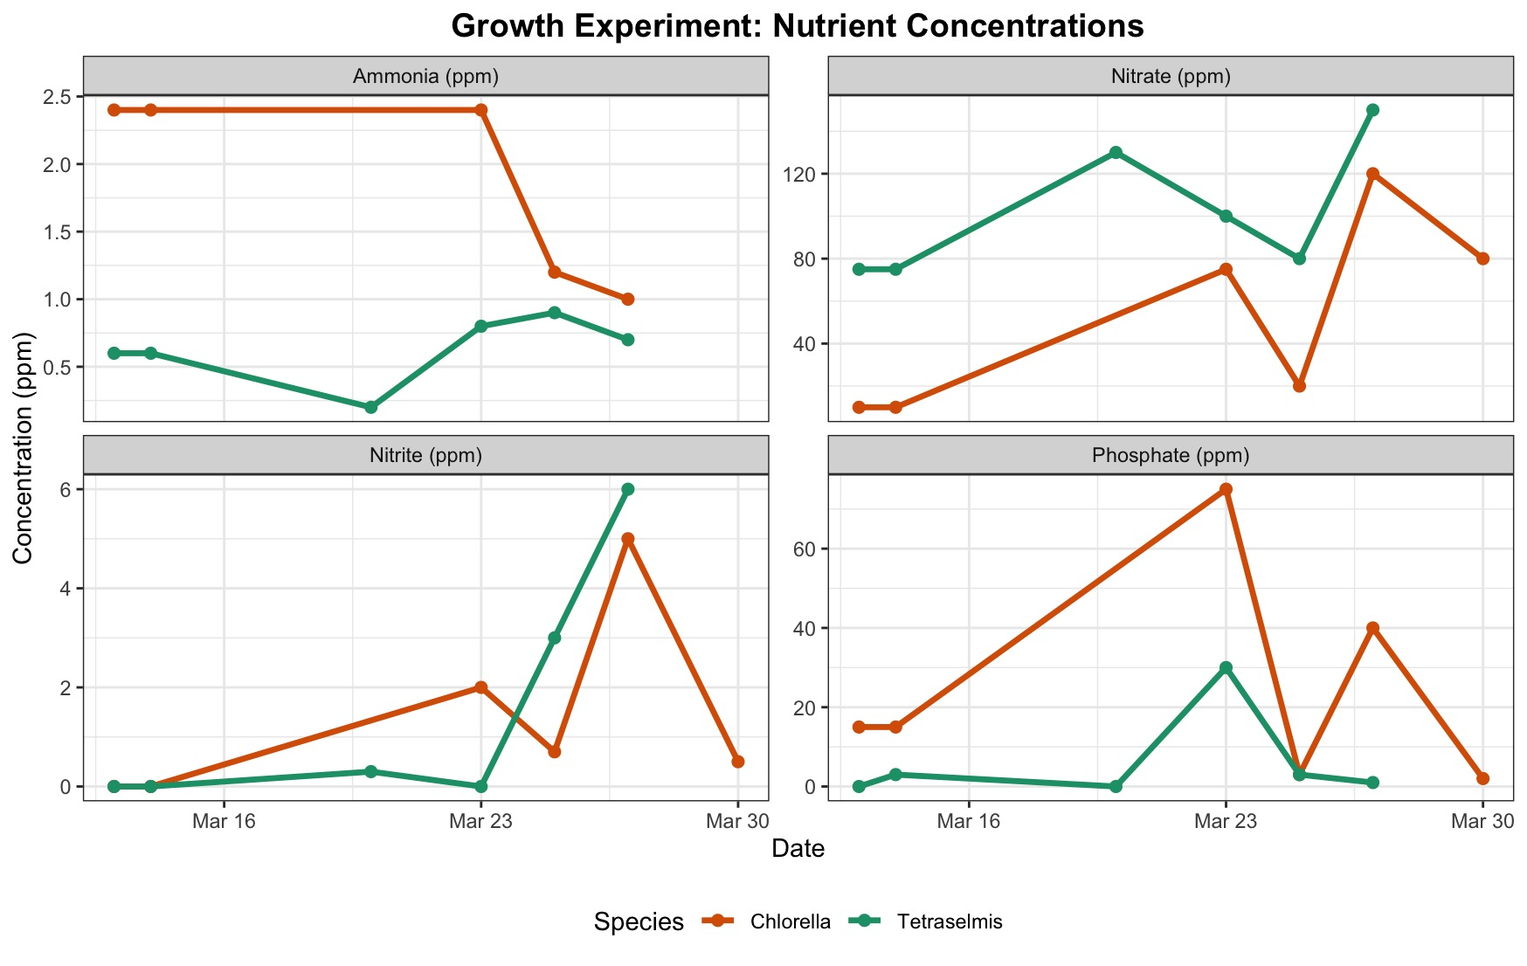
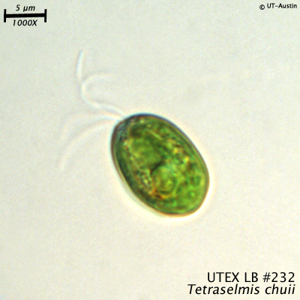
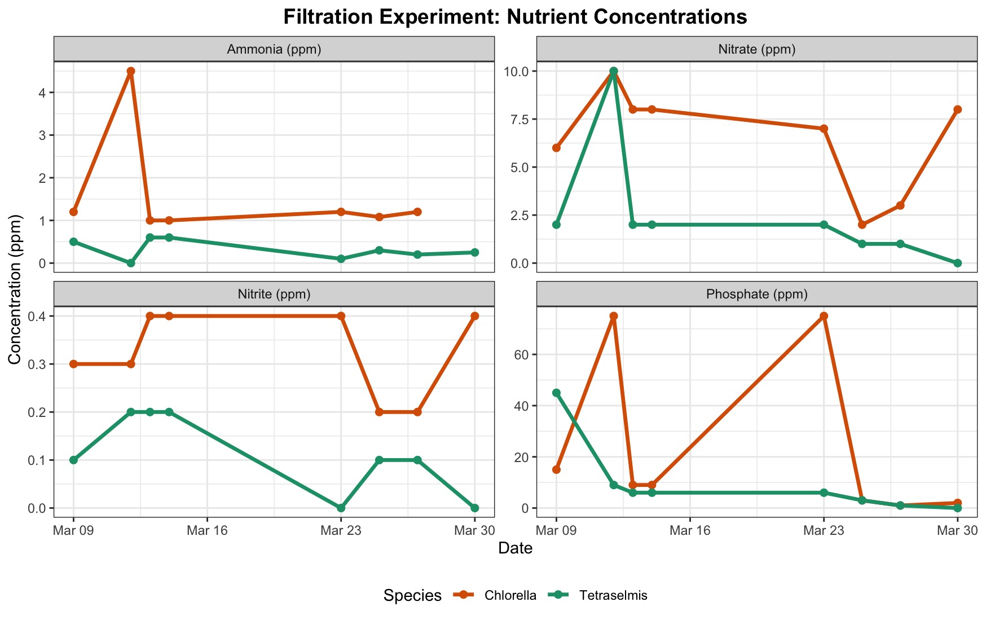
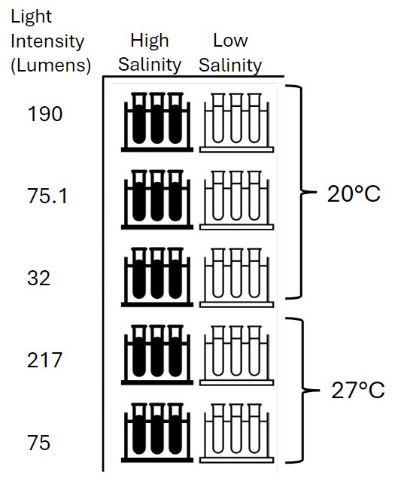
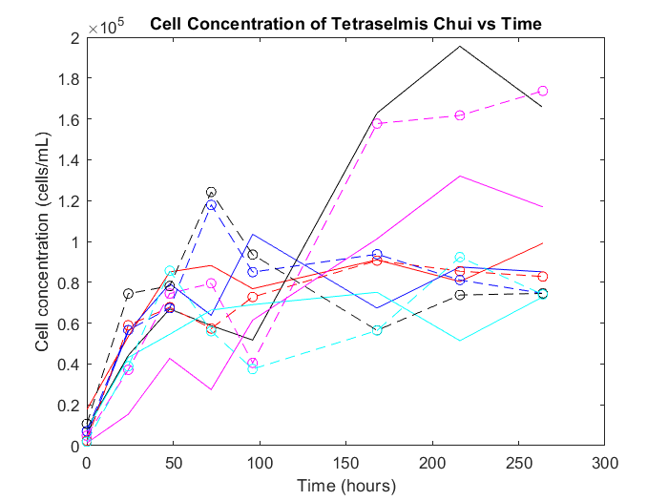
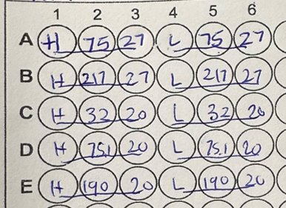
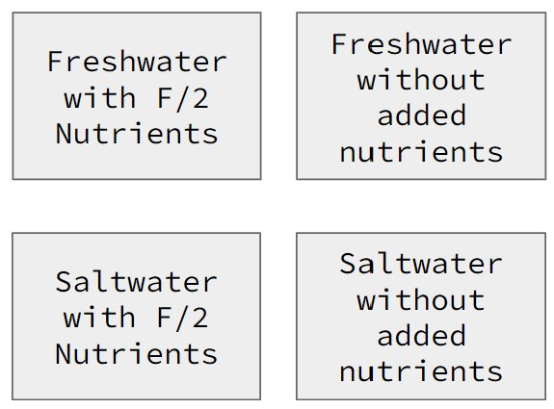
Algae Research for Filtration and Energy Capabilities
Bennett Murphy (Team Lead), Finn Hayes, Izze Titus, Eliza Shepherd, Lauren Milligan
Project Advisor: Felix Devito
Department of Ocean Engineering, University of New Hampshire
Introduction
Results
Discussion
Algae are a diverse group of photosynthetic organisms like plants, meaning they require CO2, nutrients, and light to grow, but lack complex root, stem, and leave structures
Algae has potential as a sustainable biofuel; it is abundant and replenishes much quicker than alternative biomass such as trees, corn, or agricultural waste, and grows in locations typical crops cannot
Algae can also be used as a water filtration device; they remove pollutants like CO2, nitrogen, phosphorus, and even heavy metals
Wastewater treatment with the help of algae is a promising business based on its known filtration capabilities
After harvesting and drying algae, its lipids can be extracted and refined into biofuel.
Benefit of algae is its efficient biological design and high lipid content, producing more biofuel per acre than any other biomass
Tetraselmis chui exhibits optimal growth in high-light, high-salinity, and room-temperature conditions, suggesting high feasibility for integration into standard climate-controlled building facades.
Comparative analysis with Chlorella showed visible proliferation in both species, though a two-week cultivation period was insufficient for recording significant changes in nutrient filtration levels. Future implementations will utilize extended growth cycles to fully quantify the cleaning abilities and energy production potential of these microalgae within green building systems.
To address the operational challenge of salt accumulation caused by evaporation in marine systems, we developed an automated salinity corrector that ensures stable environmental conditions by precisely introducing freshwater and maintaining the high-salinity profile required for optimal algal health and consistent energy production.
Methods
Tetraselmis Chui Lab Experiment
30 test tubes with Tetraselmis Chui were made, and their growth was observed for 2 weeks
10 conditions, each condition tested in triplicate
Each tube was filled with 500 mL of water (15 high salinity and 15 low salinity), as well as 1 mL each of Tetraselmis Chui
Every 1-2 days, the cell concentrations of each test tube were counted to observe growth
Light was set to a 12 hour on/12 hour off cycle
Tetraselmis chui, UTEX Culture, University of Texas USA
Next Steps
Next year's team can use our research as a foundation to design a physical system
A longer duration and larger scale experiment would provide a better understanding of the applications of algae power and filtration
The ideal team for continuing this project would have a strong foundation in biological sciences and experiments
Working with the Civil Engineering team to utilize algae power and filtration within a building set-up would be a possible focus point
Future partnership with the UNH AquaFort program is also a potential opportunity.
Filtration Experiment Tank Conditions
To start the algae cultures:
1400 mL of water to 14 mL of Chlorella
42 mL of Tetraselmis Chui (less concentrated)
700 mL of water added to all tanks to promote growth
F/2 nutrients added to the growth tanks
Took nutrient and climate data for ~3 weeks
Algae harvested through coffee filters
Sample Rack Layout for Cell Counter
Funding
Found overall declines in most nutrient concentrations over time for both Chlorella and Tetraselmis algae
Increased levels of light leads to higher rates of algal growth in both species
1g of algae/250ml was harvested after a 3 week period
.
This work was funded in part by New Hampshire Sea Grant's Workforce Development Project E/WFD-3, pursuant to National Oceanic and Atmospheric Administration Award No. NA24OARX417C0037.
Conditions in each tank

