Slide 1

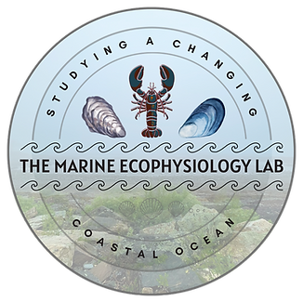
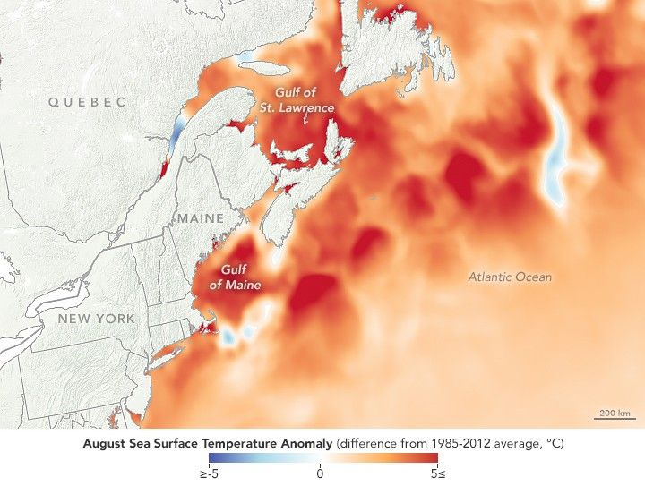

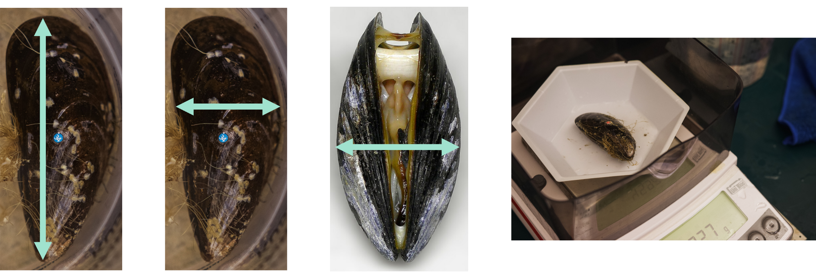
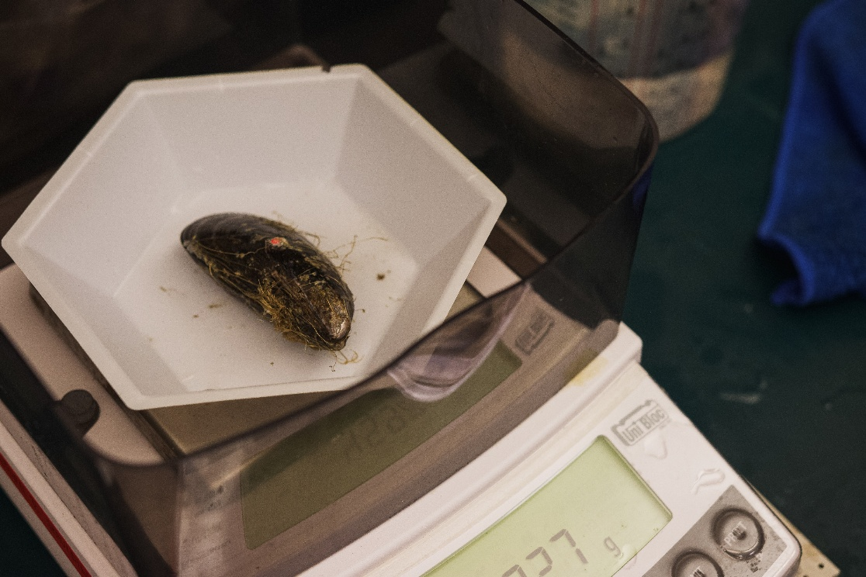
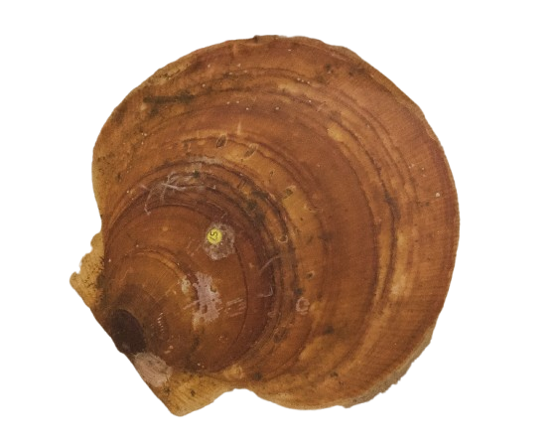
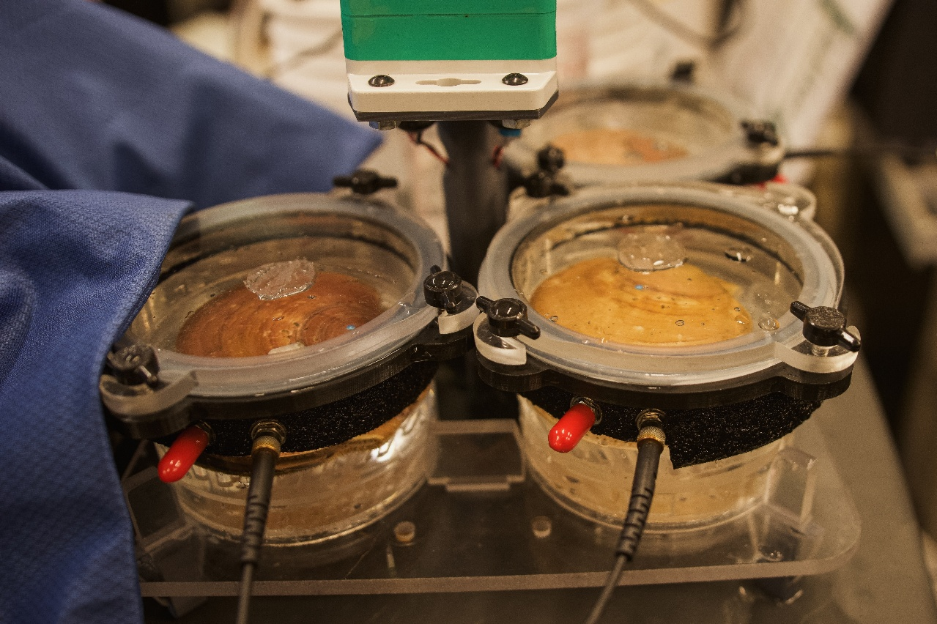
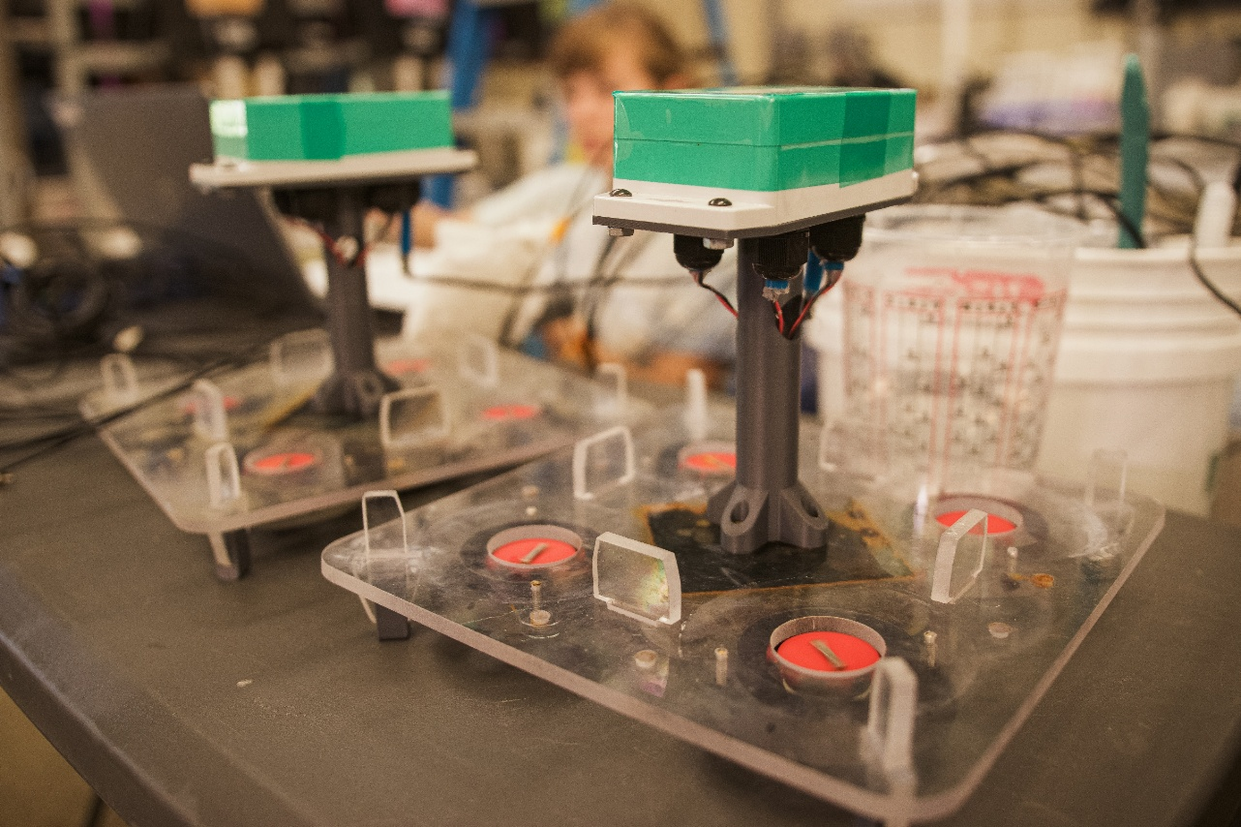
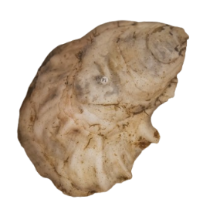

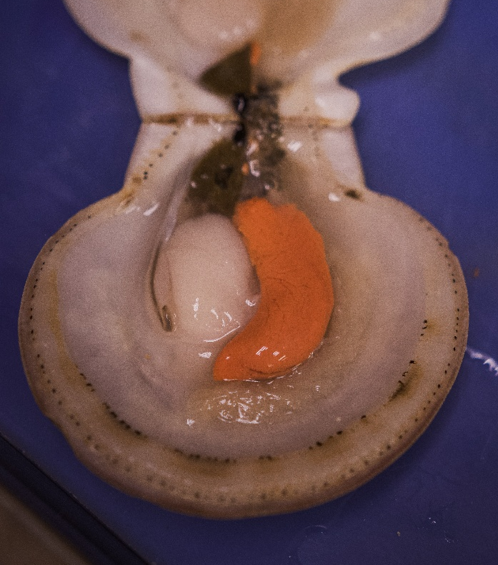
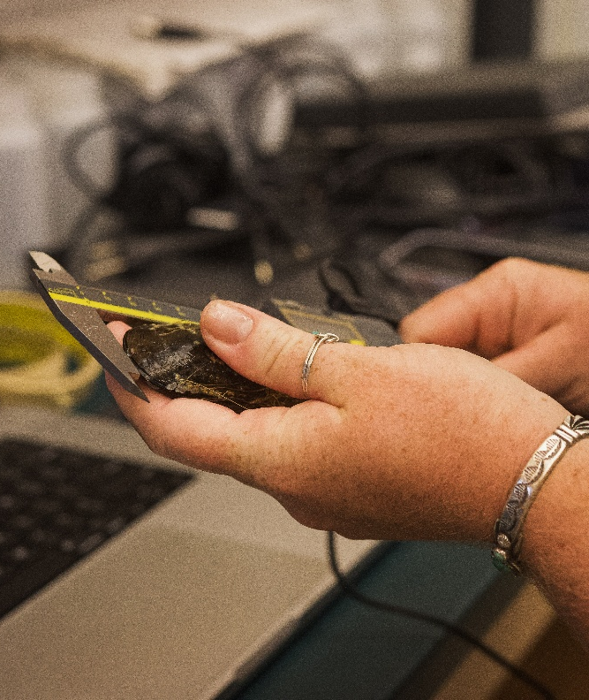
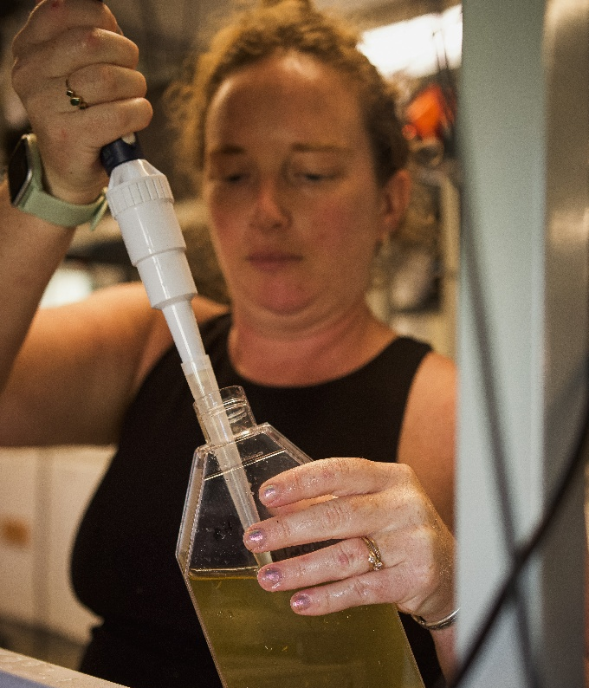
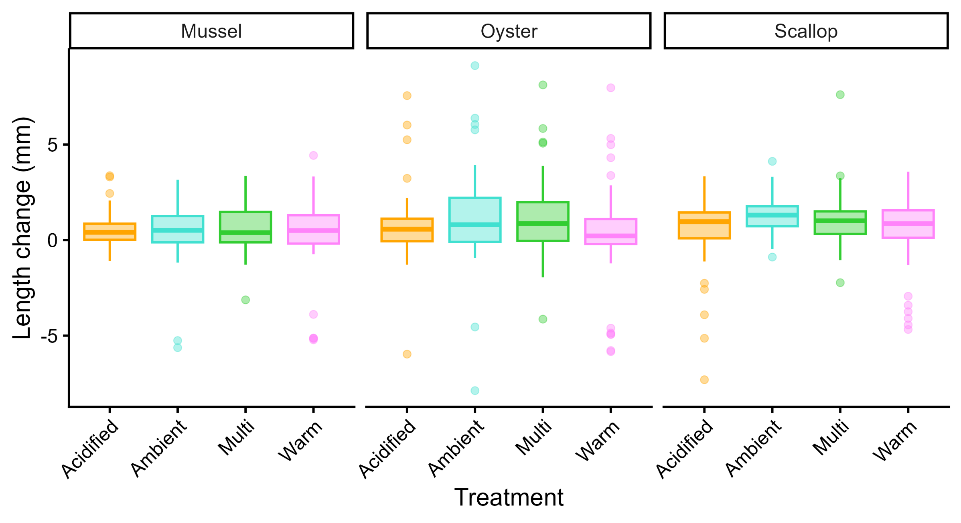
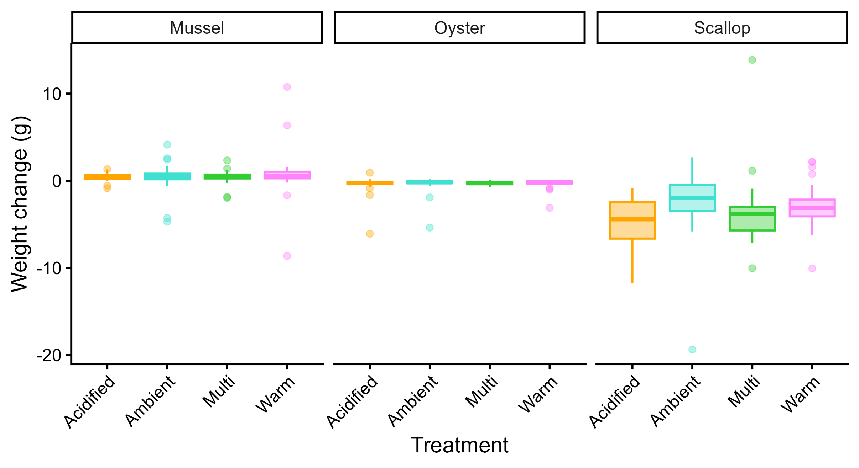
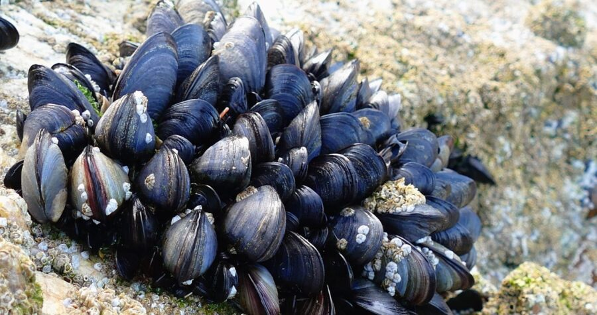
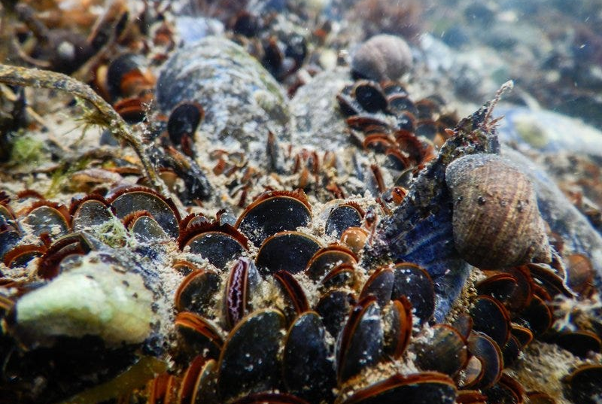
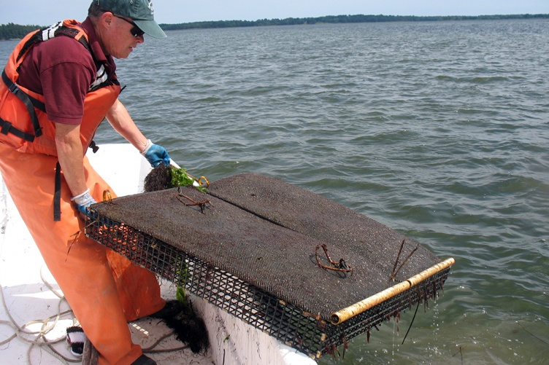
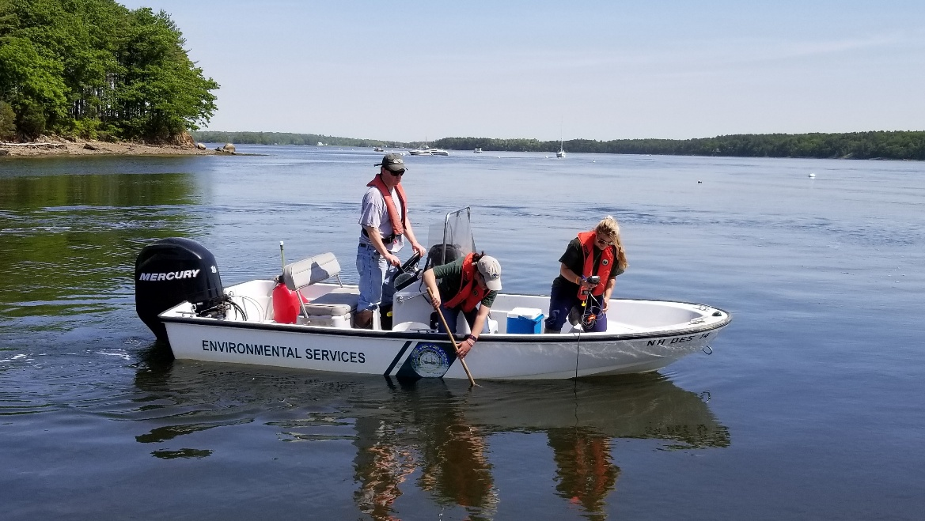
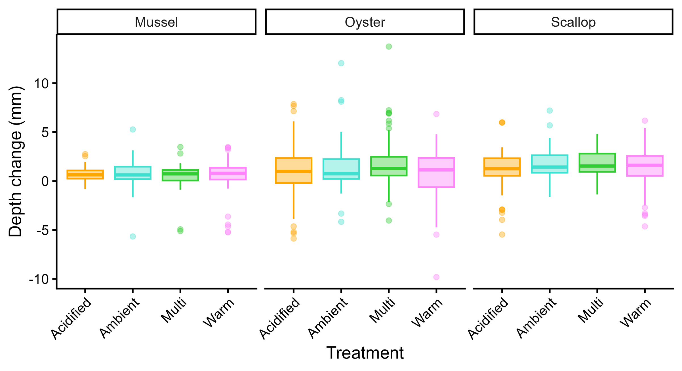
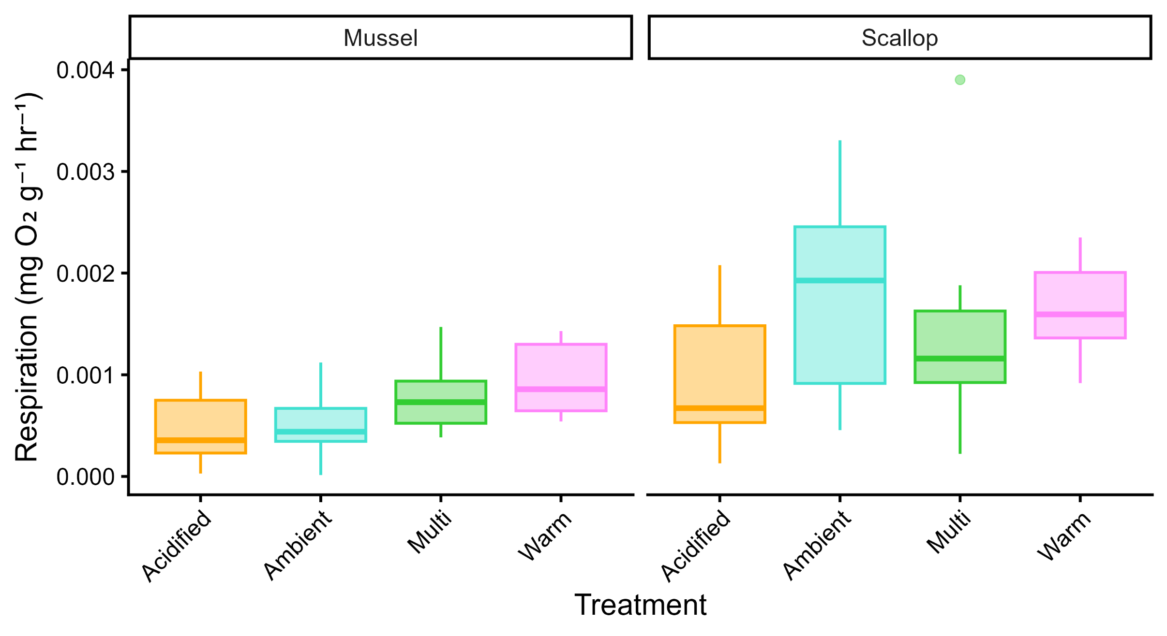

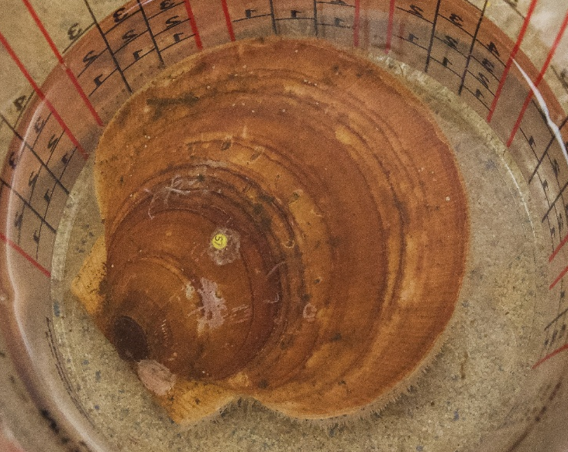
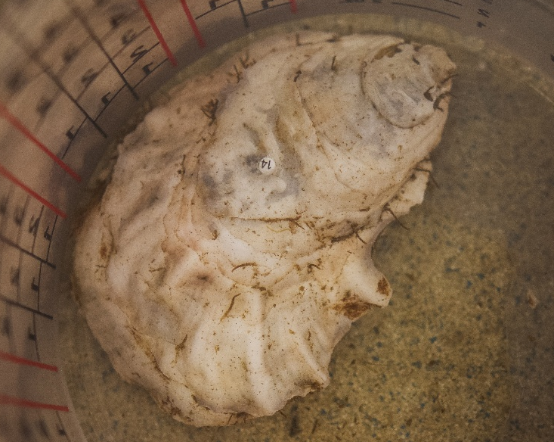
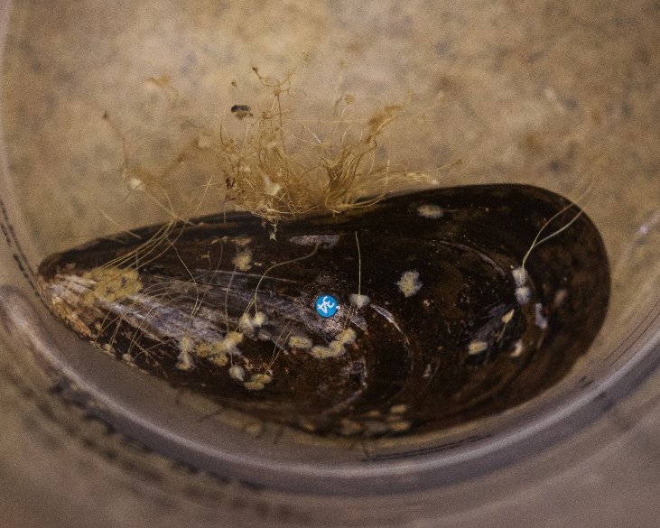
New Hampshire Shellfish Under Pressure:
Physiological Effects of Climate Change and Toxic Algal Blooms
Olivia Boyan, Hannah Gossner, Elizabeth Harvey, Brittany Jellison
Department of Biological Sciences, University of New Hampshire, Durham, NH 03824
Introduction
Methods
Conclusion
Effects of climate change
Water treatments:
Growth measurements:
Scallops under acidified and multi treatments…
Scallops regardless of treatment…
Acidified
17 °C
pH 7.5
Ambient (Control)
17 °C
pH 8.0
Ocean warming
Weight and respiration were lower
Shell growth continued
Ocean acidification
Multi
21 °C
pH 7.5
Warm
21 °C
pH 8.0
Changes in harmful algal bloom (HABs) presence
Length (mm)
Width (mm)
Depth (mm)
Weight (g)
Respiration measurements:
What does this mean?
Photo by: Lauren Dauphin and Coral Reef Watch
Acidified
17 °C
pH 7.5
Stress response
Metabolic depression
Effects influence shellfish physiology…
Algal diet treatments:
Temperature
Growth
NonTox
LowTox
HighTox
Why did weight decrease but shell dimensions increase?
Water pH
Influences
Results
Spawning during experiment?
Energy allocation to shell growth?
Not given enough food?
Diet toxicity level
from algae
Respiration
Shellfish, particularly scallops, continued to grow their shells (Fig 3., Fig 5.)
Shellfish, particularly scallops, lost weight especially under acidified conditions (Fig 4.)
Shellfish are particularly susceptible to effects because…
They are mostly sessile organisms
They feed through their tissues
What now?...
pH affects their shell health
Inform fishery and aquaculture management in New Hampshire
Continue research:
Photo by: Critter Science
Why are shellfish important?
Shell thickness or density
Fig 3. Length change (mm) by species and treatment. Length change was significantly different between ambient-warm (p = 0.0128) and multi-warm
(p = 0.0113). No species-treatment interaction or significance between species
(p > 0.05).
Fig 4. Weight change (g) by species and treatment. Weight change was significantly different between mussel-oyster (p < 0.0001), mussel-scallop (p < 0.0001), and oyster-scallop (p < 0.0001), as well as acidified-ambient (p = 0.0001), acidified-warm (p = 0.0025), and ambient-multi (p = 0.0265). Also showed species-treatment interaction (p < 0.001).
Measure dry weight
Meat weight vs shell weight
Photo by: Seacoast Online
Photo by: Krystin Ward/UNH
Photo by: NH DES
Account for spawning
Shellfish improve water quality, provide habitat, and support marine food webs
The shellfish industry provides many jobs, economic contributions, and a high value global food source
Shellfish showed lower respiration under acidified conditions (Fig 6.)
References
Objective
Analyze the effects of predicted water conditions and diet toxicity level in New Hampshire on the growth and respiration of Blue mussels (Mytilus edulis), Eastern oysters (Crassostrea virginica), and Sea scallops (Placopecten magellanicus).
Acknowledgements
Photos by: Brian Yurasits, New Hampshire Sea Grant
Fig 5. Depth change (mm) by species and treatment. Depth change was significantly different between mussel-oyster (p = 0.005) and mussel-scallop (p = 0.0001). No species-treatment interaction or significance between treatments (p > 0.05).
Fig 6. Respiration (mg O₂ g⁻¹ hr⁻¹) by species and treatment. Respiration was significantly different between mussel-scallop (p < 0.0001) and acidified-warm
(p = 0.0168). No species-treatment interaction (p > 0.05).
This work was funded through NH Sea Grant.

