Slide 1

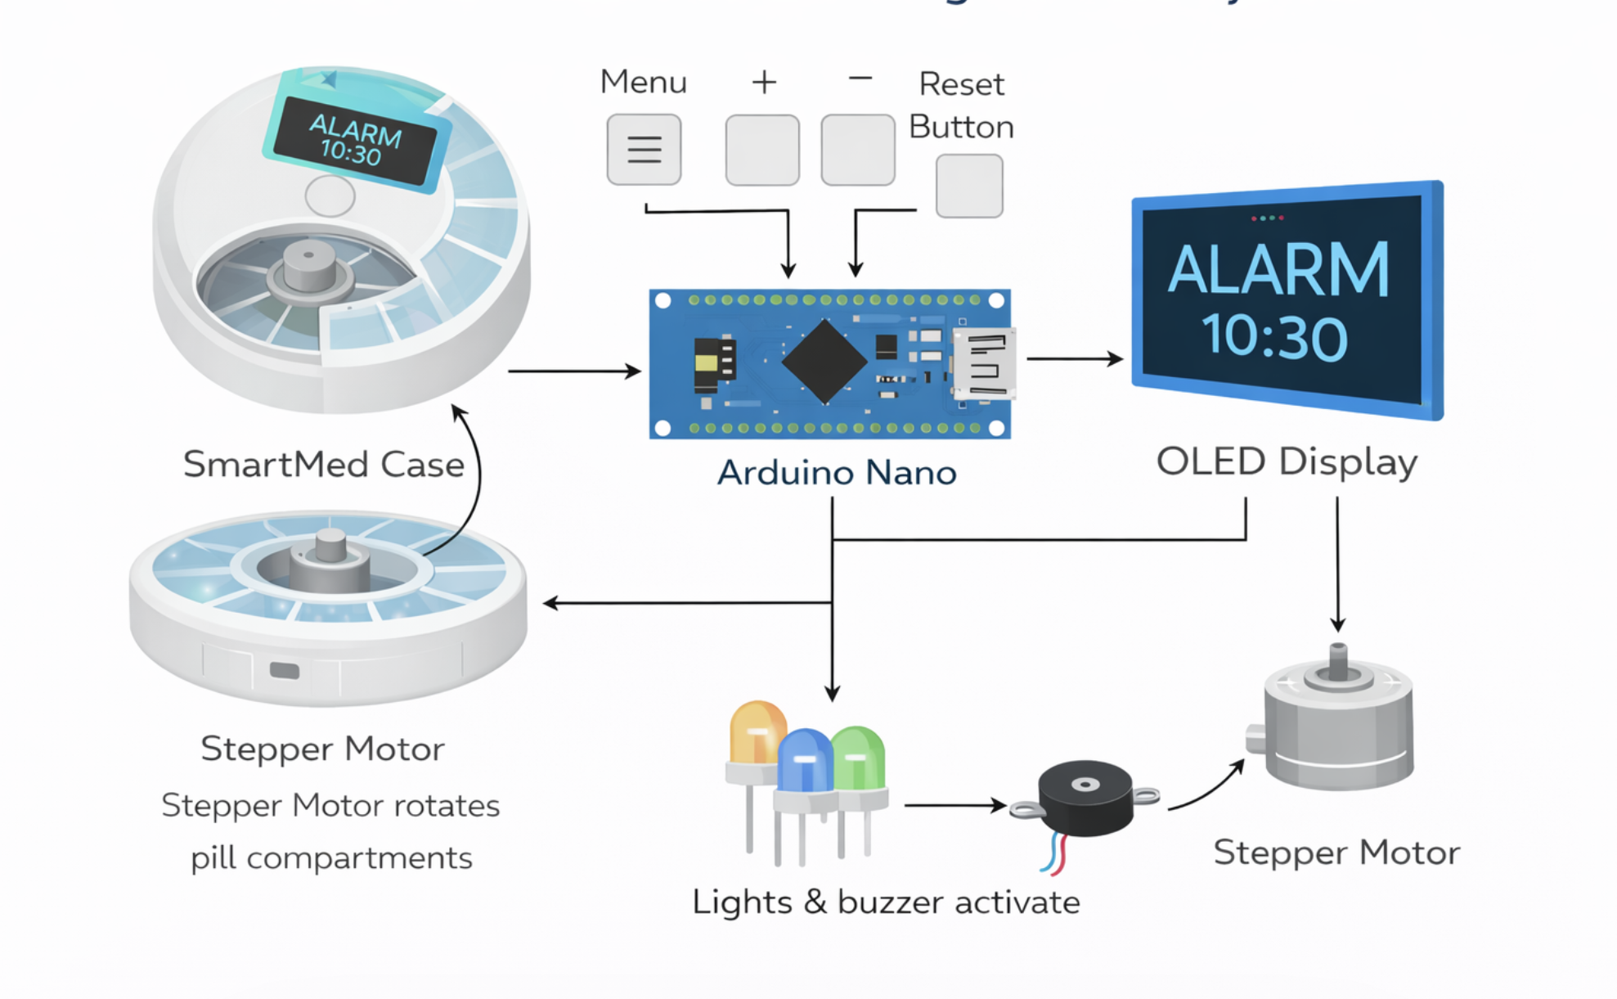
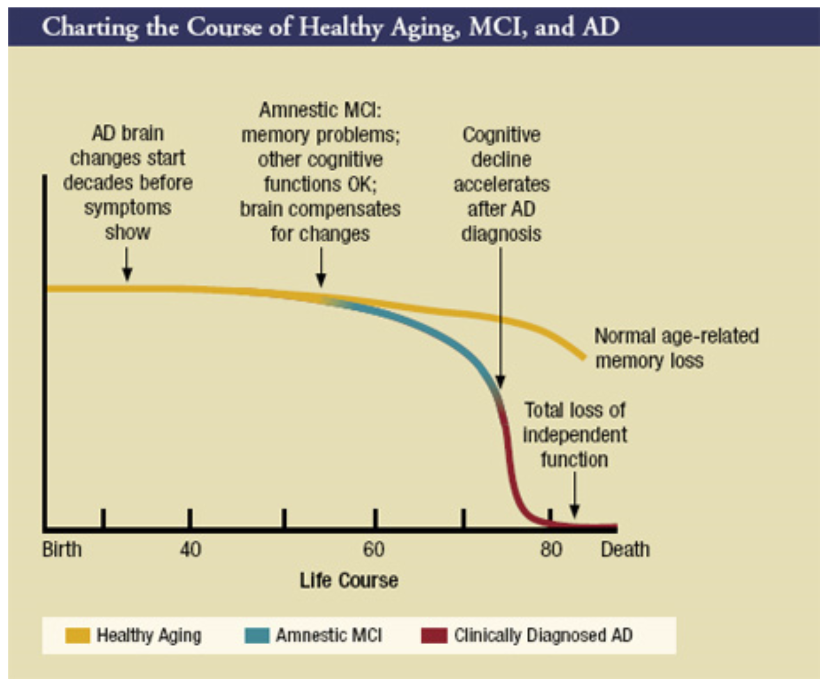
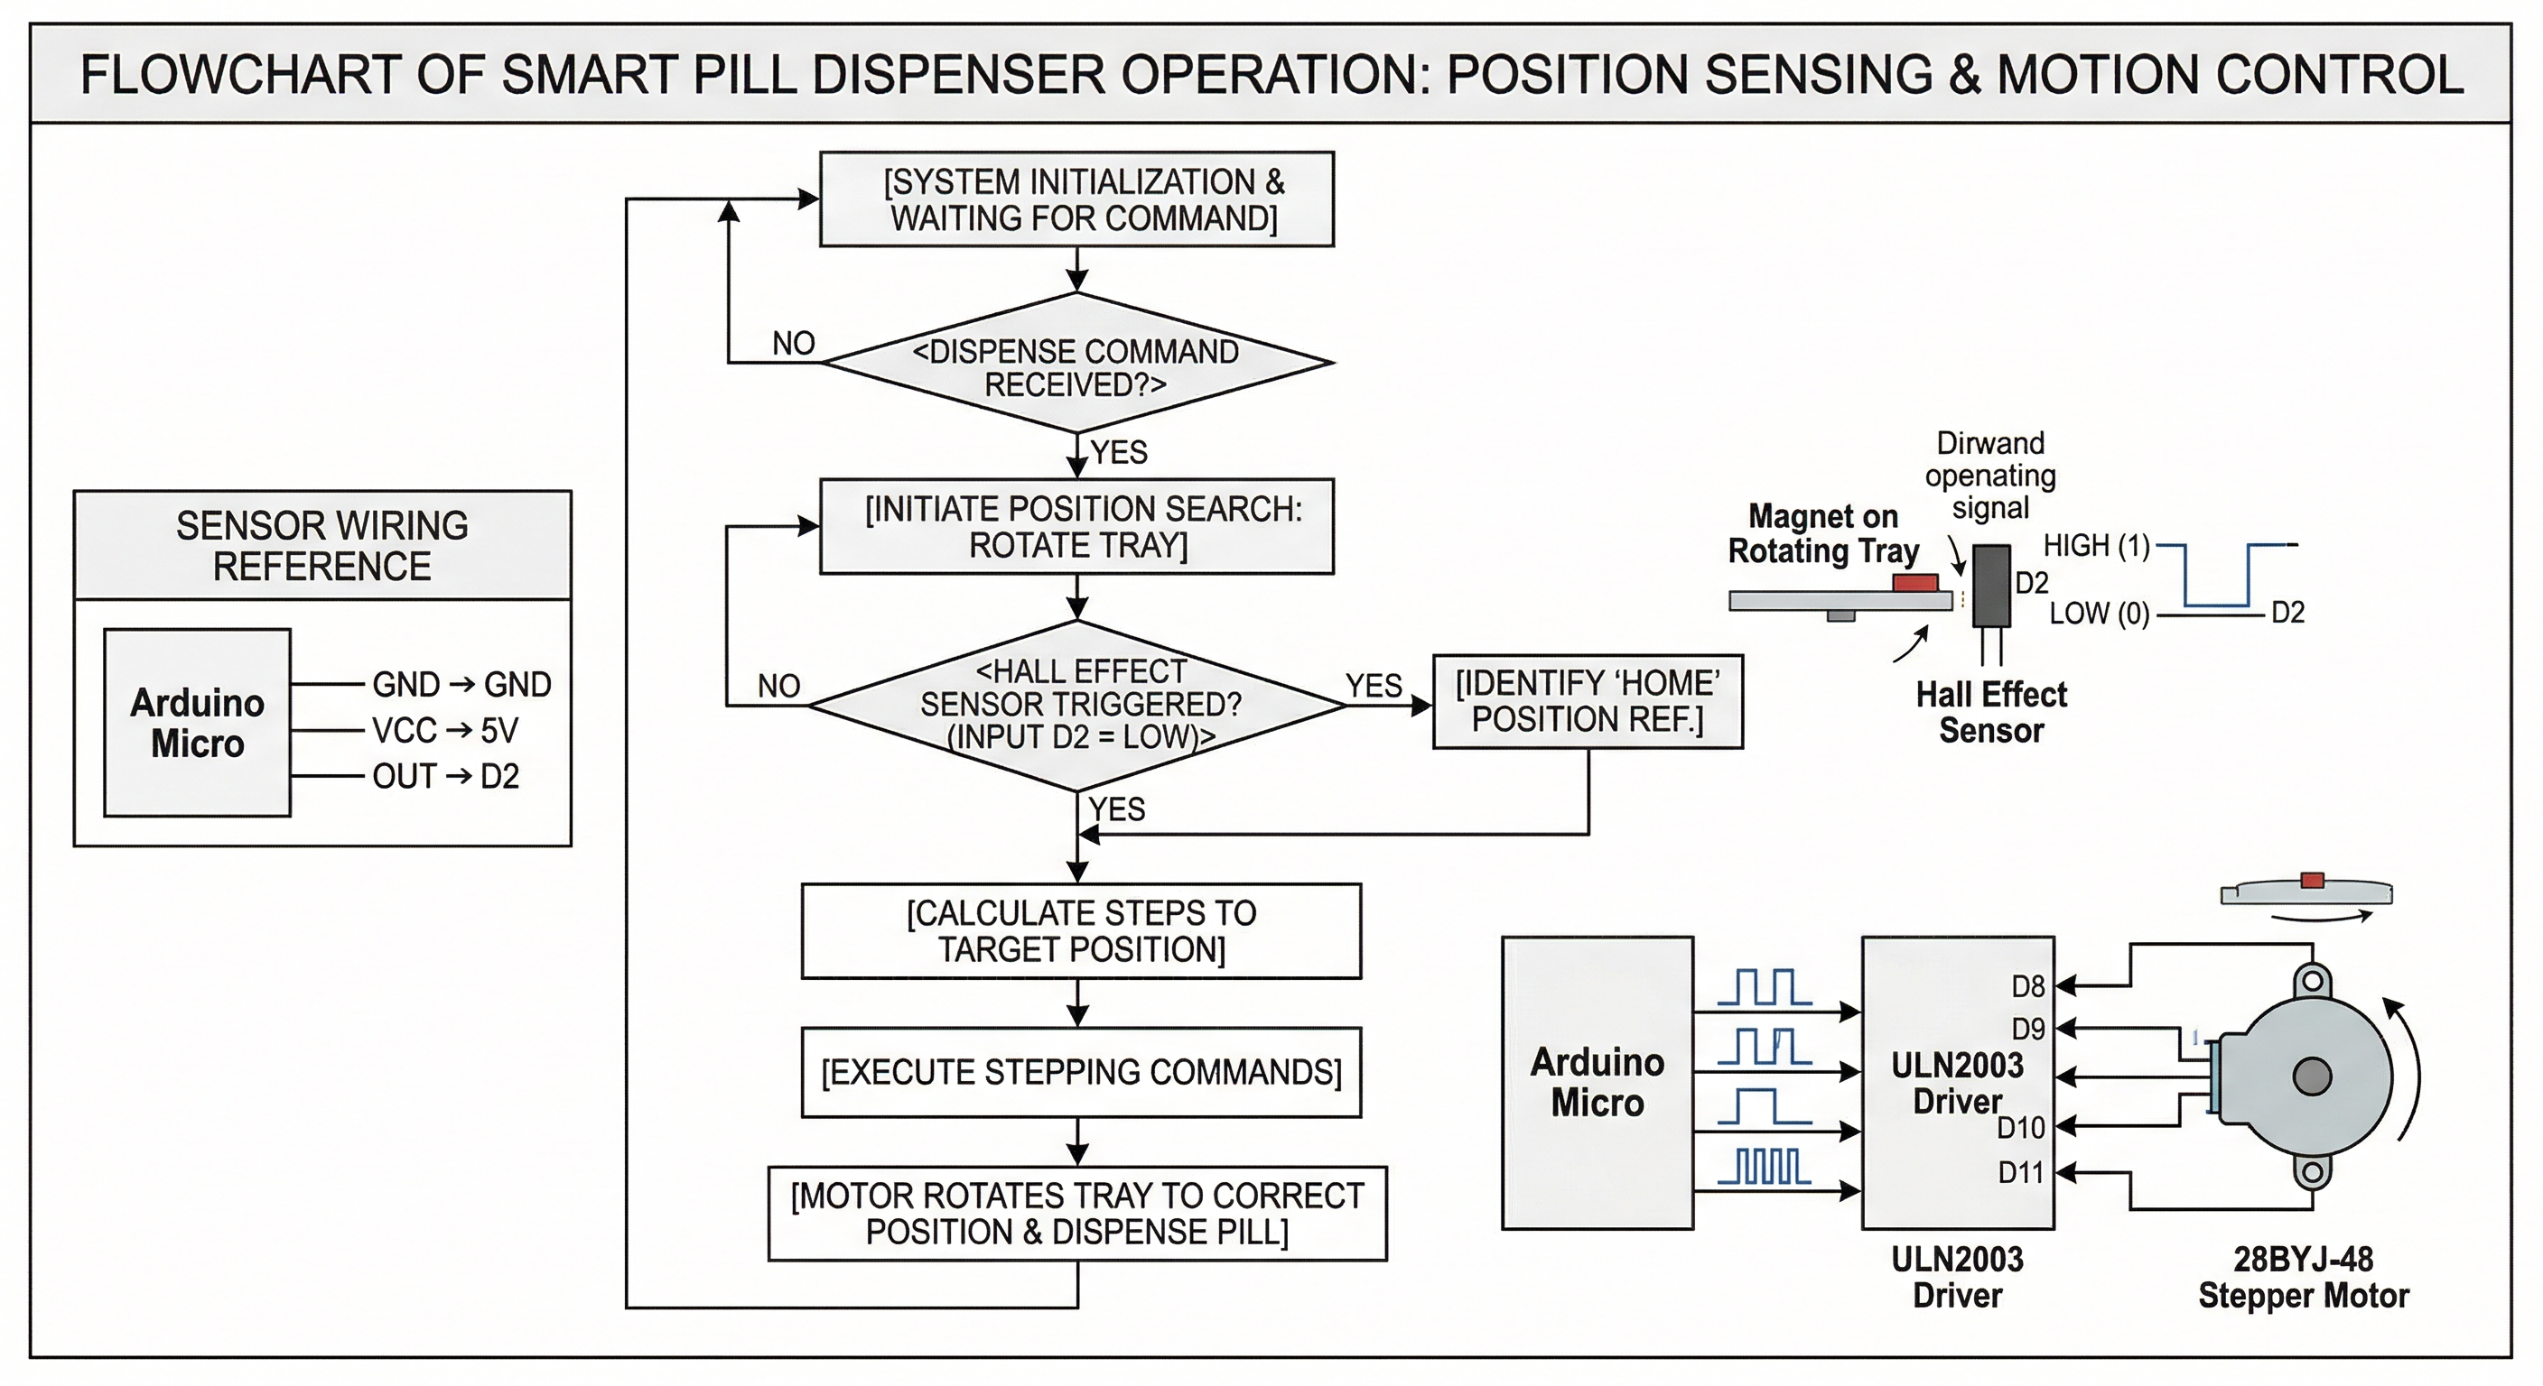


SmartMed: Sensor-Locked, Multi-Alert Pill Case for Safer Medication Adherence
Samantha Boette smb1236@usnh.edu • Jared Dumont jsd1070@usnh.edu
Project Advisor: Dr. John Lacourse
Background and Problem
Design Structure
Hypothesis
There is a high rate of non-adherence to medication regimens, particularly in patients with chronic conditions
Missing doses, taking medication at the wrong time, or double dosing can lead to serious health consequences
Current pill organizers lack physical safeguards to prevent accidental misuse
As the population ages chronic illnesses are also increasing
Difficulty remembering can cause unnecessary stress
Integrating servo-controlled mechanical locks and sensor feedback into a circular pill case will create a reliable system for preventing early or missed doses
The SmartMed device will improve medication adherence by combining physical safeguards with real-time alerts and data logging
By providing clear visual, auditory, and tactile feedback, users will experience greater independence and confidence in managing daily medications
It is expected that, compared to traditional pill organizers, SmartMed will reduce medication errors, promote consistent routines, and enhance overall safety for individuals with memory or cognitive challenges
Background Chart
Course of Healthy Aging vs AD and MCI
Position Sensing and Motion Control
Future Improvements
Retrieval Tracking: Add per-cell load cells or IR sensors to physically verify pill removal
App connection: Link the existing mobile app via Bluetooth to sync schedules and track history
Audience
Geriatric Individuals with Moderate Dexterity

