Slide 1





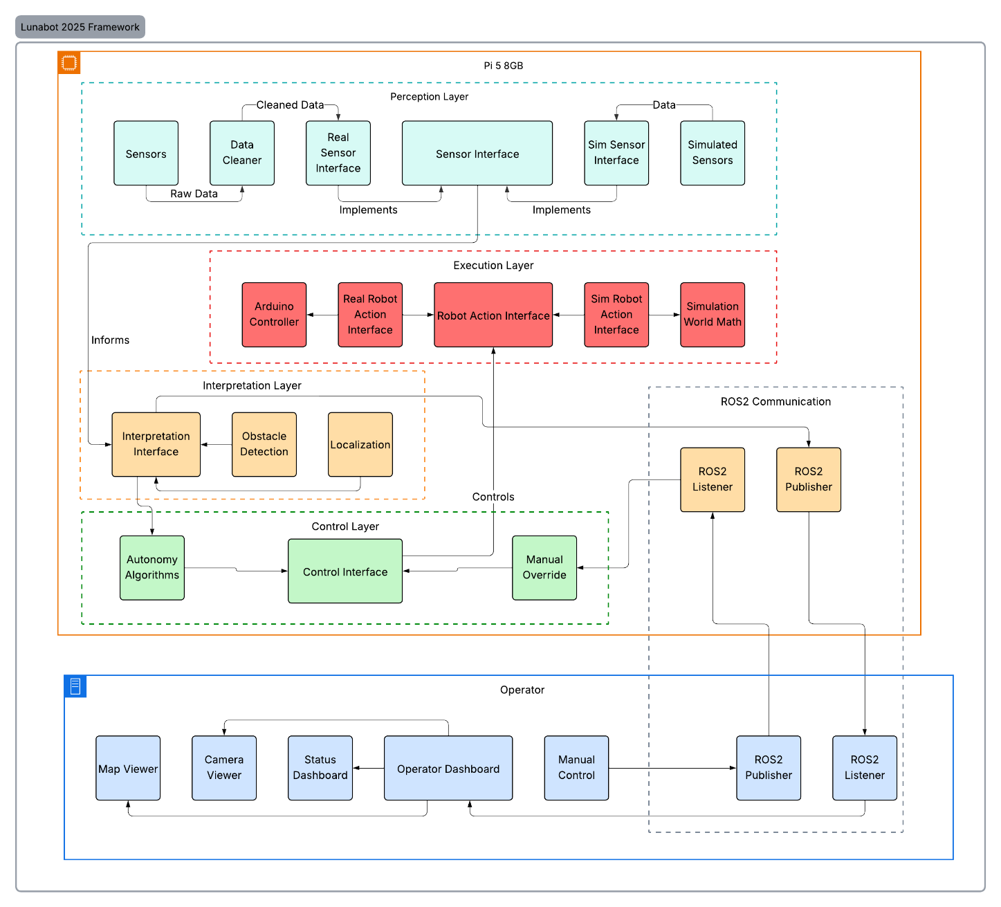

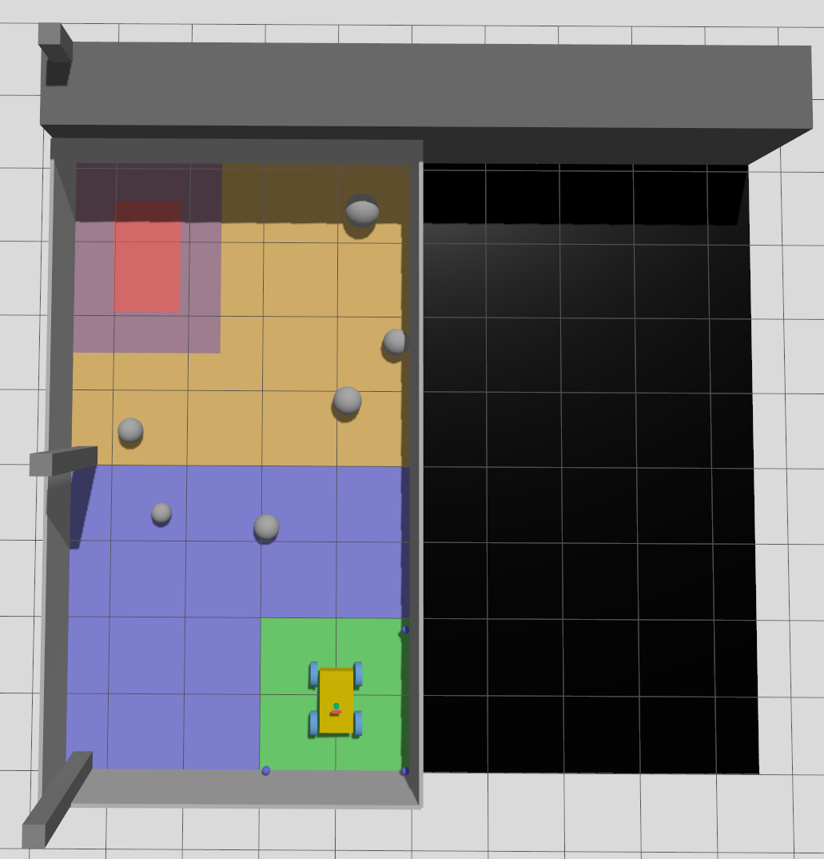
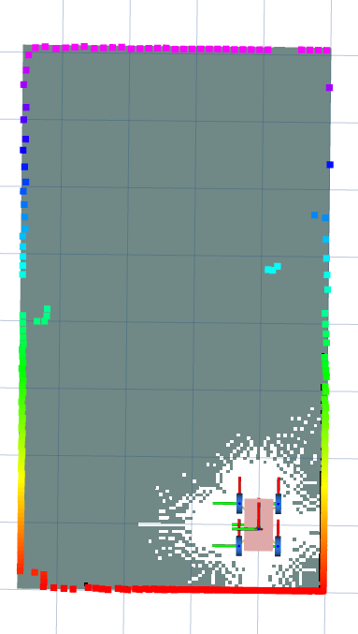
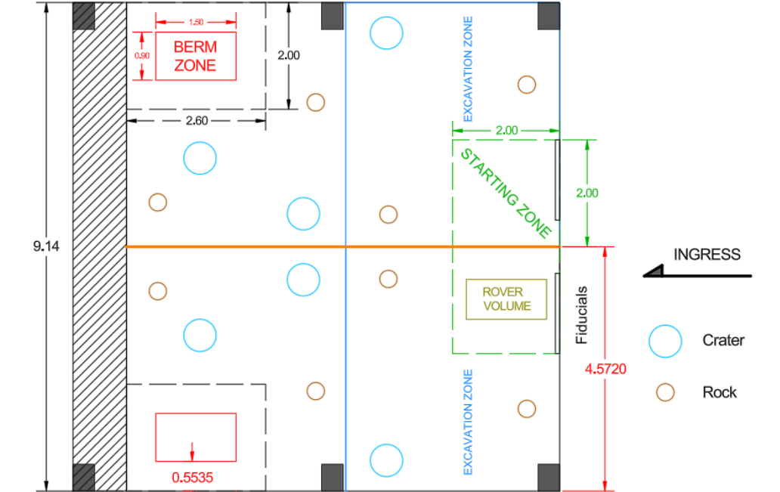
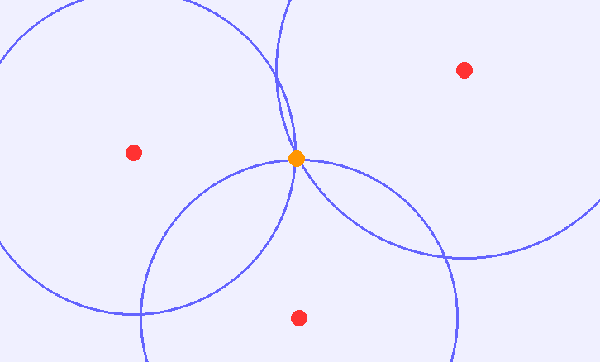
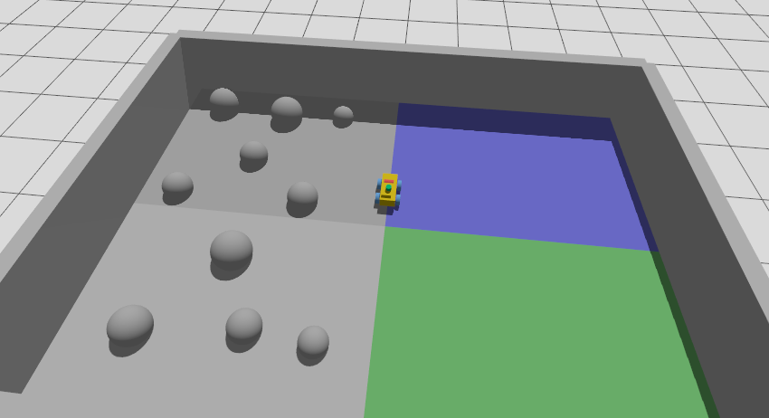

UNH LunaCats CS | NASA Robotic Mining Team
Aaron Owre, Aidan Kane, Brian Winslow, Conner Sheehan, Ethan Norcott
Department of Computer Science, University of New Hampshire
Project Overview
Software Design
Autonomous Functionality
NASA Lunabotics Competition
University of Central Florida, Kennedy Space Center
University teams are tasked with designing, building, and operating a robotic excavator capable of autonomous navigation, regolith excavation, and resource delivery in a lunar environment.
Competition Implementation Overview
System Objectives
Designed to meet NASA’s autonomous excavation requirements.
Supports fully autonomous operation with teleoperation fallback.
Enables seamless transition between simulation and real-world
development.
Modular Architecture
Decoupled perception, planning, and control layers.
ROS2-based node architecture for scalability.
Hardware abstraction layer isolates sensors from planning logic.
Simulation ↔ Real-World Parity
Identical software stack used in simulation and field testing.
Sensor interfaces abstracted for Gazebo and physical hardware.
Enables rapid validation before hardware deployment.
Localization & Perception Integration
UWB trilateration fused with SLAM pose estimates.
LiDAR and radar for real-time obstacle detection.
Dynamic cost map updates for responsive navigation.
Perception & Mapping
  LiDAR-based SLAM
    Real-time occupancy grid generation
    Handles dynamic dust occlusion.
Localization
  Sensor Fusion
    SLAM-based pose estimation
    UWB trilateration for drift correction
  Reduces cumulative odometry error
  Maintains centimeter positional accuracy
Path Planning
  Global Planner: Timed A*
    Heuristic grid-based search over occupancy map
    Minimizes travel cost while avoiding obstacles
    Replans dynamically when cost map updates
    Ensures optimal, deterministic path generation
Behavior Tree Control
  Mission Phases
    Navigate → Excavate → Navigate → Deposit
    Hierarchal task switching
  Autonomous failure recovery
    Replan on obstacle detection
    Retry navigation on failure
    Reset localization if divergence is detected
Robot used in competition is implemented using ROS2 node architecture to create a modular and scalable system, both for the current competition and for future ones.
Utilizes ultrawideband (UWB) distance sensors, lidar, radar, and a behavior tree to create a map of its surroundings, localize itself and navigate to set goals for mining and depositing autonomously.
Requirements
Functional
Autonomous navigation & mapping
Real-time obstacle detection
Excavation & deposition
Manual override capability
Simulation support
Nonfunctional
  Real-time performance
  Robustness to noise
  Power efficiency
  Reliable network communication
  Scalable & secure design
From Sensor Data to Autonomous Action
Real-time LiDAR scans are transformed into a live occupancy map, allowing the robot to localize and navigate without prior knowledge of the environment.
Evaluation
Mission Outcome
Demonstrated autonomous navigation and localization.
Integrated UWB-enhanced pose correction.
Seamless switching between
autonomous and teleoperation modes.
Impact
Enables scalable lunar excavation
without continuous human control.
Demonstrates cost-effective
localization for off-Earth environments.
Limitations
Limited full-system physical validation
due to shared hardware dependencies.
Future work
Expand full-robot integration testing.
Improve excavation autonomy refinement.
Maintain modular architecture for future team development.
Physical Testing
Simulation Testing
Physical Control
Verified LiDAR data transmission via ROS2 topics.
Validated object detection on final hardware.
UWB trilateration accuracy testing using beacon array.
Teleoperation validated on legacy platform prior to final integration.
Gazebo-based arena modeling and obstacle generation.
Randomized obstacle zones for navigation stress testing.
Independent subsystem validation.
(mapping, planning, control)
Simulated sensor noise and tested recovery behaviors.
Enabled rapid iteration prior to hardware availability.
Utilized quick_start script to easily run and build all simulations
High-Level Control & Telemetry
Raspberry Pi 5 (8GB)
  Primary onboard compute unit.
  Executes autonomy and teleoperation logic.
  Communicates with base station via ROS2.
  Streams diagnostics & system health data.
  Enables teleoperation fallback on autonomy failure.
Low-Level Motor & Actuator Control
Arduino Mega
  Dedicated real-time motor controller.
  C++ firmware for actuator & sensor control.
  Serial communication with Raspberry Pi.
  Isolates hardware timing from autonomy stack.
Acknowledgments
Professor May-Win Thein Project Advisor
Beswick Eng, ChanLing Beswick Business Sponsor
NASA Lunabotics Department, CAT Competition Host
CEPS and ME Dept. Grant & Funding

