Slide 1

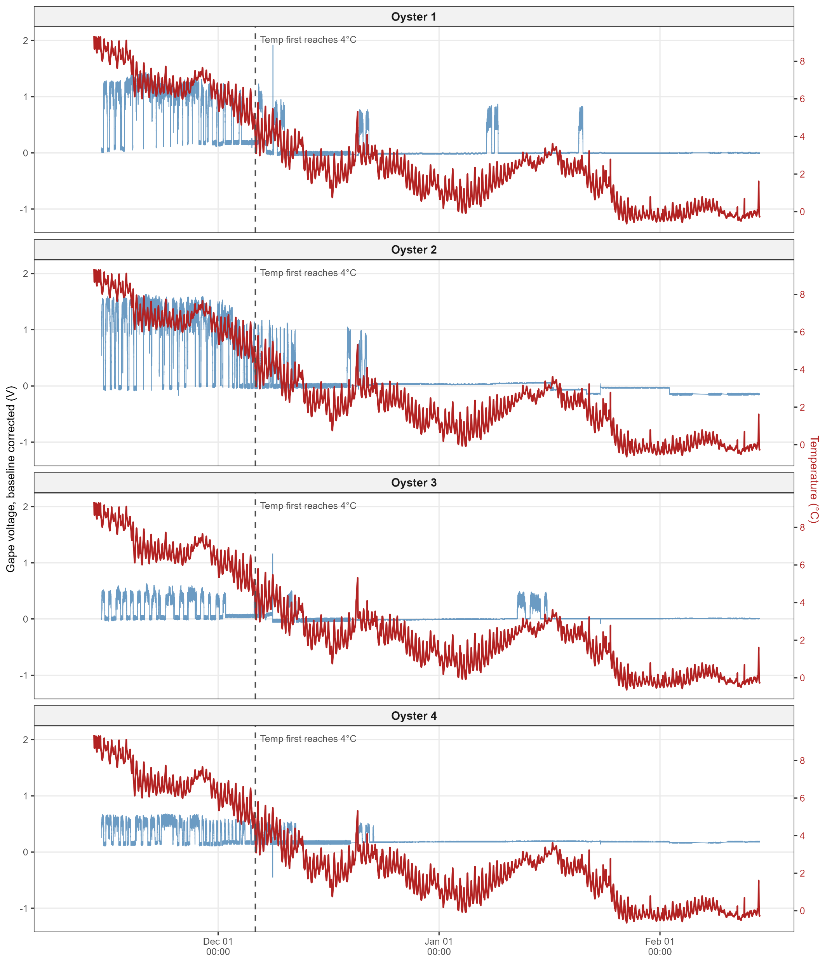

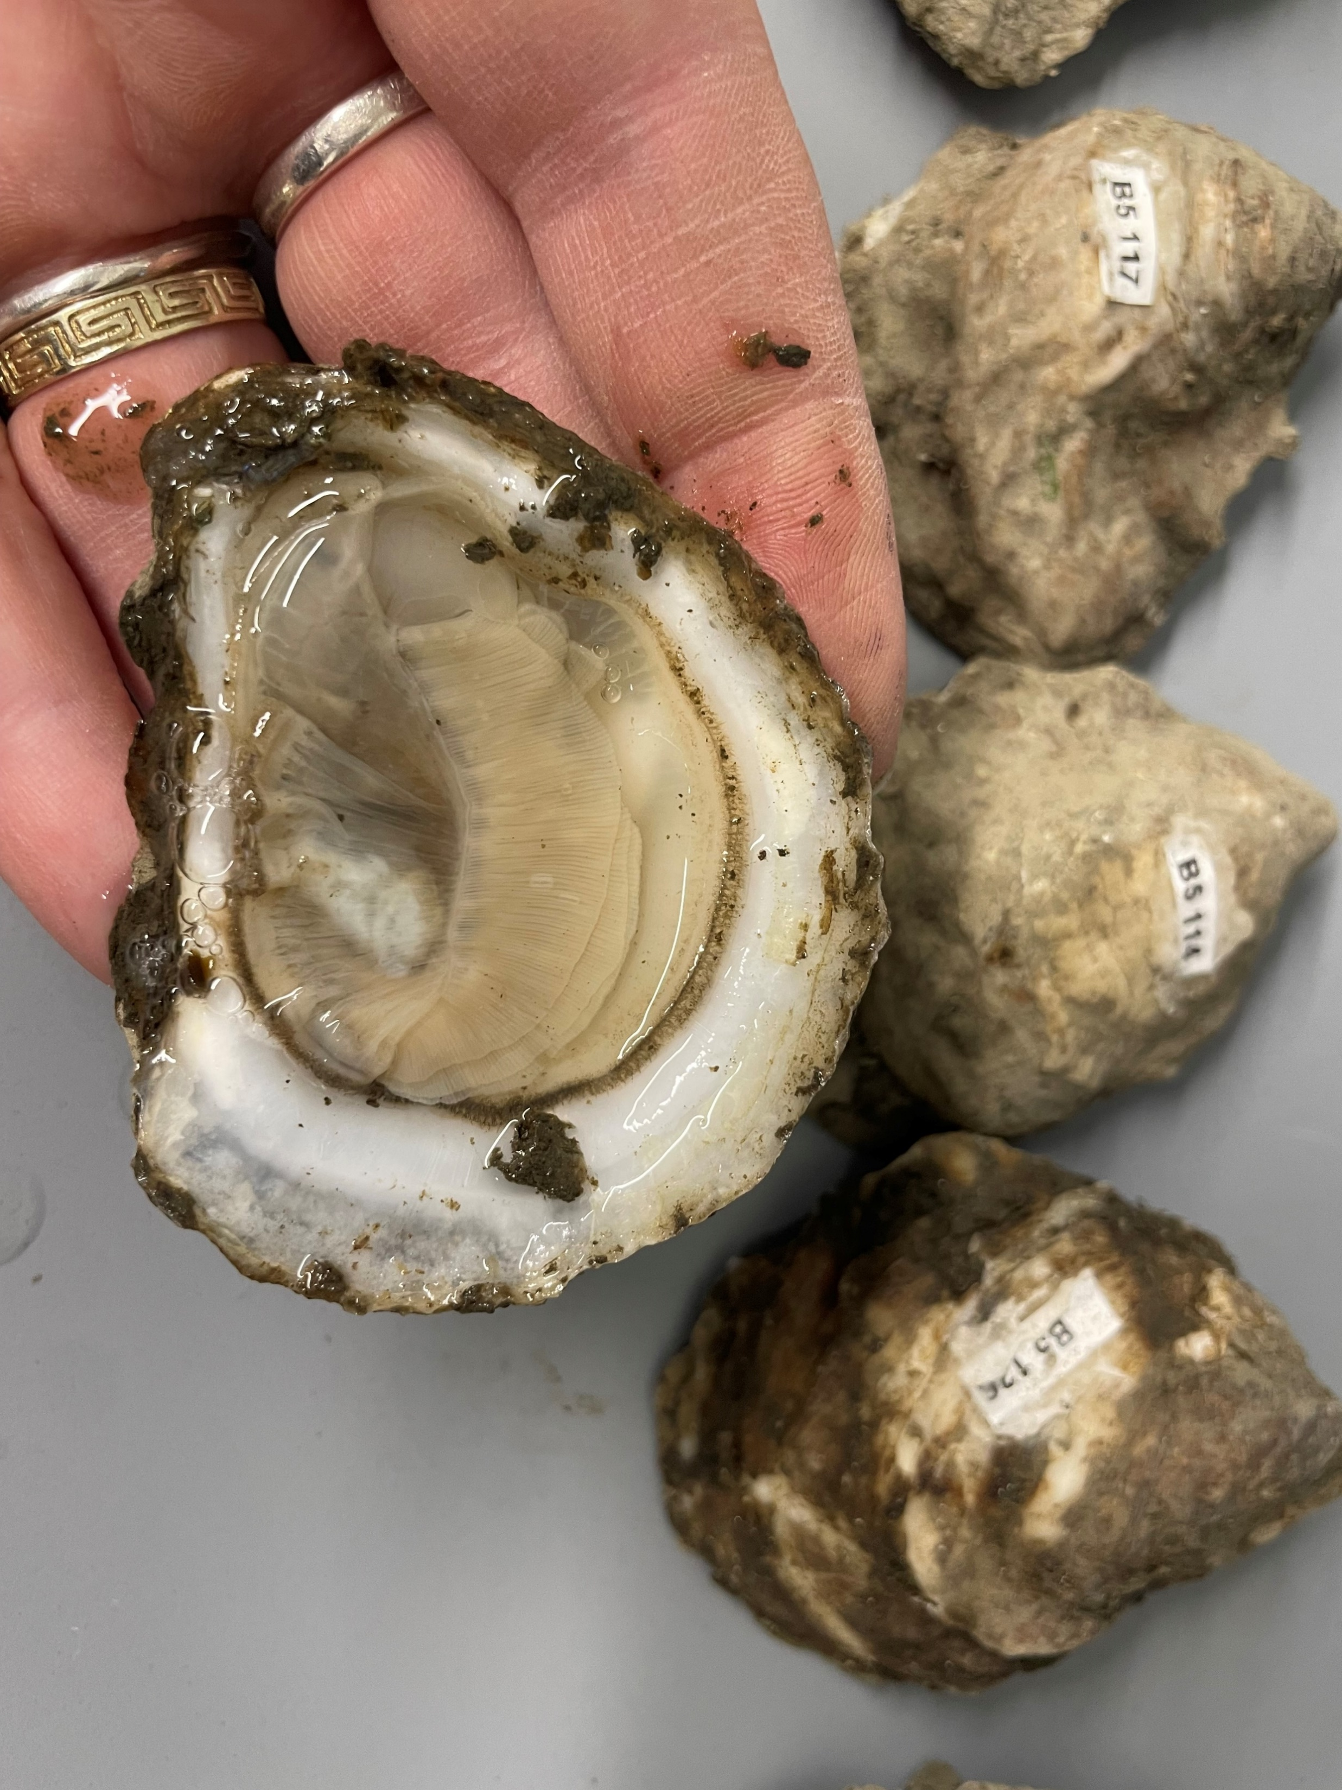
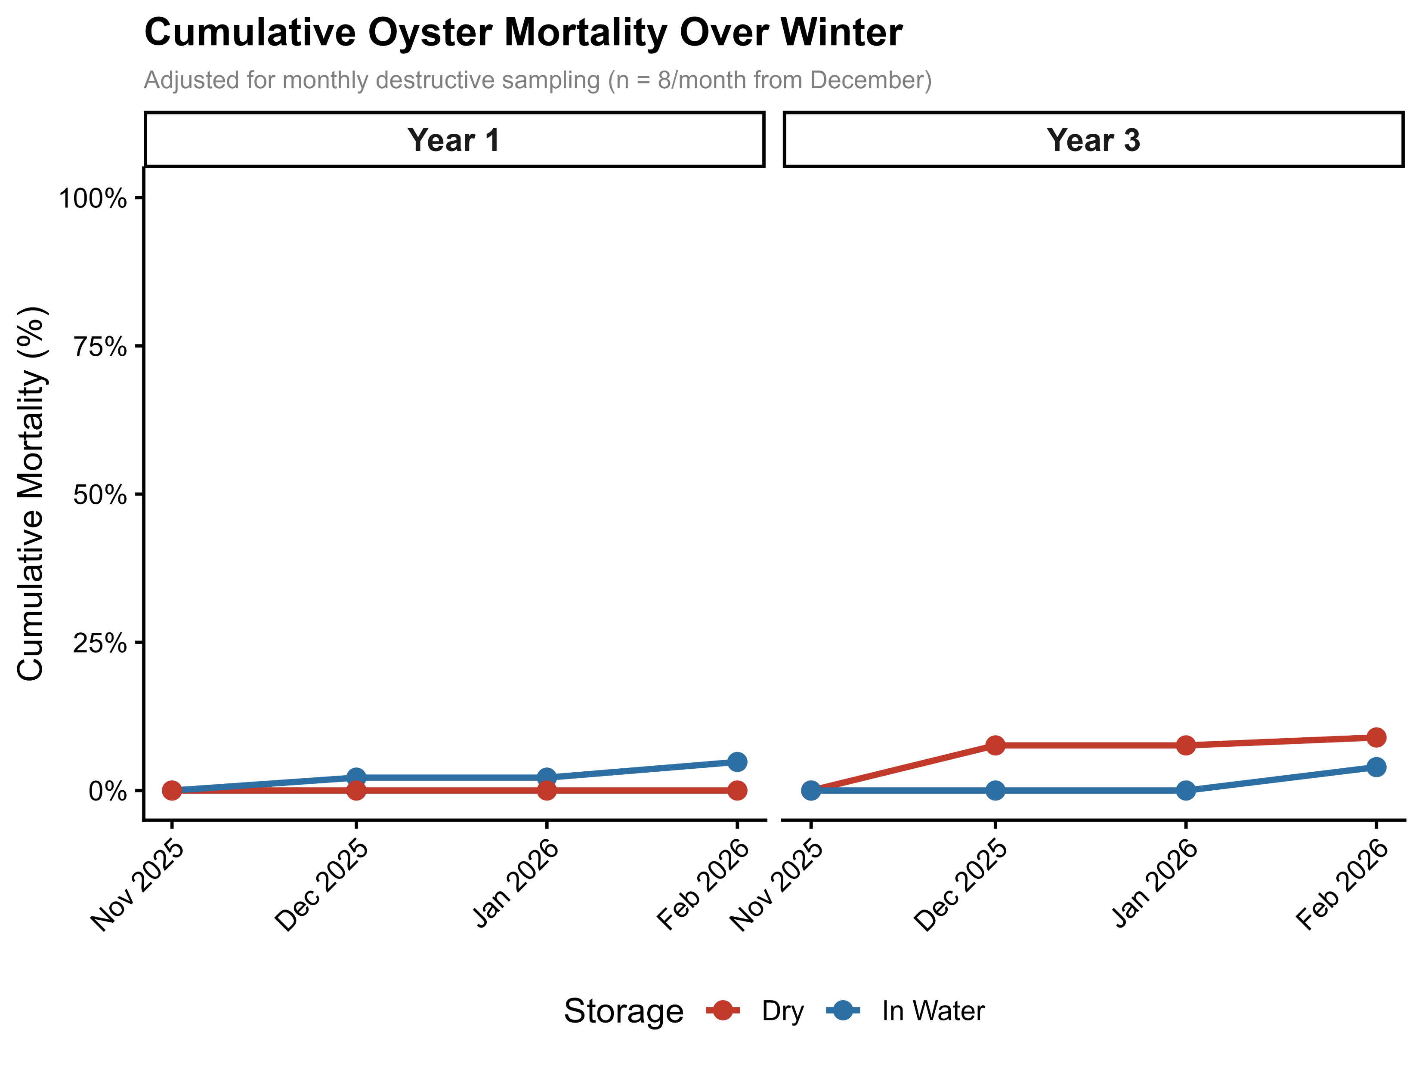
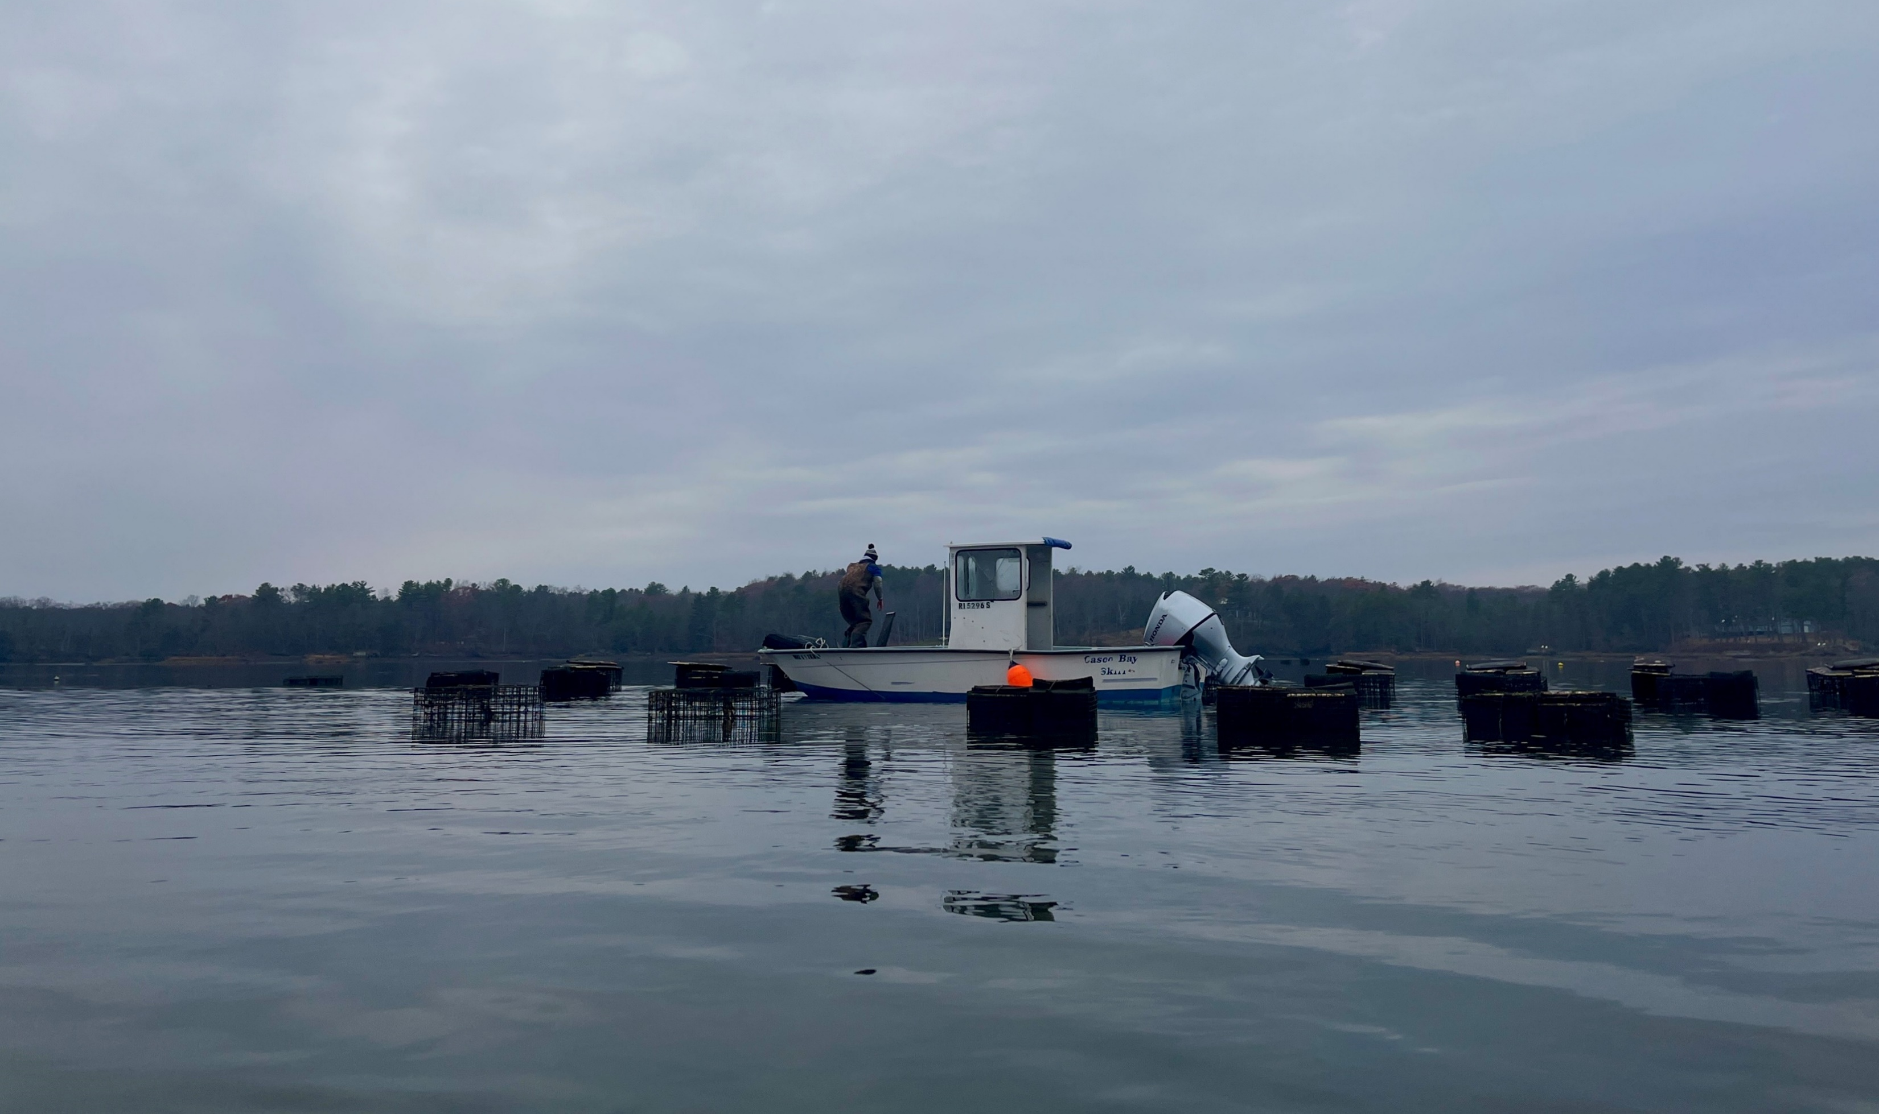

IMPACTS OF FARMING PRACTICES ON ENERGETIC PHYSIOLOGY AND SURVIVAL OF EASTERN OYSTERS OVER WINTER
.
.
Maggie M Dillon , Linas Kenter, Kaila Frazer, Selina Cheng, Brittany M Jellison
.
^{Contact: Maggie.Dillon@unh.edu}
Research Questions
How do farming practices impact eastern oyster (Crassostrea virginica) over-wintering success?
How do oysters use energy stores over winter?
Methods
Gaping Prelim
Sampling
  Oysters collected from two farms in Great Bay, NH
        1st & 3rd year age classes
        Low and high stocking densities
  Held in dry storage or flow-through system (Nov ‘25 – Apr ‘26)
        Weekly mortality checks
        Monthly growth measurements
  Monthly tissues samples for energetic assays
Gaping Monitoring
Gaping sensors proxy
for feeding activity
Sensors can help pinpoint
start of dormancy phase
Abnormal gaping patterns
can indicate stress
Closed
Background
Eastern oysters
  Provide ecosystem services
  Lucrative aquaculture
    Farming practices vary
Overwintering
Cold water → ~3–4 years to market size
  Oysters dormant ~ 4°C
    Stop filter feeding: use energy stores
Farmers in New Hampshire report high mortality
over winter
Gaping/Opening
Consistent gaping ceased within days of 4°C water temp
Will combine gaping data and energy assays to better understand how farming practices influence energy stores over winter
Energetic Assays (In Progress)
Sampling gill and body tissues
Will run assays
    1. Glycogen- short term energy store
    2. Total Lipids- longer-term energy reserve
    3. Protein- last use energy store, loss can indicate severe stress
Assays will help quantify how metabolic needs change over winter across storage treatments and age classes
Mortality Prelim
Acknowledgments
Oyster cages being prepped for winter.
Photo credit Kai Frazer
Thank you to the shellfish farmers at Virgin Oyster and Hidden Coast Farm for their time, guidance, and oysters. Thank you to the volunteers who helped in lab including Adriane Villalon and Ella Mack. Funding for this project is provided by NHAES Hatch Grant, NH00756
Mortality is low in the lab -> investigate farming methods as potential stressors.
Author Website and Detailed Methods

