Slide 1


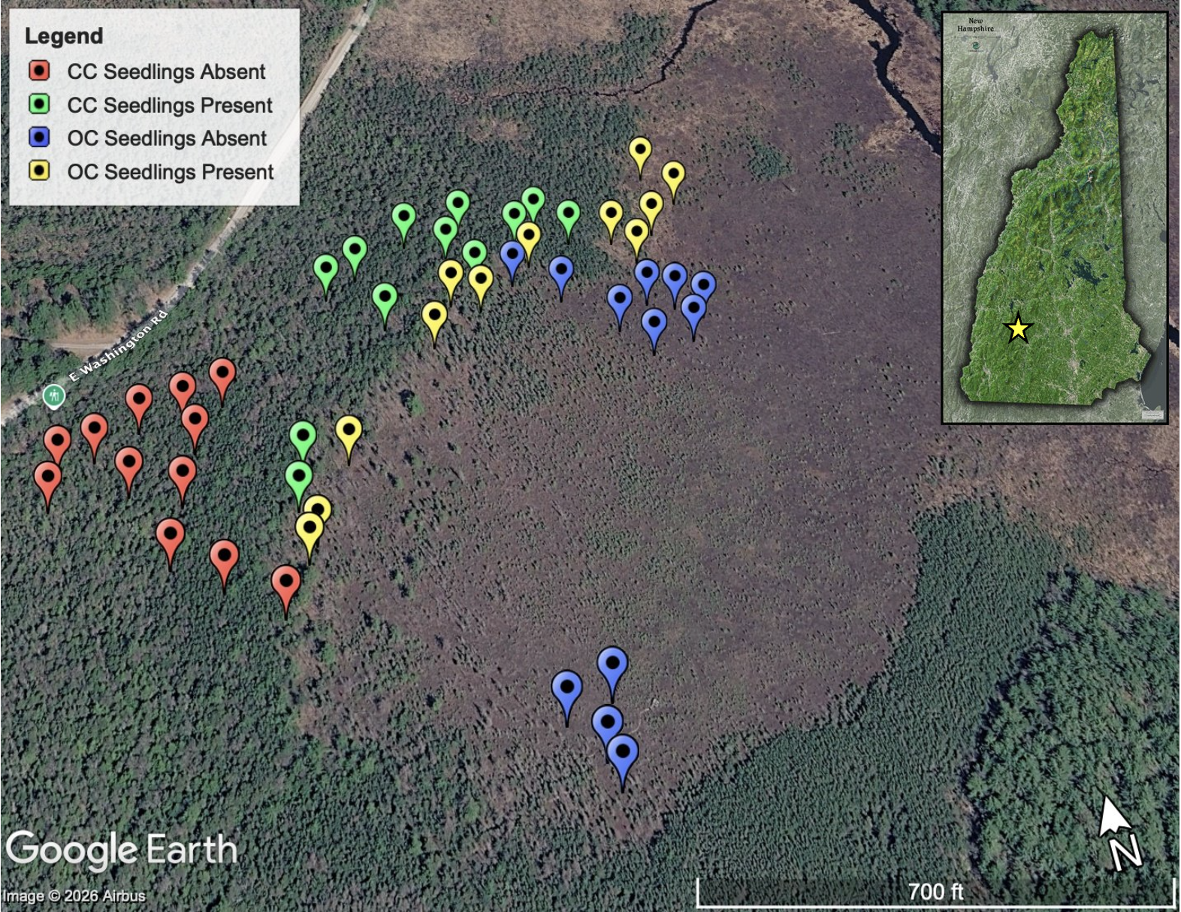
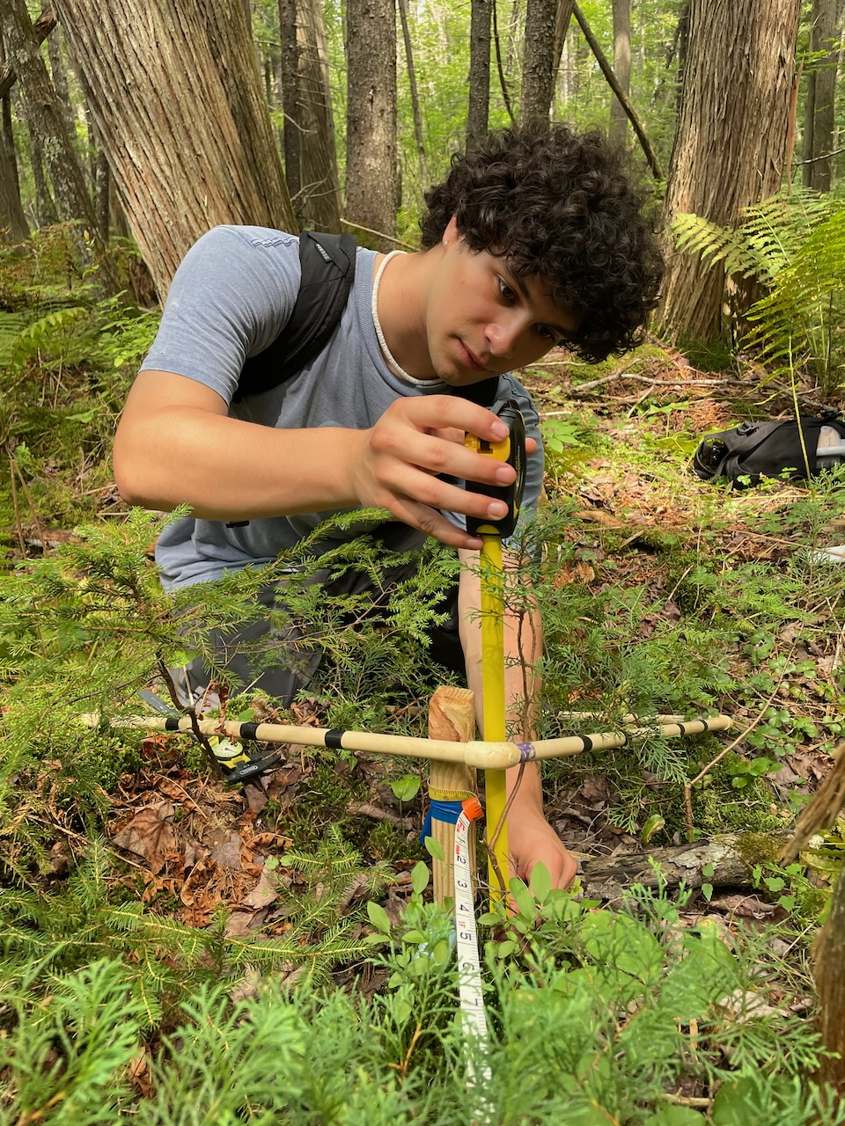
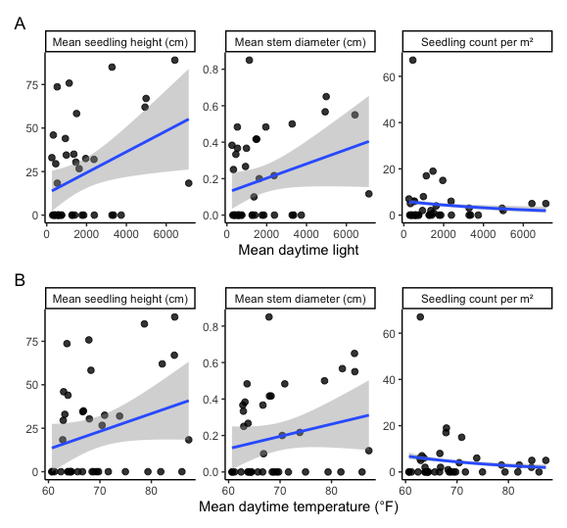
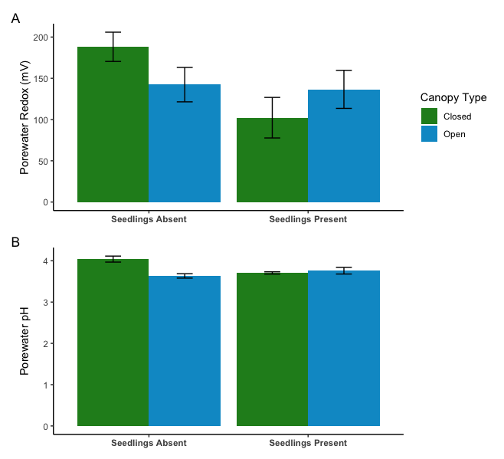
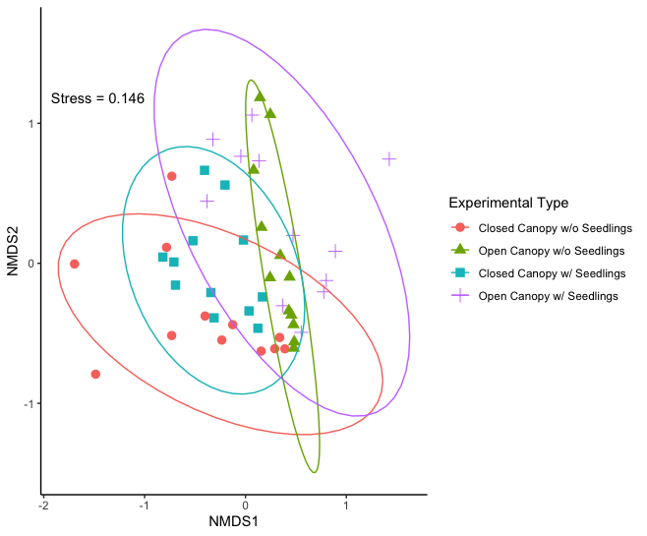
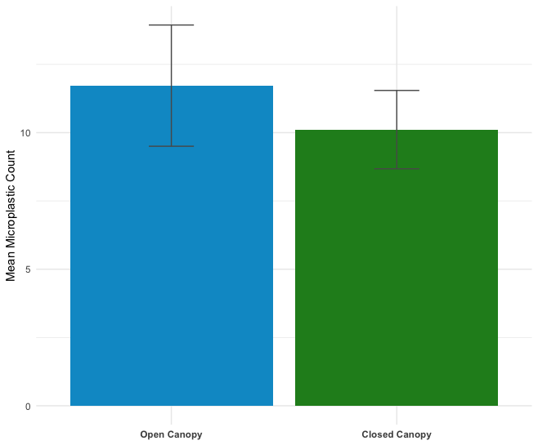
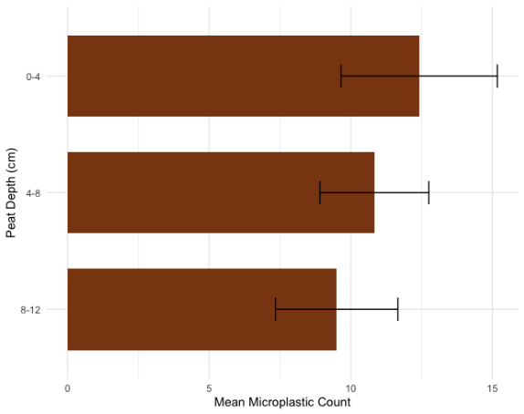
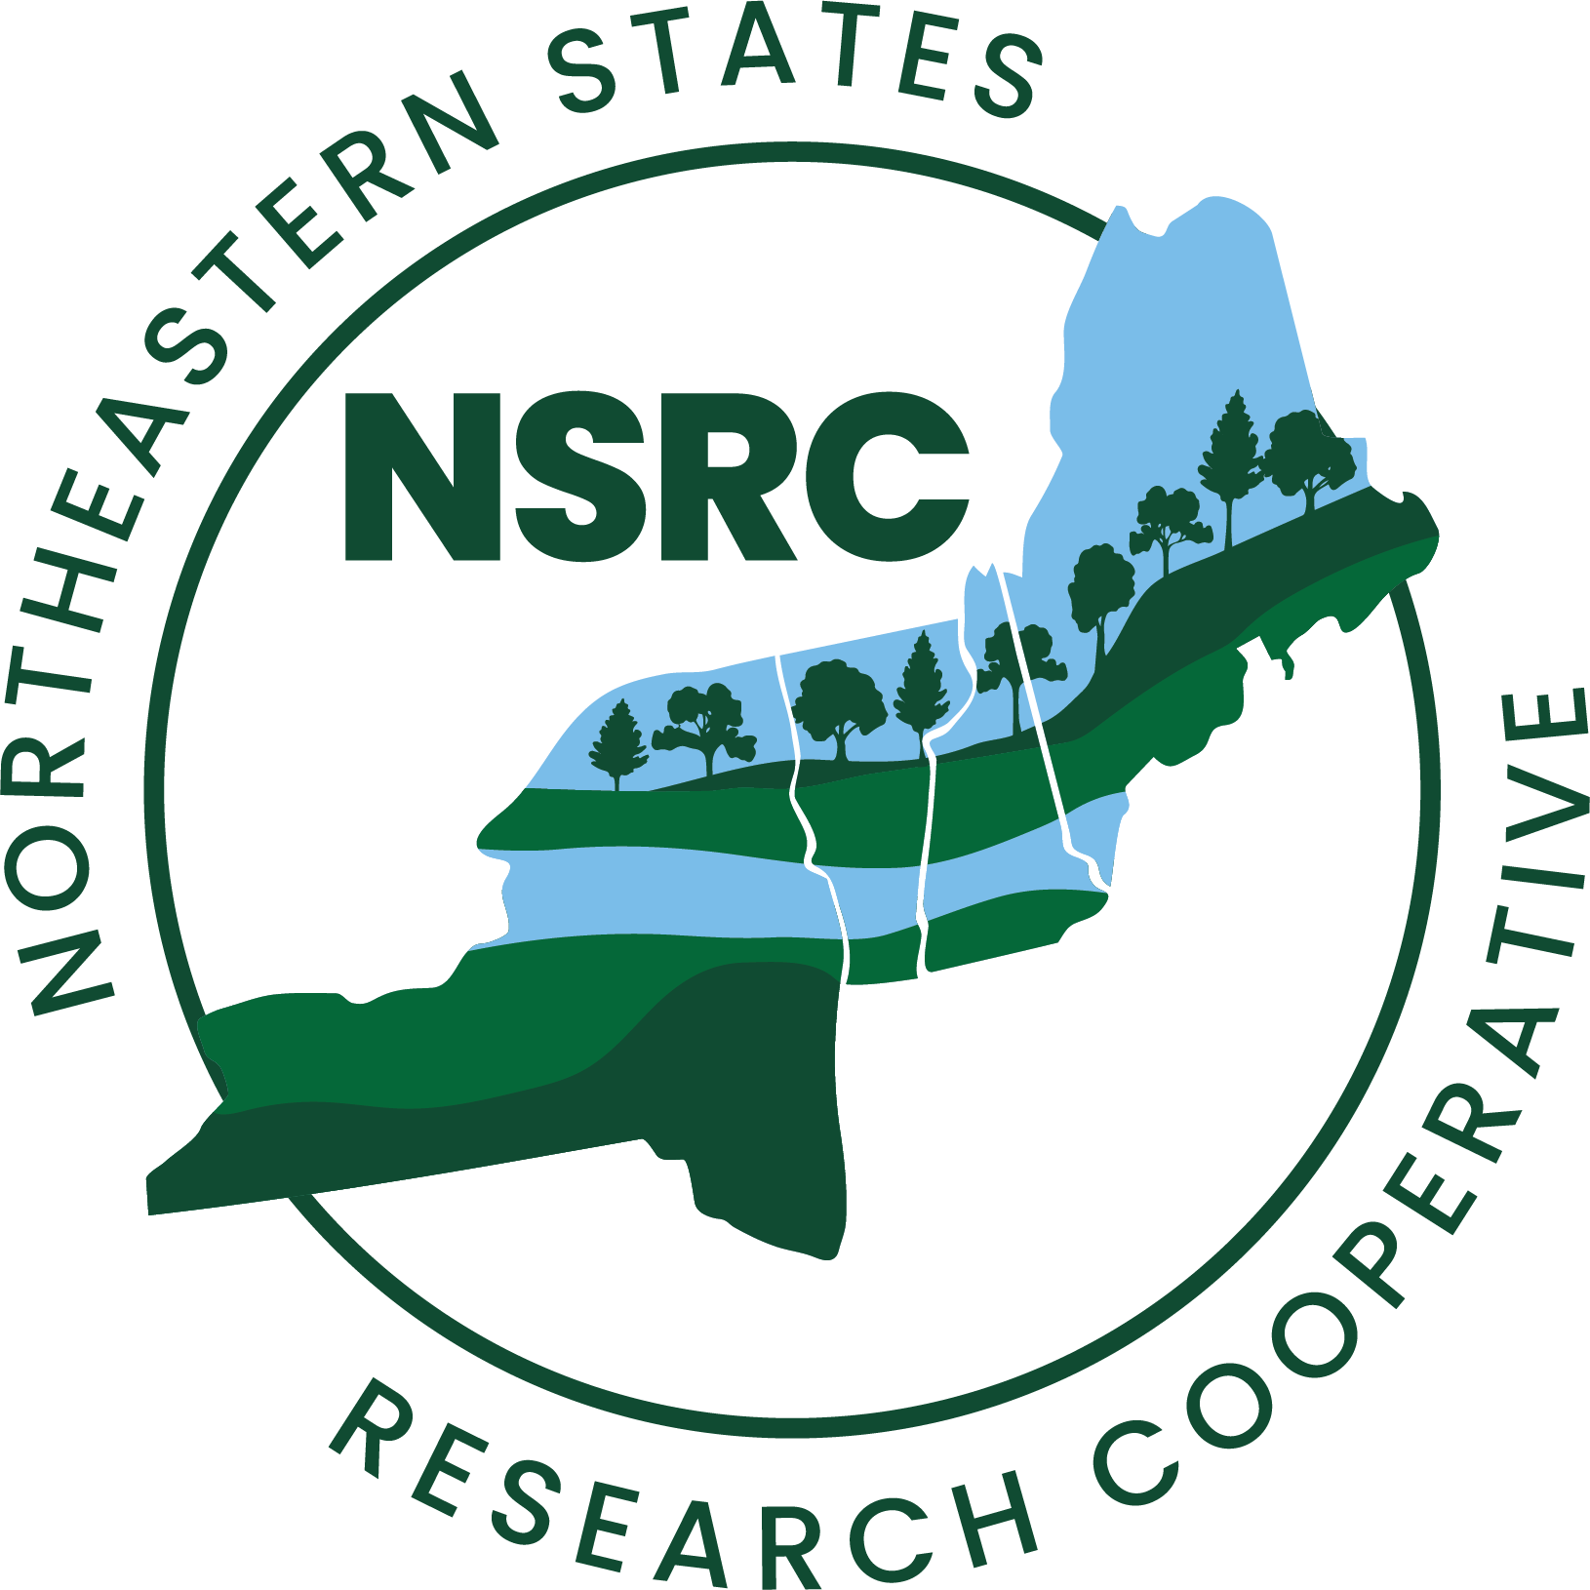

Investigating the Regeneration of Atlantic White Cedar
(Chamaecyparis thyoides) in an Inland New Hampshire Bog
Reece Ciampitti¹, Gregg Moore¹, Heidi Asbjornsen², Ashley Bulseco¹
¹Department of Biological Sciences, University of New Hampshire, Durham, NH 03824
²Department of Natural Resources and the Environment , University of New Hampshire, Durham, NH 03824
UNH Coastal Restoration and Resiliency Lab
Introduction
Methods
Atlantic white cedar (Chamecyparis thyoides) is an obligate wetland species that is restricted along the Atlantic coastal plane, their monodominant stands creating the foundation of the “cedar swamp” ecosystem². Atlantic white cedar and the forested wetland it creates provide several ecosystem services, namely carbon sequestration, water filtration, recreation, and habitat provision⁴. Atlantic white cedar’s (AWC) range has significantly declined over the past 300 years through timber overharvesting and development, and extant inland cedar swamps only occupy ~20% of their historic range^{3,5}. Conservation of remaining AWC stands is therefore critical, a key component of which is the successful recruitment and growth of seedlings. This study investigated environmental factors (microclimate, porewater chemistry, and vegetation community composition) and their potential influence on AWC seedling establishment and success at the species’ northwestern range limit in the Bradford Bog (Bradford, NH). This study also sampled peat deposits in Bradford Bog for presence and patterns of microplastic accumulation. Microplastics (plastic particles <5mm in diameter) are a large component of aquatic plastic pollution, and their presence has not yet been studied in a cedar swamp ecosystem.
Regeneration Field Sampling
Microplastic Processing
In summer 2024, established 48 circular plots in the Bradford Bog, evenly split between sites with and without AWC seedlings (n = 24 each).
Measured canopy density with a spherical densiometer and visually estimated vegetation percent cover.
Pore water extracted to measure redox potential and pH.
Recorded light and temperature throughout the growing season using HOBO loggers.
Measured AWC seedling height and stem diameter in three random quadrats per plot; quantified abundance as seedling count within a 1 m radius.
Peat cores were collected to 20 cm depth and subsampled to a maximum depth of 12 cm, representing ~65 years of accretion¹.
Cores further divided into three equal 4 cm segments, dried at 60°C, homogenized and sieved.
30% Hydrogen Peroxide added to the dried samples to digest for 48 hours.
Samples underwent two rounds of density separation with a ZnCl solution and decanting of floating solids onto a 5 µm PTFE filter.
Microplastics were visually quantified and categorized using a dissecting microscope and microplastic ID guide.
Fig. 1. Map of sample sites in Bradford Bog, comparing closed (CC) and open canopies (OC) and presence of AWC seedings.
Fig. 2. Measuring AWC seedling height and stem diameter within randomly thrown quadrat
Seedling Success Results
Microplastics Results
Fig. 3. Mean daytime light across seedling success metrics (height, diameter, count) (A) and mean daytime temperature across seedling success metrics (B). Linear model used for height and diameter comparisons and Poisson GLM for seedling count comparisons. Only significant relationship was between height and mean light (p = 0.023)
Fig. 4. Mean porewater redox potential (A) and pH (B) between open and closed canopy sites with and without seedlings. A GLM revealed that neither porewater redox (p = 0.11) nor pH (p = 0.46)were significant predictors of seedling presence.
Fig. 5. Vegetation species community NMDS (Bray-Curtis distance) in relation to each plot type. A pairwise MRPP revealed no significant difference in vegetation community between sites with AWC seedlings vs without seedlings under open (p = 0.09) and closed canopy (p = 0.1) conditions.​
Fig. 6. Mean microplastic count by canopy type, microplastics were present in peat samples from every site. A two-sample t-test indicated no significant difference in mean microplastic abundance between closed and open canopy treatments (p = 0.55)
Fig. 7. Mean microplastic count by each of the three peat depth intervals (0-4 cm, 4-8 cm, 8-12 cm). A Kruskal-Wallis test revealed no significant differences in mean microplastic count between peat depth intervals (p = 0.63).
Conclusions
References
Acknowledgements
Light exposure is correlated with AWC seedling vertical growth, though it is not a significant predictor of seedling presence/abundance.
Porewater chemistry has no effect on seedling presence, though data may have been affected by drought.
There is no apparent relationship between vegetation community and AWC seedling presence.
Microplastics are present under both open and closed canopy conditions and throughout approximately 65 years of peat accretion, 90% of which were microfibers.
Drexler, J. Z., Fuller, C. C., Orlando, J., Salas, A., Wurster, F. C., & Duberstein, J. A. (2017). Estimation and uncertainty of recent carbon accumulation and vertical accretion in drained and undrained forested peatlands of the southeastern usa. Journal of Geophysical Research: Biogeosciences, 122(10), 2563–2579. https://doi.org/10.1002/2017JG003950
Laderman, A.D. (1989). The ecology of the Atlantic white cedar wetlands: A community profile. U.S. Fish Wildlife Serv. Biol. Rep. 85(7.21).​
Noss, R. F., LaRoe, E. T., Scott, J. M. (1995). Endangered ecosystems of the United States: a preliminary assessment of loss and degradation. Biological report 28. US Department of the Interior, National Biological Services, Washington, DC
Ritson, J. P., Bell, M., Brazier, R. E., Grand-Clement, E., Graham, N. J. D., Freeman, C., Smith, D., Templeton, M. R., & Clark, J. M. (2016). Managing peatland vegetation for drinking water treatment. Scientific Reports, 6(1), 36751. https://doi.org/10.1038/srep36751
Ward, D. B. (1989). Commercial utilization of Atlantic white cedar (Chamaecyparis thyoides, Cupressaceae). Economic Botany, 43(3), 386–415. https://doi.org/10.1007/BF02858736
This work was funded in part by the NSRC Indigenous Knowledge Fund. I’d also like to thank Jenny Gibson, Seikh Sadi Tanvir, and Alex Sangermano of the Coastal Restoration and Resiliency Lab and Gage Blevins from the Brooks School for their help in the field, and Gabrielle Jarrett, Lila Wilkins, Alex Marshall, and Clara Franzoni of the Coastal Restoration and Resiliency Lab for their help with microplastic processing and data collection.

