Slide 1


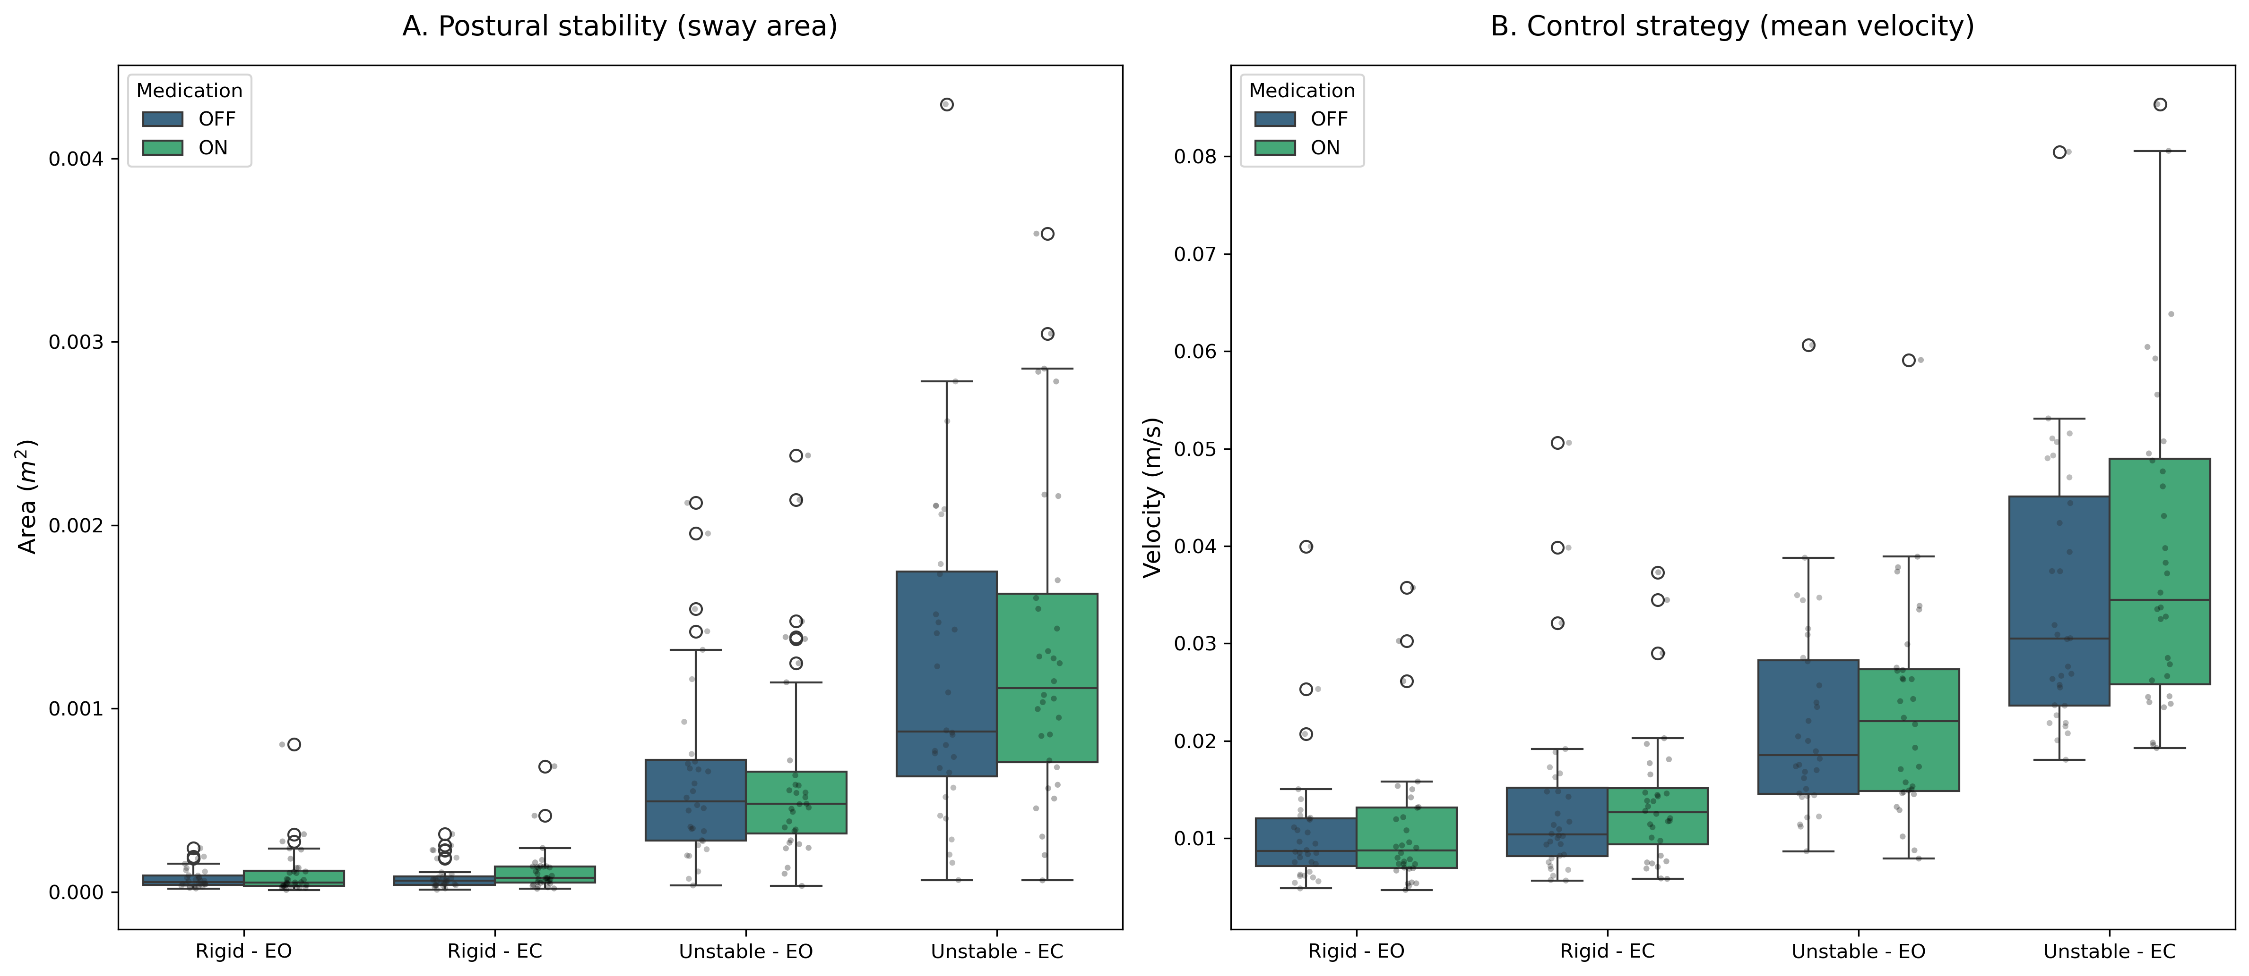
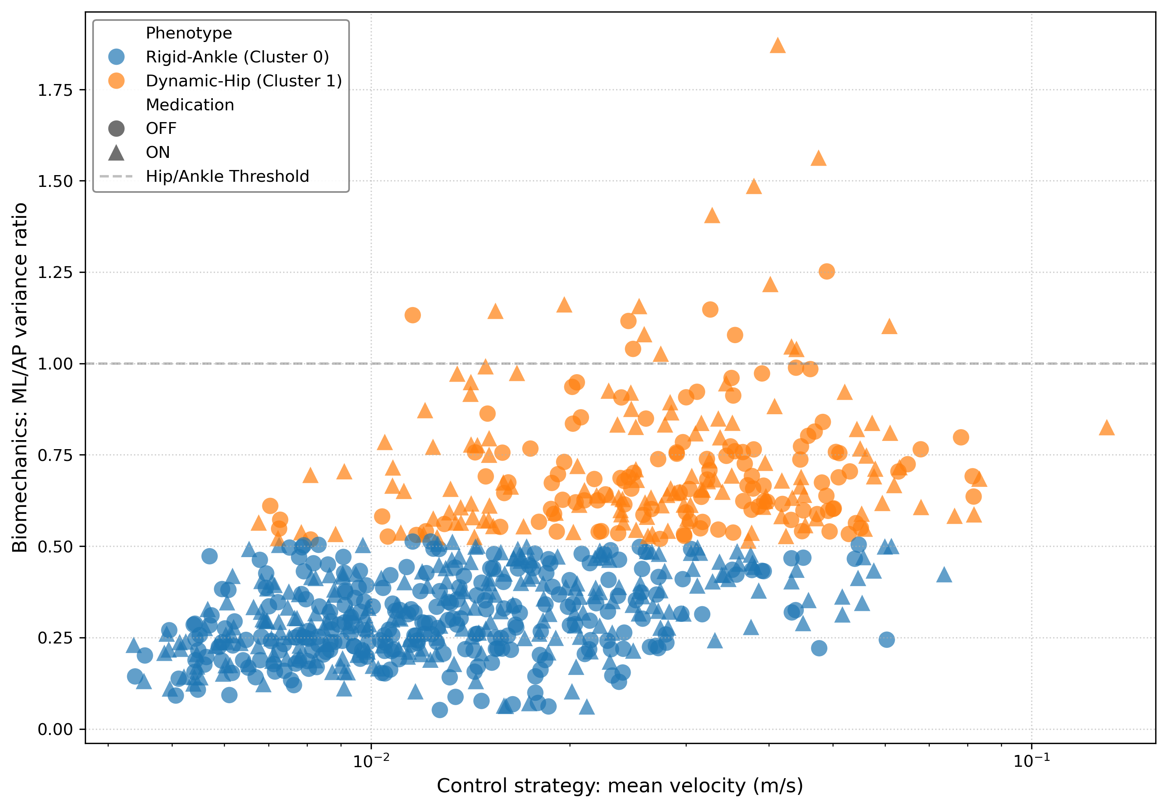
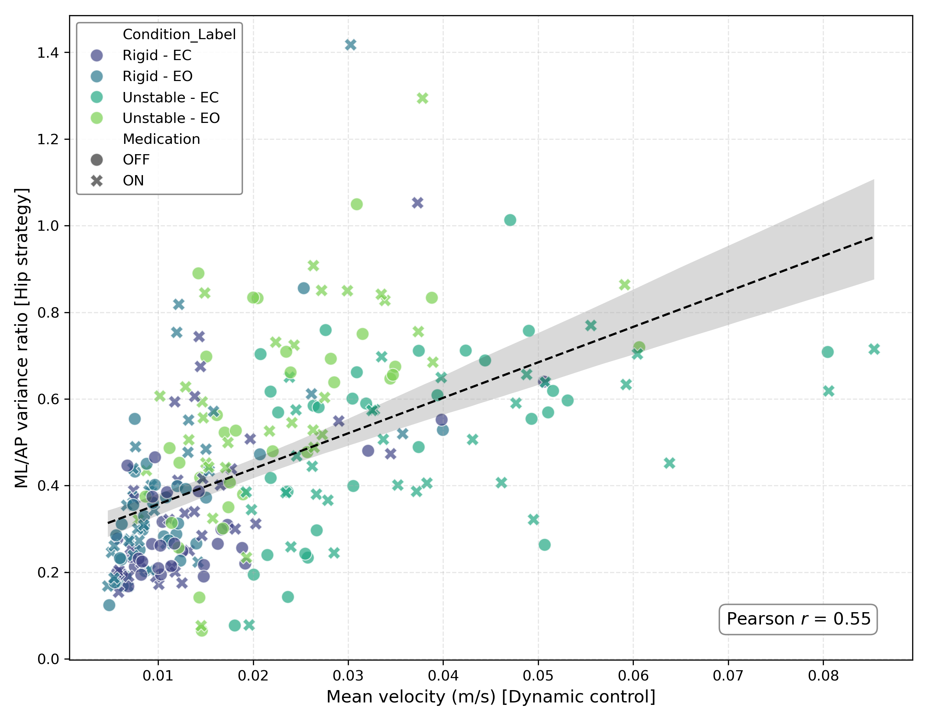
How Does Levodopa Affect Balance in Parkinson’s disease?
Insight from Machine Learning Analysis
Soomin Kwon, BS, Sanghee Moon, PhD
Department of Kinesiology, University of New Hampshire, Durham, NH 03824
Introduction
Results
Discussion
Dopa-resistant paradox
  Although Levodopa is the gold-standard treatment for Parkinson’s disease, its effect on axial symptoms is limited; patients on Levodopa often move faster but remain prone to falls.
Two possible explanations of paradox
  Sway area (traditional metric) reflect performance outcome, whereas sway velocity reflects neural control strategy (rigid vs. dynamic control)
  Parkinson’s disease is highly heterogeneous, and group-average statistics may mask responder and non-responder subgroups; machine learning can identify these phenotypes.
This study investigated whether Levodopa alters sway area or sway velocity and used machine learning to identify responder and non-responder phenotypes.
Levodopa Increases Sway Velocity but Not Sway Area
Levodopa didn’t reduce sway area but increased sway velocity, indicating that medication changes neural control strategy rather than stabilizing posture.
Increased sway velocity was associated with a transition from ankle strategy to hip strategy, suggesting restoration of sensory reweighting.
Machine learning identified a 31% non-responder subgroup that remained in a rigid control strategy despite medication
This heterogeneity explains why traditional group statistics often conclude that Levodopa has limited effects on postural instability.
Repeated measures ANOVA
Bonferroni correction (sway velocity)
 |  | Sway area (static stability) |  |  | Sway velocity (control strategy)
Effect | Source of variation | df | F-value | p-value | df | F-value | p-value
Main Effect | Medication (ON vs OFF) | 1, 31 | 1.27 | 0.27 | 1, 31 | 1.68 | 0.21
 | Surface (Rigid vs Unstable) | 1, 31 | 60.80 | < 0.001* | 1, 31 | 109.56 | < 0.001*
 | Vision (Open vs Closed) | 1, 31 | 81.65 | < 0.001* | 1, 31 | 157.09 | < 0.001*
Interaction Effect | Medication x Surface | 1, 31 | 0.27 | 0.61 | 1, 31 | 3.86 | 0.06
 | Medication x Vision | 1, 31 | 0.79 | 0.38 | 1, 31 | 3.32 | 0.08
 | Surface x Vision | 1, 31 | 83.69 | < 0.001* | 1, 31 | 89.26 | < 0.001*
 | Medication x Surface x Vision | 1, 31 | 1.26 | 0.27 | 1, 31 | 5.37 | 0.03*
Condition | Mean difference (m/s) | t-statistics | p-value
Rigid surface - eyes open (RS-EO) | 0.0003 | 0.31 | 1.00
Rigid surface - eyes closed (RS-EC) | 0.0003 | 0.23 | 1.00
Unstable surface - eyes open (US-EO) | 0.0008 | 0.82 | 1.00
Unstable surface - eyes closed (US-EC) | 0.0048 | 2.02 | 0.21
Clinical Implications
Traditional posturography using sway area on rigid surface may underestimate Levodopa effects.
Sway velocity and adaptive response to sensory conflict are more sensitive biomarkers of dopaminergic response.
Non-responders may have non-dopaminergic pathology and may benefit more from rehabilitation and sensory-based interventions rather than increased Levodopa dosage.
Clustering Reveals Distinct Rigid and Dynamic Postural Control Phenotypes
Increased Sway Velocity Is Associated with Transition to Hip Strategy
Methods
Participants information (N=32)
Characteristic | Value
Age | 65.6 ± 10.4 years
Sex | Male 24 Female 8
Hoehn & Yahr stage | 2.3 ± 0.6
Medication states | OFF (12hr withdrawal), ON (1hr after medication)
Conclusion
Levodopa changes how patients control posture, not how much they sway.
Levodopa promotes a rigid → dynamic strategy transition.
31% non-responders remain resistant to medication.
Dynamic sensory conflict testing is more sensitive than static balance tests.
Four experimental conditions
Data characteristics and analysis
References
 | Eye open | Eye closed
Rigid surface | RS-EO | RS-EC
Unstable surface | US-EO | US-EC
Data | Features | Statistics | Machine Learning
COP | Sway area | ANOVA | Random Forest
100Hz | Sway velocity | Correlation | LOSO-CV
3 trials avg | Strategy |  | K-means
 | ML/AP ratio |  | Responder vs Non-responder
Leroy et al. (2022) Effects of oral levodopa on balance in people with idiopathic Parkinson’s disease. Journal of Parkinson’s disease
Mancini et al. (2008) Effects of Parkinson’s disease and levodopa on functional limits of stability. Clinical Biomechanics
Sertic et al. (2025) Ankle proprioception and the relationship to rigidity in Parkinson’s disease. Clinical Neurophysiology

