Slide 1



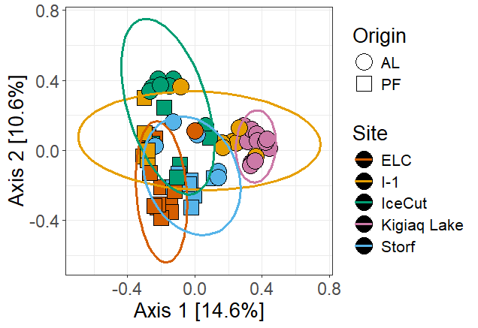
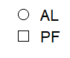
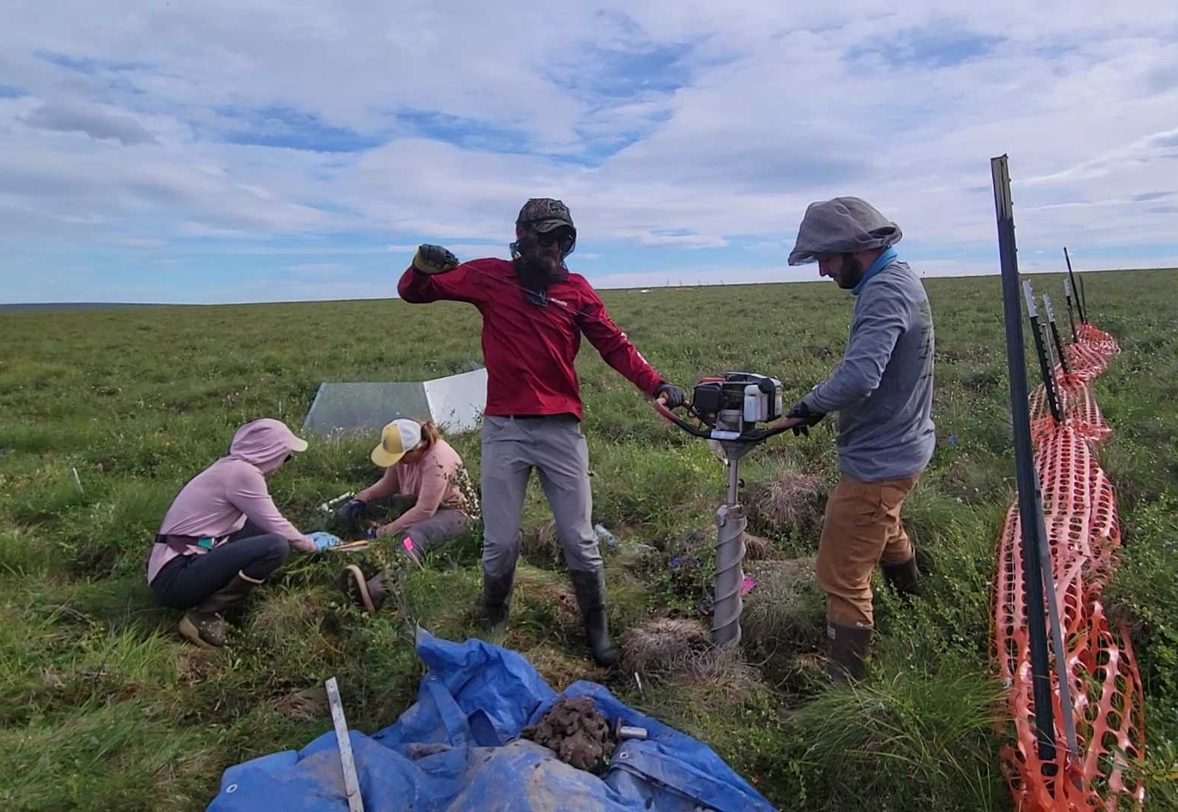
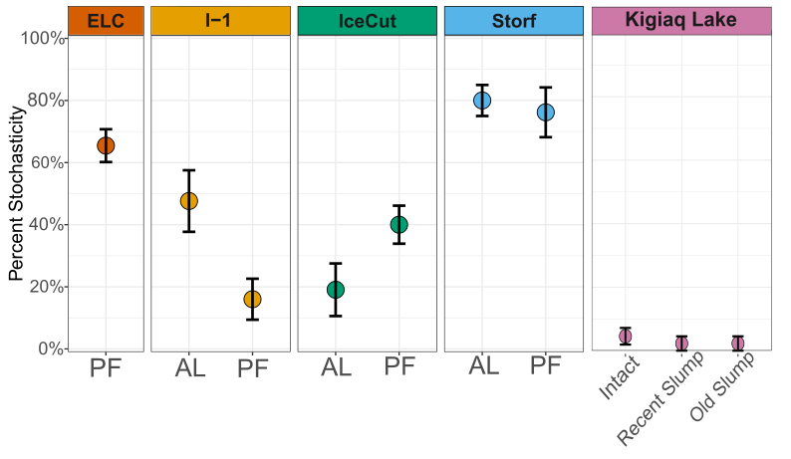
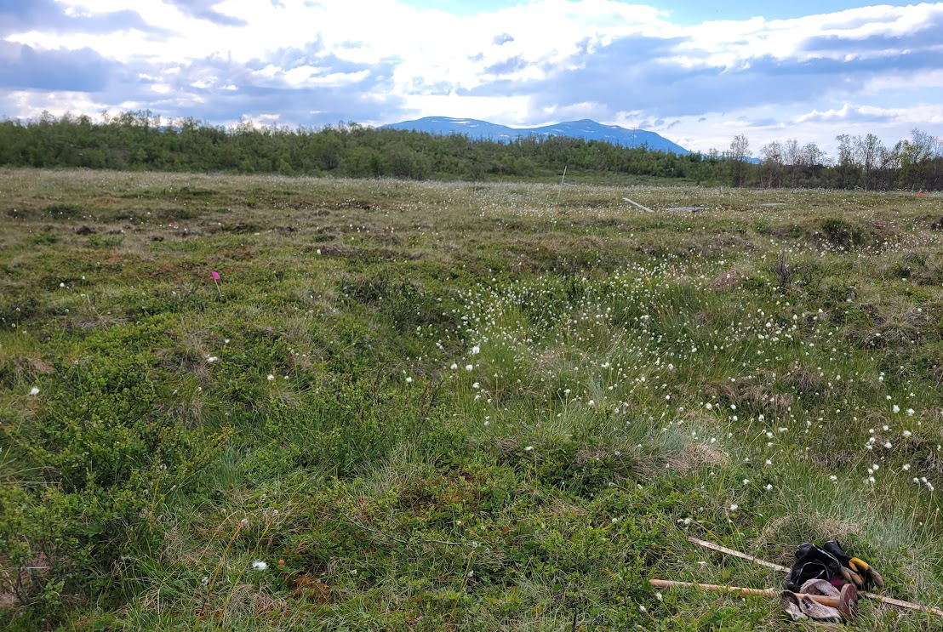
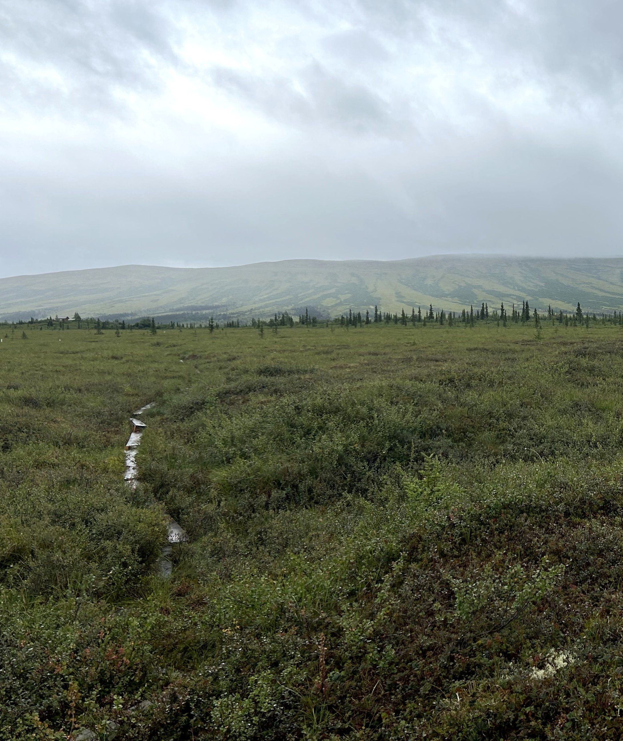
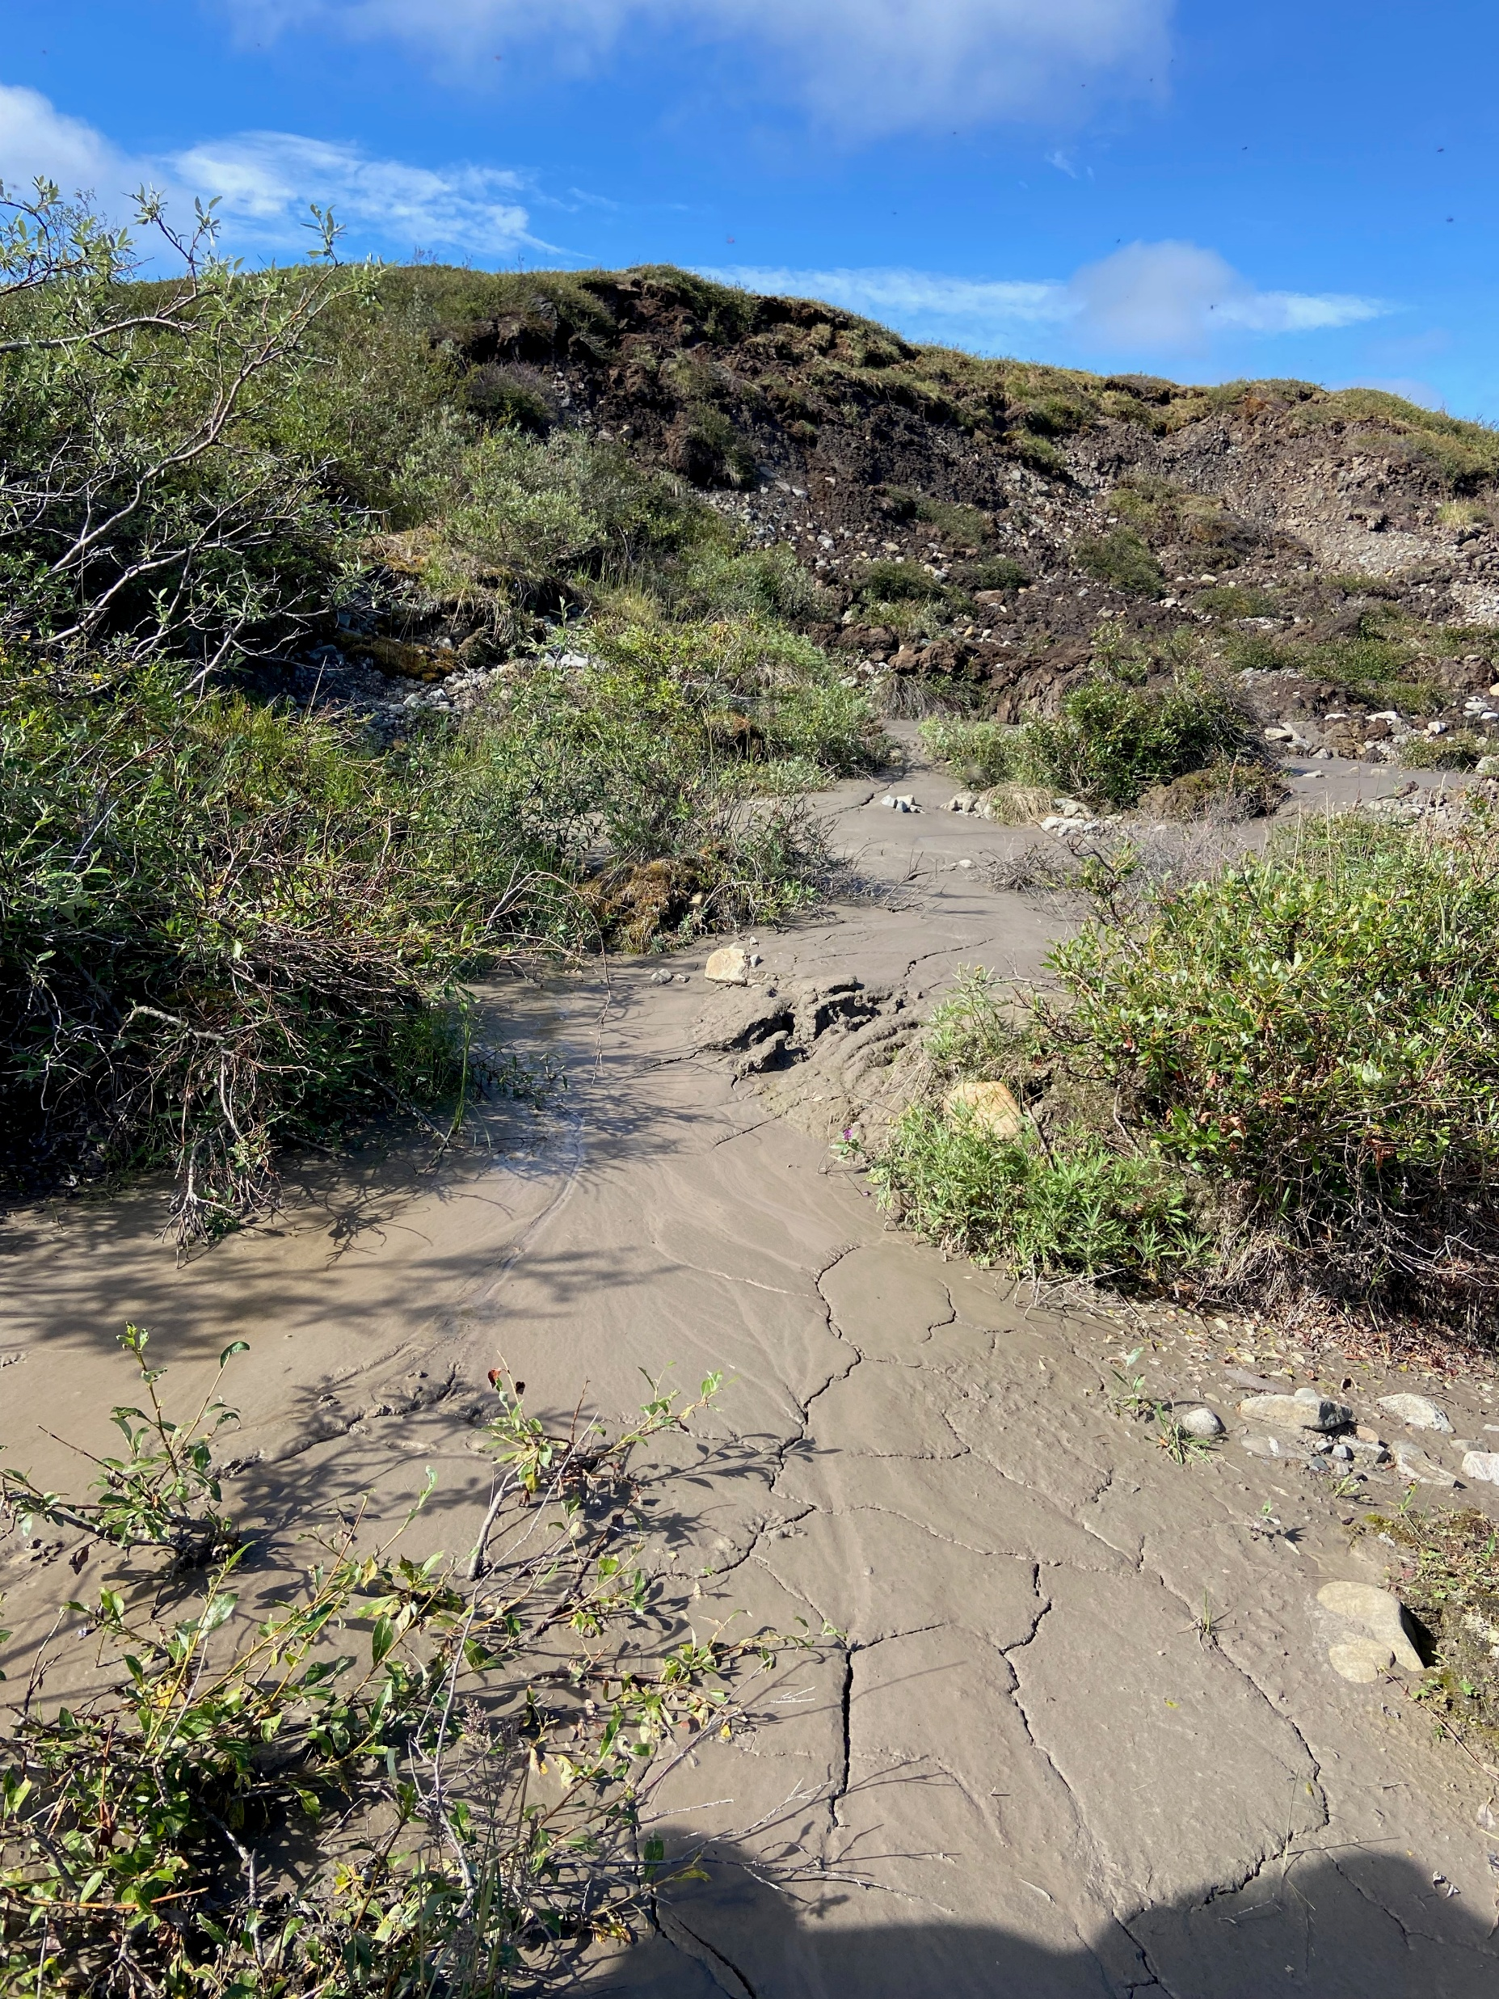
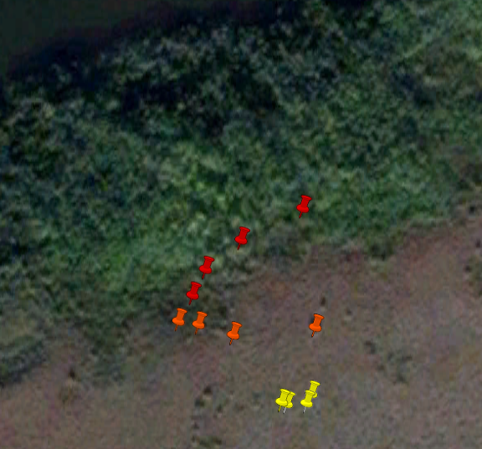
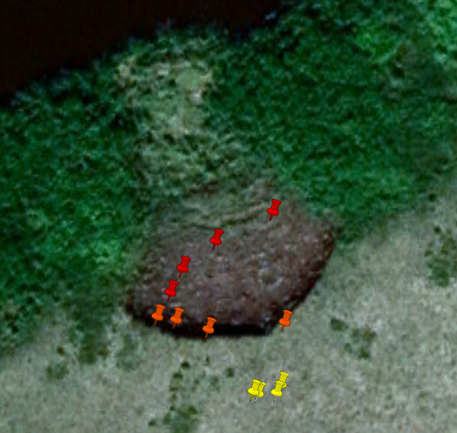
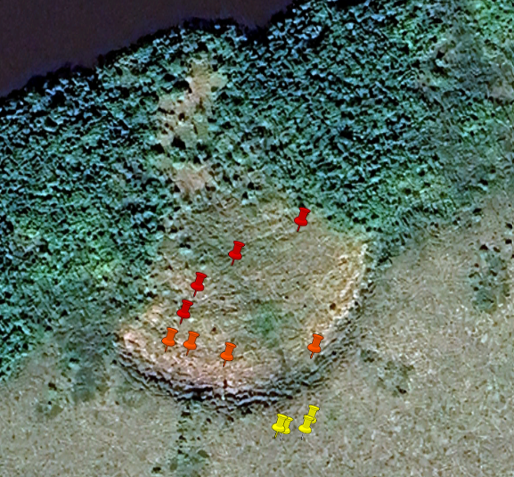
After the Thaw: Microbial Community Assembly in Changing Arctic Landscapes
Samuel P. Bratsman^{1,2}, Jessica Gilman Ernakovich^{1,2}, Margaret Davis^{1,2}, Hannah Holland-Moritz^{1,2}, Nathan Alexander^{1,2}
1. Department of Natural Resources and the Environment, University of New Hampshire, Durham, NH 2. Center for Soil Biogeochemistry and Microbial Ecology
#2144961
Background:
Permafrost thaw due to warming causes land cover shifts and alters nutrient cycling via soil microbial communities.
Modeling the impact of PF thaw on nutrient cycles requires understanding how communities are assembled post-thaw.
Experimental Thaw, Mineral PF
Permafrost is continuous and ice-rich, underlain by ice wedges.
Much lower stochasticity than equivalent snow fences in peat PF area.
Snow Fences established by Ellen Dorrepaal in 2014.
Methods:
We collected active layer (AL) and permafrost (PF) from five Arctic sites.
We extracted and amplified DNA from 60 initial samples (12 per site) and sequenced the 16S rRNA bacterial/archaeal gene.
We performed beta-null modeling to find the contribution of selection and stochasticity as pressures shaping the post-thaw community.
Ice Cut Snow Fences, AK
PCoA of microbial community composition.
Experimental Thaw, Peat PF
ELC
I-1
Ice Cut
Storflaket
Kigiaq Lake
Permafrost is discontinuous and organic, formed during the Little Ice Age (~750 years old).
Natural Thaw, Mineral PF
Unexpectedly high stochasticity in both AL and PF.
Snow Fences established in 2005 by Margareta Johansson.
Continuous PF experiencing varying stages of PF thaw, split into Minimal (early stages) and Extensive (subsidence since 1950s).
We mostly subsampled from PF for this analysis.
Monitoring maintained by Ted Schuur’s lab.
Depression in front of snow fence,
Percentage of community assembly processes that are stochastic, by site and sample type.
AL = Active Layer, PF = Permafrost
Storflaket Snow Fences, SWE
Eightmile Lake Site, AK
Next Steps / Questions:
Data presented here represents initial results from a subset of 60 samples. Further sequencing will help establish trends within and between sampling sites.
Can we find environmental correlates that explain the discrepancy between sites in dominant assembly processes?
Retrogressive Thaw Slump, Mineral PF
Recent Thaw Slump, Mineral PF
Recent thermokarst collapse.
Surprisingly, low stochasticity across every stage.
Expanding thermokarst lake in continuous, mineral permafrost zone.
Surprisingly low stochasticity in permafrost samples.
2007
2017
2023
This research takes place on the ancestral homelands of the Inupiaq (N. Alaska) and Sámi (N. Sweden) people. We acknowledge the hardships they continue to endure after the loss of unceded homelands and commit to fostering relationships and opportunities that strengthen the well-being of the Indigenous People who carry forward the traditions of their ancestors.
I-1 Thaw Slump, AK
Source: Google Earth.
Kigiaq Lake Slump, CAN

