Slide 1

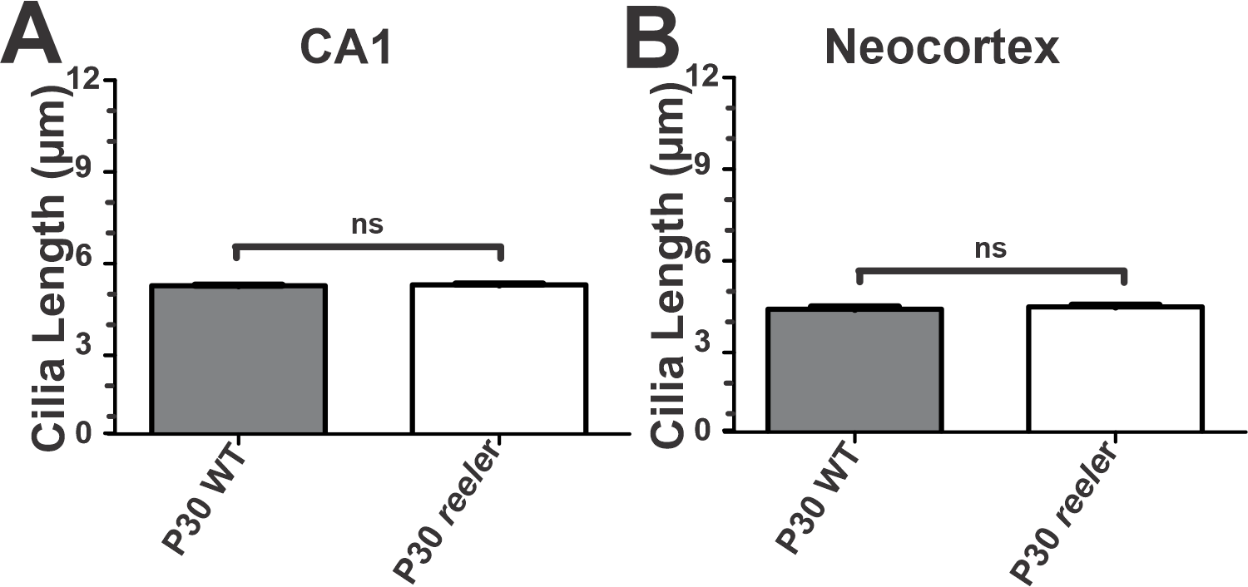
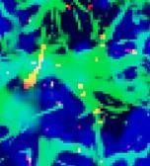
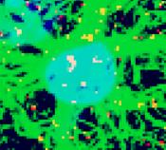
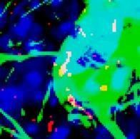
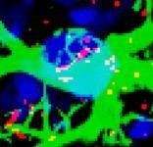
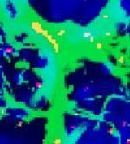
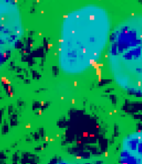
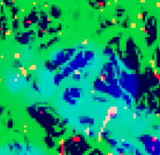
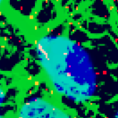
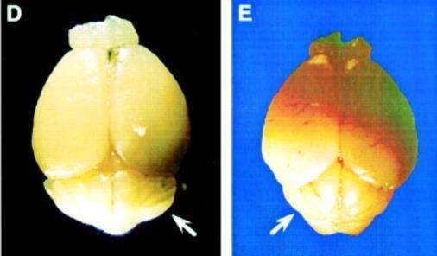
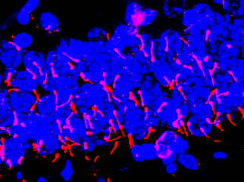
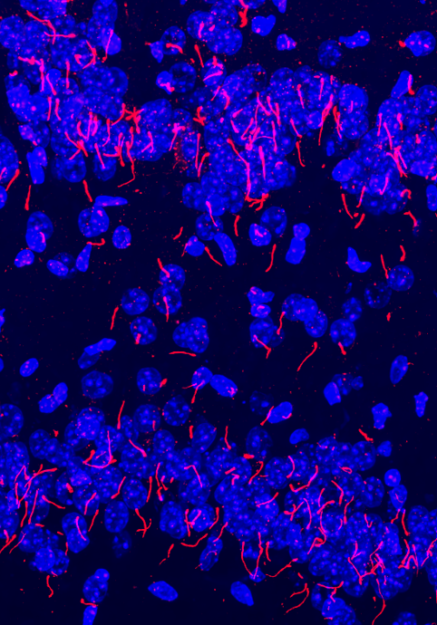
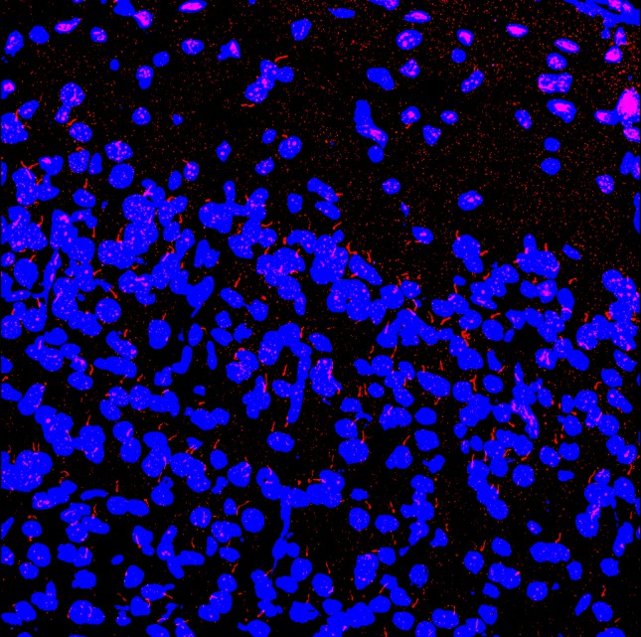
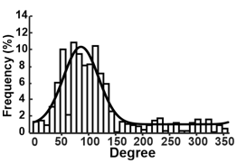
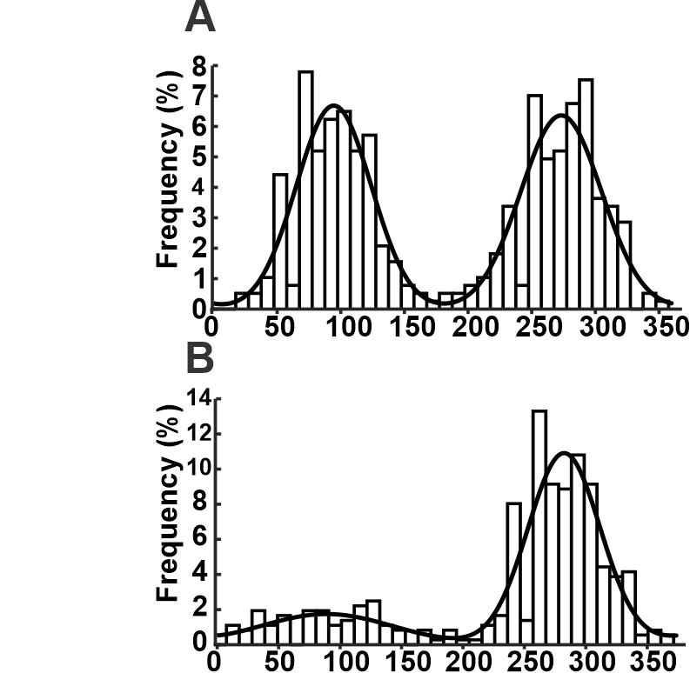

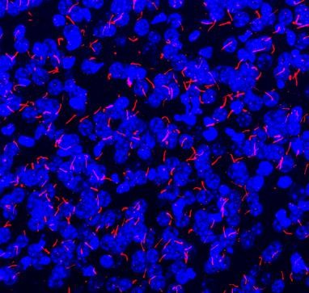
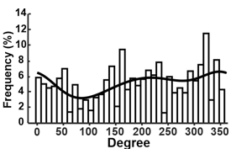
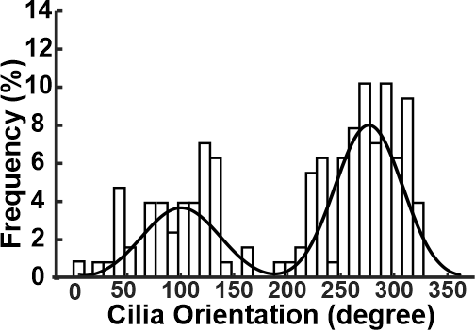
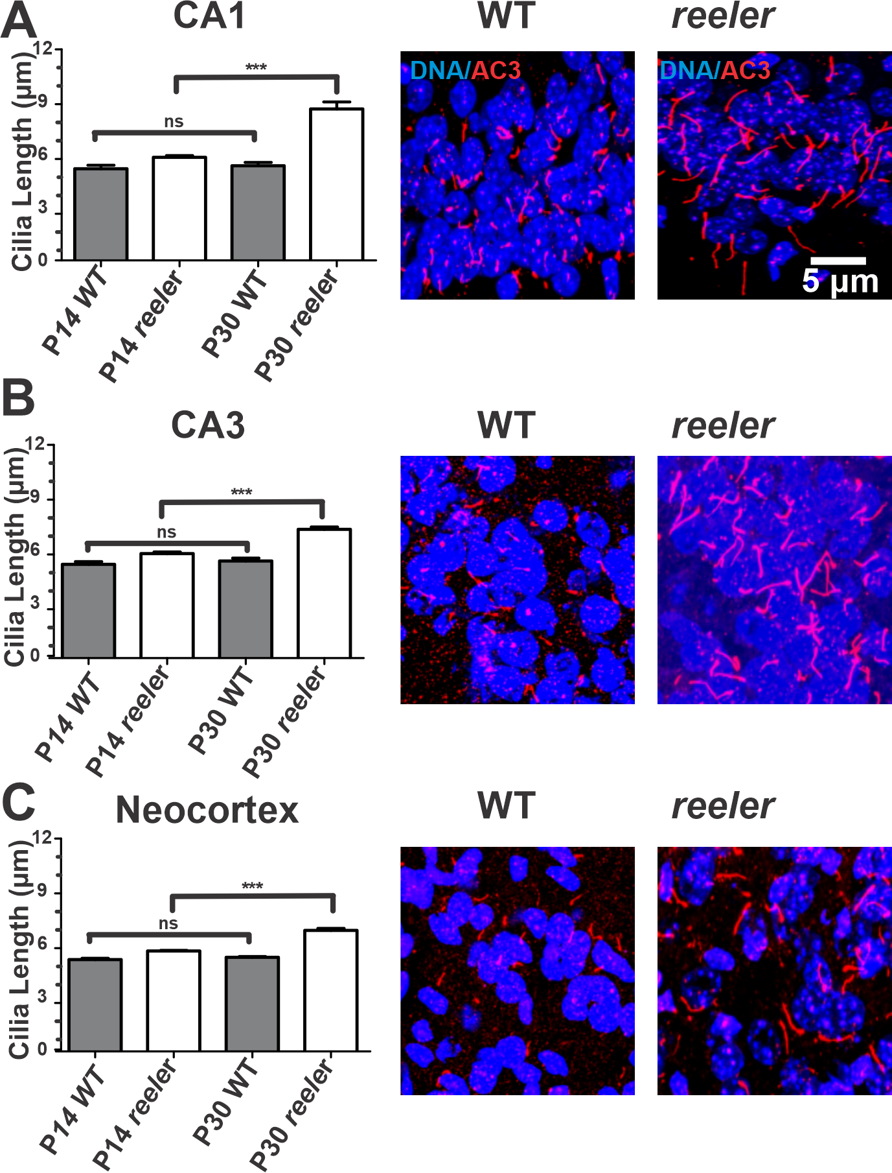
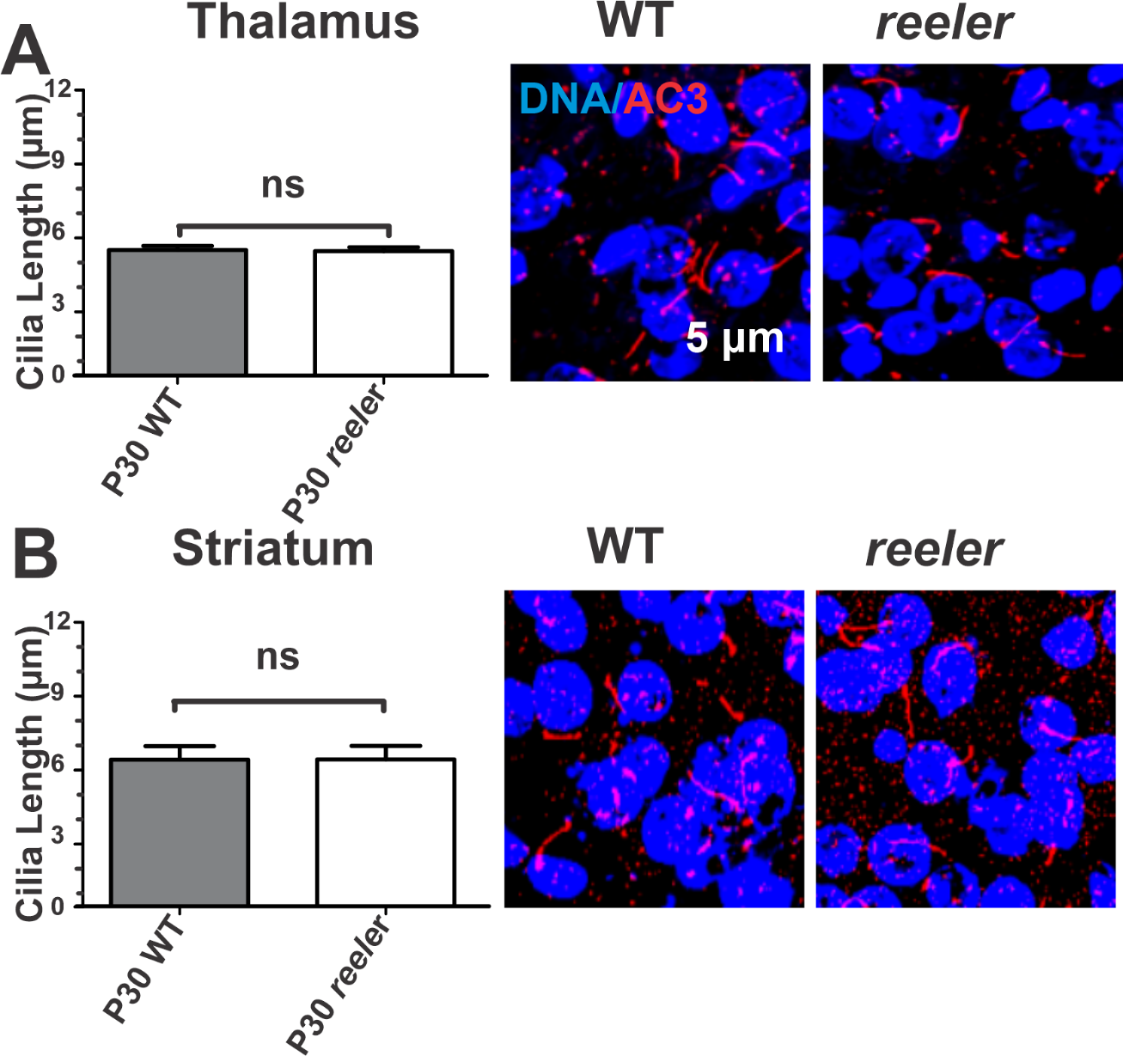
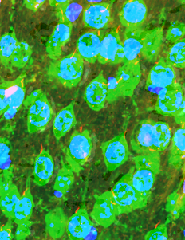
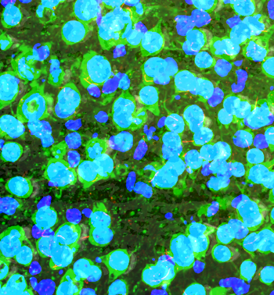
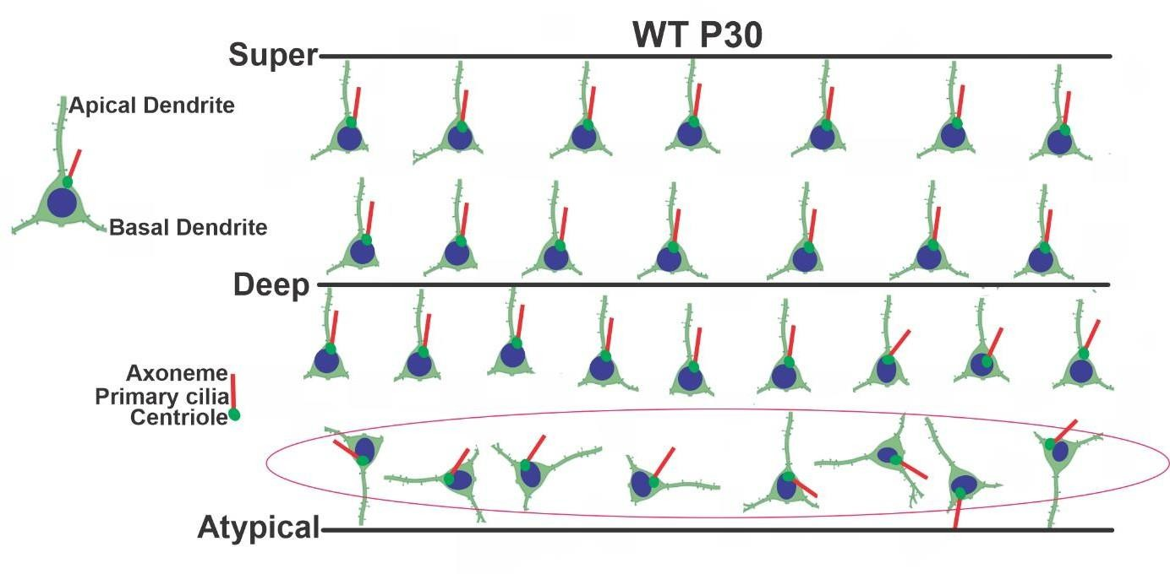

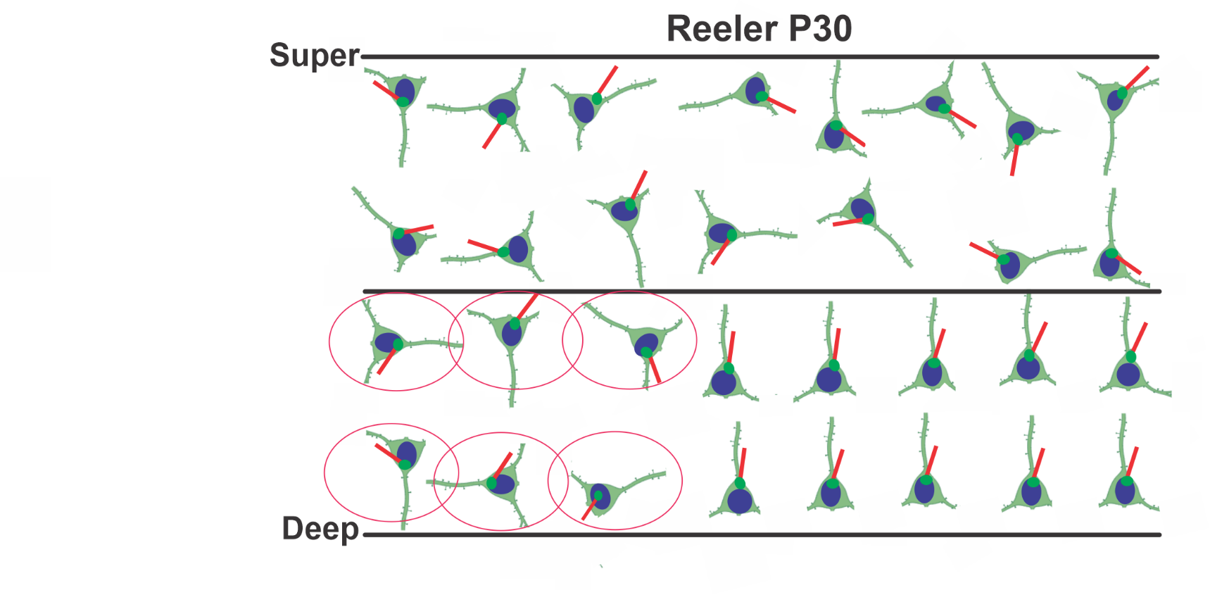

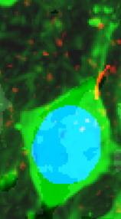




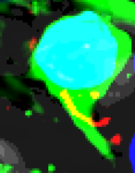
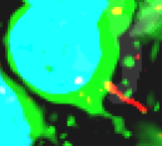
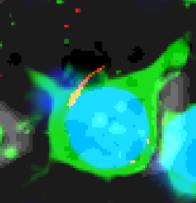
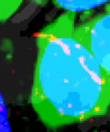
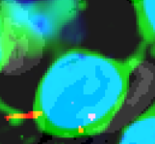

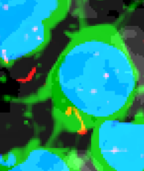

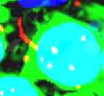
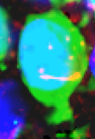
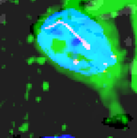
Reelin Controls Cilia Directionality and Centriole Positioning in Laminated Cortical Regions
Sumaya Akter¹, Kevin Jiang¹, Liyan Qiu¹, Mitsuharu Hattori¹ , Mark Lyon ¹, Xuanmao Chen¹
Department of Molecular, Cellular and Biomedical Science, University of New Hampshire, Durham, NH 03824
Introduction
Fig 2. Reelin does not influence primary cilia in Astrocytes and Interneurons
Fig 6. Cilia length and directionality in different brain regions.
Primary cilia are microtubule-based organelles present on nearly all mammalian cells, including neurons. It is well-known that primary cilia modulate embryonic neurodevelopment. Currently little is known about the roles of neuronal primary cilia in postnatal neurodevelopment. Defects in primary cilia cause neurodevelopmental disorders, obesity, and cognitive impairment. Reelin, a glycoprotein secreted by Cajal–Retzius cells, is essential for neuronal migration and cortical lamination. While Reelin’s role in guiding laminar organization is well established, its influence on primary cilia dynamics and centriole positioning during postnatal development remains unclear. In this study we investigated whether Reelin influences cilia length, centriole positioning, and cilia directionality in the mouse cerebral cortex.
Table 1: Cilia length in various brain regions.
Table 2: Cilia directionality in various brain regions.
A) Random Astrocyte Cilia in WT Neocortex
Brain Region | Lamination | P30 WT (µm) | P30 reeler (µm)
CA1 | Laminated | 5.38 ± 0.33 | 8.62 ± 0.88 (***)
CA3 | Laminated | 5.32 ± 0.27 | 7.04 ± 0.22 (***)
DG | Laminated | 2.90 ± 0.15 | 5.02 ± 0.20 (***)
Neocortex | Laminated | 5.36 ± 0.07 | 6.88 ± 0.20 (***)
Thalamus | Non-laminated | 5.53 ± 0.32 | 5.53 ± 0.34 (n.s.)
Hypothalamus | Non-laminated | 5.48 ± 0.35 | 5.53 ± 0.33 (n.s.)
Amygdala | Non-laminated | 5.28 ± 0.14 | 5.29 ± 0.16 (n.s.)
Astrocyte CA1 |  | 5.12 ± 0.01 | 5.14 ± 0.03 (n.s.)
Astrocyte Neocortex |  | 4.25 ± 0.14 | 4.34 ± 0.11 (n.s.)
Interneuron CA1 |  | 5.09 ± 0.11 | 5.13 ± 0.14 (n.s.)
Interneuron Neocortex |  | 5.13 ± 0.19 | 5.11 ± 0.10 (n.s.)
Brain Regions | Cilia Directional-ity | Cell Density in Lamina
Dorsal CA1 | Opposite | Compact
Ventral CA1 | Opposite | Compact
Piriform Cortex (Layer II) | Opposite | Compact
Piriform Cortex (Layer III) | Same, to the pia | Loose
Neocortex | Same, to the pia | Loose
CA1 Interneurons | Irregular | Not layered
CA1 Astrocytes | Irregular | Not layered
Thalamus | Irregular | Not layered
Amygdala | Irregular | Not layered
A-B) Bar graph displaying Astrocyte Cilia remains unchanged in CA1 and Neocortex
B) Random Astrocyte Cilia in reeler Neocortex
A-B) Bar graph displaying Interneuronal Cilia remains unchanged in CA1 and Neocortex
Methodology
Fig 3. Cilia orientation and Directionality in CA1 and Neeocortex during postnatal development
Conclusions
Brain tissues from reeler mice were collected
Immunofluorescence and Confocal microscope were used to take images from different cortical regions of the brain
To examine cilia morphology, we performed immunofluorescence using specific cilia marker like adenylyl cyclase 3 (AC3) and ADP-ribosylationfactor-like protein 13B (ARL13B).
Data analysis was conducted using Image J, GraphPad Prism, MATLAB, Python libraries.
Independent two-sample t-test to evaluate statistical significance between the WT and reeler groups.
WT CA1
reeler CA1
WT Neocortex
WT Neocortex
We discovered that Reelin influences cilia elongation, centrioles positioning and cilia directionality by controlling lamination and promoting reverse movement in the cerebral cortex but has no such effect in non-laminated areas, interneurons, or astrocytes.
This reveals a previously unrecognized role of Reelin in postnatal cortical organization.
These findings suggest a potential link to the evolutionary transition from a three-layer allocortex to a six-layer neocortex, implicating in the evolution of biological intelligence.
WT
reeler
SO
reeler Deep layer CA1
SP
SR
reeler Superficial layer CA1
reeler Neocortex
reeler Neocortex
WT CA1
Fig 1: Opposite cilia orientation in WT CA1 that preserved in the deep layer of reeler CA1, while the superficial layer shows uniformly directed cilia.
Fig 2: Uniform directionality in WT neocortex but random directionality in reeler.
Fig. 1. Reelin affects Primary cilia in laminated cortical regions
sTAMD Simulations
Acknowledgements
Fig 4. Centriole positioning relative to nuclei in different brain regions
WT Neocortex
reeler Neocortex
This study is supported by NIH grants: MH105746, GM113131, AG054729, MH126317, and MH125305. UNH COLE Awards UNH CoRE Awards
References
Yang J, Mirhosseiniardakani S, Qiu L, Bicja K, Del Greco A, Lin KJ, Lyon M, Chen X (2025) Cilia directionality reveals a slow reverse movement of principal neurons for positioning and lamina refinement in the cerebral cortex. Development (Cambridge, England) 152.
Frotscher M, Chai X, Bock HH, Haas CA, Förster E, Zhao S (2009) Role of Reelin in the development and maintenance of cortical lamination. Journal of neural transmission (Vienna, Austria : 1996) 116:1451-1455.
(A-B) Primary cilia Length in the Non-Laminated brain regions. (Left) Bar graph displaying cilia length. (Right) representative cilia images.
(A-C) Primary cilia Length in the Laminated brain regions. (Left) Bar graph displaying cilia length. (Right) representative cilia images.
Fig 4: In the deep and superficial layers of the WT mice, the centrioles of pyramidal neurons are predominantly positioned at the base of the apical dendrites, with primary cilia oriented toward the pia. However, certain neurons, referred to as atypical neurons exhibit unclear directionality or an inconsistent centriole position within the deep cortex of layer 6; close to the Ventricular Zone.

