Slide 1


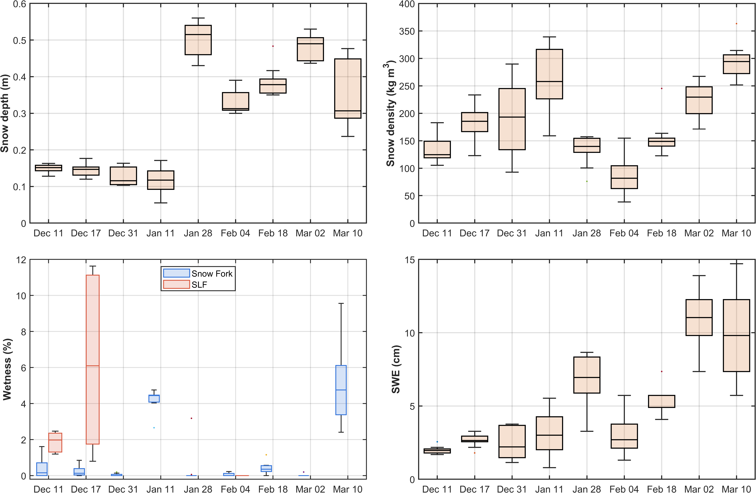
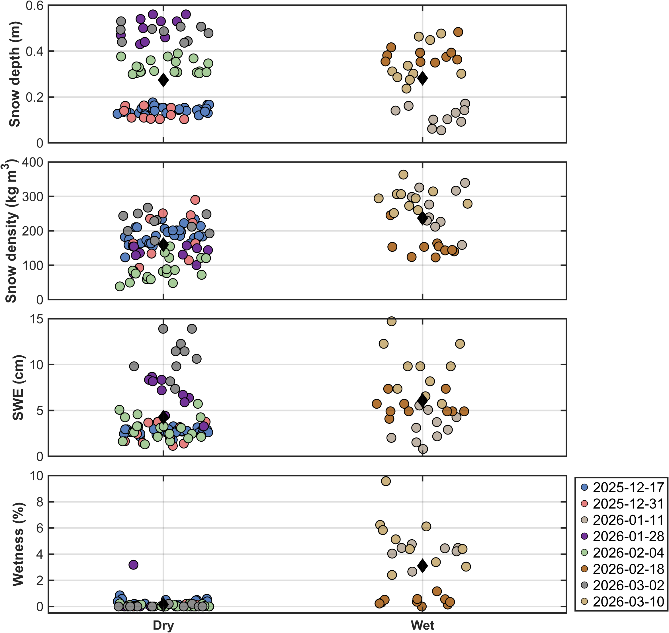
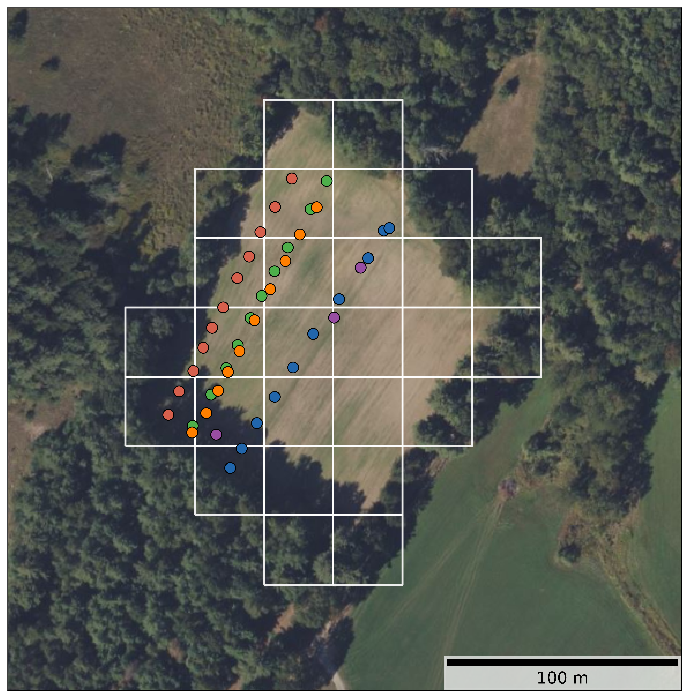
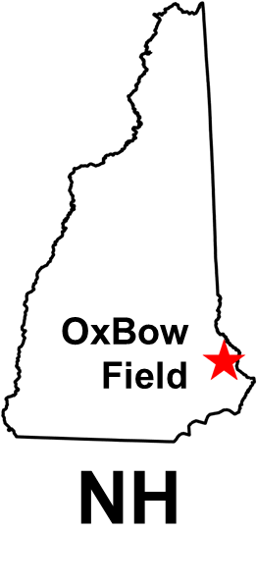
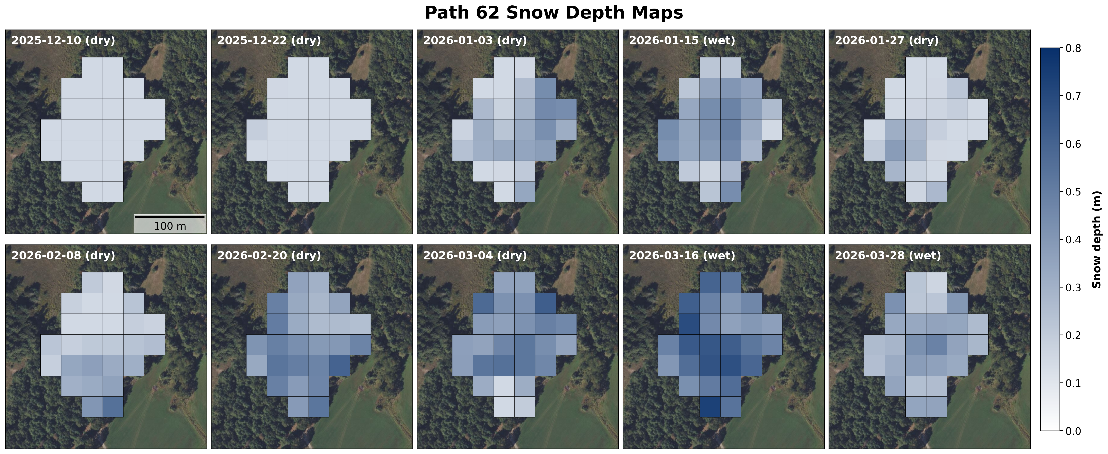
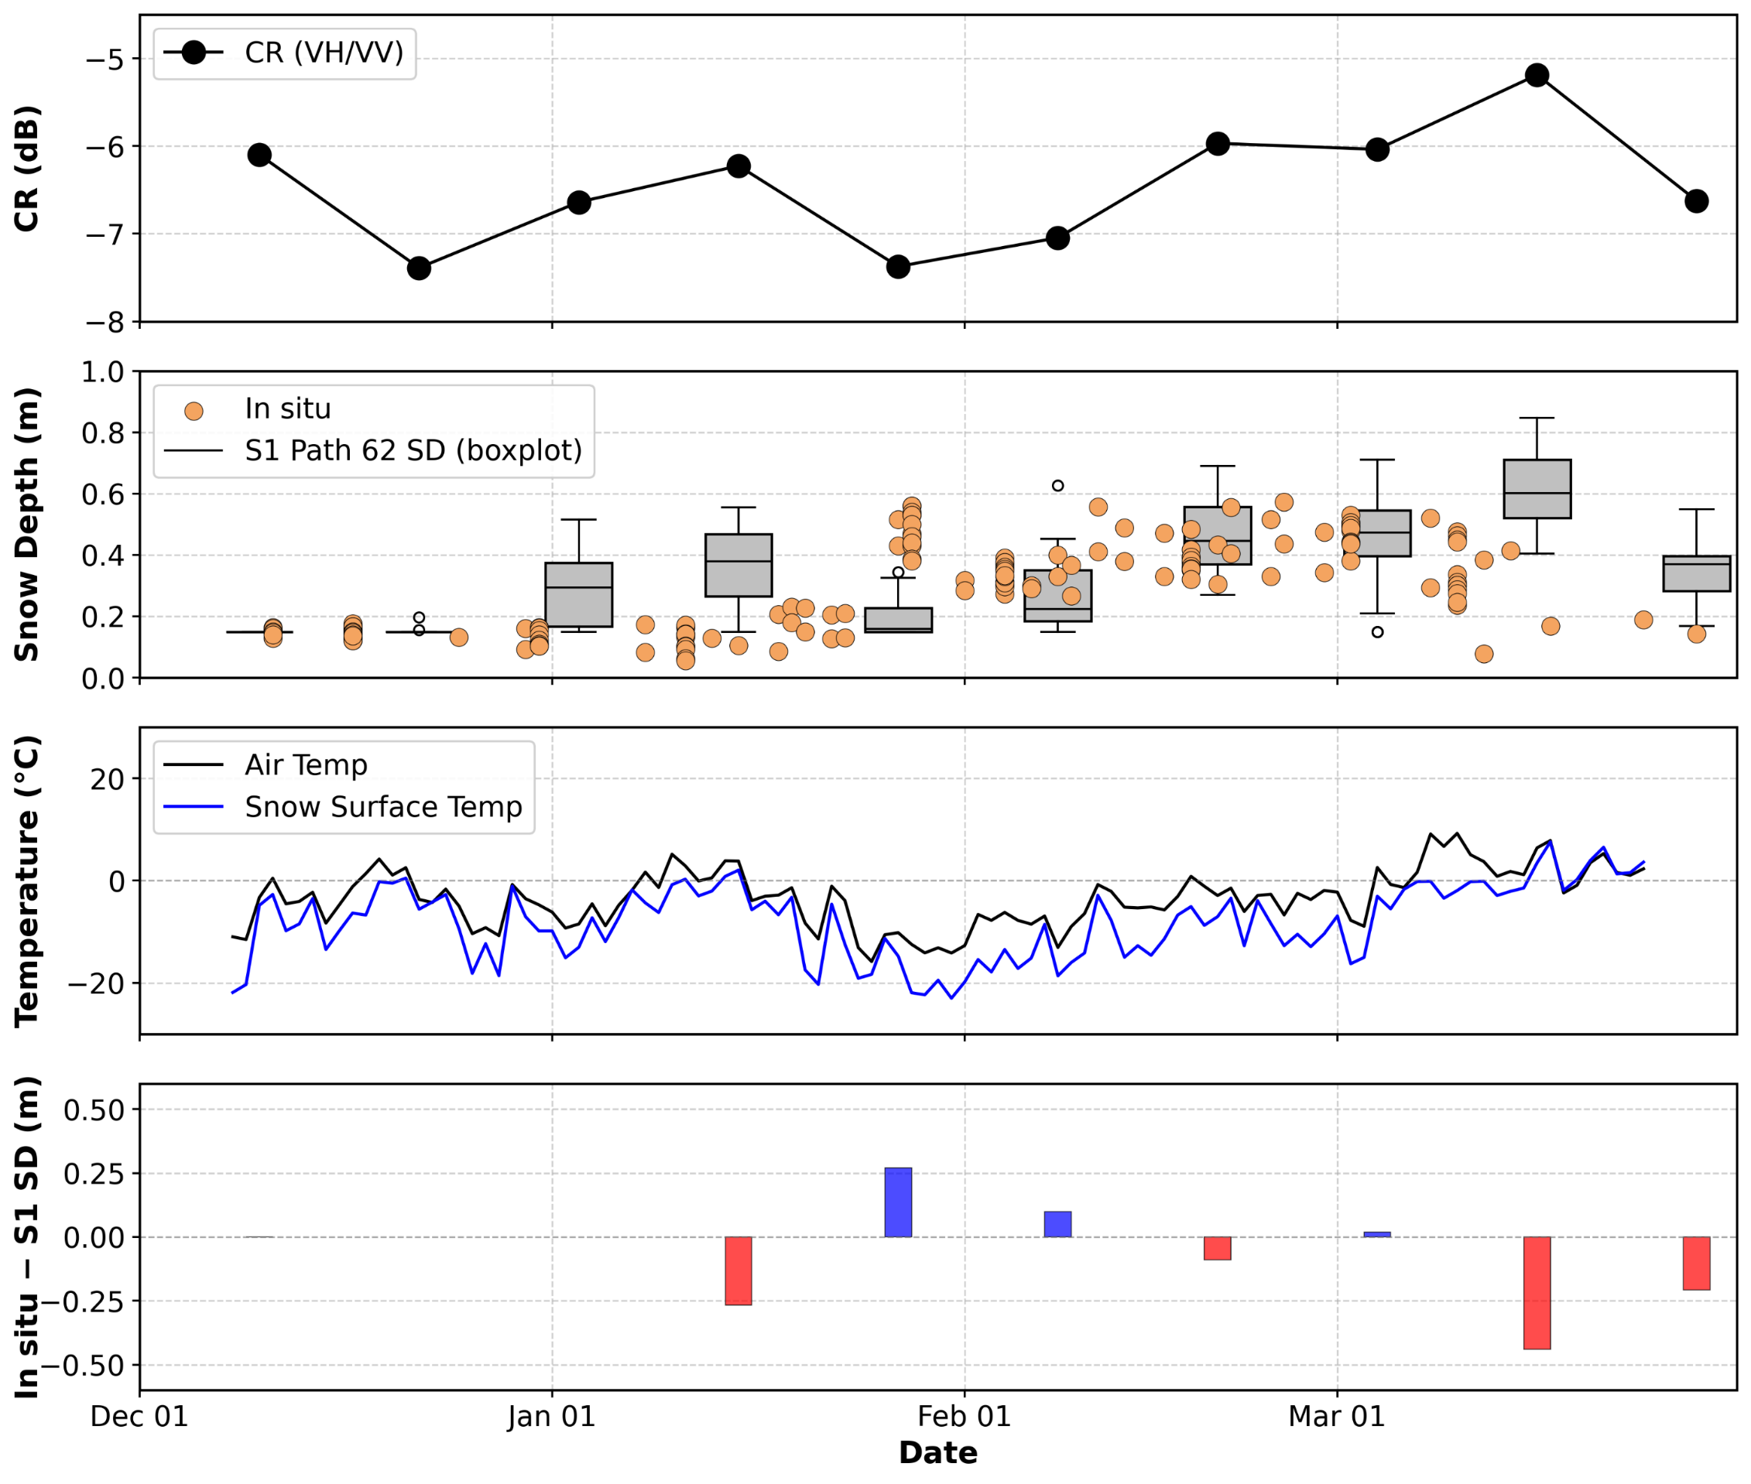

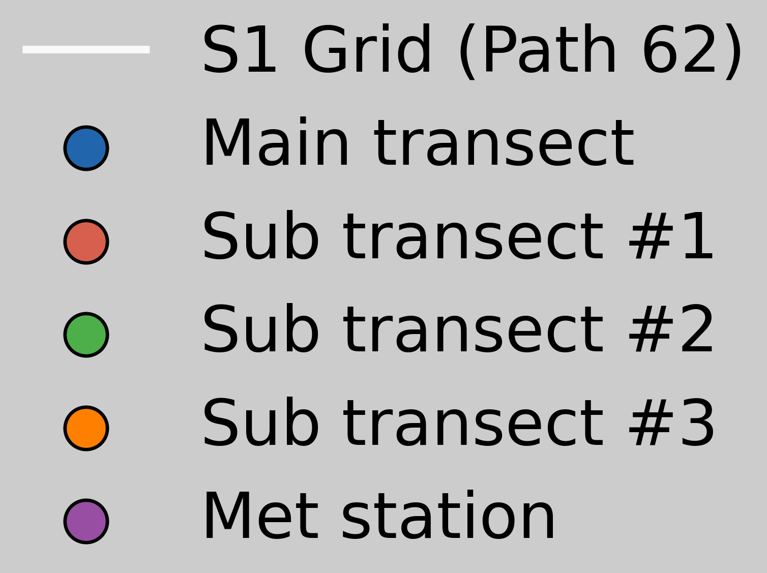
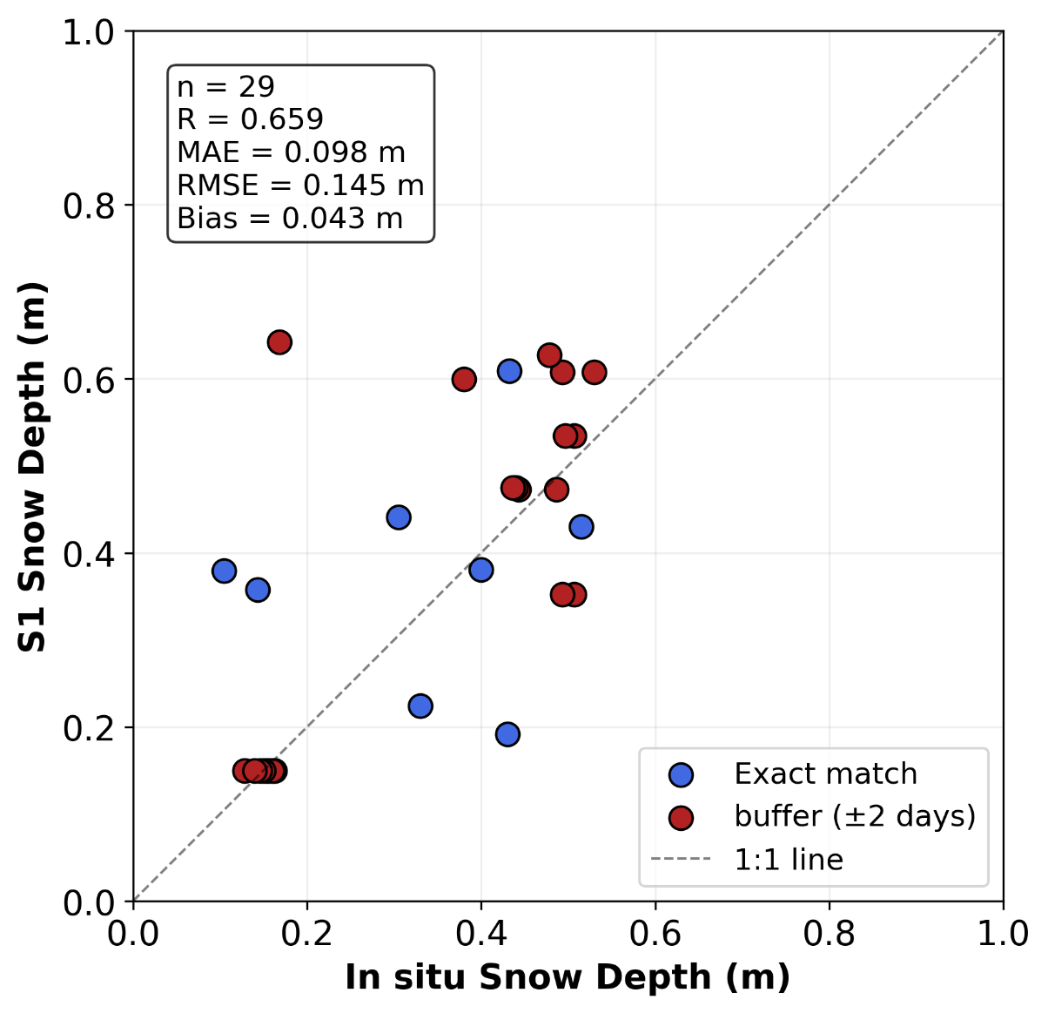

Assessing Sentinel-1 Satellite Based Snow Depth Retrieval in Shallow, Wet Snowpack during 2025-2026
${\text{MINSUN} \text{KANG}}^{\text{1,2}}$, ${\text{ADAM} \text{HUNSAKER}}^{\text{1,2}} , {\text{MAHSA} \text{MORADI}}^{\text{1,2}}$, ${\text{JENNIFER} \text{M}\text{. }\text{JACOBS}}^{\text{1,2}}$
¹Department of Civil and Environmental Engineering, University of New Hampshire, Durham, NH,USA
²Earth Systems Research Center, Institute for the Study of Earth, Oceans, and Space, University of New Hampshire, Durham, NH, USA
Email: MinSun.Kang@unh.edu
Background & Objectives
Snow Conditions (Field Sampling)
Snow plays a critical role in the Earth's water cycle and energy exchanges.
Remote sensing with Synthetic Aperture Radar (SAR) enables high-resolution, all-weather monitoring and is widely used for snow depth estimation.
Existing algorithms (Lievens et al., 2019) were developed for deep, dry snowpacks and remain poorly tested in shallow, wet conditions.
This study applies the SAR snow depth retrieval algorithm (Lievens et al., 2019) to a shallow, wet snowpack in New Hampshire
Analyze the relationship between Sentinel-1 SAR backscatter and snowpack properties.
Assess the algorithm’s ability to represent spatial and temporal snow depth variability.
The early winter (Dec–mid Jan) was characterized by shallow and wet snow condition
In late January, rapid snow accumulation (deepening $≈0.6m$) resulted in a decrease in snow density, indicating the presence of dry, fresh snow.
SWE increased with snow accumulation and showed greater variability during the late season.
Based on temperature and wetness classification, snow conditions transitioned to wet snow from late February.
Study area
Fig. 1. Study Area
(Newmarket, NH)
Date | State | Snow surf T (°C) | Air T (°C)
Dec 17 | dry | -6.36 | -0.96
Dec 31 | dry | -9.85 | -4.64
Jan 11 | wet | 0.28 | 3.05
Jan 28 | dry | -21.95 | -12.43
Feb 04 | dry | -13.49 | -6.06
Date | State | Snow surf T (°C) | Air T (°C)
Feb 18 | Wet | -5.09 | 0.99
Mar 01 | dry | -6.91 | -2.1
Mar 02 | dry | -16.26 | -8.02
Mar 10 | wet | -2.02 | 9.41
Fig. 2. Distributions of in situ snow depth, density, wetness, and SWE during the survey dates
Fig. 3. In situ Snow depth, density, wetness, and SWE under dry and wet snow conditions
SAR snow depth retrieval
This study was conducted at the Oxbow Farm field site in Newmarket, New Hampshire, during the 2025–2026 winter season.
The study area features an environmental gradient from forested edges to open field grassland at its center, winter-average solar exposure is higher.
In situ snow sampling was performed along a primary transect intersecting six Sentinel-1 pixels (Path 62), and two sub-transects, capturing the spatial variability of the snowpack.
Fig. 4. Sentinel-1 SAR snow depth maps
Fig. 5. Time series (CR (average of all pixels), snow depth, temperature, and difference between
in situ and SAR snow depth)
Method
S1 snow depth captured temporal trends observed in the in situ data, particularly during Feb–early Mar.
Best performance: cold, dry periods (2026-03-04, −2.5°C, error = 0.018 m), when CR increased consistently with snow depth.
Worst performance: wet periods (2026-03-16, 6.4°C, error = −0.440 m), when CR fluctuations led to overestimation.
Air temperature frequently crossed the freezing point. The resulting melt-refreeze cycles likely formed ice layers that enhance volume scattering and artificially elevate CR, contributing to these errors.
Validation (n = 29): R = 0.659, MAE = 0.098 m, RMSE = 0.145 m, Bias = −0.043 m. Moderate skill under shallow snow (max ~60 cm) at 30 m resolution.
Future work: incorporate snow-free baseline for SI initialization, apply spatial averaging to reduce noise, include additional S1 orbital paths, and develop wet snow corrections.
Snow depth was retrieved from Sentinel-1 C-band SAR backscatter using the empirical change detection algorithm of Lievens et al. (2019).
The cross-polarization ratio (CR) was computed as: CR(dB) = σ⁰VH(dB) − σ⁰VV(dB)
where σ⁰ is the normalized radar backscatter coefficient, representing the power scattered back to the sensor per unit ground area.
A cumulative Snow Index (SI) was derived from temporal changes in CR:
SI(t) = max(0, SI(t−1) + CR(t) − CR(t−1))
Snow depth (SD) was then estimated as: SD(t) = a × SI(t)
where a (=0.18) is a site-calibrated scaling parameter optimized by minimizing MAE between pixel-averaged S1 estimates and mean of in situ depth on matched dates.
Fig. 6. Scatter plot between in situ and SAR snow depth
Lievens, H., Demuzere, M., Marshall, H. P., Reichle, R. H., Brucker, L., Brangers, I., ... & De Lannoy, G. J. (2019). Snow depth variability in the Northern Hemisphere mountains observed from space. Nature communications, 10(1), 4629.
Data is download: The Alaska Satellite Facility (https://www.asf.alaska.edu/data-tools/mapready/ )

