Slide 1
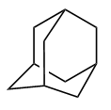

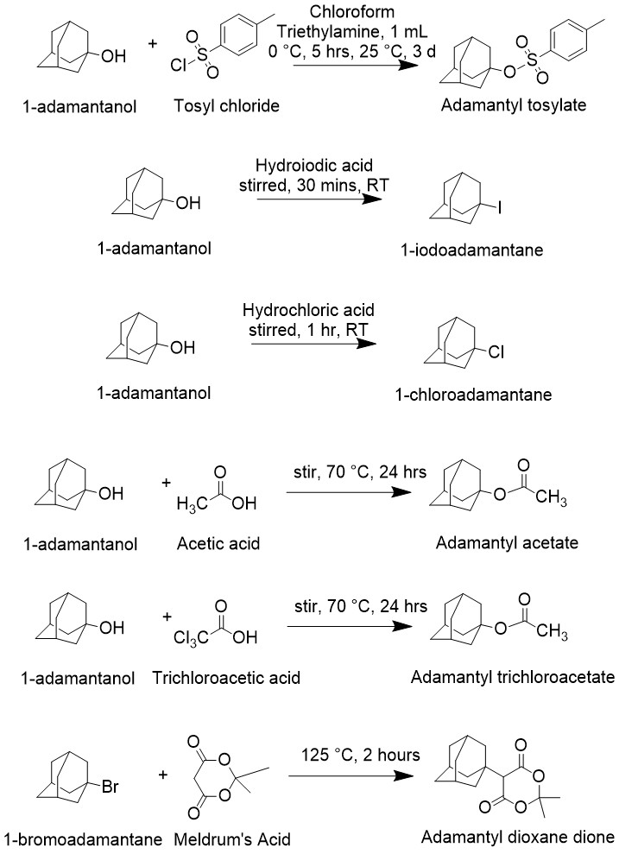
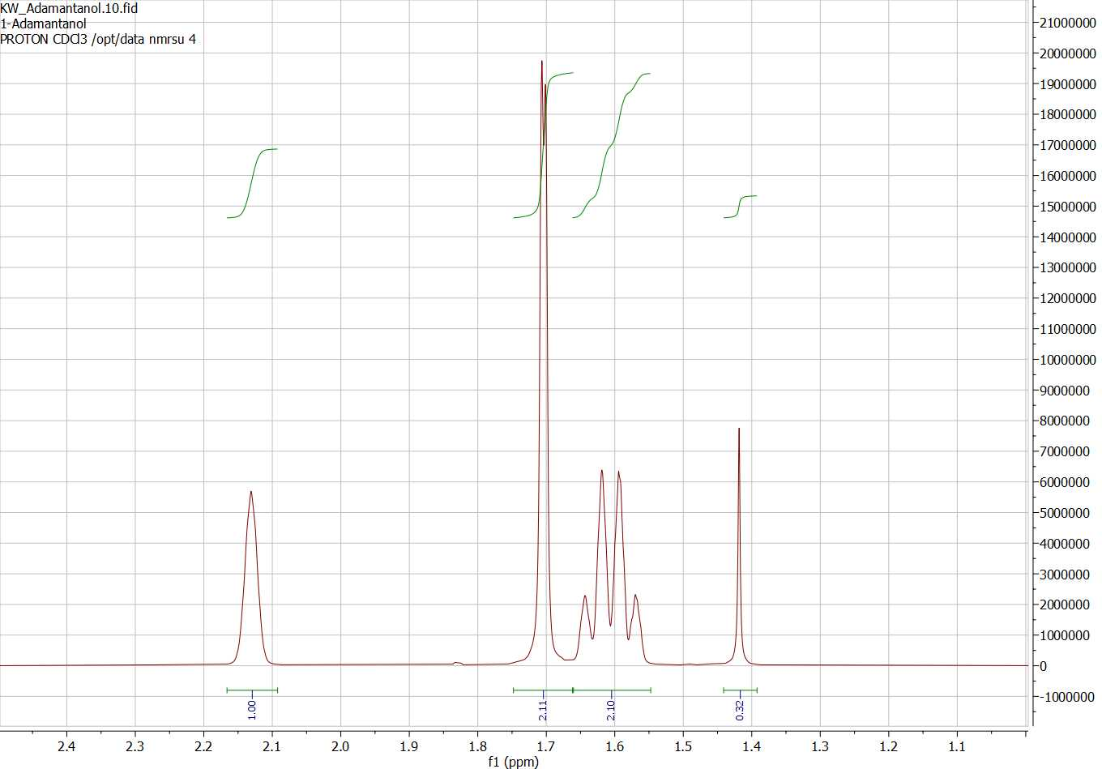


Functionalizing Adamantane with Unconventional
Leaving Groups
Kaleigh Wilson and Glen Miller
Department of Chemistry, University of New Hampshire
Introduction
Reactions Studied
Representative ¹H NMR Spectrum:
Adamantane is the smallest diamondoid (a molecule mimicking diamond crystal)¹
  Rigid, cage-like, stress-free structure²
  Relatively stable carbocations form at the bridgehead positions
If a leaving group (LG) is present at a bridgehead position, it undergoes unimolecular nucleophilic substitutions – LG ability is vital³
Various functional groups can bond to adamantane at its bridgehead/3º positions
  Typical reactions bond four identical function groups to bridgehead carbons⁴
Goal: Functionalize adamantane on demand
  Attach 4 unique LGs to 4 unique bridgehead C’s
  Utilize unique LG reactivities to create new derivatives with 4 unique functional groups
1-Adamantanol + Tosyl chloride:
¹H NMR spectrum of 1-Adamantanol:
1-Adamantanol + Hydroiodic acid:
1-Adamantanol + Hydrochloric acid:
Conclusions & Next Steps:
The tosylate and I⁻ LGs proved to be too reactive. Those products were not stable. They hydrolyzed rapidly, reforming 1-adamantanol.
Cl⁻, Br⁻ and unconventional LGs like Meldrum’s acid show promise
Next Step: Attach several LGs to adamantane in succession
Next Steps: Utilize unique reactivities of each LG to functionalize adamantane on demand
1-Adamantanol + Acetic acid:
Methods
Adamantane-based starting materials: 1-adamantanol and 1-bromoadamantane
  Use ¹H-NMR to characterize structures
React starting materials with appropriate reagents; isolate & characterize products
Record ¹H-NMR spectra of crude products and compare to starting materials
  Confirm if desired LG has attached and to molecule at a bridgehead position
  Determine %Yield of each reaction
1-Adamantanol + Trichloroacetic acid:
References
1-Bromoadamantane + Meldrum’s acid:
(1) Siliva, Pedro, et al., J. Phys. Chem., 2025, 129, 10443–10451
(2) Wichterle, Ivan, et al. Materials Open. 2024, 2, 2430001
(3) Fisher, Ethan, et al, Org. Lett. 2009, 11, 4108–4110 (4) Newman, H. Synthesis, 1972; 1972(12): 692-693

