Slide 1

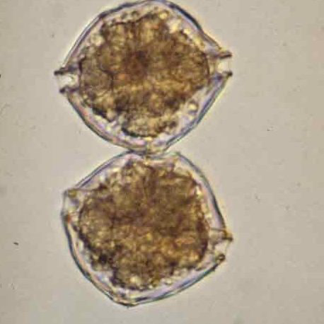
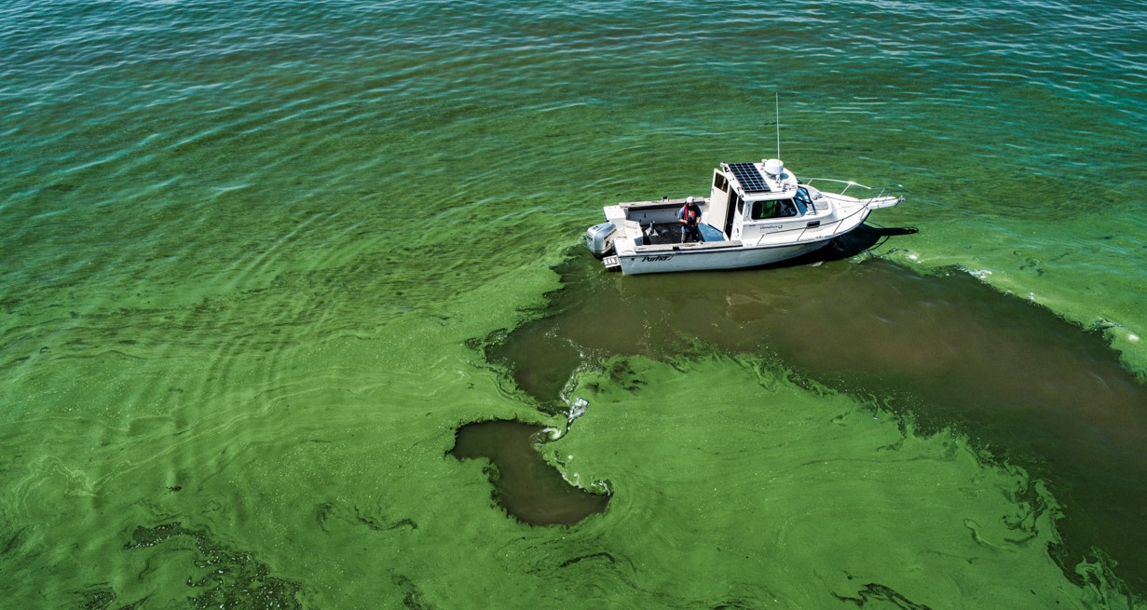
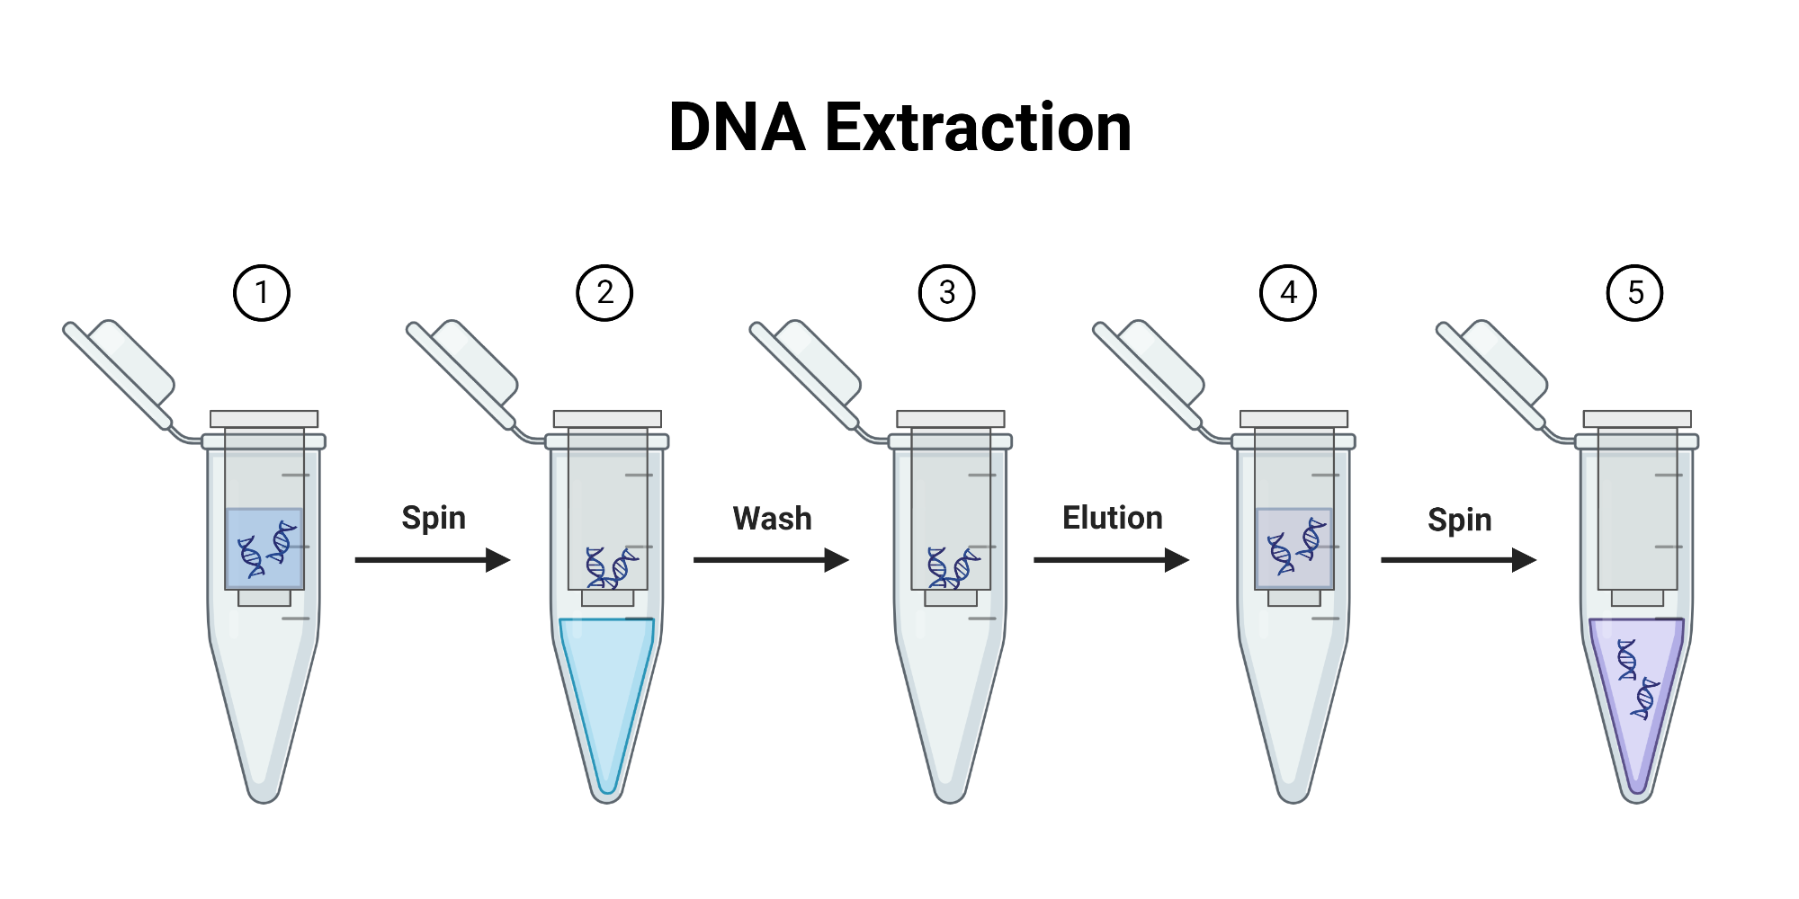
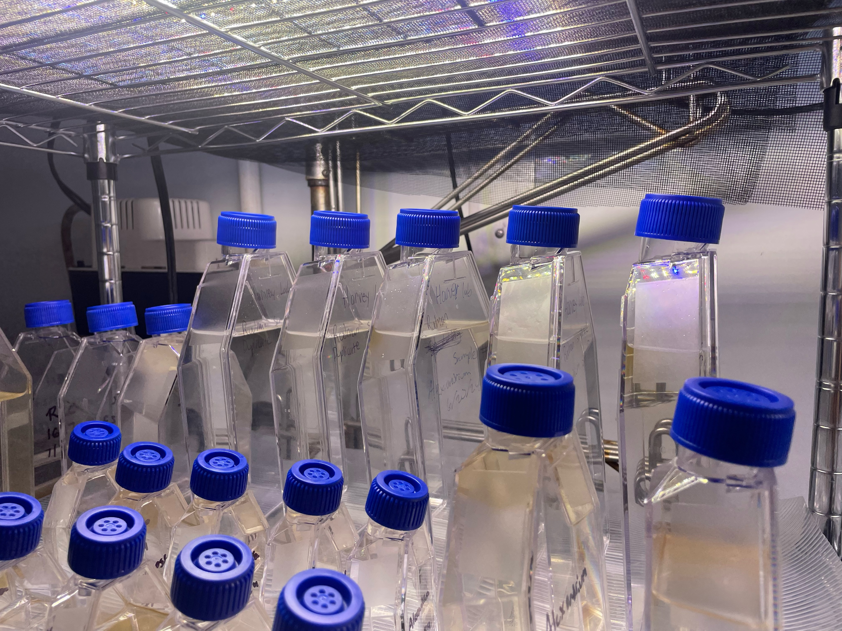
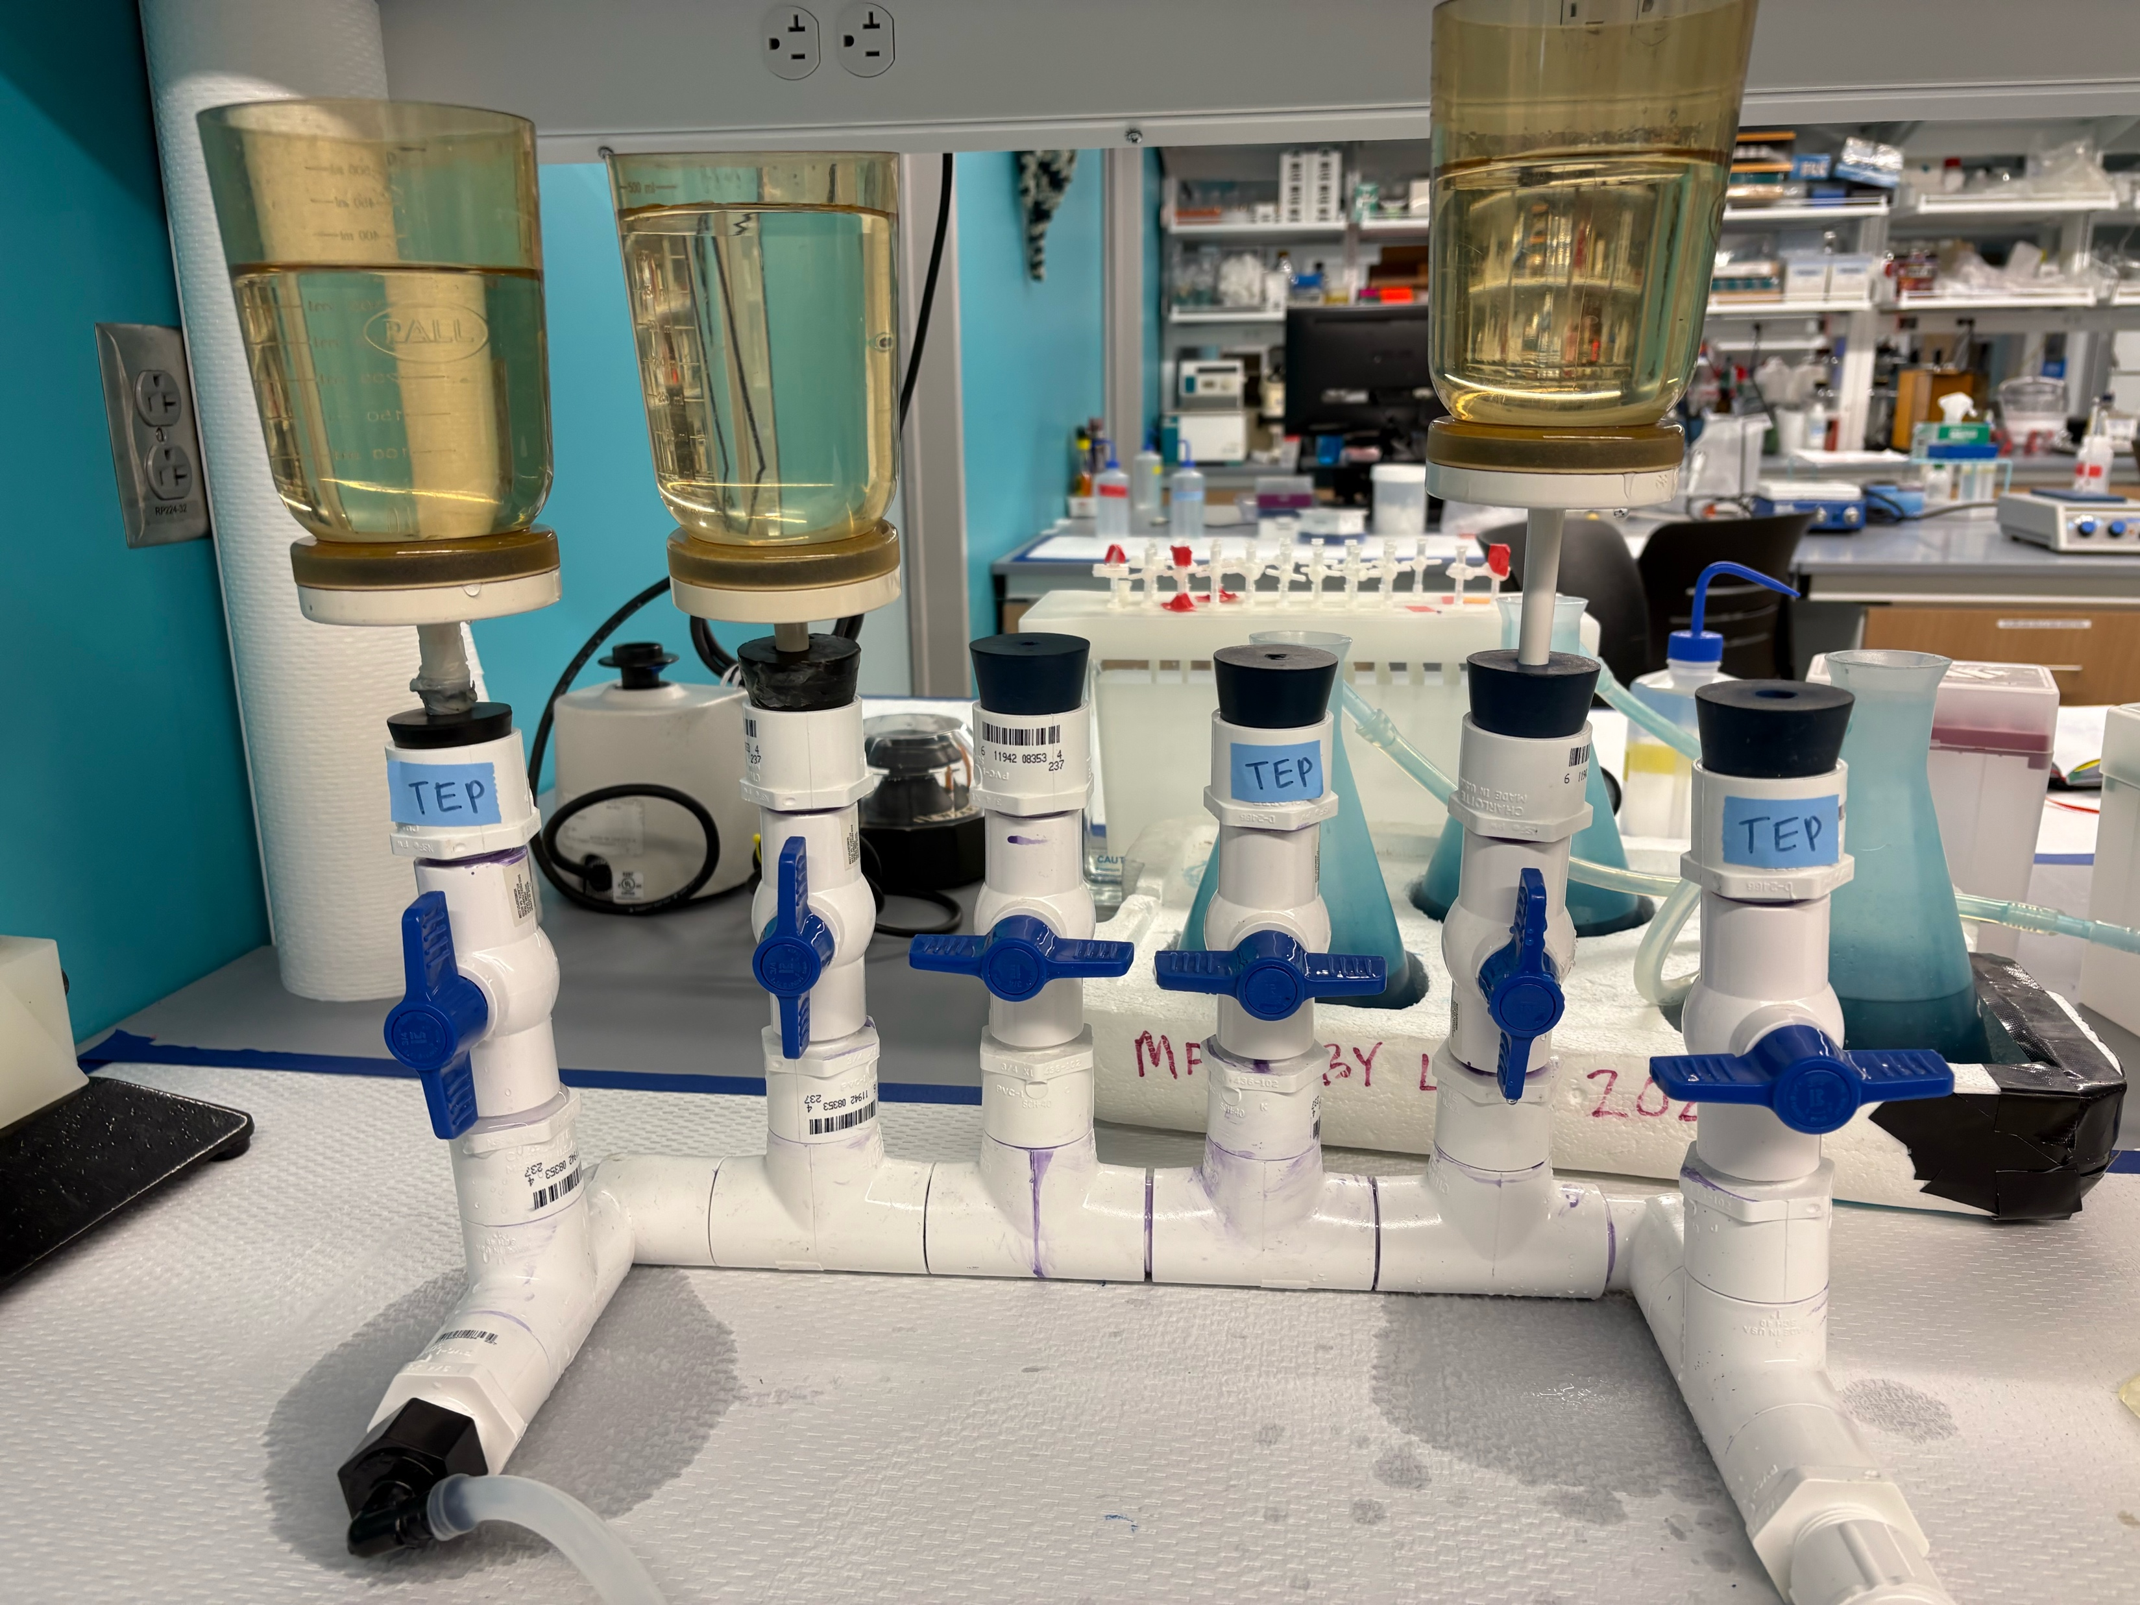
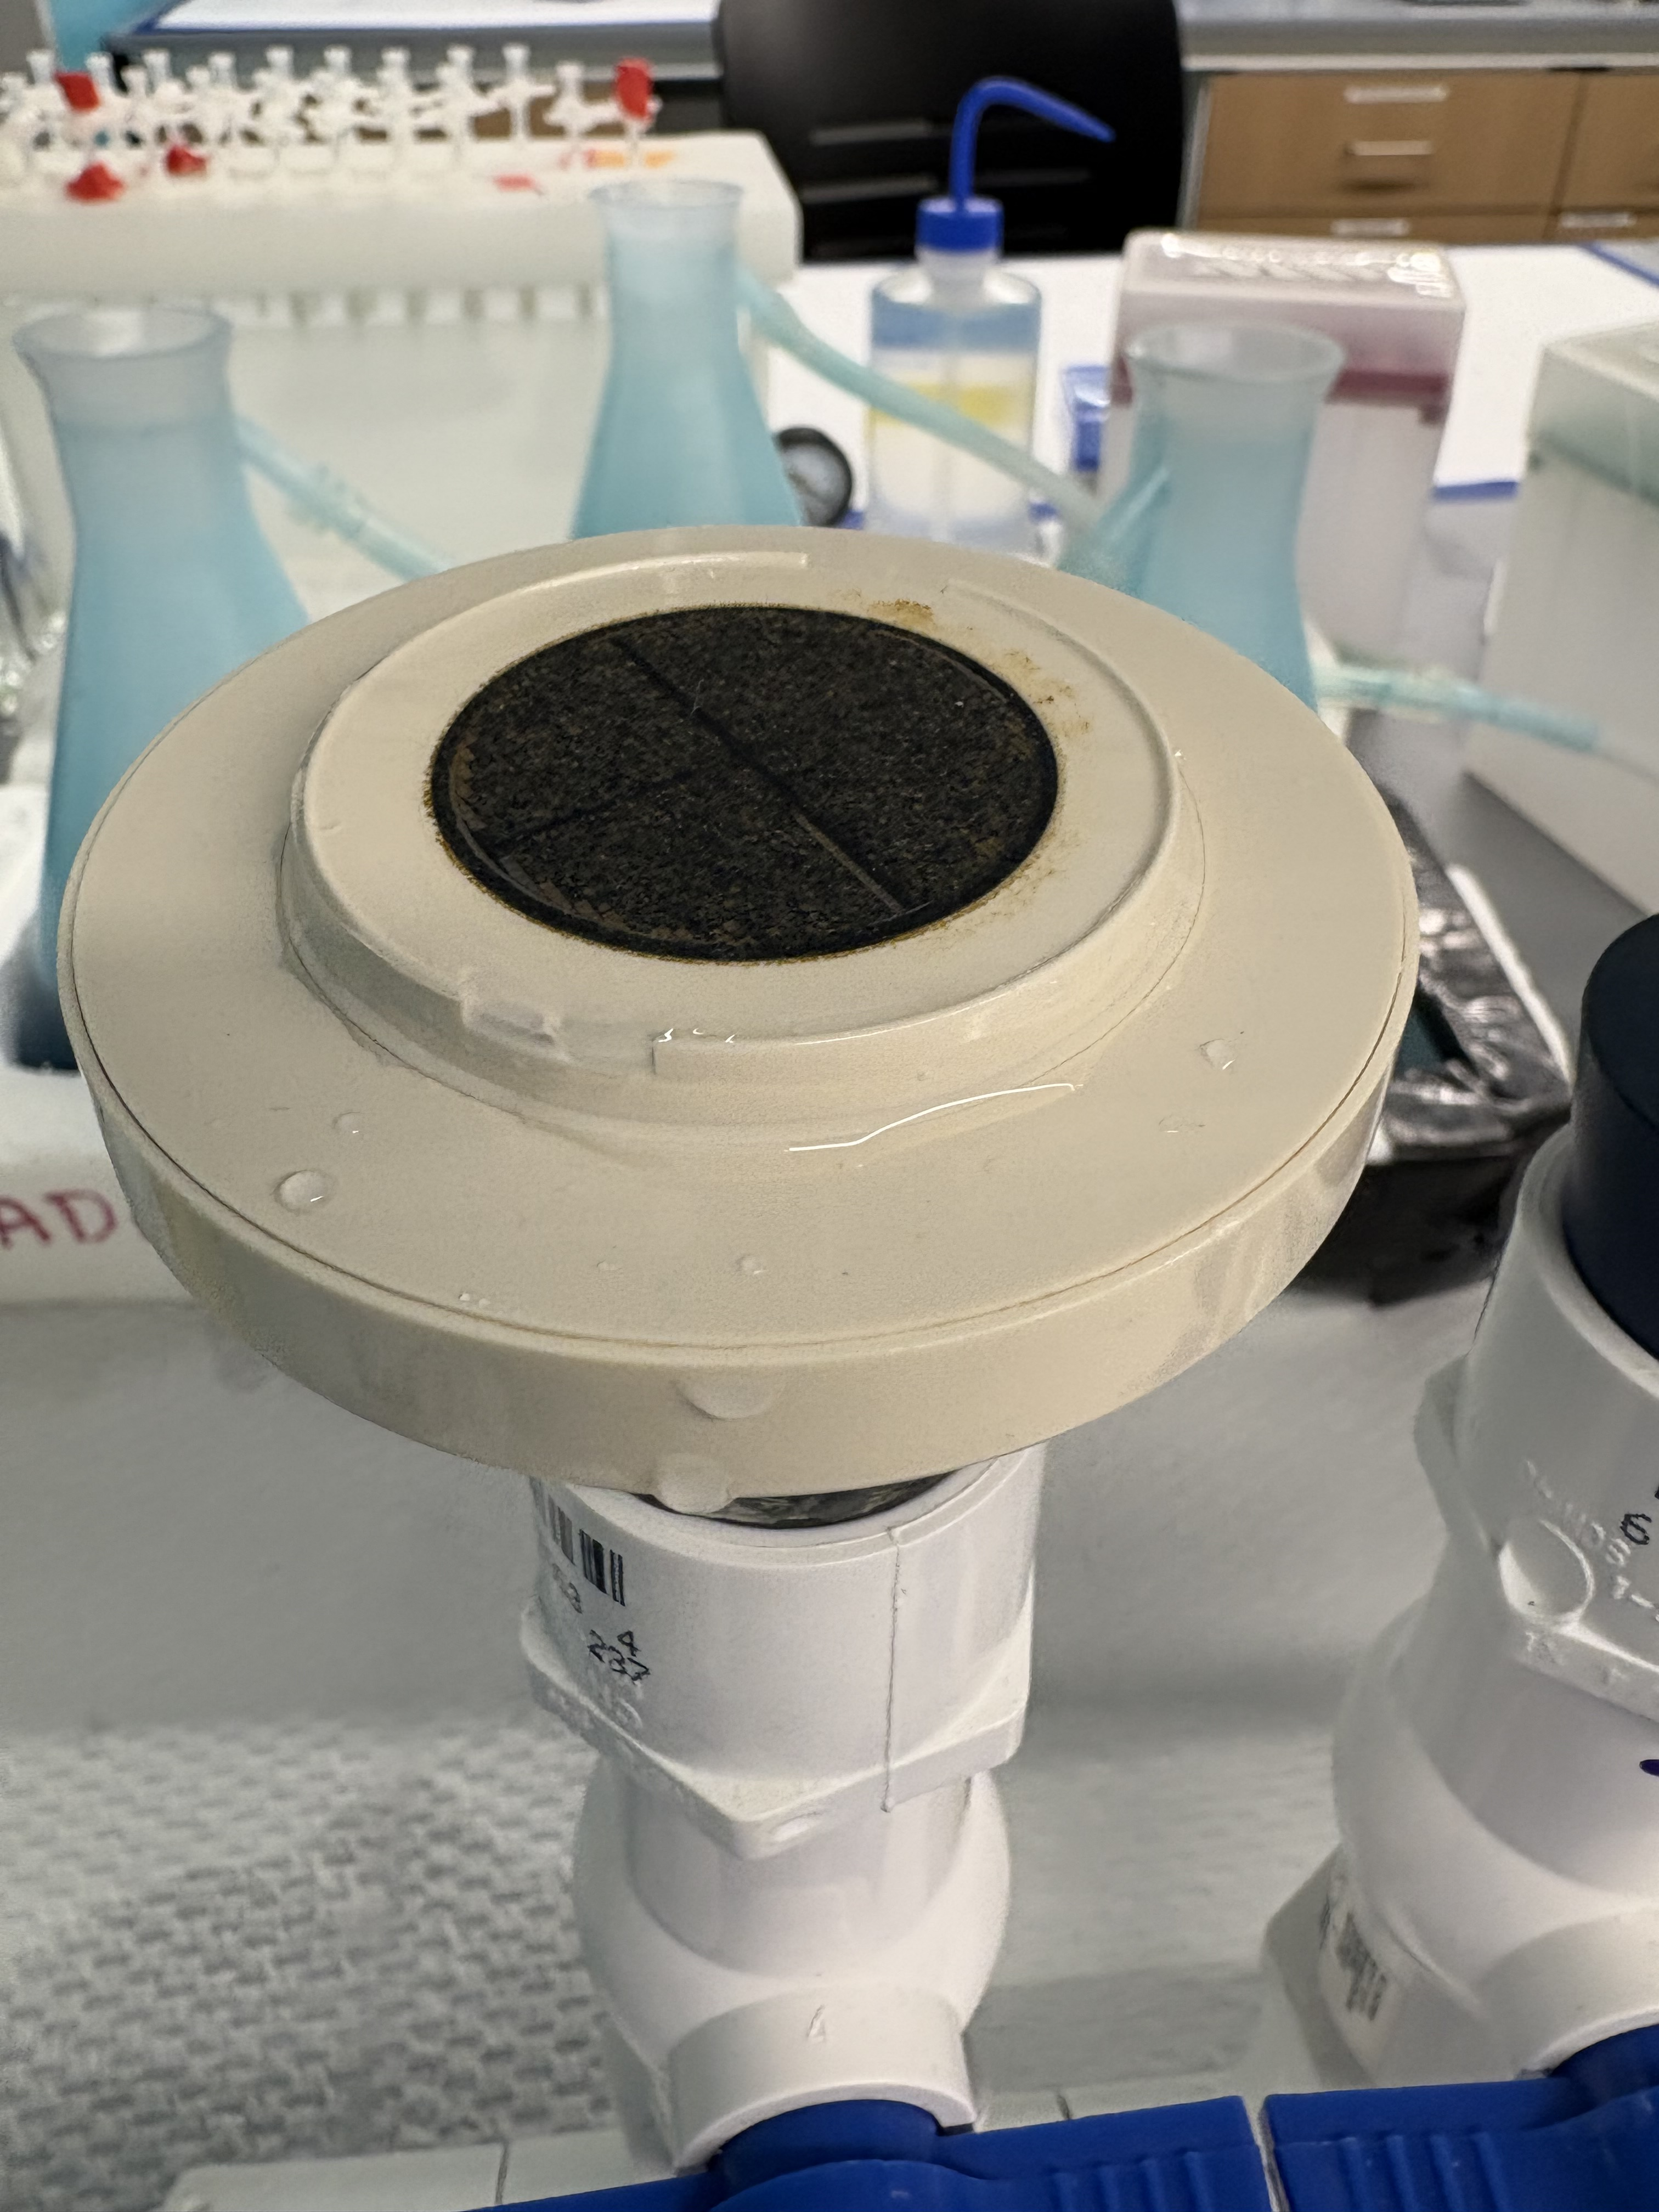
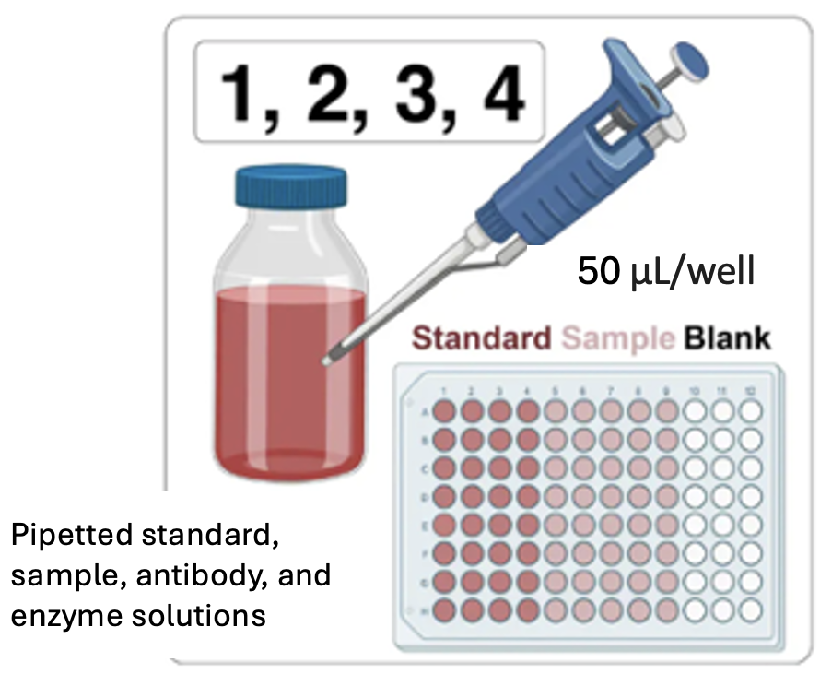
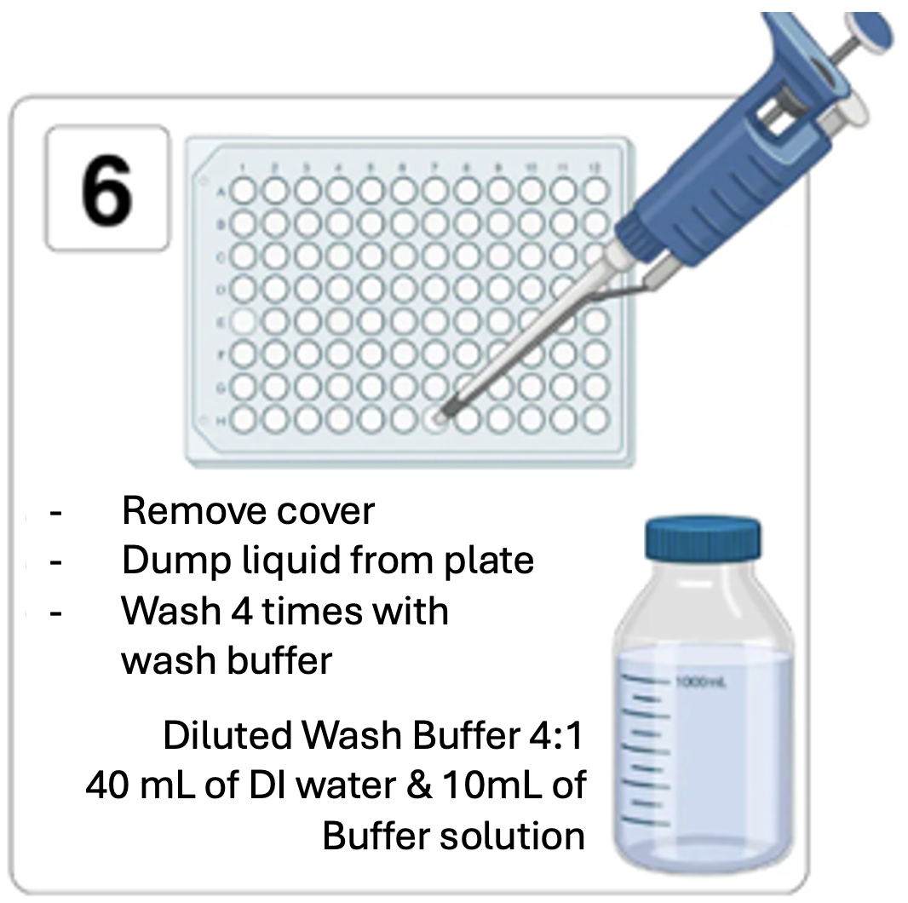
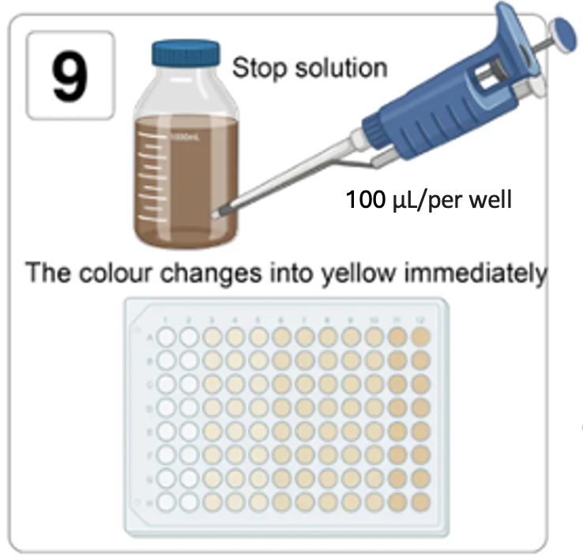
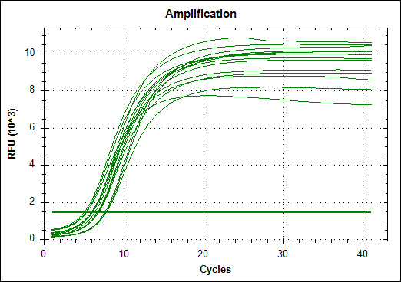
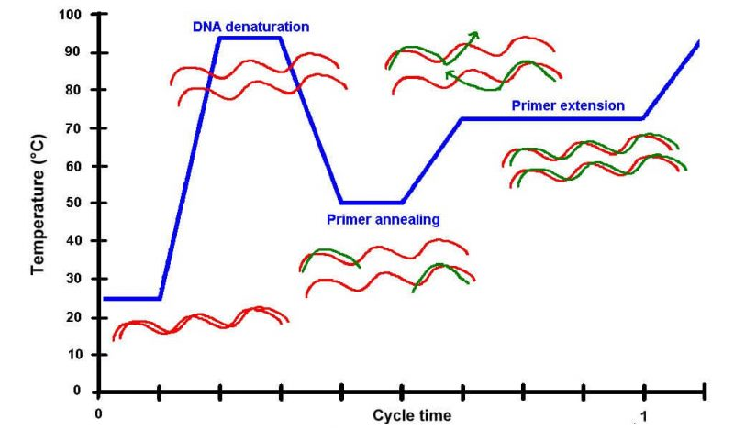
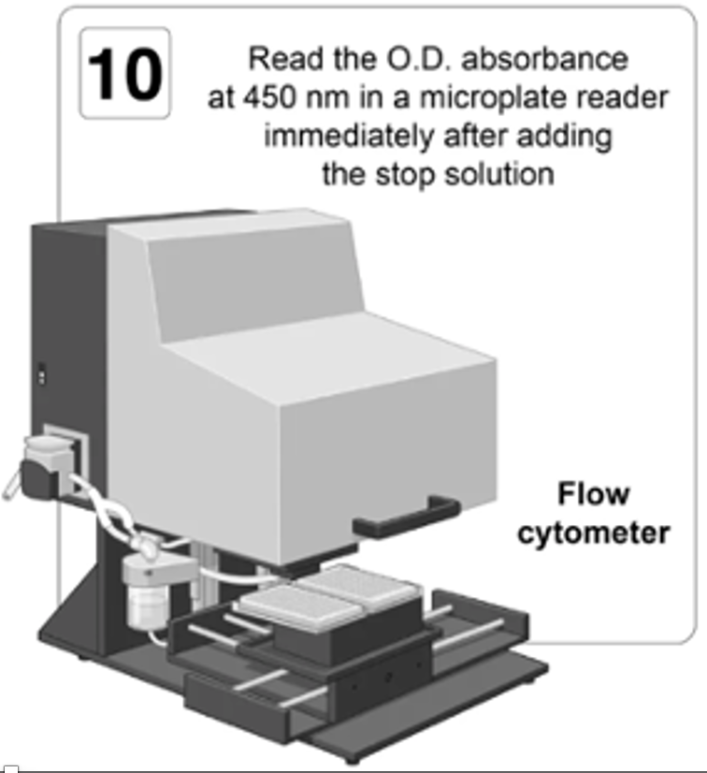
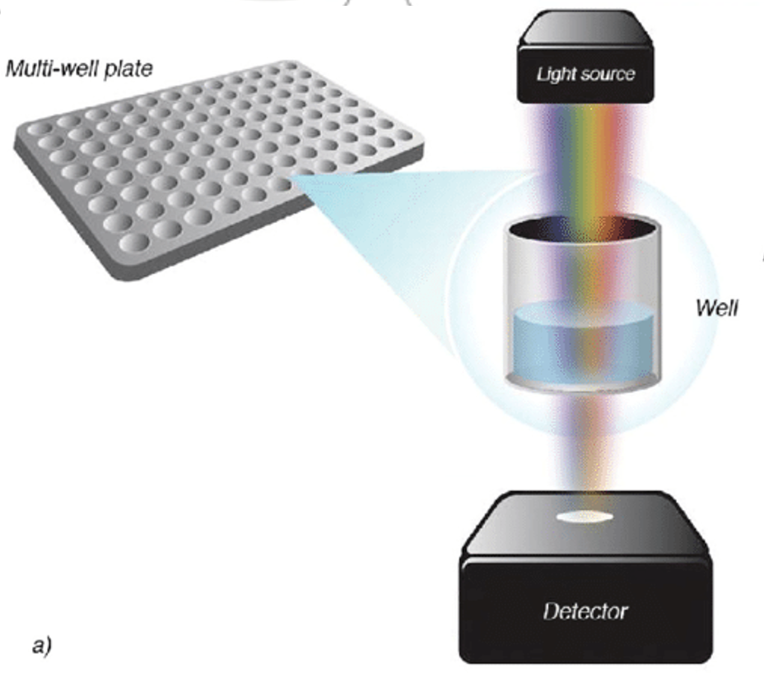
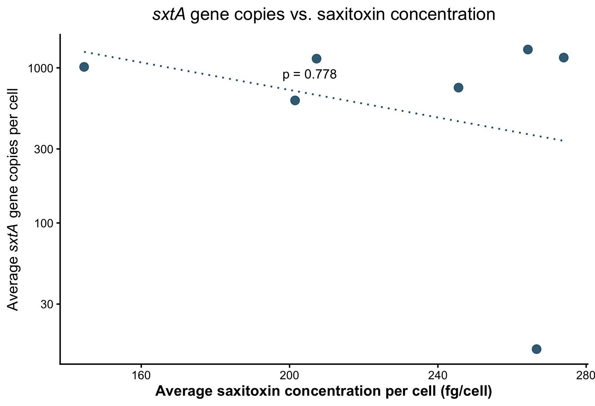
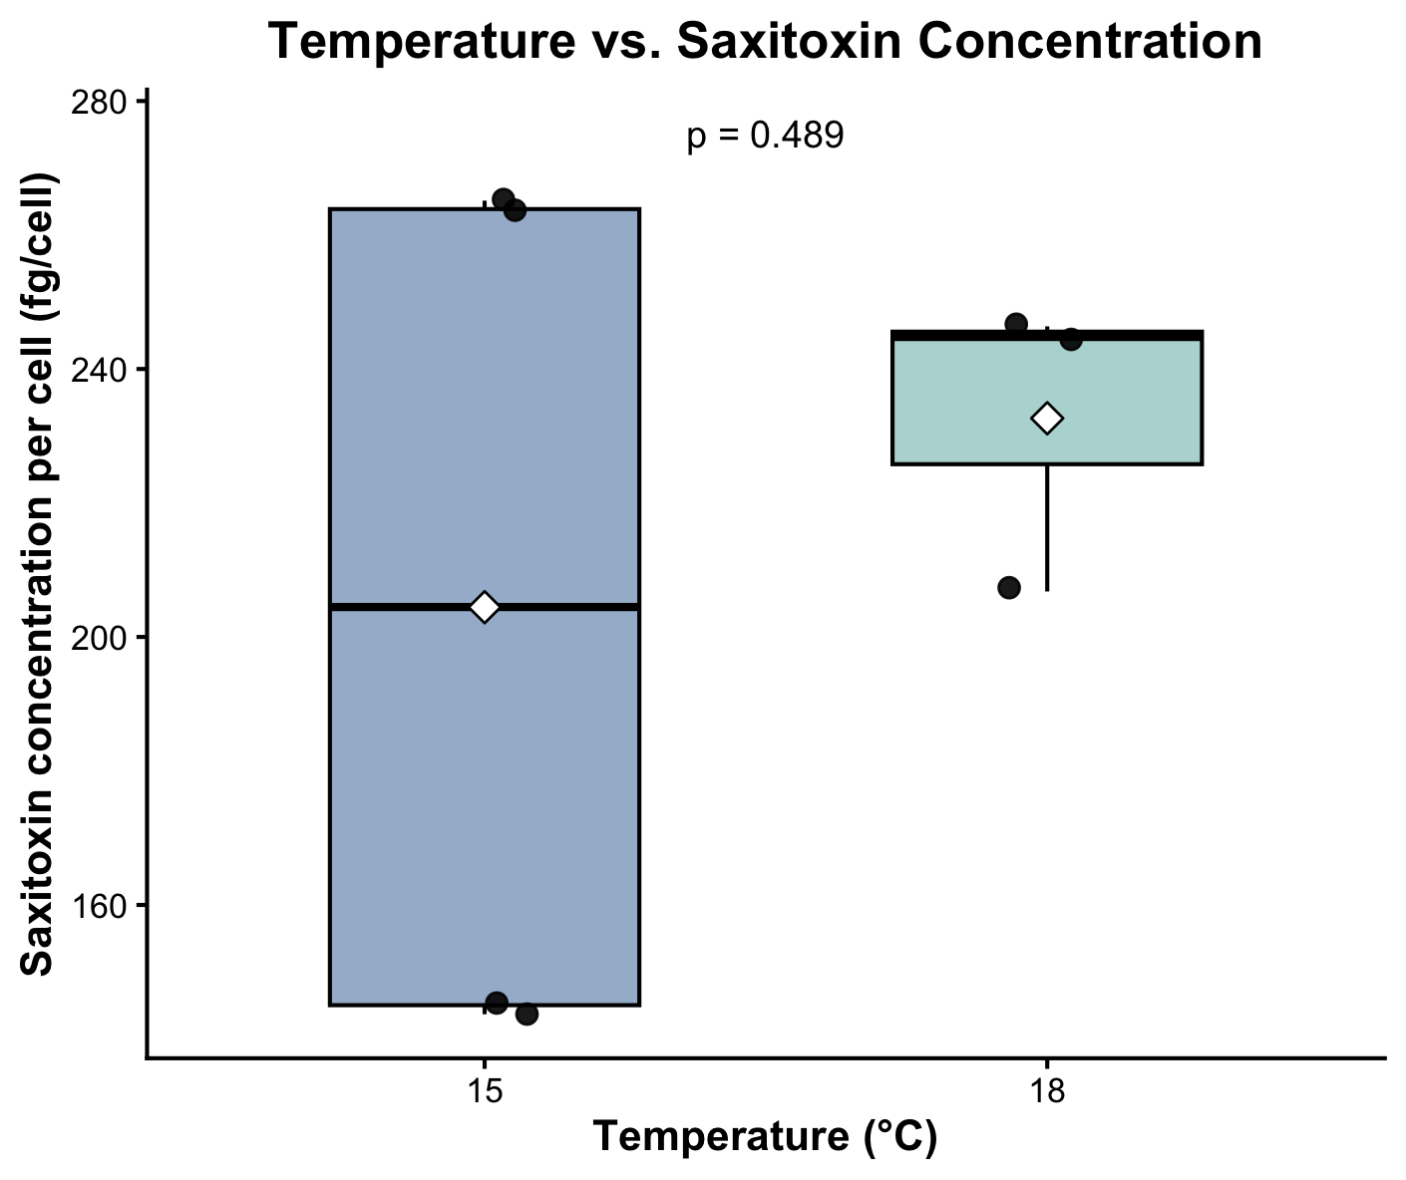
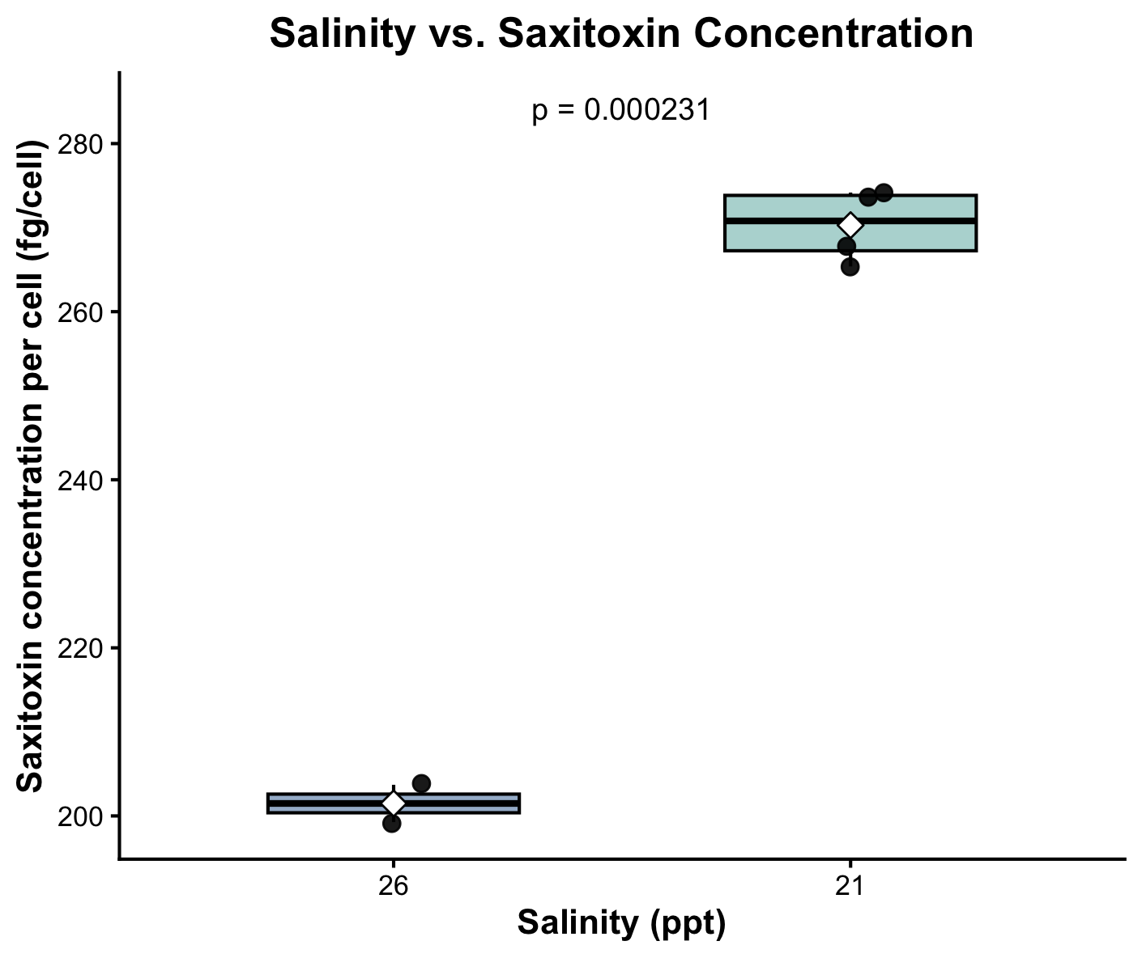
Quantifying Toxin Gene Abundance in a Harmful Algal Bloom Species Along the New Hampshire Coast
Olivia Lucia
Adviser: Dr. Elizabeth Harvey
Department of Biological Sciences, University of New Hampshire, Durham, NH
Harmful algal blooms (HABs) are increasing in severity and abundance worldwide.³
They threaten coastal ecosystems and human health through toxin production.⁴
Alexandrium spp. produce saxitoxin, a neurotoxin causing paralytic shellfish poisoning.⁵
Current monitoring measures toxin presence — but not the biological mechanisms behind it.²
How do environmental conditions influence toxin production at the genetic level in Alexandrium spp.?
No significant relationship was observed between sxtA gene copy number and saxitoxin concentration, indicating that toxin production is driven by other factors.
Salinity showed a greater influence on toxin production than temperature across treatments.¹
Together, these results suggest that toxin regulation in Alexandrium is influenced by complex environmental and cellular processes beyond gene presence.
Investigate gene expression (RT-qPCR) to assess transcriptional regulation of toxin production
Explore broader environmental gradients to better capture variability observed in natural systems.
Apply findings to field populations to improve prediction of harmful algal bloom toxicity.
¹ Shi, X., Zou, Y., Zhang, Y., Ding, G., Xiao, Y., Lin, S., & Chen, J. (2024). Salinity decline promotes growth and harmful blooms of a toxic alga by diverting carbon flow. Global Change Biology, 30(6), e17348.
² Murray, S. A., Ruvindy, R., Kohli, G. S., Anderson, D. M., & Brosnahan, M. L. (2019). Evaluation of sxtA and rDNA qPCR assays through monitoring of an inshore bloom of Alexandrium catenella Group 1. Scientific Reports, 9(1), 14532.
³ Zhen, Y., Mi, T., & Yu, Z. (2011). Quantification methods for Alexandrium catenella, a toxic dinoflagellate: Comparison of competitive enzyme-linked immunosorbent assay and sandwich hybridization integrated with a nuclease protection assay. Harmful algae, 10(6), 589-597.
⁴ Cornett, J. C., Cates, R. J., Ledger, K. J., Pinger, C. W., Hart, C. E., Laboda, K. R., ... & Hollarsmith, J. A. (2024). Assessing methods for detecting Alexandrium catenella (Dinophyceae) and paralytic shellfish toxins in Southeast Alaska. Integrated Environmental Assessment and Management, 20(6), 2189-2202.
⁵ Murray, S. A., Wiese, M., Stüken, A., Brett, S., Kellmann, R., Hallegraeff, G., & Neilan, B. A. (2011). sxtA-based quantitative molecular assay to identify saxitoxin-producing harmful algal blooms in marine waters. Applied and environmental microbiology, 77(19), 7050-7057.
Thank you to all members of the UNH Phyto lab and Dr. Elizabeth Harvey for their support and mentorship during this project.
Background
Workflow
1) Growing Cultures
2) Filtration
3) Extract DNA
Figure 4. DNA extraction (ZymoBIOMICS DNA Miniprep Kit)
Figure 1. Aerial image of harmful algal bloom in Lake Erie
Figure 2. Laboratory-grown Alexandrium spp. cultures in F/2 –Si media.
Figure 3. Filtration of Alexandrium spp. cultures using a multi-unit vacuum filtration system (left). Cells are captured on membrane filters (right), which are preserved for DNA extraction.
5) ELISA
4) Quantitative PCR (qPCR)
How it works
WASH STEP X4
Research Question
Figure 7. ELISA workflow used to measure saxitoxin concentrations in Alexandrium samples.
Conclusion
Figure 6. qPCR amplification curves showing successful amplification of the sxtA gene. Fluorescence increases as DNA accumulates over successive cycles.
Figure 5. DNA is first denatured into single strands, primers anneal to target regions, and DNA polymerase extends sequence. Cycle repeats, allowing exponential amplification of target gene (sxtA). In qPCR, fluorescence is measured at each cycle, allowing quantification of DNA as amplification occurs.
Preliminary Results
Figure 9. Effect of salinity on saxitoxin production in Alexandrium cultures. Cultures grown at lower salinity (21 ppt) exhibited higher average saxitoxin concentrations compared to higher salinity (26 ppt). This difference was statistically significant (p < 0.05), suggesting that reduced salinity enhances toxin production.¹
Future Directions
p-value = 0.778
Key Finding: Gene abundance is NOT correlated with saxitoxin production.
p-value = 0.000231
p-value = 0.489
References and Acknowledgments
Figure 8. Relationship between sxtA gene copy number and saxitoxin concentration per cell in Alexandrium cultures. Each point represents an individual sample, with average saxitoxin concentration (fg cell⁻¹) plotted against average sxtA gene copies per cell (log scale). No significant relationship was observed (p = 0.778), indicating that variation in sxtA gene copy number does not influence saxitoxin production across samples.
Figure 10. Effect of temperature on saxitoxin production in Alexandrium cultures. While some variability was observed among replicates, no statistically significant difference in toxin production was detected (p > 0.05), suggesting that the temperature range tested did not strongly influence saxitoxin production.
Notes:
My project looks at how environmental conditions influence toxin production in Alexandrium, which is a harmful algal bloom species found along the New Hampshire coast.
These blooms produce saxitoxin, which can be dangerous to both ecosystems and have paralytic effects on human health.
What I specifically wanted to understand is whether toxin production is directly related to the number of toxin genes — the sxtA gene — in each cell.
So I used qPCR to estimate sxtA gene copy number per cell and ELISA to measure the amount of toxin produced, and then compared those across different environmental conditions like temperature and salinity.
What I found is that there’s actually no clear relationship between gene copy number and toxin production. Even when gene copy number varied a lot, the amount toxin produced stayed relatively the same.
Suggesting that just because the gene is present doesn’t mean it’s actively producing toxin — so regulation might be happening at the expression level or influenced by environmental stressors. This is actually really important because a lot of monitoring currently focuses on toxin presence, but not necessarily the mechanisms behind why toxicity changes.
Salinity, however, seems to have a stronger influence than temperature. At lower salinities, more toxin was produced, indicating that toxin production is increased with lower salinity, and that environmental regulation may play a larger role.
The main takeaway here is that toxin production in harmful algal blooms isn’t as simple as “more genes = more toxin.”
That means we need to look at gene expression instead of just gene copy number, potentially using something like RT-qPCR, to see if transcriptional activity better explains toxin production.
Look beyond gene presence and focus more on environmental conditions and gene regulation to better predict bloom toxicity.
qPCR:
the accumulation of the amplification product is visualized by fluorescent dye. The reaction progression is monitored by the amount of fluorescent dye emitted after each cycle.
When the amount of PCR doubles the fluorescence increases
The cycle number at which enough amplified product has been accumulated to exceed the threshold, a defined signal intensity has to be exceed until the product is unbanded enough so that the fluorescence is detectable, is the Ct value
As the DNA is amplified during qPCR, a fluorescent signal increases. We monitor that signal over each cycle, and the point where it crosses a defined threshold is called the Ct value. That Ct value tells us how much DNA we started with—lower Ct means more starting material.
The threshold is a set fluorescence level placed above background noise within the exponential phase of amplification. The cycle at which the fluorescence crosses this threshold is the Ct value.
The threshold is just a level where we can confidently detect real signal above background noise.”

