Slide 1

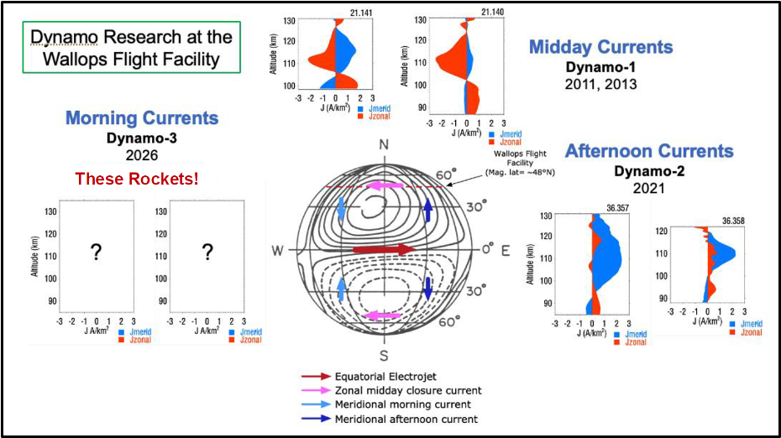
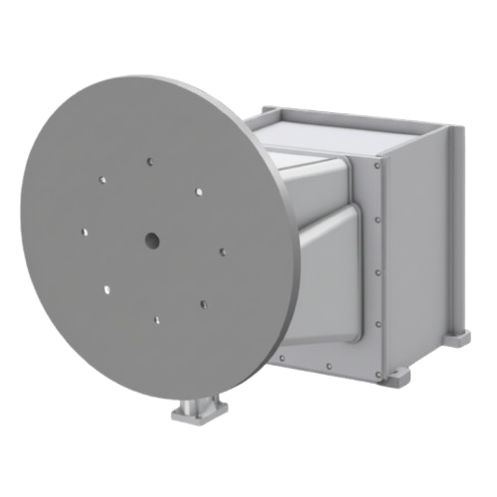
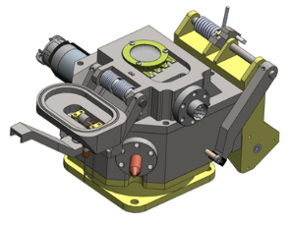
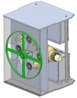
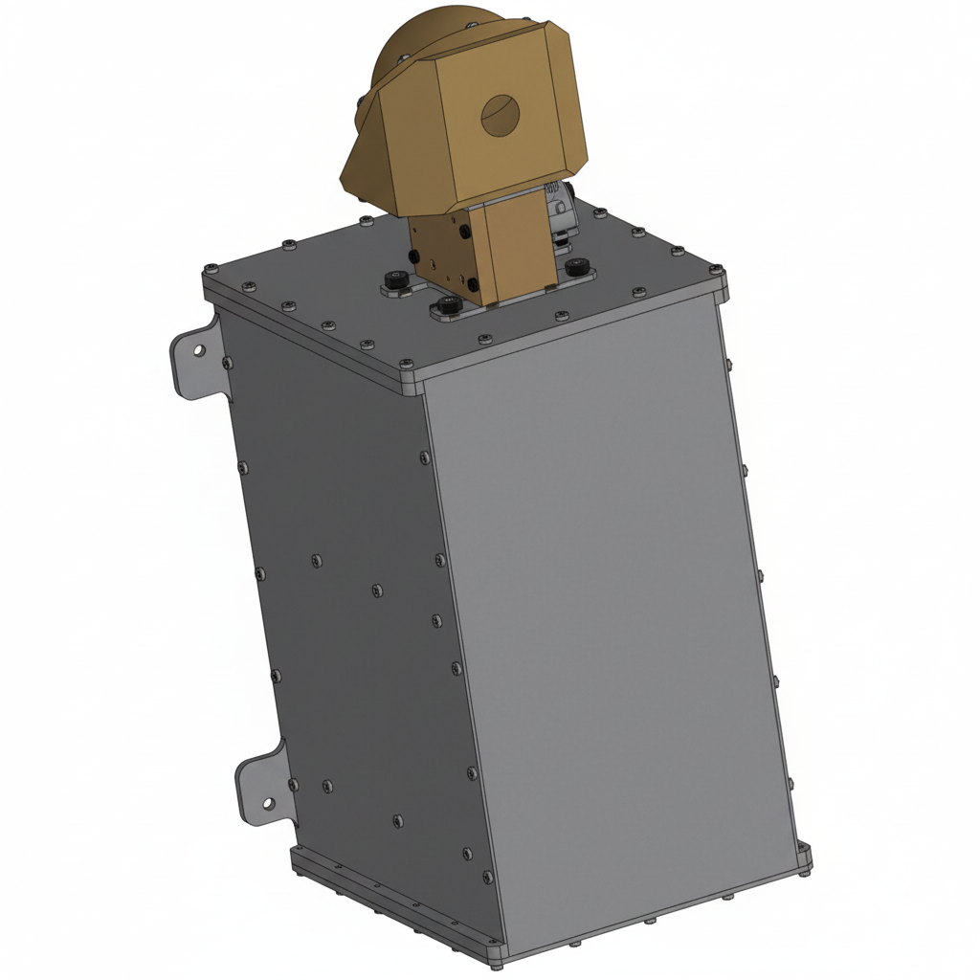
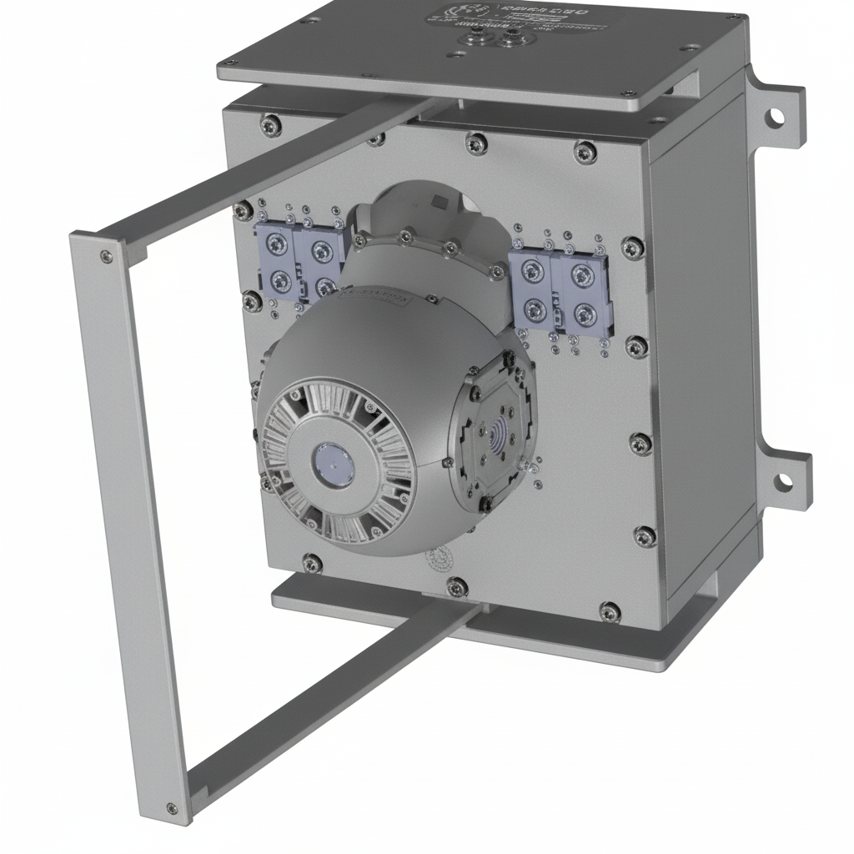
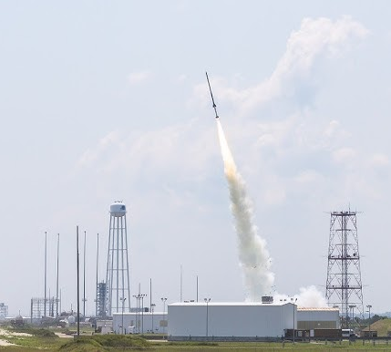
Support of the Dynamo3 Sounding Rocket Mission: Calibration of Instrumentation and Preparation for Launch
Kai Rowlands. Supervised by Dr. James Clemmons
Department of Physics, University of New Hampshire, Durham, NH 03824
Introduction
Figures
Methodology
The Earth’s ionosphere-thermosphere system is an important element within the overall heliophysical system. This atmospheric layer is responsible for linking neutral gases of the lower atmosphere to the plasma-dominated ionosphere and magnetosphere. Despite the region’s direct role in the Sun-Earth connection, understanding is incomplete due to significant shortcomings in key areas. An example is the difficult-to-explore region in the lower thermosphere-ionosphere, where significant intricate processes take place and define the behavior of the important elements of the system.
A further instance of this is the dayside ionospheric dynamo, which is a current system powered by the effect of thermospheric winds on the commingled plasma of the ionosphere. Although the general physics of this phenomenon is believed to be understood, recent detailed exploration has raised questions [1]. Further understanding requires further experimentation, and the application of sounding rockets lends itself well to the needed targeted investigations due to their ability contain multiple instruments within the fuselage and the customization of their trajectories. Due to this lack of understanding and the suitability of sounding rockets as a vessel, the Dynamo3 rocket missions were proposed to NASA and are now under development.
Mid-May, calibration of the IG sensors using our pressure standard system. Winds sensors (WCT, WIT, and MWM) will be calibrated in our winds calibration chamber. Afterward, the NMS will be calibrated in the winds chamber.
Mid-June, the first instruments to finish calibration will then be shipped to NASA/Wallops for payload integration beginning. They’ll be shipped as they are calibrated.
Mid-July, After all of the instruments have been integrated they will be shipped back to UNH for refurbishment and further spot calibrations.
Mid-August, the instruments will be shipped back to NASA/Wallops for final payload integration in preparation for launch.
Figure 1: Slide from the Dynamo3 Mission Initiation Conference illustrating how the Dynamo3 investigation will complement the results from the previous Dynamo1 and Dynamo2 investigations. (R. Pfaff, used with permission.)
Future Work
Unfortunately, the launch of Dyamo3 has been delayed until June 2027. Therefore, my work will focus on the Miniature Winds Meter (MWM). I will assist with the preparation of other instruments as needed.
Motivation
The goal of the Dynamo3 sounding rocket missions is to understand the dynamo currents, fields, and winds in the lower E-region of the ionosphere and how they relate to the currents, fields, and winds in the upper E-region and F-region.
The focus is on understanding the physics underlying the morning sector solar quiet (Sq) current system. The primary scientific objective is to determine if these lower E-region currents and winds drive locally enhanced DC electric fields. These fields typically display large amplitudes in satellite measurements in the low latitude F-region in the morning. For the first time, detailed, lower altitude variations of the morning currents, electric fields, winds, and plasma density in the region where the Hall and Pedersen mobilities are enhanced (90 – 140 km) will be measured together. A second scientific objective is to determine whether this set of measurements is consistent with the
local atmospheric dynamo equation.
Figure 2: Ionization Guage sensor
Figure 3: Winds Cross-Track
Figure 4: Winds In-Track
Acknowledgements
Many thanks to my advisor, Dr. James Clemmons for assistance in conducting this research and for providing the lab space and instruments, as well as mentorship. Thanks to Dr. Per Berglund for his advice and support
through the process of writing this proposal.
References
Figure 6: Launch of Dynamo2
National Academies of Sciences, Engineering, and Medicine (2024), The next decade of discovery in solar and space physics: Exploring and safeguarding humanity's home in space. Washington, DC: The National Academies Press, 702 pp., doi:10.17226/27938.
Pfaff, R., M. Larsen, T. Abe, H. Habu, J. Clemmons, H. Freudenreich, D. Rowland, T. Bullett, M.-Y. Yamamoto, S. Watanabe, Y. Kakinami, T. Yokoyama, J. Mabie, J. Klenzing, R. Bishop, R. Walterscheid, M. Yamamoto, Y. Yamazaki, N. Murphy, and V. Angelopoulos (2020), Unmasking the Earth’s atmospheric dynamo with spiral and currents driven by strong winds revealed by vapor trails and sounding rocket probes, Geophys. Res. Lett., 47, e2020GL088803, doi:10.1029/2020GL088803.
Figure 5: Neutral Mass Spectrograph
Figure 7: Miniature Winds Meter

