Slide 1

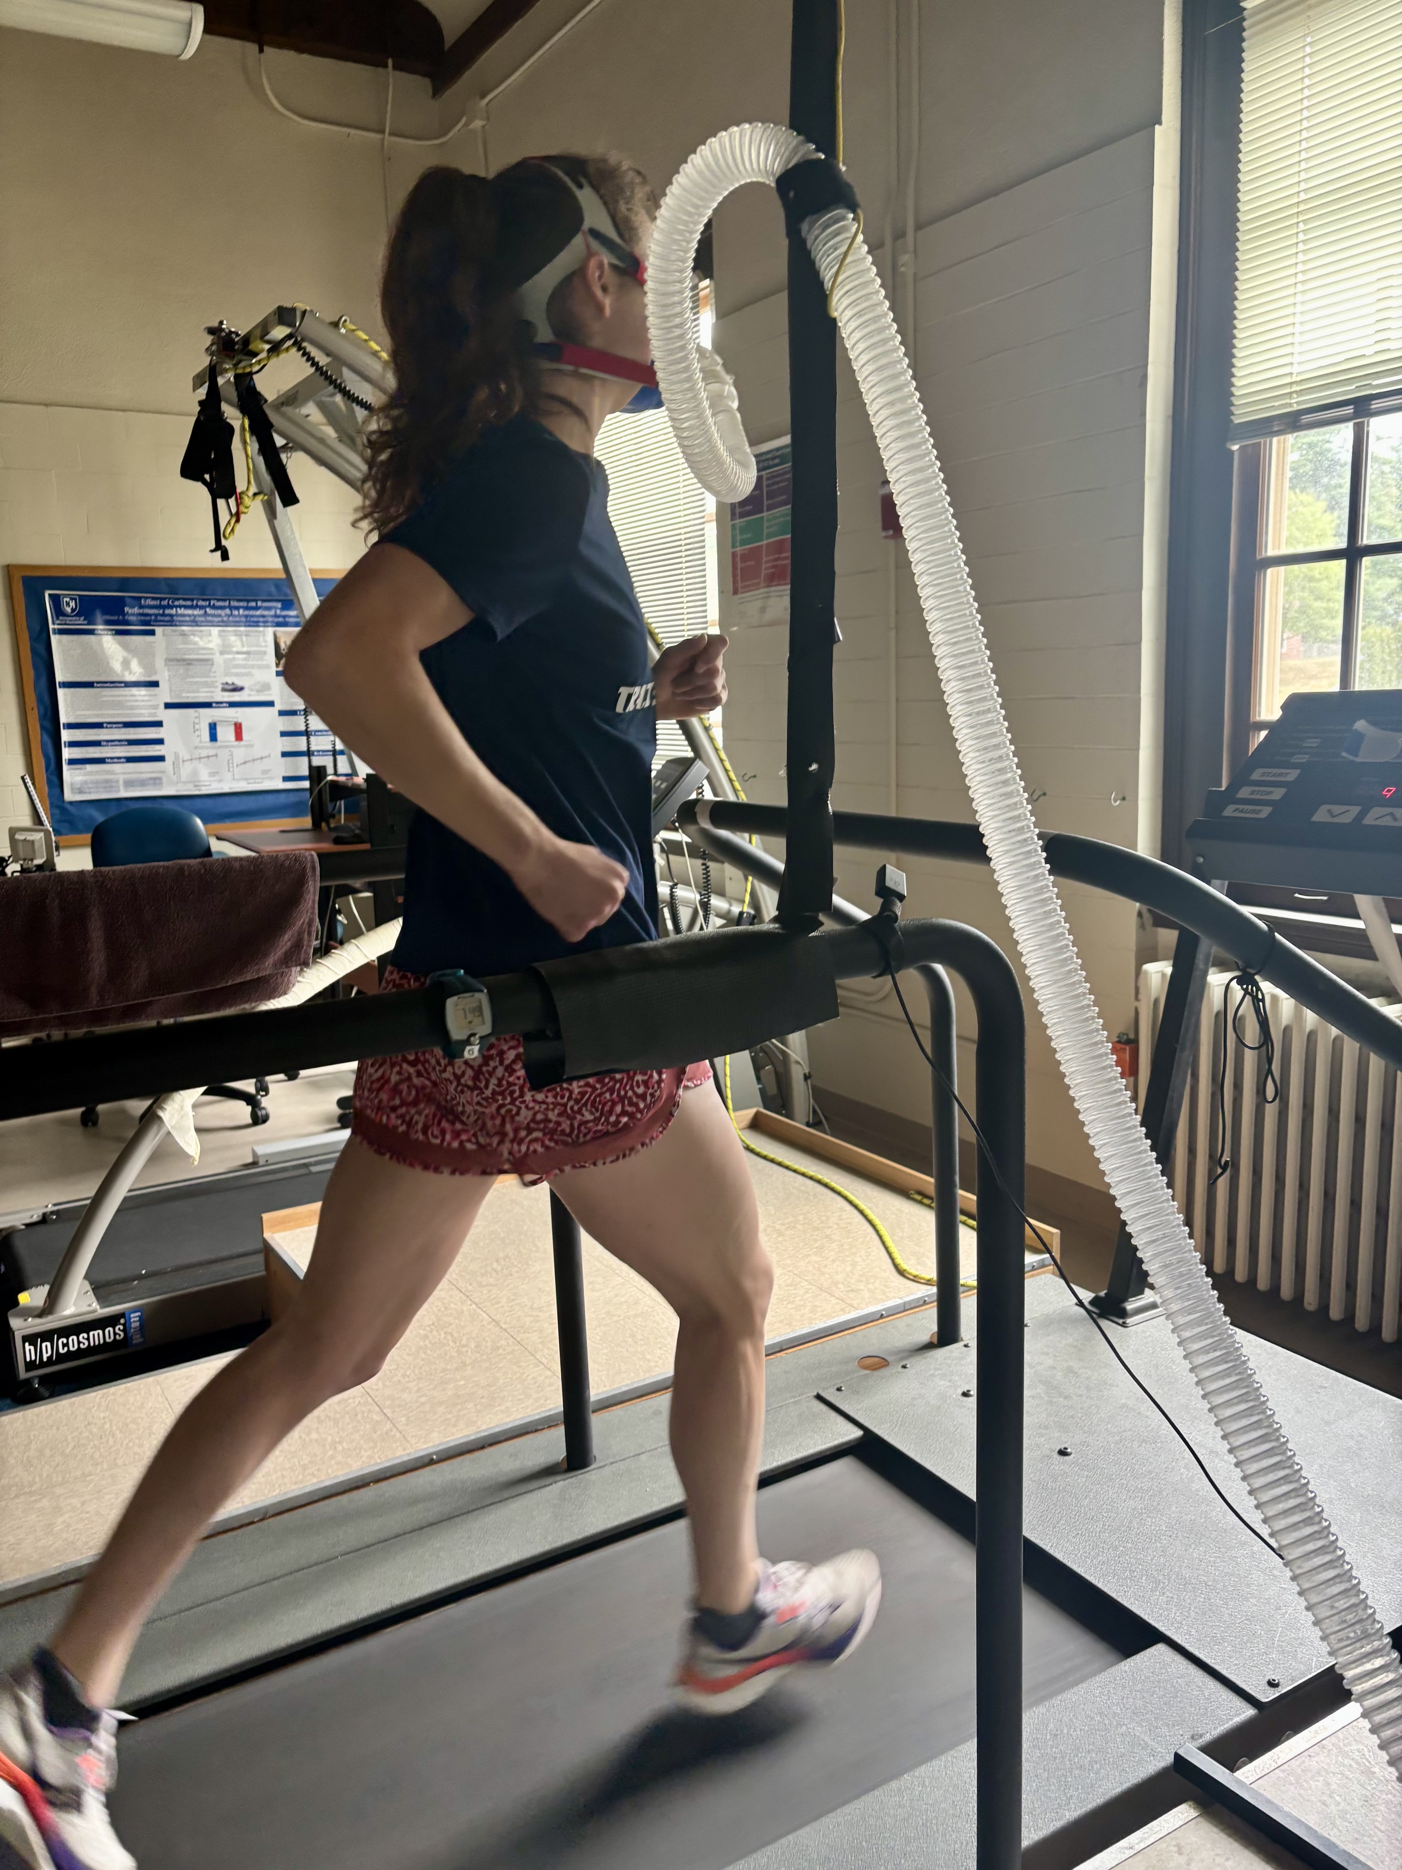
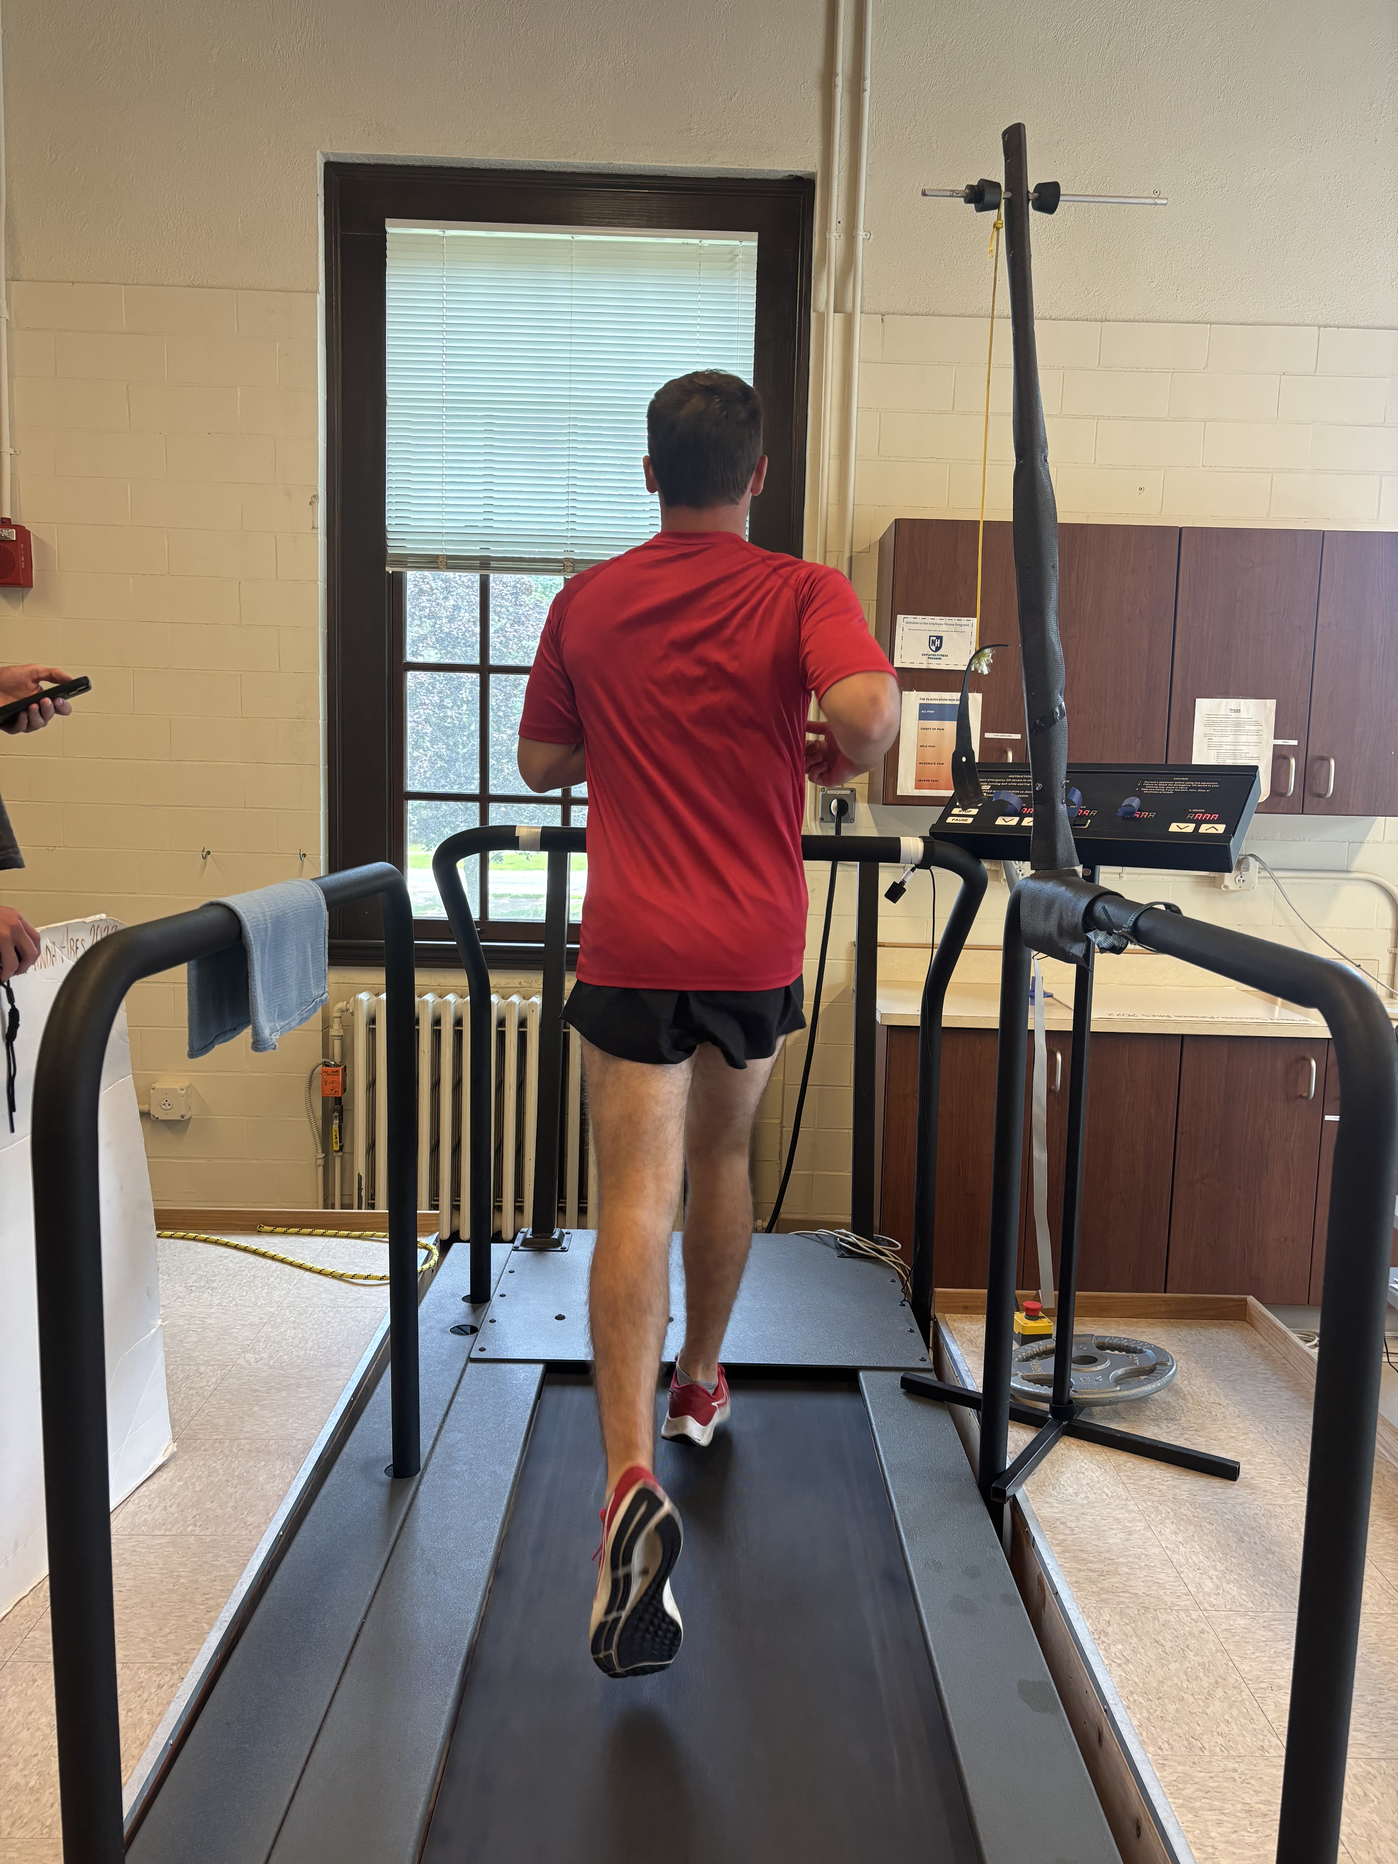
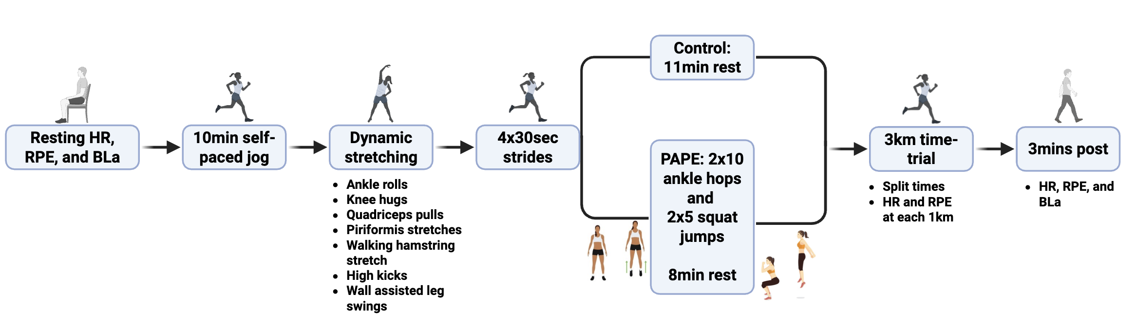
EFFECTS OF POST-ACTIVATION PERFORMANCE ENHANCEMENT ON 3KM RUNNING PERFORMANCE IN COLLEGIATE AND POST-COLLEGIATE RUNNERS
Maxwell R. Stenslie, Carter J. Norton Summer B. Cook, FACSM
Department of Kinesiology, Exercise Science, University of New Hampshire
Introduction
Methods
Post-Activation Performance Enhancement (PAPE) describes improvement in muscular performance following a high-intensity conditioning activity.¹
Mechanisms may include myosin light chain phosphorylation, enhanced motor unit recruitment, and increased neural drive.¹
PAPE has been demonstrated in power-based sports, but its role in trained endurance runners and athletes remains less established.²
One study found a 3.6% improvement in 5km running performance in experienced runners following heavy banded jump squats.³
For runners, PAPE can be induced through plyometric exercises offering a practical, low-fatigue warm-up strategy before races or workouts.
PAPE is influenced by conditioning activity, intensity, volume, recovery, and athlete training status.
Visit 1 – Familiarization & VO₂max Testing
Approved by the UNH IRB (IRB-FY2025-283)
Initial screener, informed consent, and a health/running history questionnaire
Anthropometrics of height, weight, percent body mass, and skeletal muscle mass (in kg)
VO₂max test (0% incline): males started at 12.9 km·h, females at 11.3 km·h; speed increased 0.5 km·h every 30 s until exhaustion
HR was recorded using a Polar H10 chest-strap monitor, BLa was measured from fingertip blood samples collected with a Lactate Plus Meter handheld analyzer, and RPE was assessed using the Borg 6–20 scale
Familiarization to the PAPE protocol
Visits 2–3 – Experimental Conditions
Randomized, within-subject crossover design comparing PAPE (experimental) vs. NoPAPE (control) conditions
Each participant completed two 3km treadmill time trials at 1% grade.
Participants were blinded to speed, distance, and time, and could only increase or decrease treadmill speed using a single control
They were informed only when they reached 1km, 2km, and when 200 m remained
No verbal encouragement was provided during testing
Discussion
The 3km time trial performance differed by ~0.9% between the conditions and the physiological variables were consistent between the conditions. Therefore, the plyometric-based warm-up did not induce PAPE and did not improve running performance.
This contrasts a study that found a 3.6% improvement after band resisted jump squats³. Although the athletic population and recovery period were similar, our ankle hop and jump squat protocol was a lower intensity and higher volume which may have attributed to the differential responses.
Purposes
This study examined the effects of a plyometric-based PAPE protocol on 3km running performance in collegiate and post-collegiate runners.
A secondary purpose was to assess heart rate (HR), blood lactate (BLa), and rating of perceived exertion (RPE) responses between the PAPE and control conditions.
Figure 1. Visit 2 and Visit 3 protocol
Data Analysis
Hypotheses
IBM SPSS Statistics (Version 30.0.1.0).
Dependent t-tests compared 3km performance times between PAPE and NoPAPE conditions.
Two-way repeated-measures ANOVAs (Condition × Time) were used to assess differences in BLa, HR, and RPE during the 5km time trials between conditions, with significance set at p < 0.05.
Conclusion
It was hypothesized that the runners would complete the 3km time trial faster after the PAPE protocol compared to a standard warm-up.
Improvement would occur without increases in HR, BLa, or RPE, suggesting a neuromuscular mechanism.
Results
A PAPE protocol consisting of low intensity ankle hops and squat jumps did not induce PAPE in collegiate and post-collegiate runners. Future research should determine the most effective protocol focusing on determining the appropriate volume and intensity for eliciting PAPE.
 | Rest | 1km | 2km | 3km | Post
PAPE
HR (bpm) | 65 ± 9 | 186 ± 8 | 192 ± 8 | 194 ± 7 | 127 ± 18
RPE | 7 ± 1 | 13 ± 2 | 16 ± 2 | 18 ± 1 | 12 ± 3
BLa (mmol) | 1.7 ± 0.38 | ------------ | ------------ | ------------ | 9.4 ± 3.3
NoPAPE
HR (bpm) | 62 ± 11 | 184 ± 7 | 192 ± 8 | 196 ± 8 | 125 ± 12
RPE | 7 ± 1 | 13 ± 1 | 16 ± 2 | 18 ± 1 | 11 ± 2
BLa (mmol) | 1.6 ± 0.42 | ------------ | ------------ | ------------ | 9.0 ± 1.8
Participants
Limitations
Males and females aged 18-25 years old
Completed a race in the past 6 months
Participants are current or former NCAA collegiate runners
Lifetime 5km personal bests under 19:08 (females) and 16:52 (males).
No injuries of the lower extremities in the last 6 months
N Total | 14 (8M & 6F)
Age (yrs) | 22.1 ± 1.3
Height (cm) | 174.0 ± 10
Body Mass (kg) | 64.0 ± 9.0
Skeletal Muscle Mass (kg) | 31.06 ± 6.18
Percent Body Fat (%) | 15.0 ± 5.6
VO2max (mL/kg/min⁻¹) | 60.6 ± 7.4
Participants may have experienced pacing bias, as performing a second 3km trial could improve pacing regardless of condition.
Small sample size (n = 14) limits statistical power and generalizability.
References
Table 1. Descriptive statistics of participants in the study. Data is presented as means ± standard deviation (SD).
Figure 2. Mean 3km time trial performance under PAPE and NoPAPE conditions. Bars represent mean ± SD, with individual lines connecting each participant’s performance across conditions. No significant difference was observed.
Blazevich A.J., Babault N. Post-activation potentiation versus post-activation performance enhancement in humans: Historical perspective, underlying mechanisms, and current issues. Frontiers in Physiology. 2019; 10:1359. https://doi.org/10.3389/fphys.2019.01359
Boullosa DA, Behrens M, Foster C, et al. Post-activation potentiation (PAP) in endurance sports: A review. European Journal of Applied Physiology. 2018;118(11):2401–2414. https://doi.org/10.1007/s00421-018-3970-0
Low LA, Ahmadi H, Kelly P, Willardson JM, Boullosa DA, Behm DG. Prior band-resisted squat jumps improve running and neuromuscular performance in middle-distance runners. Journal of Sports Science and Medicine. 2019;18(2):301–315.
Silva RAS, Silva-Júnior FL, Pinheiro FA, Souza PFM, Boullosa DA, Pires FO. Acute prior heavy strength exercise bouts improve the 20-km cycling time trial performance. Journal of Strength and Conditioning Research. 2014;28(9):2513–2520. https://doi.org/10.1519/JSC.0000000000000442
Wei C., Yu L., Duncan B., & Renfree A. (2020). A Plyometric Warm-Up Protocol Improves Running Economy in Recreational Endurance Athletes: Frontiers in Physiology, 11, 197. https://doi.org/10.3389/fphys.2020.00197
Table 2. Means ± SD for HR, RPE, and BLa for the control condition (NoPAPE) and experimental condition (PAPE).

