Slide 1

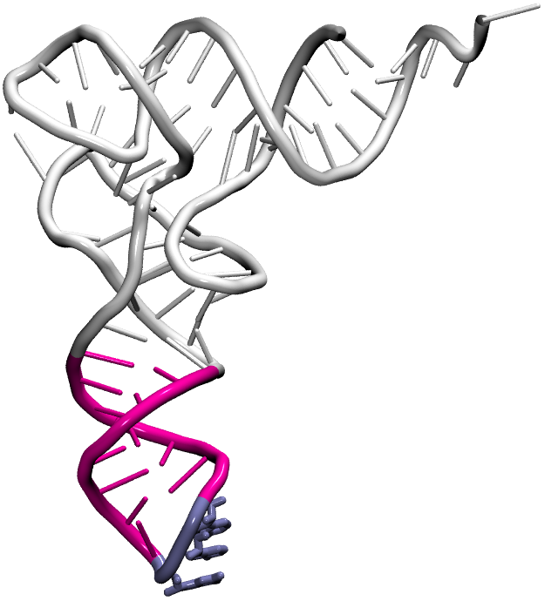
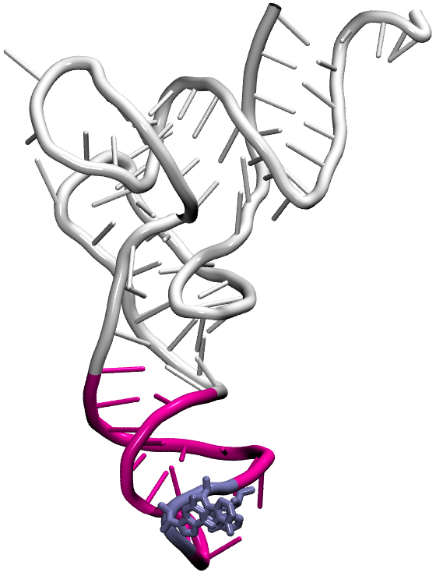
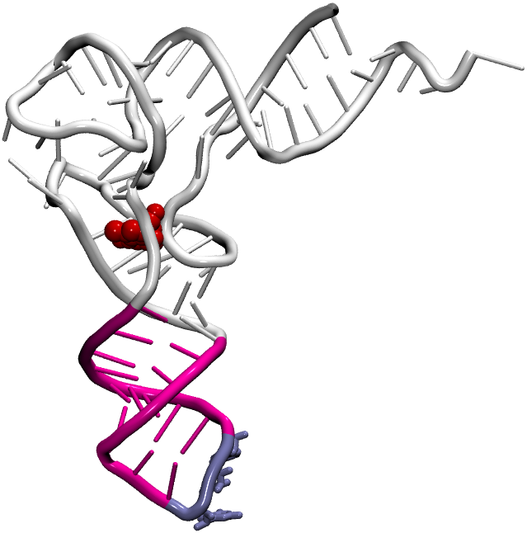
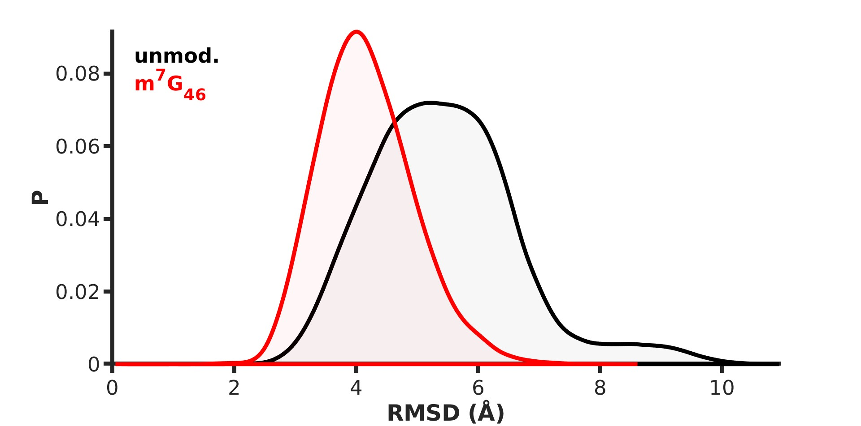
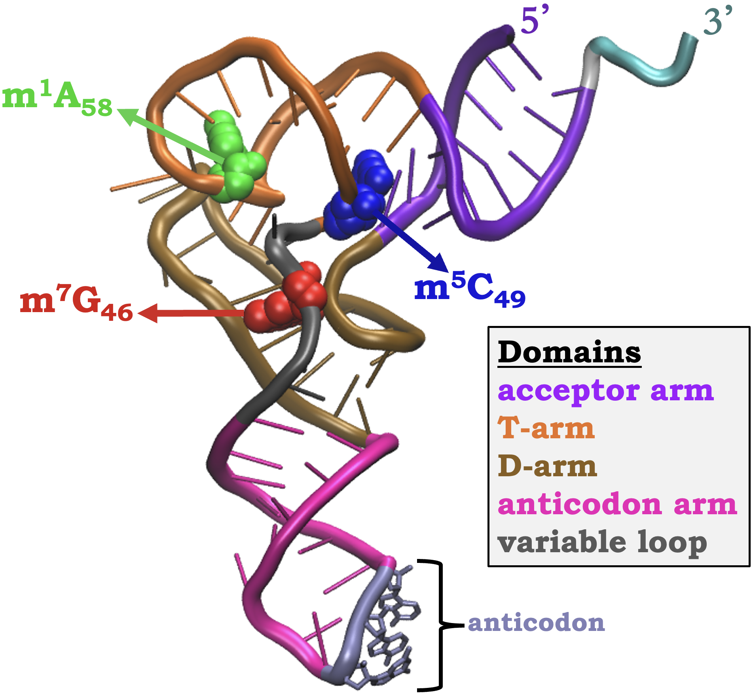
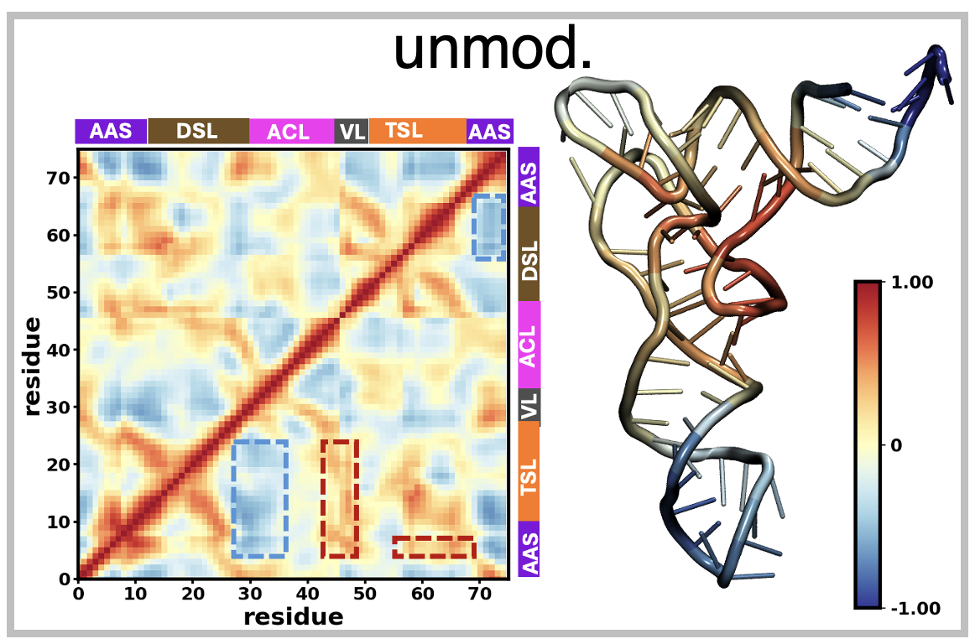
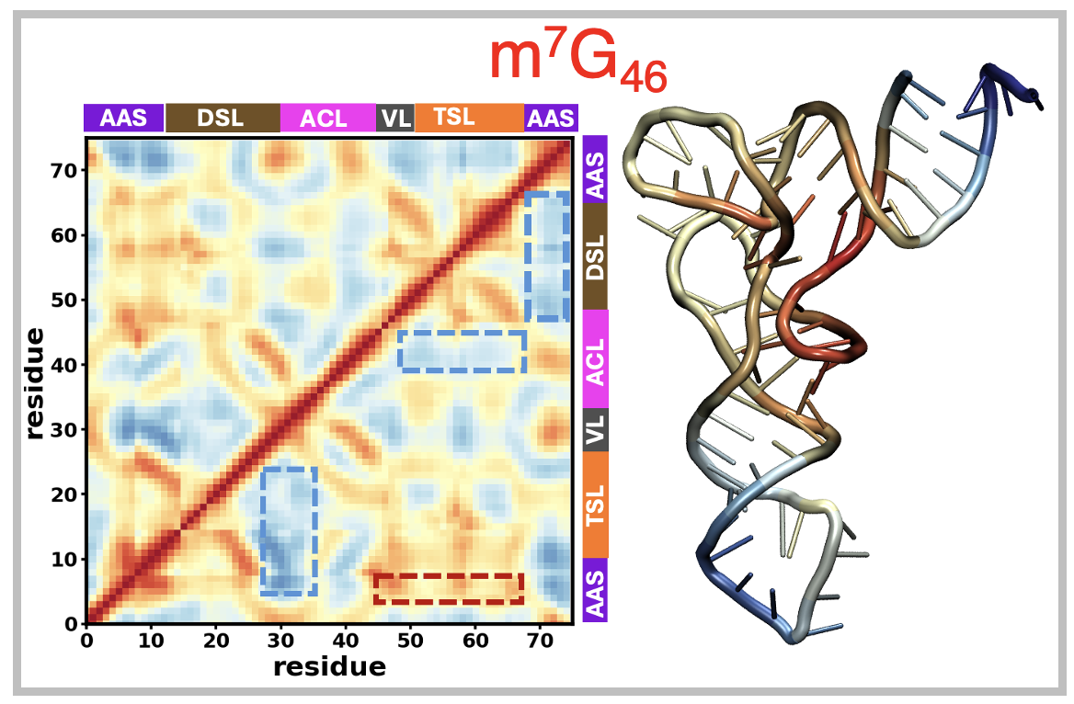
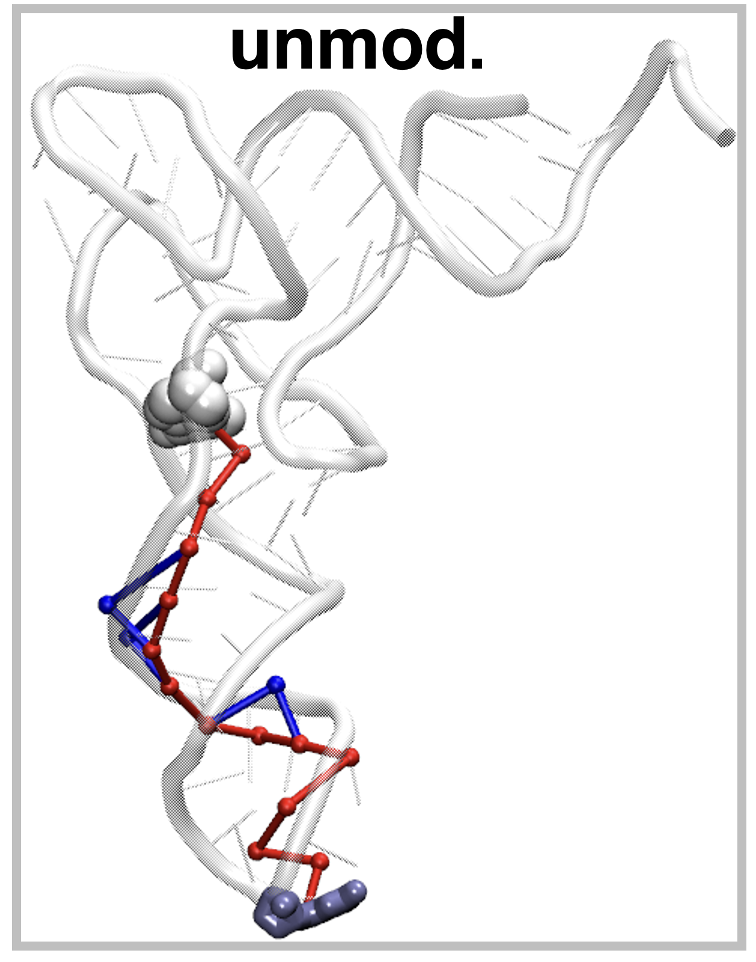
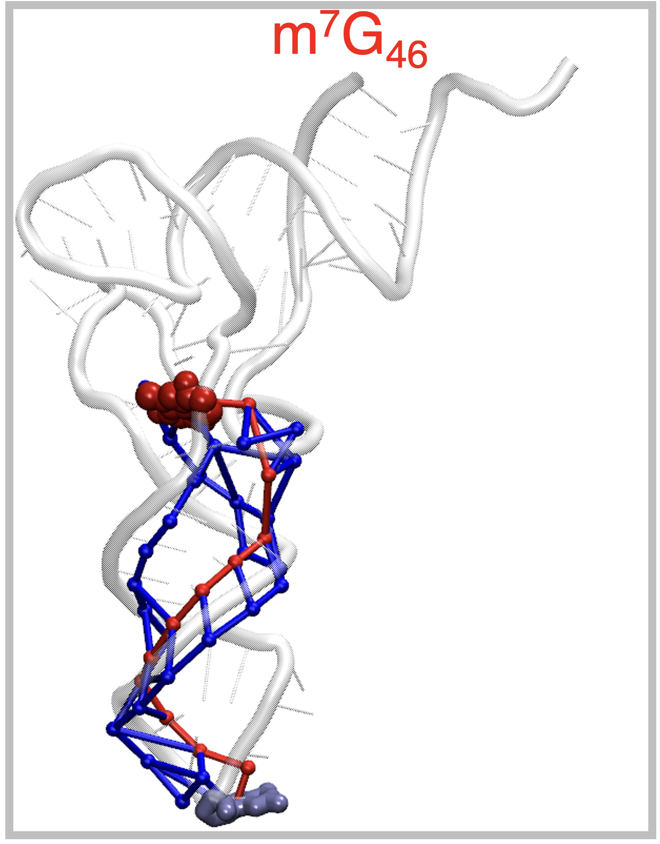
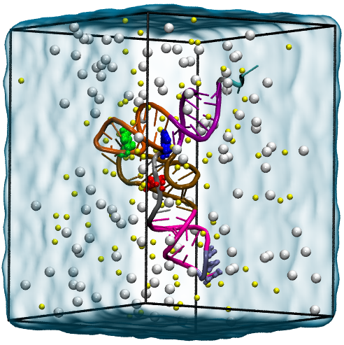
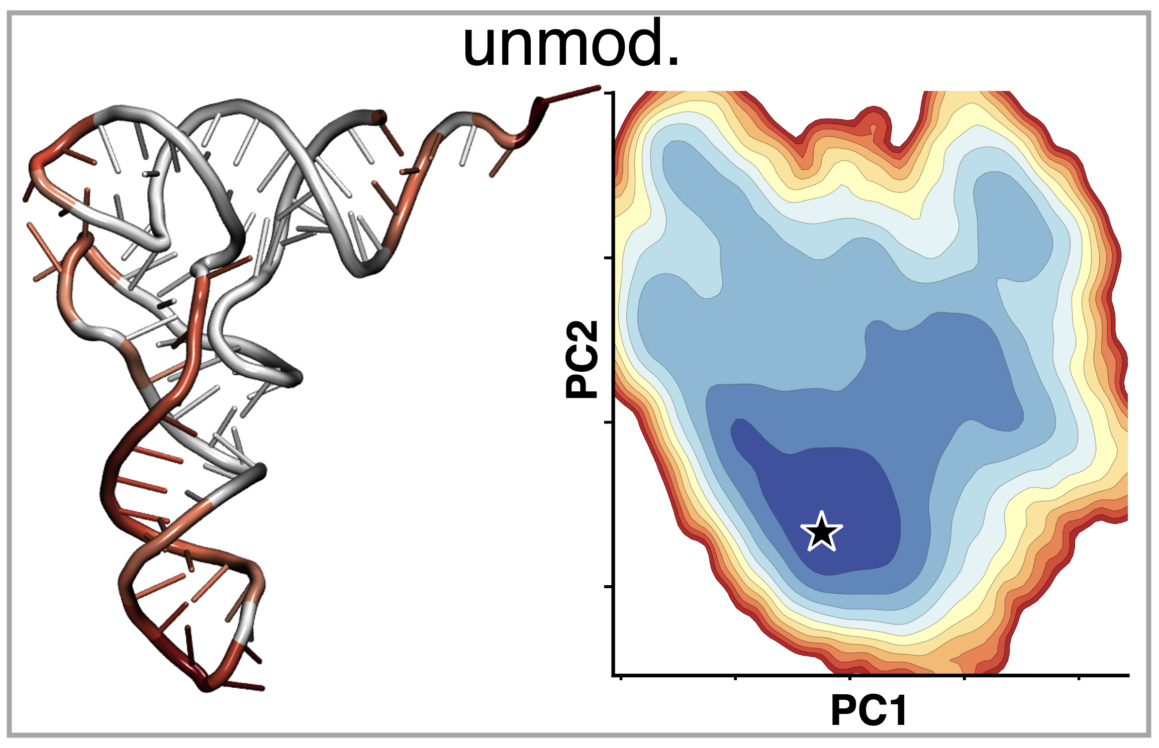
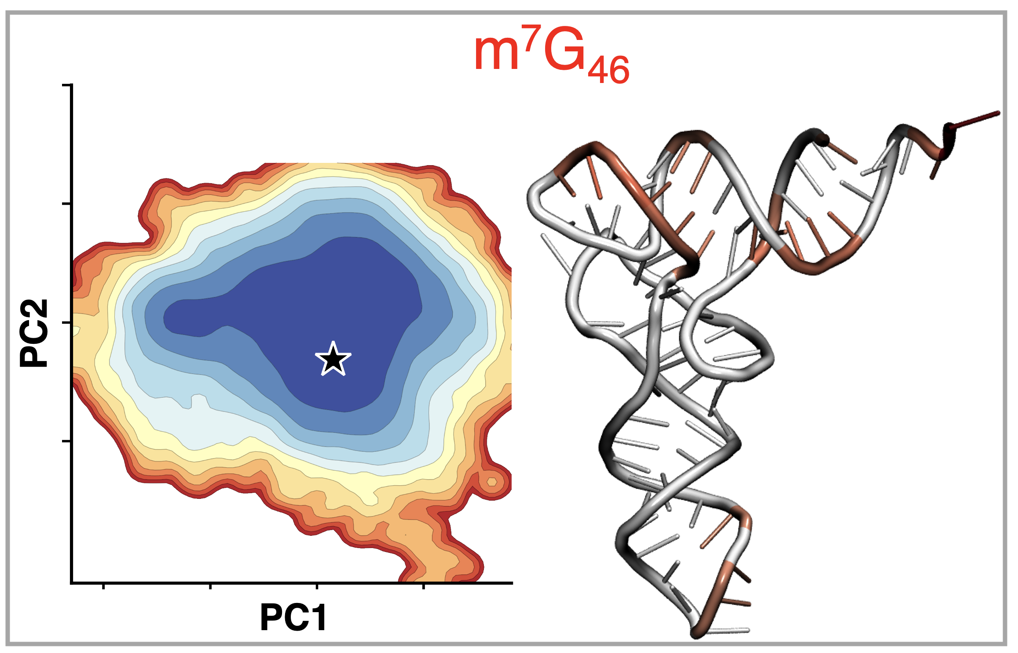
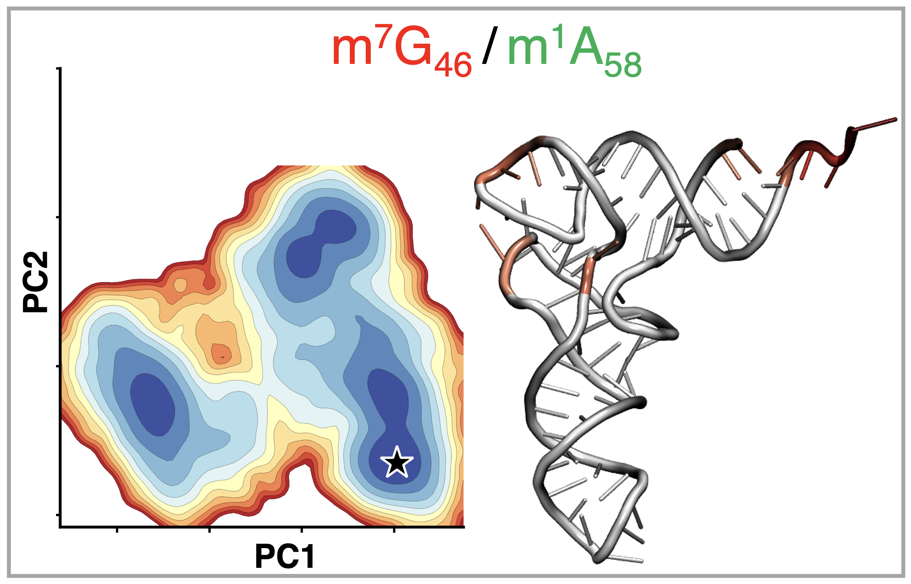
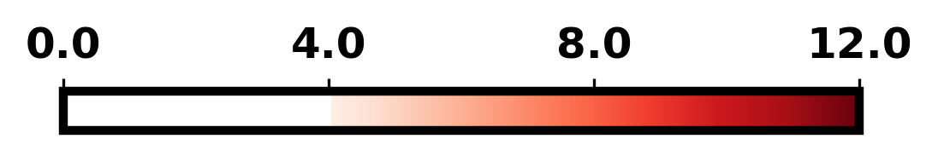
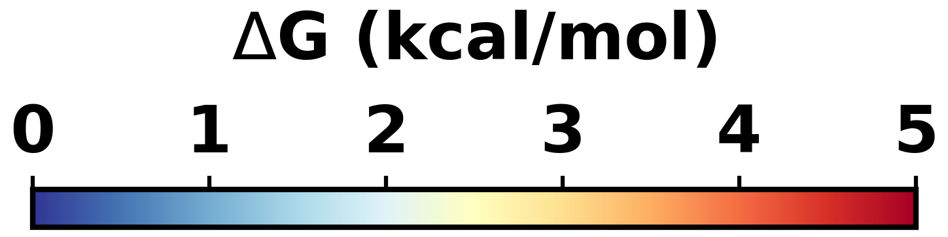
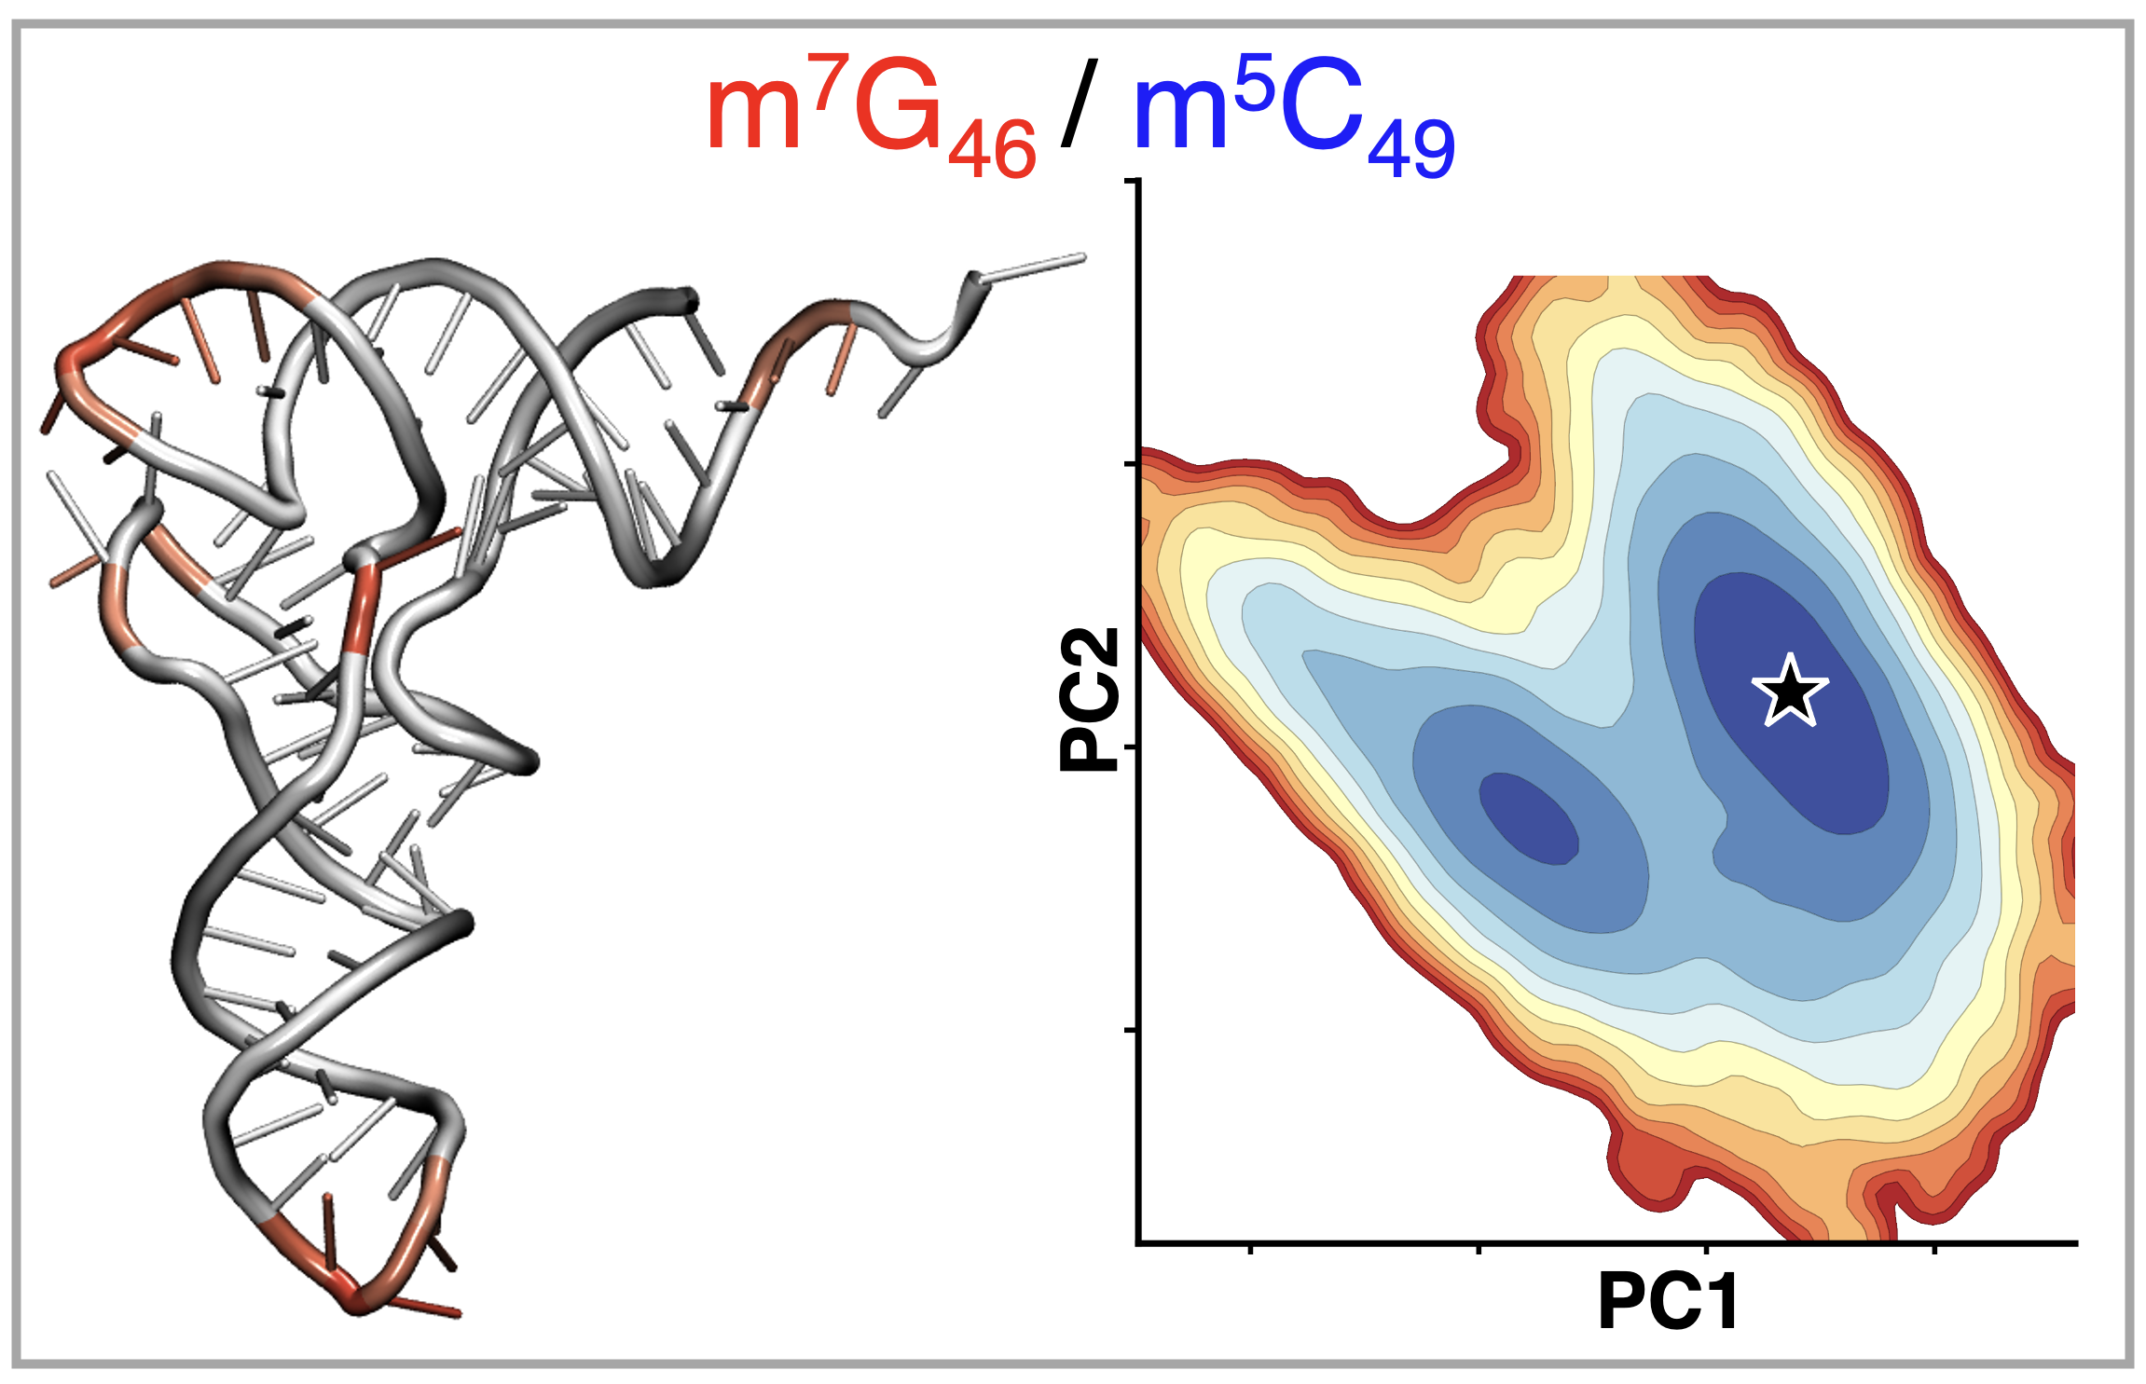
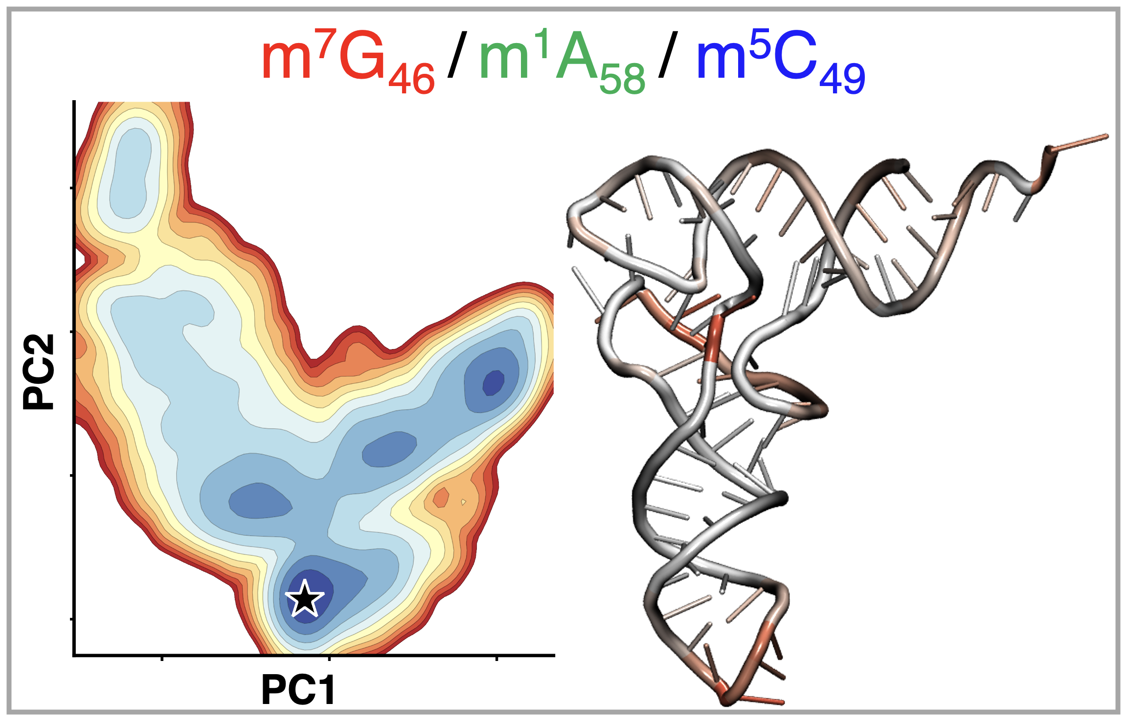
Assessing Structural Perturbations in Chemically Modified tRNA
Teddy E. Amissah and Harish Vashisth*
Department of Chemical Engineering and Bioengineering, University of New Hampshire, Durham, NH 03824
Email: teddy.amissah@unh.edu (presenter), *harish.vashisth@unh.edu
Aim
Absence of core modifications displaces the anticodon loop
m⁷G₄₆ confers the most stabilizing effect
Assess the individual and combinatorial effects of core-modifications on the conformation and dynamics of tRNA.
Structural details of tRNA
crystal structure
unmod.
m⁷G₄₆
The absence of chemical modifications results in a consistent inward displacement of the anticodon.
A single core-modification present (m⁷G₄₆) enhanced residue stability in the anticodon region.
m⁷G₄₆ confers the greatest stabilizing effect amongst the singly-modified variants.
Core-modification impact on correlation of tRNA domains and allosteric pathways
PDB ID: 1EHZ
Methods
Correlation analysis reveals that, irrespective of the presence or absence of chemical modifications, residue-residue correlations are generally conserved.
Modification of the core residues increased allosteric pathways between core-modification residues and anticodon nucleotides, which enhances inter-residue communication efficiency.
PCA reveals non-additive effects of core-modifications
References
Yared M., et al. Genes 2024, 15:374.
Saleh S., et al. RNA 2024, 30:37-51.
Zhang X., et al. J. Chem. Theory Comput. 2014, 10: 3473-3483.
Godwin R. C., et al. ACS Omega 2018, 3:10668–10678.
Solvated & ionized system
The presence of chemical modifications directly affected the conformational space explored by tRNA.
Acknowledgements
Method: All-atom Molecular Dynamics (MD) simulation
Software: Nanoscale Molecular Dynamics (NAMD)
Interatomic potential/force-field: CHARMM36
System size: 66899 atoms
Financial support: NSF CHE-2517098.
Supercomputing resources: NSF OIA-1757371.

