Slide 1
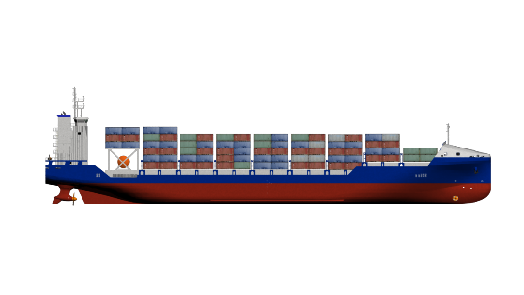

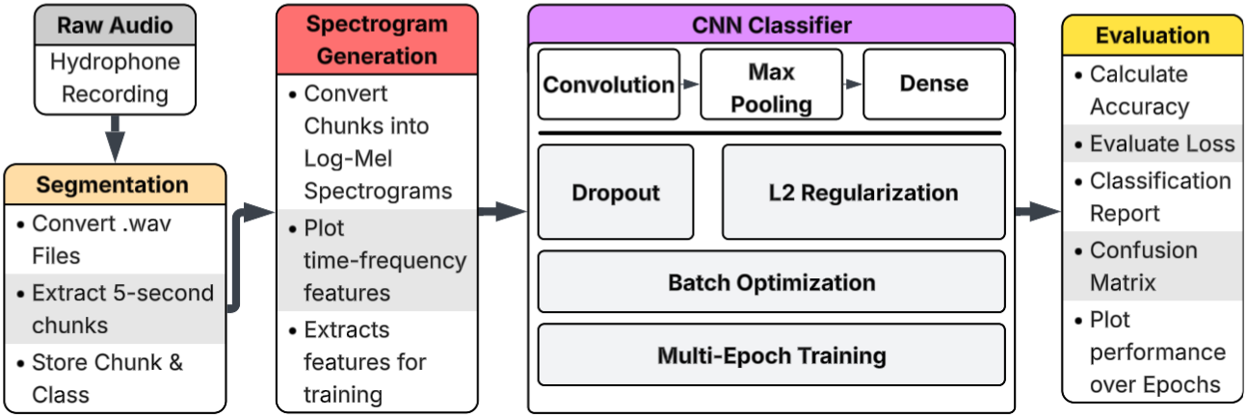
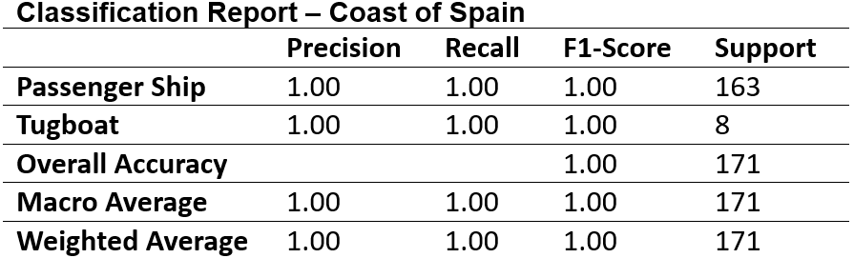
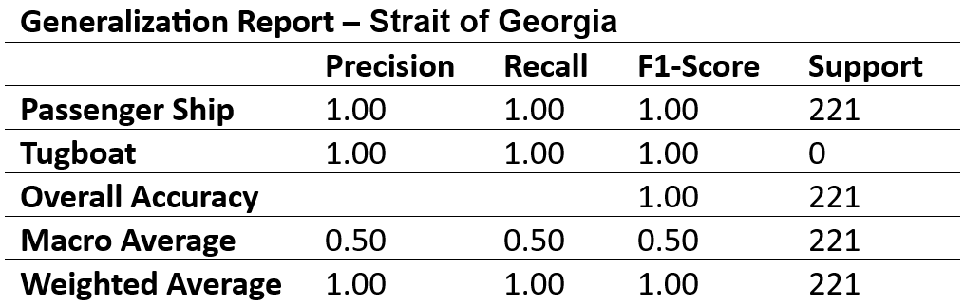
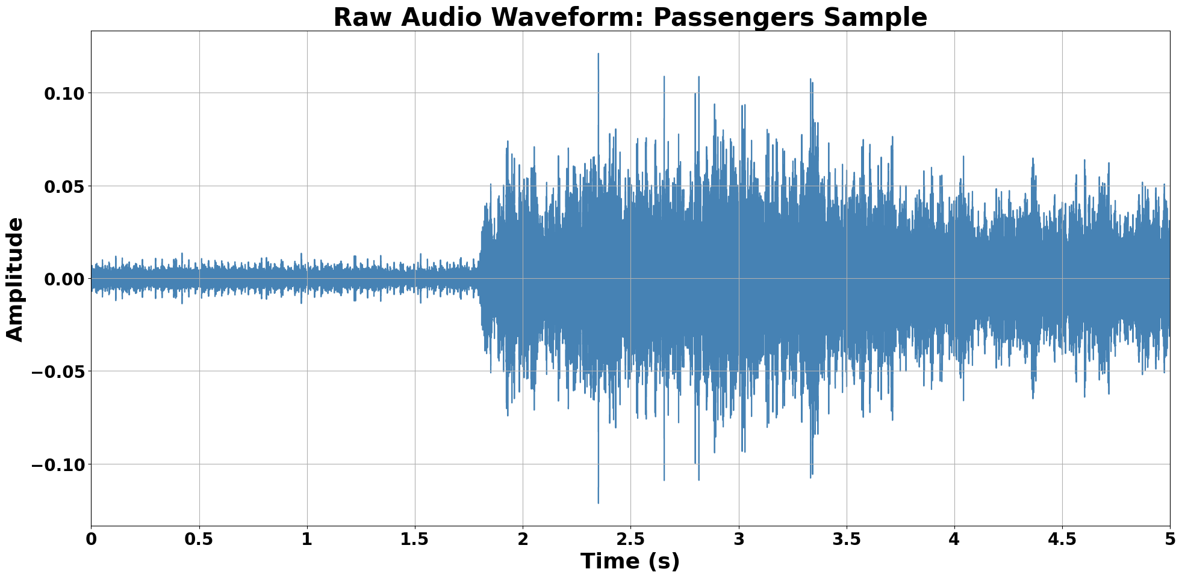
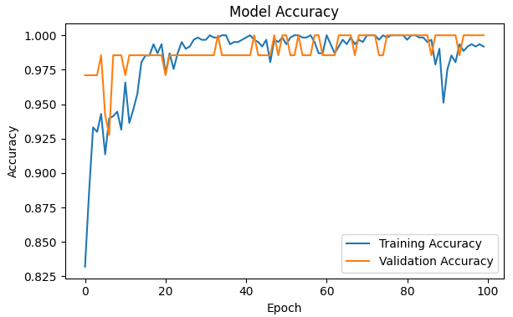
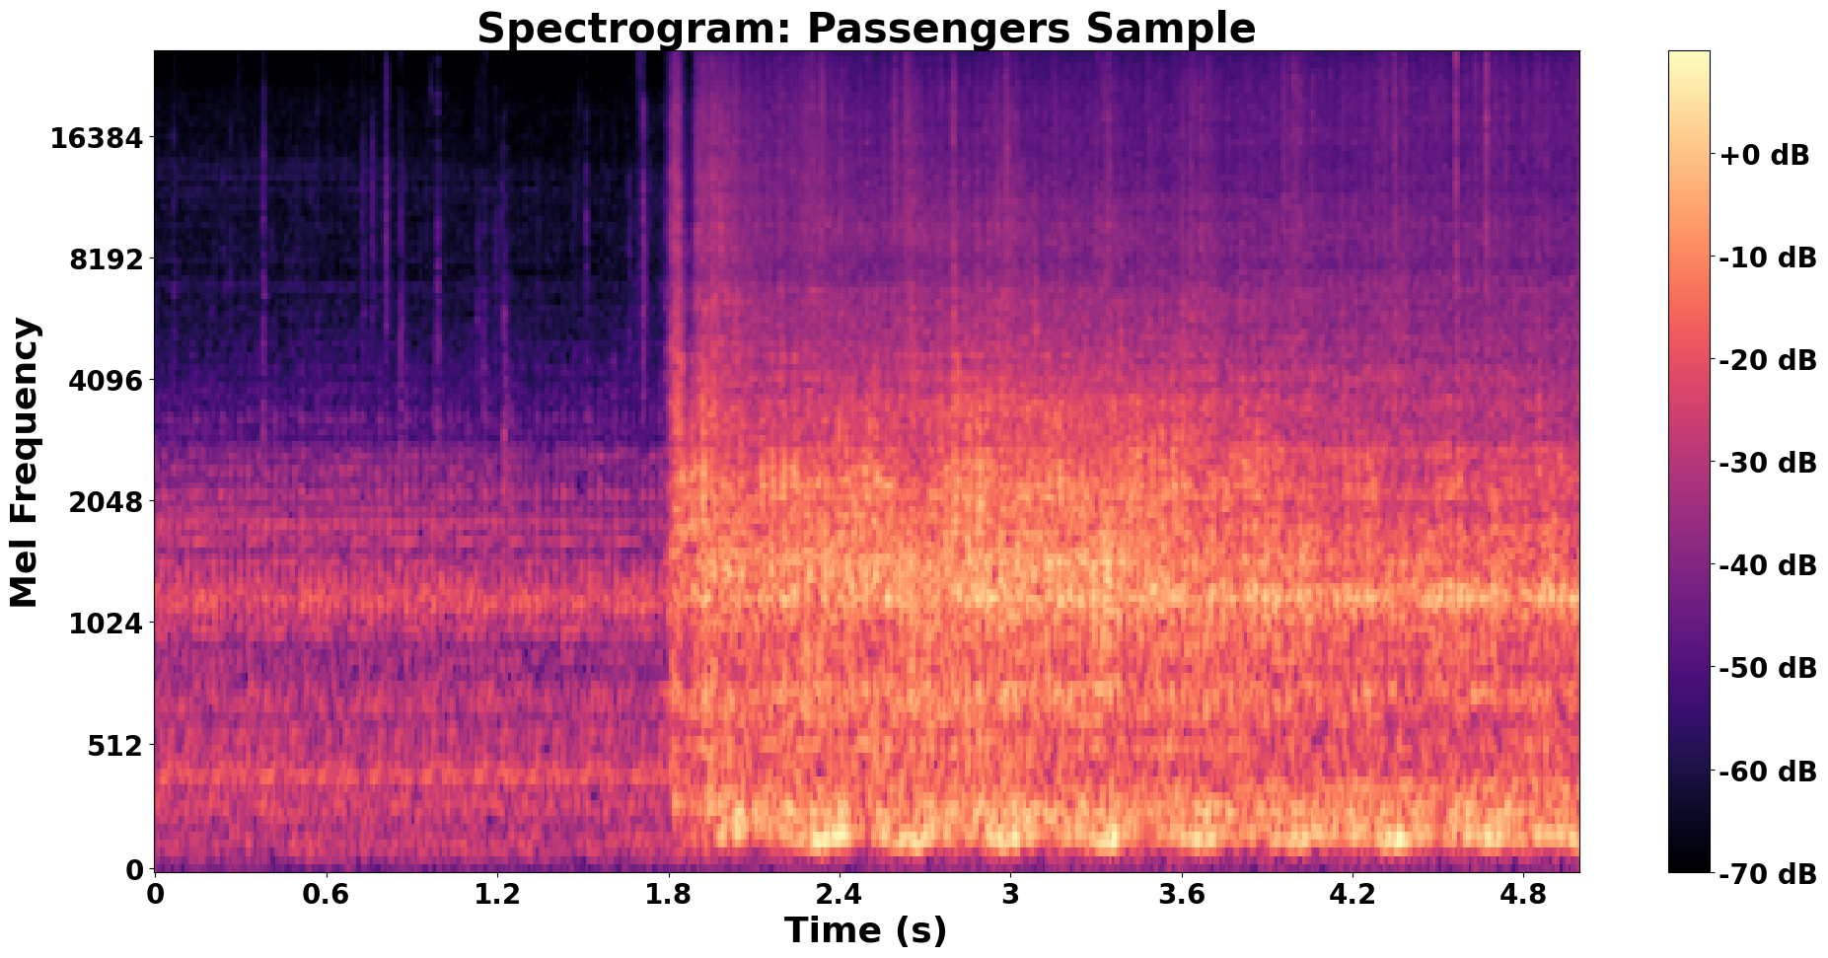
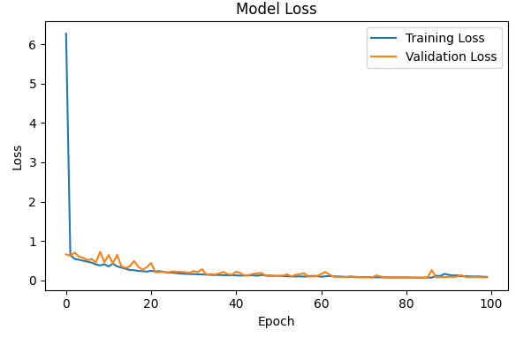
Cross-Ocean Acoustic Classification using Machine-Learning
Jack Dubeau
Advisor: Dr. Nicholas J. Kirsch
Department of Electrical and Computer Engineering, University of New Hampshire
Problem
System Block Diagram
Results
Underwater acoustic signal propagation varies drastically with temperature, salinity, depth, weather, and seabed features, causing signals to differ across ocean regions. However, acquiring labeled representative datasets from multiple regions is often impractical or restricted. As a result, machine learning models are typically trained on region-specific data, thus struggle to generalize to new unseen environments. This limits the reliably of acoustic classification systems when deployed outside their original training conditions.
The model achieved strong classification performance for passenger ship acoustic signals, reaching up to 100% accuracy on selected test cases. Training and validation curves demonstrated stable convergence with no significant overfitting, supported by the use of dropout and regularization. Confusion matrices further confirm high prediction accuracy for well-represented classes, with minimal misclassification observed.
Performance was found to be strongly dependent on dataset distribution, with the most reliable results occurring in classes with abundant training data. Additionally, consistent preprocessing—specifically normalized 5-second segmentation—played a key role in improving model stability and available data. Current results are focused on vessel-dominant classes, with ongoing work to expand classification across addition vessel types and more diverse acoustic conditions.
Coast of Spain vs. Strait of Georgia
Solution
Segment recordings into normalized 5-second chunks to reduce environment variability
Convert each segment into log-mel spectrograms (time-frequency features)
Train a CNN classifier for vessel-related acoustic signatures (focus on passenger ships)
Network structure:
  Convolutional Layers → extract spatial features
  Max pooling → reduce dimensionality and emphasize dominant patterns
  Dense Layers → perform classification
Improve generalization:
  Dropout → reduce overfitting by randomly disabling neurons
  L2 regularization → penalize complex model weights
Train using batch-based optimization over multiple epochs
Evaluate preprocessing and training configurations to determine optimal performance
Assess performance using accuracy, loss, classification reports, and confusion matrices
This project investigates a machine learning framework designed to classify underwater acoustic signals across diverse ocean environments. The goal is to reduce dependence on region-specific datasets by developing a system that minimizes the impacts of environmental variability and captures consistent acoustic characteristics. By enabling models to rely on features that are less sensitive to changes in ocean conditions, this work moves toward a “universal translator” for underwater acoustics.
Environmental Effects on Acoustic Propagation
Signal Representation and Model Performance
The propagation of underwater acoustic signals is strongly influenced by environmental conditions, primarily temperature, salinity, and depth (pressure). These factors determine the speed of sound in seawater, which directly affects how acoustic signals travel, refract, and attenuate across different ocean regions.
Temperature: higher temperatures increase the sound speed, causing signals to travel faster in warmer waters and bend toward cooler regions
Salinity: Higher salinity water density and sound speed, altering propagation characteristics across different oceans.
Depth/Pressure: Increasing pressure raises the sound speed and can create refraction effects, allow for acoustic paths over long distances
Conclusion
This project demonstrates that machine learning can effectively classify underwater acoustic signals when supported by consistent preprocessing and feature extraction, achieving up to 100% accuracy for passenger ship data.
Results emphasize the impact of environmental variability and dataset limitations on model performance. Future work will focus on improving generalization across ocean conditions and expanding classification to additional vessel types.

