Slide 1
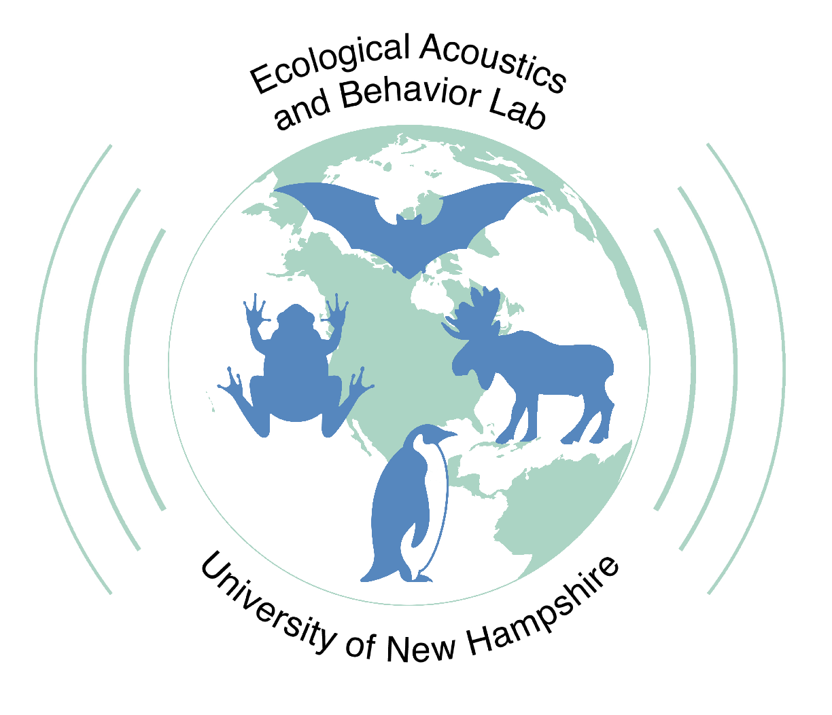



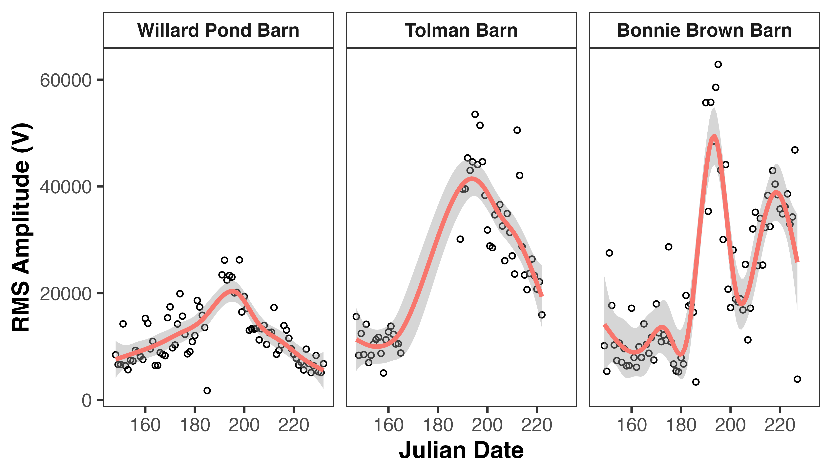
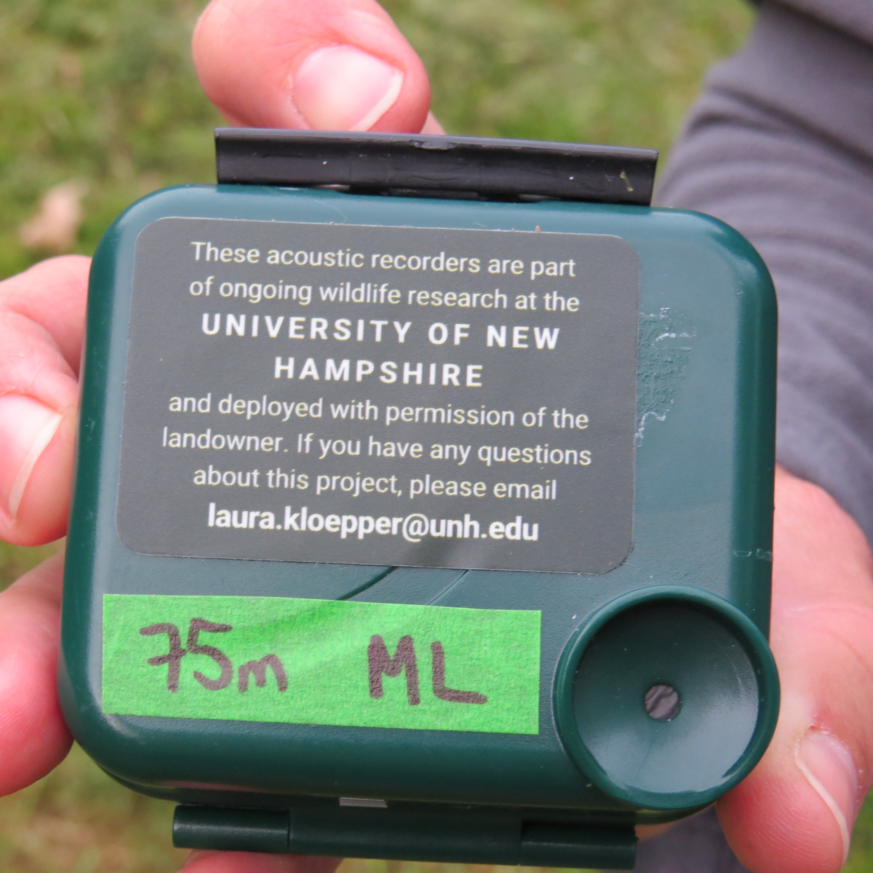
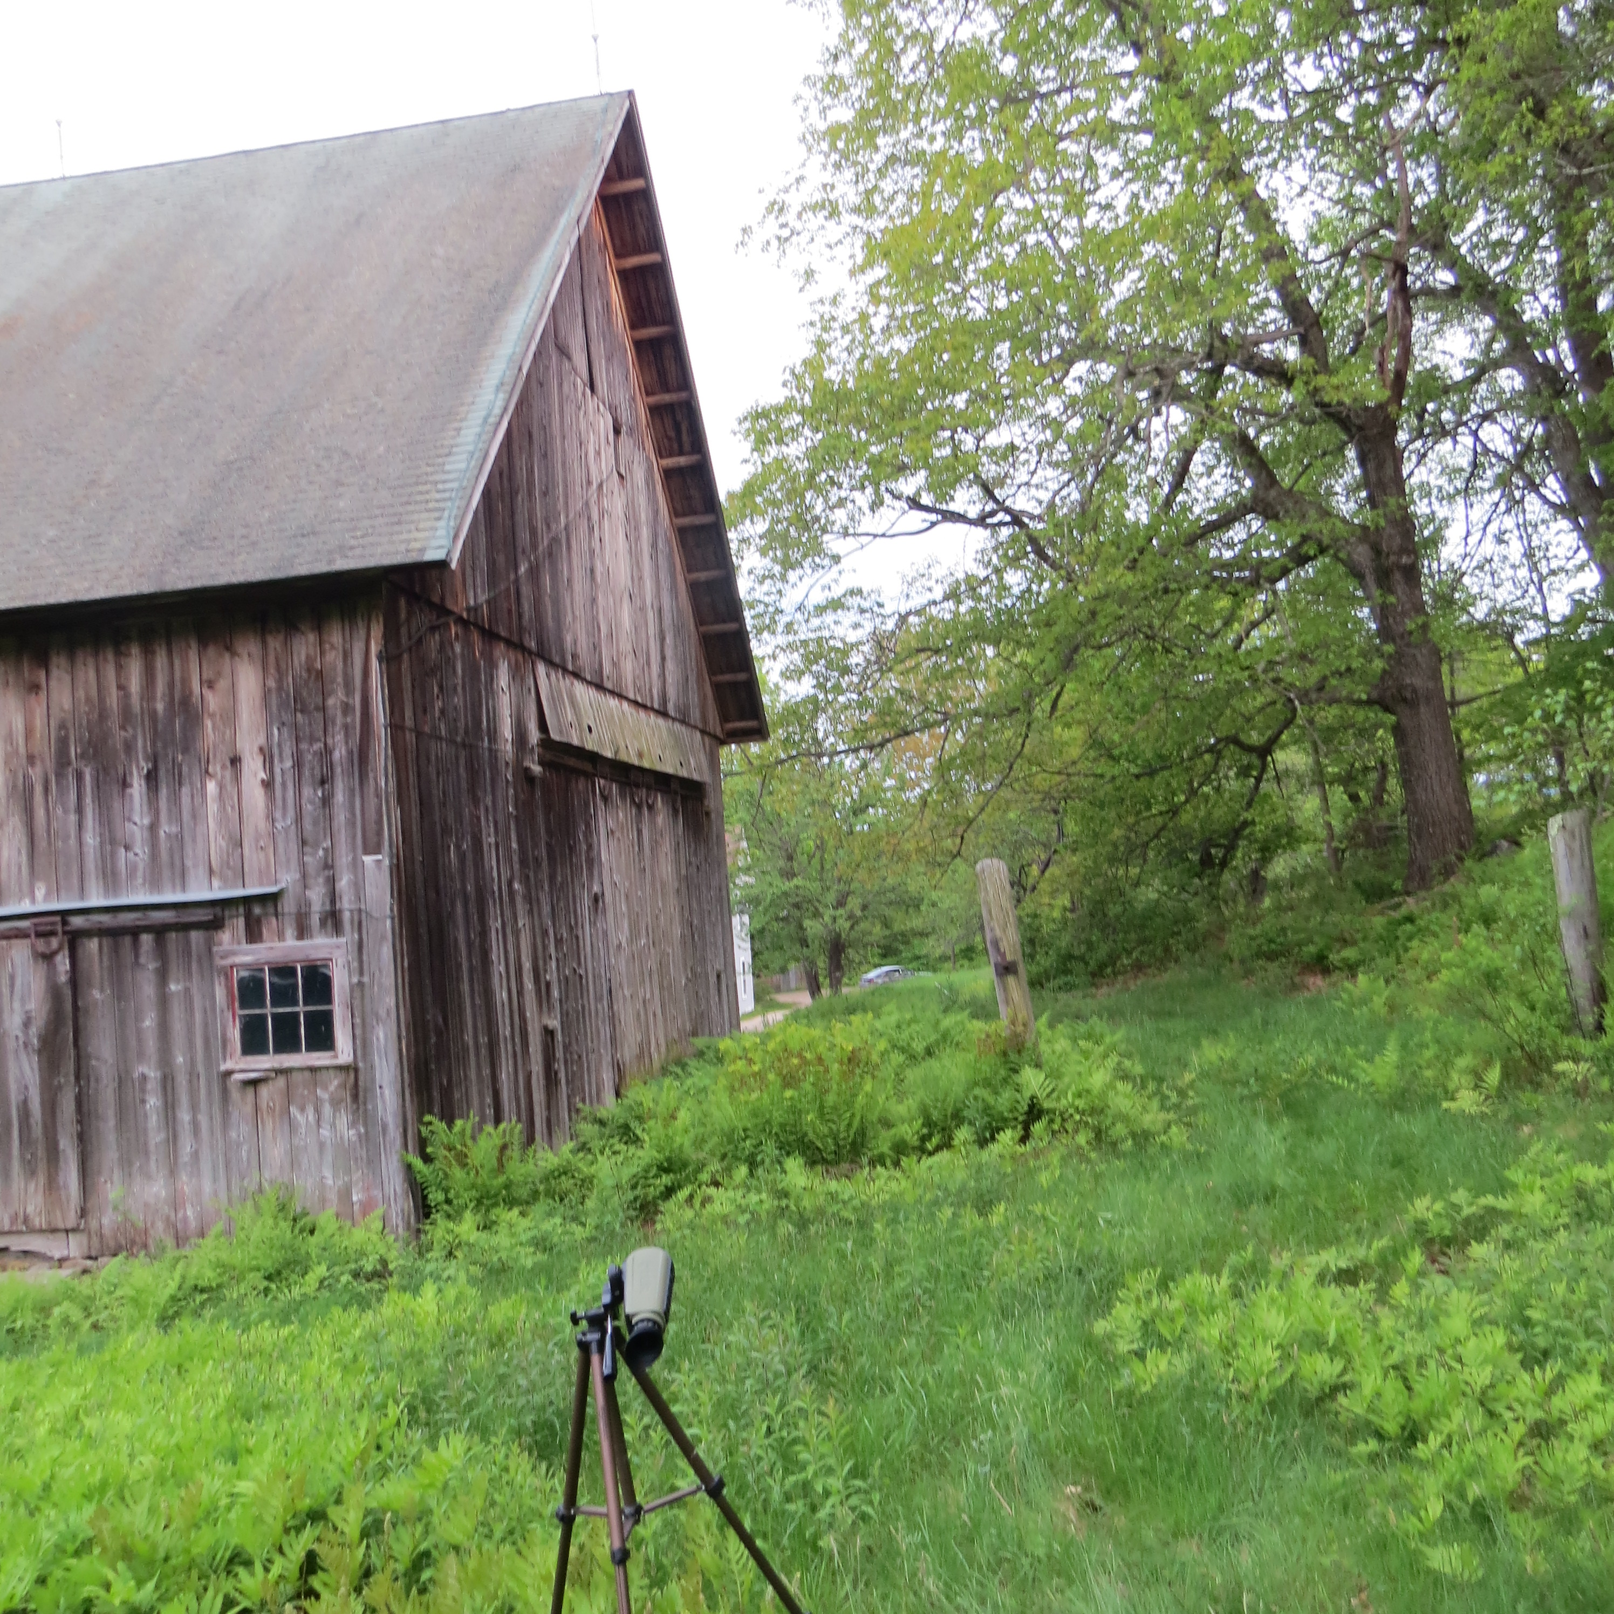
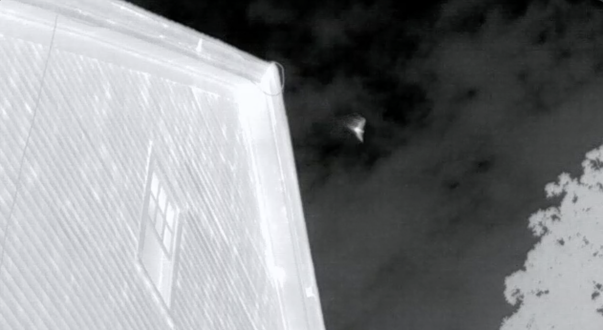
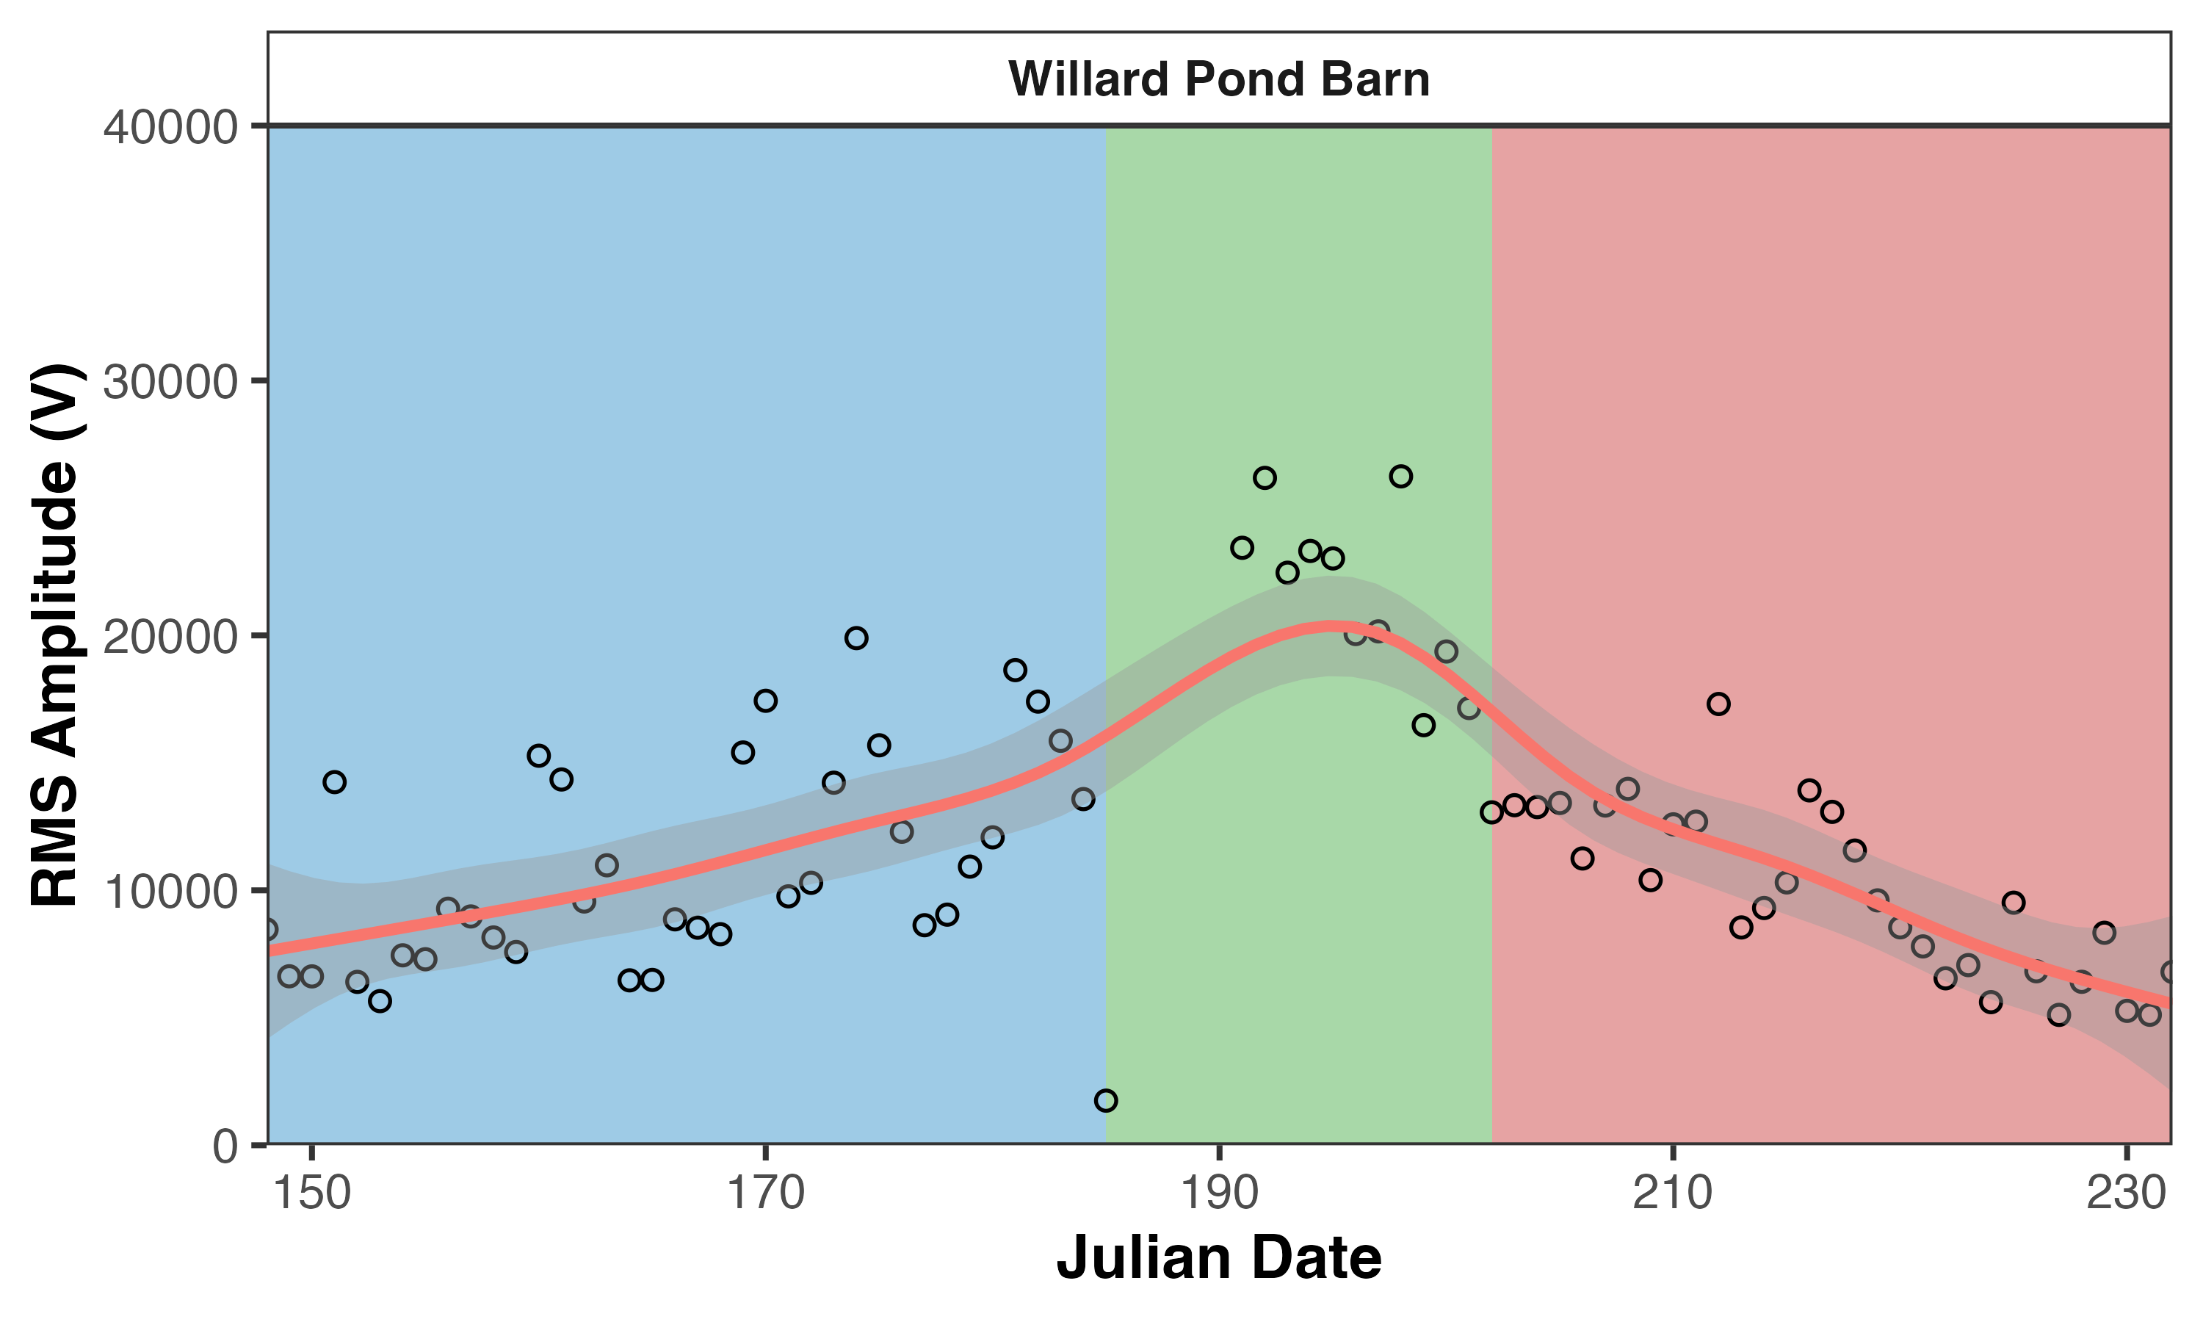
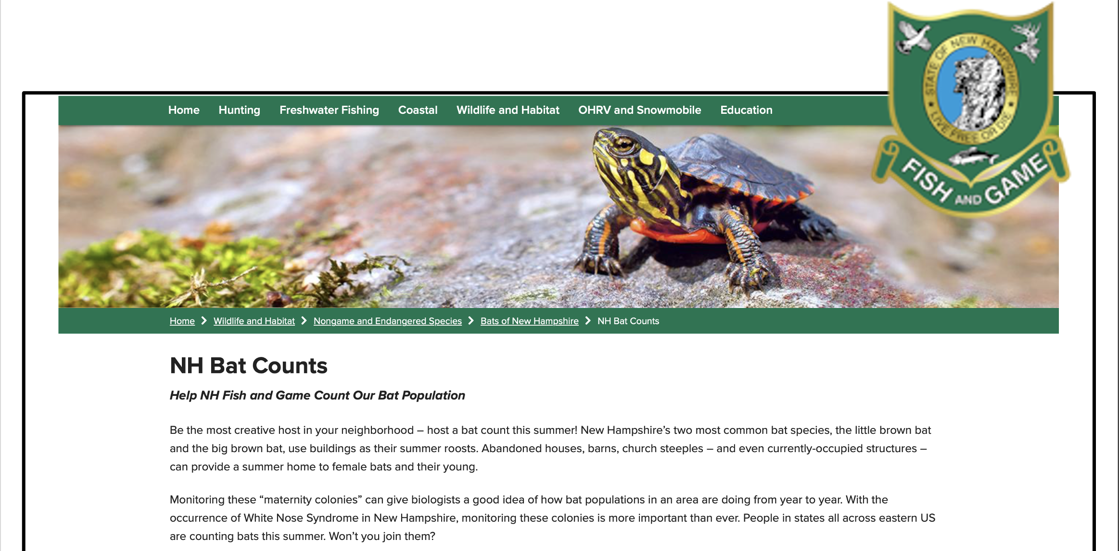
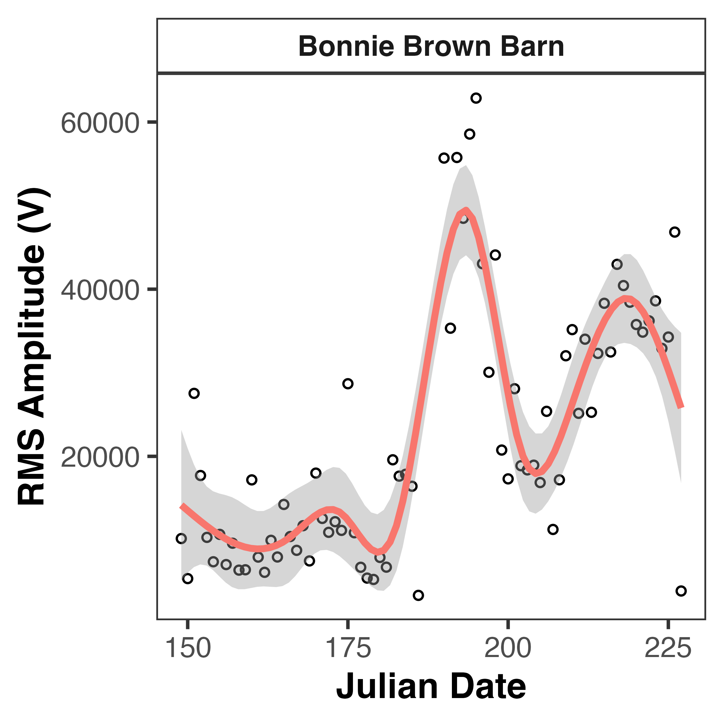
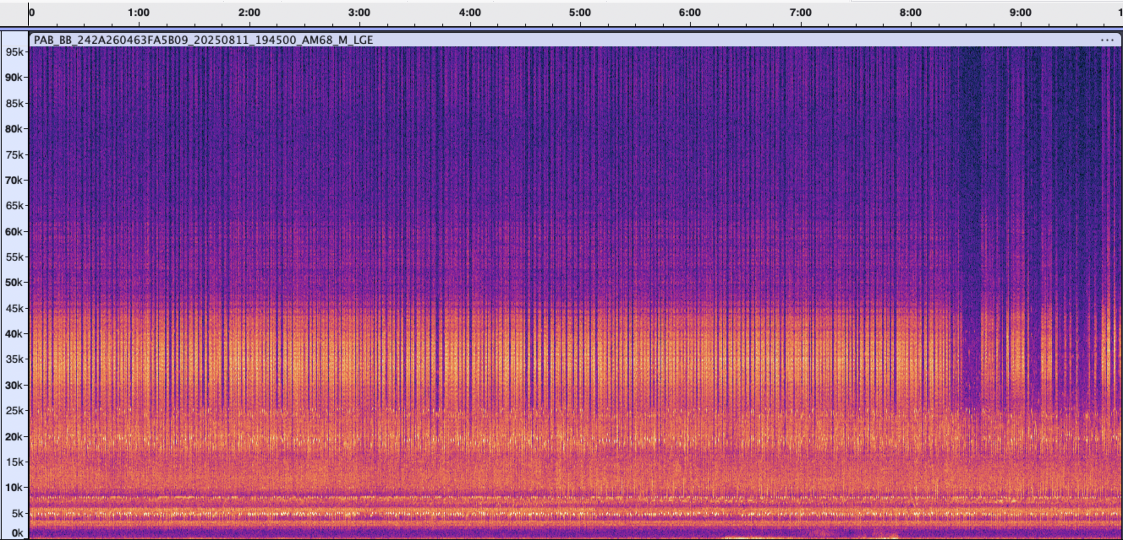
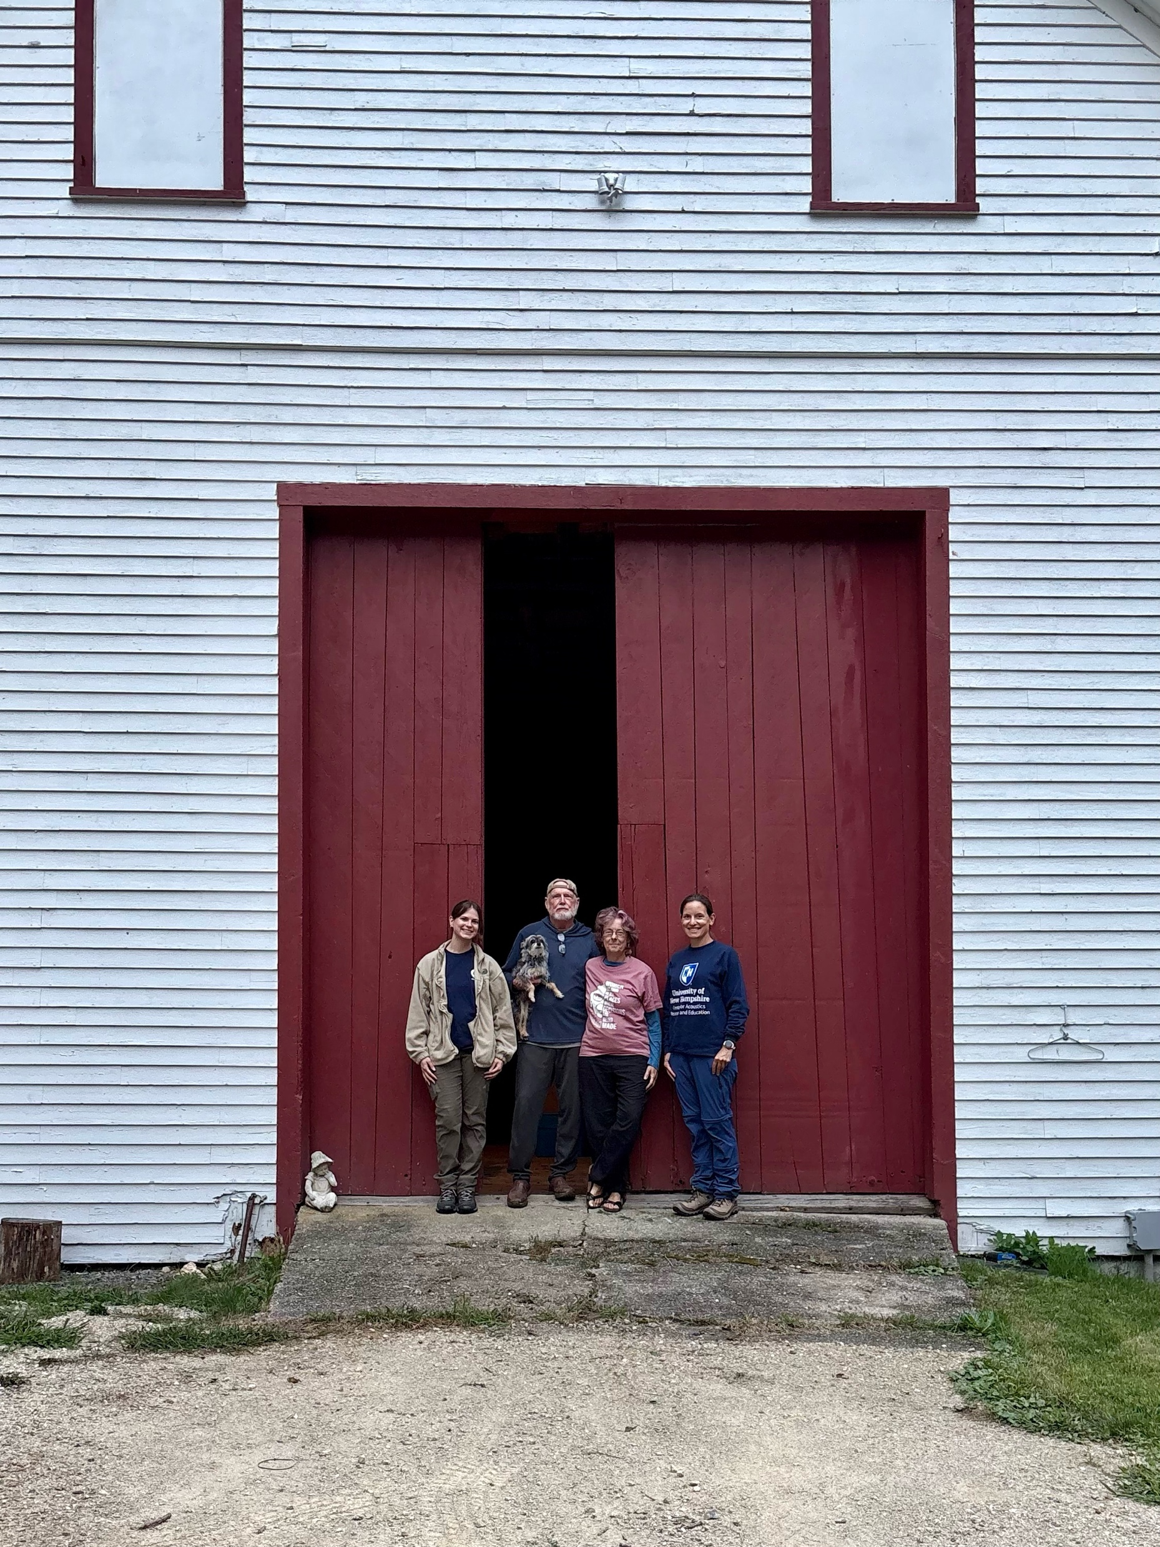
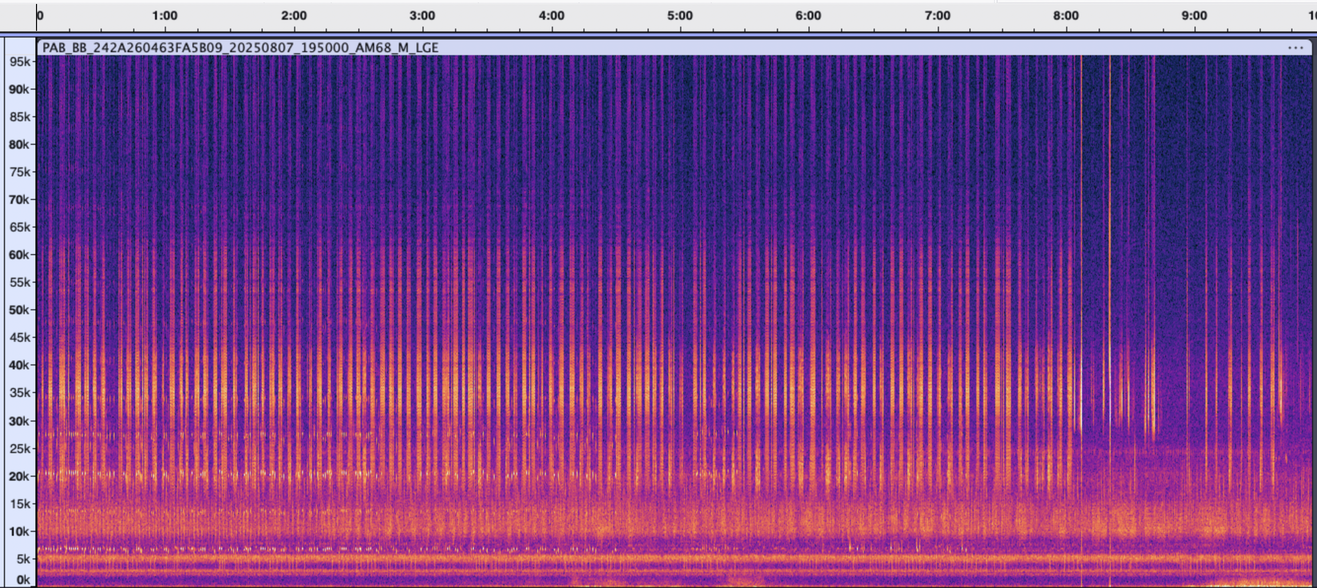
Integrating Community Conservation in the Development of an Acoustic Censusing Method
Megan Graham¹, Sandra Houghton², Haley Andreozzi¹, Laura Kloepper¹
¹University of New Hampshire, Durham, NH, 03824
²New Hampshire Fish and Game Department, Concord, NH, 03301
Abstract
Introduction
Methods
Results
The ability to monitor bat populations is vital for their conservation, especially with threats like white-nose syndrome and climate change. With some colonies reaching into the thousands along with the unpredictability of where bats may exit at dusk, it is often impossible to rely on eyesight alone to count bats. The University of New Hampshire in partnership with New Hampshire Fish and Game is developing an acoustic method to integrate into NH Bat Counts, a citizen science project that tracks bat populations in our state using community volunteers. Pilot data has shown that taking acoustic recordings of emergences throughout the summer provides not only an accurate population estimate of roosts but also shows important population trends such as pup volancy and colony dispersal. Data validation is made possible by integrating community involvement to compare our acoustic outputs to counts taken by volunteers.
Current censusing methods can be costly, ineffective, and stressful for bats.
Passive acoustic monitoring (PAM) has been used to estimate population sizes of large maternity roosts but has yet to be applied long-term.
By using PAM techniques throughout the summer, we identified important phenological events like pup volancy, peak occupancy, and dispersal from the roost.
This information can be used to make conservation decisions, as well as inform community members of when to take emergence counts.
Acoustic and Video Sampling
Acoustic monitors placed near exits
  Deployed May – August
  Records from sunset – 75 minutes
Thermal video is directed towards exits
A
B
Figure 5: RMS amplitude collected at three different sites changed throughout the summer. Dates with Audiomoth failure indicated in green
Emergence Counts x2
C
About New Hampshire Bat Counts
Peak Occupancy
Pup Volancy
Peak Occupancy
Dispersal
Number of Bats Leaving Roost
Pups Flying
Dispersal
Arrival
Birth/Pregnant Adults
May June July Aug Sep
Figure 4: Equipment used for sampling audio and thermal video including an Audiomoth (A), a thermal camera (B), and a bat emerging from a barn on FLIR video (C).
Figure 3: The expected trend of how many bats are leaving the maternity roost and when. The phenological events are displayed as well as when conservationists would typically take two emergence counts.
Data Processing
Acoustic files were processed using R
  Filtering optimized for species
Root mean square (RMS) amplitude per second was measured
RMS amplitude per second was then summarized to get a total volume from that night
  More bats = LOUDER
  Less bats = quieter
Figure 6: Changes in RMS amplitude corresponds with when we would expect to see phenological events take place.
The NH Bat Counts program, ran by the NH Fish and Game Dept., is an online database where community members can submit their emergence counts.
We can use this information to monitor bat populations over time.
Research Questions
Figure 1: NH Bat Counts homepage with F&G logo
How does nightly total acoustic energy change throughout the summer at a maternity roost?
Can we use these changes to monitor important phenological events such as pup volancy, peak occupancy, and dispersal?
Discussion
Low-cost PAM can identify population changes and phenological events
These techniques can be integrated into community science by using programs like NH Bat Counts
Seasonal insect peaks pose a challenge requiring site specific design
We plan to expand this acoustic monitoring in partnership with NH Bat Counts
Community conservation is vital in the development and support of this new science
Figure 2: Our research team standing in front of a barn used as a roost with the private landowners.
Figure 7: Ultrasonic noise from insects impacted the RMS amplitude measurement at Brown Barn. Even though this was not the intended outcome, we learned there must be some distance away from thick vegetation to avoid loud noise.
Acknowledgments: Sonja Ahlberg, Haley Andreozzi, Bonnie and Rusty Brown, Jannine Chammaro, Lizzie Cheetham, Jack Colantuoni, Valerie Eddington, Danielle Fradet, Kaitlyn Hauler, Sandi Houghton, Colby Howard, Mari Ilfeld, Maggie Johnson, Laura Kloepper, Emily-Kate Molnár, Nathaniel Pike, David Popa, Jeff Reeder, Sadie Shultz, Susie Spikol, Calla Streeter, Brett Amy Thelan, Harvey Tolman, Amaro Tuninetti, Harris Center for Conservation
References: Frick et al., 2020, Ann. N.Y. Acad. Sci.; Kloepper et al., 2016, R. Soc.; Kloepper et al., 2025, JNABR
Notes:
Bigger font
Less intro – reduce text
Bigger pics
Add box around sections
Add “about NH bat count” info before intro
Combine discussion and conclusion – reduce text and shift down
Add brief refernces section in blue band at bottom. Name, year, brief journal – site website for Bat counts
Add harris center for acknowledgment
Jeff reeder – TOLMAN

