Slide 1

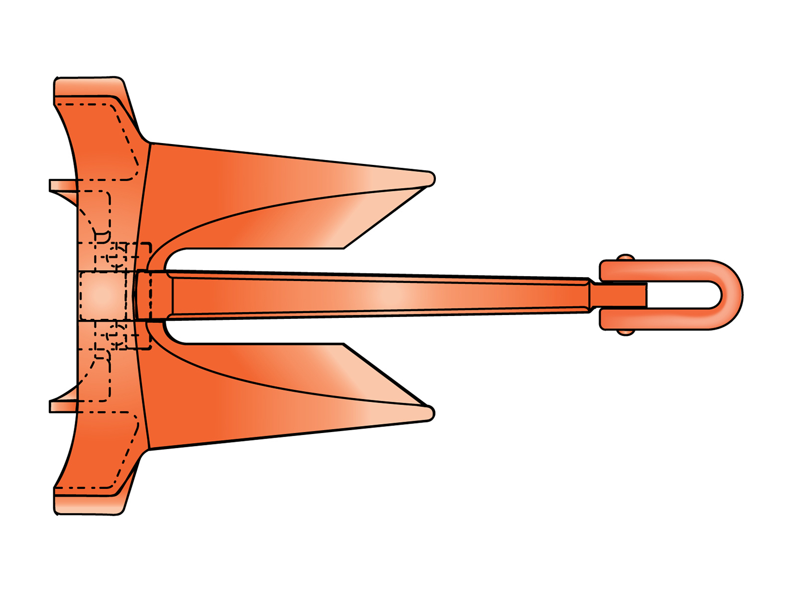
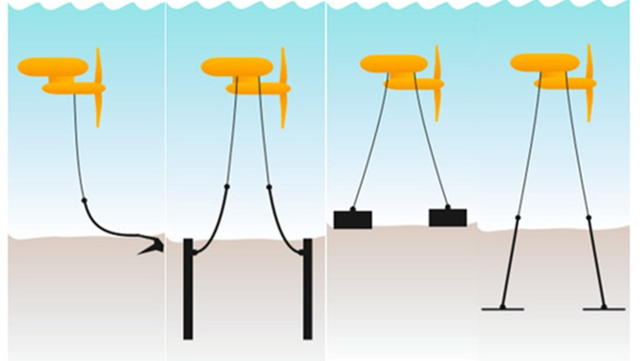
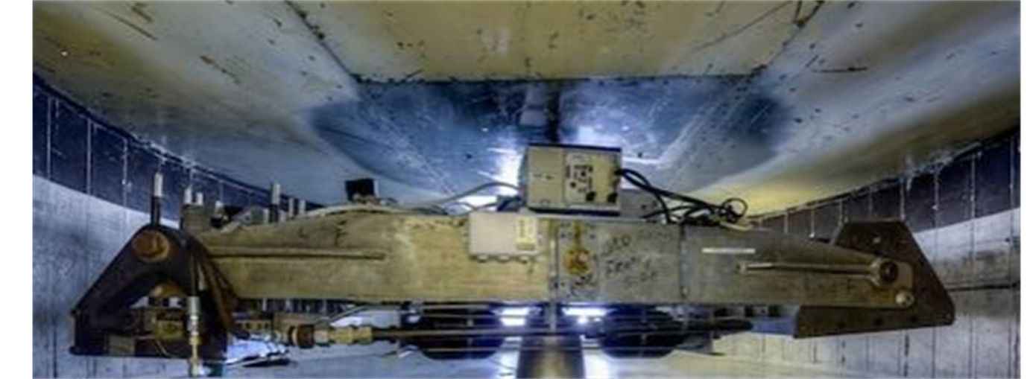
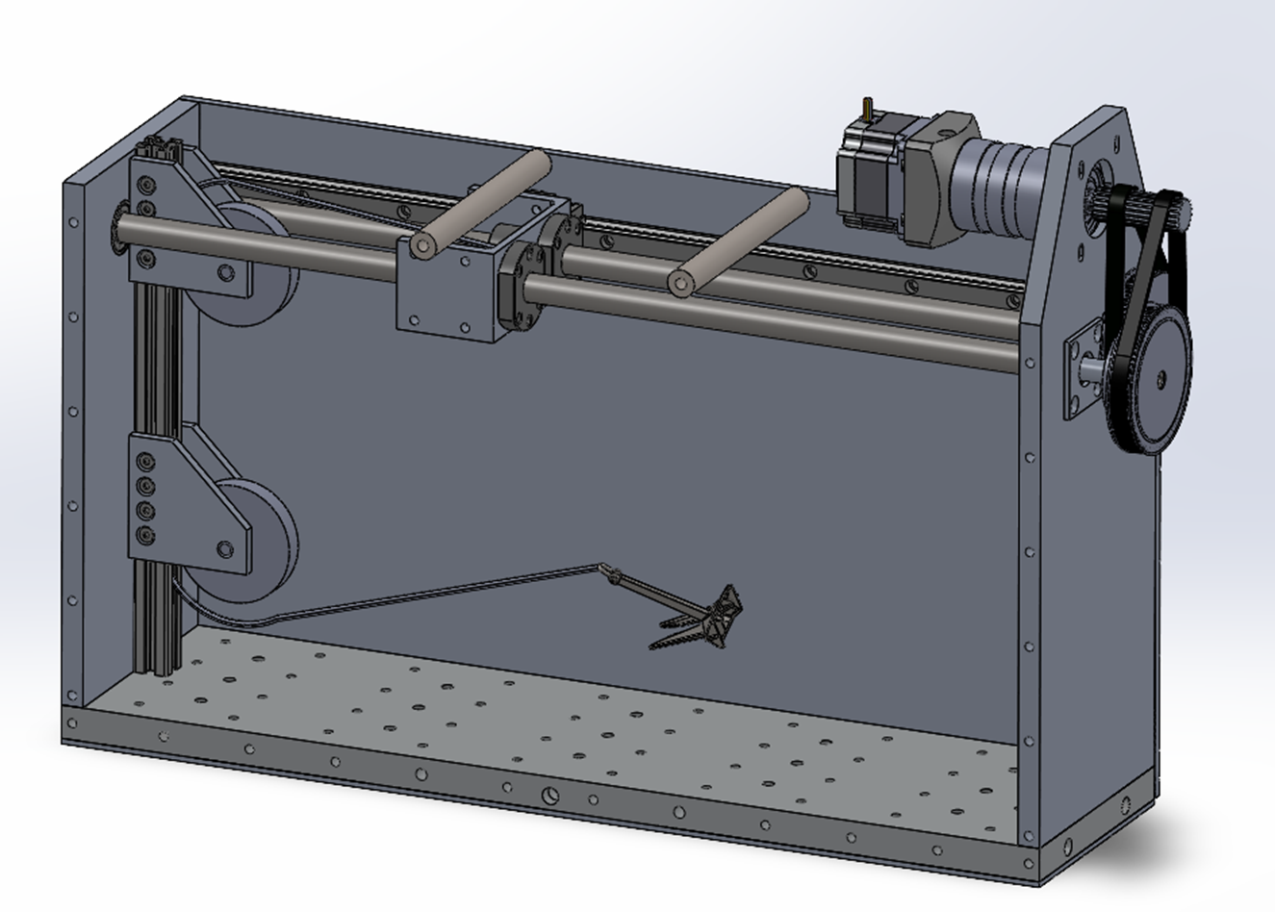
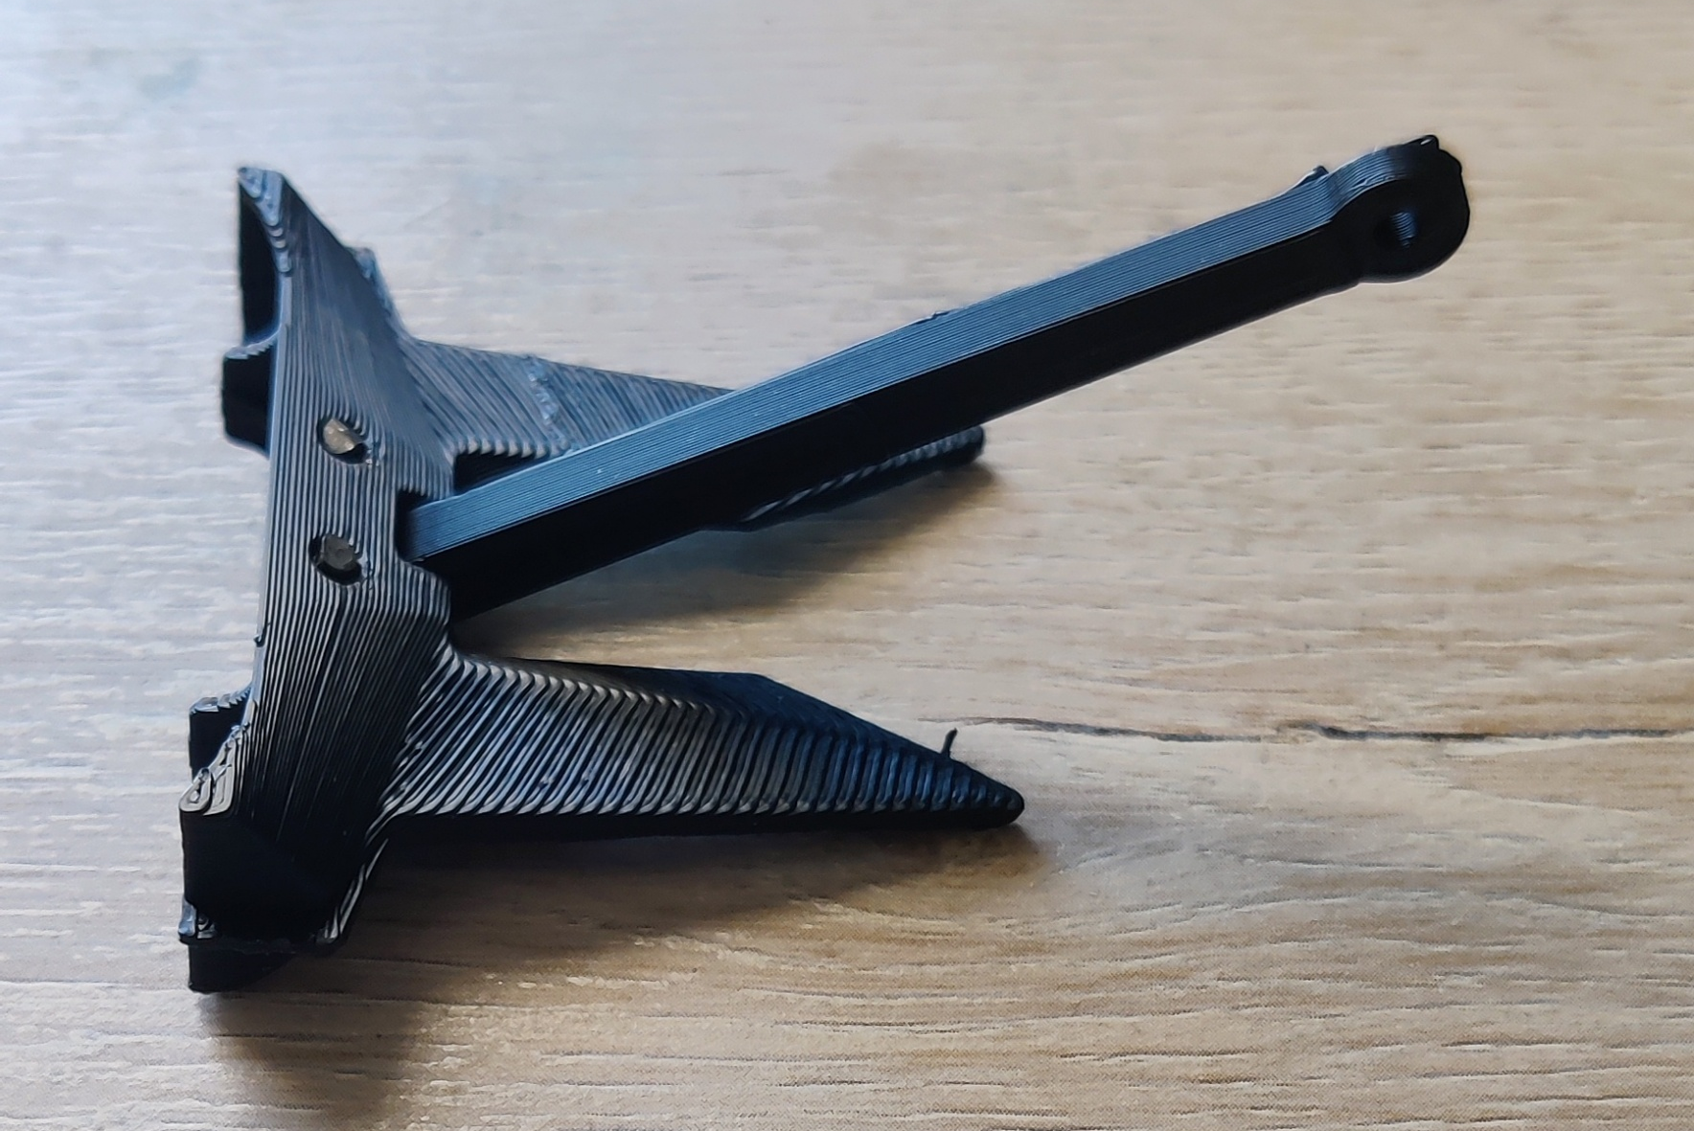
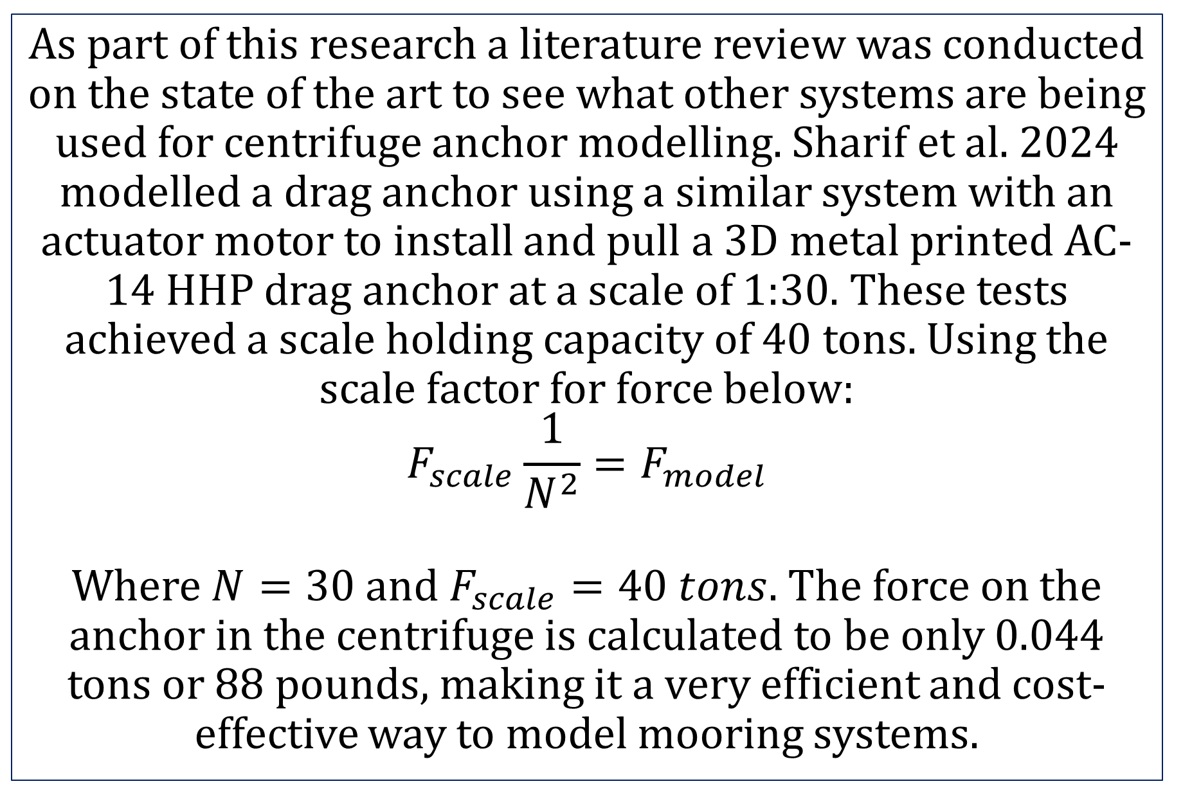
Physical Modeling of Soil-Anchor Interaction for Marine Energy Systems
Daniel Bartus
Civil & Environmental Engineering, University of New Hampshire, Durham, NH 03824
Introduction
Background
Current State
The offshore energy industry is looking towards tidal energy systems as a new form of sustainable energy from the ocean tides. Marine tidal energy systems use the ocean tides to produce energy by putting turbines in areas with strong tidal action. These tidal energy platforms consist of a buoy, turbine, and mooring system. The floating turbine spins its rotors as the tides come in and out every day to produce electricity that can be sent back to the shore. A mooring system keeps the turbine in one location so that power can be transmitted back to shore and no damage is caused to its surroundings. Designing the mooring system is a challenging portion of this new technology due to the high forces at shallow sites.
Tidal Energy Mooring Systems
UNH Geotechnical Centrifuge
The design of the strongbox and actuator have been completed and the parts for the box are being machined. Once machining is finished, the box and actuator system will be assembled, and two anchors will be tested as a baseline to ensure the model is performing as it should. One concrete gravity anchor and one AC-14 drag anchor made form 3D printed stainless steel. These anchors were chosen as they are well documented and can be easily scaled down while maintaining physical properties like center of gravity.
A few examples of mooring systems for tidal energy turbines, including, drag anchor, piles, gravity anchors, and plate anchors.
UNH has a 5G-ton beam centrifuge with a useful load of 100kg at 50G. With an extended radius of 1 meter and a 0.46m x 0.59m bucket area.
Literature Review
Model Design
Future Work
As part of this research a literature review was conducted on the state of the art to see what other systems are being used for centrifuge anchor modelling. Sharif et al. 2024 modelled a drag anchor using a similar system with an actuator motor to install and pull a 3D metal printed AC-14 HHP drag anchor at a scale of 1:30. These tests achieved a scale holding capacity of 40 tons. Using the scale factor for force below:
$$F_{scale}\frac{1}{N^{2}}=F_{model}$$
Where $N=30$and $F_{scale}=40 tons$. The force on the anchor in the centrifuge is calculated to be only 0.044 tons or 88 pounds, making it a very efficient and cost-effective way to model mooring systems.
Strongbox Design
AC-14 HHP Drag Anchor
The goal of this project is to create a centrifuge strongbox system that can be used for many years and serve as a test setup for any anchor system to be tested before it is deployed in the field. It is also intended to provide baseline tests that can be used to create future numerical models to numerically predict anchor behavior in the field.
Strongbox based on Adler et al. 2025
3D Printed AC-14 anchor at 1:50 scale
Actuator System
sTAMD Simulations
Acknowledgements
Centrifuge Scaling
The horizontal loading system uses a Dyneema String to pull an anchor that runs through two pulleys to allow for an adjustable pull angle. The string then goes to a load cell mounted on a carriage. This carriage runs along two linear rails, that are driven by two balls screws. These balls screws each have a pitch of 5mm and are attached to a belt driven 4:1 pulley reduction which spins from a 100:1 planetary gearbox attached to a stepper motor. This system of reductions is used to achieve an anchor loading rate of 1mm/min as mentioned in Jeong et al. 2021 while maintaining a motor speed sufficient to pull an anchor.
Parameter | Prototype Scale | Model Scale
Length | N | 1
Force | N² | 1
Mass | N³ | 1
Thank you to my advisors Dr. Ghayoomi and Dr. Paprocki as well as Noah MacAdam for design assistance.
The most practical method to simulate scale anchor forces on a mooring system is with a geotechnical centrifuge. A geotechnical centrifuge spins a model to a calculated acceleration to simulate high forces or large events on a smaller scale. One application of geotechnical centrifuge modelling includes exploring earthquake behavior, Madabhushi et al. 2004. When modelling with a geotechnical centrifuge certain scaling laws are used to compare results to a full-scale model, Ko et al. 1988. Some scaling laws used in this study are mentioned in the table above.
References
Adler et al. 2025
Sharif et al. 2025
Jeong et al. 2021
Madabhushi et al. 2004
Ko et al. 1988

