Slide 1

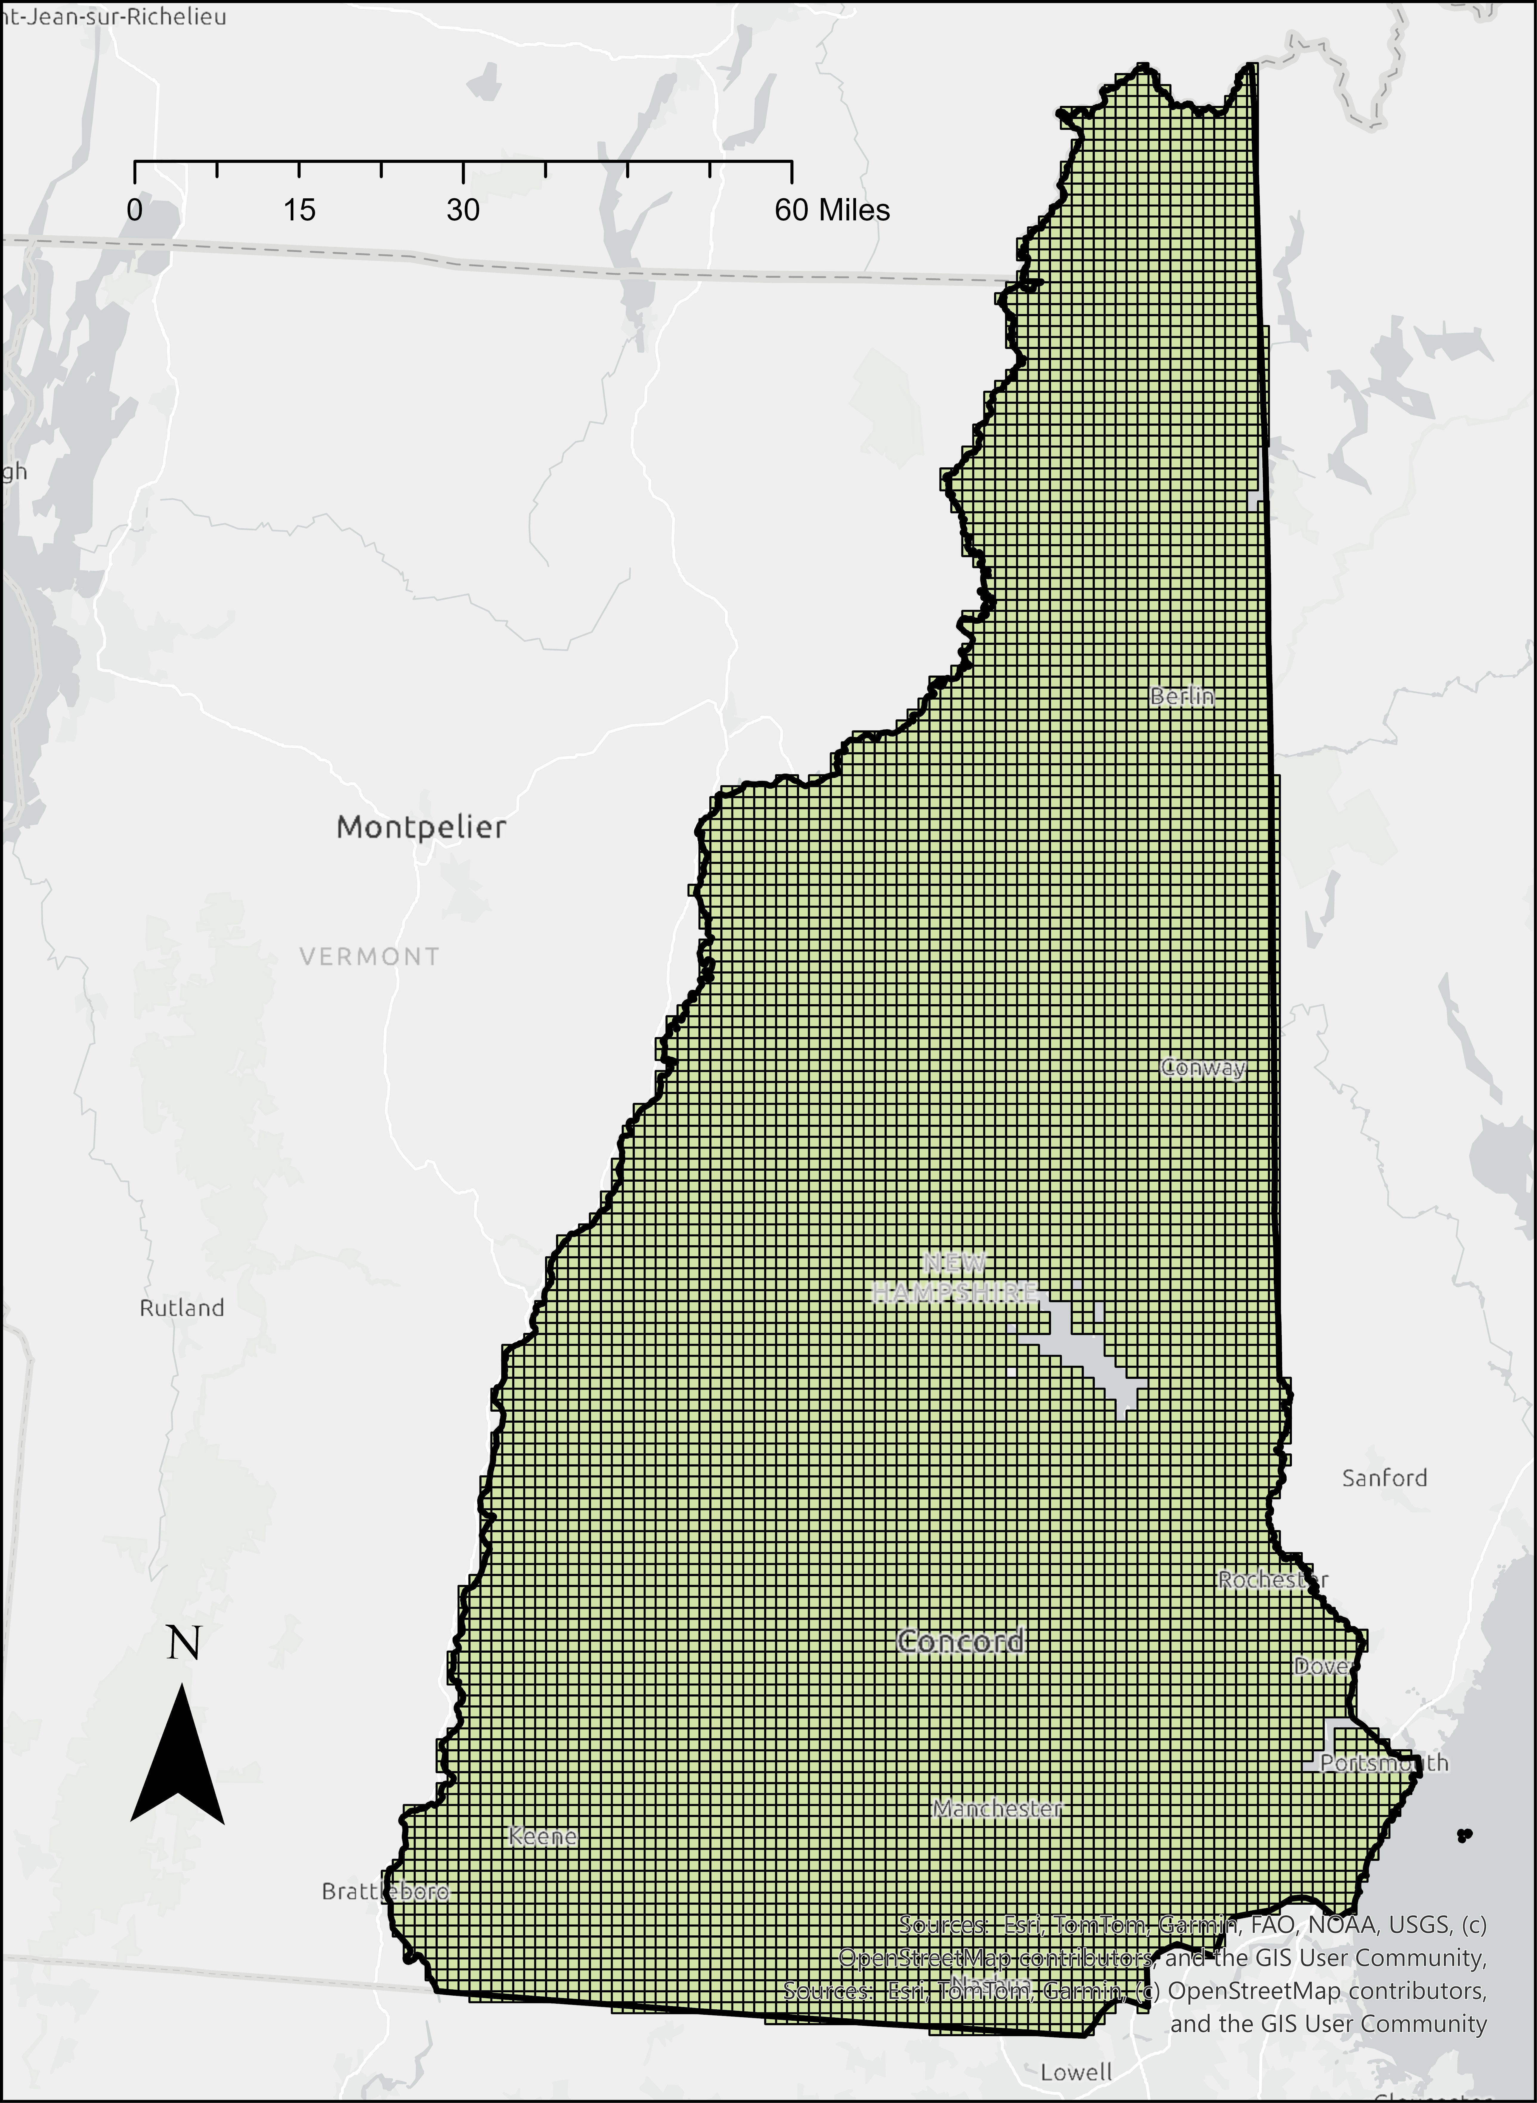
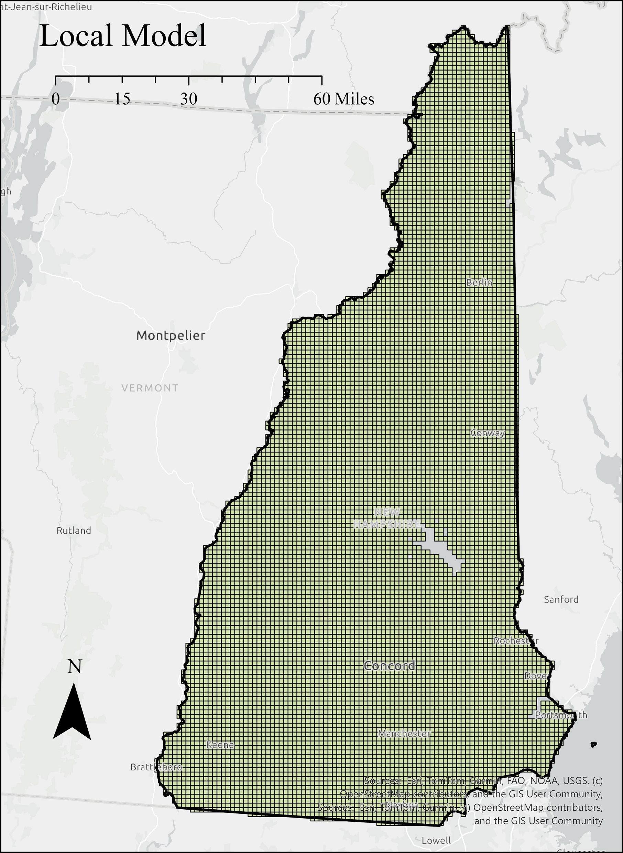
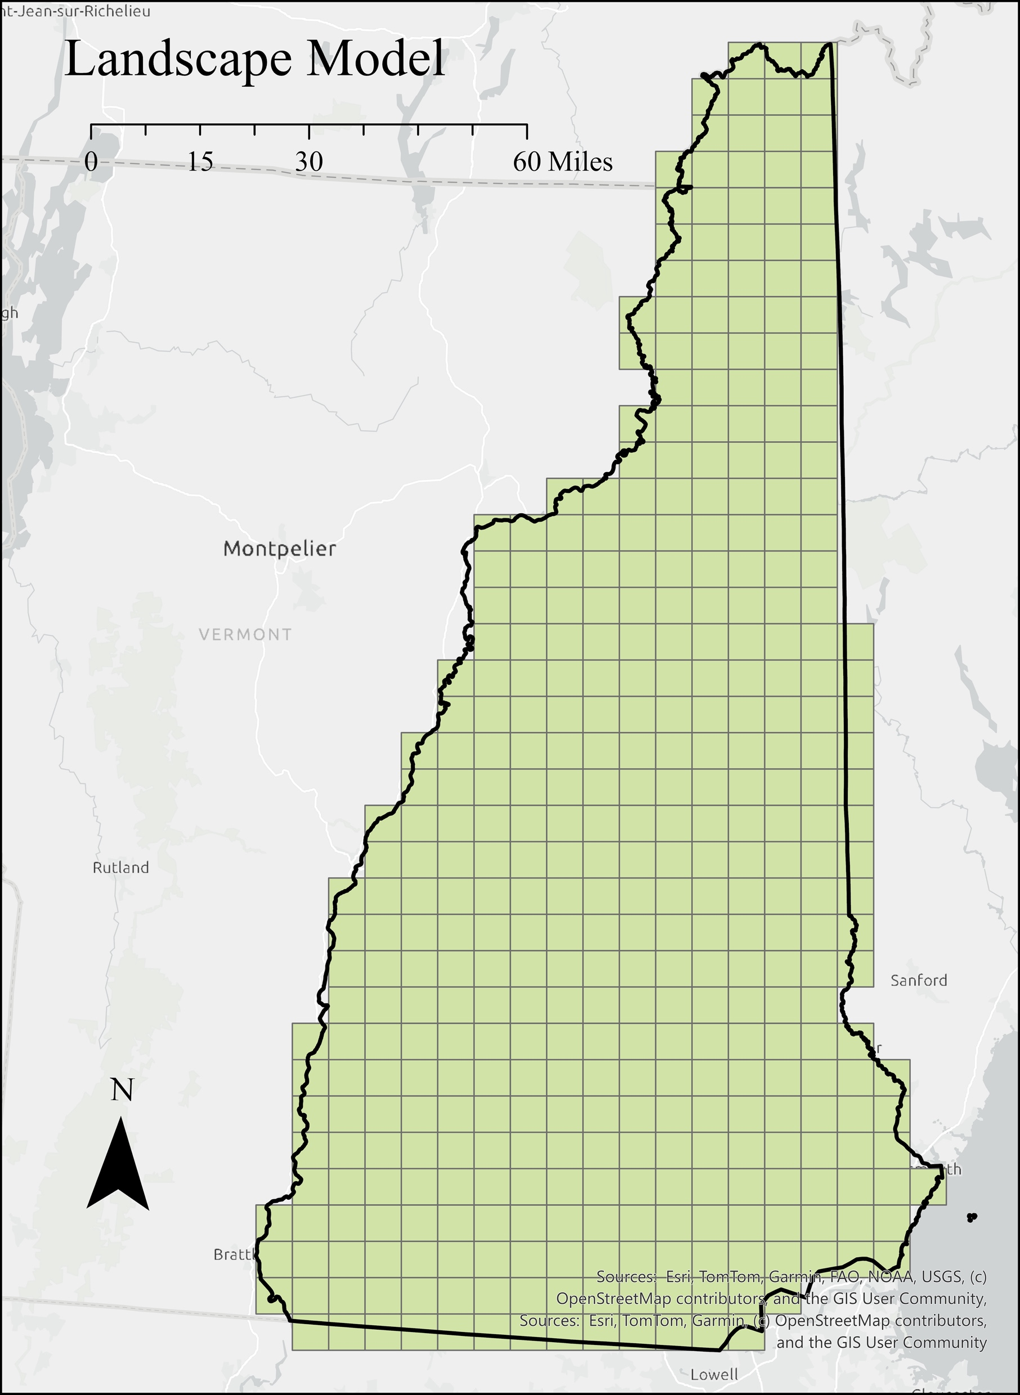

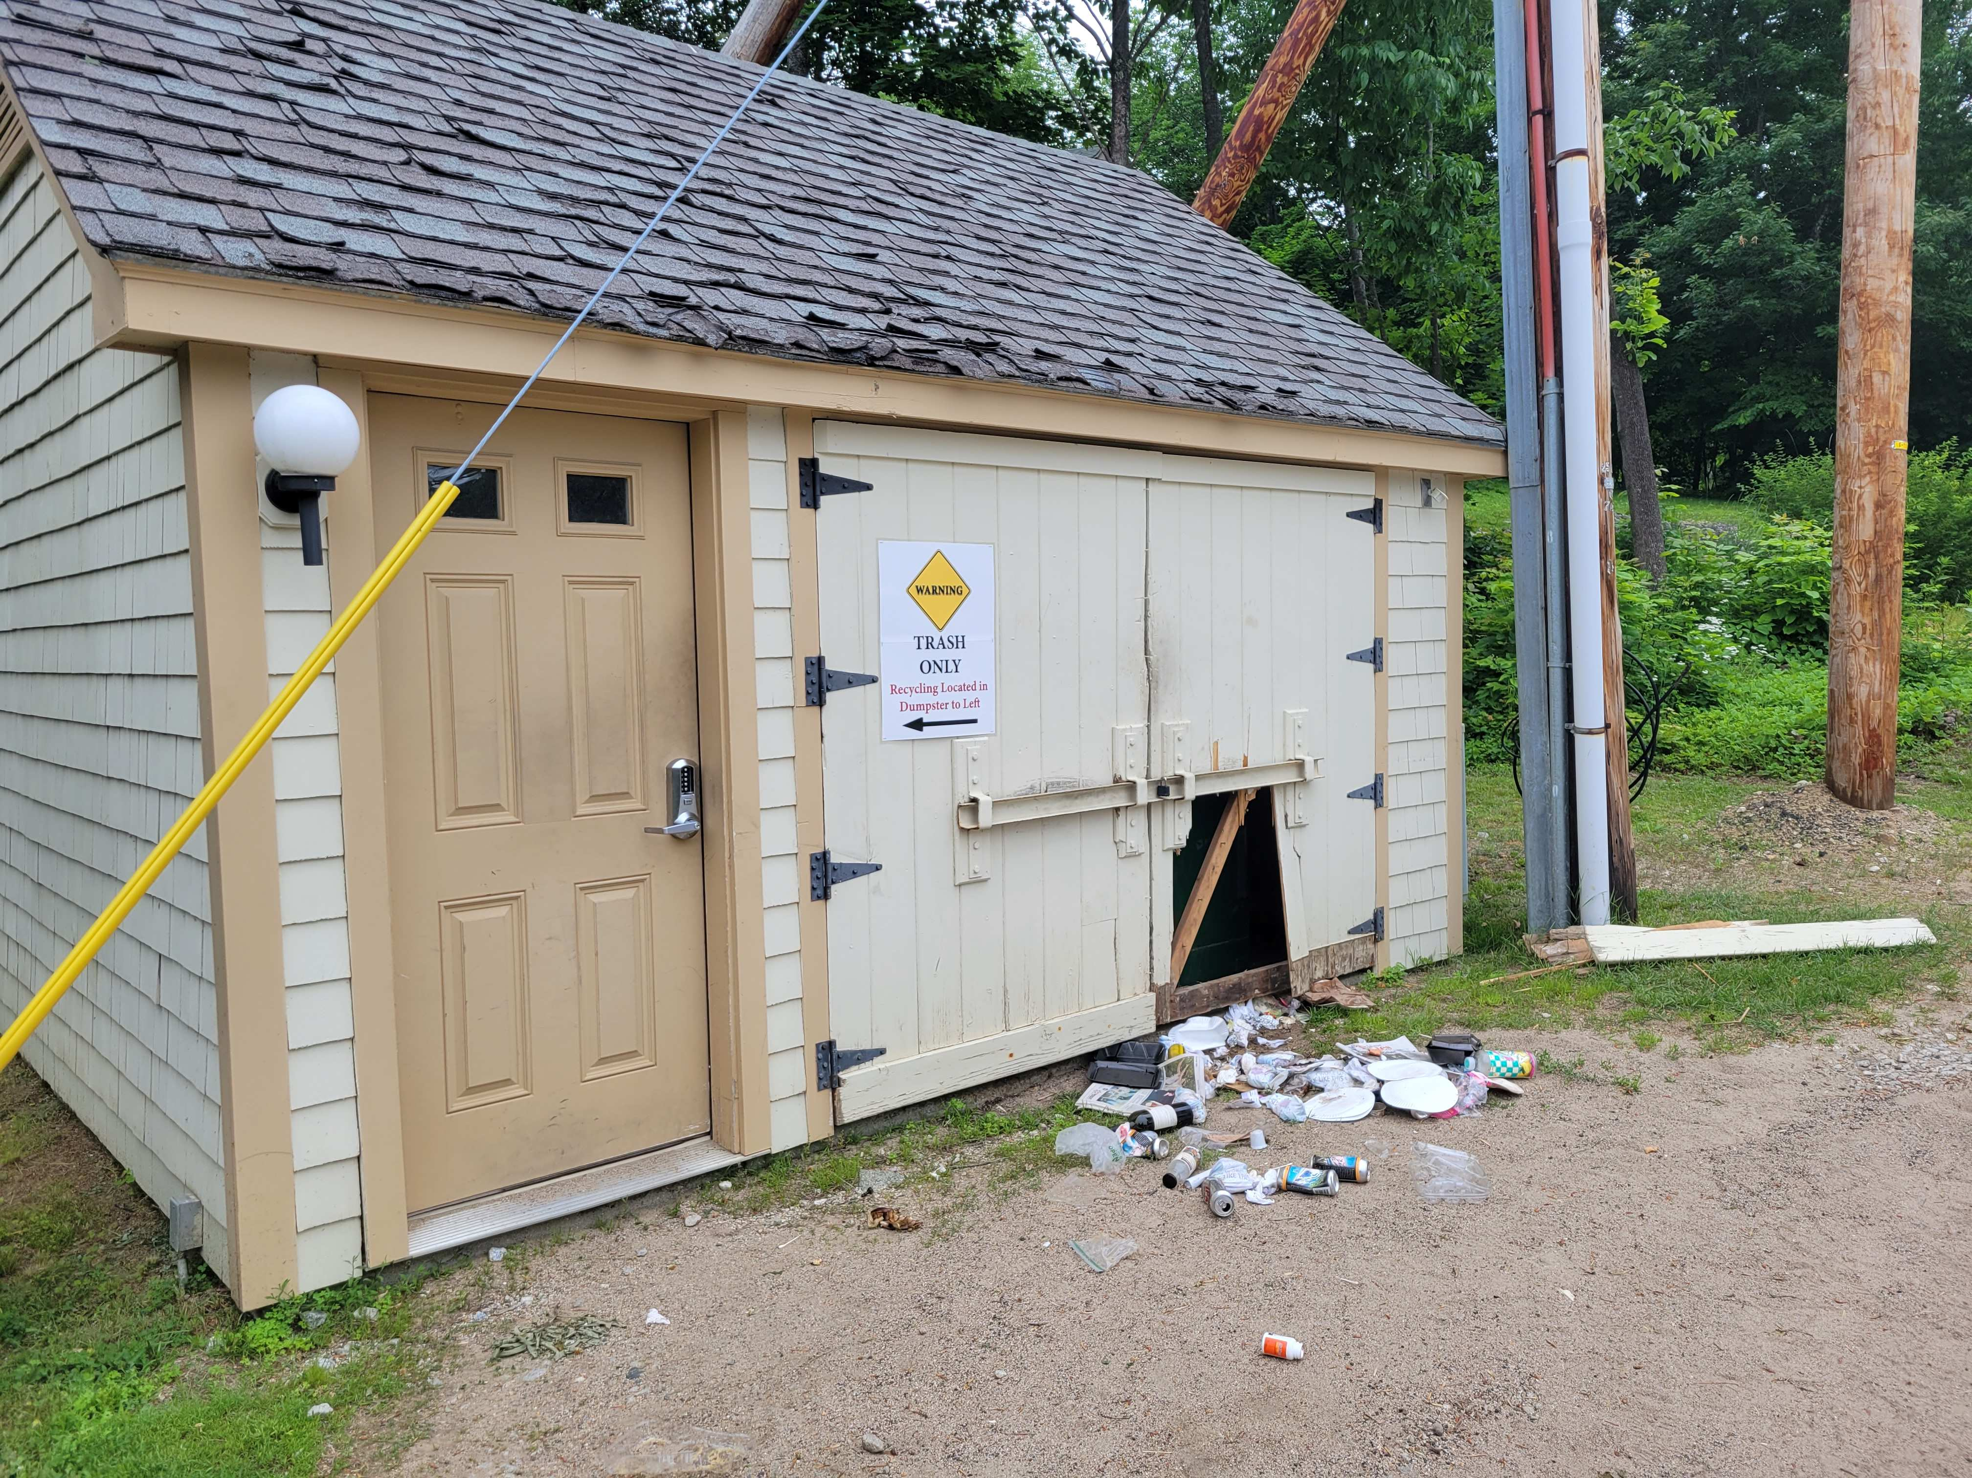
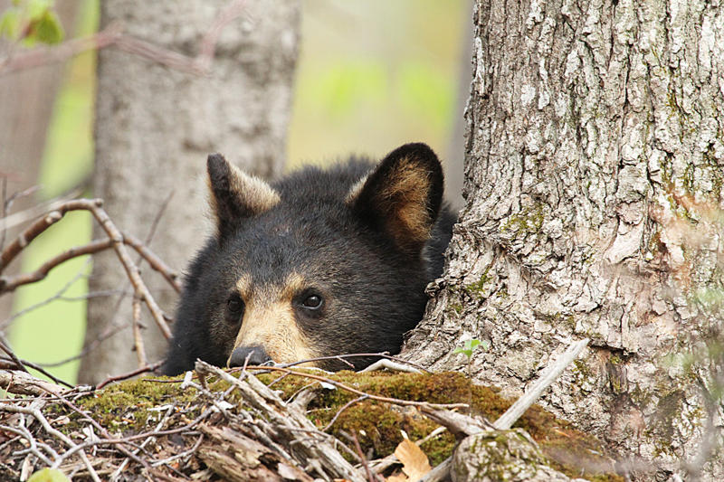
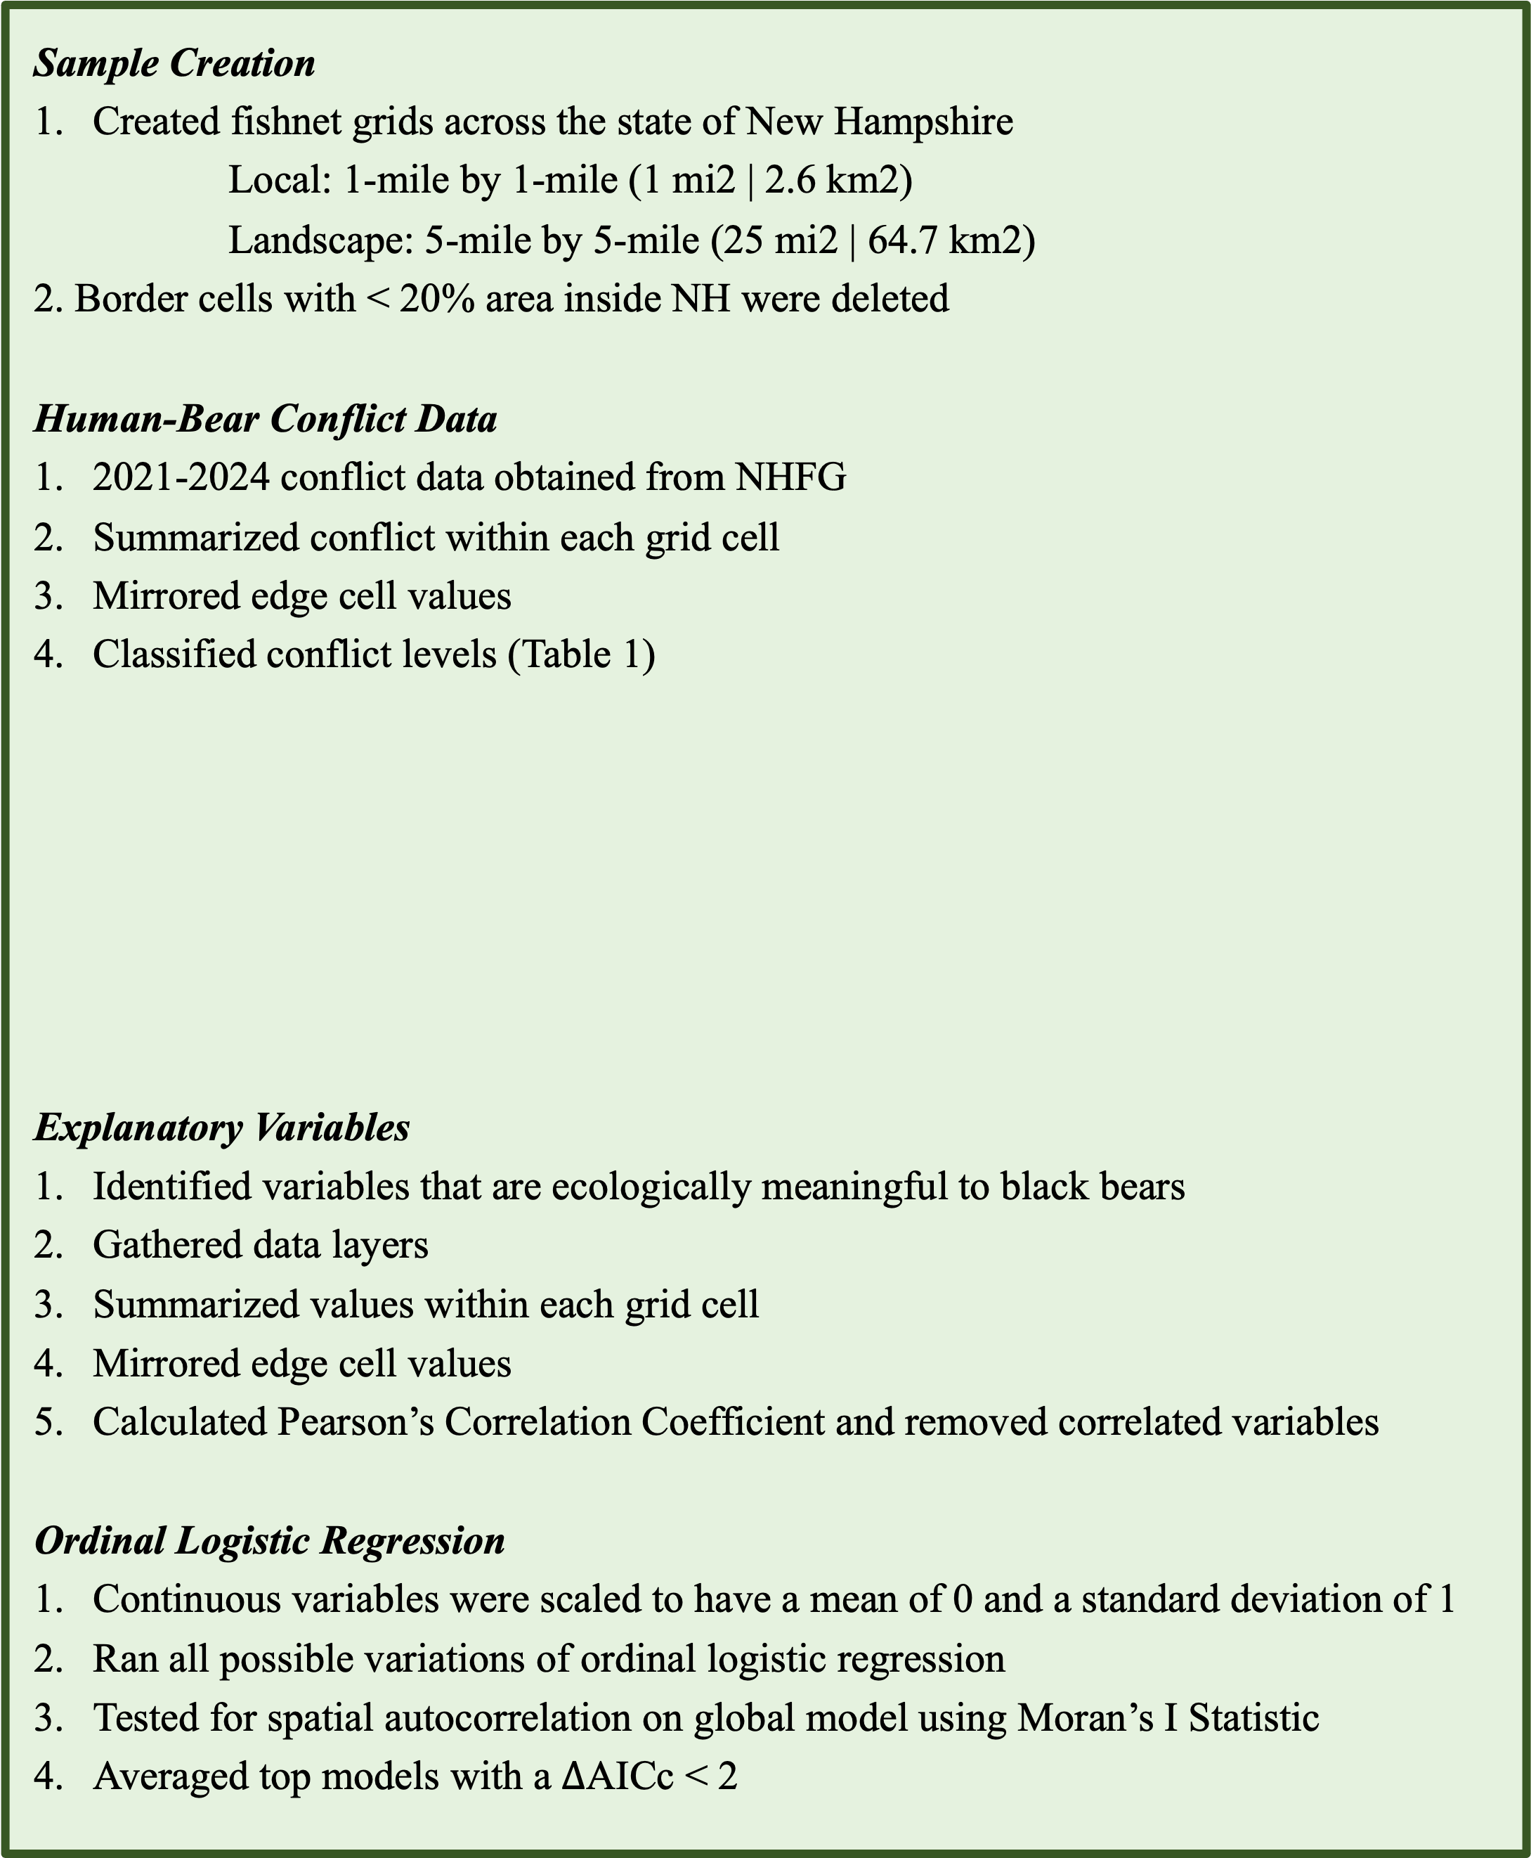
Assessing local and landscape scale predictors of human-black bear conflict levels in New Hampshire g
Shea O’Connor, Remington Moll, Russell Congalton, Andrew Timmins, & Fikirte Gebresenbet g
Department of Natural Resources & the Environment, University of New Hampshire
Introduction
Local Model
Landscape Model
Results
American black bear (Ursus americanus) (Figure 6) populations in New Hampshire have risen to approximately 6,000 individuals, exceeding the statewide goal of 4,700¹.
The rate of forest cover loss has increased from a 0.14% annual loss from 1996 to 2001 to a 0.27% annual loss from 2010 to 2018².
Large populations paired with loss of bear habitat contribute to prevalent human-black bear conflict across the state (Figure 3) that lead to property damage (Figure 5), agricultural damage, etc. (Figure 4)
Objectives
Identify anthropogenic and landscape factors influencing human-black bear conflict levels in New Hampshire.
Local scale: fine-scale bear movements (Figure 1)
Landscape scale: Bear population density (Figure 2)
Local Model
Landscape Model
Table 2. Results of averaged local model with ∆AICc < 2. Ordered by magnitude of effect. indicates significance.
*
Variable | Estimate | Odds Ratio | Adjusted SE | Pr(>|z|)
Mean Forest Patch Area | -2.02 | 0.13 | 0.26 | < 0.01*
% Wildland Urban interface | 0.86 | 2.36 | 0.06 | < 0.01*
Bear Population | 0.58 | 1.79 | 0.04 | < 0.01*
Forest Aggregation index | 0.23 | 1.26 | 0.10 | 0.02*
% Mixed Forest | -0.21 | 0.81 | 0.06 | < 0.01*
% Coniferous Forest | 0.14 | 1.15 | 0.06 | 0.02*
Forest Edge Density | -0.12 | 0.89 | 0.08 | 0.13
# Solid Waste Facilities | 0.06 | 1.06 | 0.03 | 0.03*
Trail Density | 0.04 | 1.04 | 0.04 | 0.34
% Water | 0.04 | 1.04 | 0.05 | 0.36
Mean Human Density | -0.03 | 0.97 | 0.05 | 0.58
% Agriculture | -0.02 | 0.98 | 0.04 | 0.54
% Developed | 0.02 | 1.02 | 0.05 | 0.64
% Deciduous Forest | -0.02 | 0.98 | 0.06 | 0.76
Tested variables not in top models
Mean annual days with snow
Methods
Sample Creation
Created fishnet grids across the state of New Hampshire
Local: 1-mile by 1-mile (1 mi2 | 2.6 km2)
Landscape: 5-mile by 5-mile (25 mi2 | 64.7 km2)
2. Border cells with < 20% area inside NH were deleted
Human-Bear Conflict Data
2021-2024 conflict data obtained from NHFG
Summarized conflict within each grid cell
Mirrored edge cell values
Classified conflict levels (Table 1)
Explanatory Variables
Identified variables that are ecologically meaningful to black bears
Gathered data layers
Summarized values within each grid cell
Mirrored edge cell values
Calculated Pearson’s Correlation Coefficient and removed correlated variables
Ordinal Logistic Regression
Continuous variables were scaled to have a mean of 0 and a standard deviation of 1
Ran all possible variations of ordinal logistic regression
Tested for spatial autocorrelation on global model using Moran’s I Statistic
Averaged top models with a $∆$AICc < 2
Figure 1. Local model grid cells
Figure 2. Landscape model grid cells
Table 3. Results of averaged landscape model with ∆AICc < 2. Ordered by magnitude of effect. indicates significance.
Panhandling
*
Building/Home Entry
Variable | Estimate | Odds Ratio | Adjusted SE | Pr(>|z|)
% Wildland Urban Interface | 1.00 | 2.73 | 0.17 | < 0.01*
Mean Forest Patch Area | -0.87 | 0.42 | 0.25 | < 0.01*
Mean Human Density | -0.71 | 0.49 | 0.19 | < 0.01*
% Mixed Forest | -0.60 | 0.55 | 0.12 | < 0.01*
Bear Population | 0.57 | 1.76 | 0.15 | < 0.01*
% Coniferous Forest | 0.21 | 1.24 | 0.14 | 0.13
# Solid Waste Facilities | 0.16 | 1.17 | 0.15 | 0.30
% Agriculture | -0.005 | 0.99 | 0.04 | 0.90
% Water | 0.004 | 1.00 | 0.04 | 0.90
Tested variables not in top models
% Deciduous Forest
Trail Density
Agricultural Damage: Crops
Table 1. Conflict classification (Note: values adjusted for edge cells; underlying calculations resulted in non-integer values)
Property Damage
Birdfeeders
Conflict Classification | Local Model | Landscape Model
None | 0 | 0
Low | 1 – 3 | 1 - 8
Medium/High | 4 - 32 | 9 - 74
Other: Campsite, pet injury, public safety, other
Garbage
Agricultural Damage: Livestock
Management Implications
Figure 3. NH bear conflict reports (2021-2024)
Figure 4. NH bear conflict report types (2021-2024)
Both scales identified WUI, forest patch area, bear population, and mixed forest as key predictors; the local model additionally highlighted solid waste facilities as fine-scale attractants, supporting a tiered management approach:
Local Scale Strategies
Identify and prioritize the management of larger facilities, such as the solid waste facilities, that act as high-level attractants.
Focus outreach efforts on communities that are high-risk for conflict.
Landscape Scale Strategies
Work with municipal planners to discourage low-density development that encourages bear movement through zoning and land-use policy.
Protect vast, unfragmented forest that reduces the need for movement between patches^{3,4}.
Protect mixed forest stands that provide balanced resources for bears^{5,6}.
  Small, clumped forest patches, high bear density, Wildland Urban Interface (WUI)
Figure 5. Property damage from human-bear conflict
Figure 6. American black bear (Ursus americanus)
References
Acknowledgements
Timmins, A. A. (2014, November). New Hampshire Black Bear Assessment. New Hampshire Fish and Game.
Grybas, H., Congalton, R. G., & Howard, A. F. (2020). Using Geospatial Analysis to Map Forest Change in New Hampshire: 1996–Present. Journal of Forestry, 118(6), 598–612. https://doi.org/10.1093/jofore/fvaa039
Berkowitz, Z., Bravo, L. M., & Sen Roy, S. (2025). Beware of Bear? Long-Term Spatio-Temporal Patterns of Human–Bear Conflict in Connecticut. Environmental Management, 75(3), 638–653. https://doi.org/10.1007/s00267-024 02094-x
Evans, M. J., Hawley, J. E., Rego, P. W., & Rittenhouse, T. A. G. (2014). Exurban land use facilitates human‐black bear conflicts. The Journal of Wildlife Management, 78(8), 1477–1485. https://doi.org/10.1002/jwmg.796
Fecske, D. M., Barry, R. E., Precht, F. L., Quigley, H. B., Bittner, S. L., & Webster, T. (2002). Habitat use by female black bears in western Maryland. Southeastern Naturalist, 1(1), 77–92. https://doi.org/10.1656/1528- 7092(2002)001%5B0077:HUBFBB%5D2.0.CO;2
Sadeghpour, M. H., & Ginnett, T. F. (2011). Habitat selection by female American black bears in northern Wisconsin. Ursus, 22(2), 159–166. https://doi.org/10.2192/URSUS-D-10-00032.1
Conflict data provided by NH Fish and Game. Data used to create explanatory variables were gathered from open sources.

