Slide 1

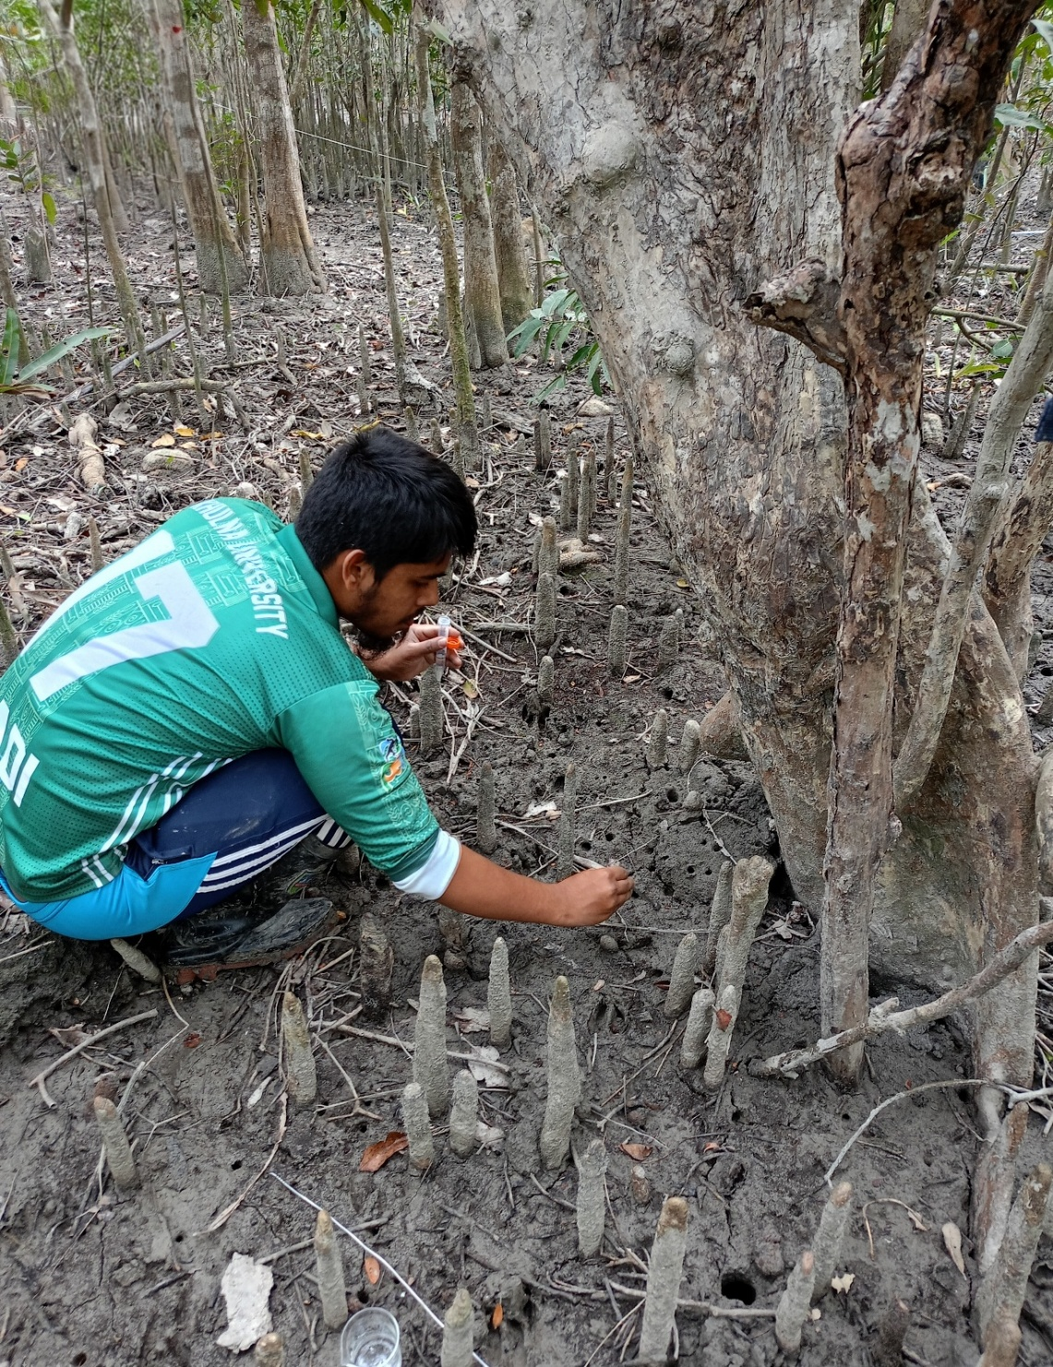
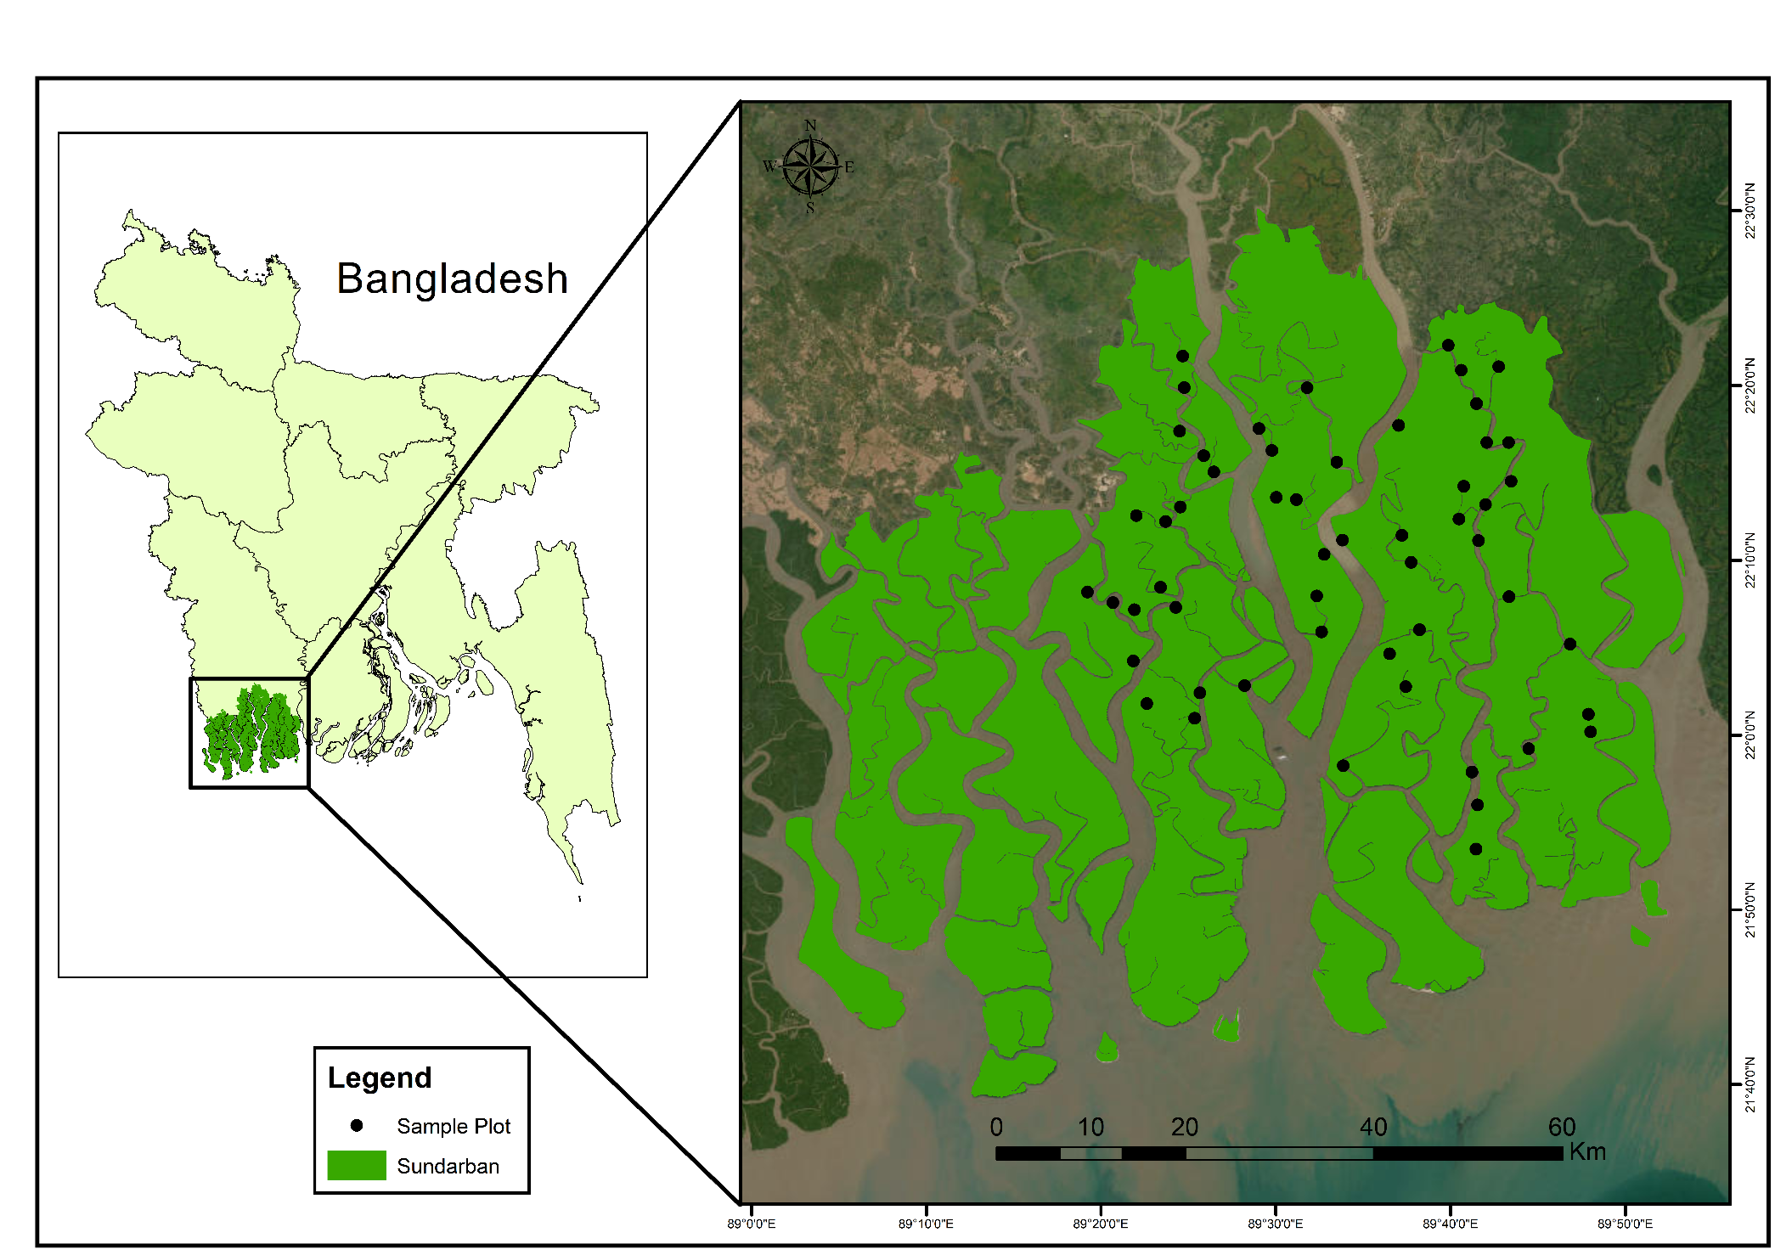
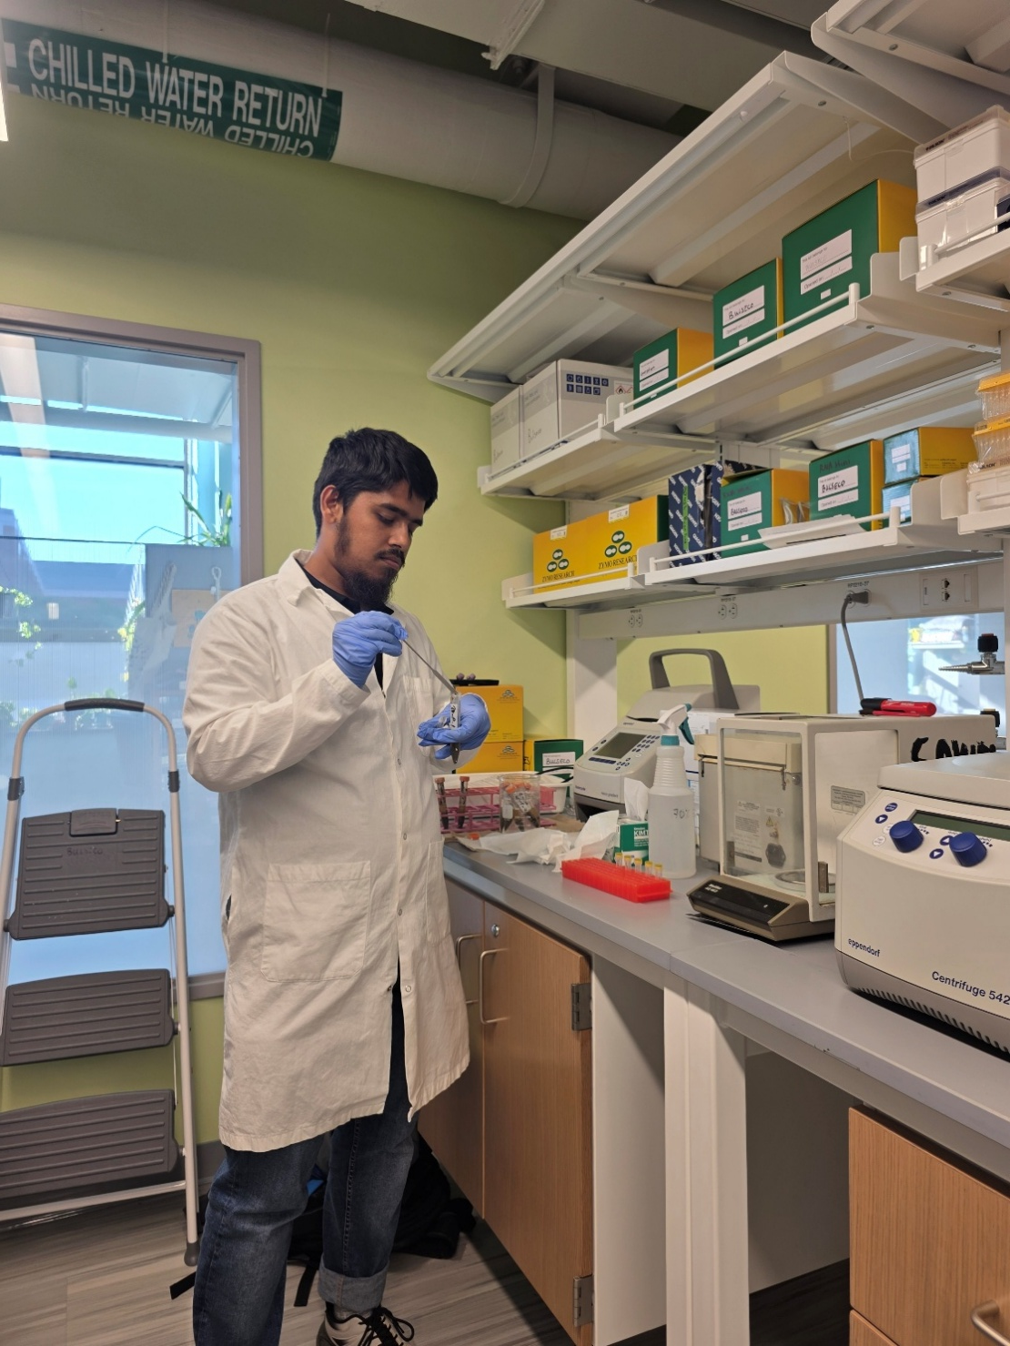
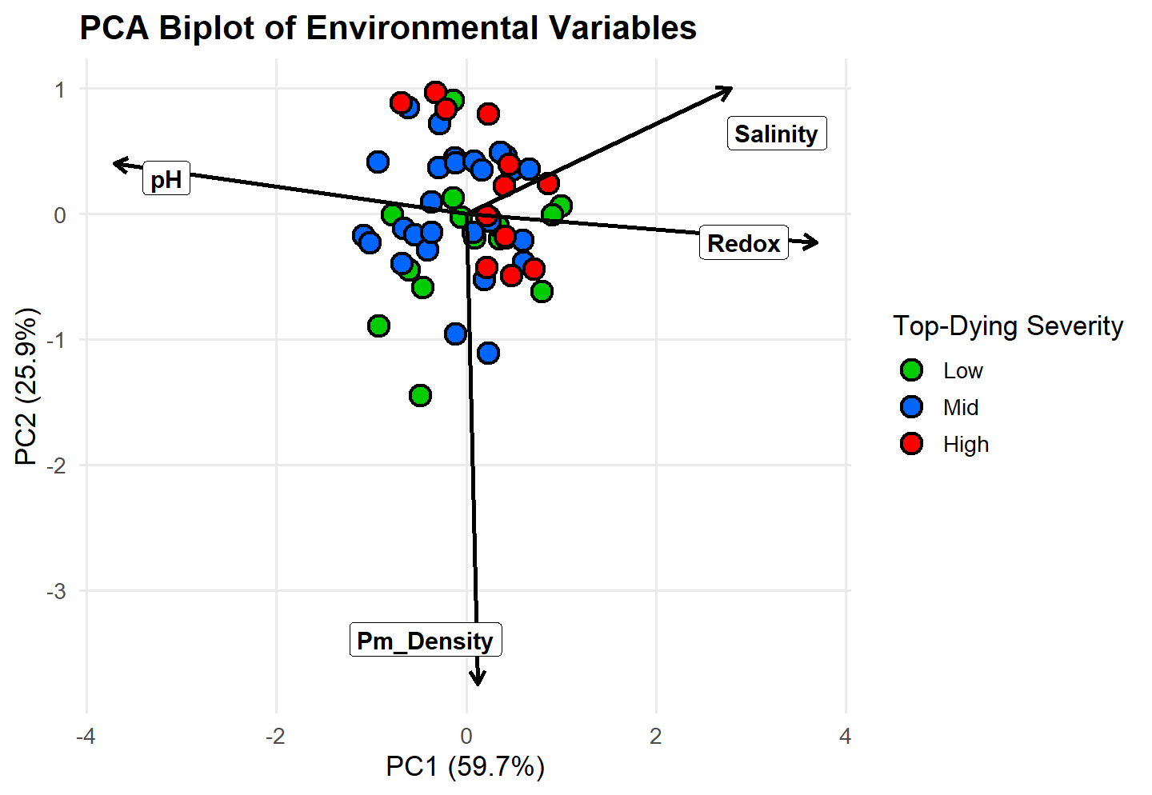
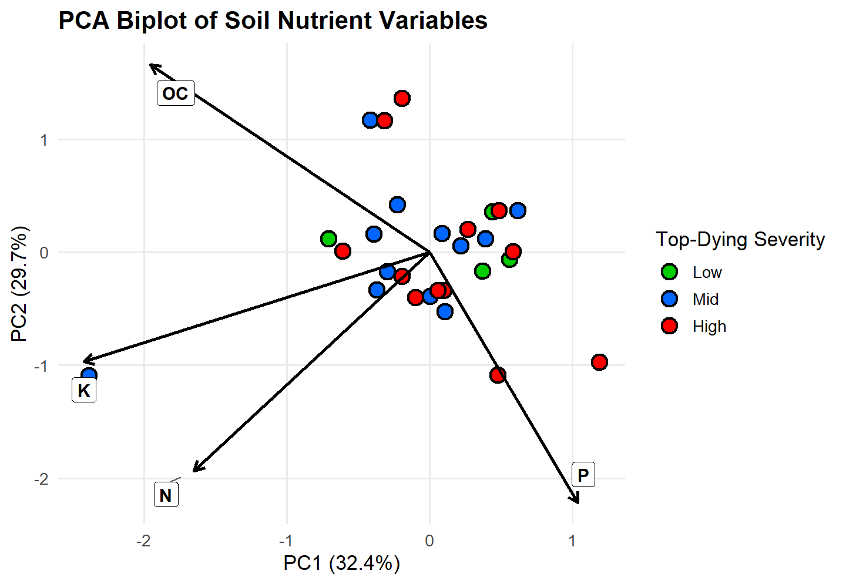
Physical and Biogeochemical Factor Influencing Top-Dying of Heritiera fomes in the Sundarbans Mangrove Forest, Bangladesh
Md Seikh Sadiul Islam Tanvir¹, Ashley Bulseco¹, Adam Wymore², Md Saidur Rahman³ and Gregg Moore¹
¹Department of Biological Sciences, University of New Hampshire, Durham, NH, USA
²Department of Natural Resources and the Environment, University of New Hampshire, Durham, NH, USA
³Forestry and Wood Technology Discipline, Khulna University, Khulna, Bangladesh
Introduction
Methodology (Cont.)
Result (Cont.)
The Sundarbans is the world’s largest single contiguous mangrove forest providing vital ecosystem services (e.g., carbon sequestration, coastal protection, and biodiversity). More than 5 million people depend on the Sundarbans for their livelihoods.
However, top-dying disease has increasingly threatened Heritiera fomes, the dominant tree species in the Sundarbans, leading to extensive mortality.
This study aims to investigate physical and biogeochemical factor influencing top-dying of Heritiera fomes in the Sundarbans Mangrove Forest, Bangladesh.
The study supports climate resilience (SDG 13), biodiversity conservation and restoration (SDG 15), and protection of coastal ecosystems that sustain fisheries (SDG 14) of UN Sustainable Development Goals.
The PCA of environmental variables (Fig. 4) showed that PC1 (59.7%) and PC2 (25.9%) explained most of the variation, with PC1 driven by higher salinity and redox potential and lower pH, and PC2 influenced by pneumatophore density.
The PCA of soil nutrients (Fig. 5) showed that PC1 (32.4%) and PC2 (29.7%) together explained 62.1% of the total variation in soil properties.
Soil nutrients showed a trade-off pattern, where phosphorus (P) was negatively associated with organic carbon (OC), nitrogen (N), and potassium (K).
The biplot indicated weak separation of top-dying severity classes, with higher severity plots associated with higher P, while lower severity plots aligned with OC-rich conditions.
Fig.1 : Study Area, Data collection & Laboratory Analysis
Methodology
Result (Cont.)
Conclusion
Field sampling was carried out across 60 circular plots (100 m² each) located in both top dying affected and unaffected areas of the Sundarbans (Fig. 1).
Plots were classified into low, medium, and high top-dying severity based on percentage of Heritiera fomes tree affected by top dying disease.
Sediment samples were collected to analyze soil physicochemical properties and nutrients (OC,N,P,K), while porewater was extracted to measure salinity, pH, and redox potential.
Tree cover, pneumatophore height (proxy for inundation level), pneumatophore density was recorded as an indicator of environmental stress.
Multivariate analyses were used to assess relationships between environmental variables and disease severity.
Top-dying severity in Heritiera fomes is strongly associated with environmental stressors, particularly with salinity and altered redox conditions.
Soil nutrient concentrations showed no significant differences across severity levels.
Multivariate analysis revealed a clear gradient of increasing environmental stress from low to high severity sites.
Structural responses (e.g., pneumatophore density) showed a declining trend with increasing disease severity.
These findings highlight the importance of physicochemical stressors in driving mangrove decline.
Fig.2 : Pneumatophore Density Across Disease Severity Classes
Fig.3 : Porewater Redox Potential Across
Disease Severity Levels
Result
Result (Cont.)
Future Works
Pneumatophore density did not differ significantly among top-dying severity classes (F = 3.01, p = 0.057), although values approached statistical significance.
Mean pneumatophore density was highest in low severity plots (74.95 m⁻²), intermediate in mid severity (63.14 m⁻²), and lowest in high severity plots (48.58 m⁻²), suggesting a decreasing trend with increasing disease severity (Fig.2).
Redox potential did not differ significantly among top-dying severity classes (F = 3.16, p = 0.051), but the near-significant result indicates a potential effect.
Mean redox values were lowest in mid (-42.72) and low (-39.04) severity plots, and higher in high severity plots (-27.74), suggesting an increasing trend in redox potential with disease severity (Fig.3).
Future work will focus on characterizing soil microbiota(Bacteria, Archaea, Fungi) using molecular approaches to identify key microbial taxa associated with top-dying severity. This will help uncover microbial indicators of disease resilience.
References
Rahman, M. A. (1996). Top dying of sundri (Heritiera fomes) and its impact on the regeneration and management in the mangrove forests of Sundarbans in Bangladesh. Impact of diseases and insect pests in tropical forests, 117-133.
Awal, M. A. (2014). Analysis of soil parameters causing dieback in Sundarbans. American Journal of Environmental Protection, 3(3), 162-171. https://doi.org/10.11648/J.AJEP.20140303.18
Fig.4 : PCA biplot showing relationships between environmental variables and top-dying severity classes
Fig.5 : PCA biplot showing relationships between Soil Nutrients and top-dying severity classes

