Slide 1


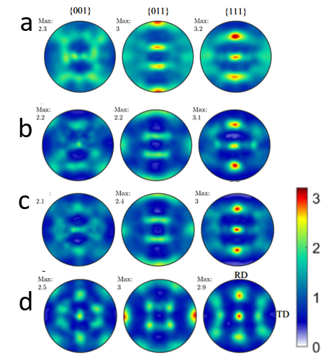
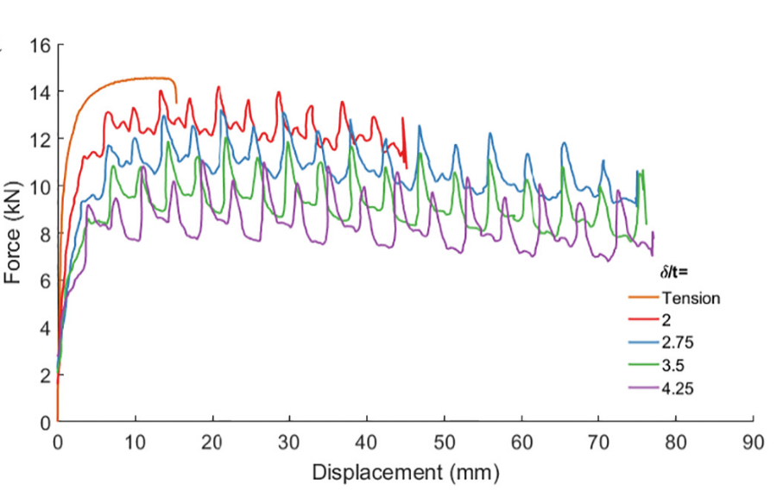
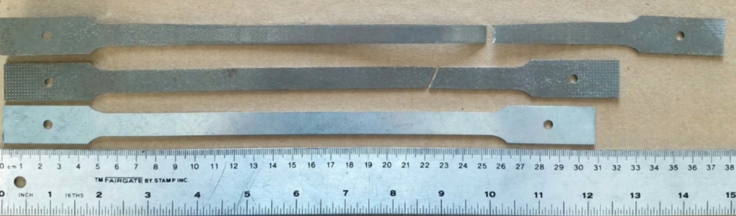
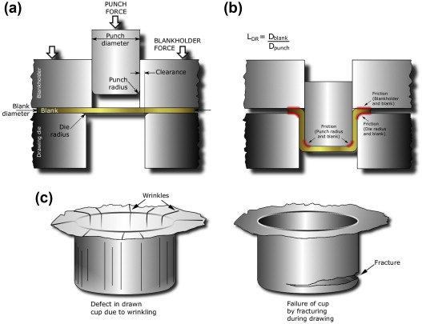
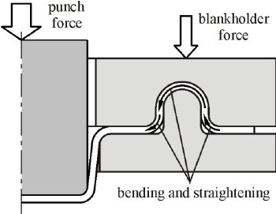
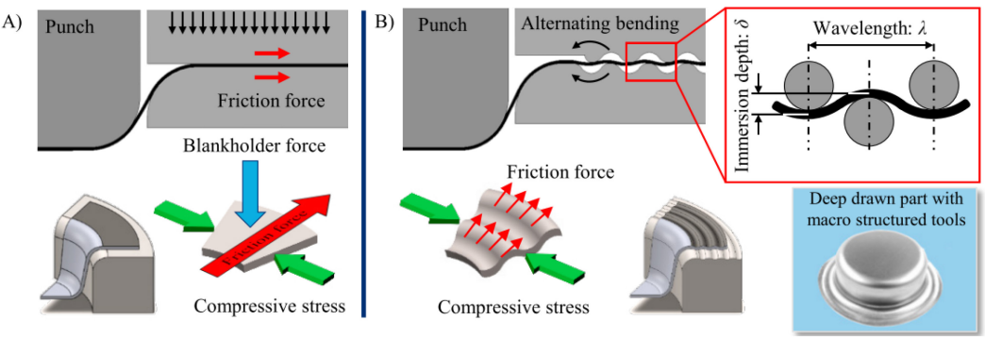
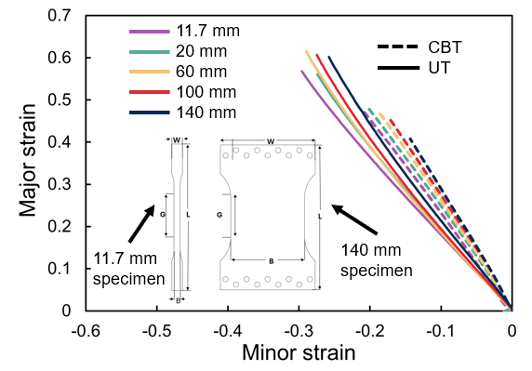
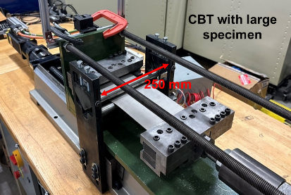
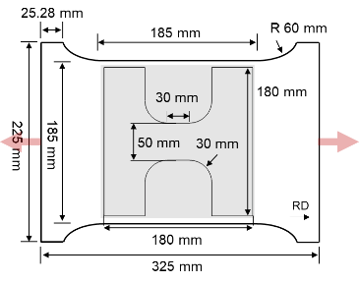
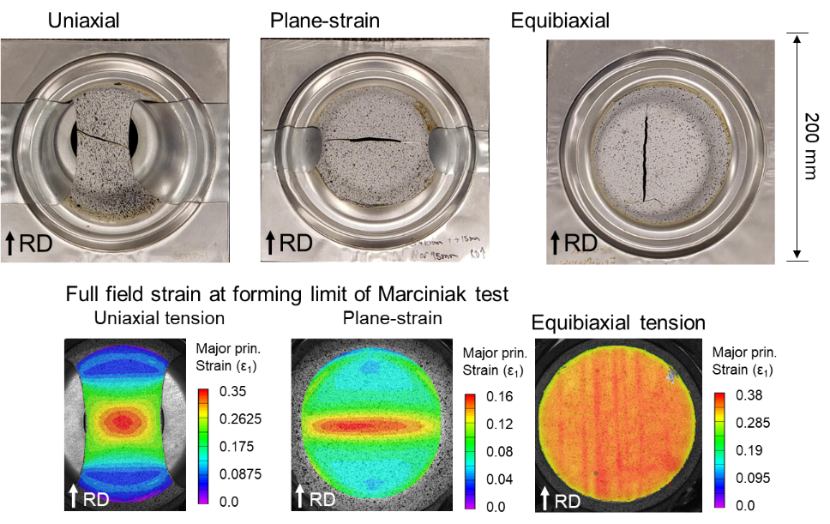
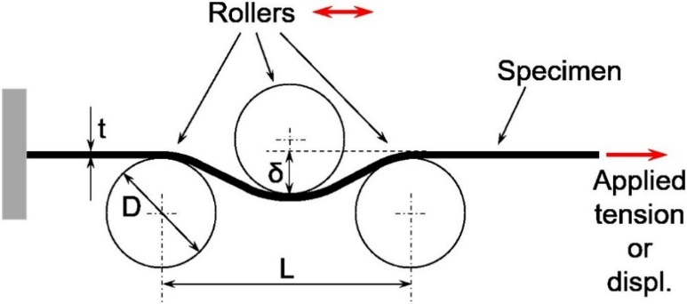
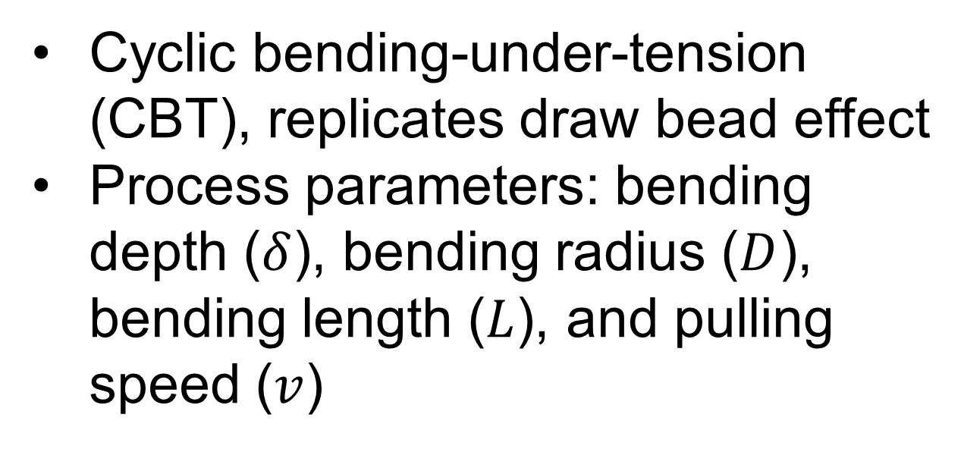
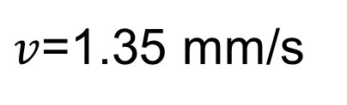

Investigation of Macro-Structured Tooling Effect on Formability Enhancement and Force Reduction in Deep Drawing Process
Desmond Mensah, Marko Knezevic, Jinjin Ha, and Brad Kinsey
University of New Hampshire, Durham, NH 03824, USA
Introduction
Formability & Force Evaluation
Texture Evolution
In deep drawing, formability is bounded by wrinkling and tearing concerns [1]. Draw beads are conventionally used to control material flow but require heavy lubrication and produce high frictional resistance. Recently, macro-structured tooling with periodic wave features on the blank holder (BH) and die surfaces has been shown to:
Reduce BHF by over 50% and forming energy by about 17% [2]
Stabilize against wrinkling through distributed line contacts rather than surface-area contact
Enable potential elimination of lubrication in stamping operations [3]
As sheet metal flows over wave peaks in macro-structured tooling, it undergoes repeated bending and unbending under superimposed tension, identical to Cyclic Bending under Tension (CBT). Therefore, CBT provides the fundamental material characterization needed to model and optimize both conventional draw bead and macro-structured forming processes.
Up to five times longer total elongation to fracture in CBT (with optimal bending depth ratio, purple in Fig. 4) compared to simple tension (orange), demonstrating significant deformation improvement.
Lower force in CBT by stress superposition, determined by the bending depth ratio in Fig. 4 and constant pulling speed.
Initial Texture (Fig. 9a)
Simple tension (Fig. 9b): Limited texture changes with slight {011} fiber alignment near the fracture zone.
CBT (Figs. 9c and 9d): Significant texture evolution, forming a pronounced {011} fiber along the stretching direction, indicative of higher strain levels achievable.
$v$=1.35 mm/s
Fig. 9 Stereographic pole figures for texture evolution in DP 1180 in (a) initial, (b) simple tension, and during CBT after (c) 2 and (d) 9 CBT cycles [4]
CBT
Simple tension
Conclusions
Undeformed
CBT effectively enhances formability by controlling material flow, preventing excessive localized thinning and suppressing wrinkling.
The deformation mode in CBT is mechanistically identical to that experienced by sheet metal in both draw bead and macro-structured (wavy) tooling processes.
Wide specimen design enables FLD testing under varied loading paths, allowing CBT to be assessed with respect to extending forming limits and predicting process windows.
These findings position CBT as a critical characterization method for optimizing both current and next-generation stamping processes, with demonstrated potential for over 50% BHF reduction and significant lubrication and energy savings in industrial applications.
Wrinkles
Fracture
Fig. 4 Force-displacement curves for simple tension and CBT with varying bending depths [4]
Failure of cup by
Fracturing during drawing
CBT effect on FLD
Defect in drawn
cup due to wrinkling
CBT process with a wide specimen design enables the study of varying loading paths, simulating deep-drawing conditions.
After CBT processing, specimens are cut for FLD analysis, where techniques like the Marciniak test and full-field strain measurements help evaluate formability.
Fig. 1 Failure forms in deep drawing process [1]
Fig. 2 Deformation of the sheet in the draw-bead region [1]
References
Qin, Y., W.A., W.-N., and Zhao, J., 2015, “Forming of Micro-Sheet Metal Components,” Micromanufacturing Engineering and Technology, Elsevier, pp. 299–322. https://doi.org/10.1016/B978-0-323-31149-6.00013-X.
Trask, M., 2023, "Improvements in Conventional Stamping through Macro-Structured Tooling with Wave Features," M.S. Thesis, The Ohio State University.
Brosius, A., and Mousavi, A., 2016, "Lubricant Free Deep Drawing Process by Macro Structured Tools," CIRP Annals, 65(1), pp. 253–256.
Poulin, C. M., Korkolis, Y. P., Kinsey, B. L., and Knezevic, M., 2019, “Over Five-Times Improved Elongation-to-Fracture of Dual-Phase 1180 Steel by Continuous-Bending-under-Tension,” Mater. Des., 161, pp. 95–105.
Fig. 3 (A) Conventional and (B) macro-structured process of deep drawing [2]
Fig. 5 CBT machine with wide grips and specimen
Fig. 6 Strain path change in various width specimens
CBT Mechanics
Cyclic bending-under-tension (CBT), replicates draw bead effect
Process parameters: bending depth ($δ$), bending radius ($D$), bending length ($L$), and pulling speed ($v$)
$$v$$
Acknowledgement
Three rollers cause the material to plastically deform locally and lower the tension load to induce deformation by subjecting the specimen to bending-under-tension.
This work is supported by the U.S. National Science Foundation (NSF) GOALI grant CMMI-2147122 (UNH) and 2147126 (BYU) and partially funded by EPSCoR awards OIA-1757371 and #1757371.
Fig. 7 Marciniak specimen for evaluation of FLD after CBT
Fig. 8 Marciniak test and full strain field measurement at limit conditions

