Slide 1




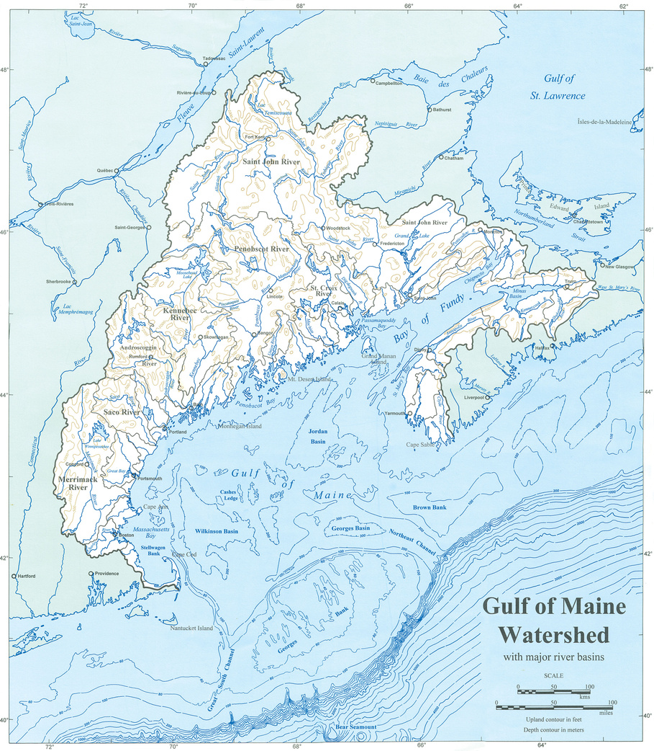
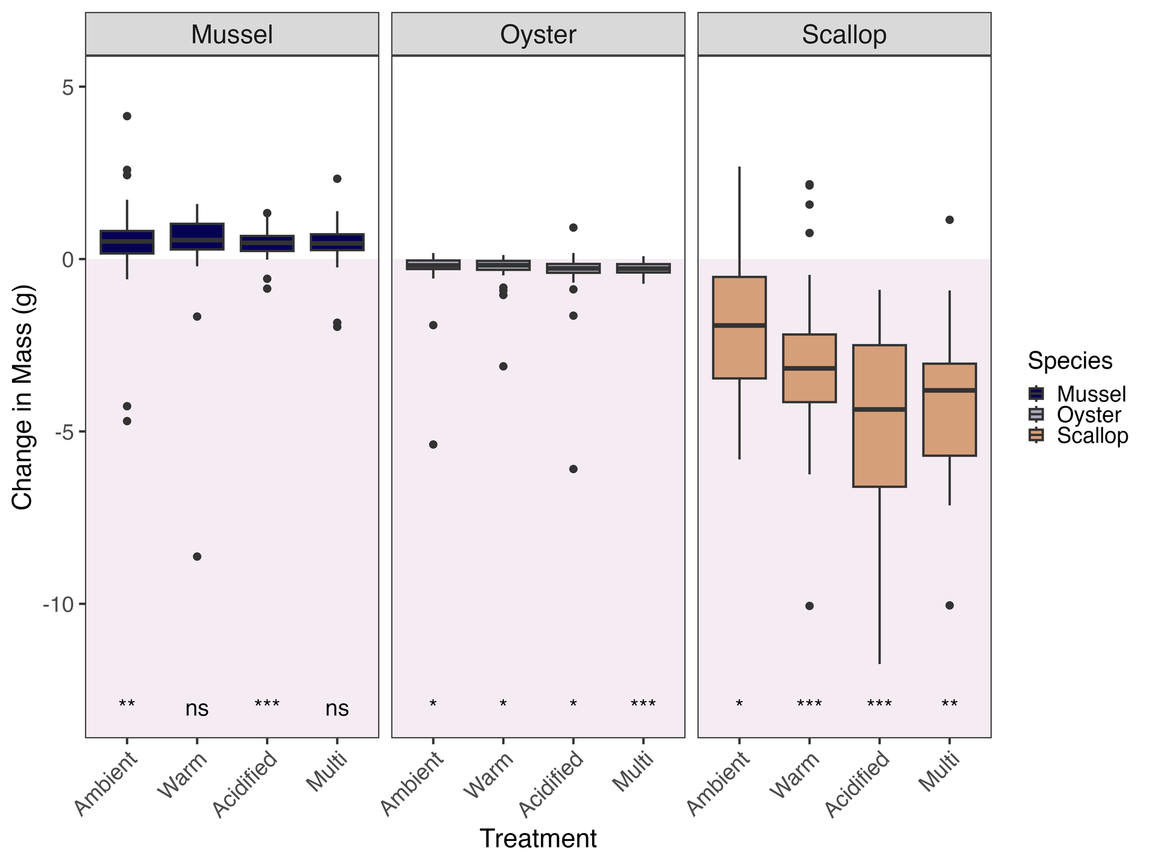
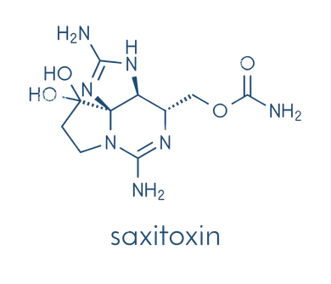
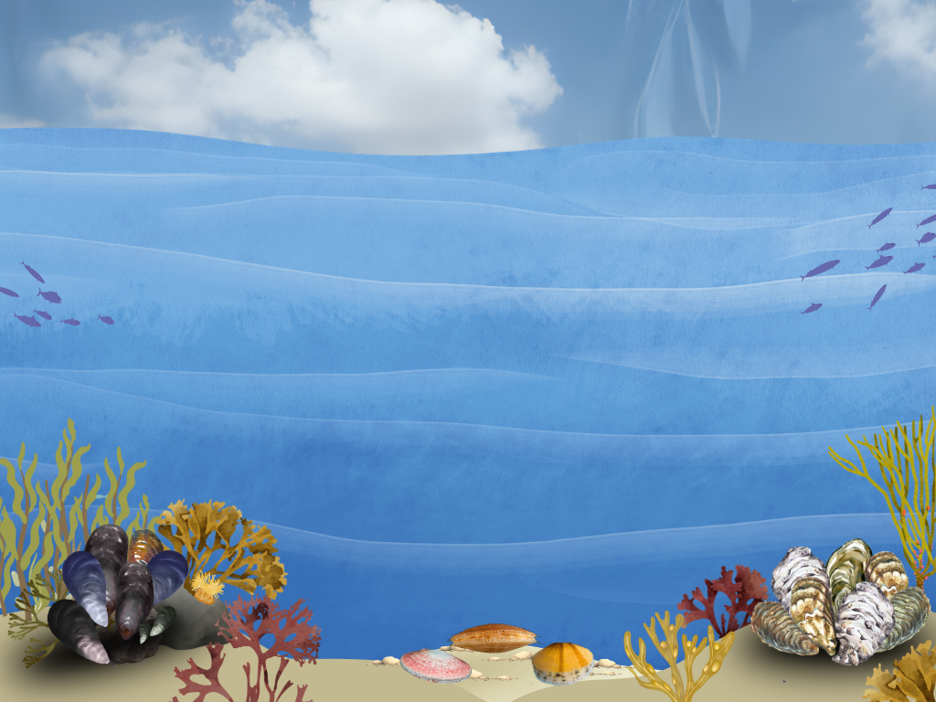



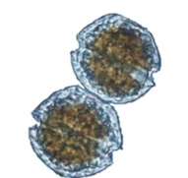



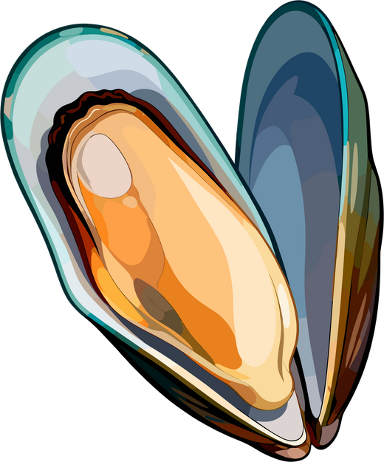

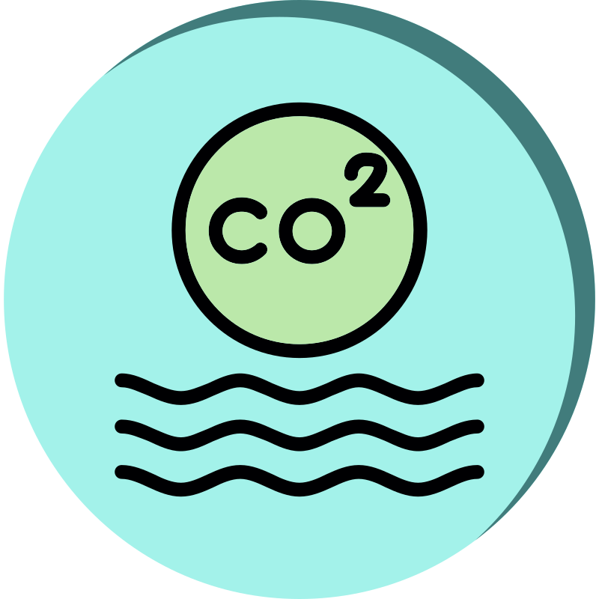

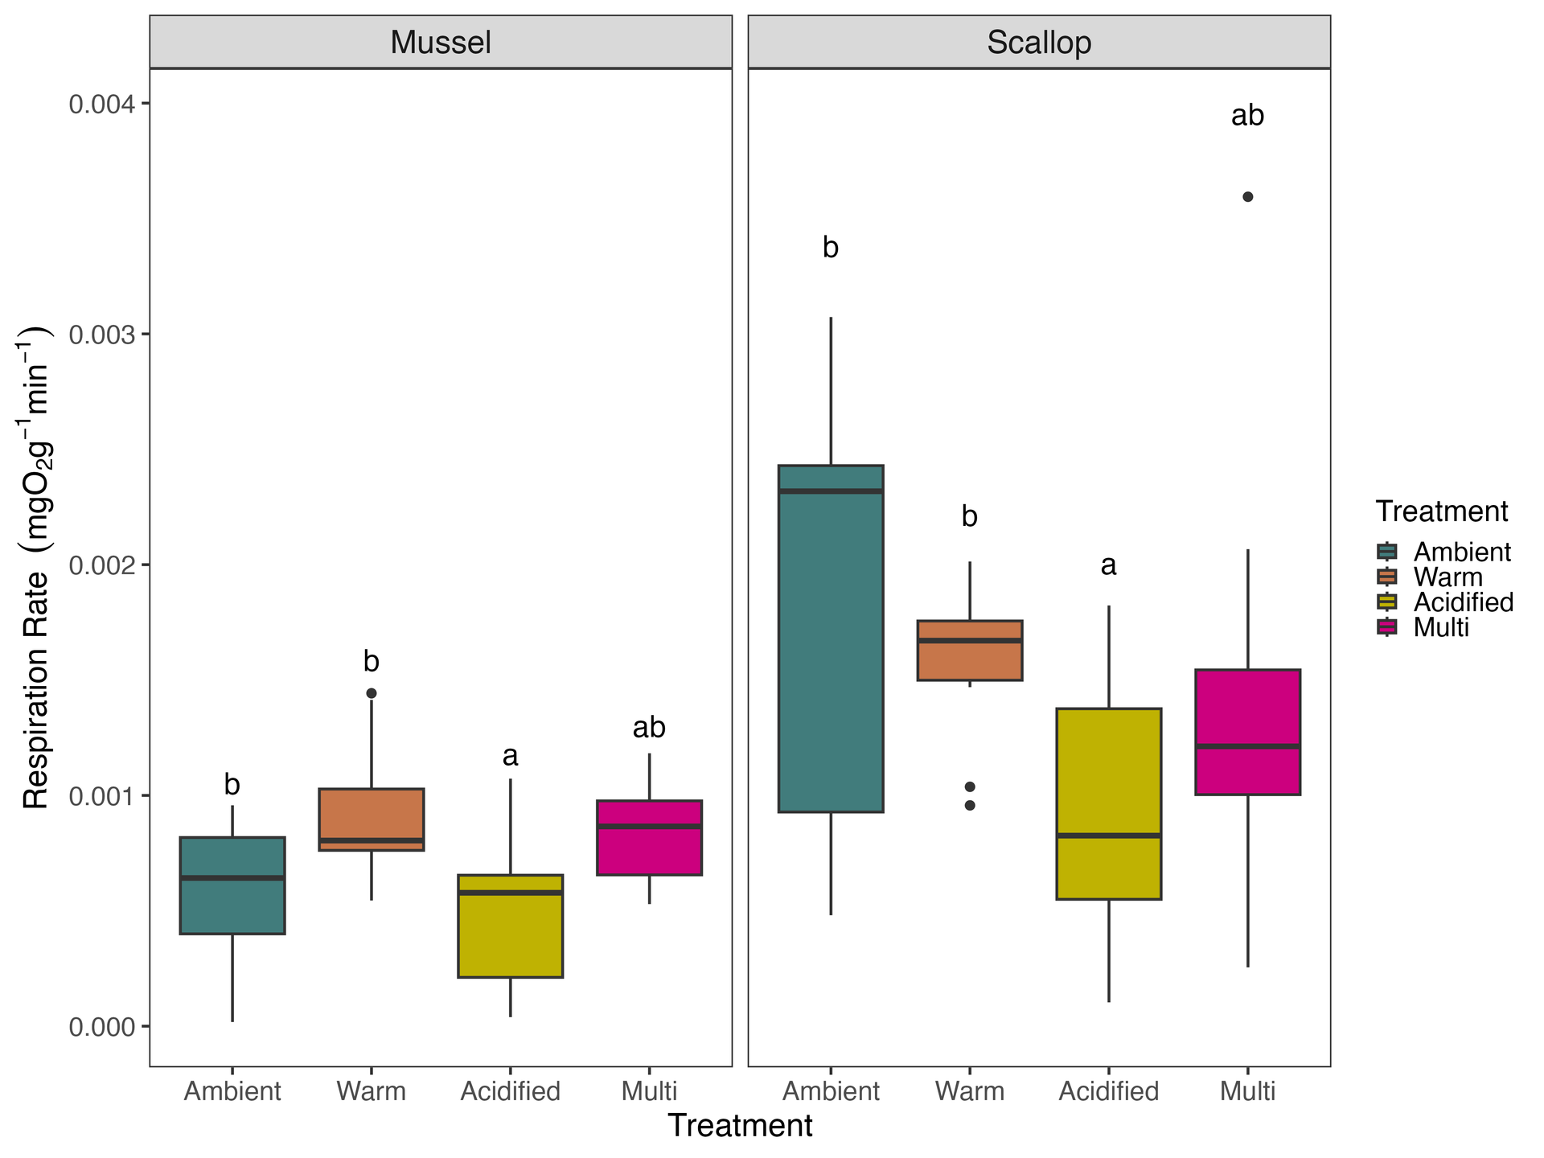


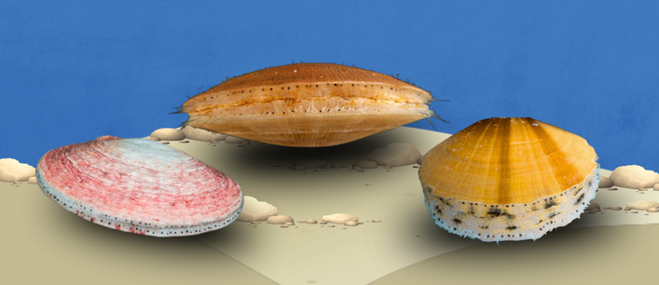
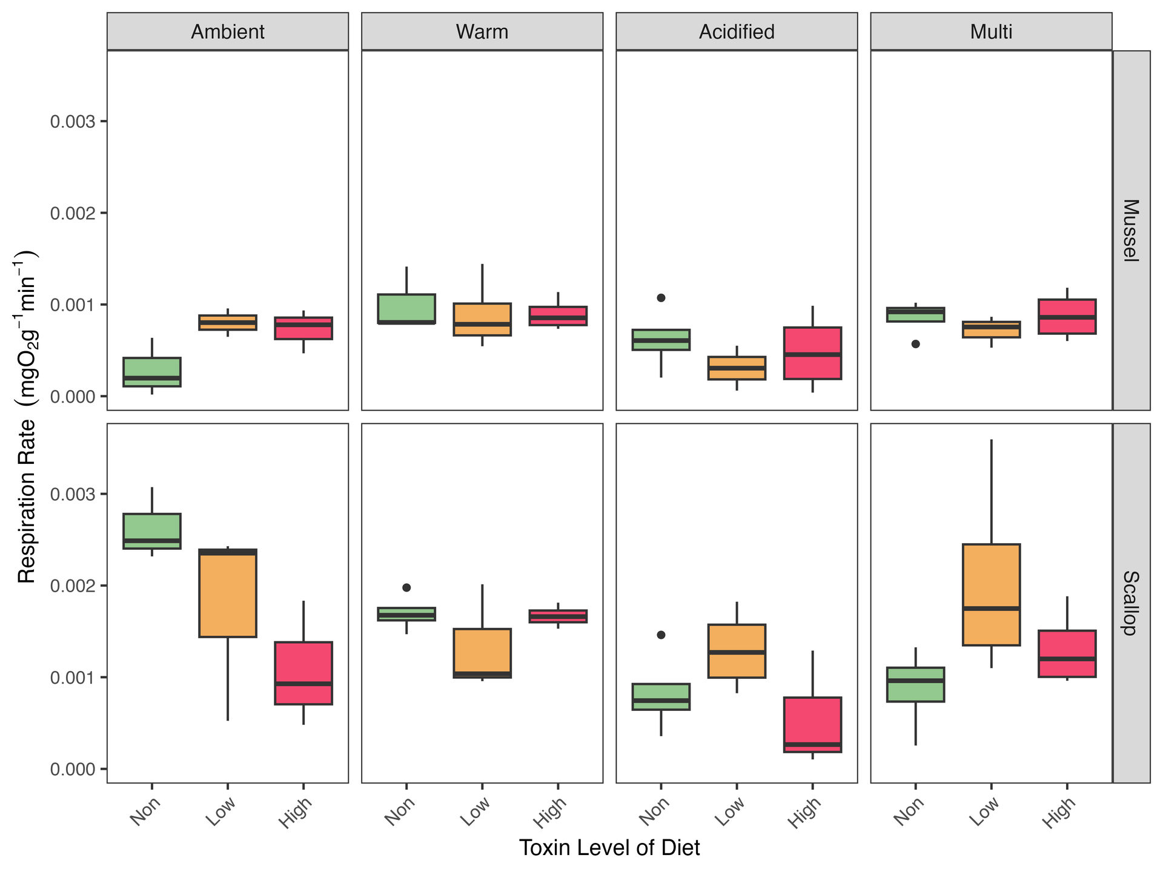
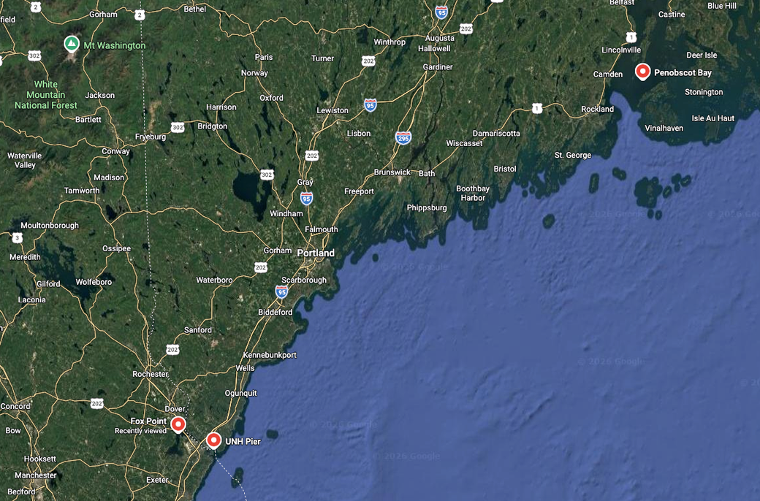
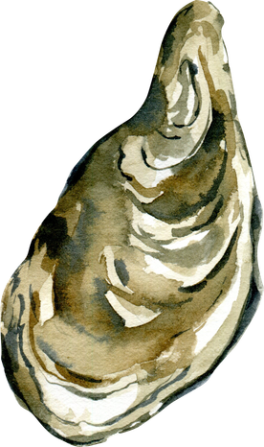
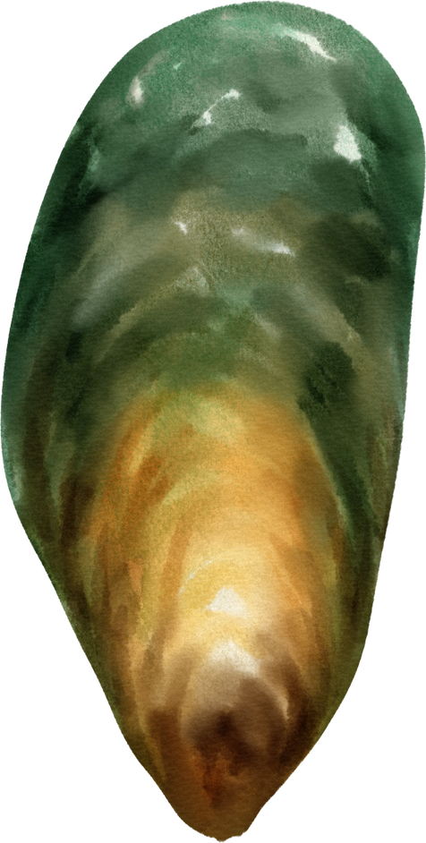
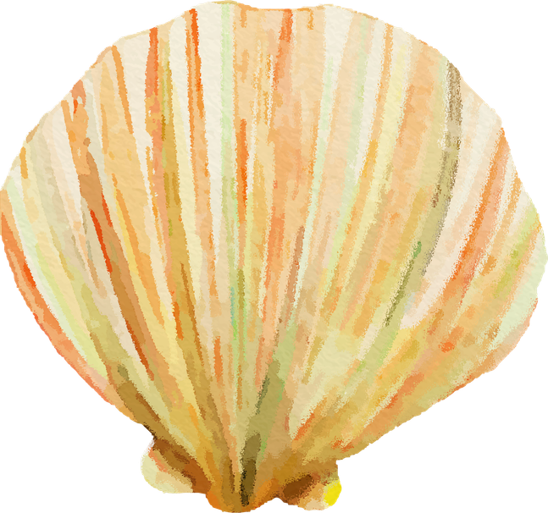






Abstract F44A-0068
The Influence of Coastal Acidification and Ocean Warming on Biotoxin Depuration Time in Commercially Valuable Bivalves
Hannah Gossner , Elizabeth Harvey, Brittany Jellison
1
1
1
1
1
  University of New Hampshire, Department of Biological Sciences, Durham, NH, USA
Background
No Toxin Data Yet, But...
Saxitoxin
Change in mass varied by species,
not treatment
Alexandrium
BIVALVES AS BELLWEATHERS
Vital ecosystem services
Vulnerable to climate change
GULF OF MAINE
Changing rapidly
Aquaculture = Important
There were no significant within-species differences in change to mass or length (not shown) as a function of environmental exposure (Tukey HSD)
1-3
23-25, 3
MONITORING AND MANAGEMENT
Monitoring for saxitoxins often relies on mussels as the sole sentinal species
HARMFUL ALGAL BLOOMS
Alexandrium fundyense Produce saxitoxin
(paralytic shellfish poisoning)
This suggests that either a) the length of the experiment was not long enough for conditions to impact growth or b) the stressors were within tolerance ranges of all species
11,21-22
8-11
COMPARATIVE PHYSIOLOGY
Variable stress response
Multiple stressors
FOOD SELECTIVITY
Variable selective capacity
Dependent on ecophysiology
12-21
Fig 1. Change in whole, wet mass (g) of individuals between the start and end of the experiment. Stars at the bottom signify significance level in the difference of the value from zero.
FDA Limit:
80 μg STX/100g tissue
4-7
Warming, acidification,
food availability
Acidification decreased respiration rates, while temperature had a “tempered” effect
Mytilus edulis
Blue Mussel
Placopecten magellanicus
Atlantic Sea Scallop
Crassostrea virginica
Eastern Oyster
Across both mussels and scallops, ambient and warm grouped together while acidification showed a slight decrease, and multi-stressor shared components of both.
This suggests a 2°C offset may be within the realm of regulatory plasticity, while a drop of 0.2 pH units might be challenging physiologically
How efficiently do three commercially harvested species of shellfish clear saxitoxin from their tissue; will this be impacted by climate change?
How well is this variability encompassed in current management?
Methods
Fig 2. Respiration rates of mussels and scallops as a function of treatment. Letters signify Tukey HSD groupings.
Sample
Collection
So does acute exposure to toxic phytoplankton impact metabolism?
n= 180
n= 180
n= 180
Acclimation Period
14 days
~14°C, pH ~7.7
While there were no significant effects of diet or species*diet on respiration rate (linear mixed effects model with tank as random effect), there were marginal differences in non-toxic vs. high toxic scallops across all four treatments.
It will be exciting to see how this translates into toxin accumulation and depuration!
Treatment
Temp
offset
pH
offset
†
†
Environmental
Exposure Period
21 days
Ambient
0°C
0
†
Warm
+2°C
0
Assay
Target
Acidified
0°C
-0.2
Feeding
  Clearance rate
  Selectivity via pseudofeces
Fig 3. Respiration rate of mussels and scallops as a function of both treatment and diet composition. Brackets signify marginal differences (0.05 < p < 0.1) between groups (post hoc Tukey test)
Multi
+2°C
-0.2
Feeding period
Days 1, 3, 5
Next Steps
  Complete processing of saxitoxin concentration samples to determine interspecies variability in toxin uptake and depuration as a function of warming/acidification
  Calculate cell ingestion rates from feeding assay to see what was ingested/rejected as pseudofeces, and if there was an impact of warming/acidification on selection
Diet
Content
(equal carbon)
Feeding Trials
10 days
Non Toxic
Isochrysis galbana
Respiration
In situ metabolism under multiple stressors
Low Toxin
I. galbana
A. fundyense
Feeding period
Days 2-5
High Toxin
I. galbana
A. fundyense
Tissue
  Toxin content (Gold Standard ELISA Assay)
  Total Protein
  Gill Microbiome?
Sources and Acknowledgements
Depuration Period
10 days
Environmental Treatments
Non-toxic Diet
Depuration
Days 1, 3, 6, 10
This work was funded in part by New Hampshire Sea Grant. Thank you to the UNH School of Marine Science and Ocean Engineering for supporting its dissemination. Thank you to Kaitlin Von Volkom, Michaela Edwards, Olivia Boyan, Branaly Varela for helping run this experiment, as well as Nate Rennels and the team at UNH Coastal Marine Lab for your technical support.
Questions?
Want to chat?
Find me here at 2/26 from 4-6pm
Or email: Hannah.gossner@unh.edu
Extended Methods
Works Cited

