Slide 1


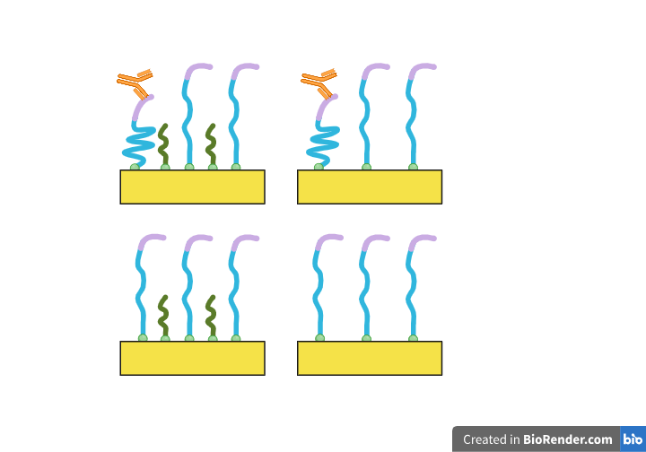
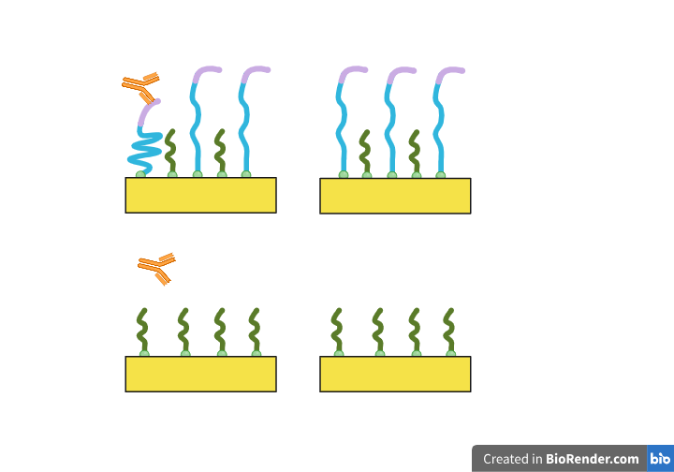
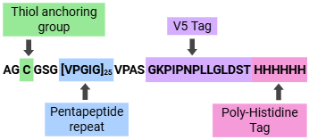
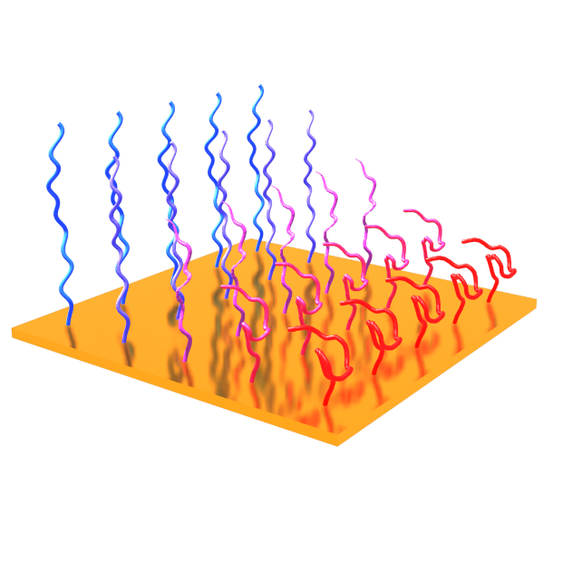


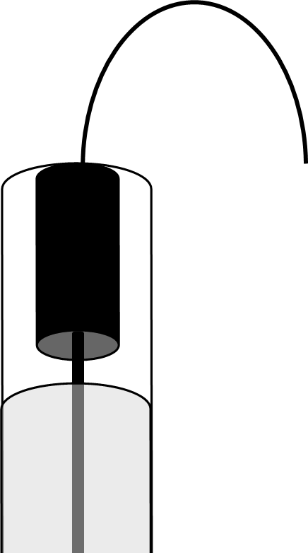





Thermal Response of Analyte-Responsive Polymer in the Presence and Absence of Anti-V5
Laurel Nelscott¹, Savannah Wakita², Eva Rose M. Balog², Jeffrey M. Halpern¹
¹Department of Chemical Engineering and Bioengineering, University of New Hampshire (UNH), Durham, NH
²School of Molecular and Physical Sciences, University of New England (UNE), Biddeford, ME
Background
Surface Modification and Data Collection
Stimulus Response
Elastin-Like Polymers (ELPs) respond to temperature
Analyte Responsive Polymers (ARPs) are ELPS that respond to analyte
The ELP used in this work is CsEL
CsEL is expected to respond to both Anti-V5 and Anti-His antibodies
Surface-Bound Thermal Collapse Response
Thermal collapse response is less defined in surface-bound ARPs
Analyte binding is expected to change the thermal collapse response
Experimental Parameters
Analyte solution used is 1 µM Anti-V5 in PBS
Anti-V5 K_{d} expected to be around 10⁻⁸ to 10⁻⁹ M
Passivated Surface, No Analyte
Modified and Passivated Surface, No Analyte
21.3 Hz
21.3 Hz
Passivated Surface With Analyte
Modified and Passivated Surface With Analyte
21.3 Hz
21.3 Hz
Amino Acid Sequence of CsEL
Temperature Increase
Legend: ● 5°C ● 10°C ● 15°C ● 20°C ● 25°C ● 30°C Analyte
Electrochemical Impedance Spectroscopy
Investigating Drift
Legend: ● Delay+0 Minutes ● Delay+20 Minutes ● Delay+40 Minutes ● Delay+60 Minutes ● Delay+80 Minutes ● Delay+100 Minutes
Electrochemical Cell
Passivated Surface, No Analyte, 5°C, 0 Minute Delay
Passivated Surface, No Analyte, 5°C, 60 Minute Delay
Input Signal:
Voltage
Output Signal:
Current
Non-Redox Mediated EIS
Solvent is PBS with or without analyte
Capacitance used for characteristic feature analysis
Frequency of 21.3 Hz chosen due to spread of capacitance values
Conclusions
References and Acknowledgements
Temperature inherently affects electron transfer
Temporal drift tempers our conclusions of analyte response
We would like to thank our fellow SEEDS Lab members as well as all our collaborators within the ​BIO-SENS project: The Pantazes Lab (Auburn University), The Balog Lab (University of New England), and The Hill Lab (University of Wyoming). ​
This work was funded by the​ National Science Foundation ​​EPSCoR award (#2119237)
3D ELP temperature image created by Dr. Stanley Feeney. Other images created with BioRender. Special thanks to Darcy Silver.
Contact Laurel Nelscott at LHN1003@USNH.EDU. Antibody sourced from Fisher Scientific. Catalog number MA5152531MG.

