Slide 1
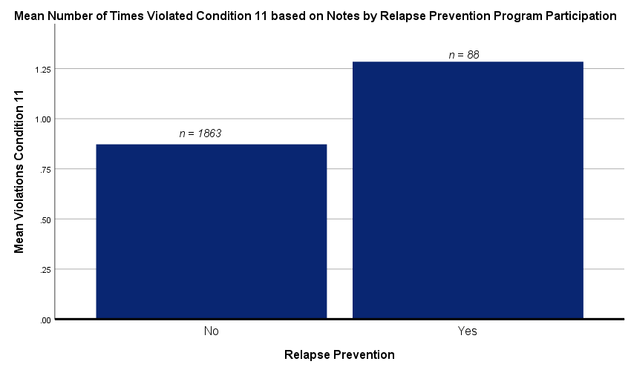
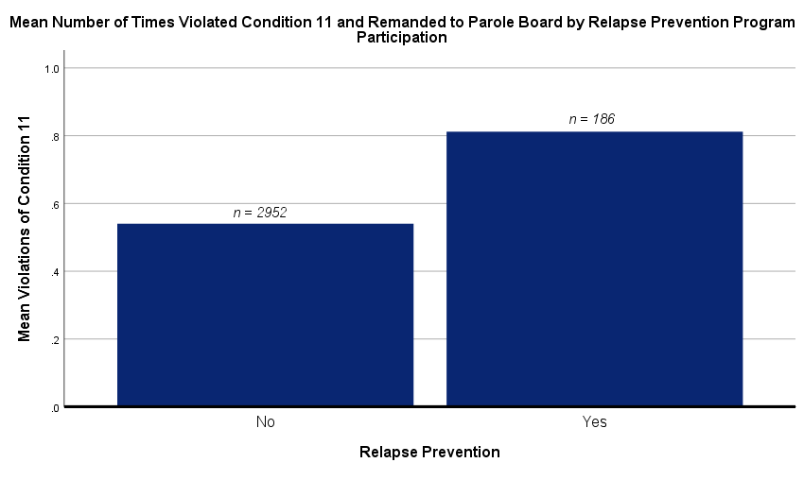
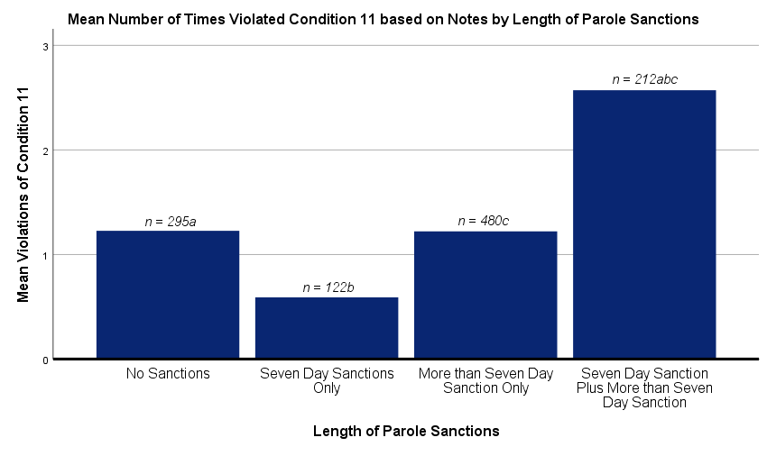
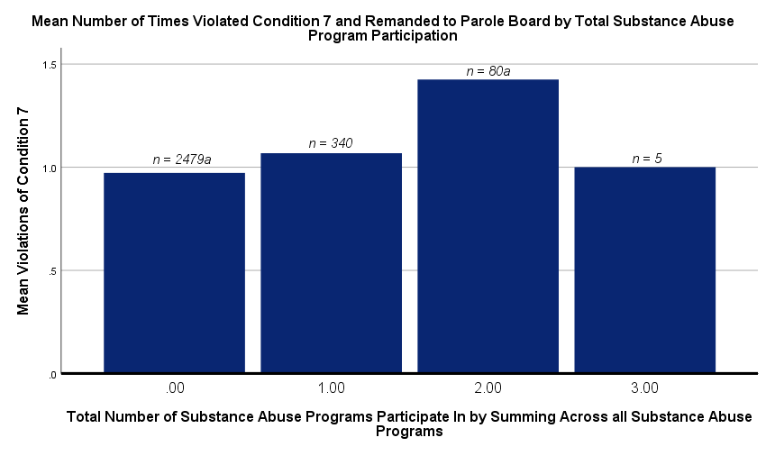
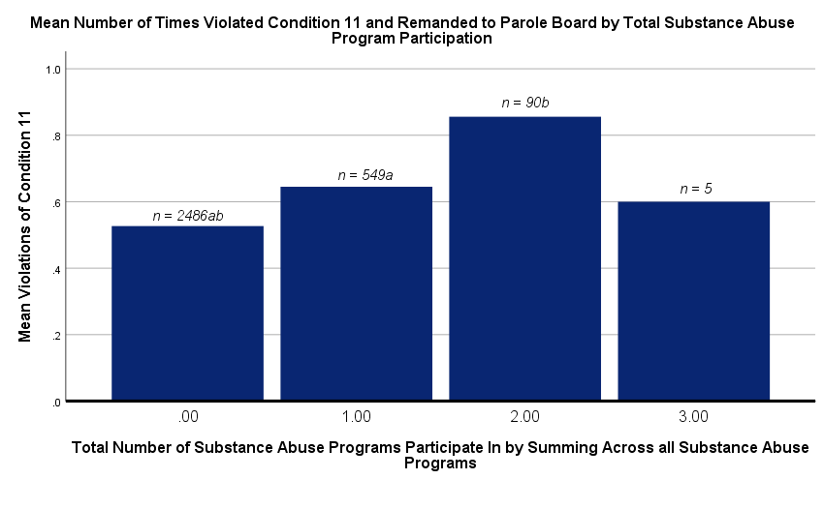
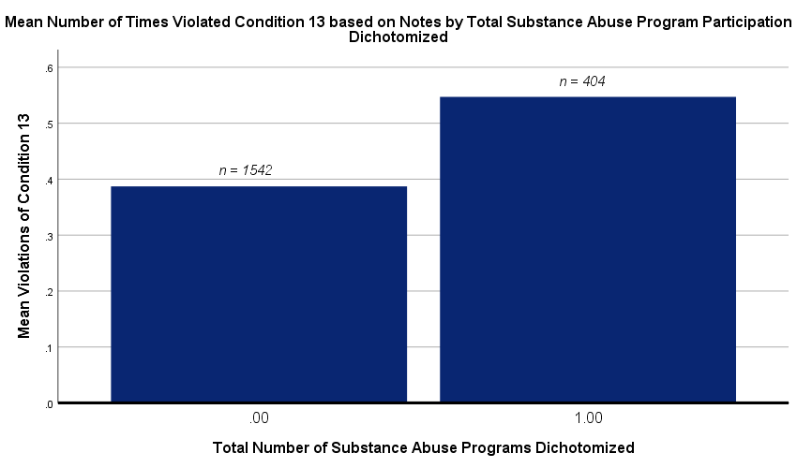
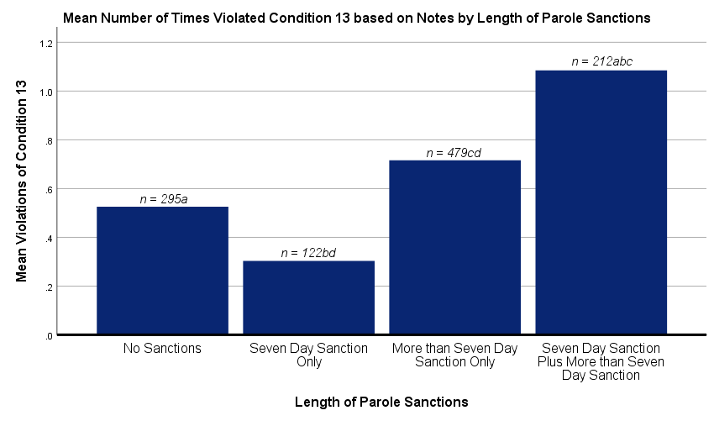
Factors that Predict Successful Reintegration of Parolees
Lauren McGrath and Madison Sundberg, under the supervision by Donna Perkins, Ph.D.
University of New Hampshire
Introduction
Key Findings
Hierarchical Regression Results: Focus and Relapse Prevention Participation on Parole Violations
Steps | Violation of Standard Parole Condition | Notes/ Remands | 5 | 7 | 10 | 11 | 13 | Total
Step 1 | Age | Notes | _* | _* | _* | * |  | _*
 |  | Remands |  | _* | _* | + |  | _*
 | Gender | Notes |  |  | _* | _* |  | _*
 |  | Remands |  |  | _*
Step 2 | Violent Offenses | Notes |  | +* |  | * | +* | +*
 |  | Remands |  | +* |  |  | Ϯ
 | Nonviolent Offenses | Notes | * | +* | +* | +* | * | +*
 |  | Remands |  | +* |  |  | Ϯ | +*
 | Drug Offenses | Notes |  | +* | +* | + |  | +*
 |  | Remands |  | +* | +* |  |  | +*
 | Sex Offenses | Notes |  | * |  | * |  | *
 |  | Remands
 | Other Offenses | Notes
 |  | Remands
 | Mean Risk Level | Notes |  | + | +* | +* | +* | +*
 |  | Remands | + | +* | +* |  |  | +*
Step 3 | Focus | Notes | * | * | * | * | * | *
 |  | Remands | * | * | * |  | *
 | Relapse Prevention | Notes | * | * | * | Ϯ* | * | _*
 |  | Remands | * |  | * | +* | * | -
Starting in 1907, New York created a parole system that is similar to modern day parole systems (Campbell, 2011). Indeterminate sentencing became a primary focus in the 1930’s after prison overcrowding concerns and social control (Bottomley, 1990). As a result, the first federal parole board was created (Fulwood, 2003). Mass incarceration proliferated across the United States throughout the 1970s and 1980s. Punitive drug policies took effect as a result (Bunzel, 1995). According to the Bureau of Justice Statistics (2017), there were 1,489,400 individuals in prisons and 745,200 in jail as of 2017. Parole was developed to control mass incarceration within the United States. Studies show that benefits from prison-based drug treatment programs (i.e. lower recidivism and successful reintegration), are heightened when combined with continued aftercare (Olson & Lurigio, 2014). Additionally, Matejkowski, Severson and Manthey (2015) found that mental health treatment, along with risk reduction and strength promotion, increased the likelihood of successful reintegration of parolees with mental illness. Our study focused on factors that affect recidivism among parolees.
Risk level was a good predictor of almost all parolee violations, concluding that the Ohio Risk Assessment System (ORAS) is a valid assessment.
When controlling for individual characteristics, criminal history, and risk level, most program participation was not predictive of violations of parole conditions. When program participation did predict violations, the relationship was generally that parolees with more participation in programs were more likely to violate the Standard Conditions.
Our predictor variables of interest better predicted violations based on parole officer notes, rather than based on actual remands to the parole board.
Results
Hierarchical Regression Results: Total Substance Abuse Program Participation on Parole Violations
Steps | Violation of Standard Parole Condition | Notes/ Remands | 5 | 7 | 10 | 11 | 13 | Total
Step 1 | Age | Notes | _* | _* | _* | _* |  | _*
 |  | Remands |  | _* | _* | + |  | _*
 | Gender | Notes |  |  | _* | _* |  | _*
 |  | Remands |  |  | _*
Step 2 | Violent Offenses | Notes |  | +* |  | * | +* | +*
 |  | Remands |  | +* |  |  | Ϯ
 | Nonviolent Offenses | Notes | * | +* | +* | +* | * | +*
 |  | Remands |  | +* |  |  | Ϯ | +*
 | Drug Offenses | Notes |  | +* | +* | +* |  | +*
 |  | Remands |  | +* | +* |  |  | +*
 | Sex Offenses | Notes |  | Ϯ |  | * |  | *
 |  | Remands |  | Ϯ
 | Other Offenses | Notes
 |  | Remands
 | Mean Risk Level | Notes |  | +* | +* | +* | +* | +*
 |  | Remands | + | +* | +* |  |  | +*
Step 3 | Total Substance Abuse Program | Notes | * | * | * | * | +* | *
 |  | Remands | * | _* | * | +* | * | +*
Method
Several zero-order correlations were statistically significant. In terms of the individual characteristics, gender was significantly correlated with violating Standard Conditions 10 and 11, in that females were more likely to violate these conditions. Additionally, age was significantly correlated with violating Standard Conditions 5, 7, 10, and 11, in that younger offenders were more likely to violate these conditions. In terms of criminal history, the more violent offenses, the more violations of Standard Conditions 7, 11, and 13. Additionally, the more non-violent and drug offenses, the more violations of Standard Conditions 7, 10, and 11. Non-violent offenses were also positively correlated with violating Standard Condition 13. A history of sex offenses was correlated with violating Standard Condition 7, in that sex offenders were more likely to obey all laws and not commit a new crime. Additionally, sex offenses were positively correlated with violating Standard Condition 11. The ORAS risk level, which was averaged across inmates’ risk assessments while incarcerated, appeared to be a reliable predictor of violating parole conditions. Risk level was correlated with violating Standard Conditions 7, 10, 11, and 13, as well as total number of violations of all 13 standard conditions, in that the higher the risk level, the more conditions violated.
For the three predictors of interest, participation in Focus programs was correlated with violations of Standard Condition 7 in that the greater number of times an inmate participated, the more likely they were to violate Condition 7. Additionally, participation in Relapse Prevention programs was positively correlated with violations of Standard Condition 11. Total number of substance abuse programs participated in was correlated with violations of Standard Conditions 7, 11, and 13 in that the more substance abuse programs parolees participated in, the more likely they were to violate those conditions. Lastly, the length of sanctions parolees received was correlated with violations of Standard Conditions 7, 11, and 13 in that the longer the sanctions, the more likely they were to violate the above conditions.
Several hierarchical regression analyses were conducted in which the variables were entered as follows: Step 1, individual characteristics control variables; Step 2, criminal history, mean risk level control variables; Step 3, our predictors of interest. Most hierarchical regression models were statistically significant models for predicting parole condition violations; however, this tended to be more because of the predictive value of the control variables, rather than the predictors of interest (see graphs on the right for significant regression coefficients for the control variables.)
Focusing on our predictors of interest, participation in Focus programs did not significantly predict violations of the selected parole conditions. Participation in Relapse Prevention programs significantly predicted violations of Standard Condition 11. Total substance abuse program participation significantly predicted violations of Standard Condition 7, in that when controlling for individual characteristics, criminal history, and mean risk level, the more times a parolee participated in substance abuse programs, the less likely they were to violate Condition 7. Additionally, controlling individual characteristics, criminal history, and mean risk level, total substance abuse program participation significantly predicted violations of Standard Condition 11, in that the more programs a parolee participated in, the more likely they were to violate Condition 11. Our final predictor of interest, length of sanction, significantly predicted violations of Conditions 11 and 13 after controlling individual characteristics, criminal history, and mean risk level, in that the longer the sanctions, the more likely they were to violate Conditions 11 and 13.
The data were provided by the New Hampshire Department of Corrections (DOC) with permission from Commissioner Helen Hanks. All data were de-identified by a former UNH student and DOC intern.
First, we ran zero-order correlations between control and outcome variables, control and predictor variables, and predictors of interest and outcome variables. We then conducted a series of hierarchical regression analyses that controlled for inmate characteristics, past criminal history and mean Ohio Risk Assessment System (ORAS) risk level, as well as one of three predictors of interest (see below). Based on specific interests shared by the NH DOC, this study focused on parolees violations of standard parole conditions 5, 7, 10, 11, and 13 (see below).
Violations were measured based on both actual remands to the parole board and on parole officer notes, in which they noted whether parolees had violated one of the 13 standard parole conditions; however, it is worth noting that parole officers have the discretion to request a remand to the parole board for a violation of a standard condition, so not all violations result in a remand and subsequent sanction.
Hierarchical Regression Results: Length of Sanction on Parole Violations
Steps | Violation of Standard Parole Condition | Notes/ Remands | 5 | 7 | 10 | 11 | 13 | Total
Step 1 | Age | Notes | _* | _* | _* | * |  | _*
 |  | Remands |  | _* | _* |  |  | _*
 | Gender | Notes |  |  | _* | _* |  | _*
 |  | Remands |  |  | _*
Step 2 | Violent Offenses | Notes |  | +* |  | * | * | *
 |  | Remands |  | +*
 | Nonviolent Offenses | Notes | * | +* | * | * | * | +*
 |  | Remands |  | +* |  | * | Ϯ | +*
 | Drug Offenses | Notes |  | +* | * | +* |  | +*
 |  | Remands |  | +* | +* |  |  | +*
 | Sex Offenses | Notes |  | * |  | * |  | *
 |  | Remands
 | Other Offenses | Notes
 |  | Remands
 | Mean Risk Level | Notes |  | +* | +* | +* | +* | +*
 |  | Remands | + | +* | +* |  |  | +*
Step 3 | Length of Sanction | Notes | * | Ϯ* | * | +* | +* | +*
 |  | Remands | * |  | * | * | * | *
Inmate Characteristic Controls | Past Criminal History Controls | Predictor Variables of Interest
Age Gender Entered in Step 1 of Model | Number of Nonviolent Offenses Number of Violent Offenses Number of Drug Offenses Number of Sex Offenses Number of “Other” Offenses Mean ORAS risk level Entered in Step 2 of Model | Participation in Focus and Relapse Prevention Programs Participation in Substance Abuse Programs Length of Sanction Entered in Step 3 of Model
Overall, our study concluded various significant findings. We found that risk level was a good predictor of almost all parolee violations concluding that ORAS was a valid assessment. When controlling for individual characteristics, criminal history and risk level, most program participation was not predictive of violations. When program participation was significant it tended to increase the likelihood of violation. We suggest that caution should be held against suggesting programs are ineffective. Inmates who participated in substance abuse programs were those with more severe substance abuse issues, which would make it more likely that they violate parole conditions. Additionally, we found the predictor variables (i.e., Focus, Relapse Prevention, Total SA Program, Length of Sanction) tended to be better predictors of violations based on notes more so than based on remands. Most models (i.e., control, predictor variables) were significant models for predicting violations of standard parole conditions. The proportion of variance accounted for was relatively small (R² ranged from .00 to .16) suggesting that 86% of the variance in parole condition violation is explained additional factors other than those measured in this study. Lastly, we found common qualitative themes including the role of parole officers’ perceptions of financial instability and lack of support structures as influencers of parolee success.
Hierarchical Regression Table Key
* | Signifies a significant zero-order correlation finding
+ | Signifies a positive regression coefficient
- | Signifies a negative regression coefficient
Ϯ | Signifies a statistic that was approaching significance
Standard Parole Conditions
1 | Will report to parole officer at times and places as directed. Will comply with parole officer instructions.
2 | Will comply with all lawful order of the court and parole board, including all court orders for the payment of fines, restitution, and other mandated fees.
3 | Will obtain permission before changing residences, employment, or traveling out of state.
4 | Will notify parole officer or any arrests, summons, or questioning by a law enforcement officer.
5 | Will seek and maintain lawful employment.
6 | Will not receive, possess, control, or transport any real or simulated weapon, explosive, or firearm.
7 | Will be of good conduct and will obey all laws.
8 | Will submit to breath, blood, or urinalysis testing for the presence of any substance.
9 | Will permit the parole officer to visit current residence for the purpose of examination and inspection and will submit to searches of my person, property, and possession.
10 | Will not associate with criminal companions and other individuals as ordered by the court or parole board, including victims, other parolees, or others with a criminal history.
11 | Will not illegally use, sell, possess, distribute, or be in the presence of controlled drugs.
12 | Will waive extradition to the State of New Hampshire and will be responsible for any costs associated with any extradition request or proceeding.
13 | Will follow specific conditions as imposed by the court or parole board. Examples include participation in AA/NA meetings, Batters Prevention programs, restraining from unsupervised contact with minors, and refraining from any use of alcoholic beverages
Discussion
Note: Categories sharing letters differ significantly.
Note: Categories sharing letters differ significantly.
Note: Categories sharing letters differ significantly.
Note: The variables were dichotomized as no participation and participation in one or more substance abuse program.
References
Bottomley, A.K. (1990). “Parole in transition: A comparative study of origins, developments, and prospects for 1990s.” Crime and Justice, 12, 319-74.
Bunzell, Sharon M. (1995). The probation officer and the federal sentencing guidelines: Strange philosophical bedfellows. The Yale Law Journal, 104(4), 933-66.
Bureau of Justice Statistics (2017).
Campbell, J. (2011). African Americans and parole in depression-era New York. Cambridge University Press, The Historical Journal, 54(4), 1065-86.
Fulwood, I., (2003). History of the federal parole system. U.S. Department of Justice, United States Parole Commission.
Matejkowski, J., Severson, M. E., & Manthey, T.J. (2015). Strategies for post release supervision of individuals with serious mental illness: Comparing specialized community corrections officers to those not serving on a specialized team. Journal of Offender Rehabilitation, 54(7), 520-37.
Olson, D. D. & Lurigio, A. J. (2014). The long-term effects of prison-based drug treatment and aftercare services on recidivism. Journal of Offender Rehabilitation 53(8), 600-19.
Note: Categories sharing letters differ significantly.

