Slide 1

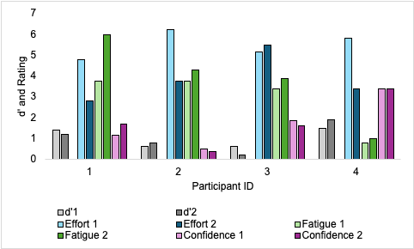
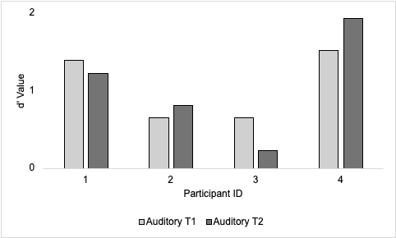
Characterizing Effects of Basal Ganglia Dysfunction in Implicit-Statistical Learning: Evidence from Parkinson’s Disease
Alyson R. Brown and Amy E. Ramage
Communication Sciences and Disorders
Background
Methods
Executive Functions and VAS
Participants
Parkinson’s disease (PD) is a neurodegenerative disorder characterized by the progressive loss of dopaminergic neurons in the substantia nigra pars compacta which disrupts the functioning of basal ganglia (BG) network. Dopaminergic degeneration impairs the balance of the direct and indirect pathways, which are essential for motor control, learning, and executive functions [1].
Implicit-statistical learning (ISL) is the ability to detect rules in patterned stimuli, such as linguistic input, and discriminate between correct and incorrect stimuli without reliance on explicit knowledge or strategy use [2]. ISL is thought to be impaired in PD due to the suspected role of the BG in this type of learning [3].
The current literature reports inconsistent findings regarding ISL in PD, with observed differences largely dependent on the experimental paradigm used [4,5,6,7]
ID | 1 | 2 | 3 | 4
Age at Testing | 67 | 58 | 59 | 72
Sex | Male | Female | Female | Male
Highest Level of Education | Master’s degree | Master’s degree | Some college | Bachelor’s degree
Race | White | White | White | White
Years Post Diagnosis | 8 | 6 | 6 | 6
ID | 1 | 2 | 3 | 4
Flanker Test | 45 | 42 | 53 | 40
List Sort Working Memory | 46 | 53 | 47 | 45
Dimensional Change Card Sort | 45 | 46 | 43 | 48
Picture Sequence Memory | 43 | 49 | 51 | 47
Table 1. Demographic information for PD participants.
Table 2. Fully corrected T-scores from the NIH Toolbox-Cognitive Battery are presented. All participants scored within the average range (T-score average = 50 ± 10​).
Specific Aims
ISL Performance
To investigate ISL in adults with PD in a natural language paradigm to further understand the role of the basal ganglia in ISL.
To investigate the correlation between measures of attention and executive function and ISL abilities in adults with PD.
Methods
The Montreal Cognitive Assessment (MoCA) [8] was administered; all participants scored ≥ 26.
Medical records were requested for all participants to gather information regarding their date of diagnosis, symptoms, medications, and a Unified Parkinson’s Disease Rating Scale (UPDRS) score [9].
The NIH Toolbox-Cognitive Battery was administered via iPad and took approximately 30 minutes. Fully corrected T-scores were calculated and reported for each measure of the cognitive battery.
ISL was assessed with the Norwegian Paradigm, an auditory non-native grammar learning task, administered at two different time points. d' (d prime) values were calculated to determine participants’ accuracy.
Visual analog scales (VAS) were administered immediately after each auditory task for participants to indicate their level of effort, confidence, and fatigue after completing the task. VAS were measured starting from the left of the arrowed line up to the participants’ mark, measuring to the nearest hundredth of an inch.
Given the small sample size, a descriptive analysis of the data was performed to identify trends and patterns between measures.
The d’ graph depicts the discriminability accuracy of each of the four participants on the auditory ISL task at both time points. Auditory T1 represents performance on the first administration of the auditory ISL task. Auditory T2 represents performance on the second administration of the auditory ISL task. Participant ID numbers are labeled on the X-axis, with d’ values on the Y-axis. d’ values greater than 0 indicate learning above chance (50%). Participants with PD performed similarly to age matched healthy controls (n = 10) (T1: M = 0.734; T2: M = 0.629).
This graph highlights d’ compared to VAS ratings. d’1 represents performance on the first administration of the auditory ISL task. d’2 represents performance on the second administration of the auditory ISL task. Perceived levels of effort, fatigue, and confidence at both time points are represented. Participant ID numbers are labeled on the X-axis, with d’ values and VAS rating scores on the Y-axis
Conclusions and Implications
References
All participants had d’ values greater than 0 on the auditory ISL task suggesting intact ISL ability despite BG dysfunction. This finding replicates previous work using AGL [4,5].
No clear trends between any of the measures of executive function (NIH Toolbox) and d’. Consistent with previous findings, ISL has weak or no relationship with executive functioning [10,11].
Visual analysis showed that greater levels of perceived effort on the VAS may contribute to decreased accuracy on the auditory ISL task.
Greater levels of perceived fatigue on the VAS may contribute to increased accuracy on ISL task.
PD was used as a model to better understand ISL mechanisms. A greater understanding of ISL may help inform language learning and relearning processes in adults with communication disorders.
[1] Rocha, G. S., et al. (2023). Basal ganglia for beginners: The basic concepts you need to know and their role in movement control. Frontiers in Systems Neuroscience, 17, 1242929. https://doi.org/10.3389/fnsys.2023.1242929
[2] Christiansen M. H. (2019). Implicit statistical learning: A tale of two literatures. Topics in Cognitive Science, 11(3), 468–481. https://doi.org/10.1111/tops.12332
[3] Plante, E., et al. (2015). The nature of the language input affects brain activation during learning from a natural language. Journal of Neurolinguistics, 36, 17–34. https://doi.org/10.1016/j.jneuroling.2015.04.005
[4] Freidle, M., et al. (2023). Implicit motor sequence learning in people with mild to moderate Parkinson's disease: Behavior and related brain function. Journal of Parkinson's Disease, 13(3), 367–378. https://doi.org/10.3233/JPD-223480
[5] Gamble, K. R., et al. (2014). Implicit sequence learning in people with Parkinson's disease. Frontiers in Human Neuroscience, 8, 563. https://doi.org/10.3389/fnhum.2014.00563
[6] Smith, J., et al. (2001). Preserved implicit learning on both the serial reaction time task and artificial grammar in patients with Parkinson's disease. Brain and Cognition, 45(3), 378–391. https://doi.org/10.1006/brcg.2001.1286
[7] Westwater, H., et al. (1998). Implicit learning in Parkinson's disease: evidence from a verbal version of the serial reaction time task. Journal of Clinical and Experimental Neuropsychology, 20(3), 413–418. https://doi.org/10.1076/jcen.20.3.413.826
[8] Nasreddine, Z. S., et al. (2005). The montreal cognitive assessment, MoCA: A brief screening tool for mild cognitive impairment. Journal of the American Geriatrics Society, 53(4), 695–699. https://doi.org/10.1111/j.1532-5415.2005.53221.x
[9] Goetz, C. G., et al. (2008). MDS-sponsored revision of the Unified Parkinson’s Disease Rating Scale (MDS-UPDRS). International Parkinson and Movement Disorder Society. https://www.movementdisorders.org/MDS-Files1/PDFs/Rating-Scales/MDS-UPDRS_English_FINAL.pdf
[10] Pedraza, F., et al. (2024). Evidence for a competitive relationship between executive functions and statistical learning. NPJ Science of Learning, 9(1), 30. https://doi.org/10.1038/s41539-024-00243-9
[11] Smalle, E. H. M., et al. (2022). Unlocking adults' implicit statistical learning by cognitive depletion. Proceedings of the National Academy of Sciences of the United States of America, 119(2), e2026011119. https://doi.org/10.1073/pnas.2026011119

