Slide 1




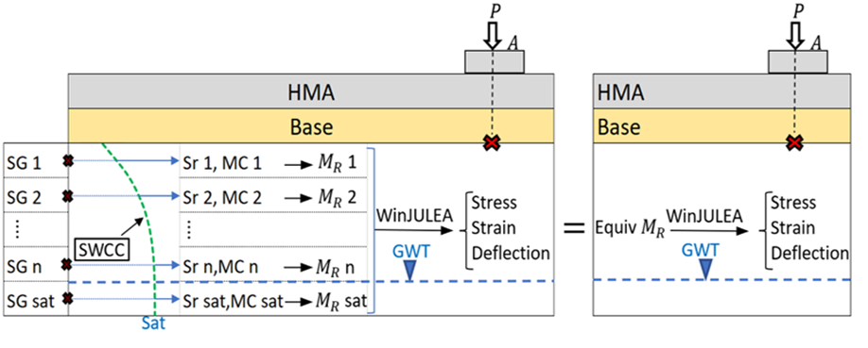
A Methodology to Account for Rising Groundwater in Flexible Pavement Analysis and Design
Fatemeh Hosseini¹(Fatemeh.HosseiniBaharanchi@unh.edu), Wei Sun¹, Ahmad Mehrabi² , Jo E. Sias¹, Mohamed Elshaer¹, Eshan V. Dave¹
¹University of New Hampshire, USA; ²California Department of Transportation, USA
Motivation
Eq-M_{R} Prediction Models
Example Application
Sea level rise and more frequent flooding are raising groundwater tables, softening pavement subgrades and shortening pavement life.
Current AASHTO 1993 and most M-E design methods only use a constant or seasonally averaged subgrade modulus and do not explicitly account for rising groundwater.
Agencies need a practical way to include groundwater-driven moisture weakening in standard design tools to improve resilience of coastal and low-lying pavements.
ESAL: 0.5 million with 1% growth
With constant GWT, PSI stays above terminal for 25 years; with rising GWT, service life reduces by ~30%.
Rutting is highly moisture-sensitive: rutting life drops to zero just after ~7.5 years under rising GWT, compared with >20 years for constant GWT.
Fatigue is less sensitive: fatigue life under rising GWT is only slightly shorter (~0.5 year) than under constant GWT for this example.
HMA: 6-in
Base 8-in
Objectives
Develop an equivalent resilient modulus (Eq-M_{R}) methodology that converts groundwater-driven moisture changes into a single subgrade modulus value.
Provide soil-specific predictive Eq-M_{R} models for all 12 AASHTO subgrade soil classes.
Demonstrate how Eq-M_{R} can be used within AASHTO 1993 and M-E fatigue/rutting models to quantify the impact of rising groundwater on pavement performance.
Subgrade: semi-infinite
A-3
Approach to Determine Eq-M_{R}
Deflection-based Eq-M_{R} selection: highest sensitivity to rising GWT; consistent with deflection-based design practice
Eq-M_{R} decreases as GWT rises into the transition zone; beyond a certain depth, M_{R} is capped at the optimum design value.
second-order polynomial fits; reproduces LEA-based Eq-M_{R} for coarse- and fine-grained soils
AASHTO 1993
M-E Fatigue and Rutting
Moisture & M_{R} Modeling
Convert each subgrade layer to different sublayers
Estimate SWCC from each soil type features and GWT level.
Compute degree of saturation vs depth for different groundwater table elevations.
Use Witczak-type relationships to convert saturation to M_{R} for each subgrade sublayer.
Summary of fitting parameters of the developed regression models
7.5 years
Equivalent M_{R} *= (a × GWT² + b × GWT + c) × M_{R,opt}
Soil type | Depth of transition zone (in) | Saturated M_{R} (psi)
A-1-a | 15.0 | 25,582
A-1-b | 15.4 | 23,993
A-2-4 | 23.6 | 20,815
A-2-5 | 16.0 | 18,114
A-2-6 | 16.2 | 16,684
A-2-7 | 16.2 | 15,730
A-3 | 24.5 | 19,385
A-4 | 141.7 | 15,544
A-5 | 126.8 | 13,026
A-6 | 225.9 | 12,155
A-7-5 | 373.8 | 8,477
A-7-6 | 614.6 | 6,261
Layered Elastic Analysis & Eq-M_{R}
Run WinJULEA LEA with depth-varying M_{R} to obtain pavement responses.
Replace layered subgrade with a single semi-infinite layer and back-calculate Eq-M_{R} that reproduces deflection at subgrade surface.
Repeat for multiple GWT depths and soil types.
Conclusions and Future works
The Eq-M_{R} framework links groundwater elevation → saturation → M_{R} → pavement response using SWCC to Witczak moisture and M_{R} models, and LEA.
Simple polynomial Eq-M_{R}-GWT relationships are provided for all AASHTO soil classes, allowing designers to plug rising GWT into AASHTO 1993 and M-E tools without changing the core software.
Application examples show that rising GWT can significantly reduce PSI-based life and rutting life, while having a smaller impact on fatigue life for the investigated section.
The method offers a practical way to incorporate climate-driven groundwater rise into current pavement design practice and resilience planning.
Future works:
  Compare Eq-M_{R} predictions with field M_{R} and performance under different GWT levels
  Improve moisture/damage transfer functions and include maintenance in life-cycle analysis
  Add Eq-M_{R} and performance curves to agency decision tools for coastal/low-lying roads
Predictive Models & Design Integration
Fit second-order polynomials relating GWT depth to Eq-M_{R} for all AASHTO soil classes.
Use Eq-M_{R} time series as inputs to:
  AASHTO 1993 PSI equation, and M-E fatigue and rutting transfer functions.
*The coefficients a, b, and c are soil-specific.
Acknowledgment
This work was supported by NOAA’s Coastal Communities’ Pavement Resilience to Sea Level Rise Using Natural and Nature-Based Features (Grant No. NA21NOS4780145). The views expressed are those of the authors, not the sponsoring agency.

