Slide 1


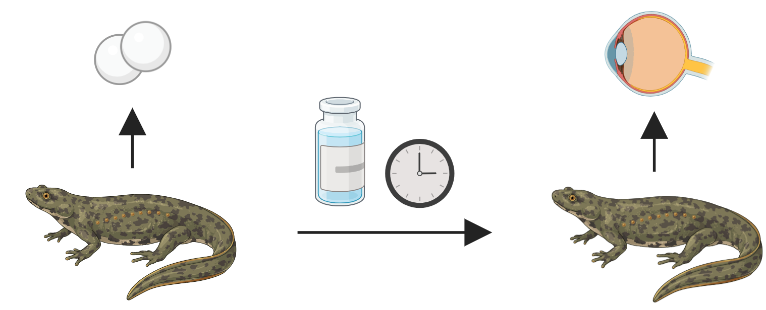
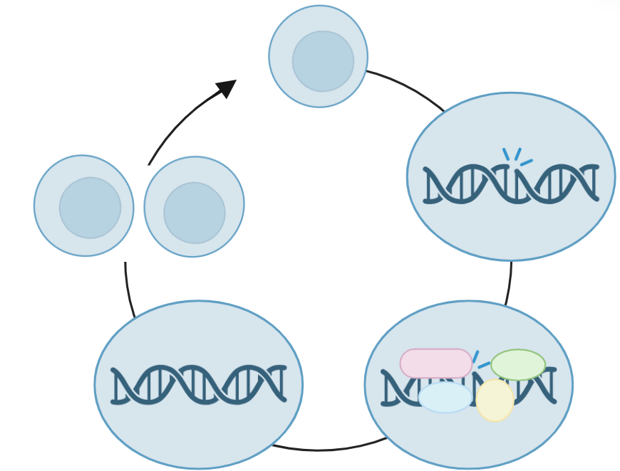
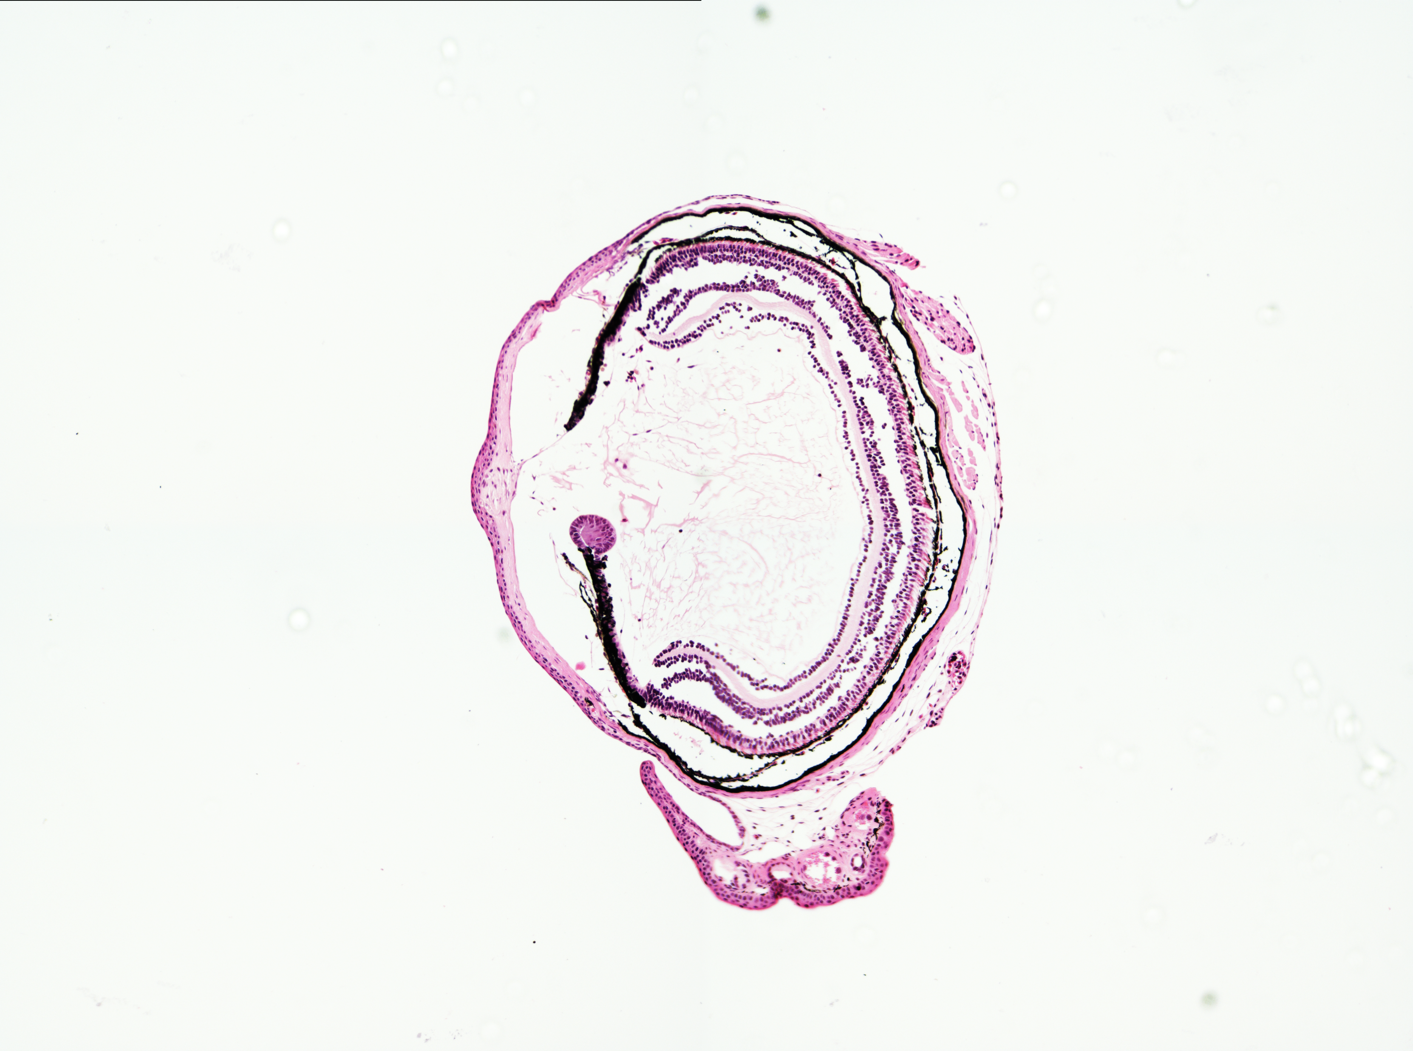
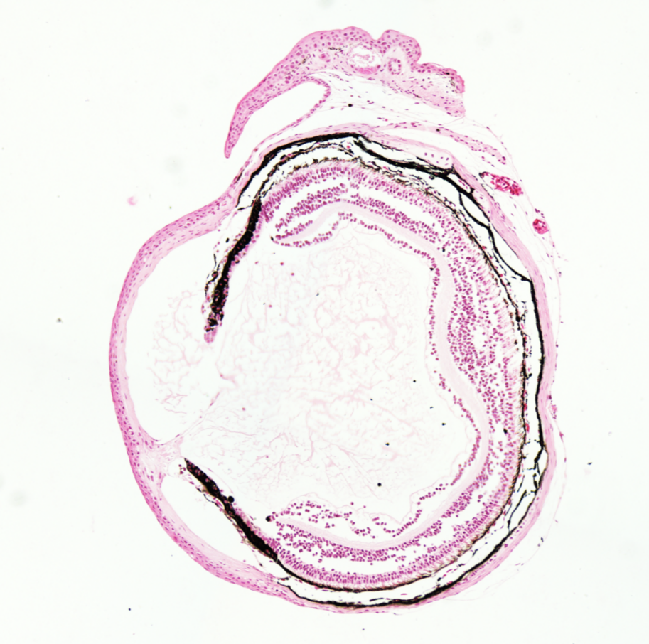
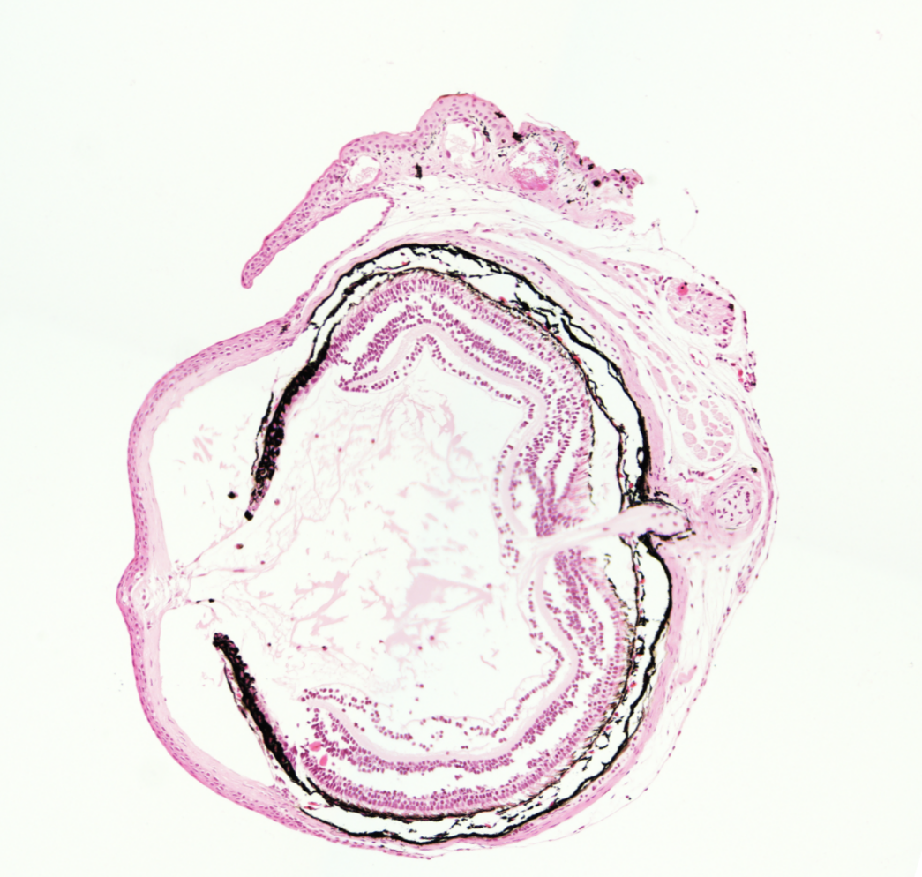
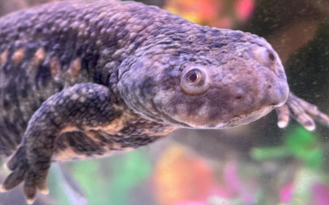
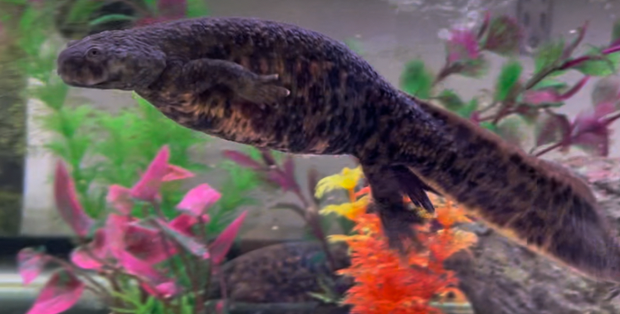
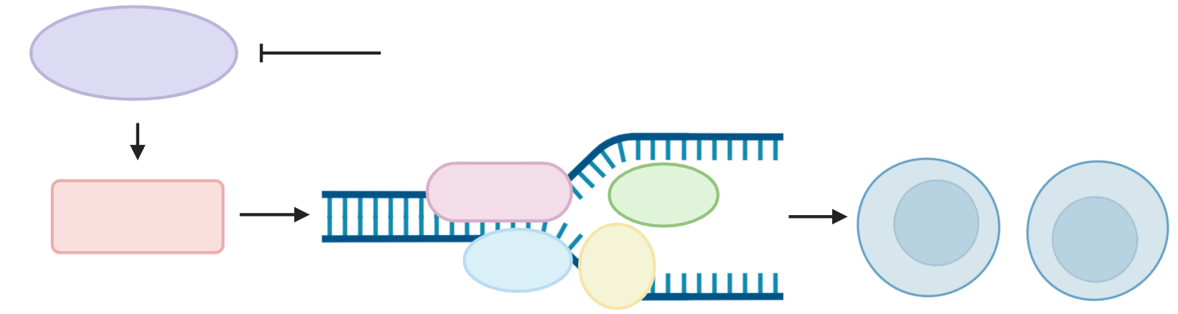
ATR Inhibition Blocks Newt Lens Regeneration
Erin McCarthy, Emmie Duval, Kostas Sousounis
MCBS, University of New Hampshire
Background
Methodology
Future Work
The Iberian Ribbed Newt (Pleurodeles waltl) is studied for its regenerative abilities. Throughout life, newts can regenerate limbs, portions of several organs, and the entire eye lens, a rare case of whole-organ regeneration.¹
During cell division, DNA damage can accumulate. Proteins can sense and repair this damage.
  This system is not perfect, and unrepaired damage can lead to cancer.
Regeneration requires rapid cell division, introducing more of this damage. Contrary to expectation, however, newts show high resistance to cancer.²
This suggests that newts have an uncharacterized, high-fidelity DNA repair mechanism that may also allow for regeneration.
3-month-old newts were subject to lens removal and were exposed to one of 22 pharmaceutical compounds for 16 days.
Whole eyes were collected, dehydrated, and embedded in paraffin for histology. Slides were stained to highlight lens vesicles.
Eyes exposed to inhibitors were compared to untreated (DMSO) eyes to identify proteins essential in lens regeneration.
Future investigations into ATR will:
Identify the mechanism behind regeneration inhibition via ATR.
Ensure the compound inhibited ATR with limited off-target effects.
Identify how downstream targets are affected by ATR inhibition.
Analyze newts’ ability to regain regenerative function after Elimusertib treatment stops.
These methods will also be applied to detect proteins essential in telomere elongation.
Applications
Understanding the mechanisms that allow newts to overcome cancer brings us one step closer to identifying solutions in humans.
This project identifies key proteins that grant newts these abilities, opening doors for further research into these targets. These results may provide insight into new interactions between already characterized proteins.
While the multitude of protein targets tested in this study were largely unsuccessful, this work has narrowed down the very broad list of potential targets.
16-day treatment
1. Cell encounters DNA damage
Results
4. Cells can proceed to division
Regenerated lens
DMSO
ATR Inhibitor Elimusertib
n=6
retina
cornea
iris
0.1 mm
ATR inhibitor Elimusertib completely blocked regeneration, suggesting the ATR DNA damage response pathway^{3,4} is essential.
ATR activates MCM proteins to open the DNA for access to the damage. Without access, damage is not repaired, and replication stalls.
  It is hypothesized that cells enter S-phase stasis, where they sit, unable to repair damage and unable to continue replication.⁵
References
3. Damage is repaired
2. Proteins sense and localize to the damage
Sousounis. K. et al, 2015. A robust transcriptional program in newts undergoing multiple events of lens regeneration throughout their lifespan Elife, 4, e09594 doi: 10.7554/eLife.09594
Kitsoulis, C.V., et al, 2020. The occurrence of cancer in vertebrates: a mini review. Biomed. Res. doi: 10.1186/s40709-020-00119-0
Biswas, H., et al, 2023. Novel Cellular Functions of ATR for Therapeutic Targeting: Embryogenesis to Tumorigenesis. Int. J Mol Sci., 24(14), 11684. doi: 10.3390/ijms241411684
Nam, E. A., & Cortez, D., 2011. ATR signaling: More than meeting at the fork. The Biochemical Journal, 436(3), 527–536. doi: 10.1042/BJ20102162
Hurley, P. J., & Bunz, F., 2007. ATM and ATR: Components of an integrated circuit. Cell Cycle (Georgetown, Tex.), 6(4), 414–417. https://doi.org/10.4161/cc.6.4.3886
Project Introduction
This project aims to identify proteins key in DNA damage response (DDR) via pharmacological inhibition. Lens regeneration was used to measure success.
Hypothesis: Inhibiting an essential protein would prevent DNA damage response and repair, preventing further replication and therefore regeneration.
Pharmacological compounds with high specificity for their targets were used to identify proteins essential for this process.
ATR
Elimusertib
Acknowledgements
The Sousounis Lab, with special thanks to Emmie Duval, Olivia Williams, Silvia Wright, and Lili Cook for their assistance, and the UNH Animal Resource Office (ARO) for animal care. Thank you to Dr. Kostas Sousounis for guidance and project concept.
Supported by University of New Hampshire's CIBBR through a grant from NIH/NIGMS under Award Number P20GM113131 to KS. Supported by NIH/NEI R00 EY029361.
MCM

