Slide 1

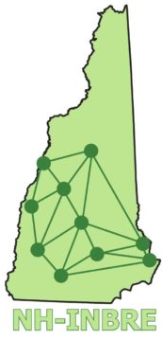
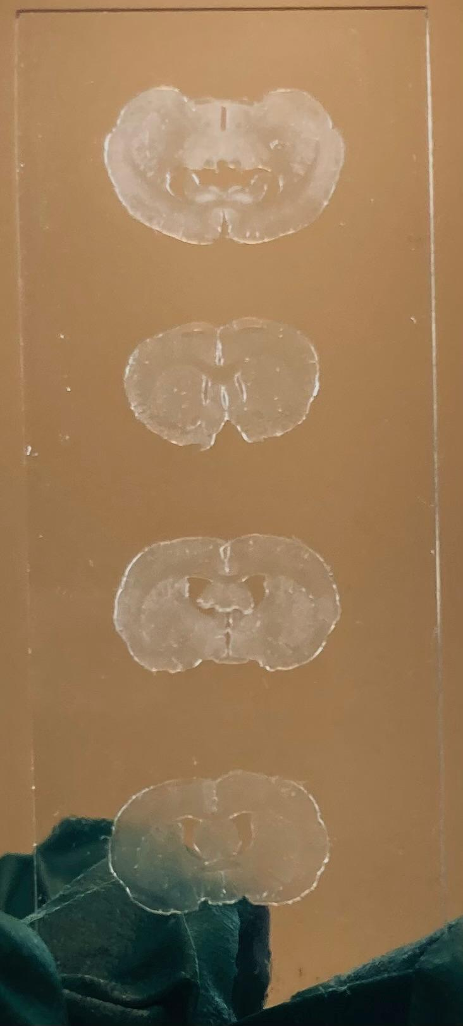
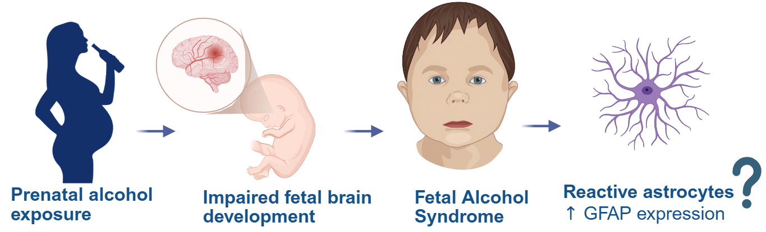
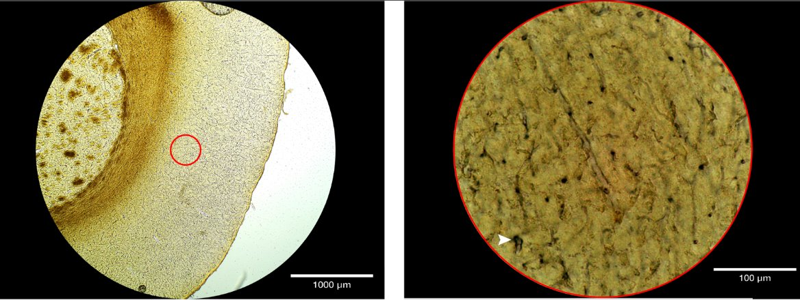
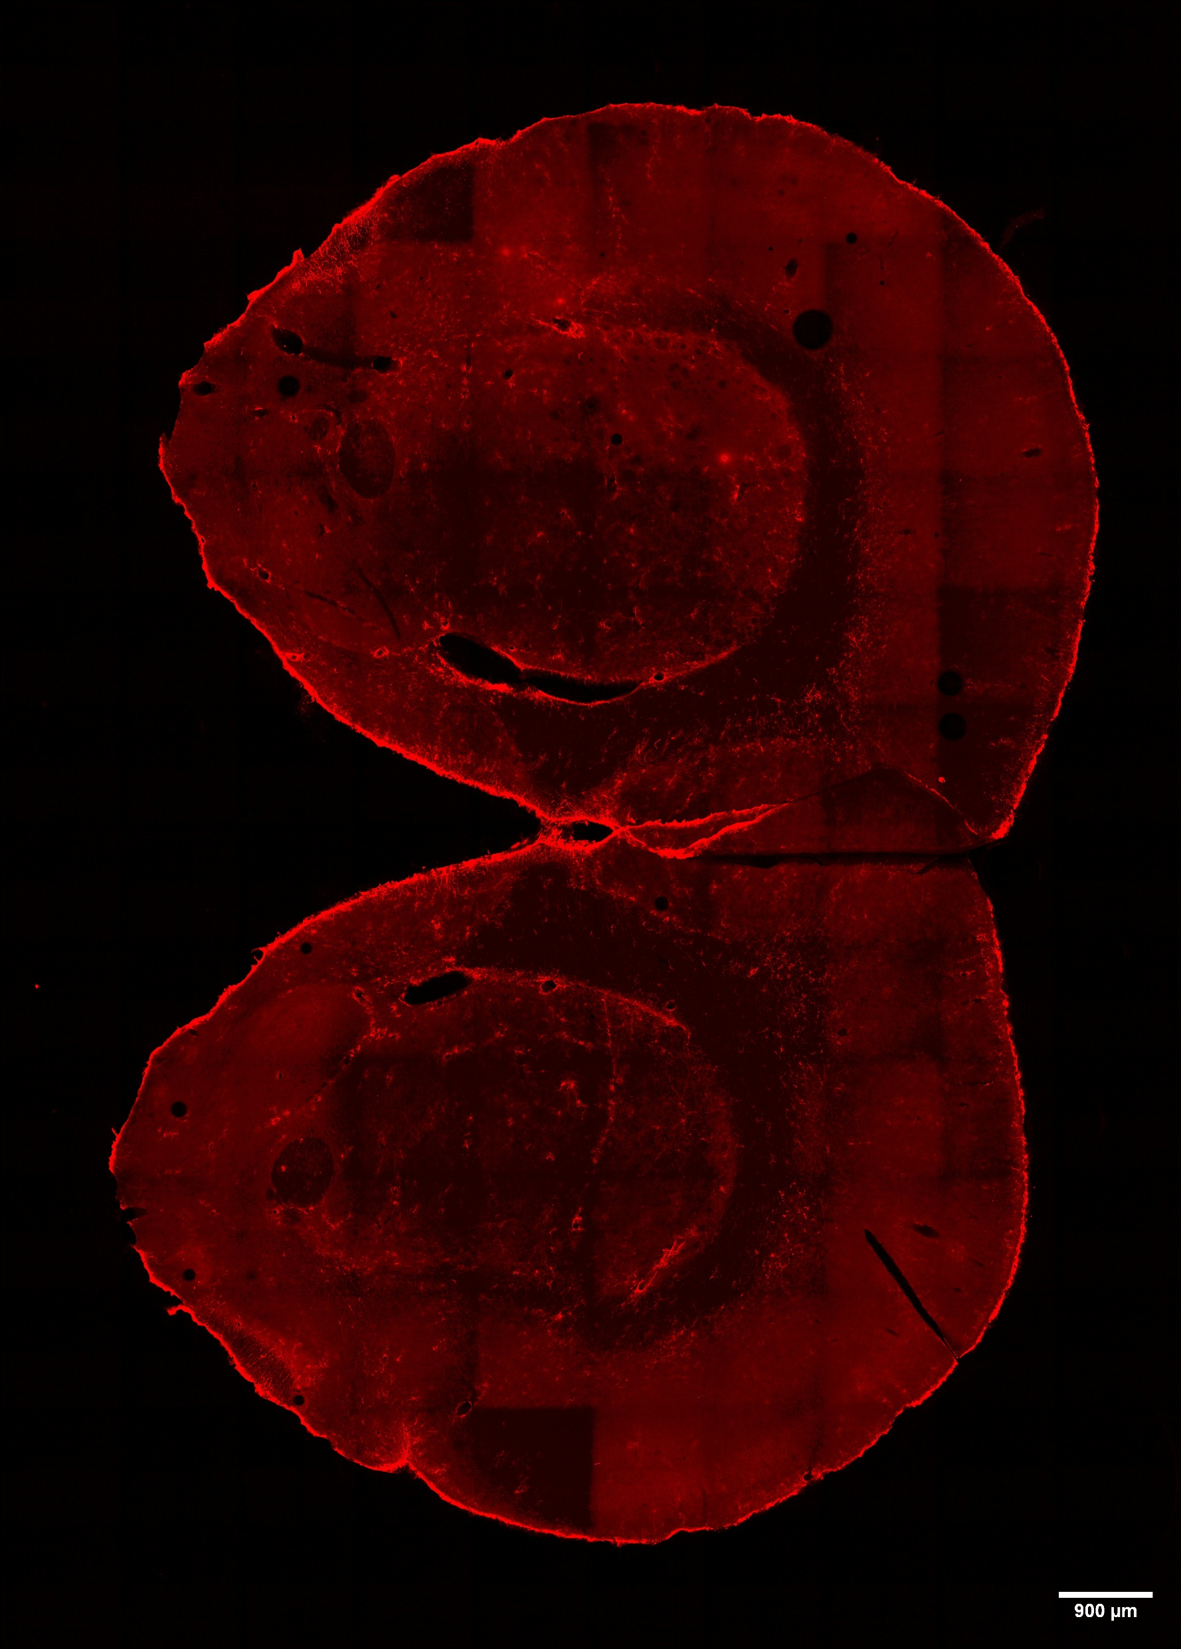
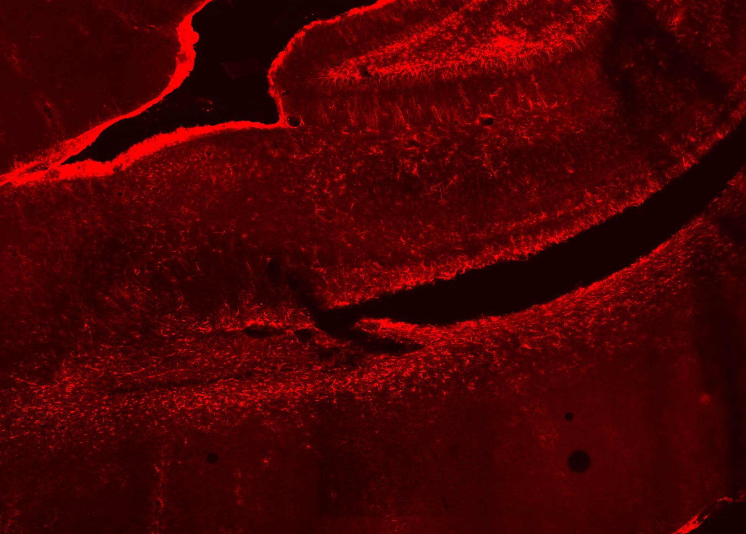
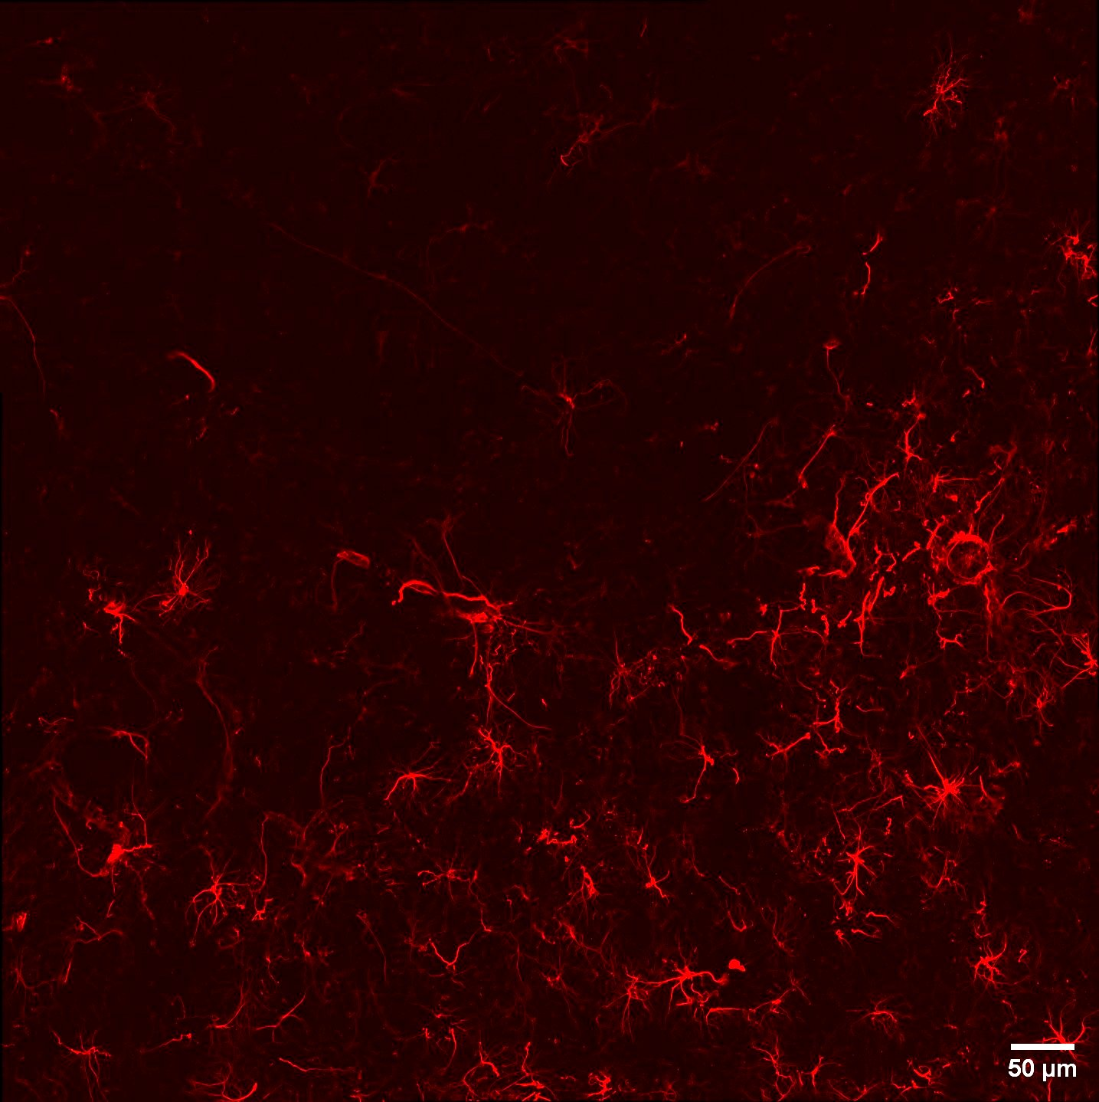
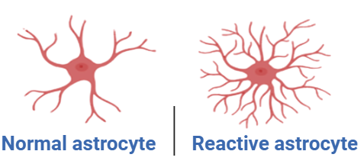
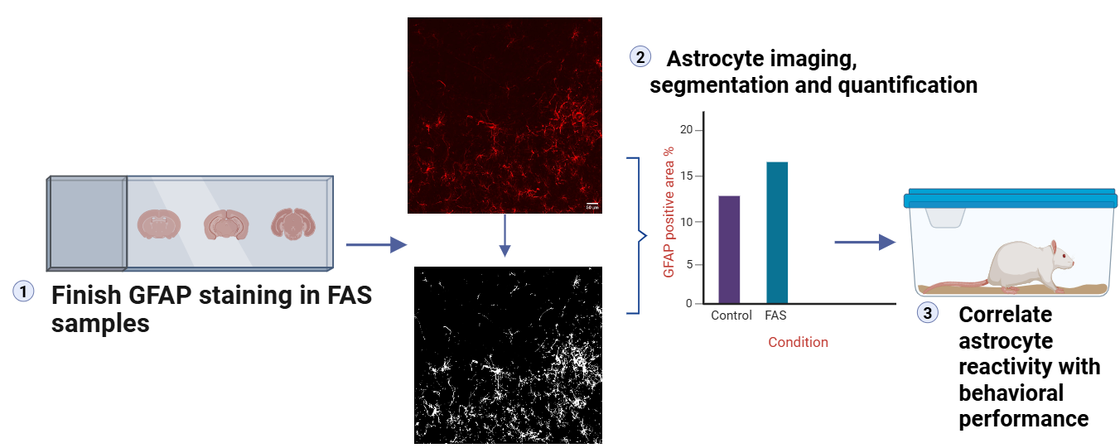
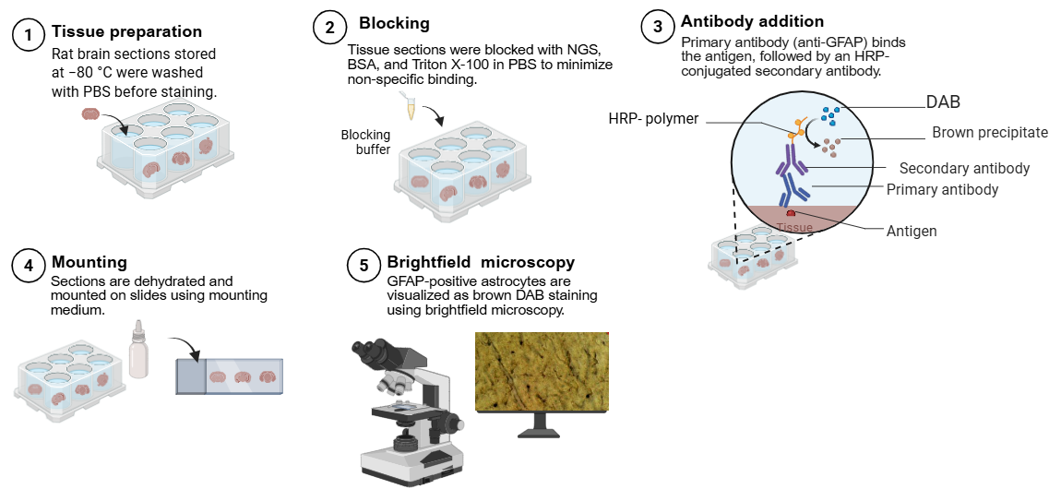
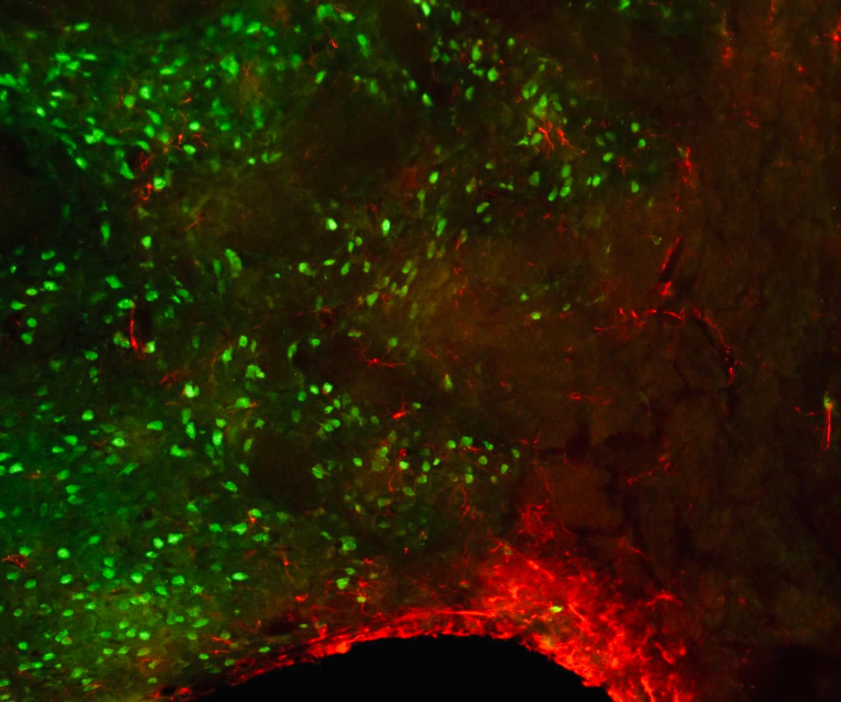
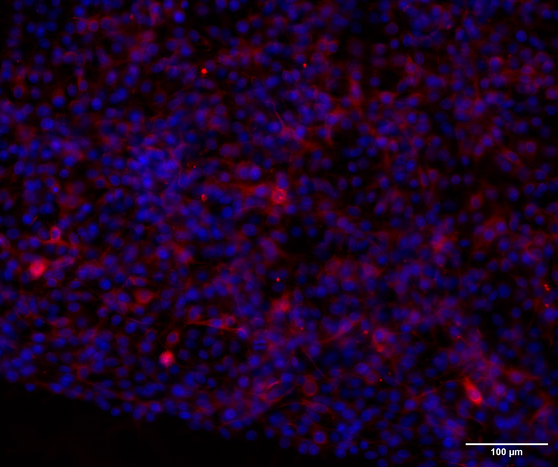
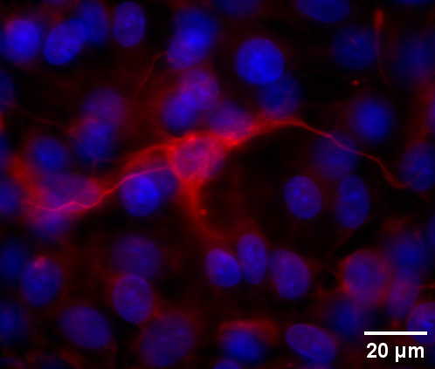
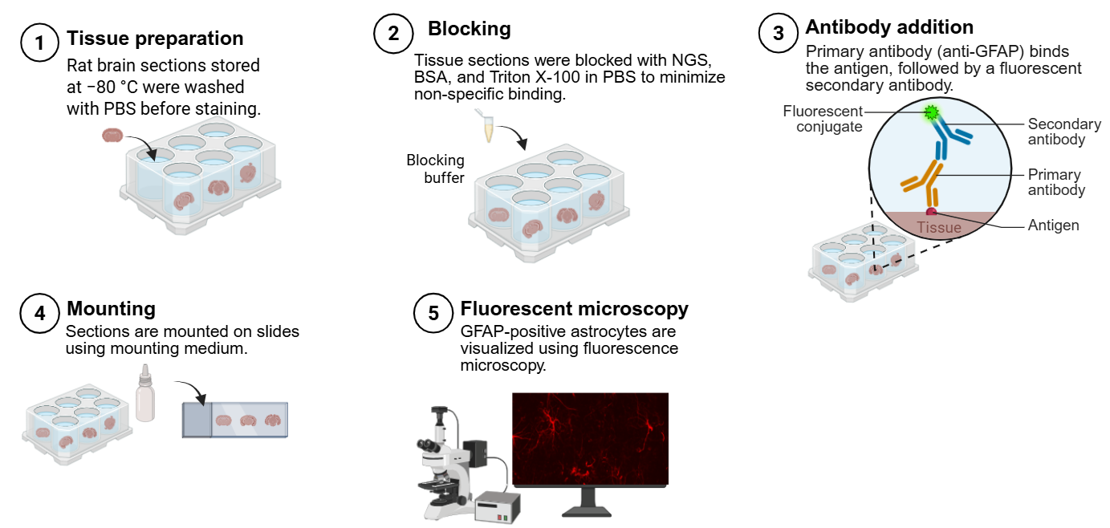
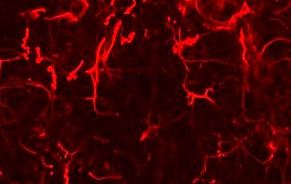
Detecting Astrocyte Reactivity in a Rat Model of Fetal Alcohol Syndrome:
Optimization of GFAP Immunostaining (IHC and Immunofluorescence)
Ninu Jacob, Mark T. Scimone, PhD, Jill McGaughy, PhD
Department of Life Sciences, University of New Hampshire, Manchester, NH
INTRODUCTION
RESULTS
CONCLUSIONS
D
GFAP immunofluorescence provided clearer and more reliable visualization of astrocytes compared to DAB-based immunohistochemistry. GFAP antibody specificity was validated using C6 astrocytic cells, and GFAP/NeuN co-immunofluorescence successfully distinguished astrocytes from neuronal cell bodies in rat brain tissue. This optimized assay provides a reliable method to investigate astrocyte reactivity and its relationship to behavioral deficits, contributing to a better understanding of neuroinflammatory mechanisms in fetal alcohol spectrum disorders.
A
B
C
Fetal Alcohol Syndrome (FAS) results from prenatal alcohol exposure and disrupts fetal brain development.¹ Alcohol exposure induces neuroinflammation, leading to astrocyte activation characterized by increased GFAP expression.²
Figure 3. GFAP Immunohistochemistry in Rat Brain Sections. (A) Coronal sections of rat brain tissue mounted on glass slides. (B–C) DAB-stained rat brain tissue imaged in brightfield at 4X with 40X zoom-in
Objective: Optimize GFAP immunostaining (IHC and immunofluorescence ) to detect astrocyte reactivity in rat brain tissue.
A
B
C
FUTURE DIRECTIONS
Reactive astrocytes exhibit hypertrophy and increased GFAP expression during neuroinflammation.
90 µm
500 µm
METHODS
Figure 4. GFAP Immunofluorescence in Rat Brain. (A) Stitched whole-brain image acquired at 10X (B) Regional view (C) High-magnification image (63X) showing astrocyte morphology.
Complete GFAP staining in fetal alcohol exposed brain sections.
Segment GFAP-positive astrocytes for image analysis.
Quantify GFAP-positive area to assess astrocyte reactivity
Correlate astrocyte activation with sustained attention performance.
A
B
C
REFERENCES
180 µm
Figure 1. GFAP Immunohistochemistry Workflow
Figure 5. GFAP/NeuN Co-Immunofluorescence and GFAP Antibody Validation.
(A) Co-immunofluorescence of rat brain showing GFAP-positive astrocytes (red) and NeuN-positive neuronal cell bodies (green). (B–C) Immunostaining of C6 astrocytic cells showing GFAP (red) and DAPI stained nuclei (blue), confirming antibody specificity and astrocyte morphology.
1.Mattson SN, Bernes GA, Doyle LR. Fetal Alcohol Spectrum Disorders: A Review of the Neurobehavioral Deficits Associated With Prenatal Alcohol Exposure. Alcohol Clin Exp Res. 2019 Jun;43(6):1046-1062. doi: 10.1111/acer.14040. Epub 2019 May 2. PMID: 30964197; PMCID: PMC6551289.
2.Kane, C. J. M., & Drew, P. D. (2021). Neuroinflammatory contribution of microglia and astrocytes in fetal alcohol spectrum disorders. Journal of neuroscience research, 99(8), 1973–1985. https://doi.org/10.1002/jnr.24735
3. Illustration were created using BioRender.com
DISCUSSION
GFAP immunohistochemistry (DAB staining) did not clearly visualize astrocytes, suggesting possible issues with tissue quality, staining conditions, or DAB signal stability.
In contrast, GFAP immunofluorescence produced clear astrocyte labeling in tissue
Co-staining (GFAP with NeuN) further demonstrated distinct labeling of astrocytes and neuronal cell bodies.
ACKNOWLEDGEMENTS
I would like to sincerely thank my PI , Dr. Mark Scimone, for his guidance, support, and valuable insights throughout this project. Special thanks Dr. Jill McGaughy for providing the tissue samples. This work was supported by NH-INBRE (New Hampshire IDeA Network of Biomedical Research Excellence) through NIH grant P20GM103506.
LIMITATIONS
Hydrogen peroxide treatment may have damaged tissue or reduced signal.
Time- sensitive DAB reaction caused variable staining.
Figure 2. GFAP Immunofluorescence Workflow
Notes:
You may expand or shorten sections as necessary

