Slide 1

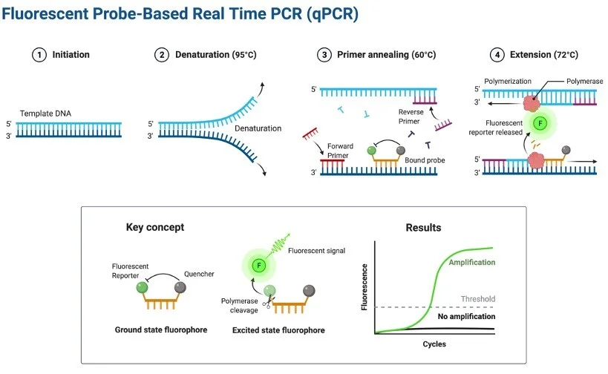
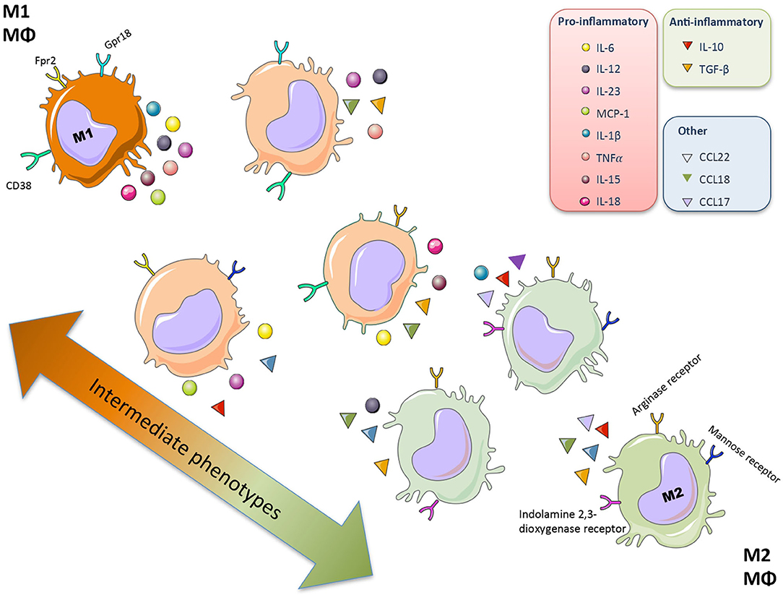


Effect of Gli3 on Cytokine Expression In Monocytes
John Kelleher, Shayan Raad and Sherine F. Elsawa
Department of Molecular, Cellular, and Biomedical Sciences, University of New Hampshire, Durham, NH 03824
Introduction
ΔΔCt method
Results
Gli3 is a transcription factor that plays a key role in mediating the Hedgehog signaling pathway.
Matissek et al., 2022 found that when Gli3 is knocked out of myeloid cells, secretion of inflammatory cytokines is reduced.
Cytokine expression by immune cells orchestrates cellular responses and can either inhibit or promote cell proliferation.
Waldenström Macroglobulinemia is a form of lymphoplasmacytic (B-cell) lymphoma and responds to cytokine signaling
Goal of study: To determine what cytokines are regulated by Gli3 in monocyte cells.
Cantero-Navarro E. et al 2021, Frontiers of Medicine
Quantitative PCR (qPCR) measures the accumulation of amplified DNA in real time through fluorescence emitted by a reporter molecule, which is directly proportional to the amount of PCR product.
The cycle threshold (Ct) represents the number of PCR cycles needed for the fluorescence signal to rise above background noise, indicating detectable levels of amplified DNA.
ΔCt = Ct (gene of interest) – Ct (housekeeping gene)
ΔΔCt = ΔCt (treated sample) - ΔCt (untreated sample)
Knockdown of Gli3 in THP-1 cells resulted in reduced IL-10 expression.
Further trials and experiments are necessary to confirm the validity of these results.
Future experiments
A ChIP assay to identify the binding sites of Gli3 within the promoter region of IL-10.
A luciferase assay on the potential Gli3 binding site within the IL-10 promoter region to confirm Gli3 activation of IL-10 expression.
An in vivo experiment to assess the impact of Gli3 knockdown in myeloid cells on B-cell populations.
https://researchtweet.com/qpcr-real-time-polymerase-chain-reaction/
Relative Gene Expression
Acknowledgements
Figure 1. Relative Expression of Gli3 in Gli3 knockdown THP-1 cells
Figure 2. Relative Expression of IL-10 in Gli3 knockdown THP-1 cells
All members of the Elsawa Lab
The Center of Integrated Biomedical and Bioengineering Research
The International Waldenstrom’s Macroglobulinemia Foundation
Methodology
Discussion
Retroviral-mediated knockdown of Gli3 was performed in the THP-1 monocyte cell line.
RNA was isolated from both retrovirus-infected and uninfected cells.
Complementary DNA (cDNA) synthesis was carried out using RNA isolated from each cell type.
Primers targeting cytokines involved in immune cell activation, recruitment, and inflammation regulation were added to the cDNA for qPCR analysis.
ΔΔCt method was used to calculate the relative gene expression between samples.
Following Gli3 knockdown, IL-10 demonstrated the greatest reduction in expression compared to all other cytokines tested.
IL-10 has been found to promote differentiation and proliferation of B-cells (Itoh & S Hirohata, 1995).
A reduction in IL-10 expression may impair B-cell proliferation.
Reducing Gli3 expression to decrease IL-10 levels and slow B cell proliferation may provide a potential immunotherapeutic approach for Waldenström macroglobulinemia.
These results are only preliminary and necessitate further trials and experiments to establish conclusive findings.
References
Itoh, K., & S Hirohata. (1995). The role of IL-10 in human B cell activation, proliferation, and differentiation. The Journal of Immunology, 154(9), 4341–4350. https://doi.org/10.4049/jimmunol.154.9.4341
Matissek, S. J., Karbalivand, M., Han, W., Boutilier, A., Yzar-Garcia, E., Kehoe, L. L., Gardner, D. S., Hage, A., Fleck, K., Jeffers, V., Rajsbaum, R., & Elsawa, S. F. (2022). A novel mechanism of regulation of the oncogenic transcription factor GLI3 by toll-like receptor signaling. Oncotarget, 13(1), 944–959. https://doi.org/10.18632/oncotarget.28261
‌

