Slide 1



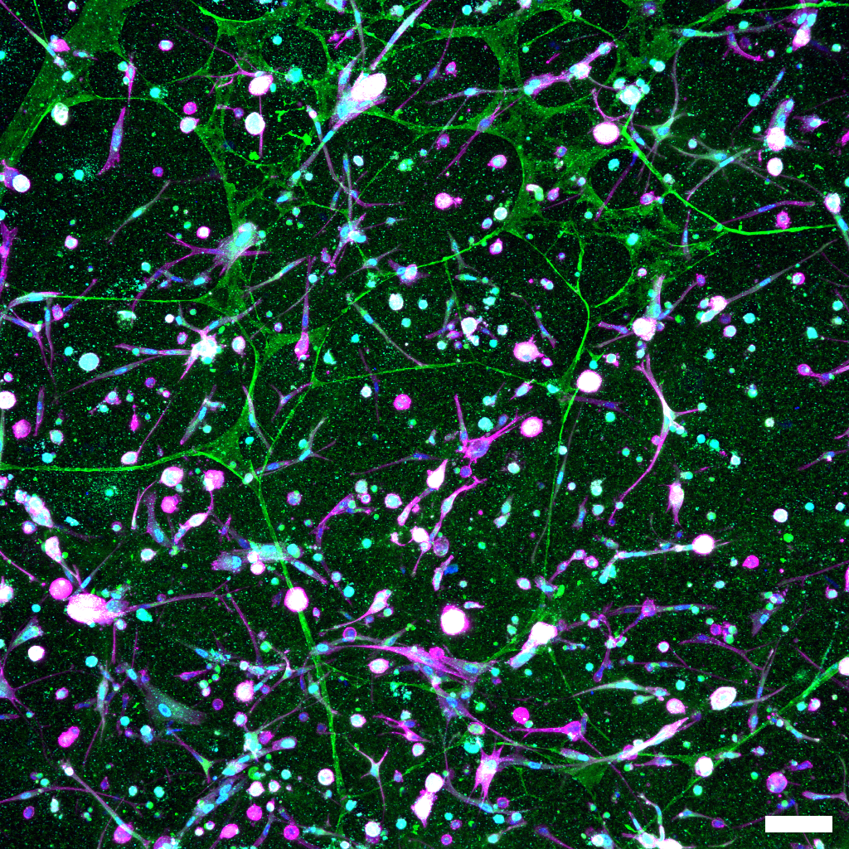
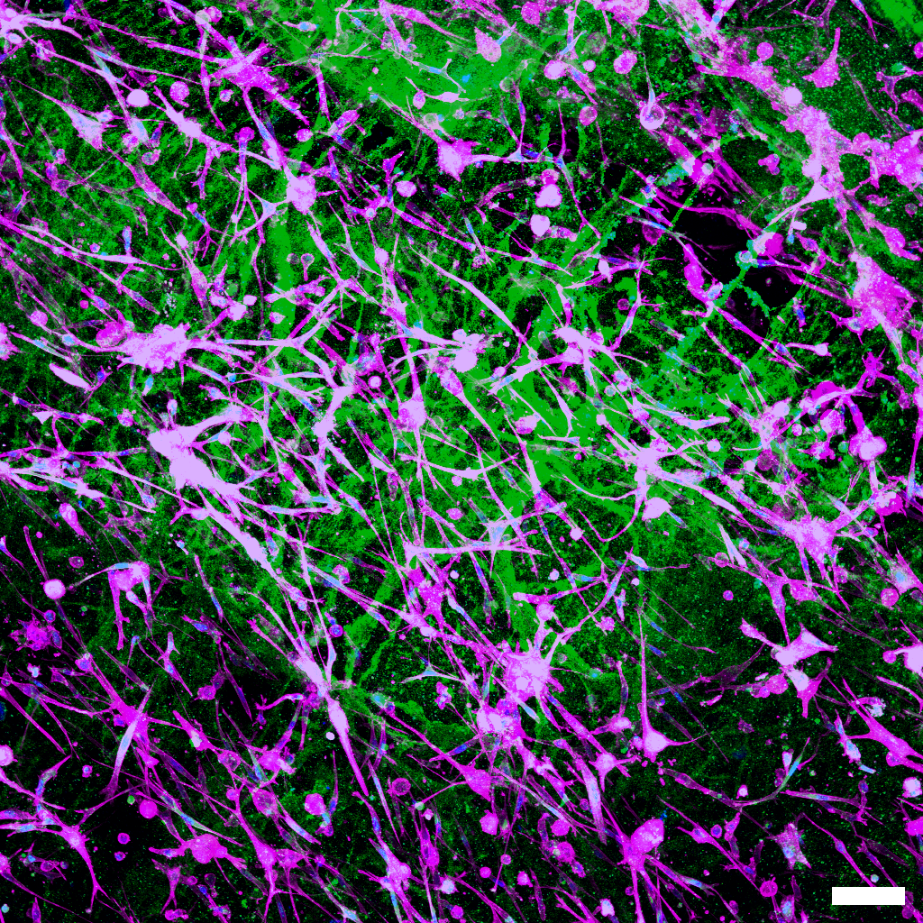
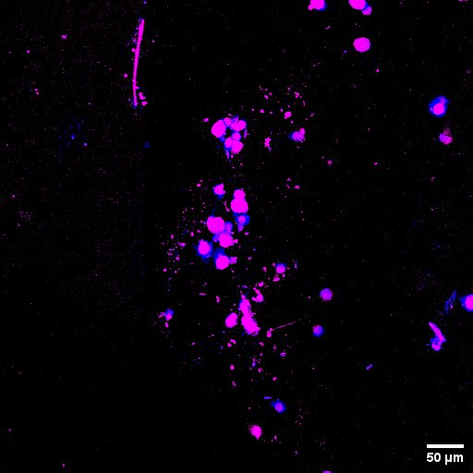
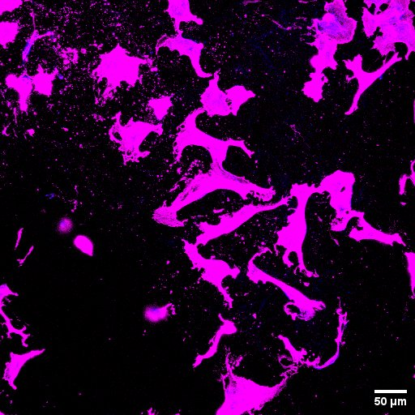
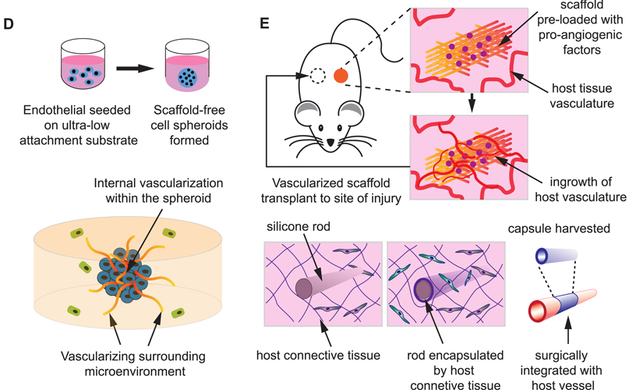
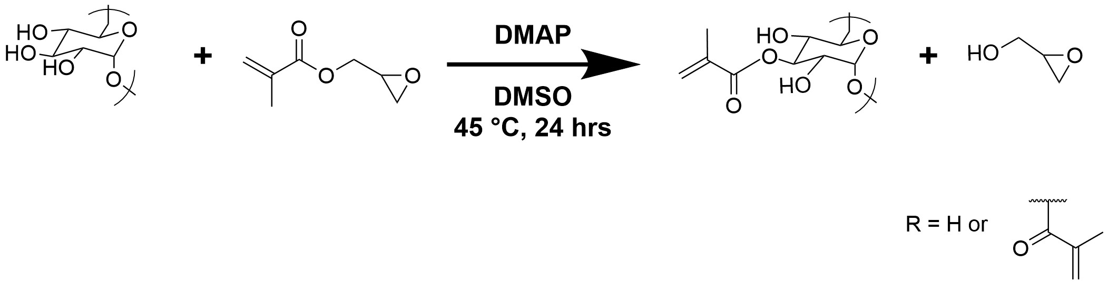
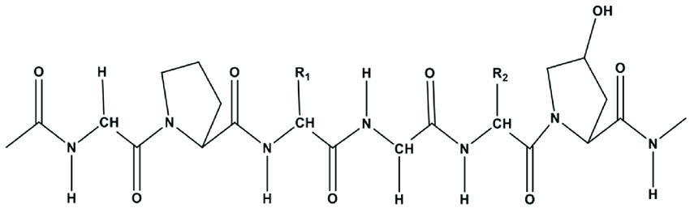
Leveraging Mechanical and Biological Properties of Composite Hydrogels to Induce Angiogenesis
Max Sefcik, Marlon Pinto, Ty Valley, Ryan Bedigian, Evan Kennedy, Rabeya Sharmin Lima, and Linqing Li*
Department of Chemical Engineering and Bioengineering, University of New Hampshire, Durham, NH, USA
* Linqing.Li@unh.edu
1. Introduction
3. Confocal HDF's
5. Confocal HUVEC’s
Hydrogels are soft materials that are formed by crosslinking hydrophilic polymers that can absorb water. Hydrogels have many shapes and properties that induce angiogenesis and sustain cells
The hydrogels in this research project are composed of a dextran/collagen mix to replicate the ECM with a protein and sugar (dextran is a polysaccharide & collagen is a protein)
Dextran gels have been proven ineffective in supporting vascularization genesis on their own
Collagen supports vascularization; however, alone, the protein has weak mechanical properties.
A Dextran-Collagen hydrogel combines the structural stiffness of dextran with the cell signaling and support properties of collagen.
Vascularization is the process of forming blood vessels.
Vascularization is driven by Endothelial cells (cells which line the inside surface of lymphatic and blood vessels)
Human Dermal Fibroblasts (HDF’s) help the process by regulating and sending signals and facilitate the formation of vessels
3.75mg/mL:3.75mg/mL
Dextran: Collagen
2.5mg/mL:7.5mg/mL
Dextran: Collagen
3.75mg/mL:3.75mg/mL
Dextran: Collagen
Green: Collagen
Phalloidin 647 (Purple): Cytoskeleton
DAPI (Blue): Nuclei
These confocal images of the HUVEC cells show similar results to the HDF cells
The cells can grow and survive, however, we did not see proof of vascularization
                Left Image – Sparse cytoskeletal extensions, collagen network thinner, fewer nuclei and overall, not highly complex structure
                Right Image – Dense, long cytoskeletal structures, more robust and interconnected collagen matrix, more complex structure
                Both gel compositions support the use of HDF cells
                2.5mg/mL:7.5mg/mL Dextran: Collagen gel has greater cell adhesion and network, indicating a more favorable cell environment
6. Reflection
During our research project, we encountered obstacles in collecting accurate data and preventing the collagen from gelling. Bacteria were a significant problem in sustaining the cells, and the molecular makeup of collagen resulted in the solution gelling, making it difficult to control. Despite the challenges, we were able to get solid research experience and data to interpret as first-year students.
4. SEM images
7. Conclusions
The Development of Dextran-Collagen hydrogels capable of supporting cell growth and inducing vascularization for brain repair after ischemic stroke has been pursued. While some formulations did not gel effectively, early results demonstrated promising cell viability and growth. This suggests that although optimal gelation of the Dextran-Collagen gels has not yet been achieved, the developed gels are biologically active and near-composition, which can support angiogenesis.
Future Work will focus on finding gel compositions that consistently show concrete evidence of vascularization, with the ultimate goal of growing blood vessels in living creatures, specifically humans.
2. Mechanism of Gel Formation
Synthesis of dextran methacrylate (DexMA)
Structure of Collagen
F
3.75mg/mL:3.75mg/mL
Dextran: Collagen
2.5mg/mL:7.5mg/mL
Dextran: Collagen
Acknowledgement
Highly porous, fibrous network created in the 50/50 Dex-Col gel
Mimics the native ECM structure, promoting natural cell behavior and growth
Varied pore sizes allow for cell infiltration and migration, alongside various cell sizes
Hybrid properties, including Dextran for strength and Collagen for cell development
Supports both HDF and HUVEC growth for angiogenesis analysis
NH BioMade IIA 1757371 and EPS-1101245
CIBBR (P20GM113131) at NIH
UNH CHBE Department
Dr. Linqing Li’s Lab, UNH
UNH Core facility and Instrumentation Center
The reaction adds a methacrylate group which allows for the polymerization of the gel
The hydrogen bonds and charge interactions occur between the negatively charged Carboxylic acid group and the positively charged amino group (NH₃⁺).
Dextran crosslinks under UV light of 365 nm
Collagen forms into a gel by incubating at 37 degrees C
References
1. Narayanaswamy R, Torchilin VP. Hydrogels and Their Applications in Targeted Drug Delivery. Molecules. 2019 Feb 8;24(3):603. doi: 10.3390/molecules24030603. PMID: 30744011; PMCID: PMC6384686.
2. Ye Eun Kim, Seung Woo Choi, Min Kyung Kim, Thanh Loc Nguyen, and Jaeyun Kim
Nano Letters 2022 22 (5), 2038-2047
DOI: 10.1021/acs.nanolett.1c04899
3. Bubli, S. Y. et al. Inducing an LCST in hydrophilic polysaccharides via engineered macromolecular hydrophobicity. Sci. Rep. 13, 14896 (2023).
4. Wang, Y., Kankala, R. K., Ou, C., Chen, A., & Yang, Z. (2022). Advances in hydrogel-based vascularized tissues for tissue repair and drug screening. Bioactive Materials, 9, 198–220. https://doi.org/10.1016/j.bioactmat.2021.07.005
5. Hydrogel—An overview | ScienceDirect Topics. (n.d.). Retrieved April 21, 2025, from https://www.sciencedirect.com/topics/chemistry/hydrogel
6. Collagen Formula. (n.d.). Retrieved April 21, 2025, from https://softschools.com/formulas/chemistry/collagen_formula/482
Notes:
SEM – 20 um
Toxicity- 100 um
Gel- 100 um
Gel with cells- 50 um, 2D

