Slide 1
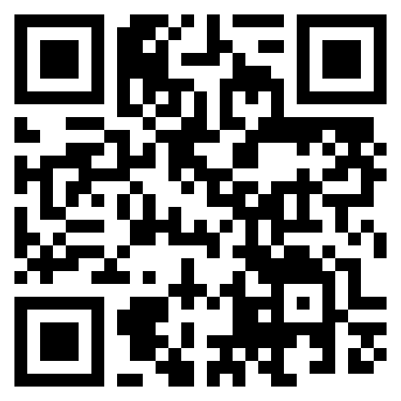
Navigating the Complex Early Childhood Systems of Care
Ivy Foster, AA Self Advocate Trainee
NH-ME LEND, Institute on Disability, University of New Hampshire
Introduction
Policy and Advocacy
Maine Parent Federation
Ensuring All Maine children have opportunity to succeed.
Maine Parent Federation (MPF) is a private
non-profit organization that provides
information, referrals, one on one telephone
support, and training to parents of children with disabilities or special health care needs and the professionals who work with these families through numerous grant-funded projects. Their services are offered at no cost to parents and are available statewide. MPF serves all Maine families of children with disabilities from birth through age 26 as identified by IDEA. Special emphasis is placed on underserved populations and isolated areas.
LD165: Expanding suspending students
9 Regional Parent Advisory Groups
Removing 282B certificate, to teach special education for 3-5 year olds.
Encouraging testimony and sharing personal stories.
LD345: IEP's forn children with disabilities now transitioning to school districts as early as age 3.
LD210: reduction or cuts for reimbursement to direct service providers.
Include Children with Autism
LD345
“An Act to Transition the Responsibility for
Child Find Activities and for Ensuring a Free,
Appropriate Public Education (FAPE) for Eligible
Children from the Child Development Services
System to School Administrative Units” A bill
to shift FAPE responsibility for children with
disabilities now as young as 3 to the local
school districts. Different from LEND’s program’s focus to work with delegates through education, not advocacy to inform decision making, MPF’s work is focused on advocacy and education as the legislation is in its initial implementation stages. Neither LEND or MPF use lobbying to affect the legislative process. MPF is currently monitoring any lower (Least Restrictive Education) LRE opportunities, including local options for programming including early care facilities, as well as parent input and feedback.
Conclusion
My LEND Leadership Placement supported the monitoring of the roll out of LD 345, by connecting with school districts in Maine that are the initial early adopters providing FAPE to 3-year-old children with disabilities. During my leadership placement many other priorities were identified over the remaining months. My time with MPF not only taught me about the resources available to families with children with disabilities and special health care needs, including:
Family-to-Family Health Information Centers
Parent Training and Information (PTI) Centers
MCHB Family Support Navigator
REAL Transition Partners
Personally, I learned how to remain flexible and to pivot when expectations within the project changed.
References
Maine Parent Federation. https://www.mpf.org/
Maine Department of Education.Early Childhood Special Education. https://www.maine.gov/doe/cds/earlychildhoodspecialeducation

