Slide 1
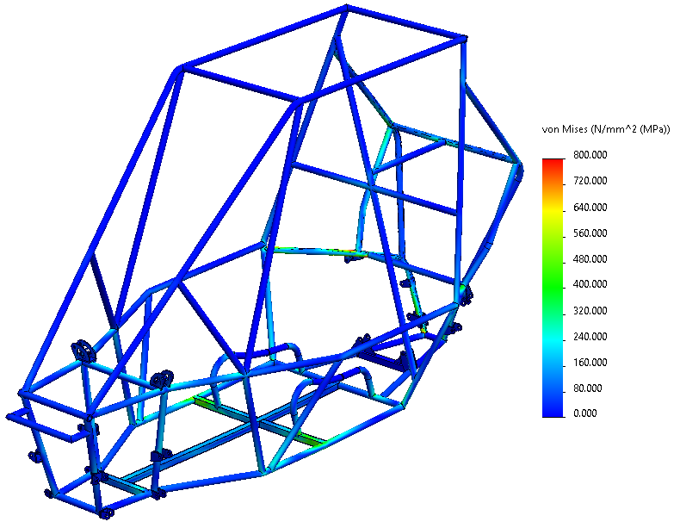
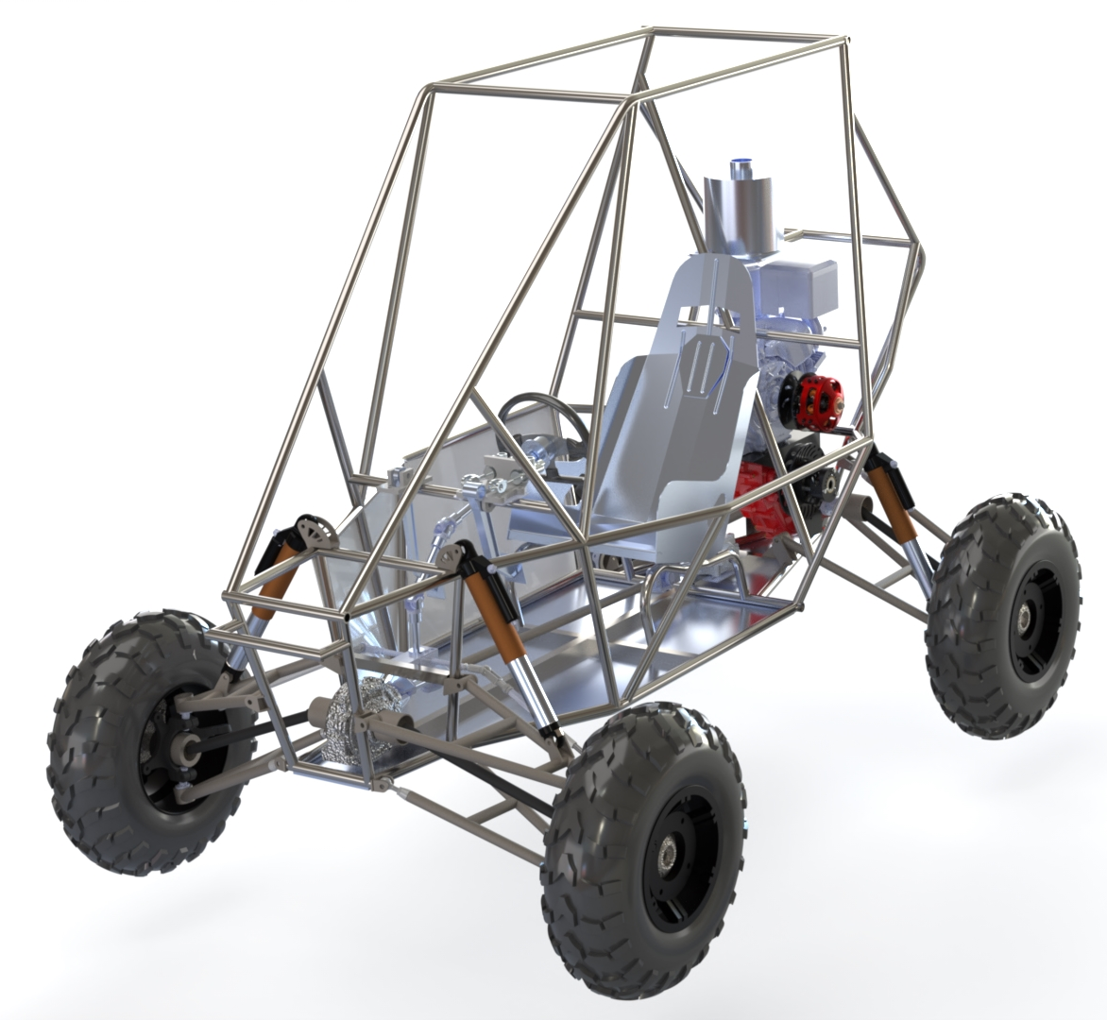
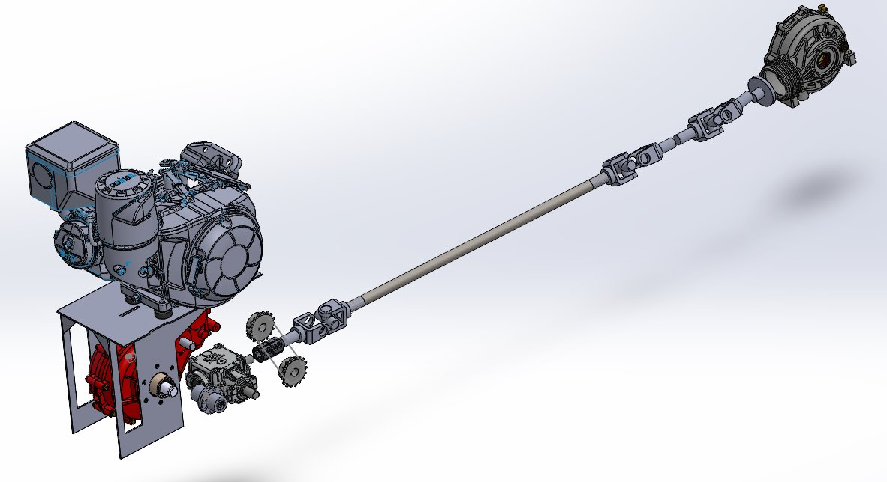
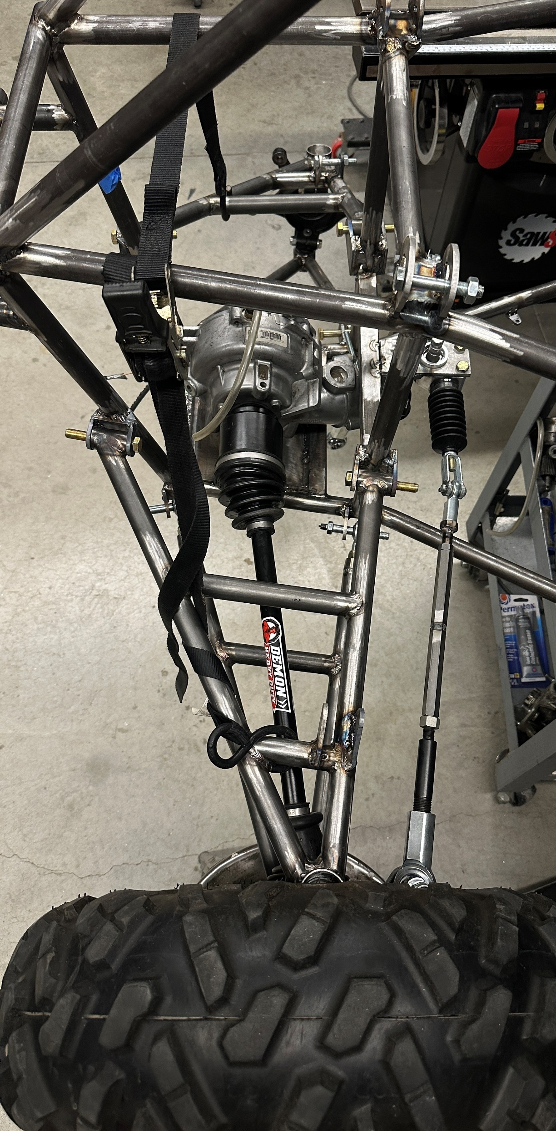
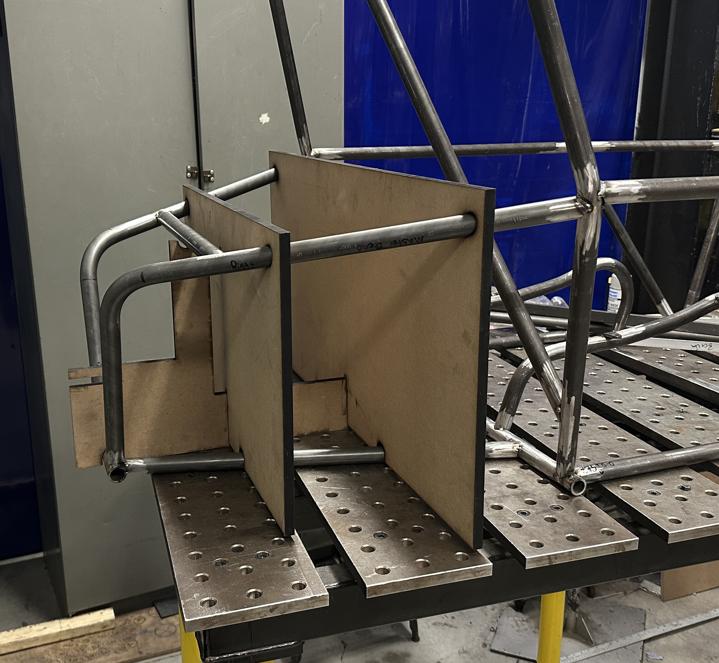
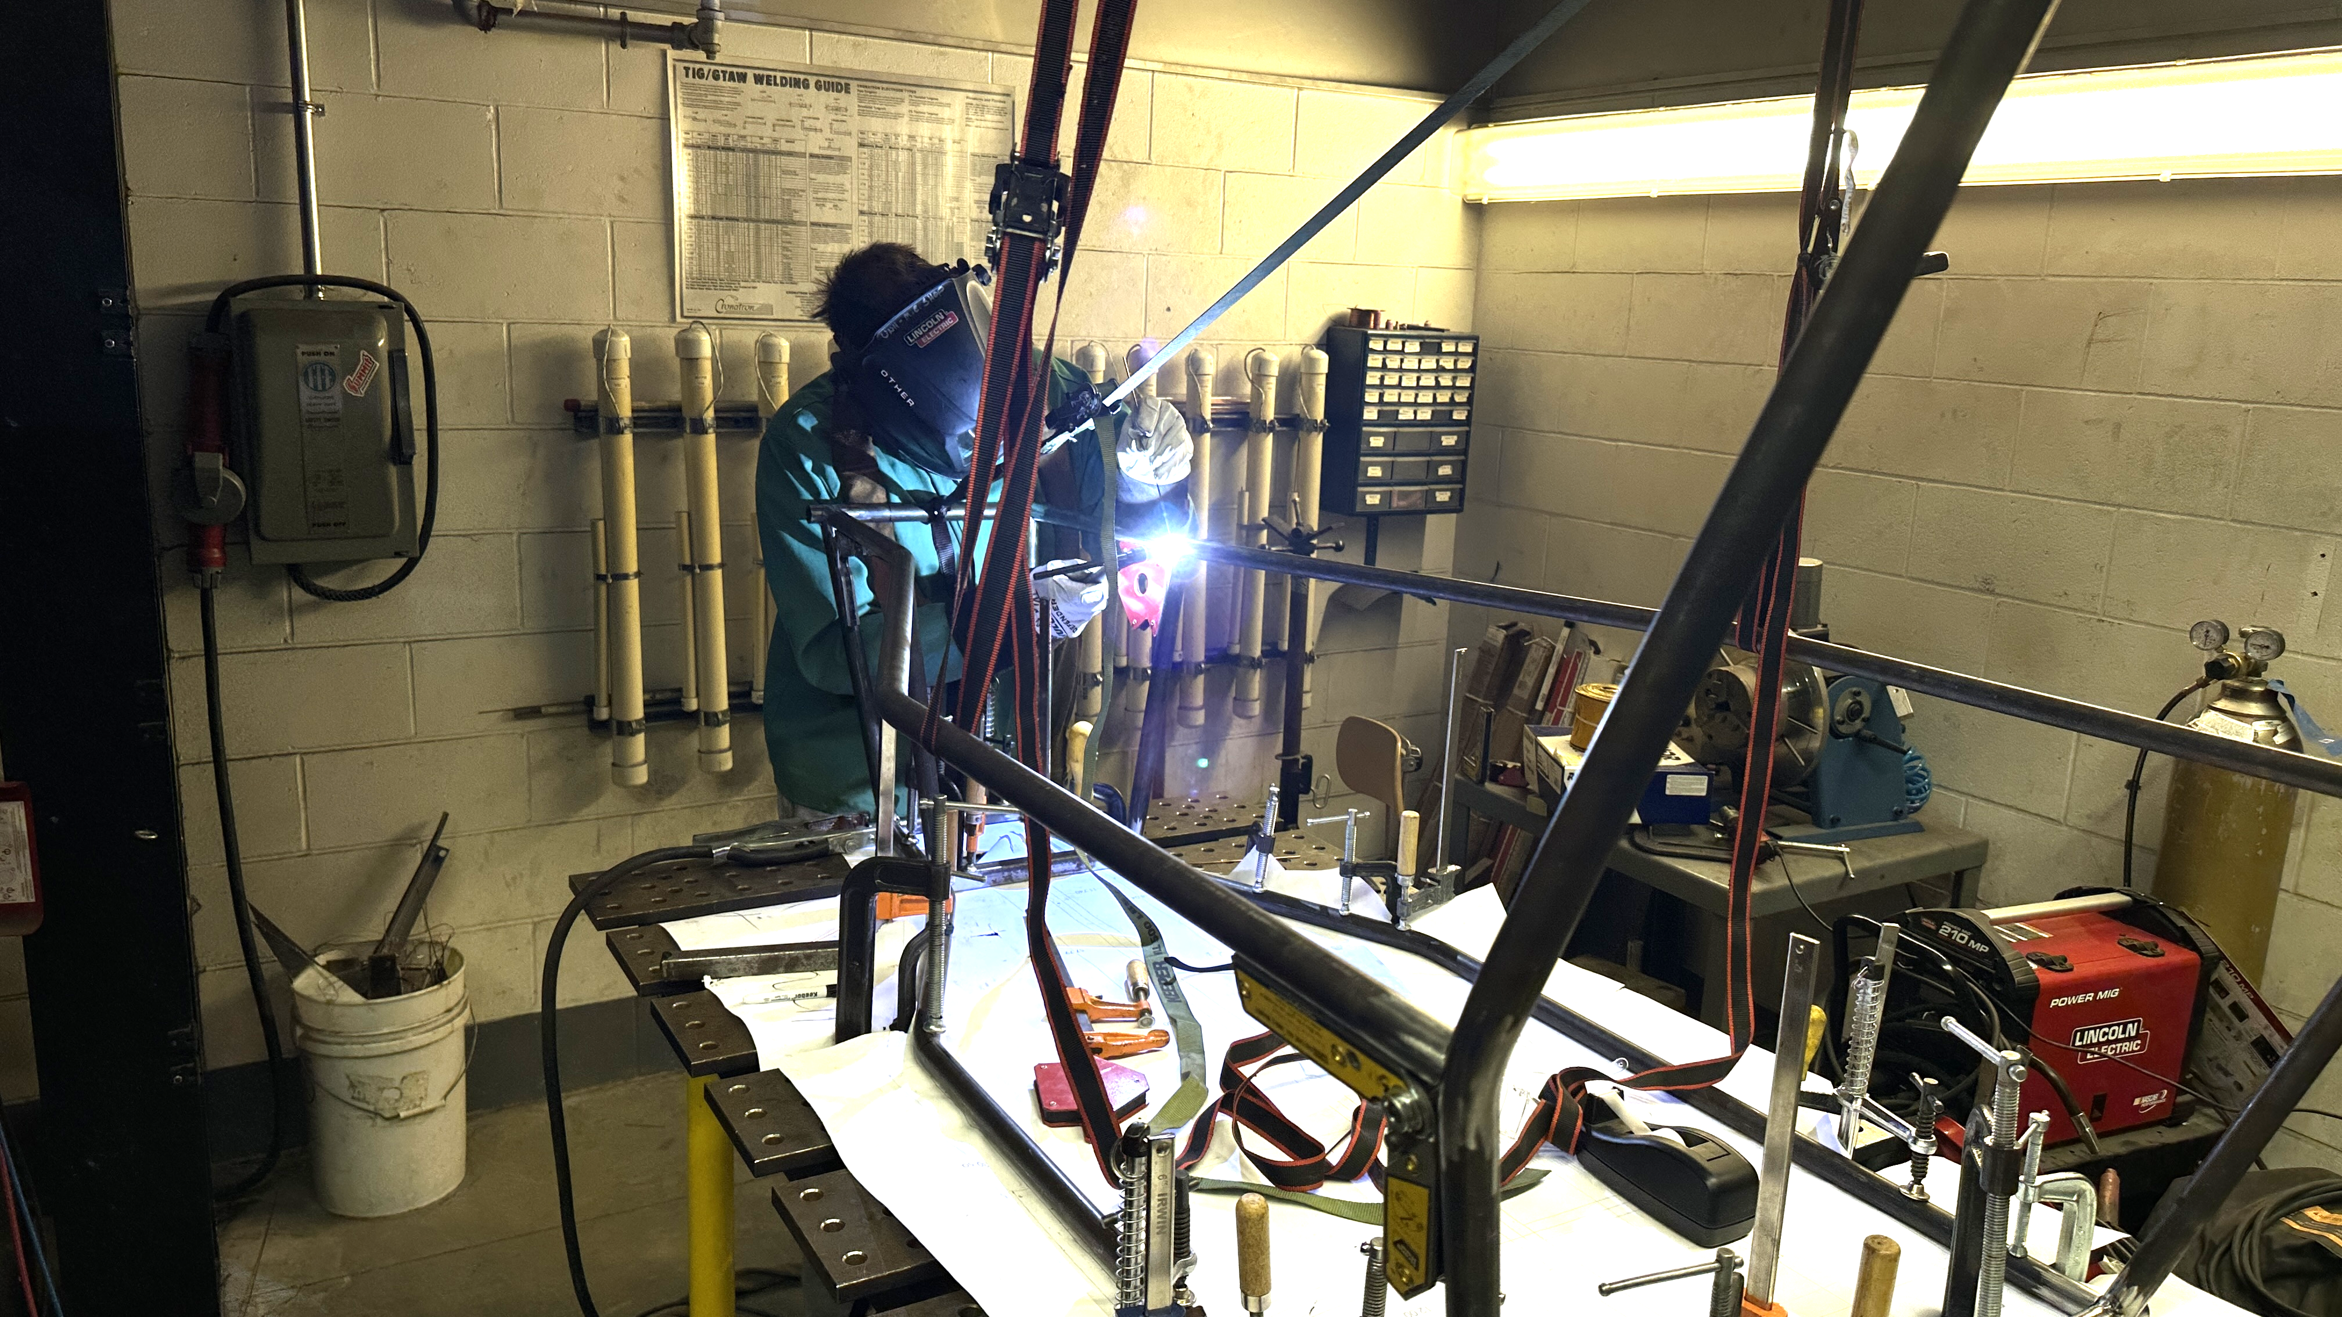
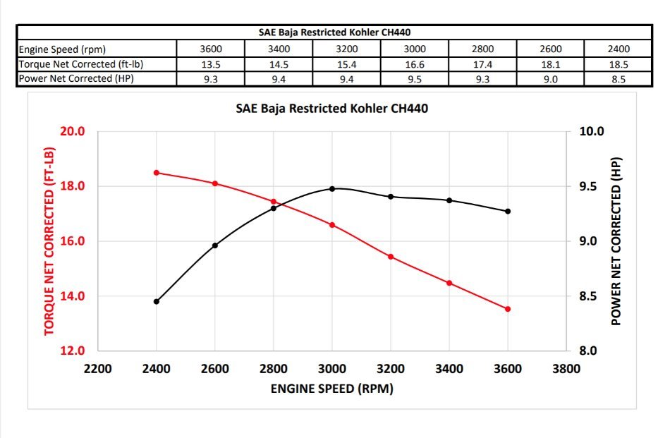
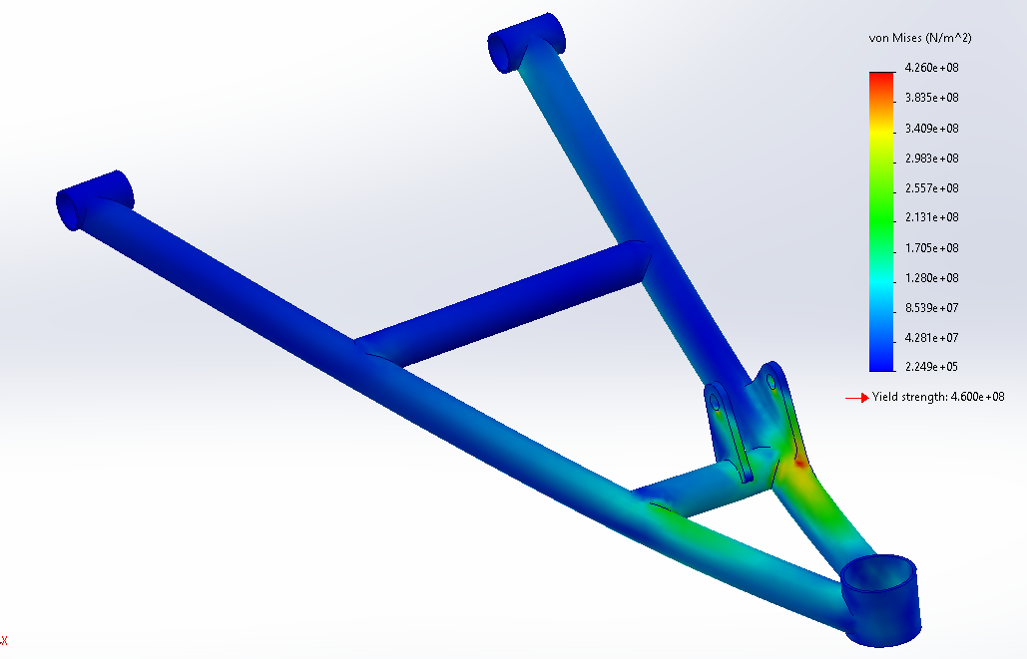
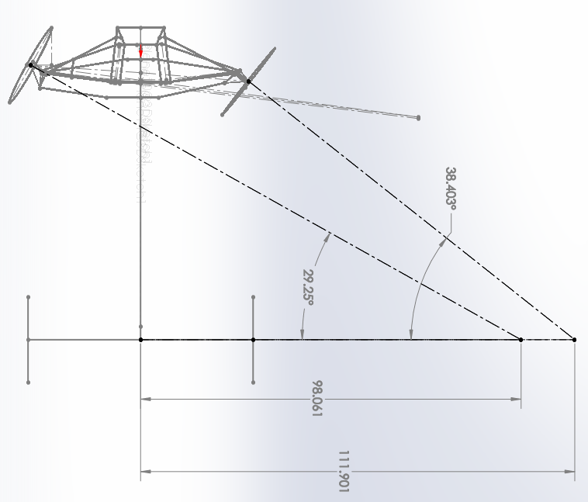
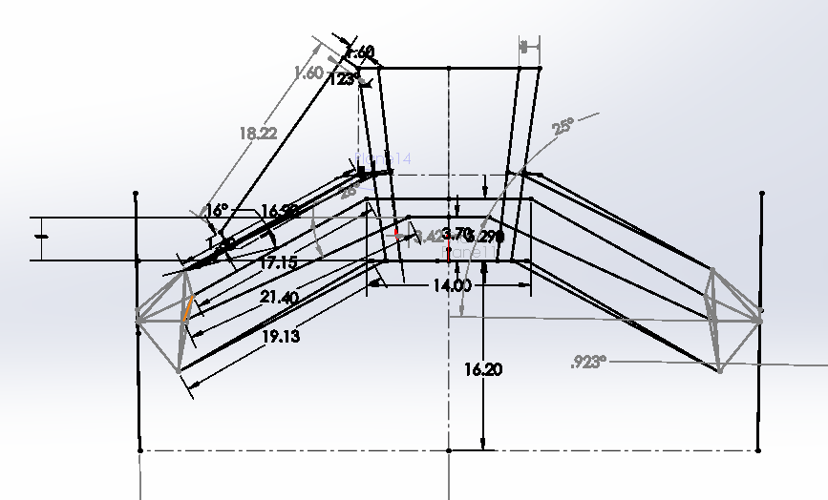
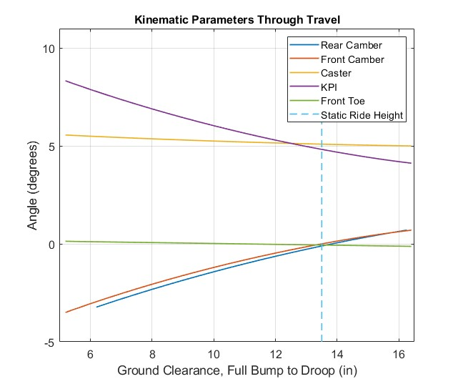
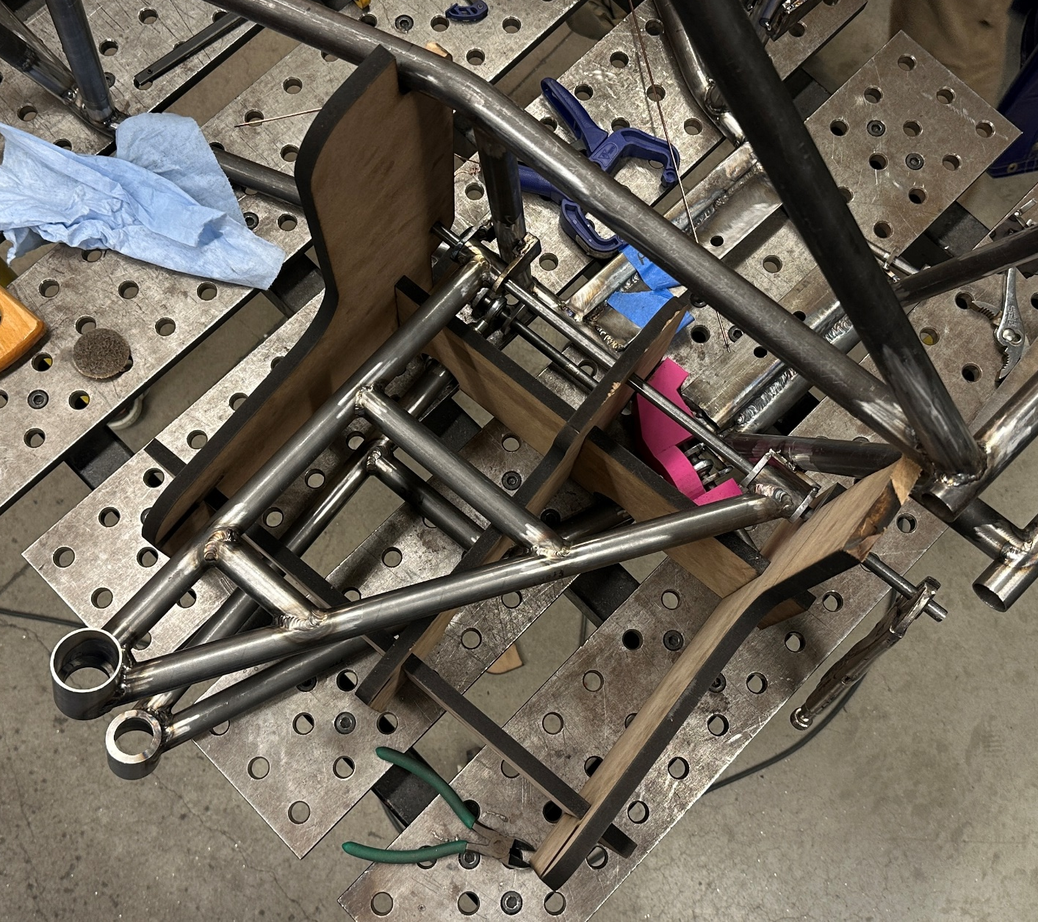
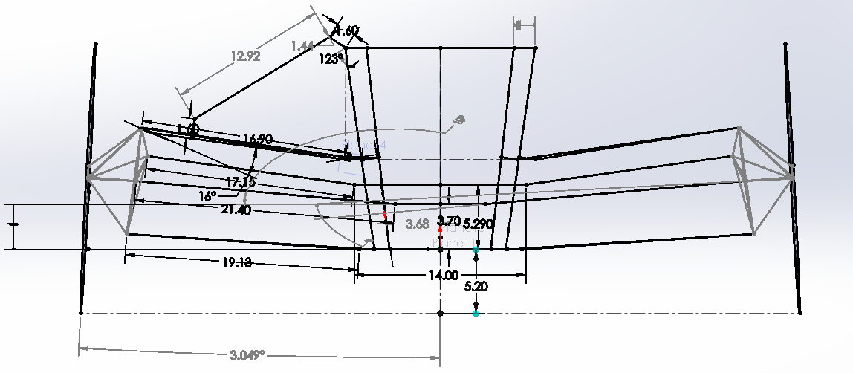
BAJA SAE Aidan MacRitchie, Ben Litvany, Eric Ball, Tyler Niswender Michael Mahoney, Henry King, Matt Harding Department of Mechanical Engineering, University of New Hampshire, Durham, NH 03824
Frame
Project Overview
Drivetrain
Design
Full frame redesign tailored to 2025 competition specs
Front-braced structure for improved weight distribution and flexibility in subsystem integration
Designed alongside suspension to support mounting locations with minimal extra material
Increased cockpit space to accommodate up to 95th percentile male
Materials
Primary Members: 1020 Steel tubing (1” x 0.120”)
Secondary members: 4130 Alloy Steel (1’’ x 0.065)
Background and objectives
Design and build an off-road vehicle to compete in the Society of Automotive Engineers (SAE) BAJA Racing series, in
Mechanicsville, MD
June 12-15, 2025
Competition Events
Static | Dynamic
Technical Inspection Design Evaluation Cost Evaluation Business Presentation | Acceleration Hill climb/traction Maneuverability Suspension/Rock Crawl 4-Hour Endurance race
Engine: Kohler CH440 10 HP
Transmission: Dana H-12 FRN transaxle and a 4x4 transfer case
Axles: Demon Powersports Heavy Duty rear axles and East Lake front axles
CVT: Purpose built Gaged Engineering GX9
Front Differential: Polaris Ranger
Transfer case: Superior Gearbox Company 90º input output bevel gear drive
Driveshaft: Custom in-house build
Engine Cradle: Custom built transmission cradle/engine mount.
5-ft drop test
Fabrication
Laser cut MDF jigs
Destructive testing of welds
Tig Welded, Root Pass & Cap
Suspension
Front Suspension
Dual unequal length A-arms
Fox Float 3 Evol Air Shocks
Polaris RZR XP 1000 knuckles
Delrin bushings in upper arms, adjustable Heims in lower
Rear Suspension
H-arm with upper camber link
Fox Float 3 Evol Air Shocks
Polaris RZR RS1 knuckles
Turnbuckle style camber links for easy tuning
Manufacturing
In-house fabrication of all control arm components
Custom machined ball joint cups & Delrin bushings
Laser cut MDF/3D-printed jigs for arms and mounting
Water-jetted mounting tabs
Controls
Steering
Rack and Pinion Steering
55% static Ackerman
8.2-ft outer turning radius
69-in wheelbase
Braking System:
Independent Front and Rear Hydraulic
Braking Systems
Dual Master Cylinder
Two Pressure Sensors for Redundancy
Electrical System
Dual Kill Switch Electrical System
Switch Controlled Front Differential
Reverse and Brake Lights
Features
 | Front | Rear
Vertical Wheel Travel | 11.3 in | 10.1 in
Static Ground Clearance | 13.5 in | 13.5 in
Avg. Motion Ratio | 0.47 | 0.52
Static Roll Center Height | 12.0 in | 10.7 in
Track width change | 5.5 in | 7.0 in
Track width | 56.0 in | 54.8 in
Toe change | 0.26º | 0º
1200 lb. vertical wheel load
Acknowledgements
Advisor: Juan Carlos Cuevas Bautista
CEPS TSC: Noah MacAdam, Scott Campbell, Sheldon Parent, CEPS Makerspace
ME Department, John Olson Advanced Manufacturing Center

