Slide 1


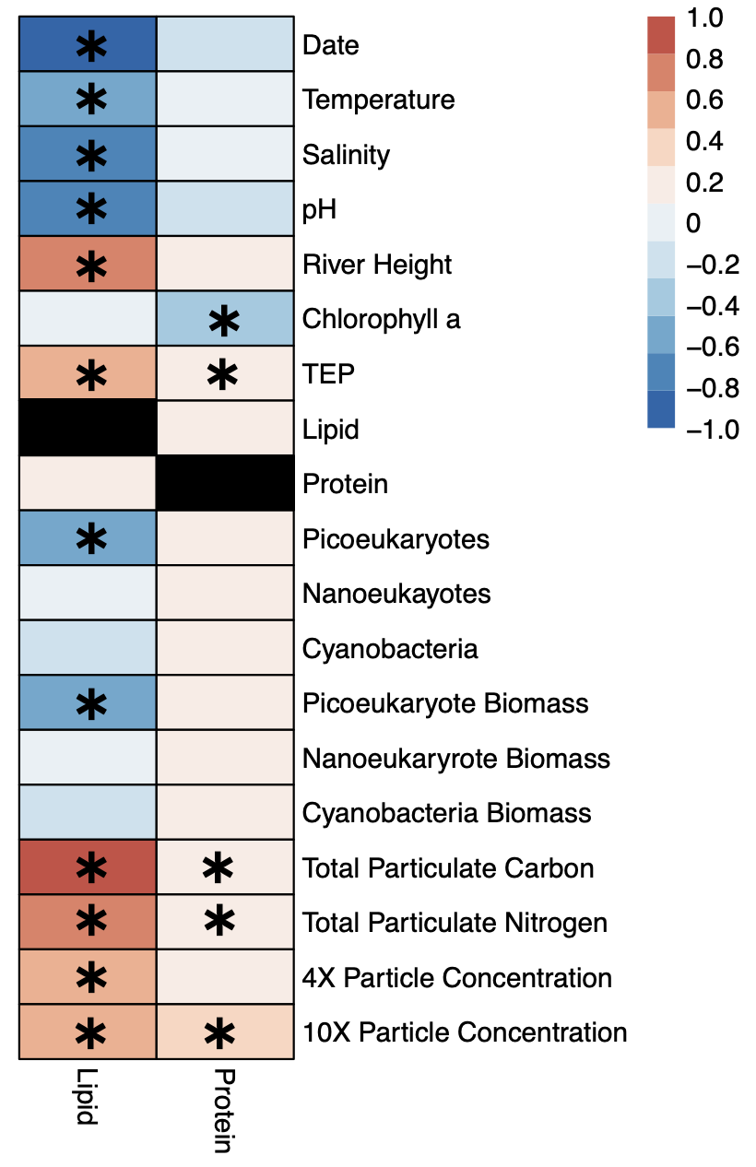
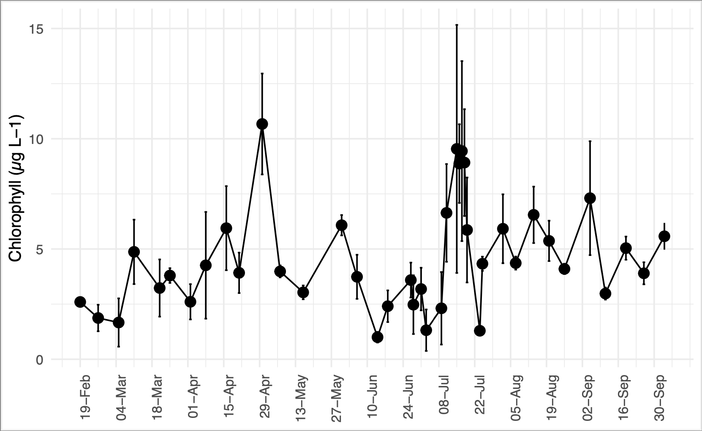
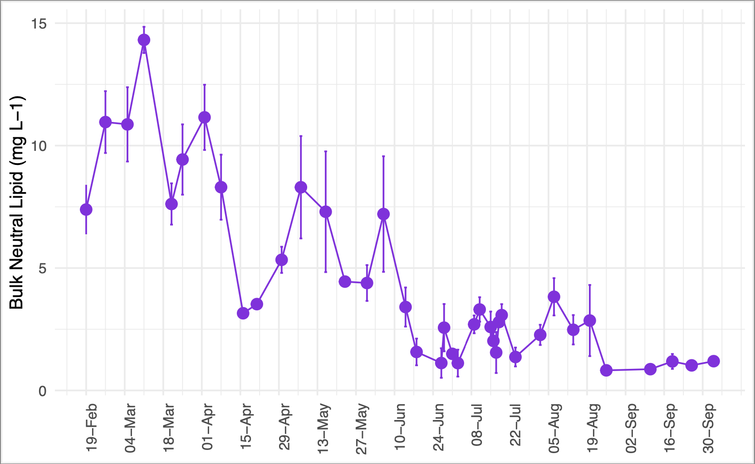
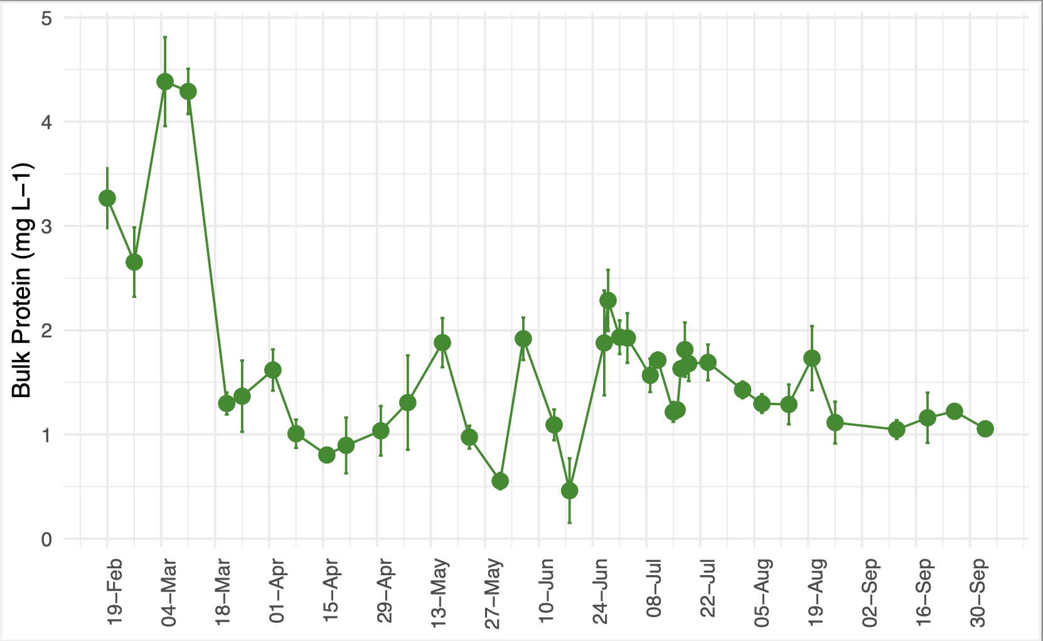
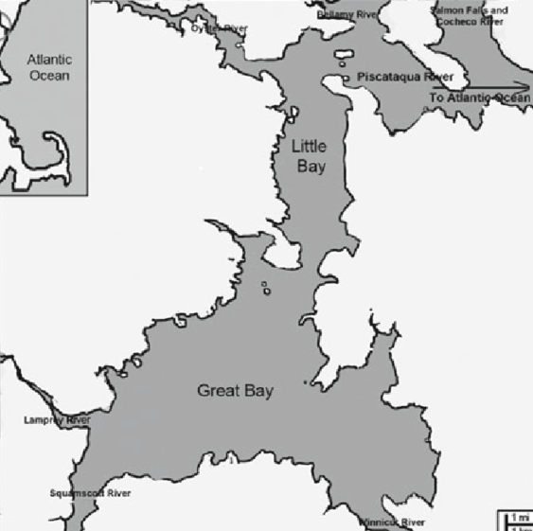
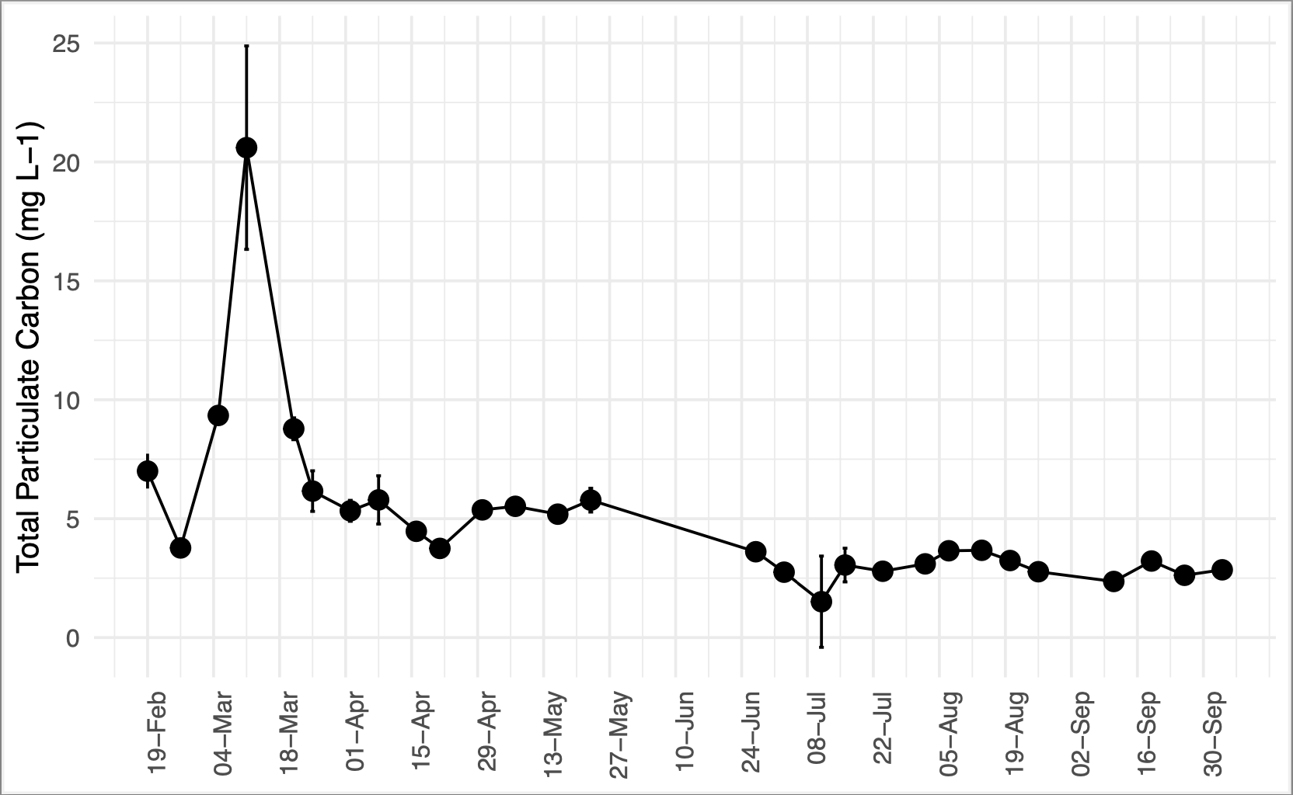


Temporal variability in the nutritional quality of estuarine plankton
Marley Gonsalves, Elizabeth Harvey
Department of Biological Sciences, University of New Hampshire
Introduction
Results
Drivers
Phytoplankton are critical for O₂ production¹ and biogeochemical cycling^{2,3} and are at the base of the aquatic food web.
Phytoplankton exhibit variation between cells⁴ and communities⁵ in size⁶, shape, and stoichiometry⁷, leading to variable macromolecular makeup⁸.
Filter feeders consume phytoplankton⁹, with variable nutritional value¹⁰.
  Proteins: primary component of phytoplankton cells
  Lipids: essential for cellular functioning, specifically linked to diet impacts.
Daily changes in lipid and protein concentrations insignificant between consecutive days
Lipid and protein concentrations remained relatively similar across tidal cycle
  Lipids driven by time and river input
  Proteins driven by carbon and nitrogen
Bulk Neutral Lipid (mg L-1)
Bulk Neutral Lipid (mg L-1)
Research Questions
Do lipid and protein concentrations in Great Bay change over time?
What parameters drive changes in lipid and protein concentrations?
Bulk Protein (mg L-1)
Bulk Protein (mg L-1)
Methods
Figure 3. Triplicate values at high (circle) and low (triangle) tide of bulk neutral lipid (purple) and protein (green). Weeks with significant differences between high and low tide are circled.
Figure 2. Daily concentrations of lipids (purple) and proteins (green). Shaded region shows standard error of triplicate values.
Figure 5. Heatmap showing Spearman correlation coefficients between lipid/protein and other measured variables. Asterisks show variables with VIP >1. Bolded boxes show the most important factors for each macromolecule.
Collect water samples and measure environmental, plankton community, and nutritional parameters.
  Seasonal: 2/19 – 10/4 (high tide)
  Tidal: 6/18 – 8/26 (low tide)
  Daily: 7/15 – 7/19 (high tide)
Look for trends over time scales, correlations between parameters (Spearman correlation coefficient), and drivers of change (partial least squares regression).
Seasonal trends in lipid and protein concentrations
  Limited relationship with chlorophyll a
  Matching spring spike in POC
Variable lipid:carbon and protein:carbon ratios
  Inverse relationship between L:C and P:C ratios
  Variable composition of organic matter
Discussion
Trends in lipid and protein concentrations are driven by terrestrial input and organic matter, rather than the phytoplankton community.
Implications
Bulk organic matter impacts nutrient cycling in the estuary and must be considered when quantifying food availability and quality for filter feeders.
Future Research
What are filter feeders eating?
Source of organic matter?
How does the estuary compare to the coast?
Chlorophyll a (µg L-1)
Bulk Neutral Lipid (mg L-1)
Bulk Protein (mg L-1)
Total Particulate Carbon (mg L-1)
Acknowledgements
Travel for this presentation was funded thanks to the Northeastern Association of Marine and Great Lakes Laboratories (NEAMGLL). Thank you to Elizabeth Harvey, Alicia Veronneau, Sara Smith, Mikayla Cote, and Michaela Edwards for their help on this project.
Figure 1. Map of Great Bay, NH, with sampling site (Jackson Estuarine Lab, Durham, NH) shown with star.
Figure 4. Seasonal chlorophyll a, bulk neutral lipid (purple), protein (green) and total particulate carbon concentrations (standard deviation of replicates shown in error bars), and total particulate carbon to lipid and total particulate carbon to protein ratios in Great Bay at high tide.
References

