Slide 1


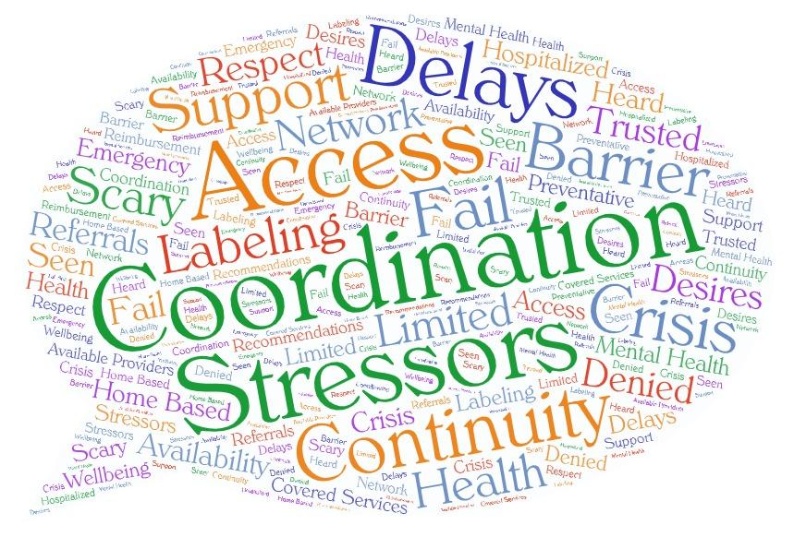
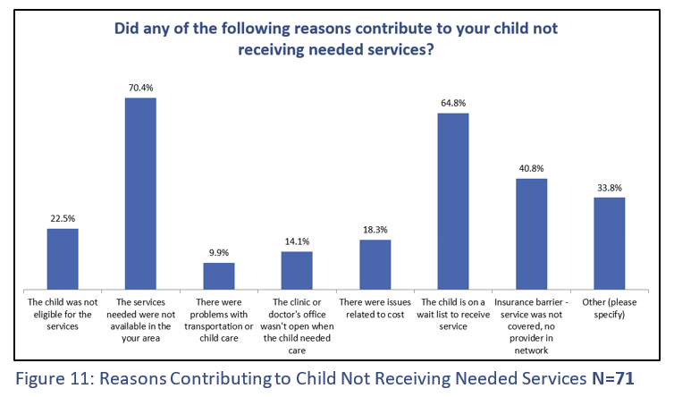
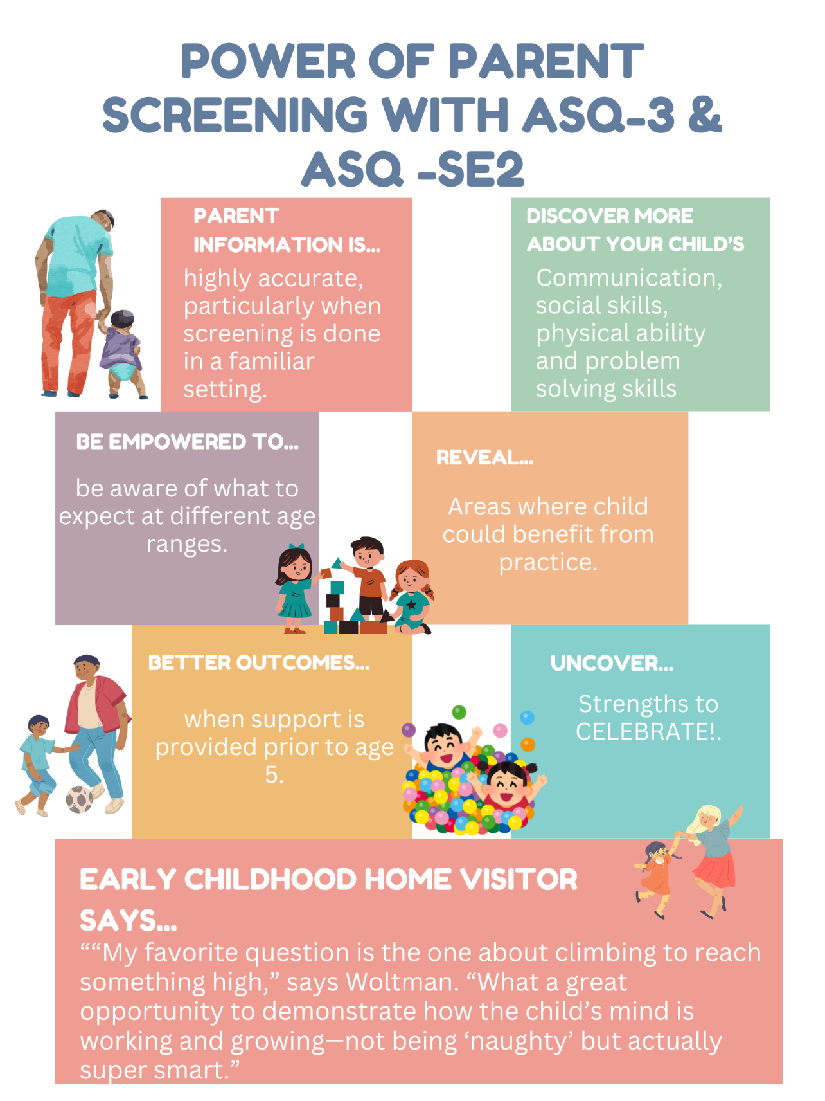
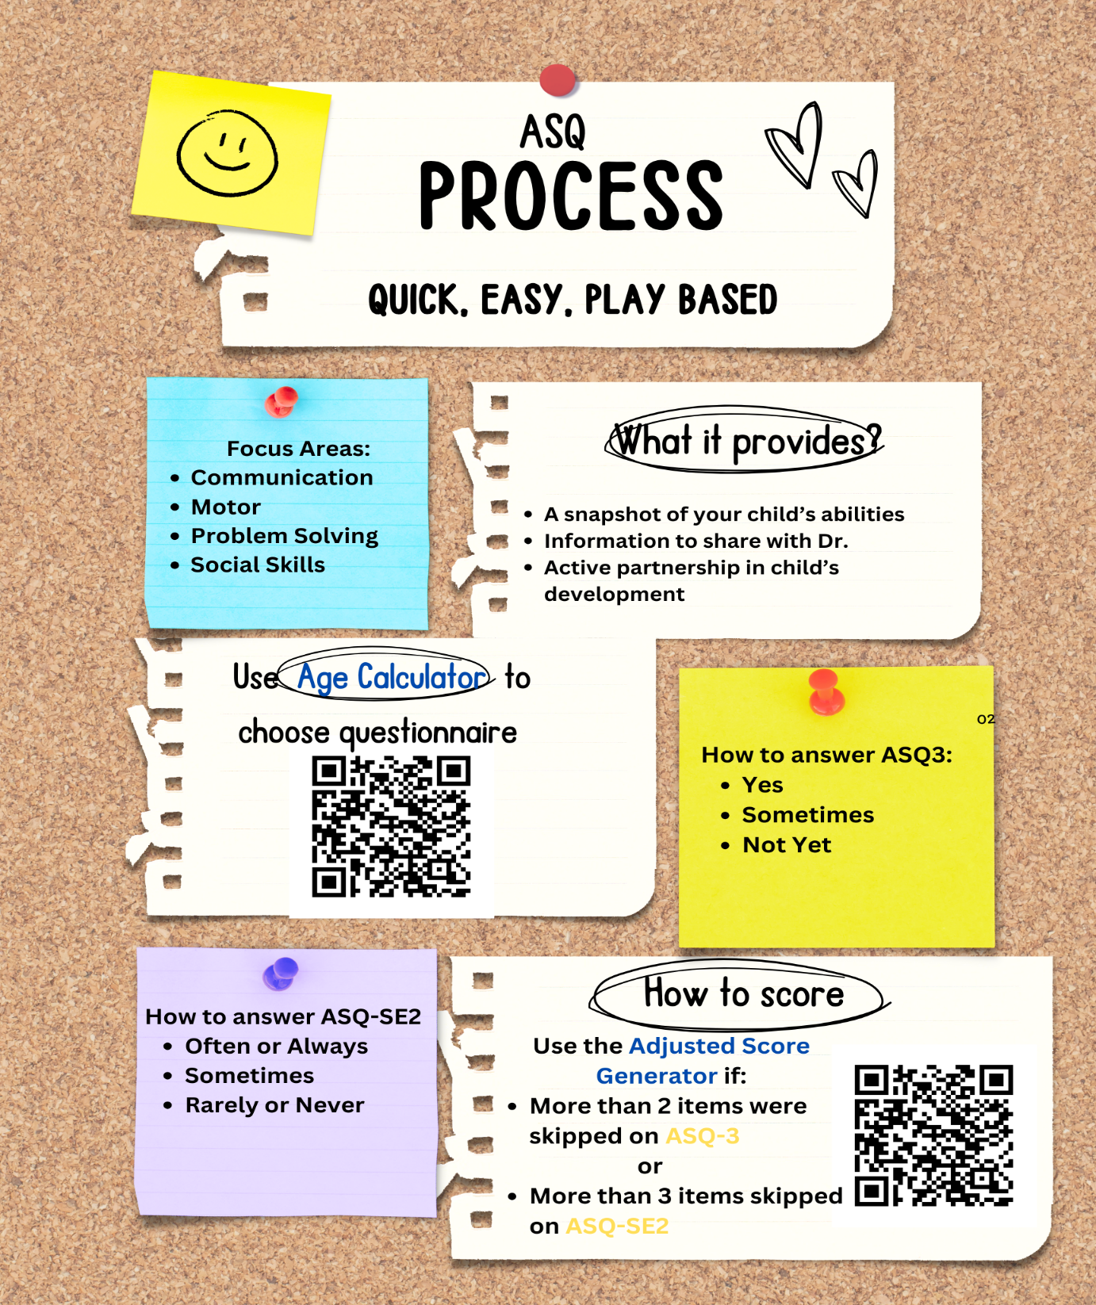
Cultivating Partnerships Within the Service System for Children and Youth
Lara Raymond, M.S., Mental Health Counseling
Institute on Disability at the University of New Hampshire
Connection: Trends in the Lack of Confidence in the Service Delivery System
The Watch Me Grow Developmental Screening System is comprised of partnerships throughout the state which ensure accessible developmental screening, information, and referrals to local agencies and/or child health providers. These connections are paramount for NH children (birth through 5 years) to receive appropriate
NHFV is a statewide family organization that provides families and youth, with a focus on children/youth with disabilities and special health care needs, and the providers who serve them, with the knowledge and support they need to make informed decisions that enhance each child’s development and well-being.
Both initiatives are intrinsically connected to the community. This provides opportunities to take what is learned from these projects and bring relevant information back to the community, giving agency to enact change to those who live and work in the community.
Title 5 Needs Assessment Background:
The Title V Maternal Child Health (MCH) Services Block Grant provides funding to states to ensure that mothers and children, including those with special health care needs have access to preventive and primary health care. Every 5 years, states conduct a needs assessment gathering information from various data sources, including a survey and focus groups, and outreach by bilingual community members.
services and supports to grow, learn and to reach their maximum potential. The WMG Centralized Access Point (CAP) at NH Family Voices offers Ages and Stages (ASQ-3) and Ages and Stages Social Emotional (ASQ-SE2) questionnaires to the community, while also offering trainings for early childhood providers.
Project Culmination: Hosted Books, Blocks, and Balls event. 25 adults and 35 children stopped by the Books, Blocks, and Balls event stations. 7 adults took ASQ-3 and ASQ-Se2, for children between 16 months and 27 months, with about half being the grandparents providing childcare. Several families verbalized being unsure about completing a screening, possibly associated with how labels affect the child and family unit. This led to the creation of two infographics that highlight the accessibility and benefits of taking part in the screening process.
Project Culmination: Quote extraction from survey results and focus groups/interviews was followed by the NHHS 2025 Titel V Strategic Planning meeting. Community feedback pointed to challenge areas encapsulated by the quote and graph below.
“It’s really hard to navigate all the resources, and I need to know about them first. I wish it wasn’t so hard to get my kid the help she needs to be successful in her life.”
Word Cloud #1 depicts a thought bubble comprised of words extracted from parent quotes in Title V Needs Assessment
Infographic # 1 focuses on addressing
parents’ uncertainty
In
Infographic # 2
Focuses on demystifying the process of completing the ASQ.
Next Steps: To share the information garnered from these projects with the wider community, to increase future trust and collaboration.
Title V Needs Assessment:
Develop plan to implement identified priority needs.
Create and disseminate infographics to the community, with data from the Needs Assessment to bolster people’s confidence to share their perspectives on services they are receiving.
Watch Me Grow
Utilize two infographics below as cover sheets and marketing during Books, Blocks, and Balls (BBB) developmental screening events.
Article submission to Act Early Newsletter
Draft action plan to develop relationships with libraries.
Priority Areas Identified at the Strategic Planning Meeting Included: focus on bullying and screentime use, address maternal and perinatal mental health, increase workforce training in primary care settings for youth mental health, and prioritize medical home model for adolescent transition to adult care.
Notes:
Left Column
Added NHFV Logo
NHFV edited info about us
Middle Column
Removed this wording (You will be able to explain it during the poster presentation) Word Cloud Image generated from quotes from Title 5 survey highlighting the desires and stressors families identified
Added Word Cloud
Moved Infographics to bottom with descriptions about and added boxes around each with description to delinate them.
Right Column
Added WMG Logo
Updated description of WMG (this is split in two boxes to “wrap” around the logo.
Watch Me Grow Background: Watch Me Grow (WMG): The Watch Me Grow, a program that offers Ages and Stages (ASQ-3) and Ages and Stages Social Emotional (ASQ-SE2) questionnaires to the community. They also offer trainings for early childhood providers, to enable daycares to have the capacity to offer the ASQ3 and ASQ-SE2 to families they engage with.
Thought We could print out the BBB Flyer and have it with your poster to explain BBB. I

