Slide 1



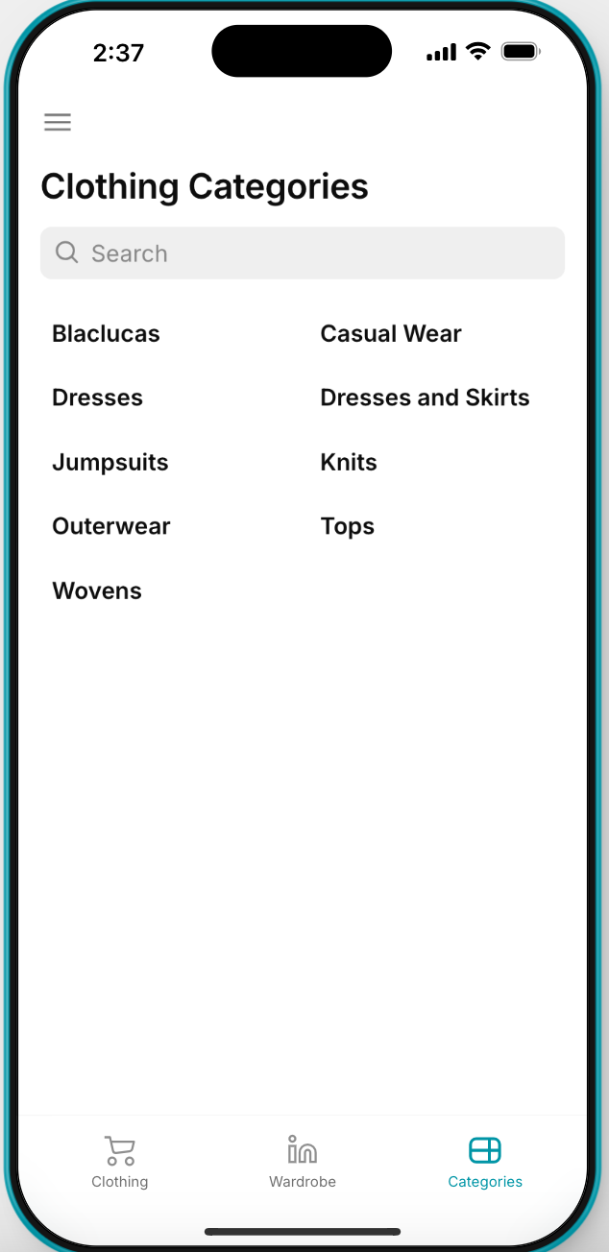
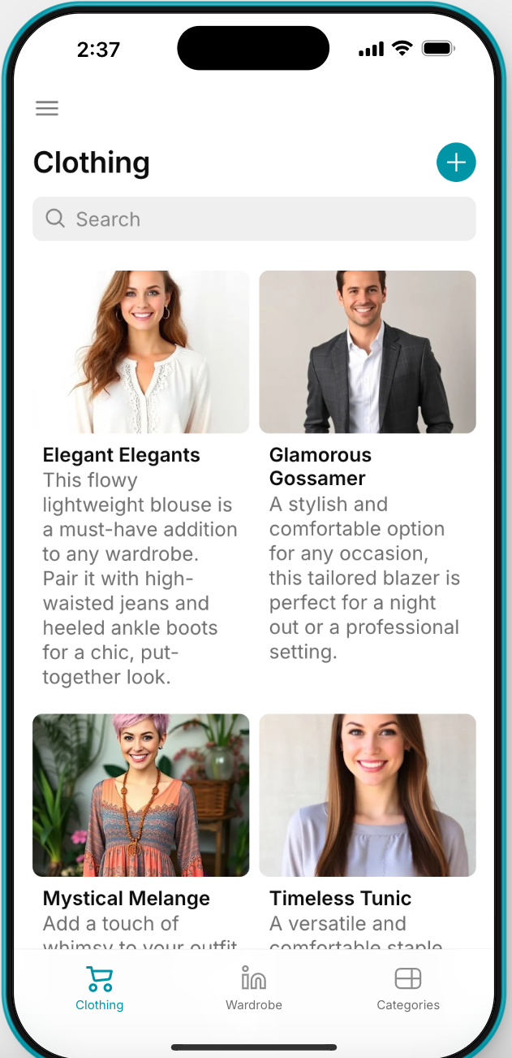
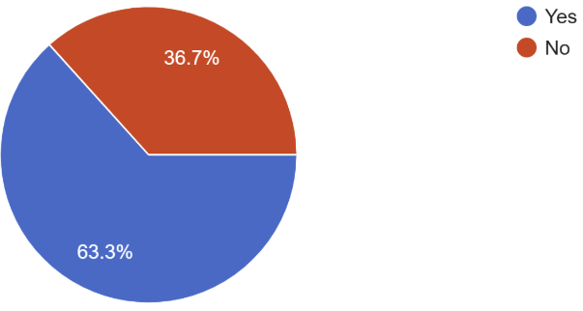

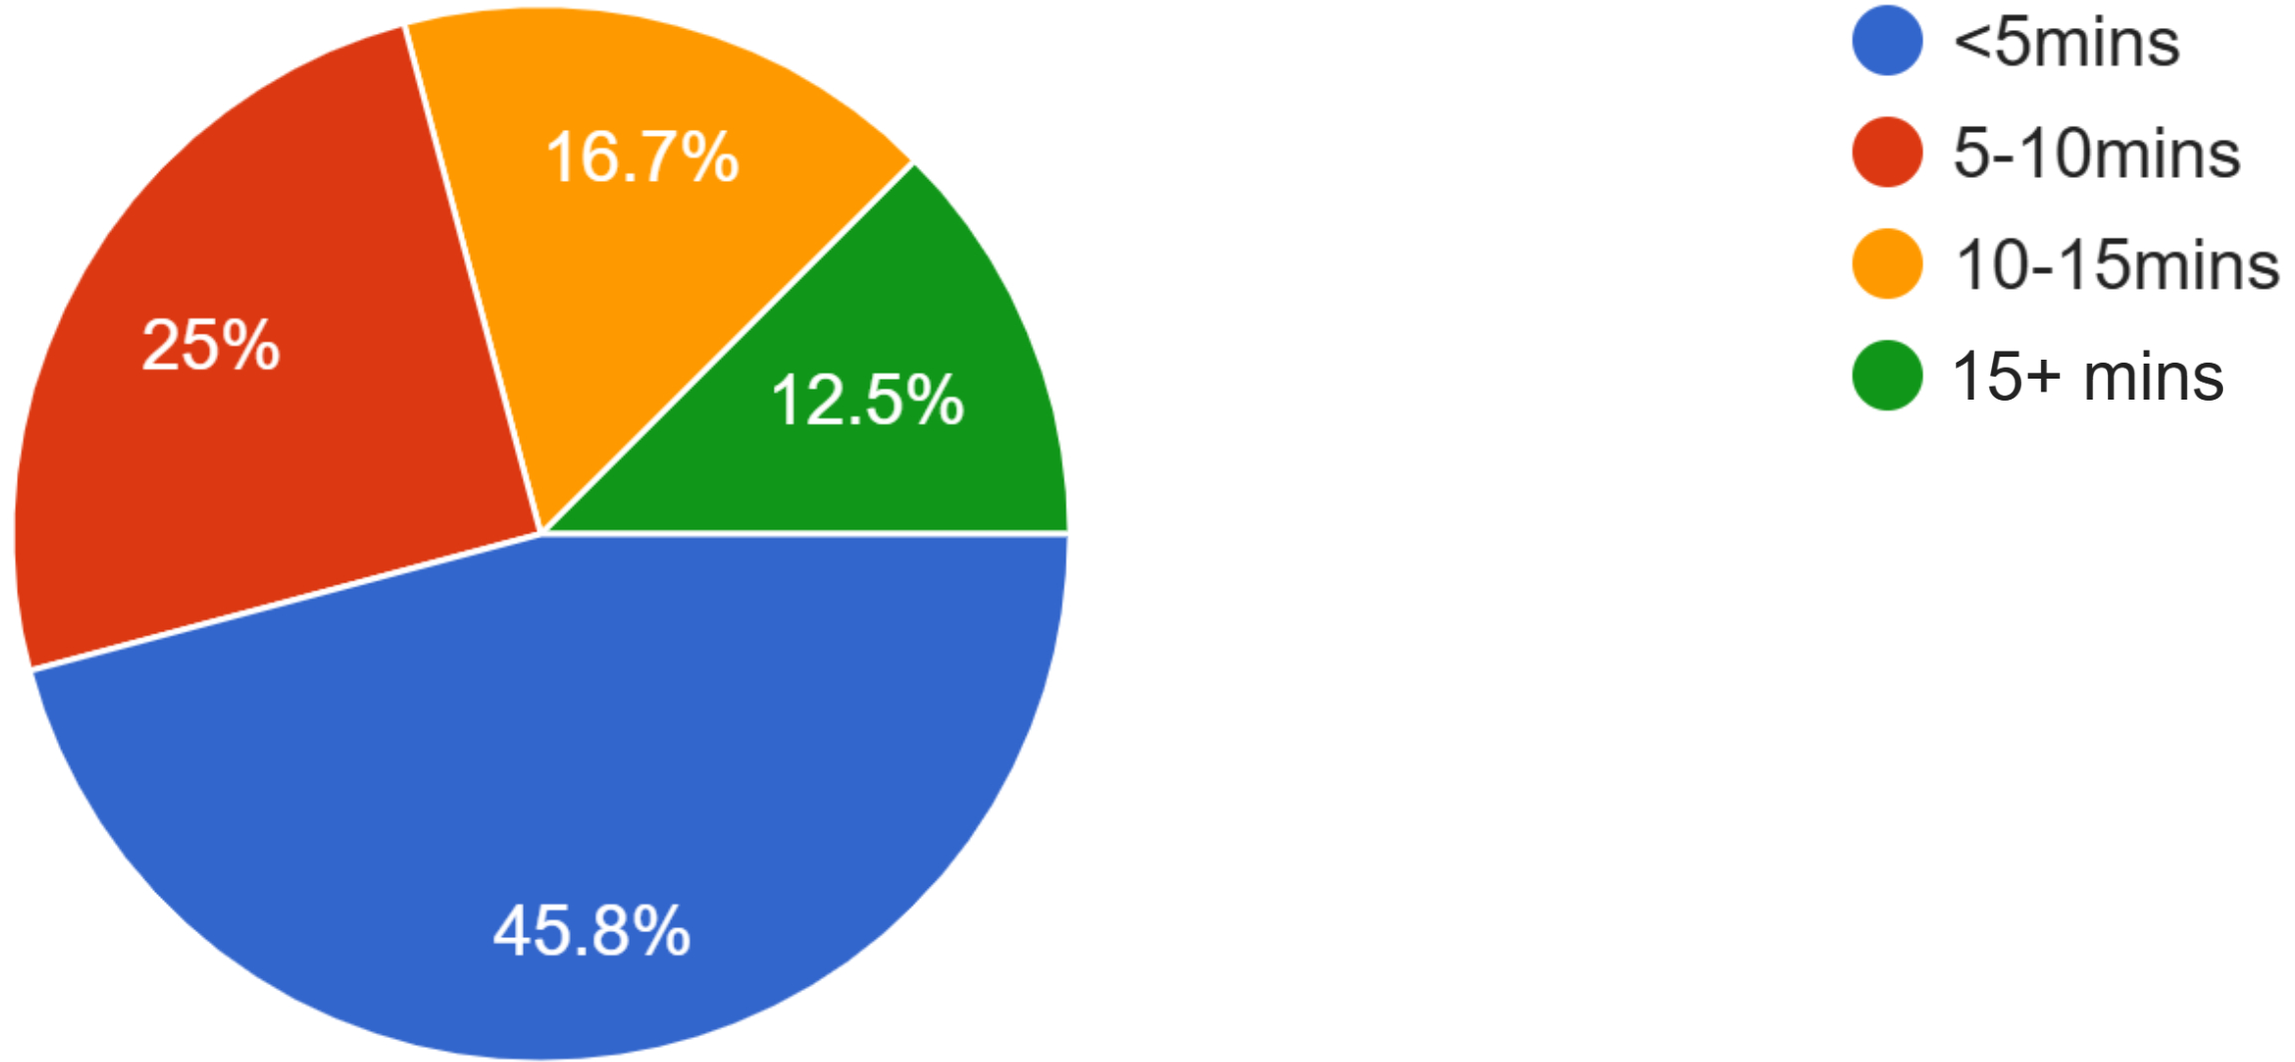





OutFind
Cecilia Lim, Sophia Harvey, Yehuda Chandra
Innovation Scholars - Internet Engineering Cohort, University of New Hampshire, Durham, NH, 03824
Problem
How OutFind Works
Statistics
Figuring out what to wear isn’t always easy. Oftentimes, students are unsure on what's appropriate for the occasion, if anything inside their limited closet is suitable, or are worried about what other people think about their own fashion choices. Creating the perfect outfit on top of an already demanding college schedule can oftentimes lead to an unnecessary amount of mental stress and precious time wasted.
Do you think that the time spent planning an outfit could be used better elsewhere?
What if there was an app to easily organize your closet, generate unique outfits, share ideas, and ultimately eliminate outfit stress?
On average, how much time do you spend planning out an outfit?
Solution
OutFind is a free and intuitive social media and outfit inspiration app that allows its users to:
- Find outfit inspiration from other profiles
- Create outfit combos using AI
- Post public outfits
- Manually design your own
outfit
- Store clothes in the virtual
wardrobe
- Discover your new and
improved style!
Surveyed ~100 UNH Students
Technologies Used
Future Implementations
Front End Back End
- Develop a calendar planner to organize future outfit ideas
- Add item descriptions and links to the respective store pages
- Build chat and comment features between users and posts
- Generate “For You Pages” based on individual content preferences
- Create local marketplace to buy and sell new or used clothes
- Import size measurements and preferences settings
Acknowledgements
Instructors: Kyle Ouellette & Dean Sullivan

