Slide 1
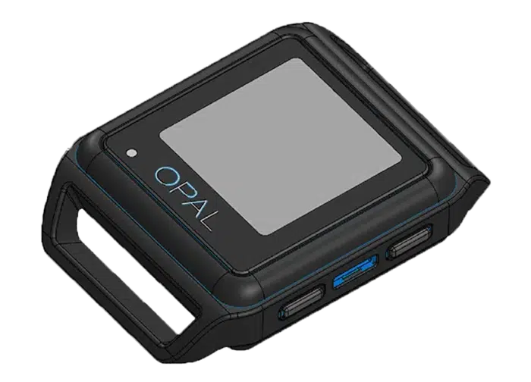
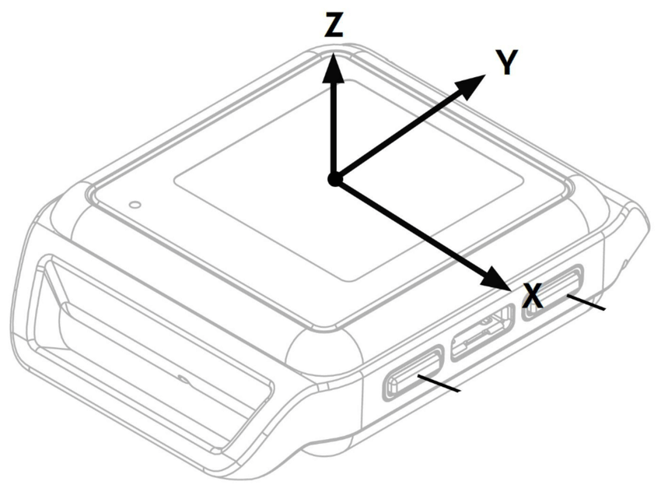
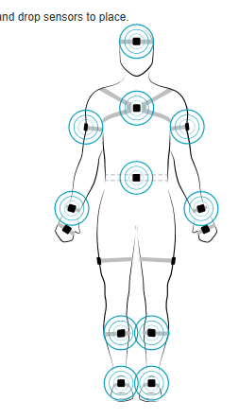
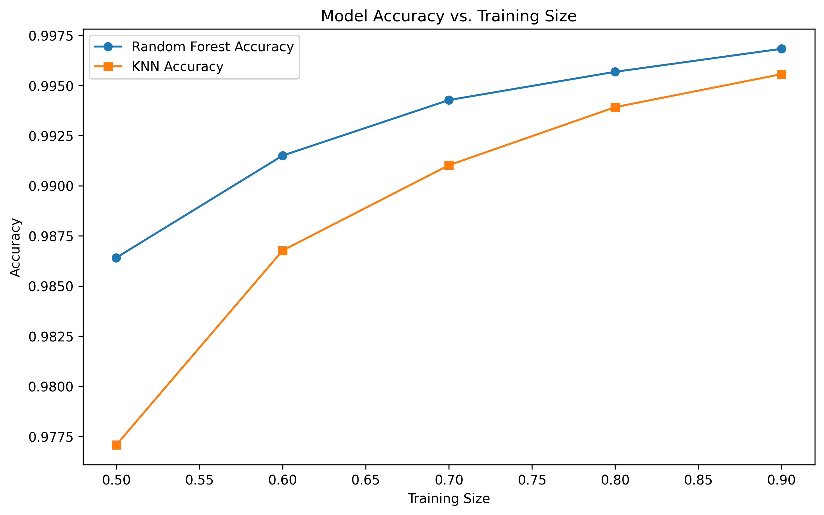
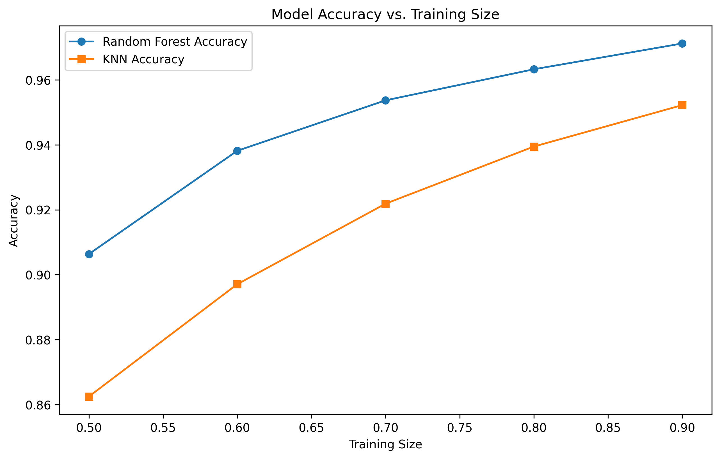
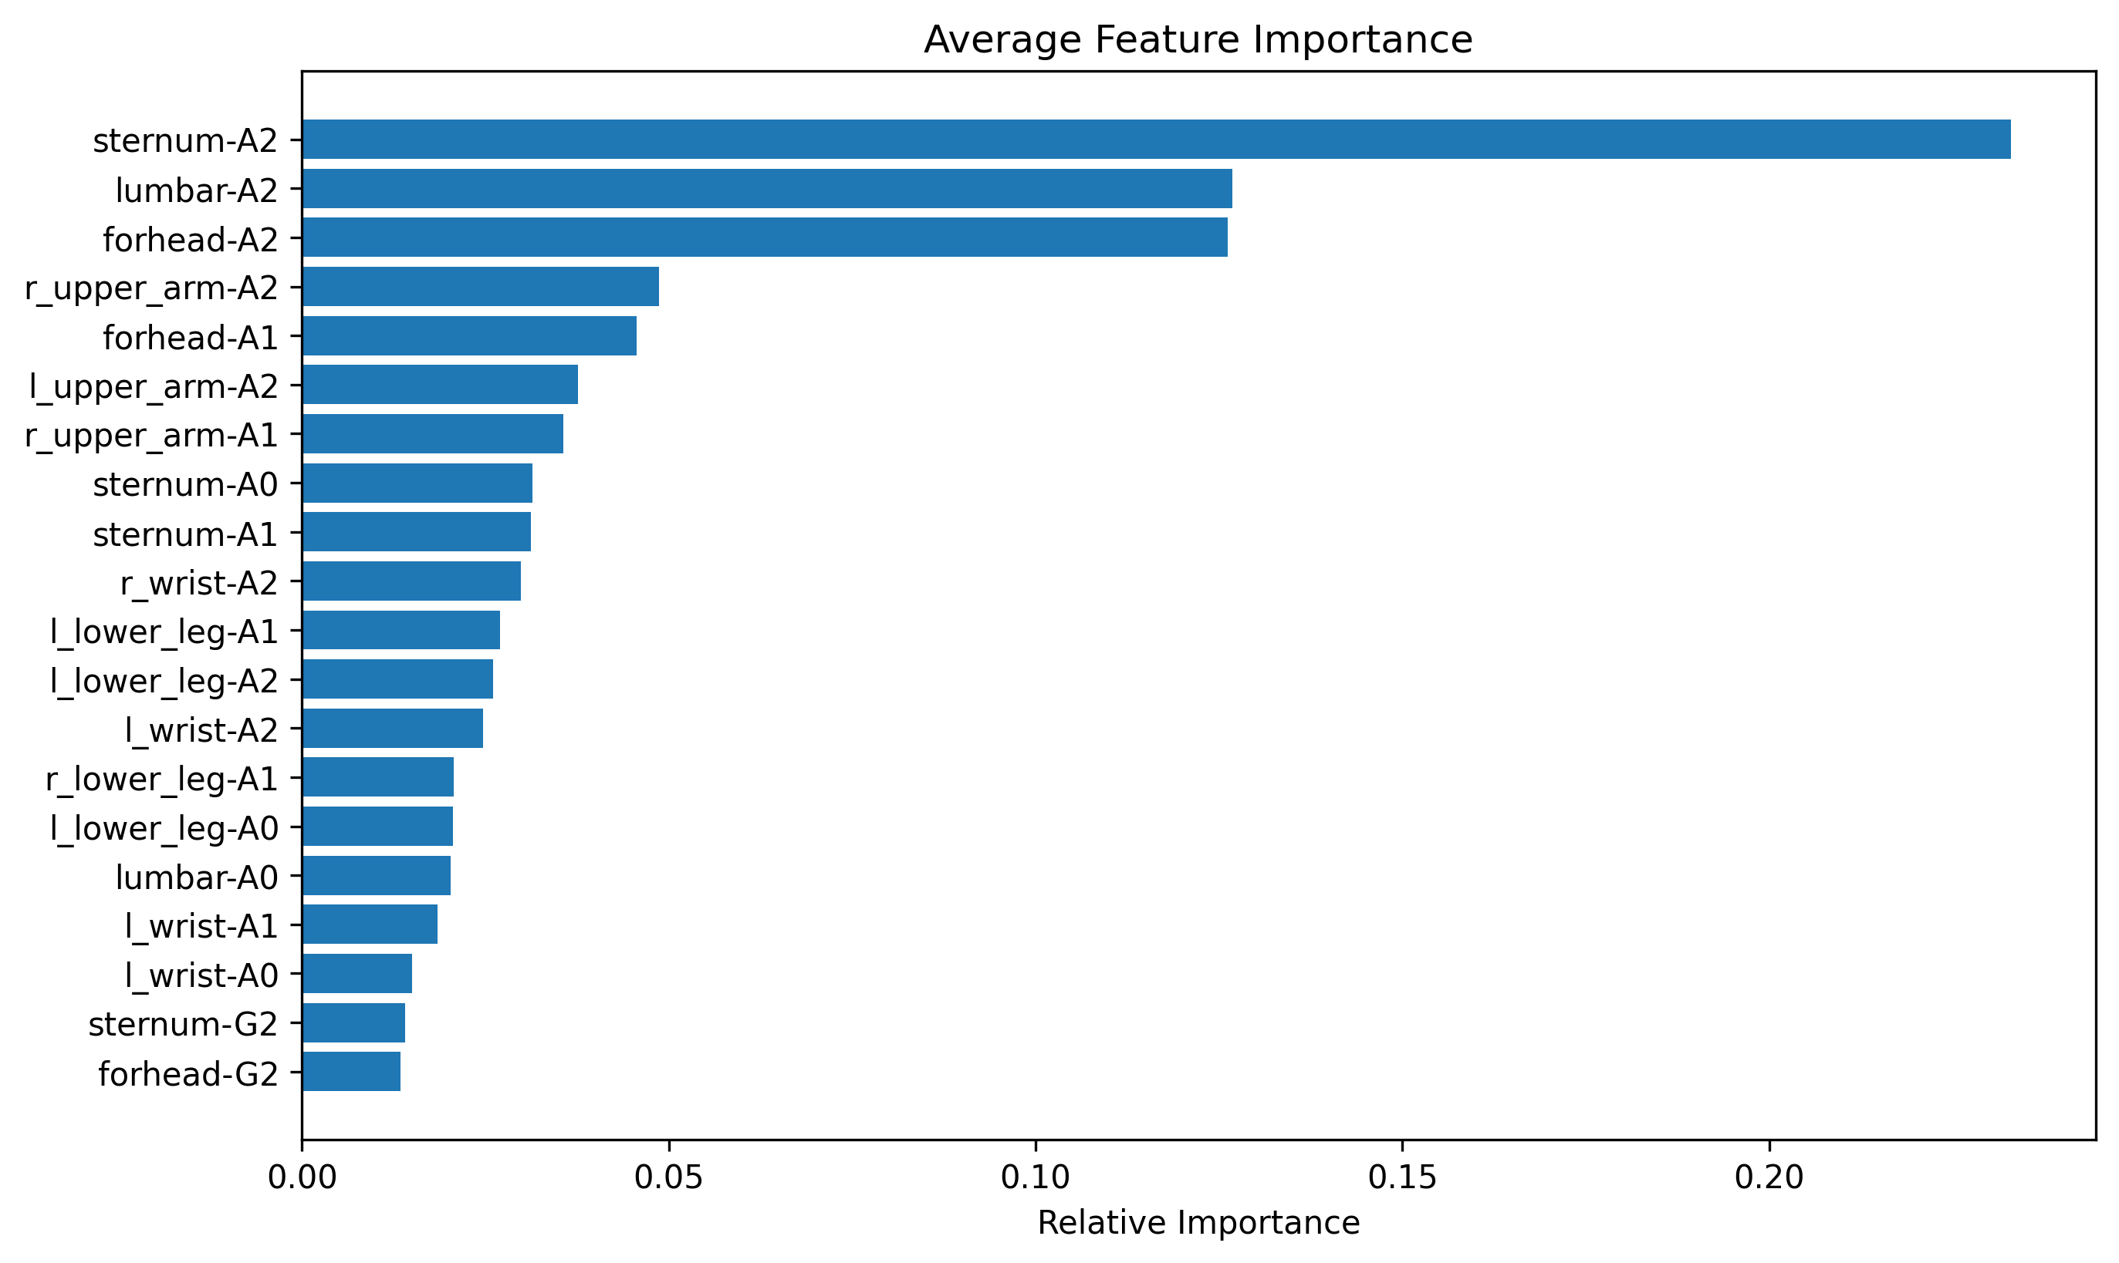
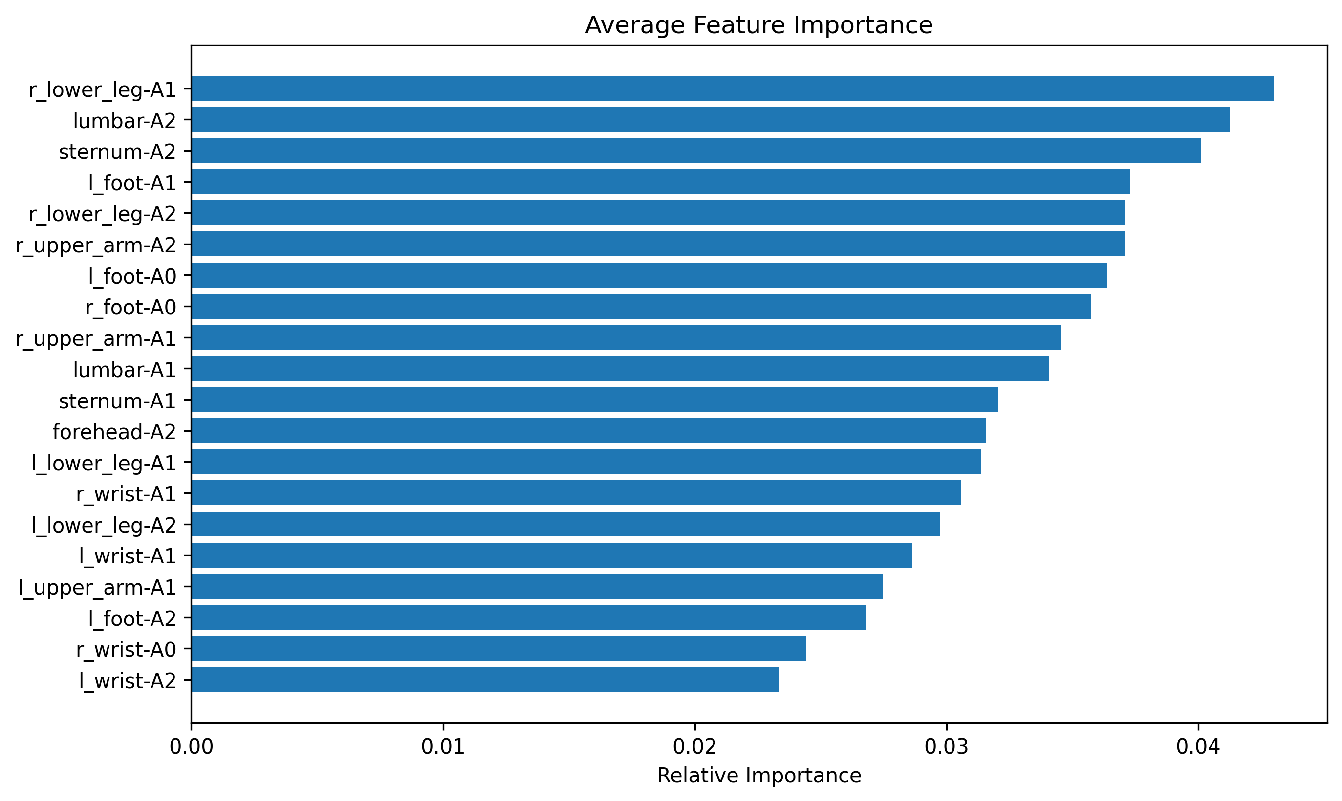
Human Movement Analysis From Posture Analysis to Baseball Pitching Analysis Joey Blair¹, Trevor DeMarco¹, James Tyler¹, Aidan Mahoney¹, Sanghee Moon, PhD² (PI) ¹Computer Science, University of New Hampshire, Durham, NH 03824 ²Kinesiology, University of New Hampshire, Durham, NH 03824
Introduction
Data Collection & Pre-processing
Results
Inertial Measurement Unit (IMU)
An IMU is a sensor device that measures angular velocity, acceleration, and magnetic fields to track motion and orientation.
Machine Learning (ML)
ML models can analyze and categorizing data collected from IMU sensors monitoring human movement while performing various actions.
In this study, we explored two research questions:
Can ML models classify good or bad postures while performing different motor tasks?
Can ML models classify good or bad pitching in terms of accuracy?
This project aimed to develop ML models to analyze IMU sensor data on human movement, laying the groundwork for future models to aid in analyzing various human movements.
Data Collection
Used 11 IMU sensors to capture 130 measurements per second.
Posture analysis: 4 movements including standing, walk, timed up and go, and stand & walk, each with good and bad posture variations.
Movement analysis: Developed a procedure to collect data on pitch throwing and accuracy.
Raw data exported as an h5 file, convertible to CSV using the h5py Python library.
Extensive data processing performed to ensure usability.
Data pre-processing
Data preprocessing and cleaning done via a Python script.
Each h5 file contains 22 CSVs, which must be combined into a single dataset.
Used pandas to append data frames into one large dataset.
Script tasks (alter column headers, specify targets, validate script functionality after completion).
Final Random Forest Classifier on Movement Data
Pitch Location | precision | recall | f1-score | support
1 | 1 | 0.97 | 0.98 | 1004
2 | 1 | 0.95 | 0.97 | 2758
3 | 0.98 | 0.97 | 0.98 | 3747
4 | 1 | 0.96 | 0.98 | 2793
5 | 0.94 | 1 | 0.97 | 9334
6 | 1 | 0.93 | 0.97 | 828
7 | 1 | 0.95 | 0.97 | 3163
8 | 1 | 0.93 | 0.96 | 1313
9 | 1 | 0.92 | 0.96 | 237
accuracy |  |  | 0.97 | 25177
macro avg | 0.99 | 0.95 | 0.97 | 25177
weighted avg | 0.97 | 0.97 | 0.97 | 25177
Final Random Forest Classifier on Posture Data
Posture Type | precision | recall | f1-score | support
Bad | 0.99 | 0.90 | 0.94 | 25551
Good | 0.91 | 0.99 | 0.95 | 25269
accuracy |  |  | 0.95 | 50820
macro avg | 0.95 | 0.95 | 0.95 | 50820
weighted avg | 0.95 | 0.95 | 0.95 | 50820
Conclusion
ML models can accurately predict movement outcomes using IMU sensor data.
We predicted pitch accuracy correctly 97% of the time and posture classification 95% of the time.
The ability of these models likely generalizes to more complex assessments using IMU sensor data.
Ranging from general rehabilitation to sports performance.
The biggest bottleneck to this approach is the amount of data available.
Far more robust results could be obtained if access to large datasets covering a wide array of different movement profiles were available.
Requirements
Functional requirements
The movement analyzing system achieves an F1 accuracy score greater than 0.61 for the correct classification of the specified behavior/categorization.
Data collected from IMU sensors is seamlessly process, cleaned, and analyzed by the rest of the system.
Non-functional requirements
Results are easily readable for the user.
Results are clear and thoroughly detailed.
The system is relatively easy to apply to a patient and use.
The system allows for future scaling and expansion through a well-documented and constructed architecture.
Figure 1 – Prediction accuracy of the RF and KNN models for the posture test.
Figure 3 – Prediction accuracy of the RF and KNN models for the pitching test.
Acknowledgments
We would like to express our gratitude to Sanghee Moon (sponsor), David Benedetto (project advisor), UNH CS and IT Department, UNH Kinesiology Department for their support and guidance throughout this project.
Figure 2 – Random forest feature importance for the posture test.
Figure 4 – Random forest feature importance for the pitching test.

Slide 2
Abstract
Certain movement disorders and neurological conditions can cause abnormal movements and altered gait/posture. More than 10 million Americans are affected by some type of movement disorder, including 7 million who are affected by Essential Tremor and 1 million that are affected by Parkinson’s Disease. The aim of our project was to develop foundational ML models that could be adapted/ built upon by subsequent teams to develop machine learning algorithms that can accurately analyze human movements for use in patient rehabilitation; Specifically, to identify and aid in the correction of movement disorders such as Parkinson’s Disease and Essential Tremor. In terms of a measure of success for our project, our MOV stated that our project will be successful if our ML algorithms could identify biomechanical deficits in real-time and achieve an F1 score greater than 0.61 for the given categorization, making an improvement on previous iterations of similar projects done by our sponsor and paving the way for a model that will allow physical therapists to more easily diagnose and rehabilitate movement disorders.
In addition to working with posture data (good vs. bad), we extended our approach to a pitching experiment. This experiment collects biomechanical data to identify pitching performance and mechanics. By integrating both the posture dataset and the pitching data, our solution demonstrates versatility for not only clinical rehabilitation but also sports performance applications.

